Slide 1

Process Modelling with Neuro-Fuzzy Systems
University of Coimbra
Doctoral Program in Information Science and Technology
Real Time Learning in Intelligent Systems
June 12, 2017
Joaquim Pedro Bento Gonçalves Pratas Leitão

Slide 2
OBJECTIVES
Sugeno-type Neuro-Fuzzy System (NFS) to model the dynamics of a process with intertia.
Map system’s input space to output space by a series of IF-THEN rules
2
Joaquim Leitão – Real Time Learning in Intelligent Systems
Notes:
Sugeno NFS – Output das regras é uma combinação linear das variáveis de input (neste caso)

Slide 3
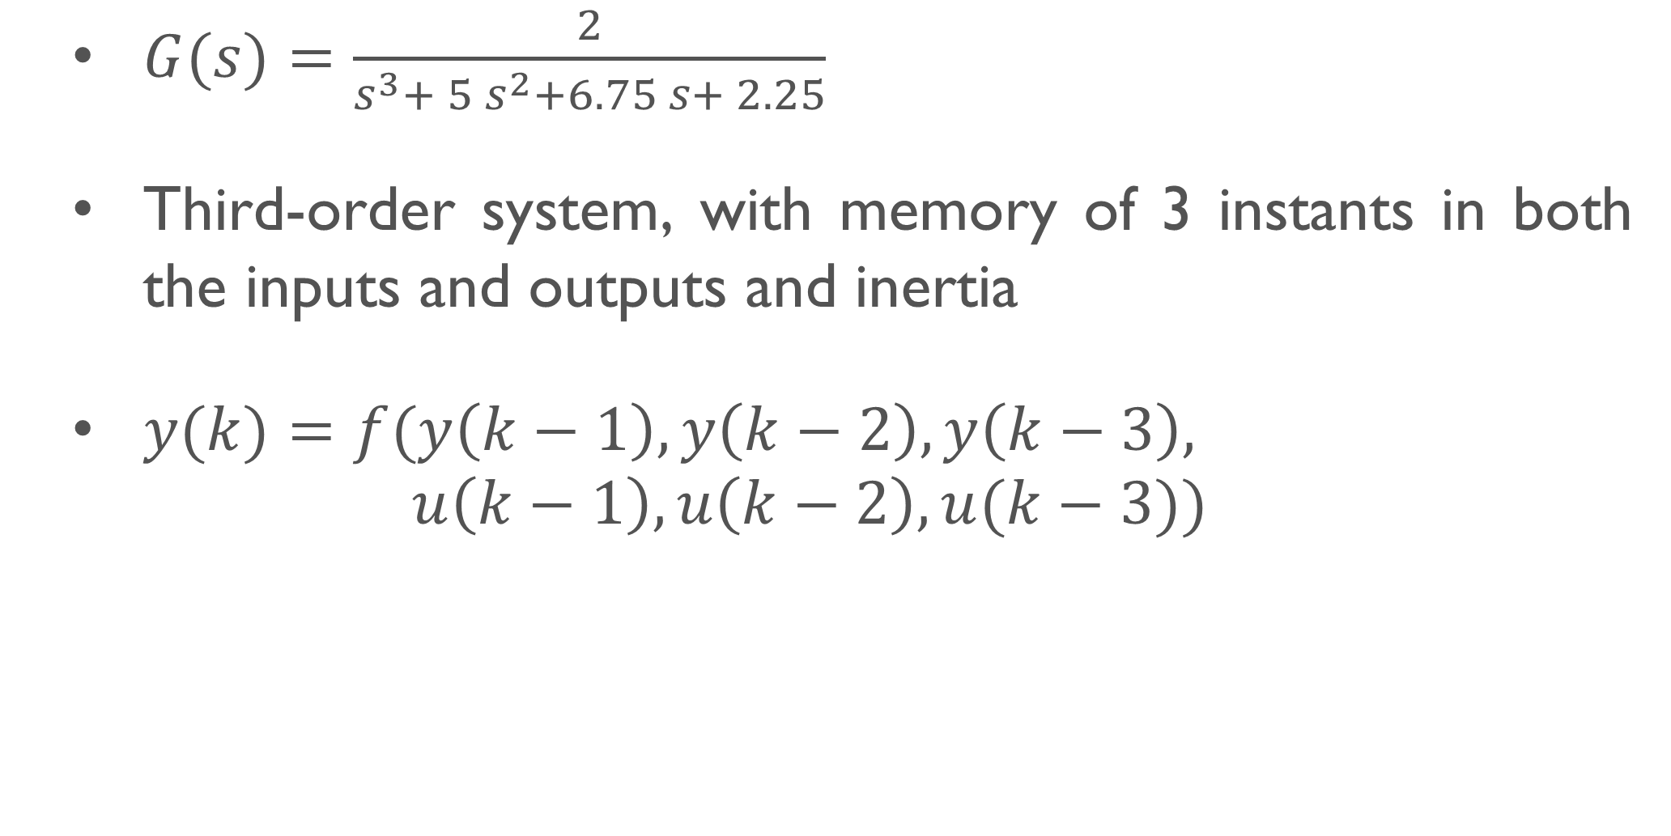
MODELLED SYSTEM
$G(s)=\frac{2}{s^{3}+ 5 s^{2}+6.75 s+ 2.25}$
Third-order system, with memory of 3 instants in both the inputs and outputs and inertia
$y(k)=f(y\left(k−1\right), y\left(k−2\right),y\left(k−3\right),$ $u\left(k−1\right), u\left(k−2\right), u(k−3))$
3
Joaquim Leitão – Real Time Learning in Intelligent Systems
Notes:
Sistema de 3ª ordem: tem mais pólos (3) do que zeros (0) ; Pode-se provar que o sistema tem memória…
Inércia -> inputs num dado instante apenas influenciam outputs de instantes futuros; Logo podemos escrever a saída do sistema em cada instante da forma…

Slide 4
METHODOLOGY
Learning Stage
Data Collection
Fuzzy Rules Initialisation
Fuzzy Rules Optimisation
Assessment Stage
4
Joaquim Leitão – Real Time Learning in Intelligent Systems
Notes:
Recolha de pares (input, output) do sistema, que sejam representativos de toda a gama de valores admissíveis nos domínios respetivos
Inicialização das regras através de um processo de clustering; Utilização de uma estrutura ANFIS para fazer tuning às regras anteriormente obtidas

Slide 5
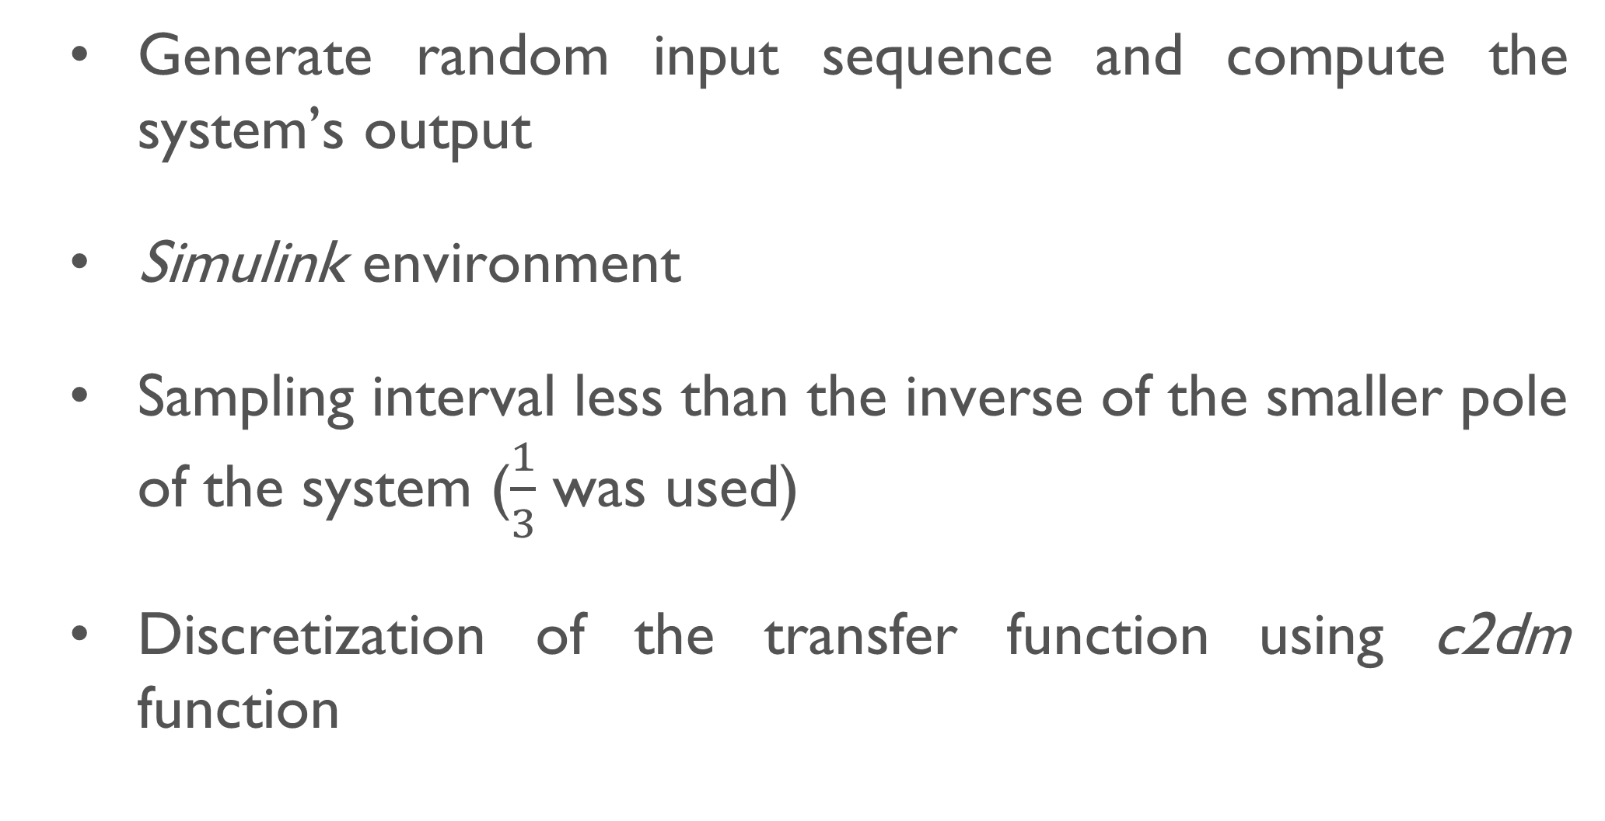
DATA COLLECTION
Generate random input sequence and compute the system’s output
Simulink environment
Sampling interval less than the inverse of the smaller pole of the system ($\frac{1}{3}$ was used)
Discretization of the transfer function using c2dm function
5
Joaquim Leitão – Real Time Learning in Intelligent Systems
Notes:
Sampling interval é a frequência com que os dados são gerados (discretization interval)

Slide 6

DATA COLLECTION
$G(z)=\frac{0.1079z^{2}+ 0.1413z + 0.009003}{z^{3} − 0.8794z^{2} + 0.1766z − 0.006738}$
Total Simulation time of 500 instants
70-30 split of generated data
6
Joaquim Leitão – Real Time Learning in Intelligent Systems

Slide 7
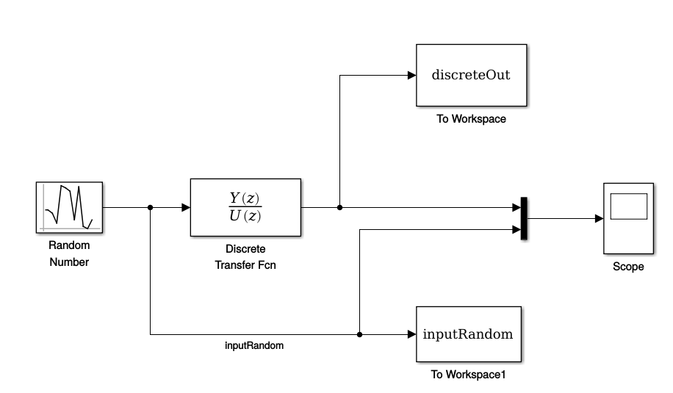
DATA COLLECTION
7
Joaquim Leitão – Real Time Learning in Intelligent Systems

Slide 8
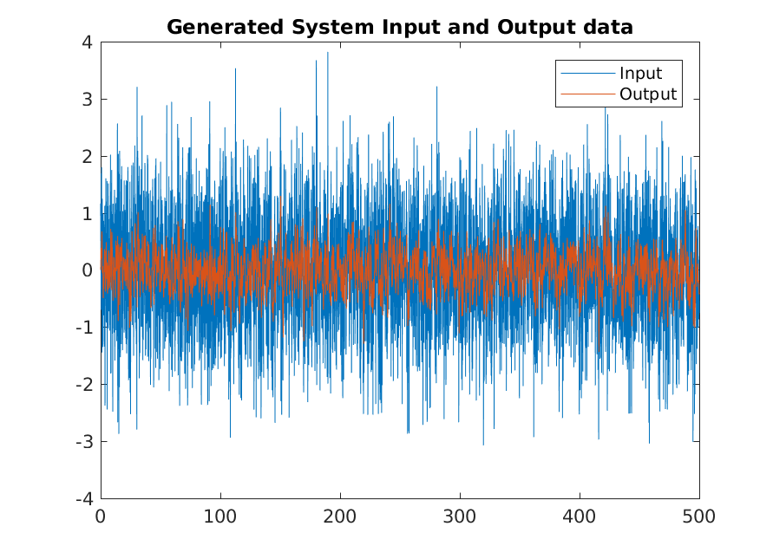
DATA COLLECTION
8
Joaquim Leitão – Real Time Learning in Intelligent Systems

Slide 9
FUZZY RULES INITIALISATION
Fuzzy Inference Systems (FIS)
Initial estimations for the fuzzy rules are produced as a result of a clustering process on training data (genfis function)
Subtractive Clustering
Fuzzy C-Means Clustering
9
Joaquim Leitão – Real Time Learning in Intelligent Systems
Notes:
Utilizámos os valores por default do MATLAB para cada uma das abordagens

Slide 10
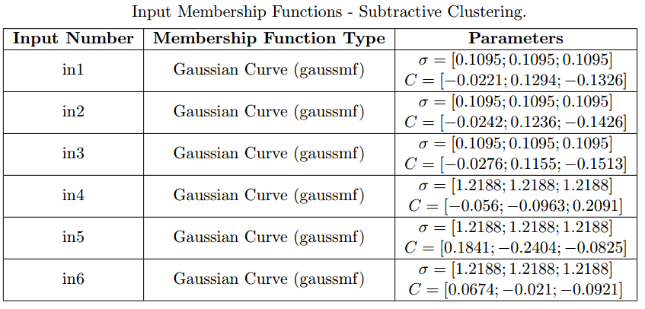
FUZZY RULES INITIALISATION
10
Joaquim Leitão – Real Time Learning in Intelligent Systems
Notes:
Dizer que temos 3 membership functions para cada antecedente das regras

Slide 11
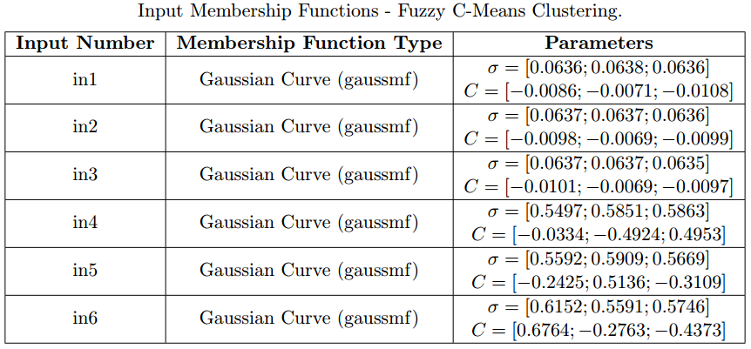
FUZZY RULES INITIALISATION
11
Joaquim Leitão – Real Time Learning in Intelligent Systems

Slide 12
FUZZY RULES OPTIMISATION
ANFIS structure to optimise both FIS
Backpropagation Optimisation
Hybrid Optimisation
MATLAB’s anfis function with 200 epochs
Performance assessed with test data and Root Mean Squared Error (RMSE) metric
12
Joaquim Leitão – Real Time Learning in Intelligent Systems
Notes:
Cada um dos dois Fuzzy Inference Systems anteriormente obtidos foi otimizado com backpropagation e hybrid method

Slide 13
FUZZY RULES OPTIMISATION
Subtractive Clustering + Backpropagation ☑
Fuzzy C-Means Clustering + Backpropagation ☑
Subtractive Clustering + Hybrid ☒
Fuzzy C-Means Clustering + Hybrid ☒
13
Joaquim Leitão – Real Time Learning in Intelligent Systems
Notes:
Alterações nas funções de pertença foram detetadas para os casos em que a otimização foi feita com Hybrid method

Slide 14
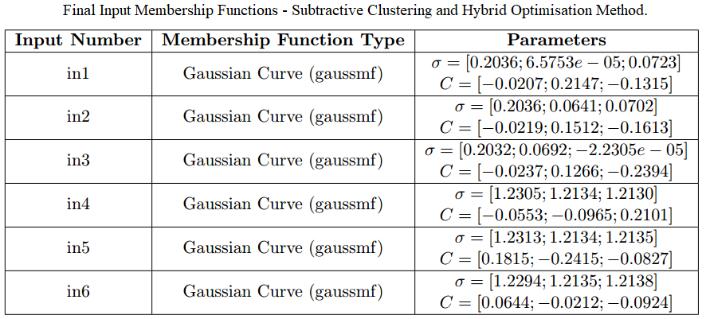
FUZZY RULES OPTIMISATION
14
Joaquim Leitão – Real Time Learning in Intelligent Systems

Slide 15
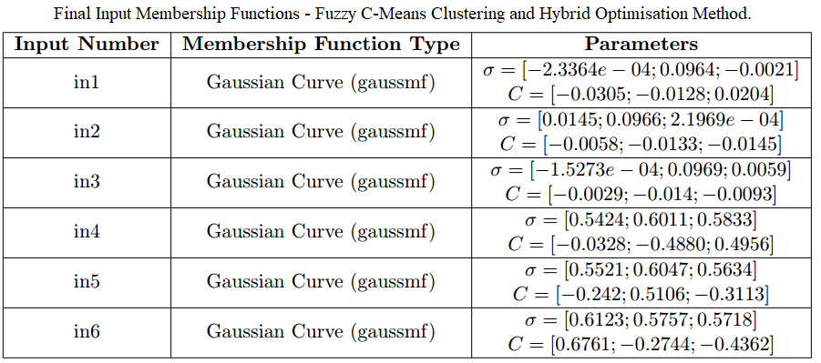
FUZZY RULES OPTIMISATION
15
Joaquim Leitão – Real Time Learning in Intelligent Systems

Slide 16
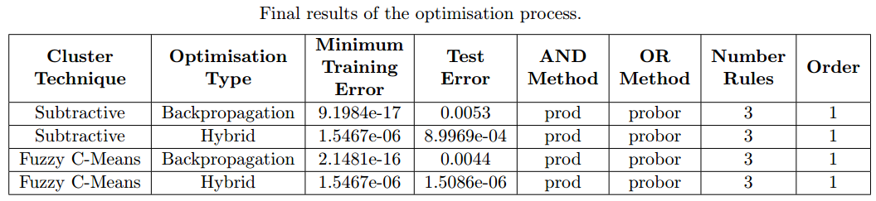
FUZZY RULES OPTIMISATION
Lack of generalisation capacity for Backpropagation method
Errors with Hybrid method remain more stable during training and testing
Suggest a more general (and more desirable) model
15
Joaquim Leitão – Real Time Learning in Intelligent Systems

Slide 17
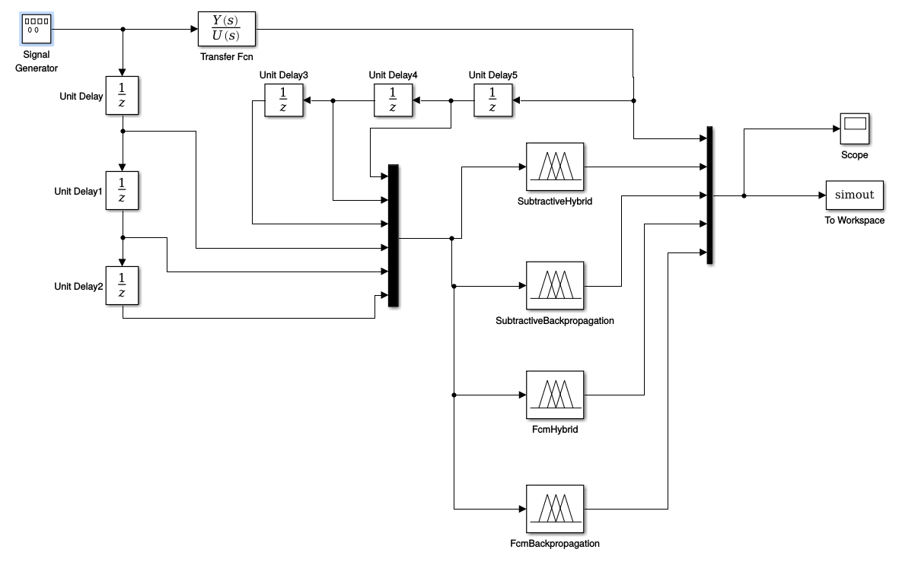
ASSESSMENT
17
Joaquim Leitão – Real Time Learning in Intelligent Systems
Notes:
Simulink; Signal generator que gera sinais com diferentes características fornecidos a cada um dos 4 sistemas ANFIS anteriormente treinados; Output de cada um destes 4 sistemas é comparado com o sistema “real”

Slide 18
ASSESSMENT – SIGNAL GENERATOR
Sawtooth
Sine
Square
Amplitude 1; Units in Hz
Sampling interval set to value defined during data collection
18
Joaquim Leitão – Real Time Learning in Intelligent Systems

Slide 19
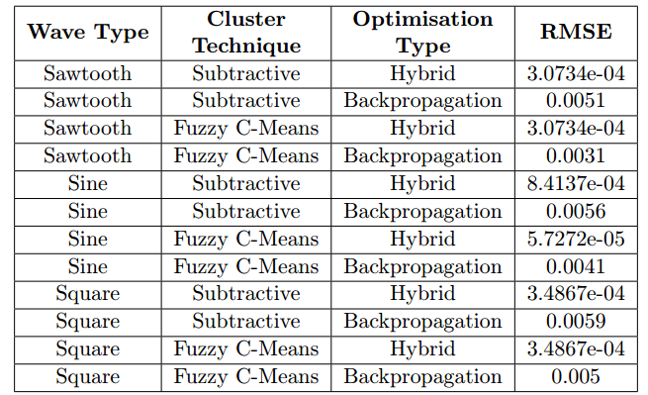
ASSESSMENT
19
Joaquim Leitão – Real Time Learning in Intelligent Systems
Notes:
Erro mais reduzido para a função seno com FCM e Hybrid optimisation
Overall, Hybrid optimisation leva a RMSEs cerca de uma ordem de magnitude inferiores ao backpropagation

Slide 20
ASSESSMENT
Low RMSE registered for the different wave types
NFSs can accurately reproduce the dynamics of the system being modelled
20
Joaquim Leitão – Real Time Learning in Intelligent Systems

Slide 21
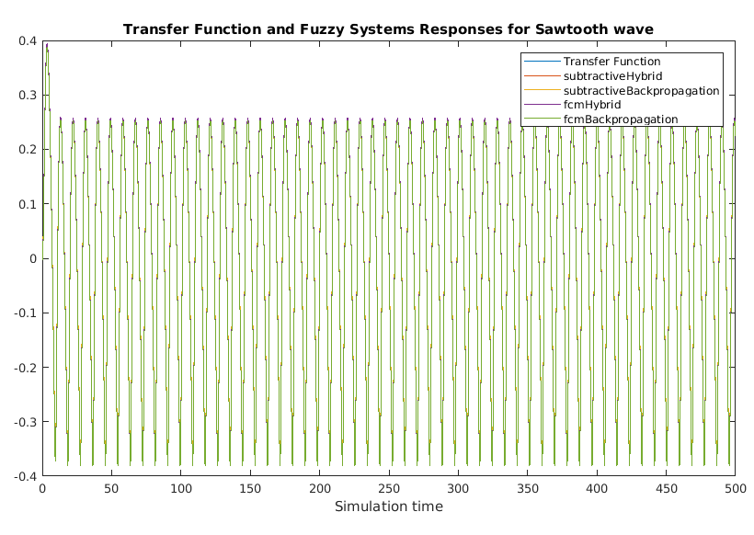
ASSESSMENT
21
Joaquim Leitão – Real Time Learning in Intelligent Systems

Slide 22
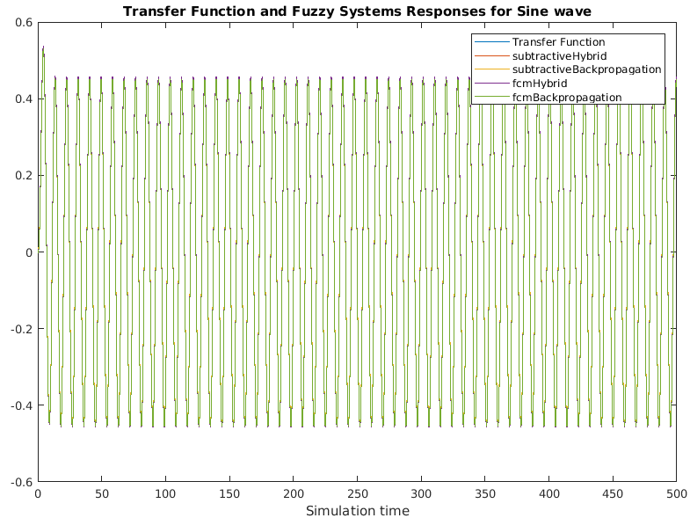
ASSESSMENT
21
Joaquim Leitão – Real Time Learning in Intelligent Systems

Slide 23
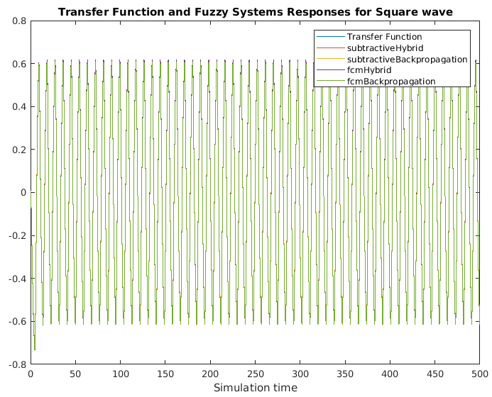
ASSESSMENT
21
Joaquim Leitão – Real Time Learning in Intelligent Systems

Slide 24
CONCLUSIONS
Neuro-Fuzzy Systems were projected and developed to model the dynamics of a given process
Outputs very similar to the real system, for the different NFSs trained
Hybrid optimisation produced more general NFSs, with smaller RMSEs in test data for different input signals
22
Joaquim Leitão – Real Time Learning in Intelligent Systems
Notes:
Outputs muito semelhantes, no entanto verificámos que Hybrid optimisation tem resultados melhores (erros menores) independentemente da técnica de clustering utilizada para a estimação inicial das regras

