Slide 1
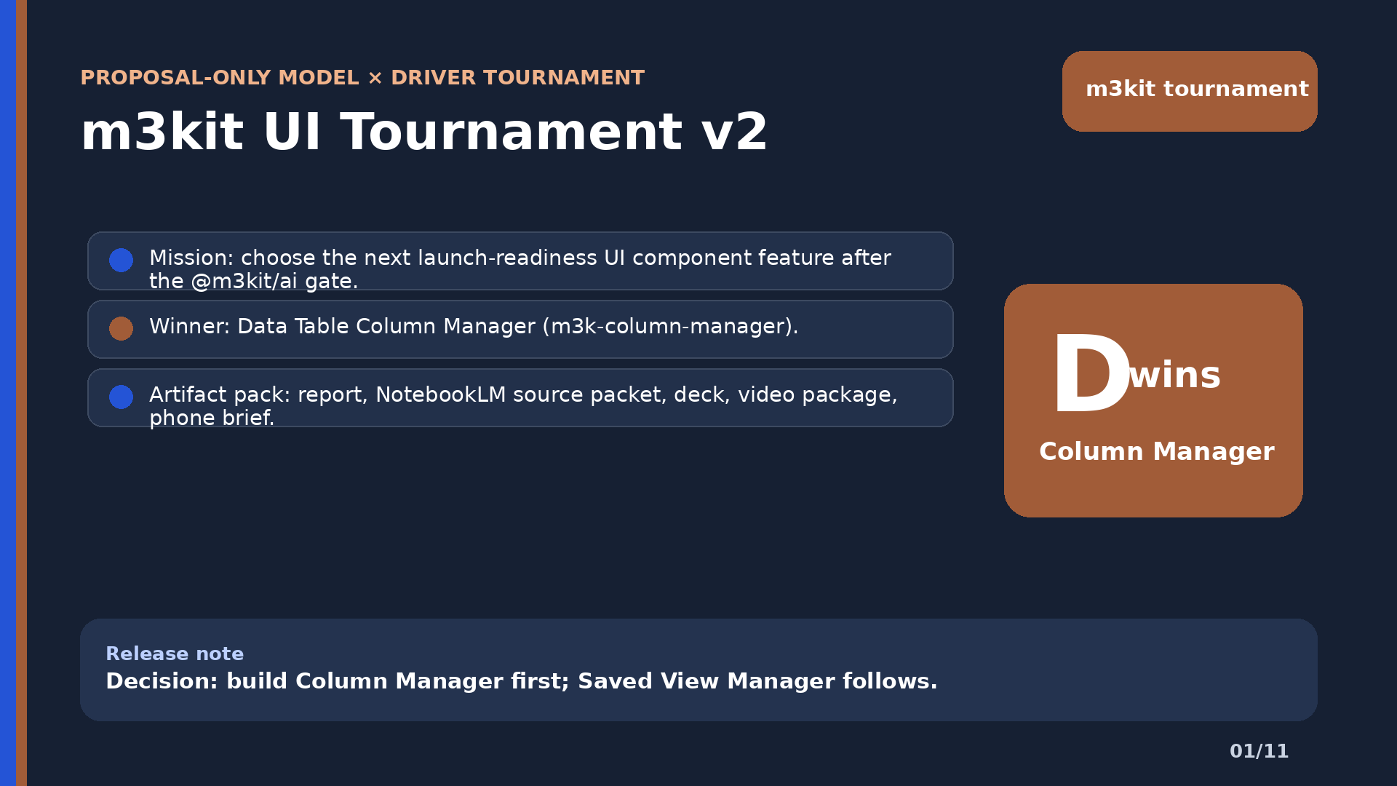
Slide 1: m3kit UI Tournament v2

Slide 2
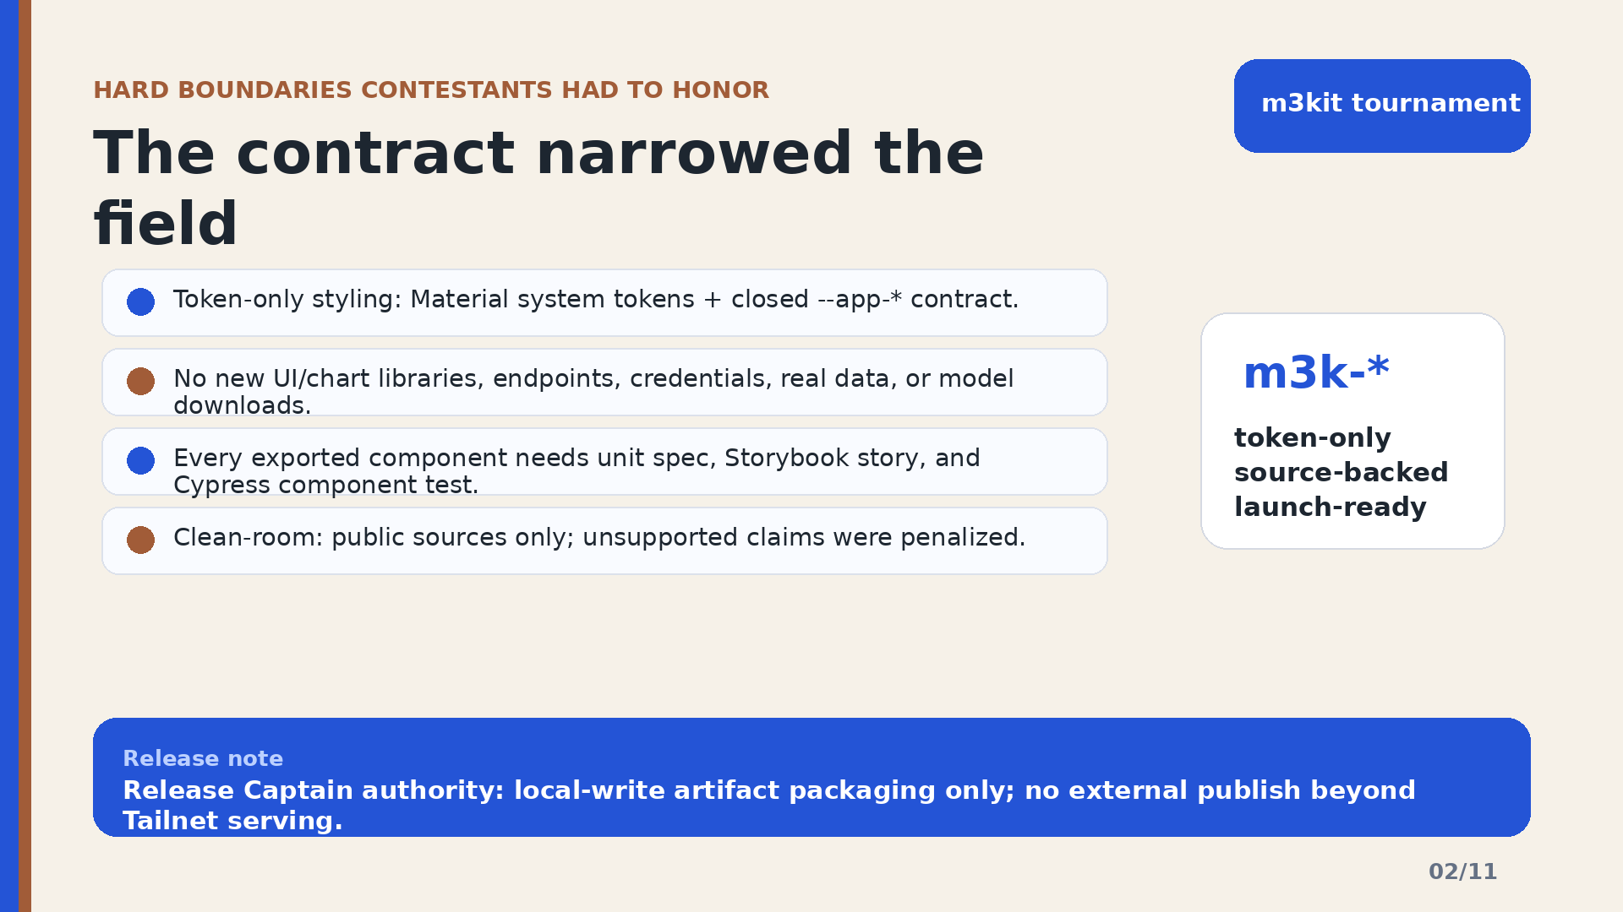
Slide 2: The contract narrowed the field

Slide 3
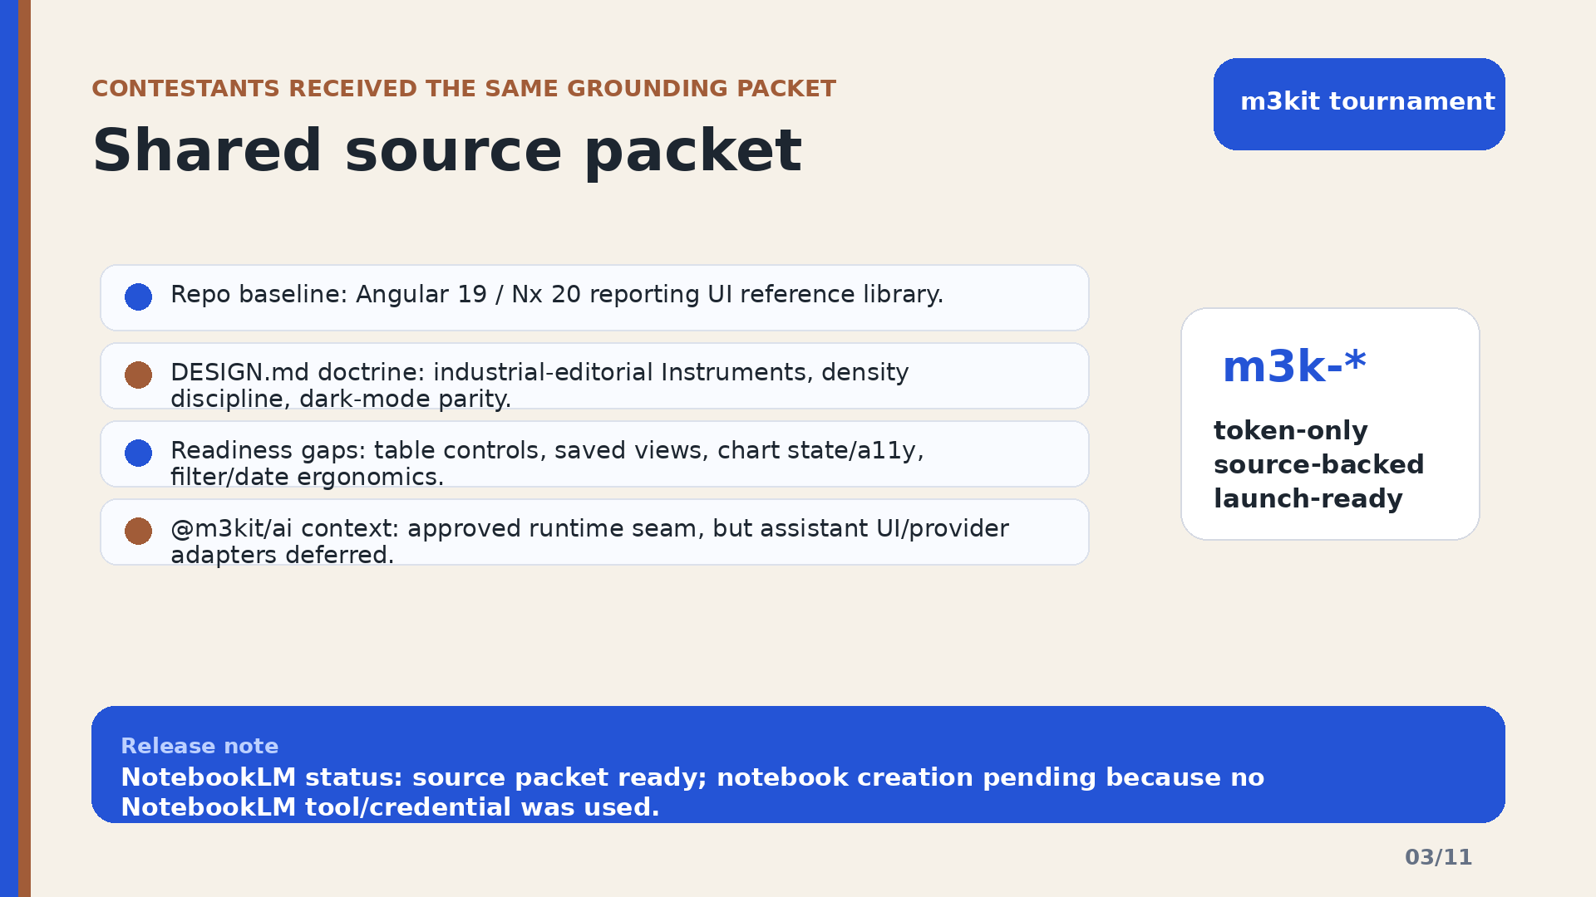
Slide 3: Shared source packet

Slide 4
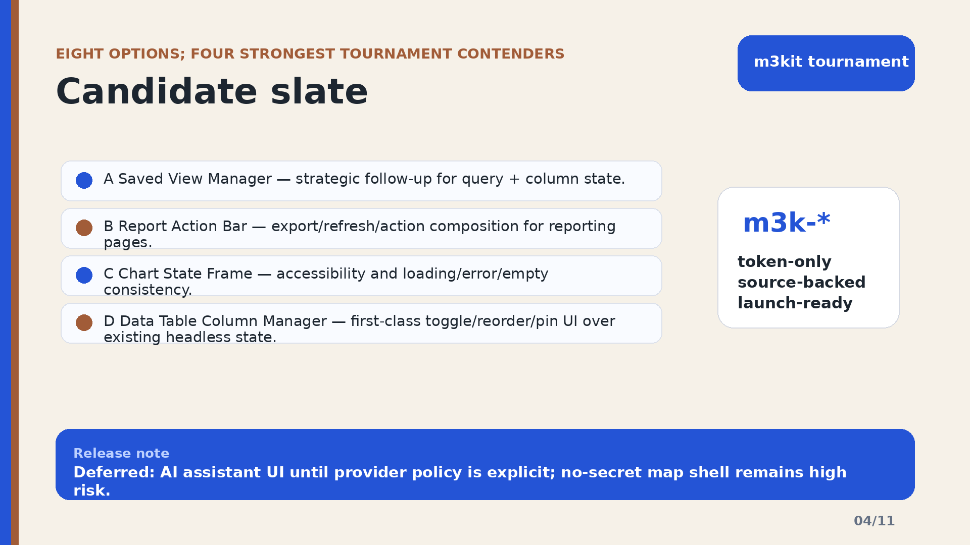
Slide 4: Candidate slate

Slide 5
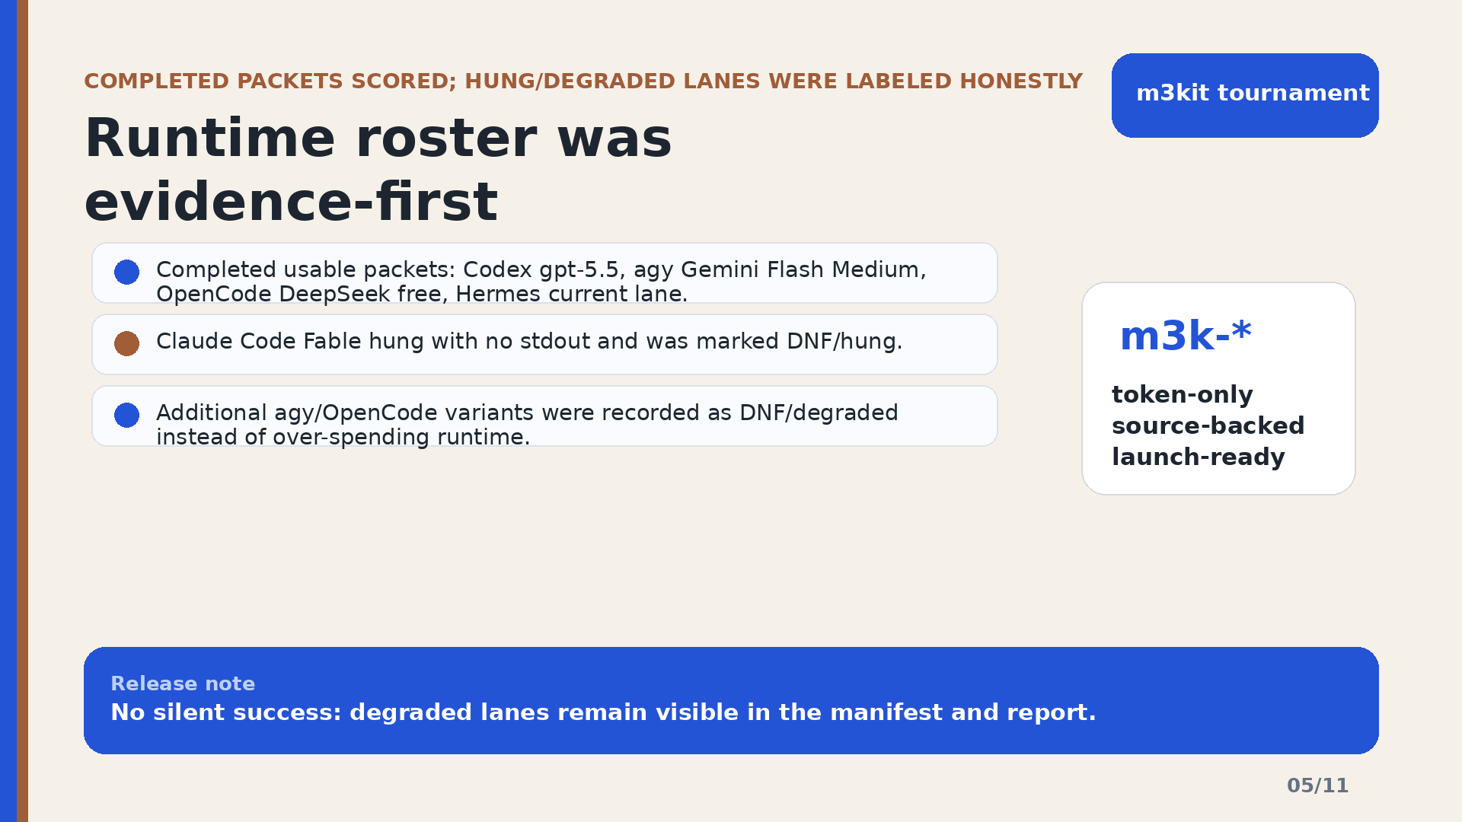
Slide 5: Runtime roster was evidence-first

Slide 6
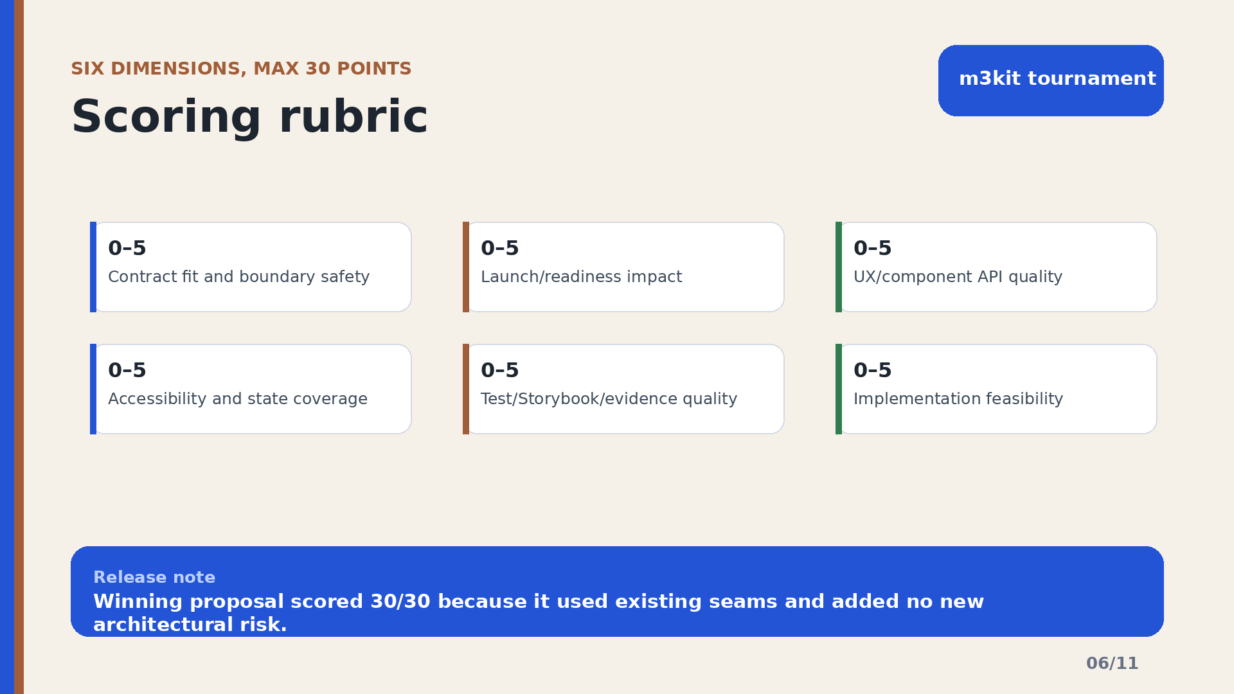
Slide 6: Scoring rubric

Slide 7
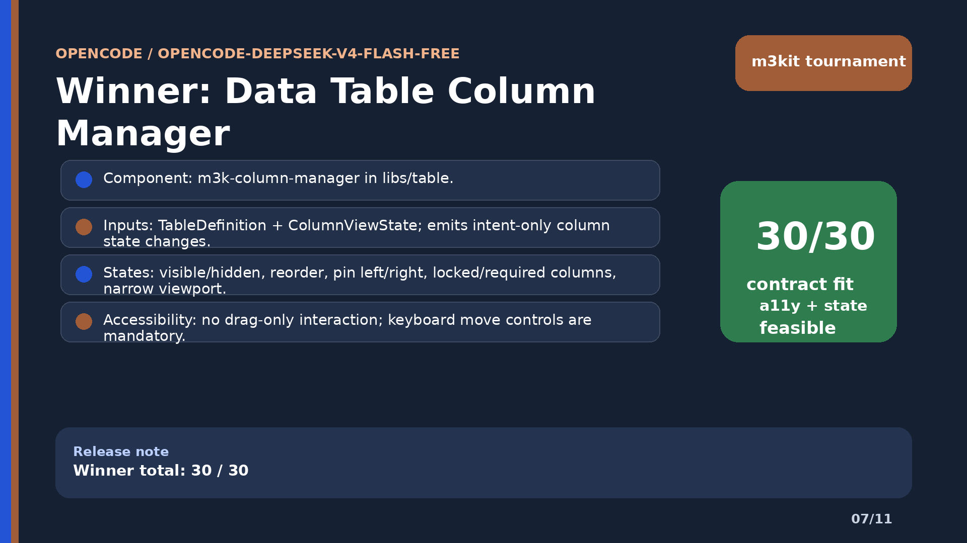
Slide 7: Winner: Data Table Column Manager

Slide 8
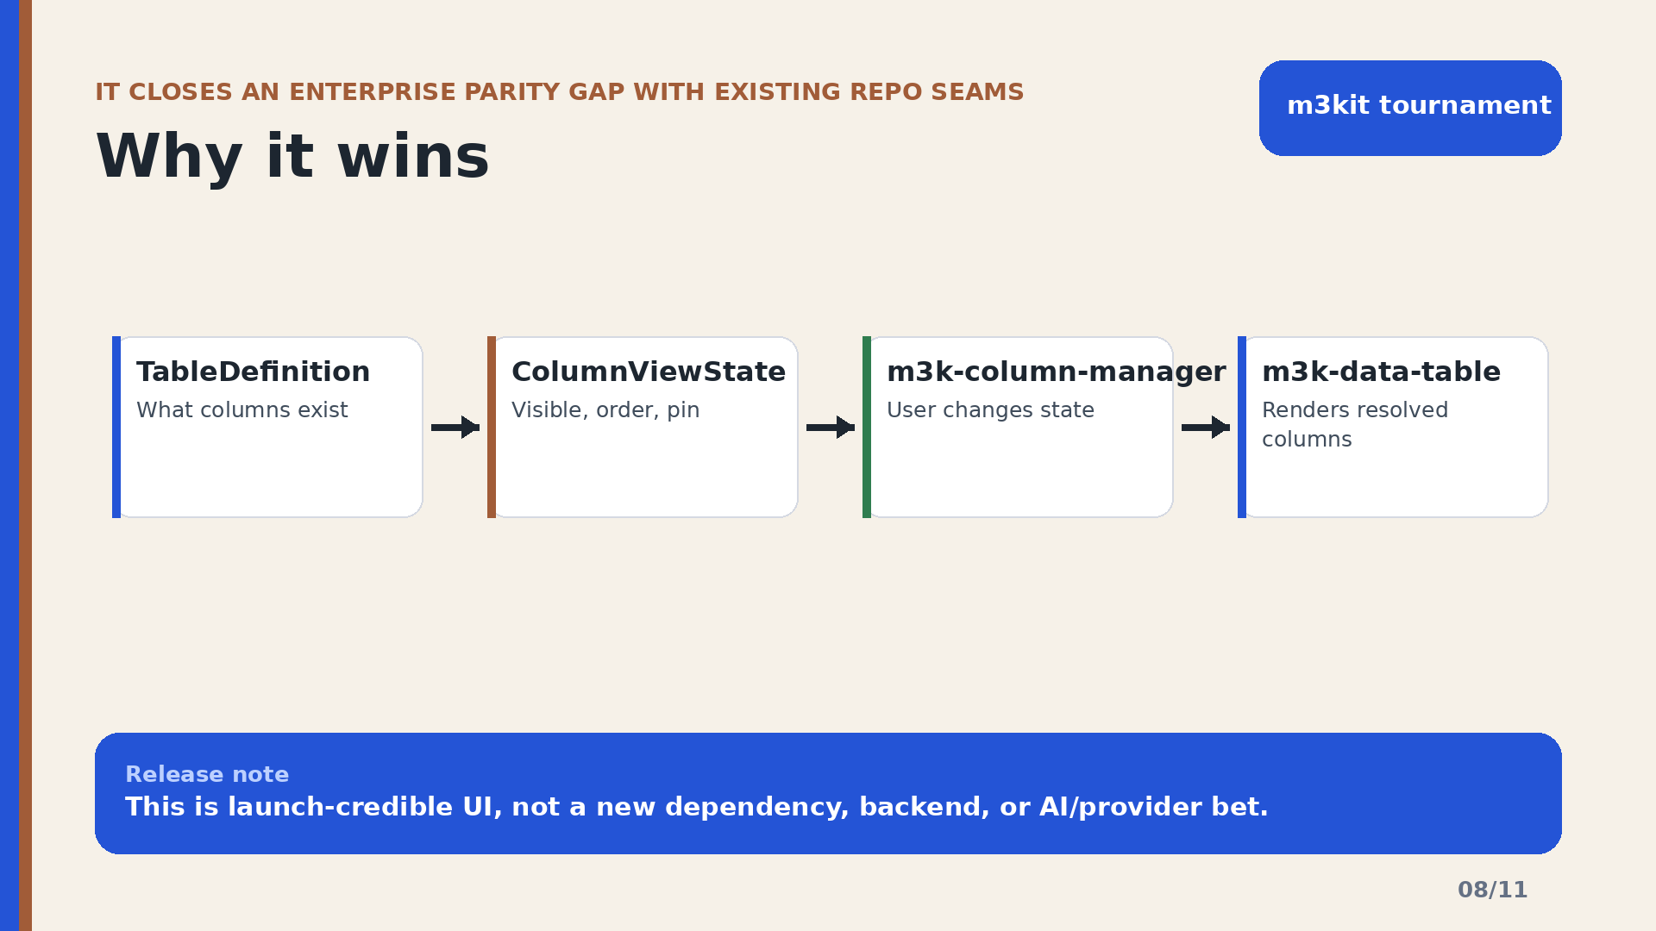
Slide 8: Why it wins

Slide 9
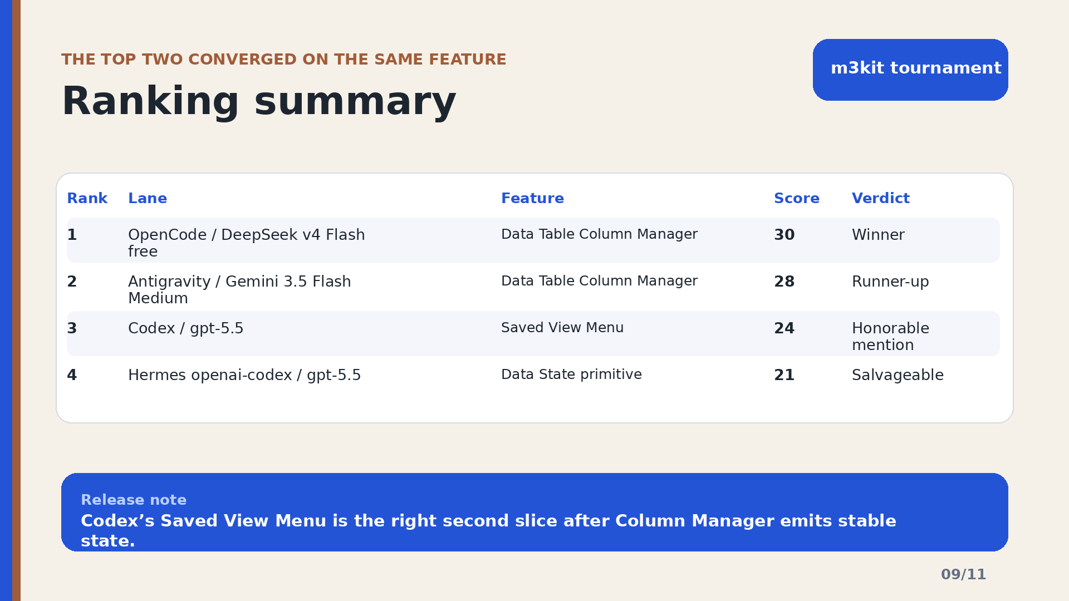
Slide 9: Ranking summary

Slide 10
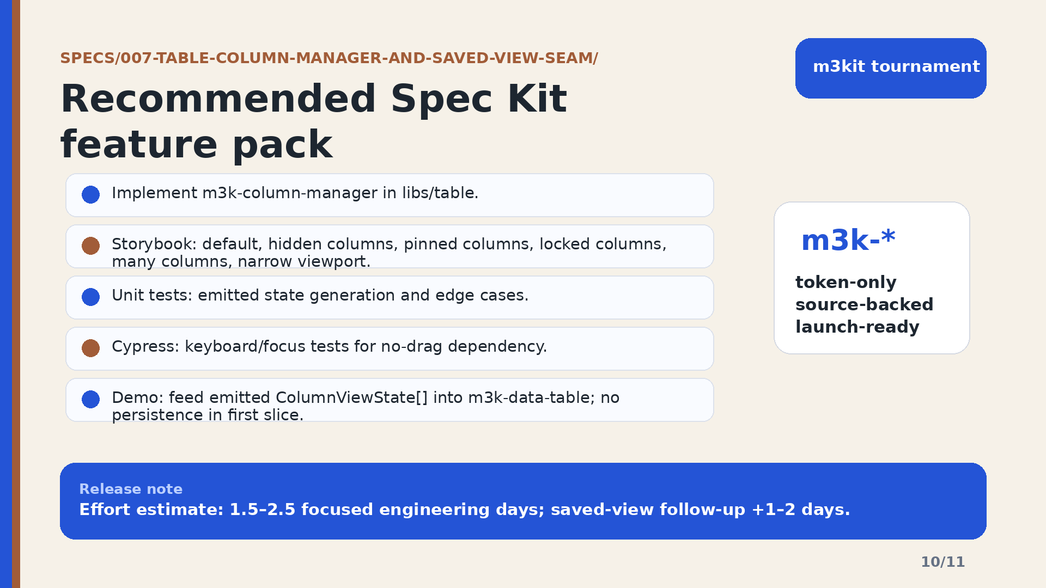
Slide 10: Recommended Spec Kit feature pack

Slide 11
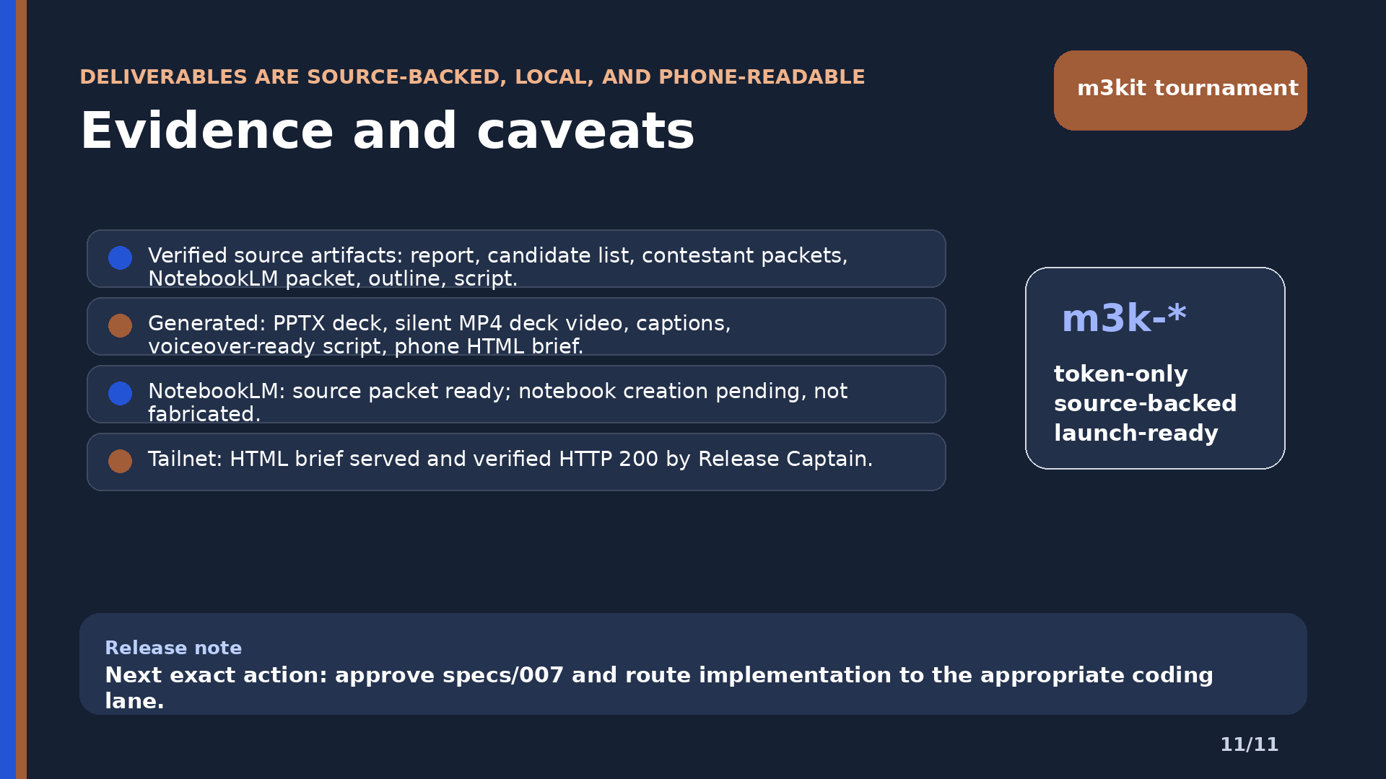
Slide 11: Evidence and caveats

