Slide 1

GENERATIVE AI FOR SCIENCE
CHAPTER 6 •
Physics-Informed
Neural Networks
Embedding Physical Laws in Deep Learning
PINNs
Surrogates
PDEs
Scientific ML
https://leanpub.com/generativeaiforscience
Classroom Presentation

Slide 2



The Challenge: Scientific Simulations
Traditional scientific simulations are computationally expensive:
CLIMATE MODELS
CFD SIMULATIONS
MOLECULAR DYNAMICS
Weeks
Days
Hours
on supercomputers
per configuration
of GPU time
The Problem: Researchers need to explore thousands of parameter combinations, run sensitivity analyses, and make real-time predictions — but traditional simulations are too slow.
Solution 1: PINNs — embed physics directly into neural networks
Solution 2: Surrogates — 1000×+ speedup with neural approximations

Slide 3

What are Physics-Informed Neural Networks?
PINNs are neural networks trained not only on data but also on Partial Differential Equation (PDEs, conservation laws, boundary conditions).
Key Benefits:
Data Efficiency
Requires less training data due to physics constraints
KEY INSIGHT
Physical Consistency
Instead of learning patterns purely from data, PINNs embed centuries of accumulated physical knowledge directly into the loss function.
Solutions always obey known physical laws
Better Generalization
Extrapolates beyond training data
Solution represented as:
uθ(x, t) = PINN(x, t)
Interpretability
Combines data and theory explicitly
where θ are the network weights

Slide 4
Traditional Neural Network vs. PINN
Physics-Informed NN
Traditional Neural Network
Learning Process:
Learning Process:
Data
+
Physics
NN
Data
→
NN
→
Prediction
↓
vs
PINN
Loss = MSE(ŷ, y)
✗ Ignores physical laws
✗ Requires lots of data
✗ May violate physics
✗ Poor extrapolation
Loss = Data + Physics + BC
✓ Embeds physical laws
✓ Data efficient
✓ Always physics-consistent
✓ Better extrapolation

Slide 5
PINN Architecture & Loss Function
LOSS FUNCTION
NETWORK ARCHITECTURE
ℒ = ℒPDE + λ₁ℒIC + λ₂ℒBC
ℒPDE — Physics Residual
How well does solution satisfy the PDE?
⋮
⋮
⋮
Output
Input
ℒIC — Initial Condition
50
50
50
Match u(x, 0) = sin(πx)
4 hidden layers × 50 neurons • tanh activation • 7,851 parameters
ℒBC — Boundary Conditions
Key Innovation: Use PyTorch autograd to compute derivatives ∂u/∂x, ∂u/∂t, ∂²u/∂x² automatically!
Enforce u(0,t) = u(1,t) = 0
λ = 10 weights IC/BC more heavily during training

Slide 6
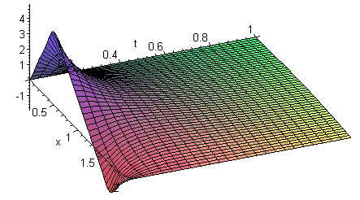
Example 1: 1D Heat Equation
Solve the classic heat diffusion equation:
GOVERNING PDE
Training Setup:
∂u/∂t = α · ∂²u/∂x²
5,000
200
200
α = 0.01 (thermal diffusivity)
Collocation Points
IC Points
BC Points
Initial Condition
Boundary Conditions
u(x, 0) = sin(πx)
u(0,t) = u(1,t) = 0
Total: 5,400 training points
u(x,t) = temperature • x = position [0,1] • t = time [0,1]
Epochs
Optimizer
LR
3D
3,000
Adam
10⁻³
Analytical solution exists:
u(x,t) = sin(πx) · e
(https://sites.math.duke.edu/education/baltimore/sample.html)

Slide 7


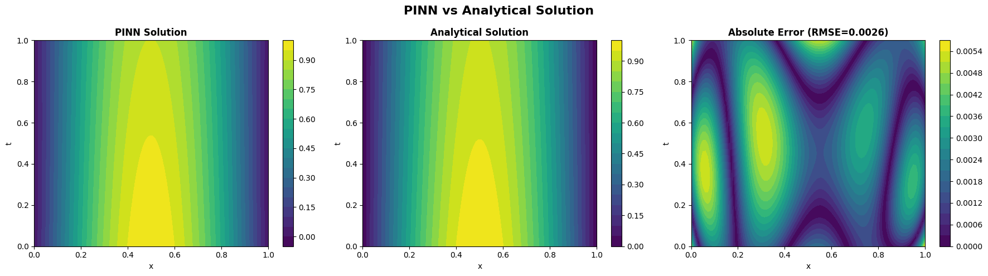
Heat Equation: Results
Performance Metrics:
PINN Solution vs Analytical Solution
RMSE VS ANALYTICAL
0.0023
✓ Excellent accuracy!
PINN
Analytical
Error
Max Error
Time
Contour plots of temperature u(x,t) over space-time domain
0.0044
0.4 min
Final Training Losses:
Key Observation: PINN solution is visually indistinguishable from the analytical solution. Error is uniformly small across the entire domain.

Slide 8

ADVANCED EXAMPLE
Navier-Stokes Equations
The fundamental equations governing fluid motion — air, water, blood, ocean currents.
X-MOMENTUM
Y-MOMENTUM
CONTINUITY
∂u/∂t + u·∂u/∂x + v·∂u/∂y
= -∂p/∂x + ν∇²u
∂v/∂t + u·∂v/∂x + v·∂v/∂y
= -∂p/∂y + ν∇²v
∂u/∂x + ∂v/∂y = 0
(mass conservation)
Variables: u,v = velocity components • p = pressure • ν = kinematic viscosity
Why Use Analytical Benchmark?
PINN Approach
We use Taylor-Green vortex (known solution) to verify PINN works before applying to real problems without analytical solutions.
Input: (x, y, t) → Output: (u, v, p)
4 hidden layers, 64 neurons each

Slide 9









Navier-Stokes PINN: Results
Velocity Magnitude |u|
Pressure p(x,y)
Analytical
PINN
Error
Analytical
PINN
Error
VELOCITY RMSE
PRESSURE RMSE
RELATIVE ERROR
2.7×10⁻³
1.7×10⁻³
<1%
✓ PINN captures full vector structure of the flow
✓ Correct vortex rotation and symmetry
✓ Sub-percent errors across domain

Slide 10
PINNs for Climate Modeling
Atmospheric modeling with real ERA5 reanalysis data:
Key Capabilities Gained:
INPUTS (4D)
→
OUTPUTS (3 vars)
lat, lon, pressure, time
T, q, u
ERA5 (Discrete)
PINN (Continuous)
5 pressure levels
1°×1° grid
6-hourly
Any pressure level
Any location
Any time
Physics Constraints Enforced:
Hydrostatic Balance
∂T/∂p ≈ -(g/R)·(T/p)
Interpolation: Predict at any pressure level
Super-resolution: Finer spatial resolution
Energy Conservation
∂T/∂t + u·∂T/∂x ≈ 0
Derivatives: Automatic ∂T/∂p, ∂q/∂t
Moisture Conservation
Gap filling: Smooth interpolation
∂q/∂t + u·∂q/∂x ≈ 0

Slide 11


PART II
Neural Network Surrogates
Replace expensive simulations with fast neural network approximations.
TRADITIONAL SIMULATION
NEURAL SURROGATE
✗ Hours/days per run • ✗ Expensive HPC clusters • ✗ Limited exploration • ✗ No real-time predictions
✓ Milliseconds/prediction • ✓ Runs on laptop • ✓ 1000s of scenarios • ✓ Real-time analysis
HOW IT WORKS
Step 1
→
Step 2
→
Step 3
Run simulations
Train NN on data
Use NN for inference
TYPICAL SPEEDUP
ACCURACY (R²)
1000×+
~0.98

Slide 12




Example: CO₂ → Temperature Surrogate
Train a surrogate to predict global temperature anomaly from CO₂ concentration using real observational data.
Scenario Predictions
Data Sources:
CO₂: NOAA Mauna Loa (1958–present)
Temp: NASA GISTEMP anomalies
Temperature response under different CO₂ pathways
LSTM SURROGATE
Input: CO₂ sequence (24 months)
Hidden: 64 units, 2 layers
Output: Temperature sequence
R² Score
Speedup
0.978
3282×
Test Scenarios:
Note: Simplified teaching demo. Real climate involves aerosols, methane, volcanic activity, solar variability, and internal cycles.
Stabilization
Low Growth
Medium
High Growth

Slide 13
When to Use What?
Use PINNs When...
Use Surrogates When...
Use Hybrid When...
✓ Physical laws (PDEs) are known
✓ Expensive simulations exist
✓ Physics is partially known
✓ Data is limited or expensive
✓ Many parameter combinations
✓ Both sim + experimental data
✓ Physics consistency is critical
✓ Real-time predictions needed
✓ High accuracy required
✓ Solving inverse problems
✓ Uncertainty quantification
✓ Model correction needed
✓ Complex boundary conditions
✓ Optimization loops
✓ Missing physics terms
Heat transfer, fluid dynamics, structural mechanics
Climate scenarios, engineering design, drug discovery
Weather prediction, turbulence, multi-physics

Slide 14
Key Takeaways
Embed physics directly into neural networks via loss functions
Autograd computes PDE derivatives automatically
Surrogates provide 1000×+ speedup for expensive simulations
RESULTS FROM THIS CHAPTER
Understand Physics
Validate Rigorously
Quantify Uncertainty
Start Simple
Know the PDEs
Test vs analytical
Report confidence
Known solutions first

Slide 15

References & Resources
Software Libraries:
Key Papers:
DeepXDE
PyTorch
JAX
Raissi et al. (2019)
PINN library
Deep learning
Autodiff
Physics-informed neural networks: A deep learning framework for solving forward and inverse problems. J. Comp. Physics
Data Sources:
ERA5: ecmwf.int/era5
NOAA CO₂: gml.noaa.gov
NASA GISTEMP: data.giss.nasa.gov
Karniadakis et al. (2021)
Physics-informed machine learning. Nature Reviews Physics
Lu et al. (2021)
Full working code:
rewriting.ai/bookcode/ai4sci.php
DeepXDE: A deep learning library for solving differential equations. SIAM Review
Jin et al. (2021)
Next Chapter:
NSFnets for the incompressible Navier-Stokes equations. J. Comp. Physics
Chapter 7 — Domain Applications in Chemistry, Biology, Physics, Geoscience, and Medicine

