Slide 1
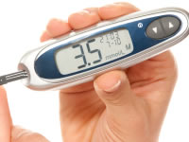
Case 1
Your patient is on insulin infusion at 3ml/hr. Their blood glucose is 3.5mmol/l on their most recent capillary blood glucose.
What do you do now?

Slide 2
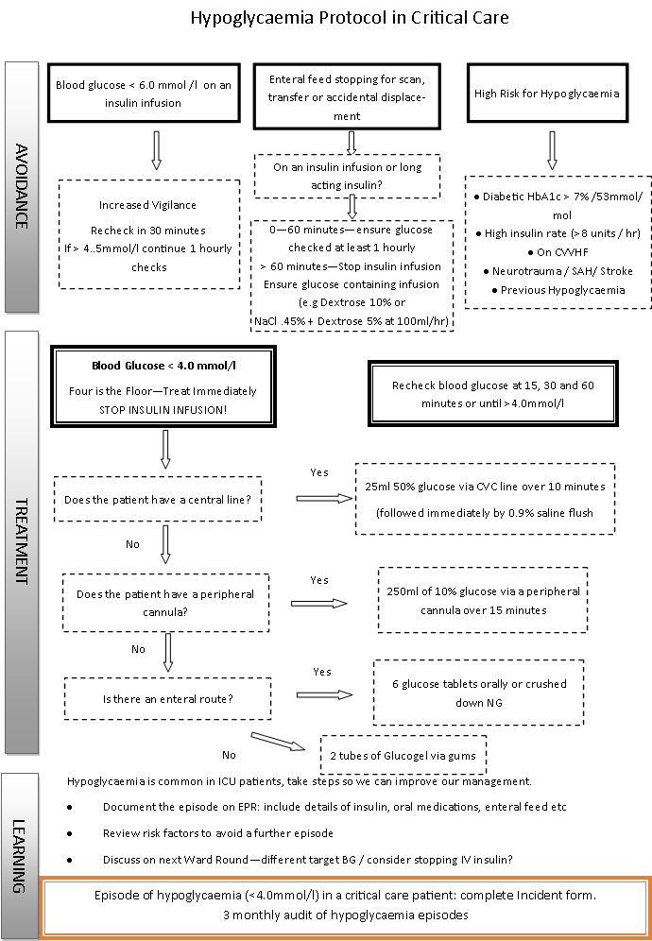
Case 1 Hypoglycaemia
4 is the floor….stop IV insulin and treat the hypo!
What access do they have?
Central line? 50% dextrose 25mls
Peripheral IV? 10% Glucose 250mls
NG or oral route? Glucose tablets x 6 crushed
No enteral route? Glucogel x2 to gums

Slide 3
Case 1 Hypoglycaemia
Why does it matter?
Profound and prolonged hypoglycaemia cause serious brain damage and death. It is thankfully rare…:
However- even less severe episodes of hypoglycaemia in critical care are associated with an increased risk of death. Why is this?
Hypoglycaemia causes multiple physiological changes at the time and for days afterwards:
Reduced availability of endogenous vasopressors such as noradrenaline
A surge in cortisol and other hormones with a subsequent loss later on…
Reduction in cardiac conduction pathways causing bradycardia
….all pretty important if your patient is recovering from critical illness.
So how do we avoid this?
No feed no need: avoid unopposed insulin – ensure NG feed or IV glucose
Glucose below 6? IV insulin not required
4 is the floor: stop insulin and treat the hypo

