Slide 1
Insulin Calculator Training
www.saferinsulin.org
What, why and how to use it.

Slide 2
Insulin Calculator (Dynamic versus Static VRII)
What is it for?
Paper based Variable Rate Insulin Infusions (“Static” VRII’s) adjust insulin according to the current blood glucose
e.g. BG 14.6mmol/l → insulin at 4mls/hr
This doesn’t take into account how the patient is responding to insulin
e.g next BG = 14.3mmol/l → blood sugar hasn’t changed much but the paper VRII will still tell you to give insulin at 4ml/hr

Slide 3
Insulin Calculator (Dynamic vs Static)
A “Dynamic VRII” will adjust the rate up if not responding but will also (more importantly) decrease the rate as the blood sugar is falling
The idea is to find the steady state of insulin required for the individual patient whilst keeping them in the target range
Our aim is control hyperglycaemia whilst minimising the risks of hypoglycaemia and glucose variability.

Slide 4
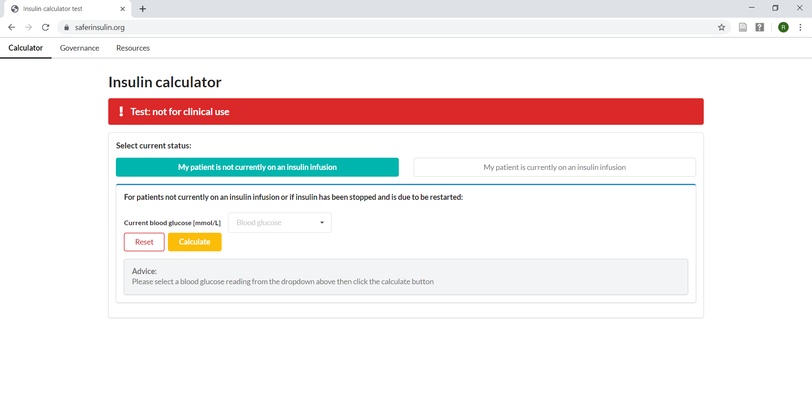
Starting a patient on insulin
If blood glucose is greater than 10mmol/l for 2 consequetive readings…
Enter patient’s BG in the section
“My patient is not currently on an insulin infusion”

Slide 5
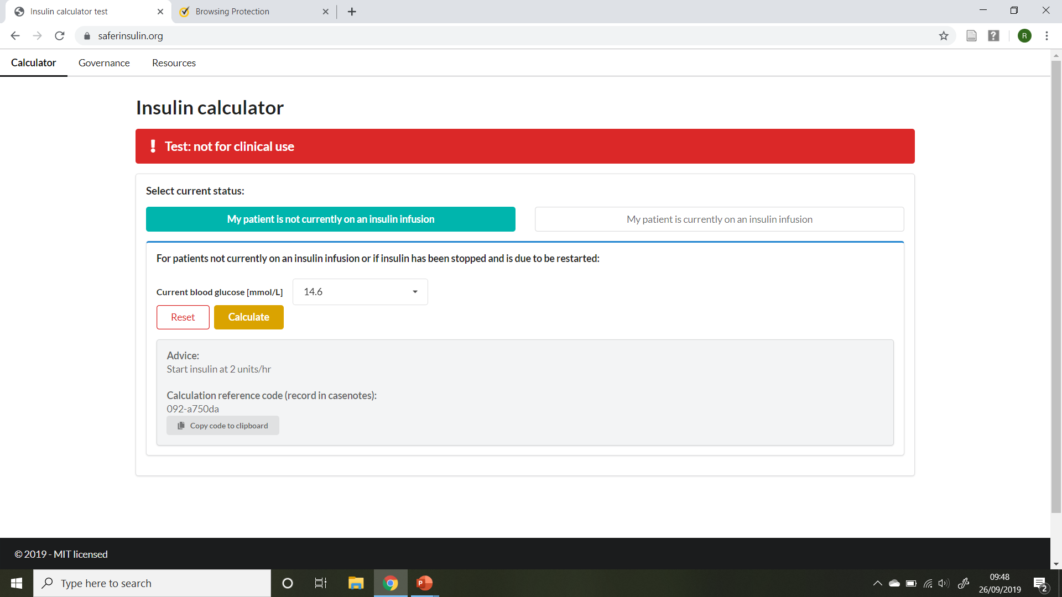
Starting a patient on insulin
Start insulin at advised rate
Copy reference code to clipboard

Slide 6
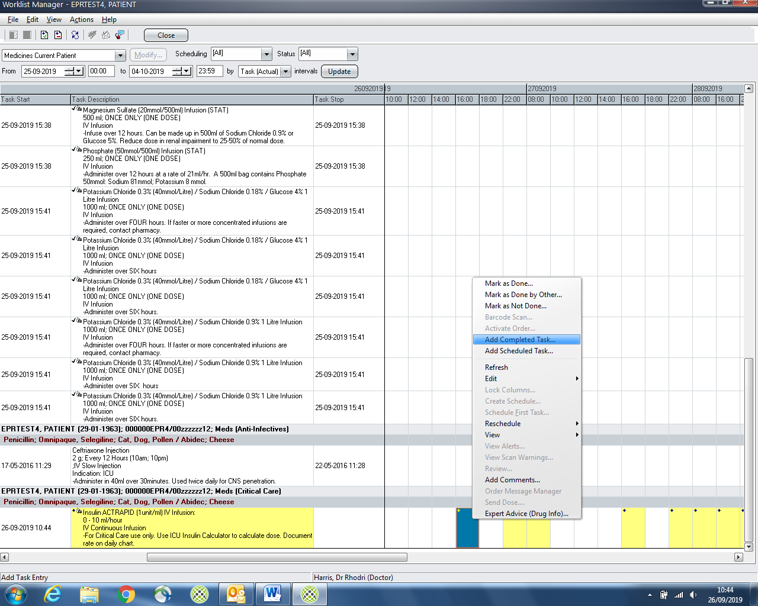
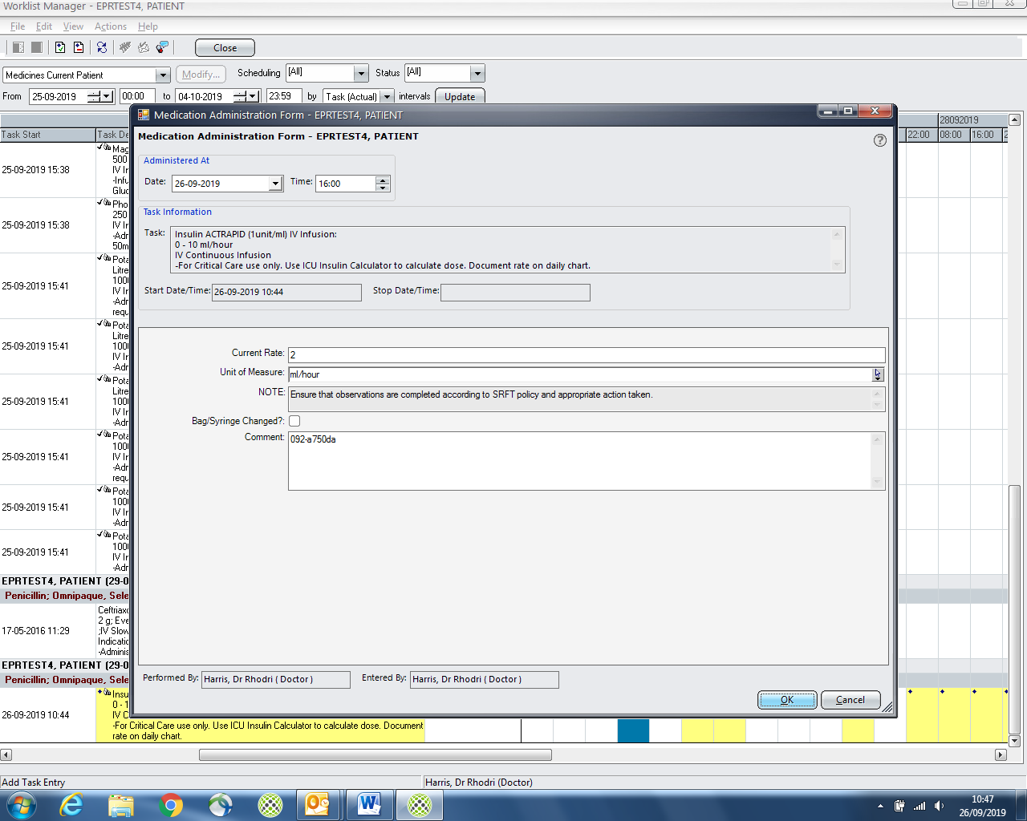

Starting a patient on insulin
3. Add task against insulin prescription
on EPR
4. Enter new insulin rate and…
5. Paste reference code in comments

Slide 7
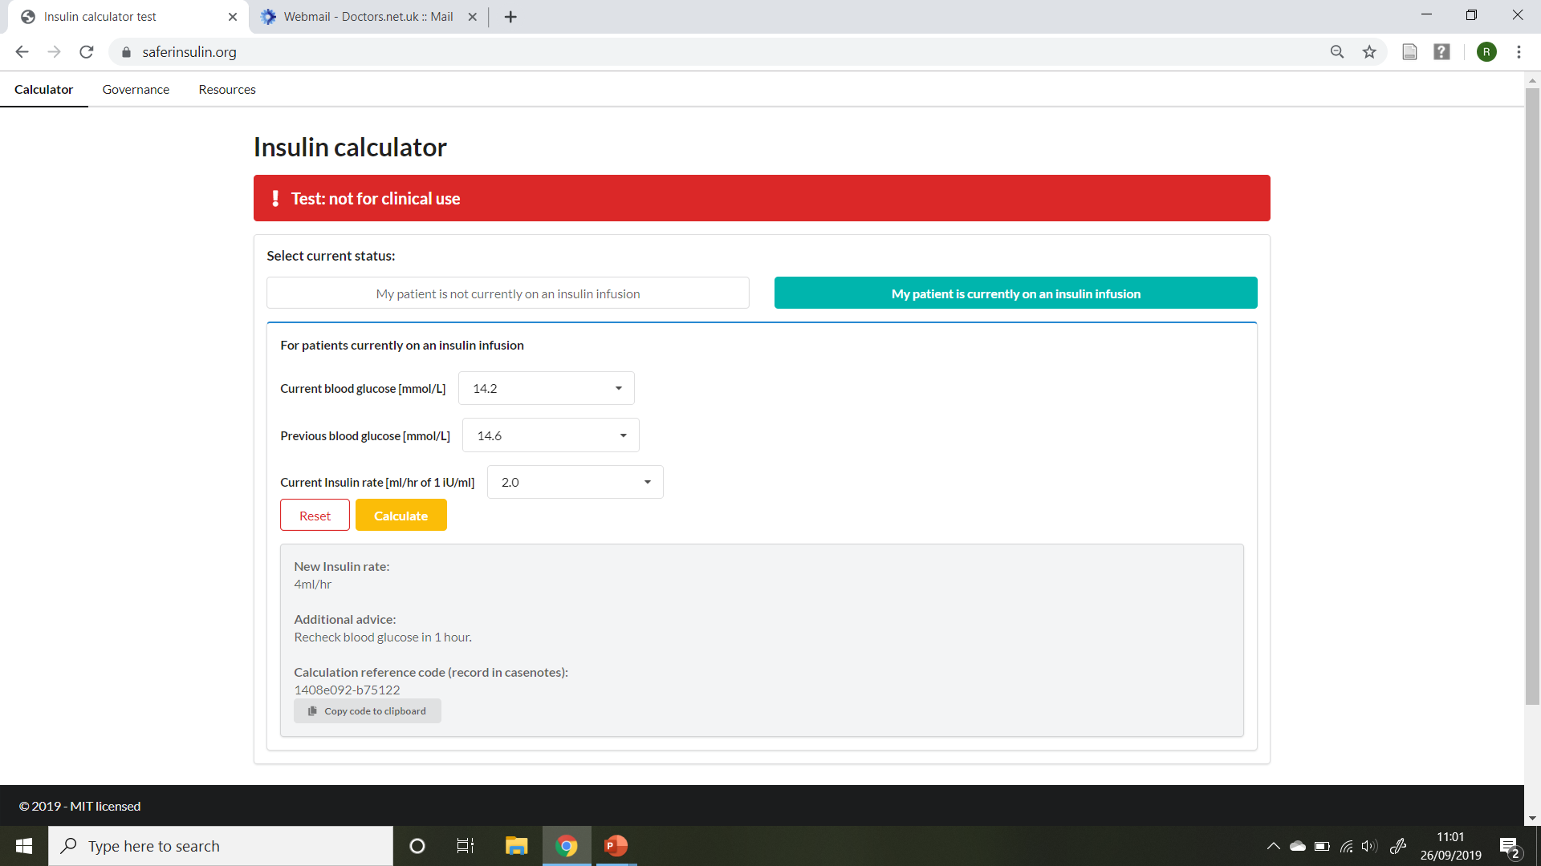

Adjusting the insulin rate
Recheck blood glucose after 1 hour
Choose the “My patient is currently on an insulin infusion” tab
Enter new blood glucose, previous blood glucose and current insulin rate
Hit “Calculate”
Adjust rate
Copy reference code
Add new task in EPR against insulin prescription
Enter new rate
Paste reference code

Slide 8
Most important points
Insulin should be commenced when blood glucose is confirmed >10mmol/l
Target range 6-10mmol/l
No insulin required below 6mmol/l
Urgently treat hypo’s <4mmol/l
Use your clinical judgement…if the advice doesn’t feel right, ask for a senior opinion

