Slide 1
Smarter code with databases and data aware controls
Jeroen Pluimers
wiert.me
jeroen@pluimers.com
Notes:
Smarter code with databases and data aware controls
Jeroen Pluimers
For most Delphi applications, working with data in your UI is really important.
This session shows you a few smart things you can do with the Data Aware Control framework in Delphi (the framework connecting DataSet/DataSource/Data Aware Controls) in a generic fashion.
You will see the strengths and weaknesses of fields in the Fields Editor.
Features of the Fields Editor that most people overlook, and the combination of ClientDataSets with normal databases.
Then you discover some of the inner workings of the Data Aware Control framework.
You learn how the inner workings of this infrastructure are organized, and where can you access it.
A key thing is to learn the different roles a DataSource can play, and how to optimize the placement of them in your application.
In a generic fashion you will learn how to translate this towards Data Aware Controls.
How to automatically give them different apperances for read-only, required and failed data entry.
Finally you will learn some tricks to automatically disable the Enter key when a ComboBox is expanded, and enabled the Enter key (and default buttons) when the ComboBox collapses.
During this session you will also see some other key aspects of Delphi: the Run-Time Type Information.
It allows you to solve some problems in a really generic and interesting way

Slide 2
Smarter code
for … in with TDataSets

Slide 3
Would it be nice to…
  var
  Index: TDataSetEnumerationRecord;
  begin
  for Index in XokumClientDataSet do
  if Assigned(Index.DataSet) then
  begin
  // ...
  end;
  end;

Slide 4
Helpers
Introduced in Delphi to support.NET
  .NET class hierarchy difers of Win32
  Methods, functions and properties were different or missing
Class helpers can make these extensions
Now also available as
Record helpers

Slide 5
Helpers
Helpers (class or record or simple)
function as long as the helper is visible to the user
So:
  Helper in the same unit,
  or helper in a unit in the uses list

Slide 6
Helpers for TDataSet & TParams
  type
  TDataSetHelper = class helper for TDataSet
  public
  //1 Returns first field that matches,
  // if no matching field then exception
  function FieldByAnyName(
  const FieldNames: array of WideString): TField;
  //1 Support for ... in loop providing TDataSetRecord
  function GetEnumerator: TDataSetEnumerator;
  end;
  TParamsHelper = class helper for TParams
  public
  function ParameterByAnyName(
  const ParameterNames: array of WideString): TParam;
  end;

Slide 7
Helpers for TDataSet (2)
  type
  TDataSetEnumerator = class
  strict private
  FDataSet: TDataSet;
  FFirstItem: Boolean;
  FEmpty: Boolean;
  public
  constructor Create(const DataSet: TDataSet);
  function GetCurrent: TDataSetRecord;
  function MoveNext: Boolean;
  //1 Mark the for ... in
  // enumeration result as TDataSetRecord
  property Current: TDataSetRecord
  read GetCurrent;
  end;

Slide 8
Overview of data layers

Slide 9
Overview of data layers
Data Aware controls
DataSource
DataSet
Data Access Solution
Database

Slide 10
Overview of Data Layers
DataSet
DataSet
(Table)
DataSource
DatabaseName
TableName/SQL
DataSource
DataField
Data access
Data Control
(dbEdit)
DB

Slide 11
Overview – Generic application
Form: data aware components (visible)
dbGrid
dbNavigator
dbEdit
dbText
DataSource
DataModule: data access components (invisible)
DataSet
DataSet
Connection
Data Access Layer
Notes:
Connection layer handles things like
transactions (locking, commit/rollback, separation/visibility)
Authentication (login, users, passwords)

Slide 12
BDE application
Form: data aware components (visible)
dbGrid
dbNavigator
dbEdit
dbText
DataSource
DataModule: data access components (invisible)
Query
Table
Database
Session
Borland Database Engine

Slide 13
dbExpress application
Form: data aware components (visible)
dbGrid
dbNavigator
dbEdit
dbText
DataSource
DataModule: data access components (invisible)
SQLDataSet
SQLQuery
SQLConnection
dbExpress

Slide 14
ADO application
Form: data aware components (visible)
dbGrid
dbNavigator
dbEdit
dbText
DataSource
DataModule: data access components (invisible)
ADOTable
ADOQuery
ADOConnection
ADO

Slide 15
Modularizing data layers

Slide 16
Delphi – Modularization
Average Delphi app unit structure
Main Form
Customer
Form
Customer
Data
Module
Order
Form
Order
Data
Module
Database
Data
Module

Slide 17
Delphi – Modularization
Good Delphi app unit structure
Main Form
Customer
Form
Customer
Data
Module
Order
Form
Order
Data
Module
Database
Data
Module

Slide 18
How come good is better than bad?
Look for modularization in real life…
  Houses - rooms
  Cities - suburbs/blocks
  People - digestion system
  Parliament - parties
Sometimes modularization works
Sometimes it doesn’t ☺

Slide 19
Modules are everywhere…
So why does it work?
  Internal Cohesion HIGH
  External Coupling LOW
    If also ‘uniform’: great!
    If also ‘directional’: even better!
Notes:
Low external coupling makes your modules less dependent on each other.
It will become easier to split a module or move features form one module to another
Directional coupling gives a clear indication about what depends on what.

Slide 20
Modularization – database apps
Let’s apply this knowledge
to our database apps
Especially: where to put the DataSource…
Where is your DataSource?

Slide 21
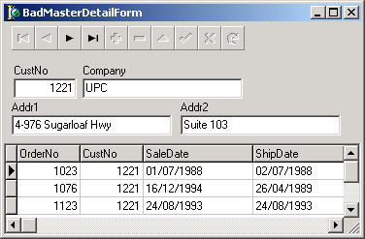
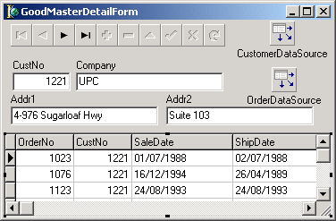


Modularization – DataSource
Bad 3 Internal Links
6 External Links
Good 6+2 Internal 2 External Links
Notes:
Except for coneptual reasons, this is also handy for practial reasons
Sometimes the Delphi IDE ‘forgets’ external links and erases them.
If you have few external links, they are much easier to retore.

Slide 22
Modularization – the datasource
DataSource has two goals
    Binding GUI controls
    Providing Master-Detail relations
  GUI binding:
  put DataSource on Form
  Master-Detail relations:
  put DataSource on DataModule

Slide 23
Modularization – gain
Flexibility
  Change of GUI
  Change of Data Access
  Re-use of modules across projects

Slide 24
Component hierarchy
Delphi 5 Object Hierarchy.pdf

Slide 25
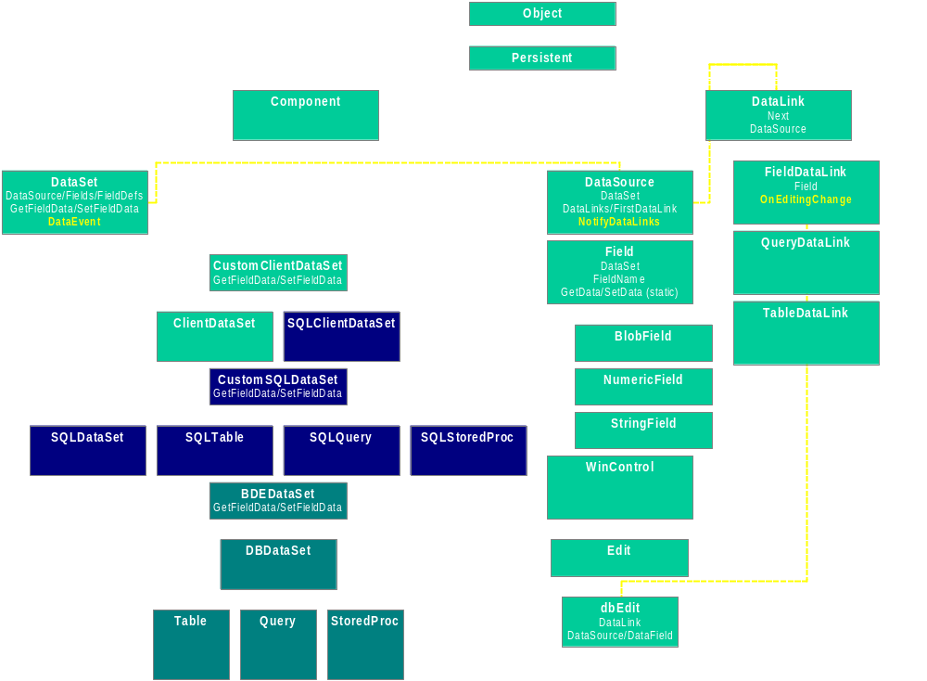
Component hierarchy – overview

Slide 26
Datasets
GetField/SetField
and more...

Slide 27
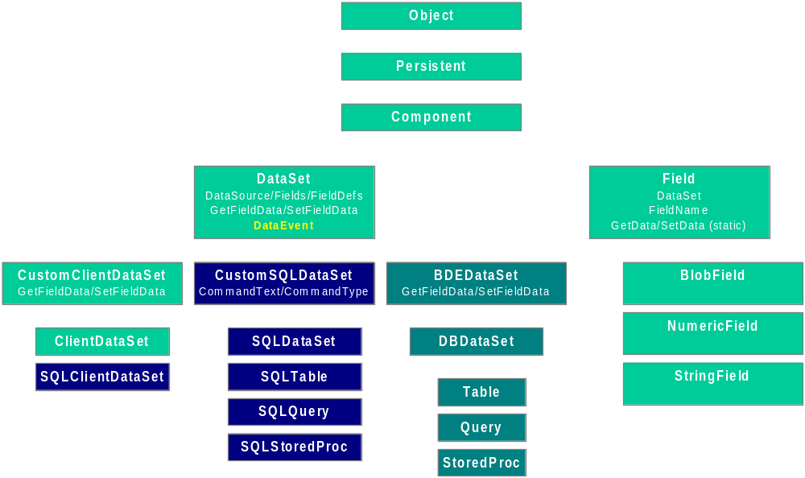
Component hierarchy – DataSets

Slide 28
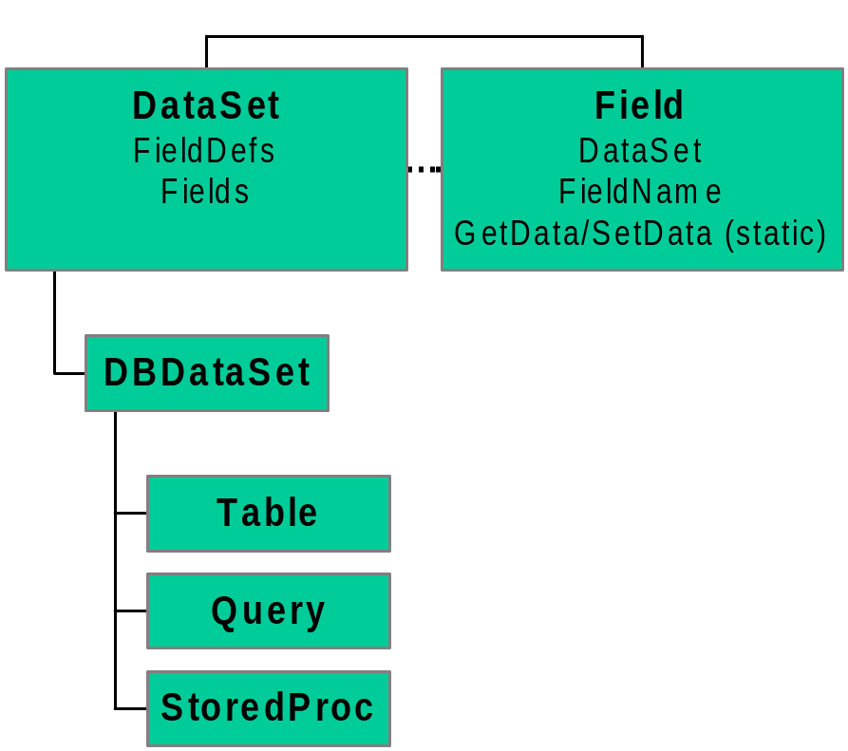
DataSet/Field – until D2
Result
  Tight coupling with BDE
Bound to
DBDataSet
Bound to BDE

Slide 29
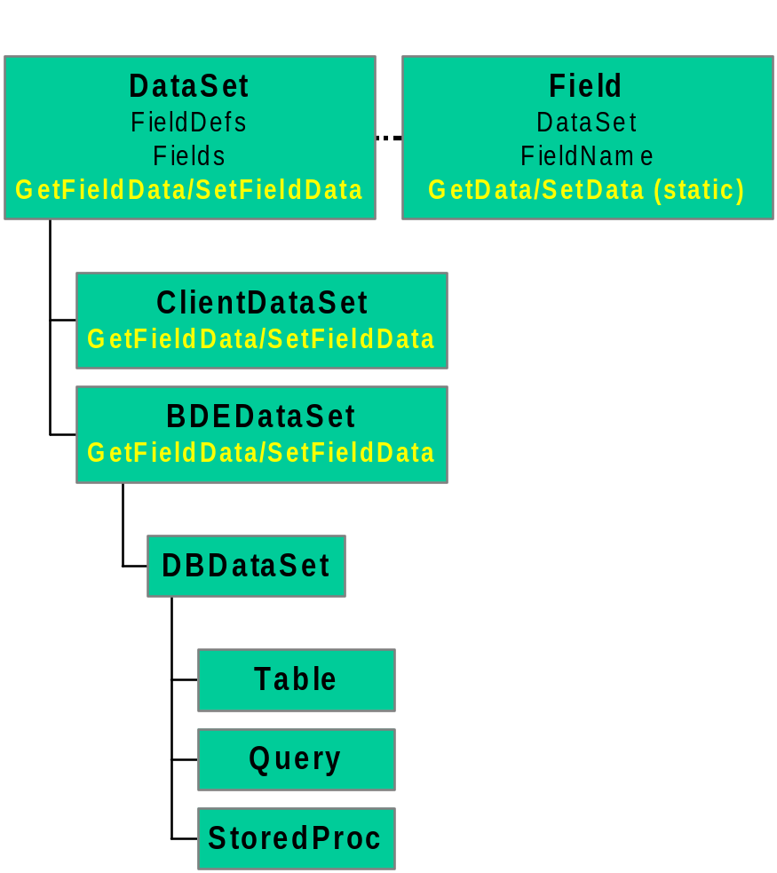
DataSet/Field – D3 and up
Freedom of choice
  BDE, DataSnap, ADO, IBX, DBX, dbExpress, FireDac, …
Bound to
DataSet
Virtual:
no forced binding

Slide 30
GUI binding
DataLinks

Slide 31
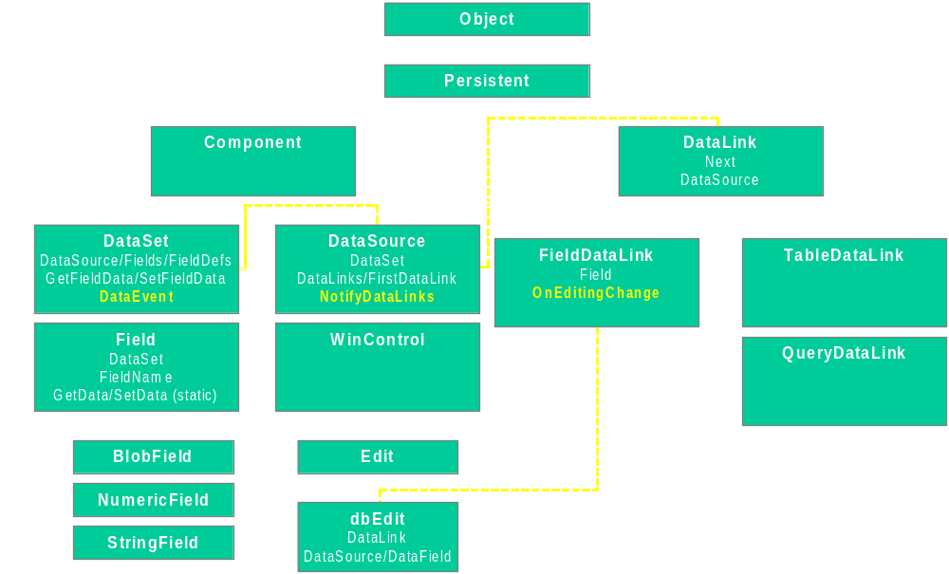
Component hierarchy – Binding

Slide 32
So: TDataLink is interesting
Choose which TDataLink (or descendant to use)
  TDataLink
    TDataSourceLink
    TDBCtrlGridLink
    TDetailDataLink
      TIBDataLink
      TMasterDataLink
    TFieldDataLink
    TGridDataLink
    THTTPDataLink
    TListSourceLink
    TMultiDimDataLink
    TNavDataLink

Slide 33
Demo’s
TDbDisplayLabel
  Shows the TField.DisplayLabel
  in a data aware control
  Uses TFieldDataLink
    Note: changes will not be reflected when DataSet.Active=false
    this is by design in the VCL
    (same reason a DBGrid will not show columns in that state)
Fields editor
  More than just adding TFields
  Drag & Drop to other forms
  Navigate through record

Slide 34
Demo’s (2)
TDataLinkReflector
  Makes the virtual functions of a TDataLink available as Events
TRecordArrivedNotifier
  For people having a Paradox background
    property DataSource
    event OnArriveRecord

Slide 35
Demo’s (3)
TDataAwareControlController
  Dynamically change the appearance of your data aware controls depending on the properties of the TField objects they bind to
  Reacts on
    ReadOnly
    Required
  Has scope and ownership awareness

Slide 36
Q & A
Questions after the conference?
jeroen@pluimers.com

