Slide 1

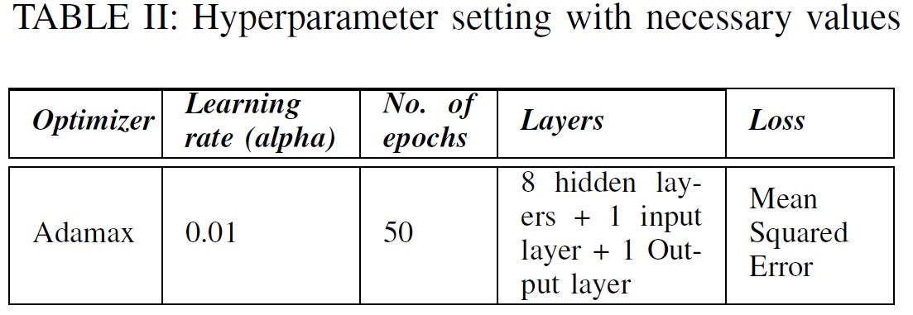
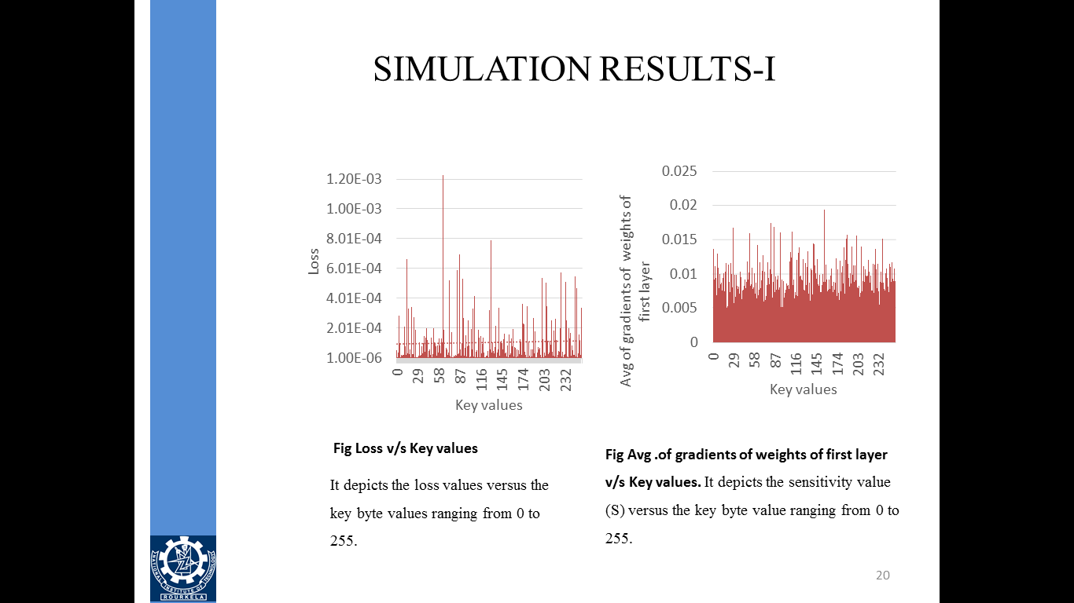
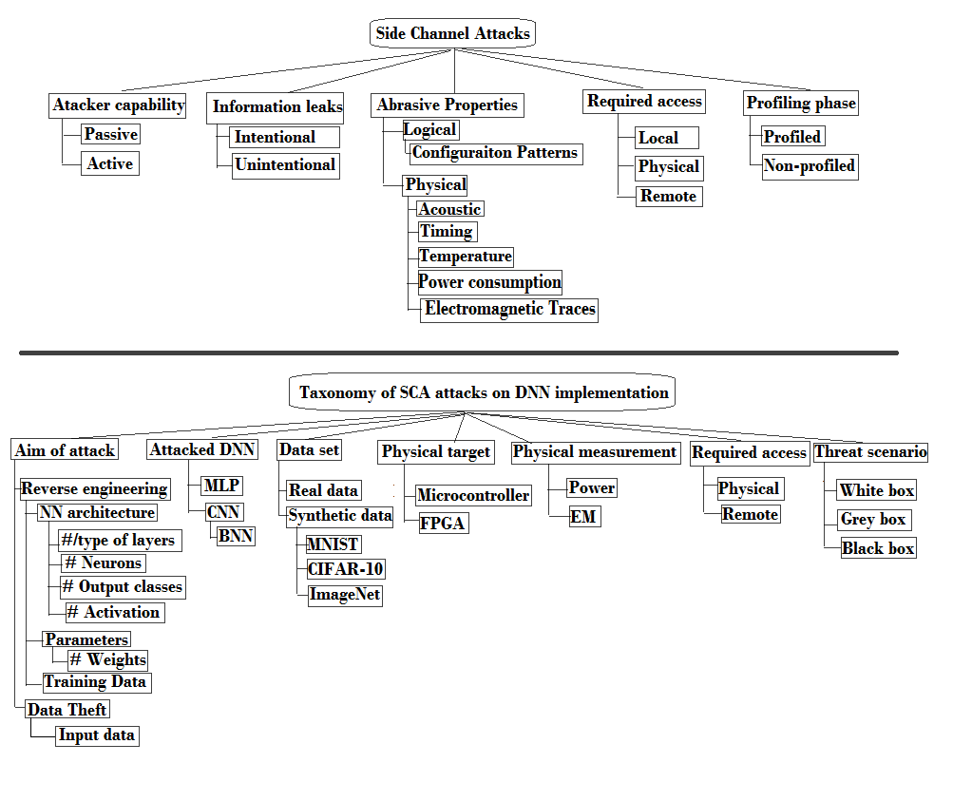
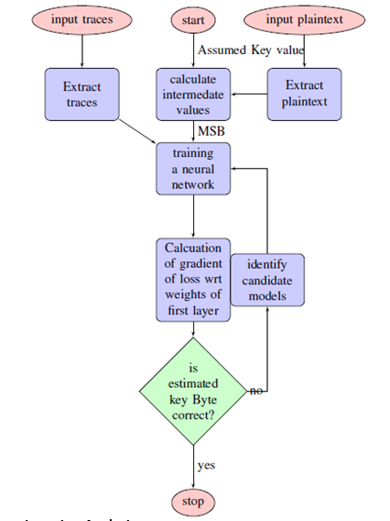
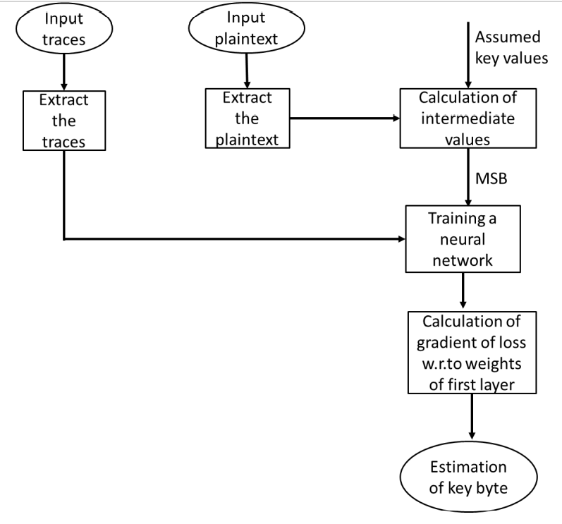
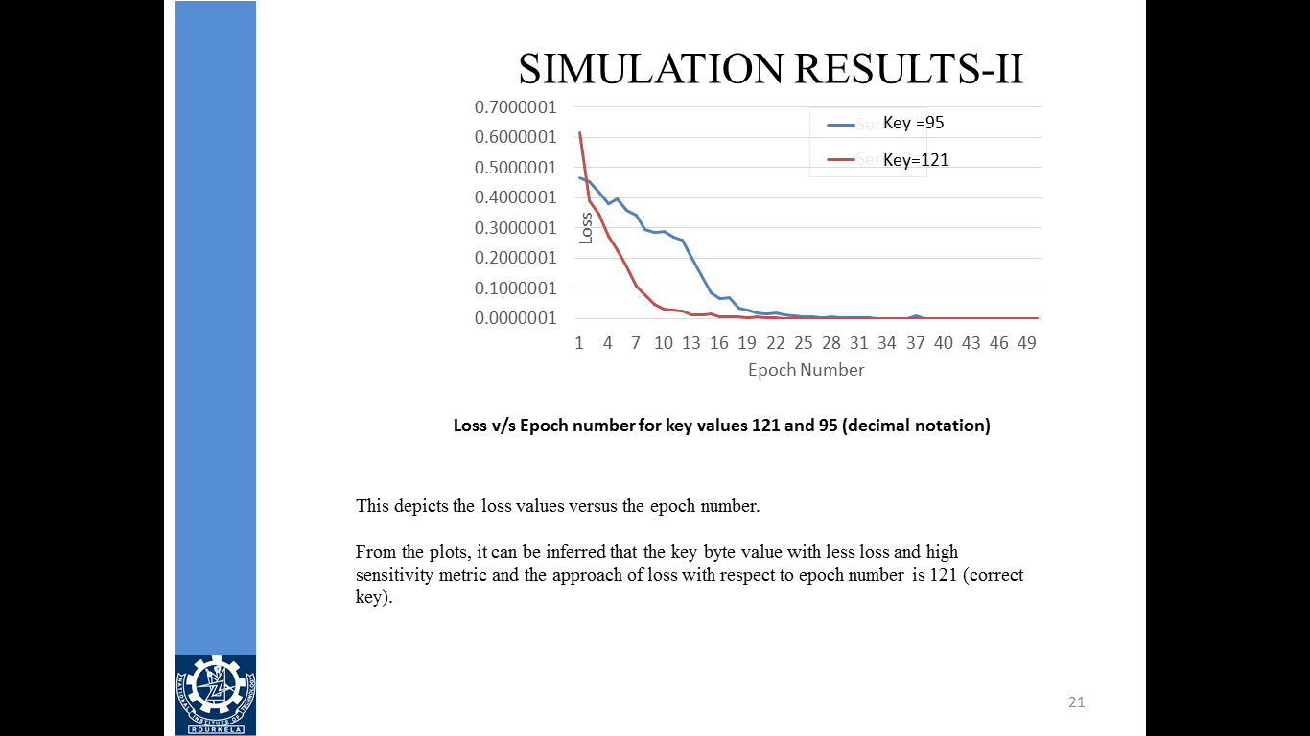
DAC YF
Non-Profiled phase Learning SCA based Power Analysis
Jaganath Prasad Mohanty, Kamalakanta Mahapatra, NIT Rourkela India
Motivation and Goals
Summary of Attacks
Proposed Solutions and Results
Conclusions
In this analysis, a deep neural network is developed and trained, and based on the DL metrics the secret key is revealed.
The input traces are given to the network which act as training data. MSB of the intermediate value calculated is given as the training label for the network.
For each key value ranging from 0 to 255, the network is trained and the key value for which the network gives the best metrics is the desired key value.
The byte number of the key revealed is the byte of the key value being used to calculate the MSB of the intermediate value.
Power Side-Channel analysis
recovers sensitive information not only from physical proximity to a device but
also from basic knowledge of sample leaked data collection.
With minimum mean squared error metric, power analysis using a deep learning test case increase confidence level of proper identification of leaked data.
Comparison with state-of-the art technology in this work shows improved performance in the non-profiled SCA category of detection
Generally Side Channel Analysis is done on physical behavior of a device depending on the data it manipulates.
We use divide and conquer strategy to recover secret value chunk wise. Implementation does not use secret in single cycle. SCA characterizes this dependency in order to retrieve information on sensitive data.
Main exploitable physical behaviors are Execution time, Power consumption of device and Electromagnetic emanation of the device
 | Algorithms | Non-profile | Technique | Methods
Our Propose Method | AES 128 | Yes | Deep Learning | MLP, DDLA
B Timon | AES | Yes | Deep Learning | MLP, DDLA, CNN
Ashraf et.al. | AES 128 | Yes | Deep Learning | Preprocessing with Auto-encoders
Mukhtar et.al. | ECC | No | Machine Learning | Preprocessing SVM, MLP
Kwon et.al. | PRESENT | No | Supervised Learning | DL-LA, MLP, CNN
References
S. Mangard, E. Oswald and T. Popp, Power Analysis Attacks - Revealing the Secrets of Smartcards, Springer, 2007.
Mark Randolph and William Diehl, “Power Side-Channel Attack Analysis: A Review of 20Years of Study for the Layman,” Cryptography 2020, 4, 15; doi:10.3390/cryptography4020015.
Davide Bellizia, Balazs Udvarhelyi, and Francois-Xavier Standaert, ”Towards a Better Understanding of Side-Channel Analysis Measurements Setups”, UCLouvain, ICTEAM/ELEN/Crypto Group
Hospodar, G., Gierlichs, B., De Mulder, E. et al., “Machine learning in side-channel analysis: a first study”. Journal of Cryptographic Engineering 1, 293, 2011. doi: 10.1007/s13389-011-0023-x.A.
Mndez Real, M.; Salvador, R. “Physical Side-Channel Attacks on Embedded Neural Networks: A Survey.” Preprints 2021, 11, 6790. https://doi.org/10.3390/app11156790
Yu, Weize & Kose, Selcuk.” A Lightweight Masked AES Implementation for Securing IoT Against CPA Attacks”. IEEE Transactions on Circuits and Systems I:pp. 1-11.2017, doi: 10.1109/TCSI.2017.2702098.
Libang, Z.; Xinpeng, X.; Junfeng, F.; Zongyue, W.; Suying, W., ” Multi-label Deep Learning based Side Channel Attack”. In Proceedings of the 2019 Asian Hardware Oriented Security and Trust Symposium (AsianHOST), Piscataway, NJ, USA, 16–17 December 2019; p. 6
Timon Benjamin, “Non-profiled deep learning-based side-channel attacks with sensitivity analysis”, IACR Transaction on Cryptography. Hardware Embedded Systems 2 ,no. 4, 107–131,2019.
D. Kwon, H. Kim and S. Hong, ”Non-Profiled Deep Learning-Based Side-Channel Preprocessing With Autoencoders,” in IEEE Access, vol. 9, pp. 57692-57703, 2021, doi: 10.1109/ACCESS.2021.3072653.
M. Tehranipoor, “A survey of hardware Trojan taxonomy,” IEEE design & test of computers, pp. 27(1):10-25, 2010.
Attacks Taxonomy
Related Publications
Vijayakanthi Gonella, Jaganath P Mohanty, A Swain, Kamalakanta Mahapatra, “Differential Metric Based Deep Learning Methodology for Non-Profiled Side Channel Analysis”, 2021 IEEE International Symposium on Smart Electronic Systems (iSES) (Formerly iNiS), MNIT Jaipur, India
Acknowledgements
Fig. Flow chart of Differential Deep Learning Analysis
I would like to thank the support of project SMDP-C2SD, sponsored project from MEITY, Government of India
In this space you can put the logos of your university and your sponsors

