Slide 1


Introduction to Teradata

Slide 2
Contents
What is a Data Mart?
What is a Data warehouse?
What is Teradata?
What are the Teradata features?
What is the Teradata database architecture?

Slide 3
What is a Data Mart?

Slide 4
What is a Data mart
A data mart is generally a relatively small application- or function-specific subset of the data warehouse database created to optimize application performance for a narrowly defined user population.
Data marts are often categorized into three different types:
  Independent data marts
  Dependent data marts
  Logical data marts

Slide 5
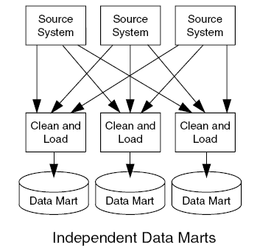
Independent data marts
Independent data marts are isolated entities, entirely separate from the enterprise data warehouse.
Their data derives from independent sources, which are entirely separate from the enterprise data warehouse and have a high likelihood of producing data that does not match that of the warehouse.
Notes:
Independent data marts are also sometimes referred to as data basements.
A data basement is a collection of independent data marts. Suppose you have parts that you
decide to store in your basement. There is no particular rhyme or reason to what part is stored
or where it is stored other than convenience. Continuing the analogy, what is stored in the
basement depends on what any family member decides needs to be stored there. If you need to
locate a part that you think might have been stored in the basement, you ask everybody in the
family if they have seen it recently and then you make your search based on their recollections.
If you need to visit more than one basement to find your parts, it is unlikely they will be
compatible even if you are able to find them.
This method of storing data is essentially the same as the mix of paper databases and mixed
hierarchical and relational online databases spread among multiple departments that supports
many businesses today. It is the sort of situation that businesses generally want to escape, not
automate.

Slide 6
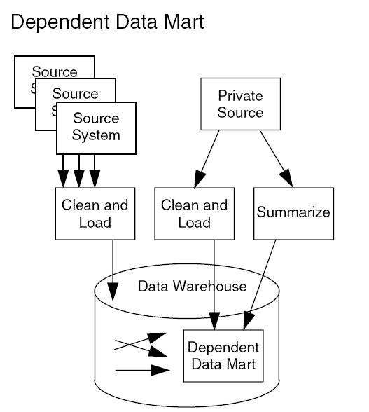
Dependent data marts
Dependent data marts are derived from the enterprise data warehouse.
It uses only data that is derived from the enterprise data warehouse data store and also permits its users to have full access to the enterprise data store when the need to investigate more enterprise-wide issues arises.
Notes:
Sometimes dependent data mart may result in a data junkyard depending on how its implemented.
In the data junkyard, all data begins with a common source (in this analogy, “cars”), but they
are scrapped, rearranged, and generally junked to get some common parts that the yard
operator believes are useful to his customers. The parts collection in the junkyard relates more
to what has been useful in the past: previous supply and demand determines what the user can
access.
Continuing the analogy, you, as a user, visit the junkyard and search through the various
wrecks you encounter in hopes of finding the part you need. To find your part (to answer
your question), you will probably need to scavenge through several different junkyards.
The approach results in a decision support environment molded, and compromised, from a
specific, well known set of questions and responses rather than around your ever-changing
business needs.

Slide 7
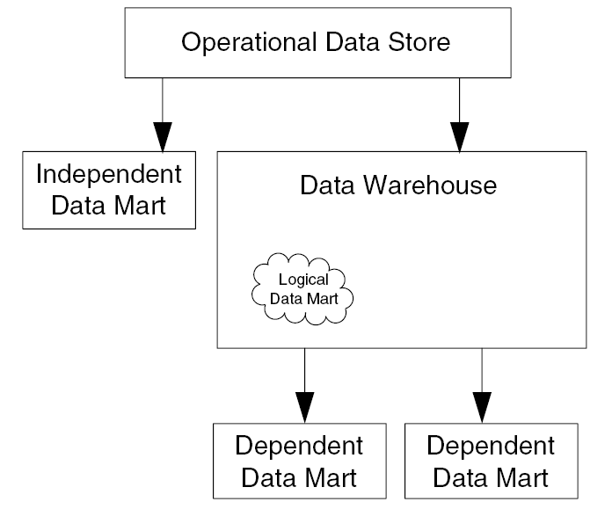
Logical data marts
The logical mart is a form of dependent data mart that is constructed virtually from the physical data warehouse.
Data is presented to users of the mart using a series of SQL views that make it appear that a physical data mart underlies the data available for analysis.

Slide 8
The Data Mart Centric Approach
The data mart-centric approach begins with one or several highly customized data marts and then attempts to expand the kernel into a full blown data warehouse.
If designing a data warehouse from the ground up, is not part of the plans from the beginning, this approach results in failure.
Notes:
Prospective builders of data warehouses are frequently advised to “start small” with a data mart and use that kernel to expand gradually into a full blown data warehouse. This approach to warehousing generally leads to failed projects for several reasons.
Sometimes the new data mart is so successful that the configuration is overrun by user demands. The databases grow too large too fast, response times become unacceptably long, and user frustration leads to searching for other ways to get the answers.
The more common reason for failure is that the data mart is immediately unsuccessful because it is designed in such a way that users are unable to retrieve the sort of information they want and need to extract from the data. Databases are highly denormalized to respond to a small set of canned queries; summaries, rather than detail data, comprise the database so that fine-grained exploratory data analysis is not possible; and support for ad hoc queries is either absent or so poor as to discourage users from bothering with them.

Slide 9
What is a Data Warehouse?

Slide 10
The Data Warehouse - The Classic Concept
First introduced by Bill Inmon in 1993, a data warehouse is a historical database containing tables derived from an active operational database.
The data in the warehouse had the following set of attributes:
  Subject-oriented
  Integrated
  Time-variant
  Nonvolatile

Slide 11
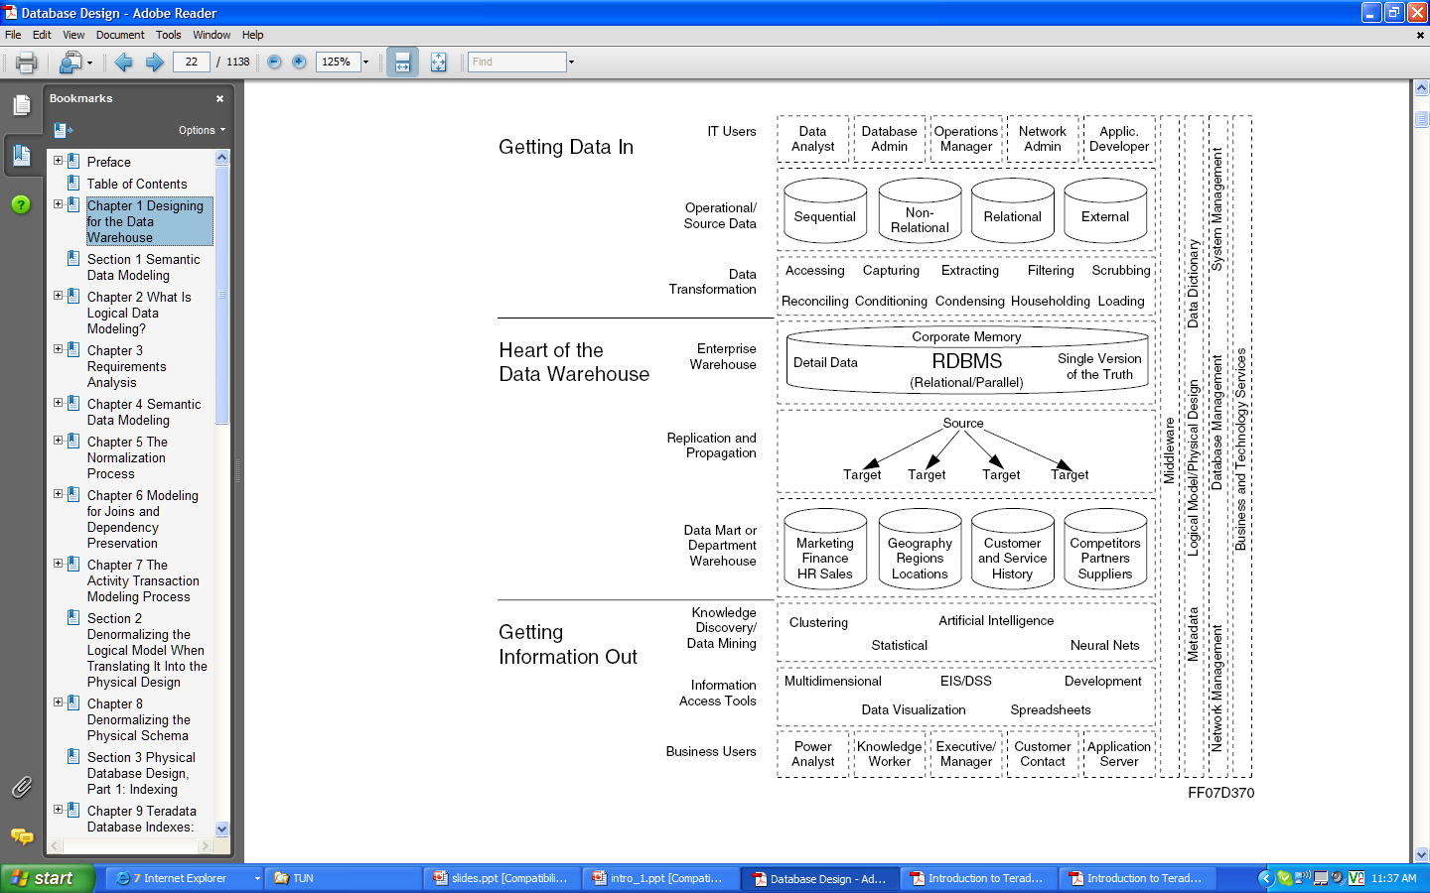
The Data Warehouse

Slide 12
The Teradata Data Warehouse
In the classic data warehouse, nonvolatile means no inserts. No deletes. No updates. No changes. The data warehouse is a static, historical structure.
The Teradata data warehouse is dynamic.
It is an active data warehouse that supports the ongoing, day-to-day business of the living enterprise, including many aspects of the traditional operational data store.
Enterprise business rules are isomorphic with the rules of the data warehouse.
Its most characteristic attribute is its volatility. The Teradata data warehouse is a dynamic entity.
Notes:
The Teradata parallel technology is optimized to perform tasks in a normalized environment
that other relational DBMSs cannot match with a denormalized schema. Among the special
performance advantages built into the Teradata system are the following: star join and other
join optimizations, full table scan optimization, specially designed index types, a full
complement of SQL aggregate and ordered analytical functions, and the most sophisticated
parallel-aware SQL query optimizer available.

Slide 13
What is Teradata?

Slide 14
What is Teradata?
A global leader in enterprise data warehousing and analytic technologies.
In data warehousing arena for over 27 years in over 60 countries delivering data warehouse appliance solutions.
Has about 1,000 customers, with annual revenue of about $1.6 billion from data warehousing solutions.
The Teradata enterprise data warehouse provides integrated and extensible technology for a single application neutral repository of a company's current and historical data, forming the framework of the business intelligence architecture.
Provides functionality for large, complex, mixed workload environments.

Slide 15
What is Teradata?
It has specific strengths (e.g., strong penetration, data models and professional services) in the vertical markets such as retail, financial and banking, telecom and manufacturing.
Its largest and most prominent customer is Wal-Mart. Other customers include companies like AT&T (formerly SBC), Dell, Continental Airlines, Overstock.com, FedEx, Vodafone, Gap Inc, and eBay.
Its main competitors are other mature DBMS solutions such as IBM's DB2, Microsoft and Oracle.
Its latest data warehouse release is Teradata 12. Its features include high-performance parallel database technology, a cost-based optimizer, a sophisticated mixed workload management tool, a full suite of data access and management tools and data mining software.

Slide 16
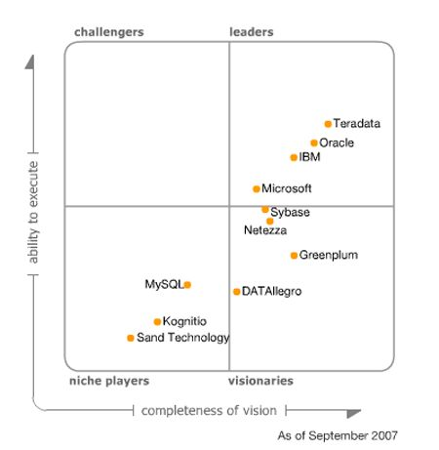
Gartner’s Magic Quadrant for Data Warehousing and DBMS
Ability to Execute: Ability and maturity of the product and the organization. Portability of the product. Ability to run and scale in different operating environments.
Completeness of Vision: Ability to understand the functionality needed to support the data warehouse workload design, the product strategy designed to meet market requirements, and the ability to understand overall market trends and influence/lead the market when necessary.
Teradata is positioned as a leader in the Magic Quadrant.

Slide 17
What are the Teradata features?

Slide 18
Teradata Technology Features
A relational database management system designed for enterprise data warehousing
A massively parallel processing system
A shared nothing architecture
Linear scalability in all dimensions of a database system workload (i.e., data volume, breadth, number of users, complexity of queries)
Notes:
A shared nothing architecture is a distributed computing architecture in which each node is independent and self-sufficient, and there is no single point of contention across the system.

Slide 19
More on Teradata features…
Acts as a single data store that can accept large numbers of concurrent requests from multiple client applications.
Unconditional parallelism, with load distribution shared among several servers.
Complex ad hoc queries with up to 64 joins.
Parallel efficiency, such that the effort for creating 100 records is same as that for creating 100,000 records.
Scalability, so that increasing of the number of processors of an existing system linearly increases the performance. Performance thus does not deteriorate with an increased number of users.

Slide 20
What is the Teradata database architecture?

Slide 21
Teradata Database Architecture
The hardware that supports Teradata Database software is based on Symmetric Multi-Processing (SMP) technology.
The hardware can be combined with a communications network that connects the SMP systems to form Massively Parallel Processing (MPP) systems.
The BYNET loosely couples all the SMP nodes in a multinode system. It enhances interprocessor communication and creates a fault-tolerant environment. If one BYNET should fail, the second can handle the traffic.
Notes:
Each processor node is a hardware assembly containing several, tightly coupled, central processing units (CPUs) in an SMP configuration. An SMP node is
connected to one or more disk arrays with the following installed on the node:
• Teradata Database software
• Client interface software
• Operating system
• Multiple processors with shared memory
• Failsafe power provisions
An MPP configuration is a configuration of two or more loosely coupled SMP nodes.
BYNET : A multinode system has at least two BYNETs. This creates a fault-tolerant environment and enhances interprocessor communication. Load-balancing software optimizes the
transmission of messages over the BYNETs. If one BYNET should fail, the second can handle the traffic.

Slide 22
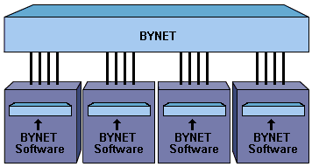
The Teradata Architecture
Physical layout of 4 node system
MPP System
MPP System
MPP System
Each Node is an SMP System. The maximum nodes can be up to 512.
Each Node is an SMP System.

Slide 23
References
Introduction to Teradata Warehouse, release 12.0, September 2007, B035-1091-067A
Database Design, release 12, September 2007, B035-1094-067A
Feinburg, D., Meyer, M., "Magic Quadrant for Data Warehouse Database Management Systems," Gartner RAS Core Research Note, October 10th 2007.
Teradata. (2008, Aug 5). In Wikipedia, the free encyclopedia. Retrieved August 10, 2008, from http://en.wikipedia.org/wiki/Teradata

