Slide 1
Educationary Leap
A better solution for service-learning opportunity management
©Team Educationary Leap 2018

Slide 2
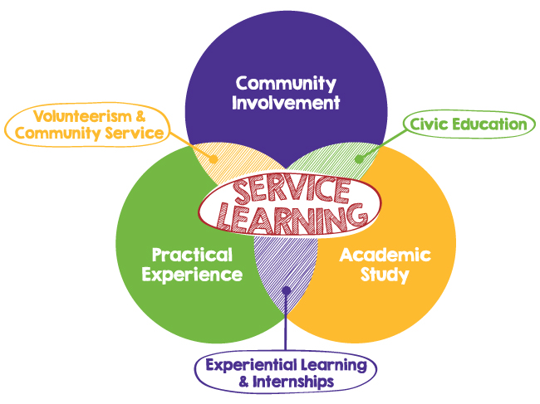
What is Service-learning?
Service-learning is an educational approach that combines learning objectives with community service in order to provide a pragmatic, progressive learning experience while meeting societal needs.

Slide 3

Service-learning at Bellevue College
Service-Learning curriculum takes advantage of volunteer positions both on- and off-campus. Volunteer responsibilities apply concepts or skills pertinent to course outcomes. Students learn while engaging with the community, and the community benefits from student participation.

Slide 4

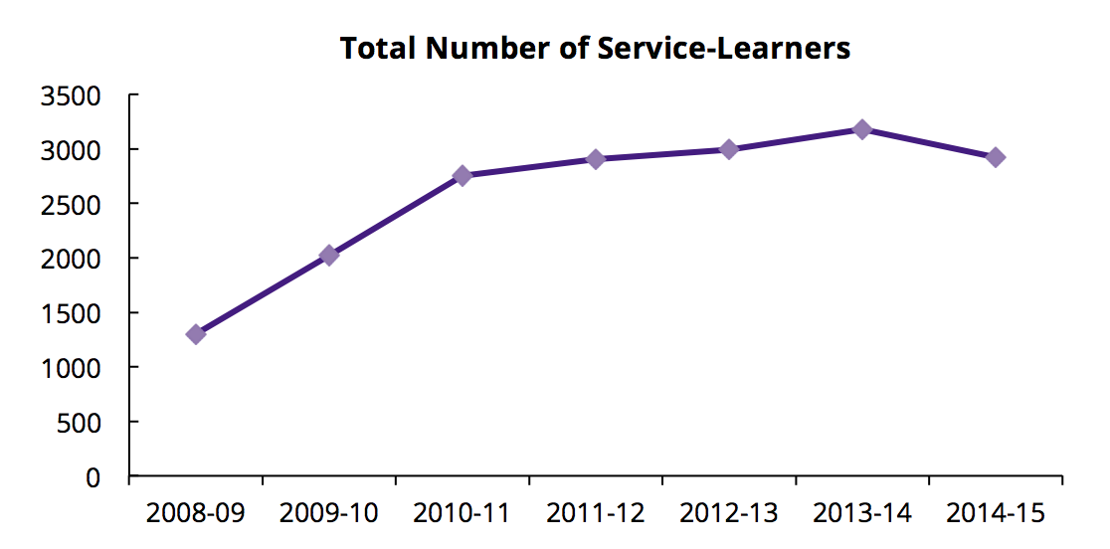
The demand is growing
2920
58400
375
$1,608,336
*Source: https://www.washington.edu/carlson/files/2015/08/2014-15-Carlson-Center-Annual-Service-Learning-Report.pdf
Notes:
University of Washington:
Over the course of the 2014-2015 academic year, a total number of 2,920 students (in 110 courses) enrolled into service-learning opportunities in 375 community partner organizations, completed over 58,400 hours of service, and the estimated net worth of these student service hours totals $1,608,336.

Slide 5
eLeap: The right solution
Create Opportunities
Manage Opportunities
Apply for Opportunities
Connecting Faculty, Instructor and Students

Slide 6
Main Features
User Management
Opportunity Management
Privileges Management
Sign Up
Sign In
Profile
List
Filter
Create
Edit
Delete
Approve
Reject
User roles
User privileges

Slide 7
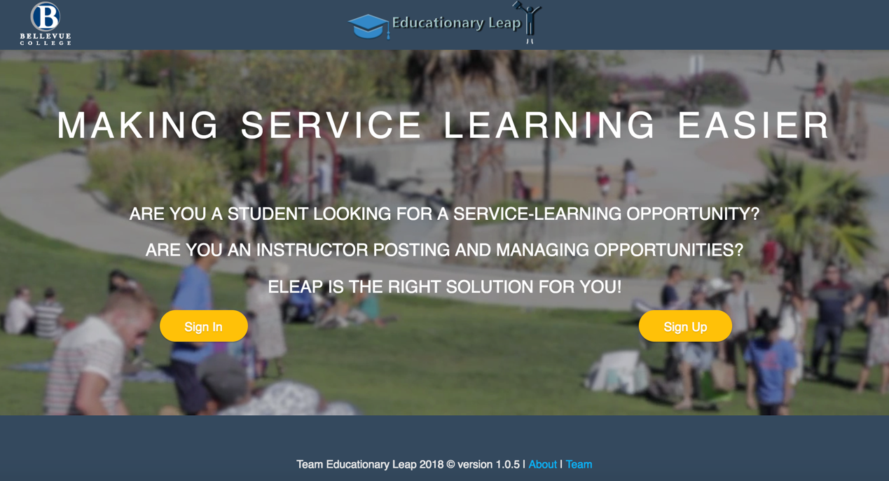
Design: Homepage
Homepage

Slide 8
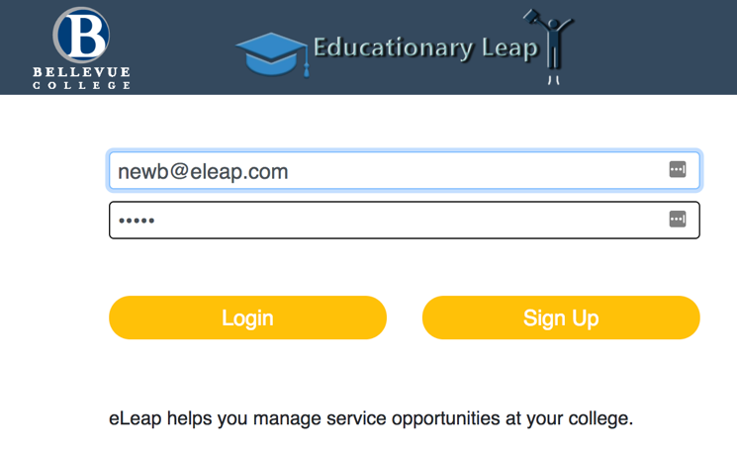
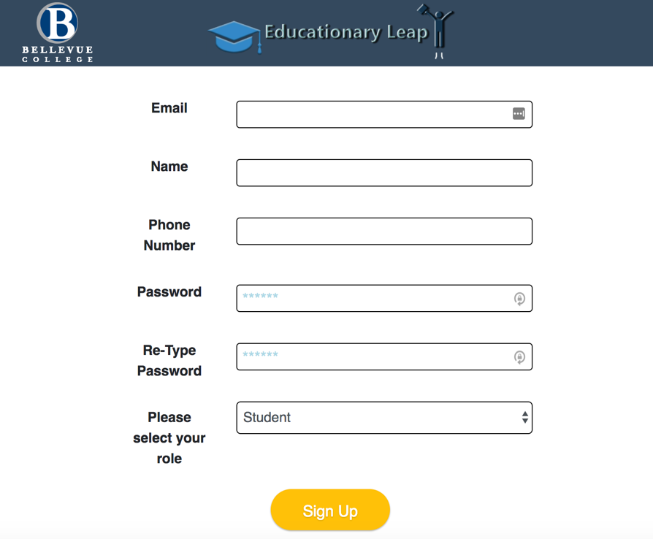
Sign In / Sign Up

Slide 9
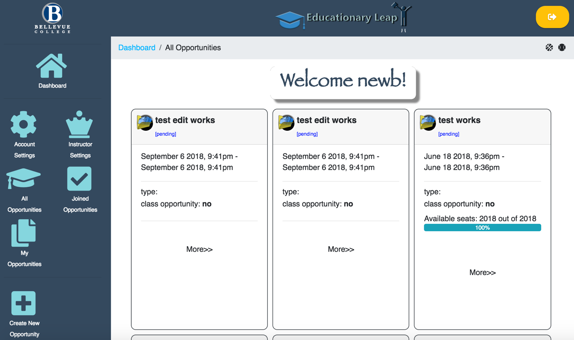
Opportunities Listing

Slide 10
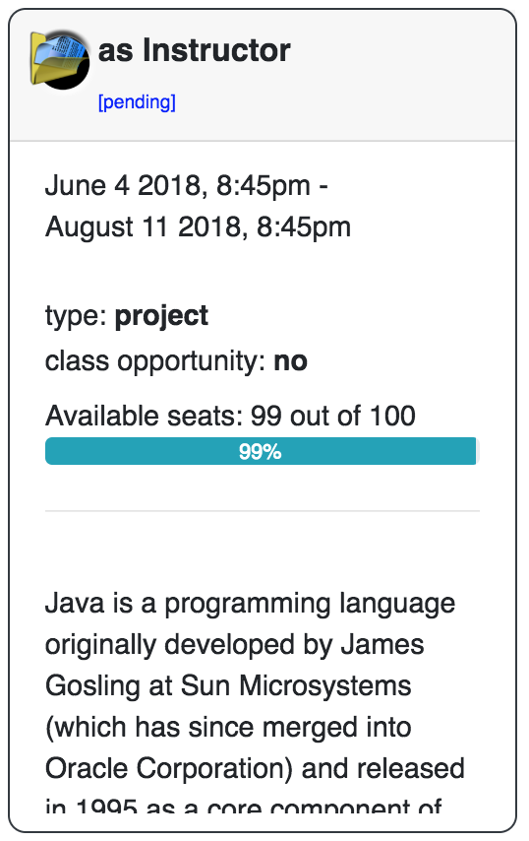
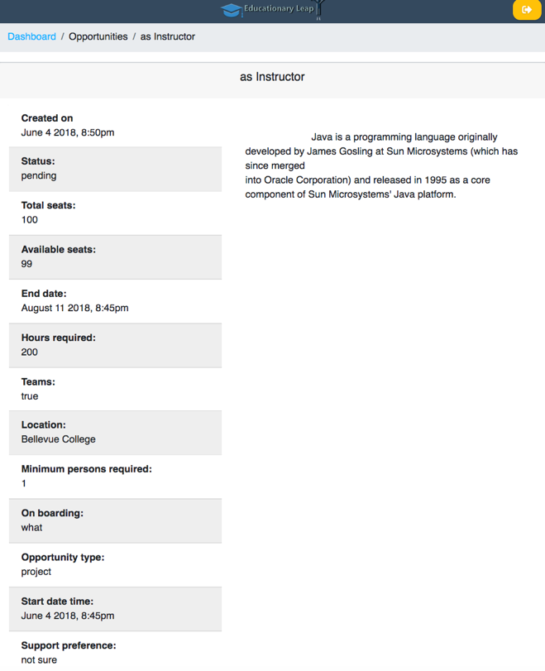
Opportunities Info Card / Details

Slide 11
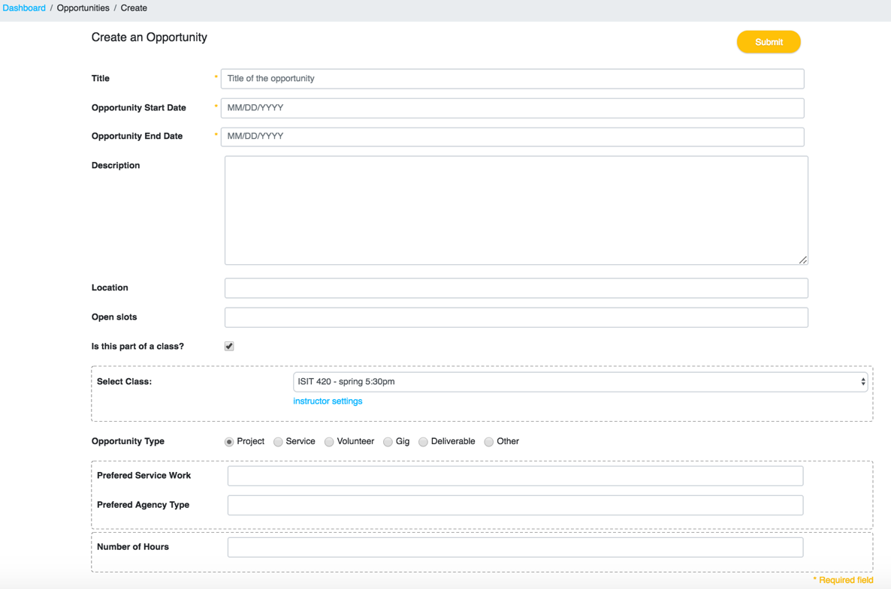
Create An Opportunity

Slide 12
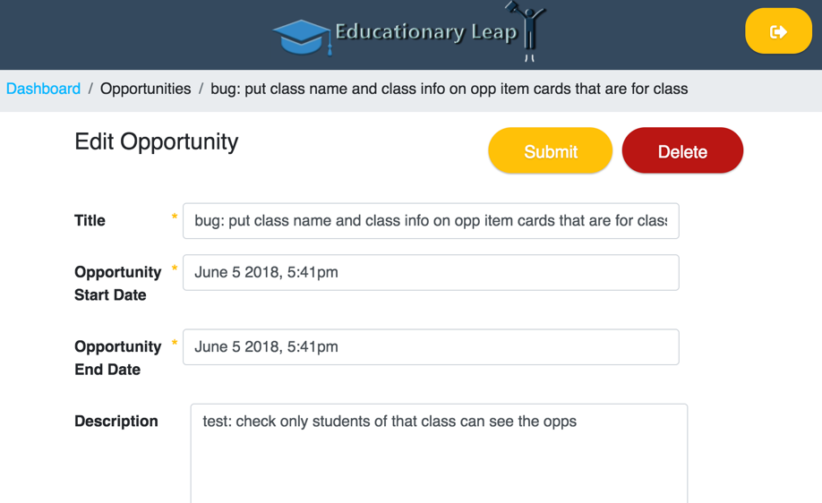
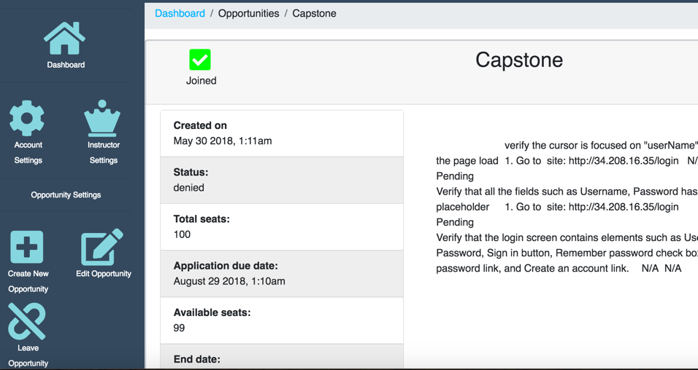
Edit / Join / Leave Opportunity

Slide 13
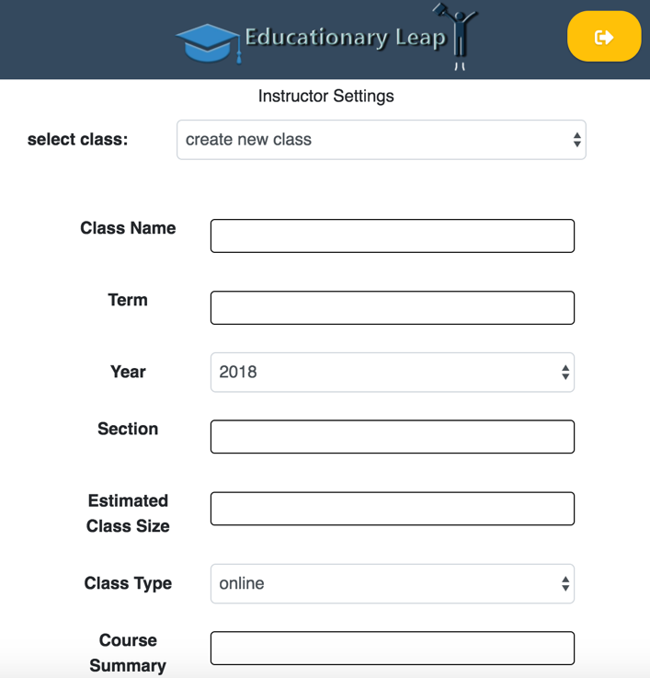
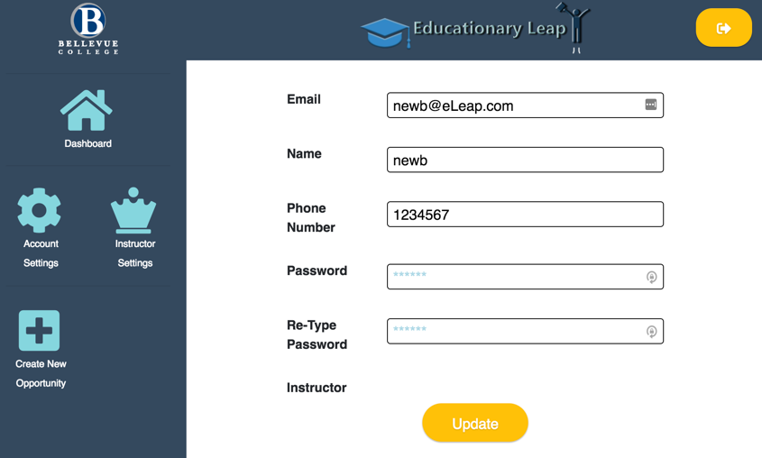
Design: Instructor / Account Settings

Slide 14
Tech highlight
Frontend
Responsive Design
Coding Language
JS
CSS3
HTML5
SQL
Framework
Backbone.js
Bootstrap
Infrastructure
AWS
SQL

Slide 15
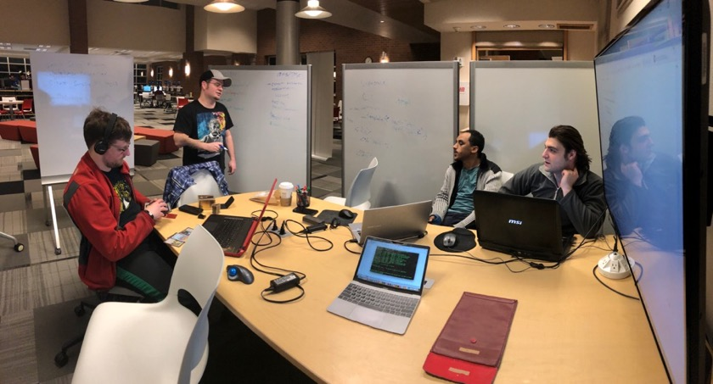
The Team
Instructor: Maricel Medina-Mora
Project Manger: Leo
Lead Engineering: JP
DBA: Aren
Design/UI: Sunny
Test: Belete

Slide 16
Live Demo

Slide 17

Thank you!
©Team Educationary Leap 2018

