Slide 1
GIT
Introduction to version control and the popular version control software Git

Slide 2
AGENDA
Based on Pro Git book: Chapter 1- 3
Intro to version control
Introduction to Git
Git example
Git, Github, and Gitlab

Slide 3
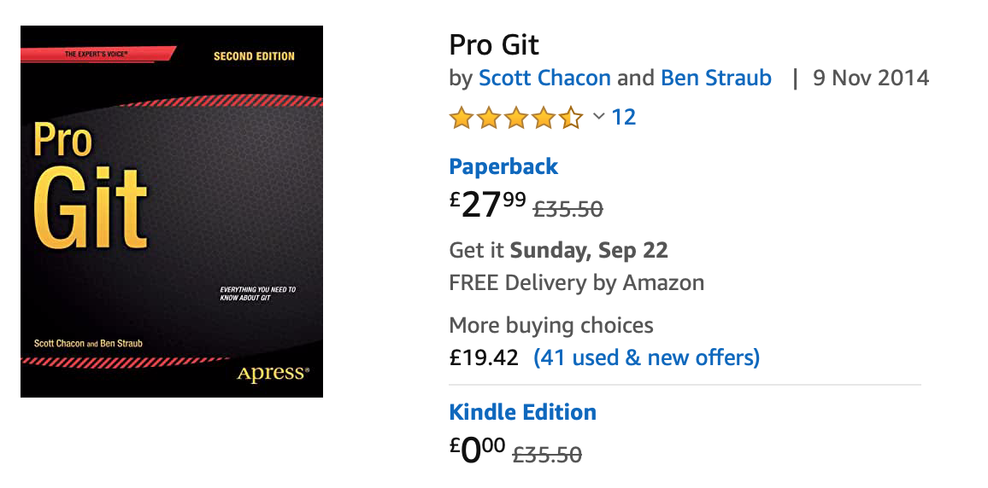
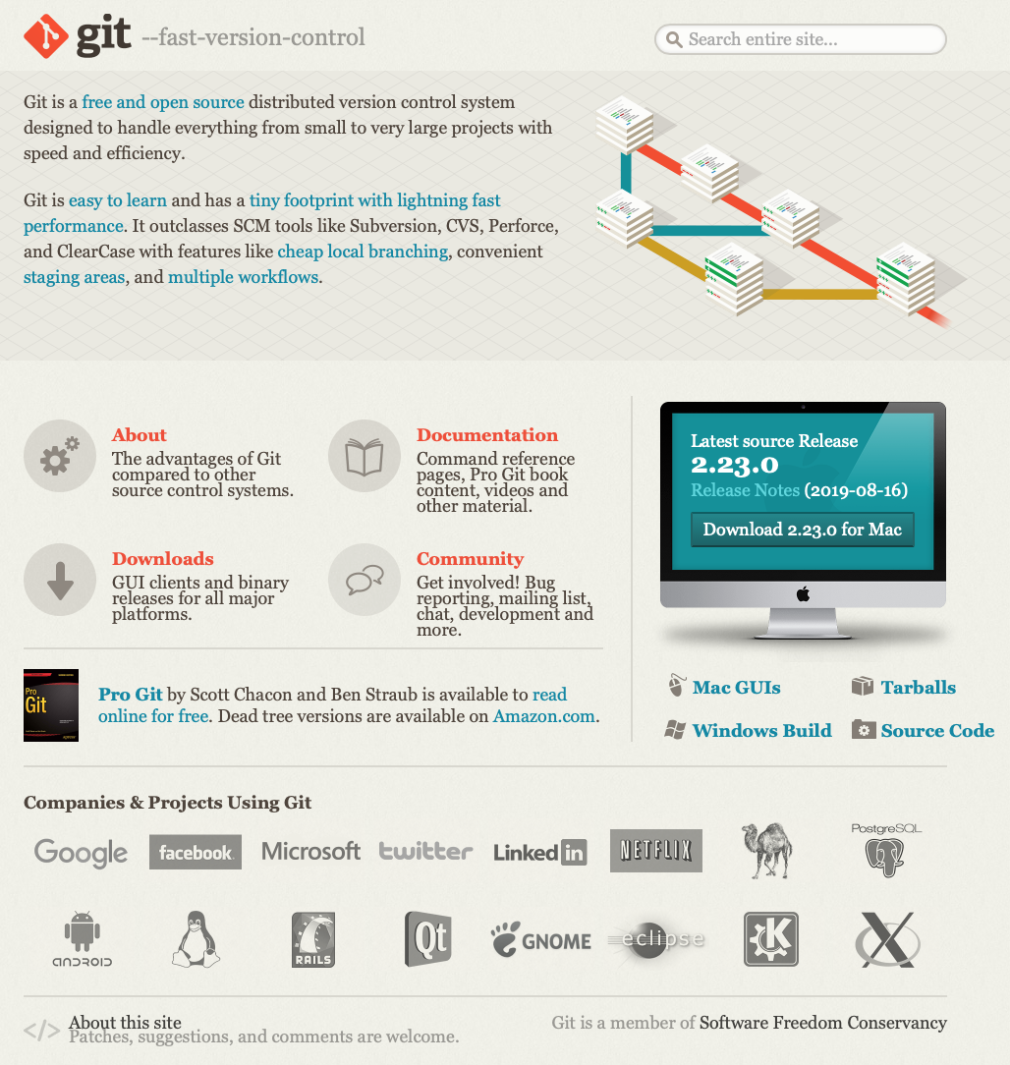
FREE BOOK
If you want to know more about Git there is a free book that this talk is based on.
Thank you Scott Chacon and Ben Straub
Everything you need to know on Git is free
eBook (amazon and other providers
Website: https://git-scm.com

Slide 4
Version Control – what is it?
Simply it’s a way of controlling a version of something
Revision – prove the process of creation (audit: who, when, what)
Reversion – roll back to a previous version
Reflection – shows people the state of a product e.g. 1.0.1 then 1.1.0
Review (Compare) – two different versions one with a problem one without
Different Levels of Version Control
Local – one computer, single VC database
Centralised (CVCS) – lots of computers; one, central VC database
Distributed (DVCS) – lots of computers; mirror of VC database

Slide 5
History of Git – don’t cross developers
2002 – Linux kernel project started using DVCS called BitKeeper
2005 – Linux community fall out with Bitkeeper (no longer free! ☹)
Community including Linus Torvalds start to develop own DVCS
2005 – Git born
Fast
Simple
Strong for non-linear development (1000s of parallel branches)
Distributed
Handle large projects
Free

Slide 6
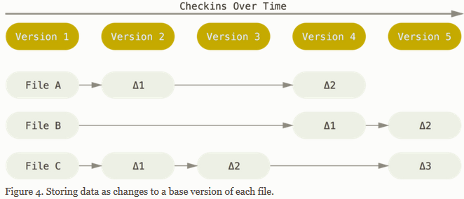
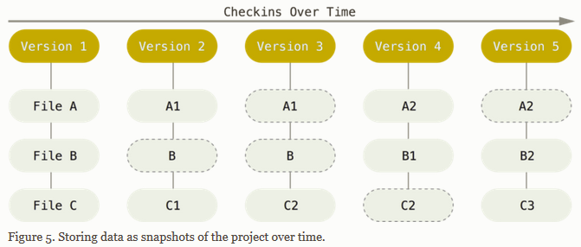
What is Git?
Delta-based version control
Git thinks differently to other VCS about data
CVS, Subversion, Perforce, Bazaar: track a set of files and the changes to those files as delta-based version control or file based changes
Git – tiny snapshots of the whole system. Every change is a new picture. If no change to a picture it leaves the picture unchanged
Snapshot-based version control
Reference: What is Git?
https://git-scm.com/book/en/v2/Getting-Started-What-is-Git%3F

Slide 7
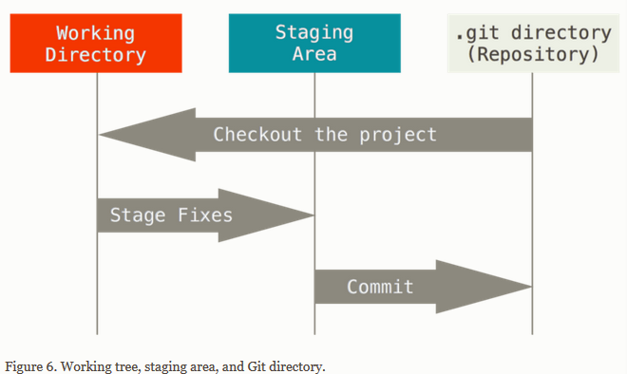
Git also is
Local – works offline until it needs to go on line (compare Centralised VCS)
Integral – it tracks everything with a checksum (SHA-1 hash) which can be used for tracking
Only Adds – everything is undoable as it just subtracts the adds
Three States (important ☺)
Modified – changed a file but NOT committed to the database (Git knows about all saved changes)
Staged – marked Modified in its current version to go into next Commit
Committed – change is committed and stored in the local database
Reference: What is Git?
https://git-scm.com/book/en/v2/Getting-Started-What-is-Git%3F

Slide 8
EXAMPLE OF GIT IN ACTION
1. Check if git is on your machine
git version
This will tell you if git is on your machine. If not then need to download and install.
2. Create a project
Create folder git_practice
Create file to track: hello_world.py
Create gitignore (git ignore)
This holds the folders that git shouldn’t track. You don’t want git tracking files that are not relevant
Add __pycache__/ .gitignore
Python creates a directory to store automatically generated files with extension .pyc when you run a .py file
Check if git is installed
Create project to be version contolled

Slide 9
EXAMPLE OF GIT IN ACTION
Folder called git_practice, file called hello_world.py, hidden file called .gitignore
3. Initialize a Repository
git init
This initializes an empty repository in git_practice
Repository = set of file git is tracking/versions
Creates a hidden folder .git (check ls –aF)
4. Check Repo status
git status – shows the status of the files tracked
Branch – version being worked on
Commits
5. Add Files to Repository
git add . >> adds all files to be watched
git status >> shows the status
Initialize git repo
Check repo status

Slide 10
EXAMPLE OF GIT IN ACTION
4. Make a Commit
git commit –m “Started project”
-m is the message attached to the commit in the git log
Result shows the branch and the two files that have changed/been added
5. Checking the Log
git log
This shows the commits logged
git log -- pretty=oneline
Little easier to read
Make first commit
Check the log for commits

Slide 11
EXAMPLE OF GIT IN ACTION
4. Change a file – change hello_world.py
print ("Hello London Software Developers")
print ("Welcome to the home of software development")
5. Check status
git status
Git has noticed the change to the file and highlights in red.
6. Commit Change
Git commit –am “Extended Greeting”
-am means add file change to store and add message
Second commit
Check the log for commits

Slide 12
EXAMPLE OF GIT IN ACTION
7. Reverting a Change not committed
Revert back to an old version.
Add line to hello_world.py
Print(”Opps – I need to put things back”)
git status confirms it’s not committed
git checkout .
This takes away the change without having to do anything to the IDE. Amaze balls
Reverting a change

Slide 13
EXAMPLE OF GIT IN ACTION
8. Reverting a Checked-in commit
git log --pretty=oneline
This shows all the commits that git has been tracking. Each commit has a key that can be sued to revert to
git checkout [xxxxxx]
Detached HEAD – HEAD is the current state of the project
By checking out a previous commit you create a parallel universe! Left master branch as we’re going back in time to this commit. This is the Head [branch]
git status shows where the head was detached
git checkout master
Now on the master branch (check status) and things have returned to normal.
git reset -- hard [xxxxxx]
Again you’ll see the file has been changed back
9. Deleting the Repository
Check out Previous commits

Slide 14
GITS GIT, GITHUB, GITLAB
GitHub
Bought by Microsoft for loads of money
Remote, shared Git
Create issues, people see theme work on them and commit the changes for others to use
Communication AND version control system
When ready to share = Create PULL Request
People work on the pull request version
Merge request brings the work back into Trunk
GitLab
All in

Slide 15
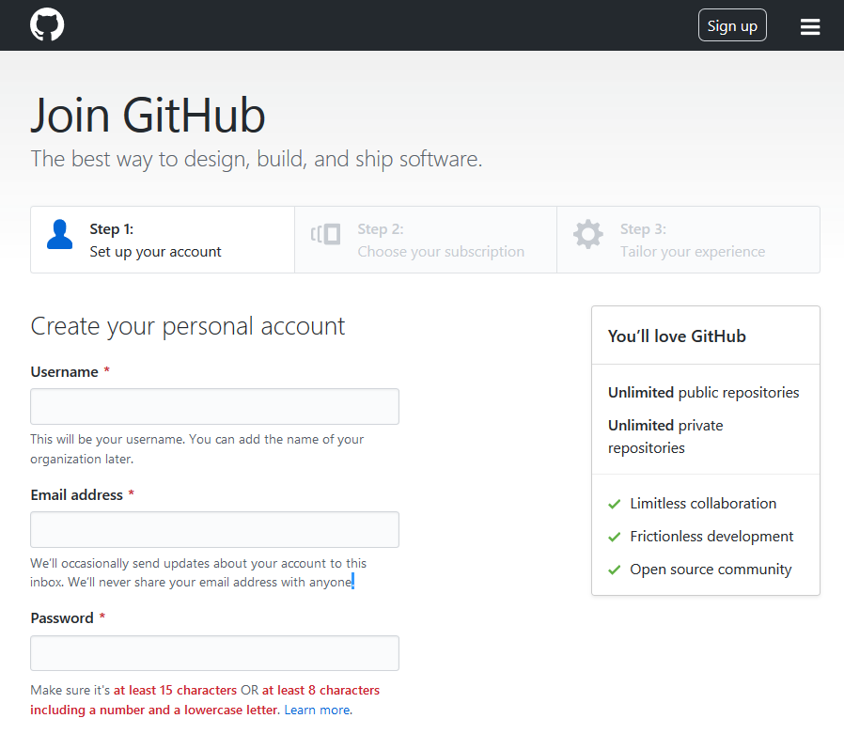
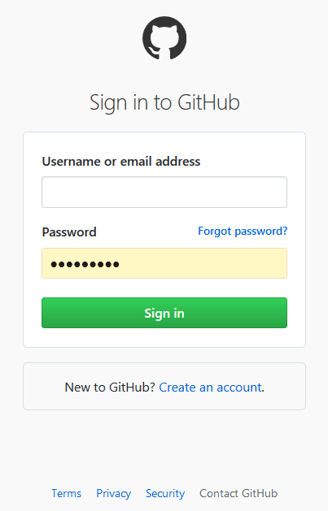
What is GitHub?
“Code hosting platform for version control and collaboration” GitHub
No coding, terminal windows, knowledge of VCs needed
Need a github account (email address and password)

Slide 16
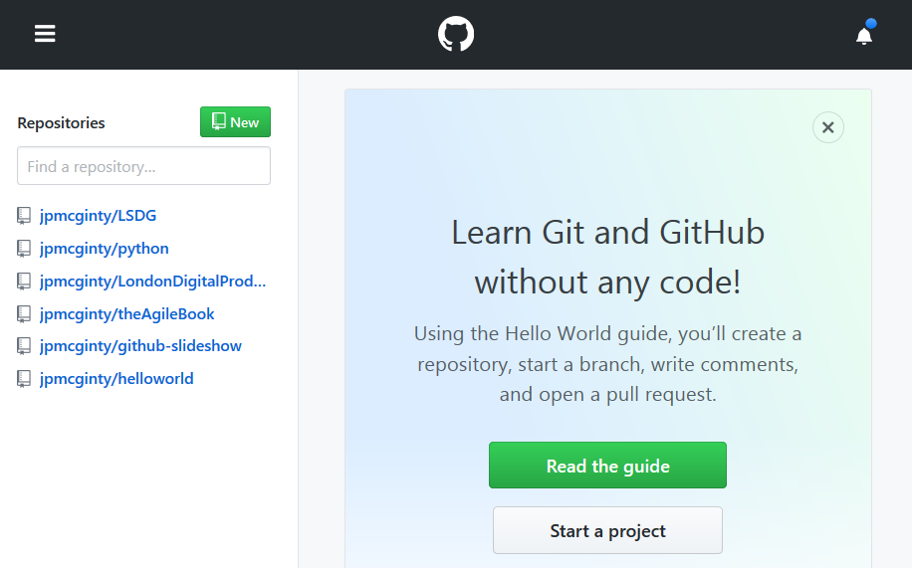
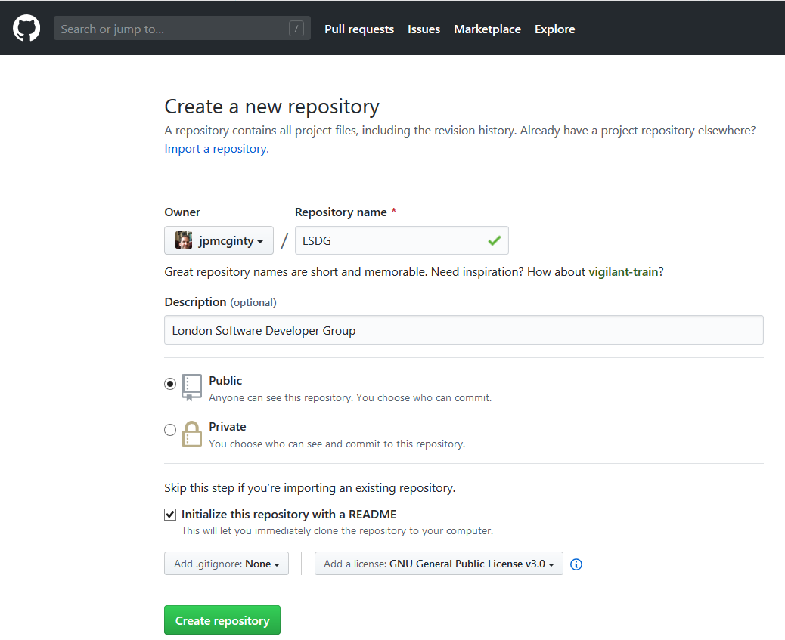
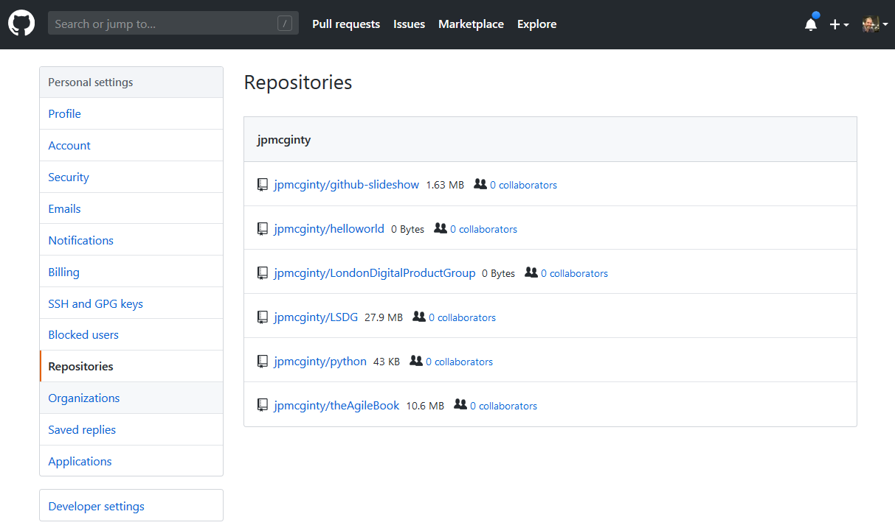
Exercise on GitHub
Create new repository
Add repository name and description
Set Public or Private
Create README files
Add licence info
DONE!
New GitHub repo created

Slide 17
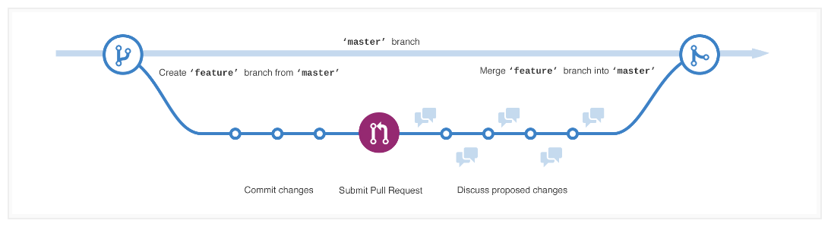
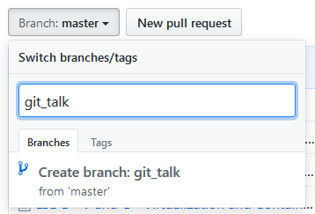
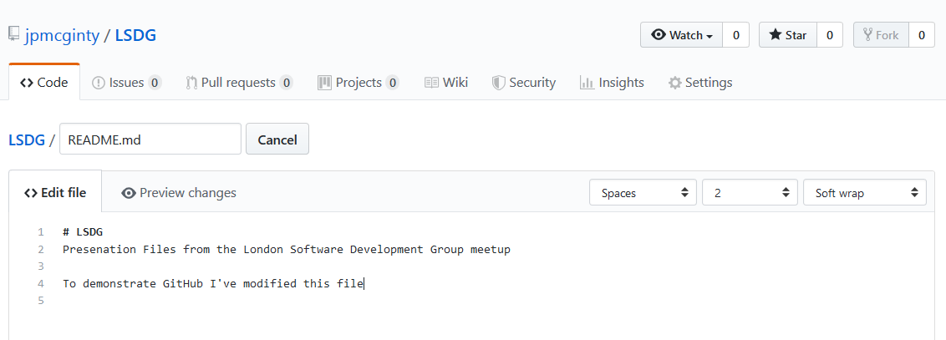
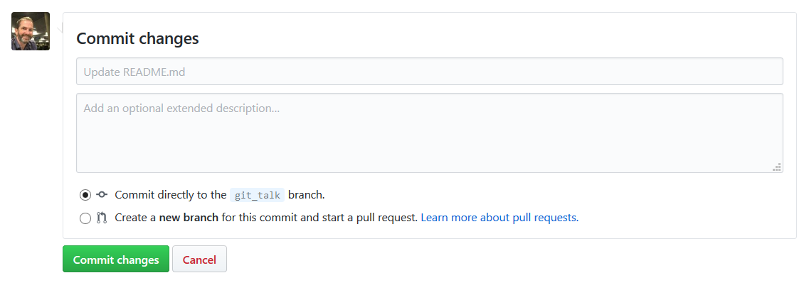
Create a Branch
Default branch is called “master” (sometimes referred to a “Trunk”)
Create new branch called “git_talk”. This is a copy of master. Change the README file
Commit the change

Slide 18
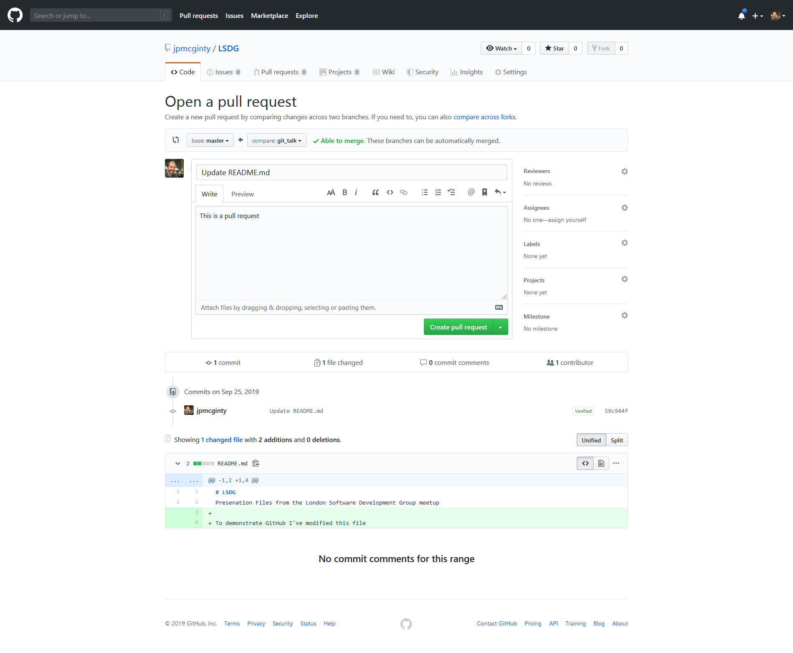
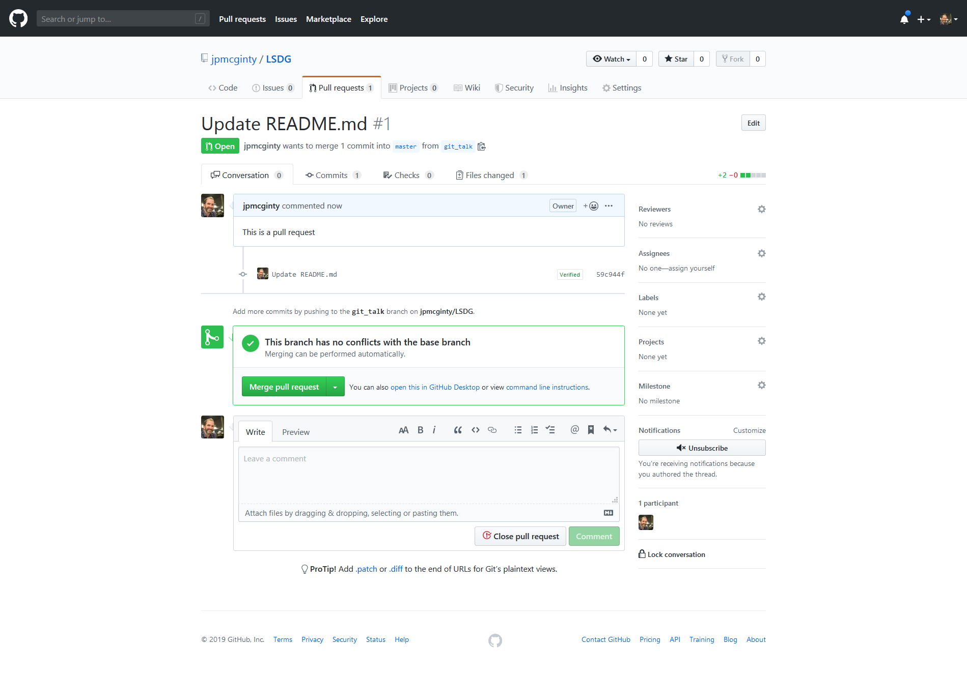
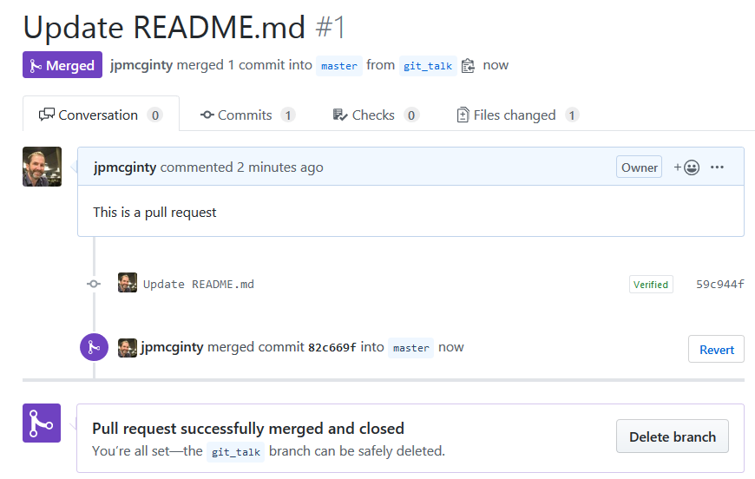
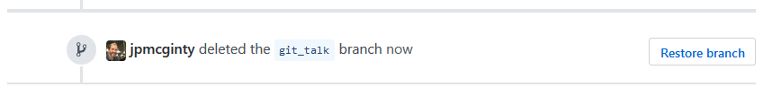
Create a Pull Request
Click Pull Request
Check where the pull is going to
Add a comment
‘Create Pull Request’
Click Merge to merge with master
Delete branch

Slide 19
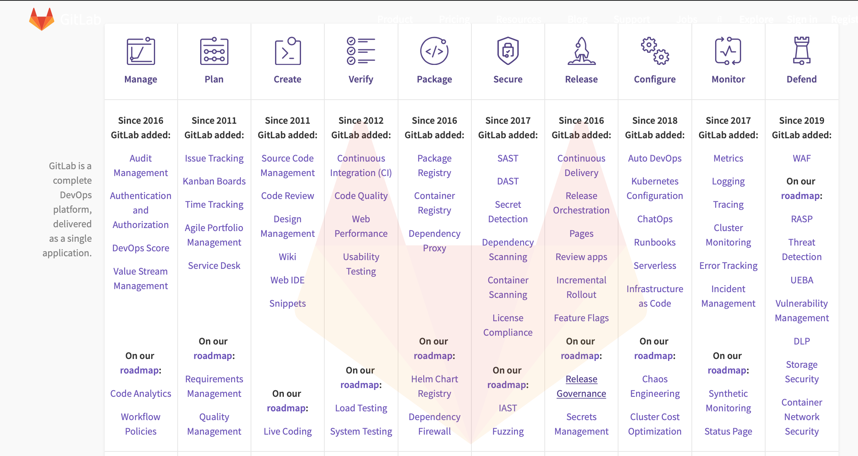
What is GitLab?
“Complete CI/CD toolchain out-of-the-box. One interface. One conversation. One permission model. Thousands of features.”
-- GitLab
GitLab is a web-based DevOps lifecycle tool that provides a Git-repository manager providing wiki, issue-tracking and CI/CD pipeline features, using an open-source license, developed by GitLab Inc
-- Wikipedia

Slide 20
THANK YOU

Slide 21
END
Thank you for listening
London Software Developers (LSD) is part of the London Digital Developers (LDD) group. If you are interested in presenting for the LDD let me know.
londondigitaldevelopers.com – Building a home for digital developers

