Slide 1
Unified Control Plane for Hybrid and
Multi-cloud Kubernetes clusters
By Team TeleCommunity
Global Hackathon 2K23

Slide 2
Agenda
Agenda / Contents
Team TeleCommunity Intro
Business Case
How do we solve it?
Deeper Dive into the solution
Solution’s Impact
Conclusion and Q&A

Slide 3
We are Team TeleCommunity!
"Beyond Boundaries: Telecommunity, the Future of Unity!"
Rasma (0719592)
Leonid (U906064)
Shilpi (N771822)
Nathan(R734058)
Mariah(V81950)
Jasper (V748487)
Prakash (F597962)
Krishna(N693628)
Daniel (D641909)

Slide 4
So, What’s the problem?
Agenda / Contents
With the current JPMC business strategy of migrating to the cloud, we are dealing with the number ONE challenge of managing multi-cloud environments
Complexity
Each cloud service provider has its own infrastructure, API, and service standards that our teams must understand and manage
Using separate tools to manage both infrastructure and application lifecycle is complex, time-consuming, and costly

Slide 5
How do we solve it?
By doing it the “Kube way”
Introduce Cluster-API into the picture
It brings declarative, Kubernetes-style APIs to cluster creation, configuration, and management
It provides consistent, provider-agnostic, and scalable cluster management
It simplify cluster lifecycle management in a cloud-native way and make developers happy
The team selected Crossplane as its testbed

Slide 6
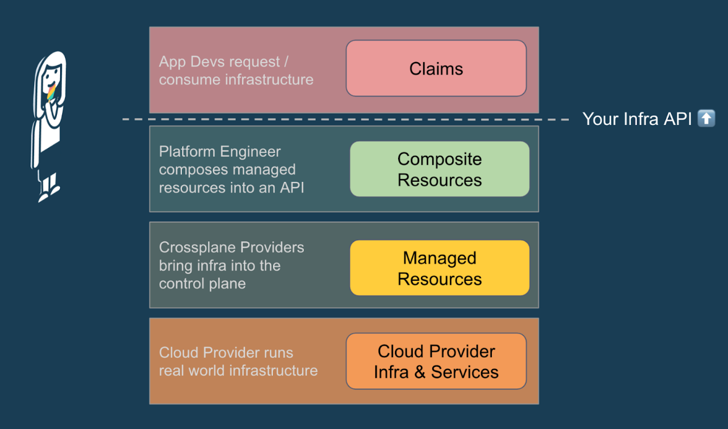
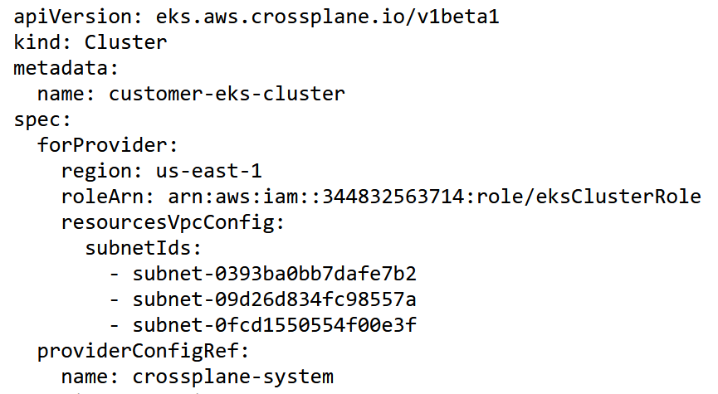
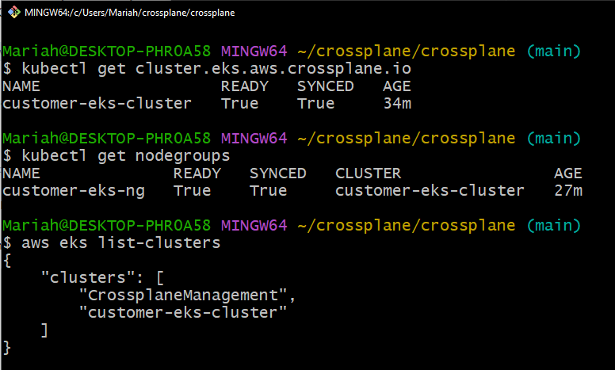
Deeper Dive into the solution
Crossplane Architecture
Providers
Managed sources
Composite resources
The Crossplane Core

Slide 7
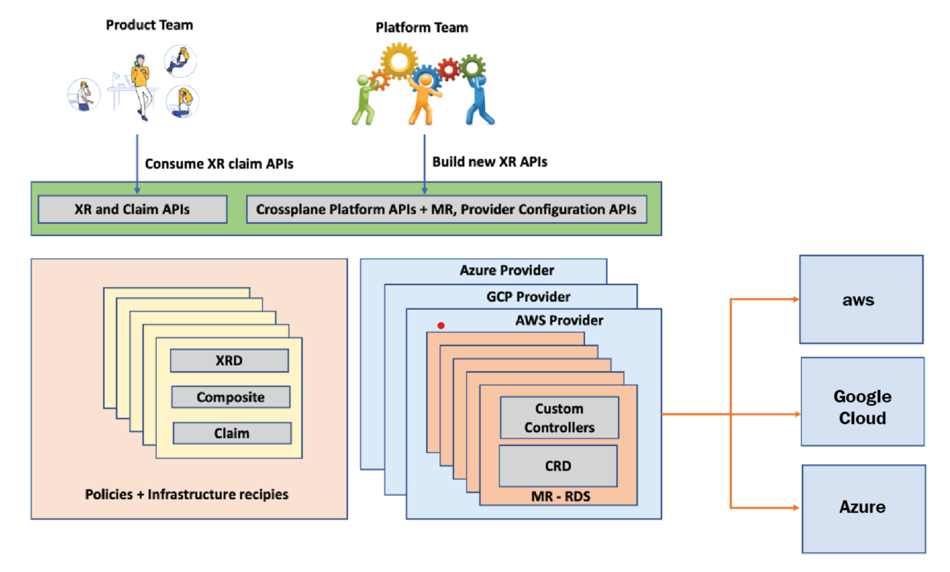
Deeper Dive into the solution (cont.)
Product and Platform team Interaction

Slide 8
Final Thoughts – Solution’s Impact
Adopting the Cluster API will enable us to better manage our Kubernetes clusters and other cloud services, scale efficiently and ultimately reduce costs
A forward-looking strategy that aligns with our cloud migration efforts and adopting cloud-native technologies
Crossplane can provide a unified control plane, infrastructure as code capabilities, governance, and streamlined operations

Slide 9

Q & A
Checkout our Github repo:
https://github.com/jpmchackathon2k23/crossplane
Also available by clicking go/telecommunity

