Slide 1

Asterisk: Just for the Heck of It!

Slide 2
Asterisk: Just for the Heck of It!
Official Description: Asterisk is a free and open source framework for building communications applications and is sponsored by Digium.
...yada, yada, yada...
Real Description: Asterisk is very cool software that let's you do all kinds of crazy phone stuff. Also, sometimes people use it for, you know, phone systems and whatever.

Slide 3

Asterisk: Just for the Heck of It!
What can I do with it?
Manage multiple incoming lines
Many phones - with different purposes
Check a database – write a database
Run a Call Center
Run Call Centers in different towns and connect them
Automated out-bound calling (but lose my number, please)
Home automation
Auto-attendants, voicemail, bunches of other stuff

Slide 4

Asterisk: Just for the Heck of It!
There is a Book! The Book is Free!
http://www.asteriskdocs.org/

Slide 5
Seriously - Why?!?
Top 5 Reasons for Running Asterisk at Home
Number 5 – Learn more by doing!
Number 4 – Fire your Telco!
Number 3 – Features and Applications!
Number 2 – The Everest Imperative (Because it's there)

Slide 6

Seriously - Why?!?
Top 5 Reasons for Running Asterisk at Home
Number 1
We might just be geeks.
This is my reason, btw.

Slide 7
Terminology
ATA: Analog Terminal Adapter – Device to connect analog phones or lines to VoIP systems. ATAs can be...
PBX: Private Branch eXchange – Term that used to mean “Great Big Phone System”. Now used to describe pretty much any business-style system.
Dialplan: What calls do when the come in to a switch. Usually a fairly linear set of steps that a call will take based on menus or other factors.
Trunk: A telephone line (old-style or VoIP) for incoming and outgoing calls.
POTS: Plain Old Telephone Service – This is a real term that real phone people use. Really.
There are many more, of course...

Slide 8
Protocols: Most Often Seen
SIP aka Session Initiation Protocol – Used to control multimedia communications sessions (like a voice call) – Not limited to VoIP, but most commonly found there – Requires more firewall config to support outside lines or phones (generally port 5060 and 1000+ high ports for media) – Lines/trunks available from VoIP providers
IAX aka Inter-Asterisk eXchange – Created for Asterisk, in case there was any confusion – Requires one UDP port for outside lines or phones (4569, usually) – We are really talking about IAX2 when we talk about IAX – Lines/trunks available from VoIP providers

Slide 9
Protocols: Not as Often Seen
MGCP aka Media Gateway Control Protocol – Early player in commercial systems – Really two protocols (SDP or Session Description Protocol and RTP or Realtime Transport Control)
H.323 – Among the original media protocols – Still very common for conferencing systems and some VoIP solutions
… And Many More – Mostly Proprietary ...

Slide 10
Codecs: Commonly Used
G.711 aka uLaw – Industry standard – 64 Kbps – Very low CPU overhead – OK for Fax (and Modem) – Compressed (sort of, but really Companded – compressed then expanded, so not really, but sort of)
G.726 – Like G.711 but half the bandwidth (only 32 Kbps in Asterisk) – Compressed – Higher CPU load – No Fax or Modem – May be worth playing with if you don't need Fax
GSM – Lower bandwidth at 13 Kbps – Good balance of quality and load – Best for wifi connections (my opinion) – Unreliable for Fax

Slide 11
Codecs: ...and the Rest!
G.729A – Really thin @ 8 Kbps – Higher CPU load (from compression) – Requires licensing $ - Very popular in commercial VoIP systems and on phones
ILBC (Internet Low Bitrate Codec) – Requires license, but at no cost – Not a standard yet – Very thin – Very little support on today's phones
Speex – Variable bitrate – No standard yet, and since it's free, it may be awhile – Really thin in operation
MP3 – Not for voice, but all over the place for Music on Hold, because MP3.

Slide 12
Decisions
Hardware?
Our choice: Atom box from eBay
OS/Distro?
Our choice: Debian 7 (Wheezy)
Asterisk Version?
Our choice: 1.8 Certified – Built from source

Slide 13
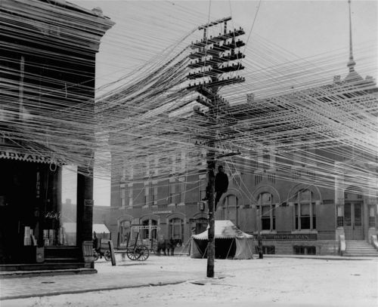
Let's Try It Out!
The demo starts here...

Slide 14
Asterisk Dialplan
Application | Number
ANAC | 1212
Auto-Attendant / IVR | 1451
Day Mode | 1242
Echo Test | 1215
Extended Weather | 1256
Last Caller | *69 / 1169
Mode Check | 1241
Music on Hold Test | 1221
Night Mode | 1243
Application | Number
Ringback | 1213
Silent Termination | 1216
Time | 1277
Tonesweep | 1217
Voicemail – By Station | *98 / 1198
Voicemail – General Dial-In | *99 / 1199
Voicemail – Main Mailbox | *97 / 1197
Wake-Up Call | 1211
Weather | 1255
Phones: 1111 to 1117
IVR Options: 1 = VM, 2 = Attendant, 5 = Open Conference
Open Conference 1711, Managed Conference 1722/1723

Slide 15
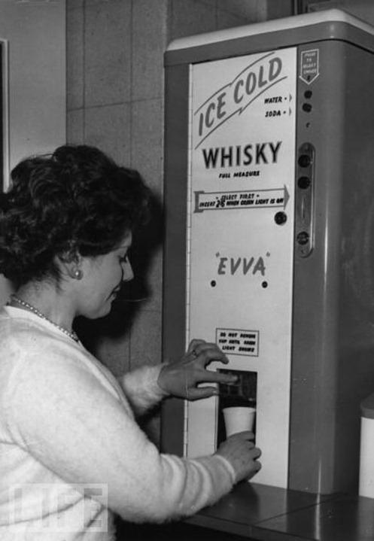
Asterisk: It's Almost This Cool

Slide 16
Introduction to Asterisk
Joe McNeely
jm.fwlug@gmail.com
https://github.com/jpmcneely/Asterisk
--------------------------------------------------
Fort Wayne Linux User Group
April 16, 2015

