Slide 1

Phylogenetic Gaussian processes for Ancestral Reconstruction of Bat Echolocation Calls
J.P. Meagher
July 4, 2017

Slide 2




Acknowledgements

Slide 3

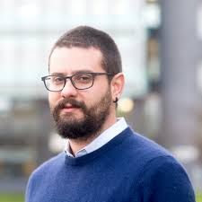
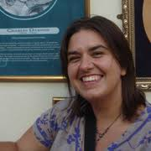
Acknowledgements
Mark Girolami
Imperial College London
Theo Damoulas
University of Warwick
Kate Jones
University College London

Slide 4
Ancestral Reconstruction of Bat Echolocation Calls – What’s the point?

Slide 5
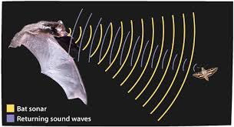
Ancestral Reconstruction of Bat Echolocation Calls – What’s the point?

Slide 6
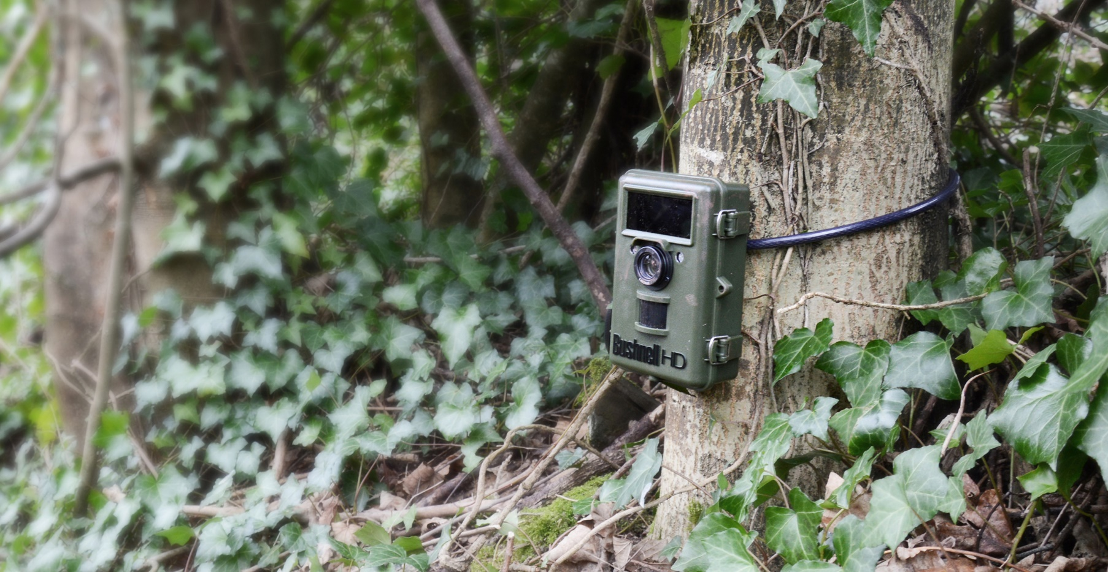
Ancestral Reconstruction of Bat Echolocation Calls – What’s the point?

