Slide 1

Phylogenetic Gaussian processes for the Ancestral Reconstruction of Bat Echolocation Calls
J.P. Meagher
July 4, 2017

Slide 2


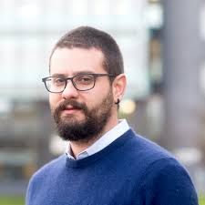



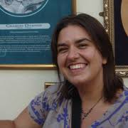
Acknowledgements
Mark Girolami
Imperial College London
Theo Damoulas
University of Warwick
Kate Jones
University College London

Slide 3
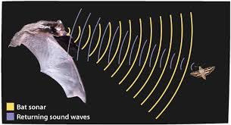
Bats: Some Background

Slide 4
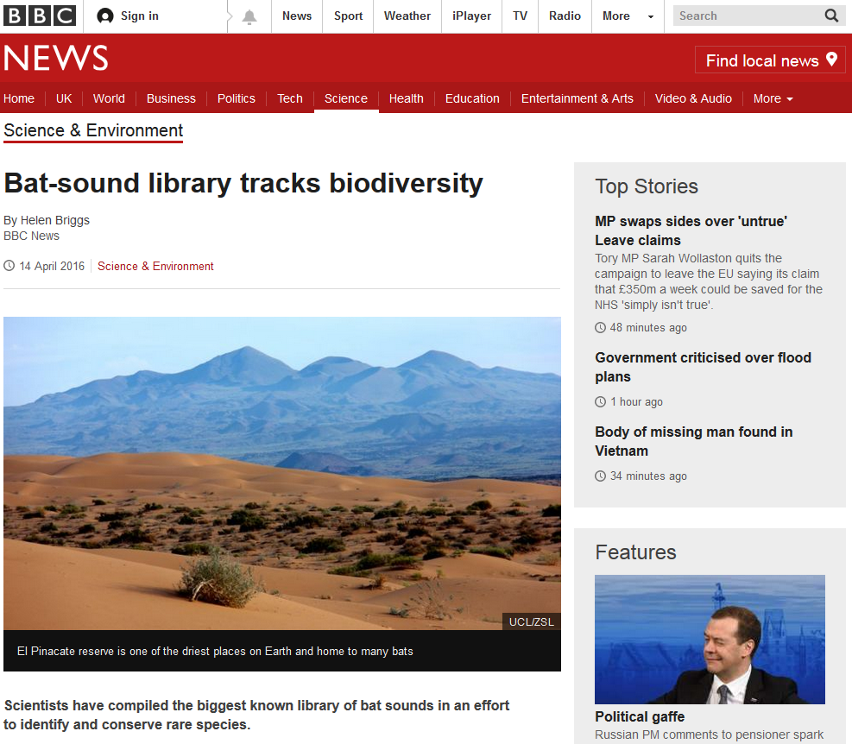
Bats: Engaging the Public

Slide 5
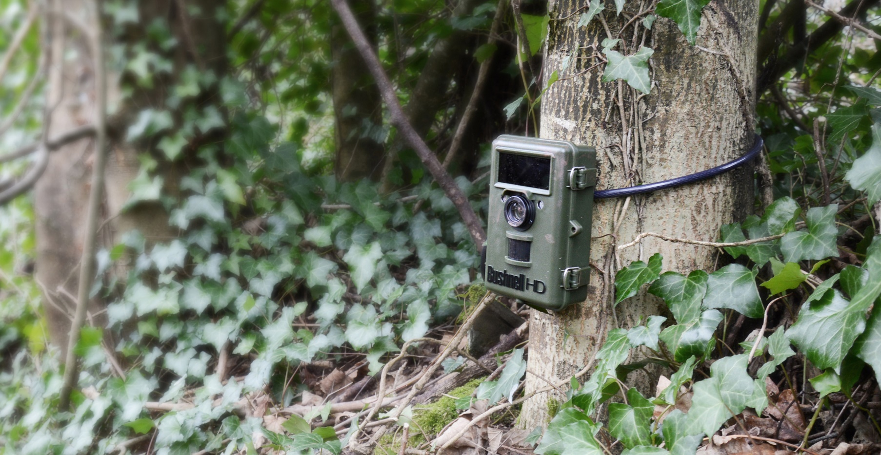
Bats: Non-invasive Monitoring

Slide 6
Research Project Summary

Slide 7
Ancestral Reconstruction: A Definition
The extrapolation back in time from measured characteristics of individuals (or populations) to their common ancestors.

Slide 8
Continuous Character Trait Evolution
Phylogenetic Ornstein-Uhlenbeck Process

Slide 9
Function-Valued Traits: A Definition
A trait that is repeatedly measured, along some continuous scale, where measurements can represent points on a curve, and both means and covariances along the trajectory can change, gradually and continually.

Slide 10
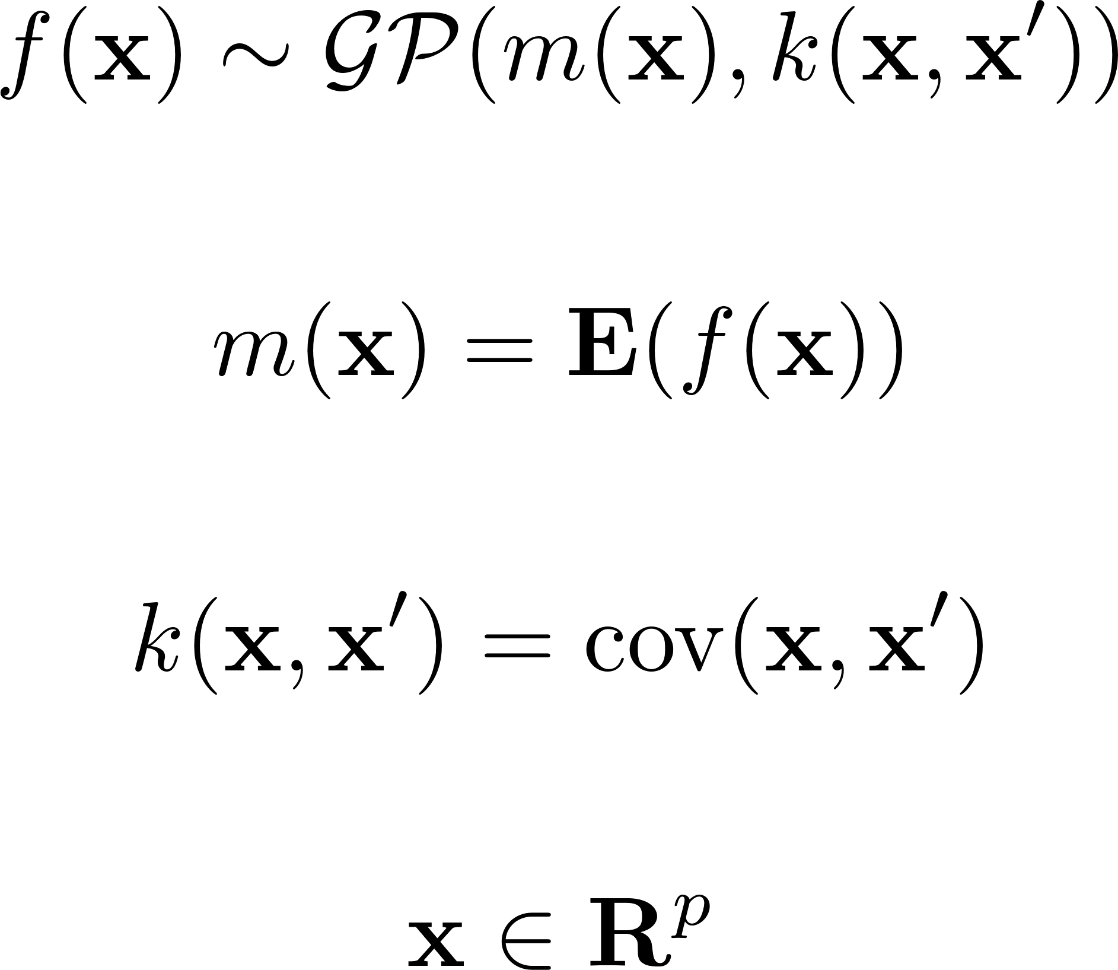
Gaussian Processes
A collection of random variables, any finite number of which have a joint Gaussian distribution.

Slide 11
Phylogenetic Gaussian Processes: Assumptions
Conditional on their common ancestors in the phylogenetic tree T any two traits are statistically independent.
The statistical relationship between a trait and any of its descendants in T is independent of the topology of T
The marginal GP along each branch of the phylogeny is space-time separable.

Slide 12
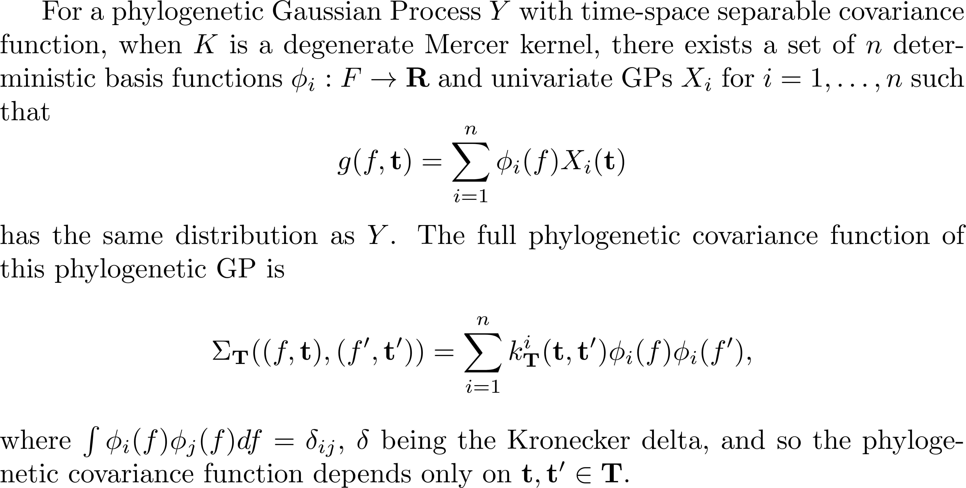
Phylogenetic Gaussian Processes: Theoretical Result

Slide 13
Bat Echolocation Calls: The Phylogenetic Tree

Slide 14
Bat Echolocation Calls: A Function-Valued Trait

Slide 15
Bat Echolocation Calls: Independent Basis

Slide 16
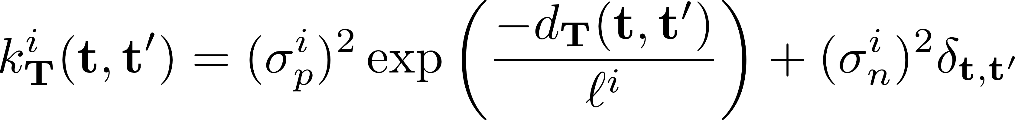
Results: Phylogenetic Ornstein-Uhlenbeck Process

Slide 17
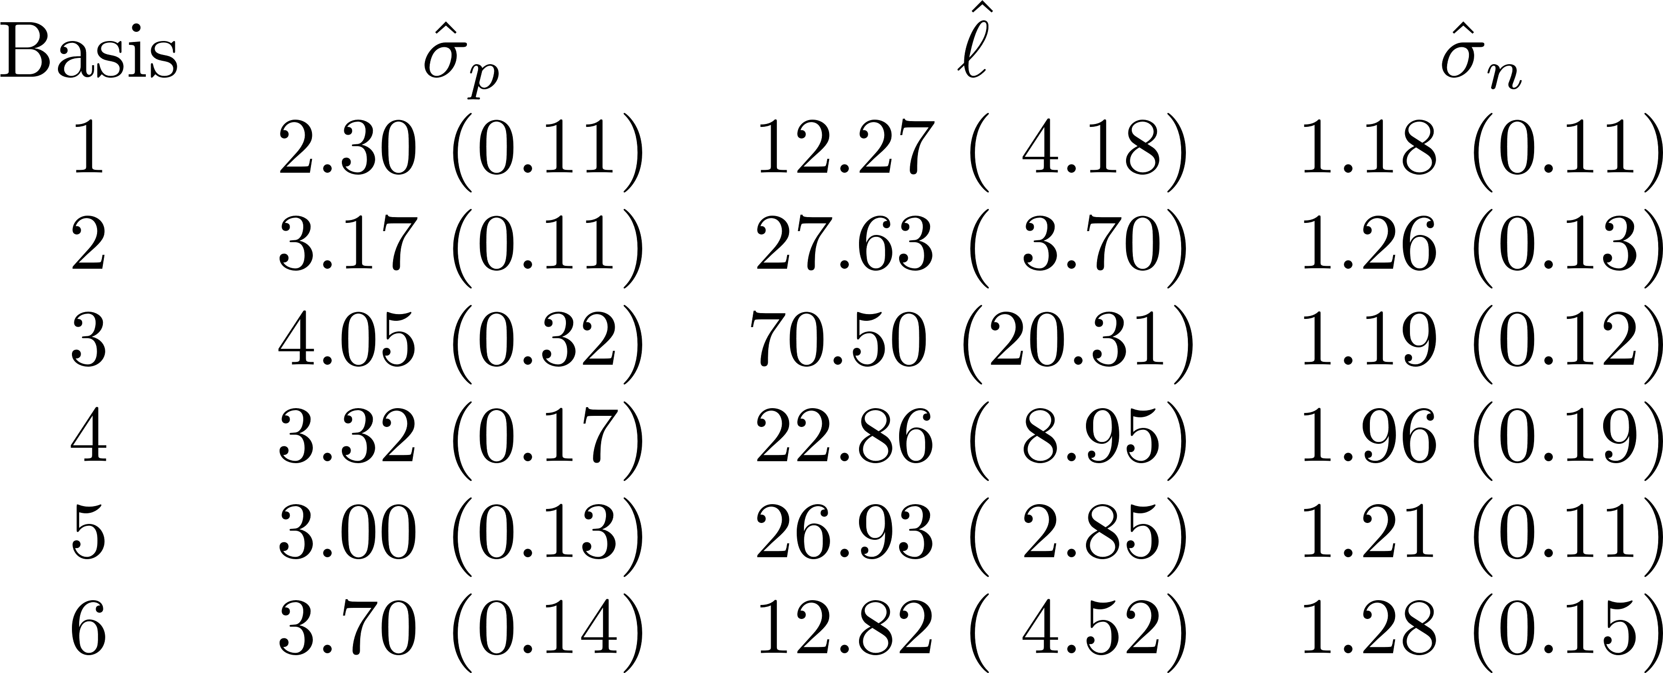
Results: Hyperparameter Estimates

Slide 18
Results: Hyperparameter Estimates

Slide 19
Results: Posterior Predictive Distributions

Slide 20
Conclusions
Phylogenetic Signal Identified
Strong Phylogenetic signal at low frequencies.

Slide 21
Future Work
Implement the Phylogenetic Gaussian Process Regression Model for Echolocation Call Spectrograms.
Consider Alternative Echolocation Call Representations.
Consider Alternative models for the evolutionary dynamics.

