Slide 1
Pet Grooming Machine Learning Project
JP Mendieta
Can I predict how often a customer will bring his/her pet to be groomed?
K-Nearest Neighbor Model
Based on breed, number of pets, address

Slide 2
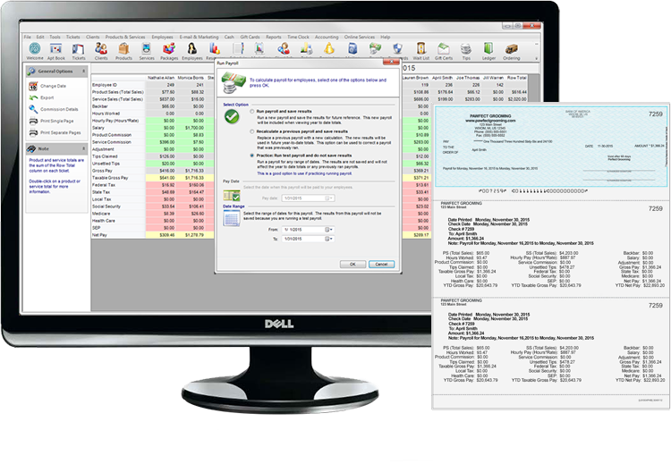

Client Management Application
Clients
City | Phone | Name
Rockville | 202-555-1234 | Lannister
Olney | 202-555-2345 | Stark
Sandy Spring | 202-555-3456 | Baratheon
Silver Spring | 202-555-4567 | Targaryen
Pets
ClientID | Breed | Gender | DOB | Barker | Name
4750 | Basset Hound | Female | 10/6/11 14:31 | FALSE | Weezy
4750 | Chihuahua | Male |  | FALSE | Felix
4752 | Toy Poodle | Male |  | FALSE | Tito
4753 | Golden Retriever | Male |  | FALSE | Murphy
Clients.shape
(3189,55)
Pets.shape
(3989,40)

Slide 3
Client Management Application
City | Count
Olney | 949
Silver Spring | 551
Brookeville | 472
Rockville | 323
Gaithersburg | 179
ZIP | Count
20832 | 932
20833 | 470
20853 | 247
20906 | 216
20905 | 177
Breed | Count
Shih Tzu | 279
Golden Retriever | 219
Bichon Frise | 161
Yorkshire Terrier | 155
Maltese | 148
ClientID | Count
4675 | 9
5644 | 6
4348 | 5
5107 | 5
4864 | 5
Did Client 4675 really have 9 pets?
How can I categorize 485 breeds?
Find avg breed weight
Set size based on weight
Two most popular names:
Lucy & Max

Slide 4
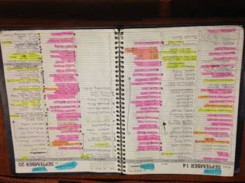
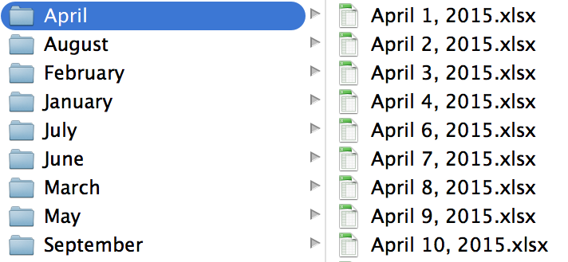
Appointment Data
(or lack thereof)
Appointment Book
Payment Spreadsheet
for path, dirs, files in os.walk(directory):
for f in files:
payment = pd.read_excel(os.path.join(path,f),sheetname=0)
date = datetime.datetime.strptime(f.replace('.xlsx',''), '%B %d, %Y')
day_of_week = date.weekday()
. . .
date_client_count.append((date,day_of_week,credit_count, check_count,cash_count, total_count))

Slide 5
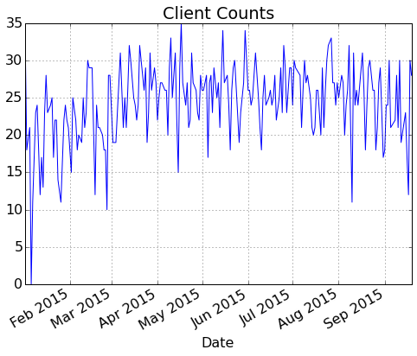
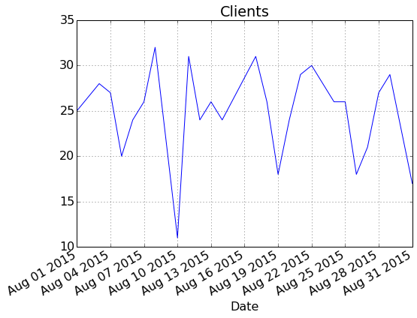
Appointment Data
(or lack thereof)
AUG 2015
Weekday | Mean Count
0 | 22.6
1 | 27.5
2 | 20
3 | 23.75
4 | 26.5
5 | 29

Slide 6
Next Steps
Addresses
Map Addresses (OpenStreetMap API)
Calculate distances
Continue enriching data (Pet Sizes)
Start putting together K-Nearest Neighbor Model

