Slide 1

Exploring One-Cell Inversion Method for Transient Transport on GPUs
Joanna Piper Morgan, Ilham Variansyah, Todd S. Palmer, & Kyle E. Niemeyer
The Center for Exascale Monte Carlo Neutron Transport (CEMeNT) at Oregon State University
Time-Dependent and Radiative Transfer Methods
The International Conference on Mathematics and Computational Methods Applied to Nuclear Science & Engineering
Niagara Falls, Ontario, Canada
Wednesday August 15th, 2023

Slide 2
The Field
Higher ordered transient computations are needed for hi
GPU acceleration is imperative for computations launched at exascale

Slide 3
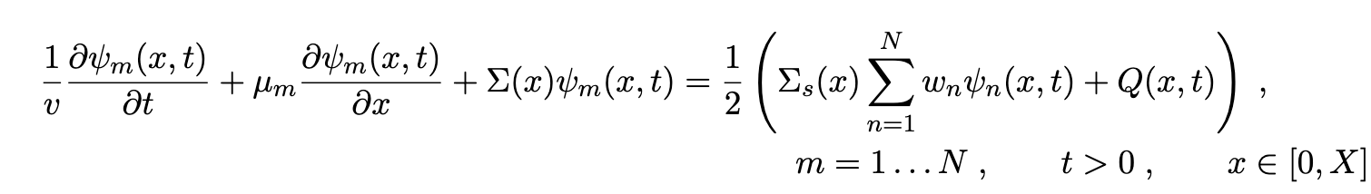
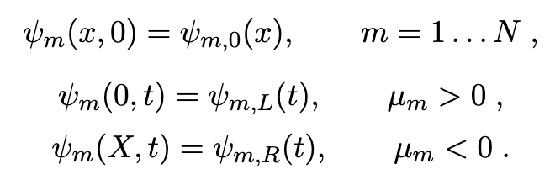
Neutron Transport
World’s simplest problem…
Assumptions:
Slab wall geometry
Axi-symmetric
Isotropic source and scattering
NOT SS!!!!

Slide 4
Higher Order Discretization
By coupling a 2nd order space and 2nd order time scheme we can increase the solve work for the GPU to chew on

Slide 5
Time Dependent Multiple Balance

Slide 6
Simple Corner Balance

Slide 7
Iterative Methods
Intrgro-PDE requires some kind of iterative method to solve the
We want to go fast!!!
N_{angle} << N_{cell}

Slide 8
Big-sky Problems
BIG PROBLEMS
N = 4* N_{time} * N_{angle} * N_{group} * N_{cell}

Slide 9
Source Iteration

Slide 10
One Cell Inversion

Slide 11
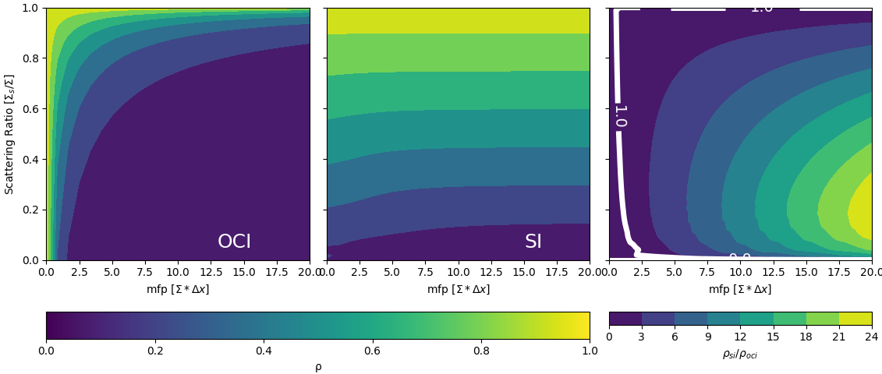
OCI v SI Steady State

Slide 12
Discretization Fourier Analysis

Slide 13
Negative Fluxes!

Slide 14
Testbench
SIMT

Slide 15
Validation

Slide 16
Validation Problems
AZURV1
MC/DC

Slide 17
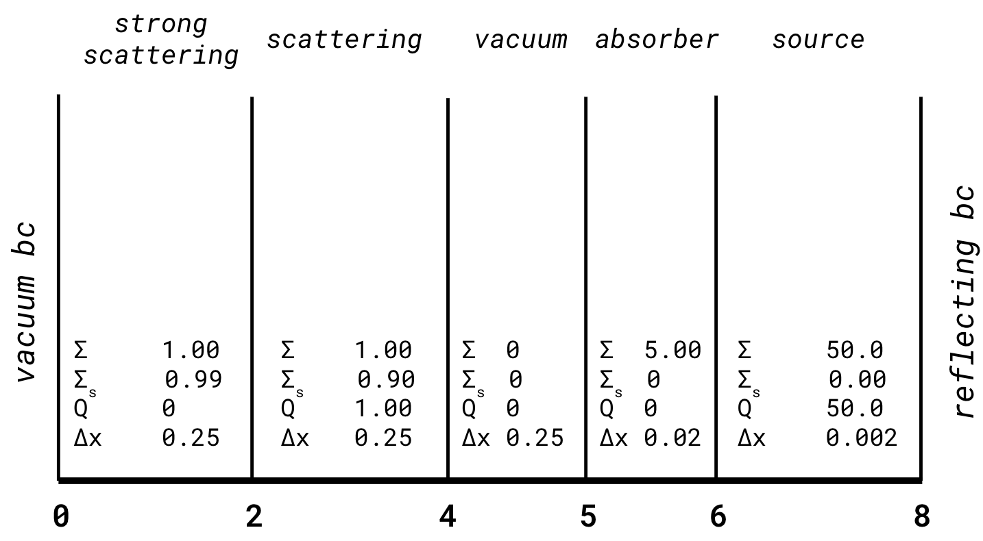
Transient Reed’s-esq problem

Slide 18
Transient Reed’s-esq problem
plot

Slide 19
Transient Reed’s-esq problem
table

Slide 20
Performance Comparisons
Problem deff

Slide 21
S4

Slide 22
S16

Slide 23
S32

Slide 24
S64

Slide 25
S128

Slide 26
S256

Slide 27
Conclusions

Slide 28
Future Work

Slide 29
Citations

Slide 31
Backmatter

