Slide 1
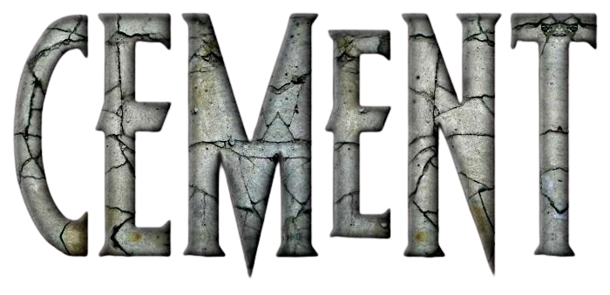

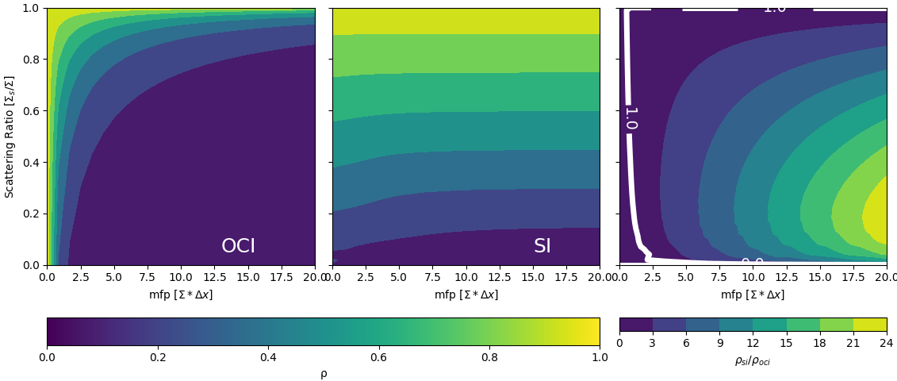
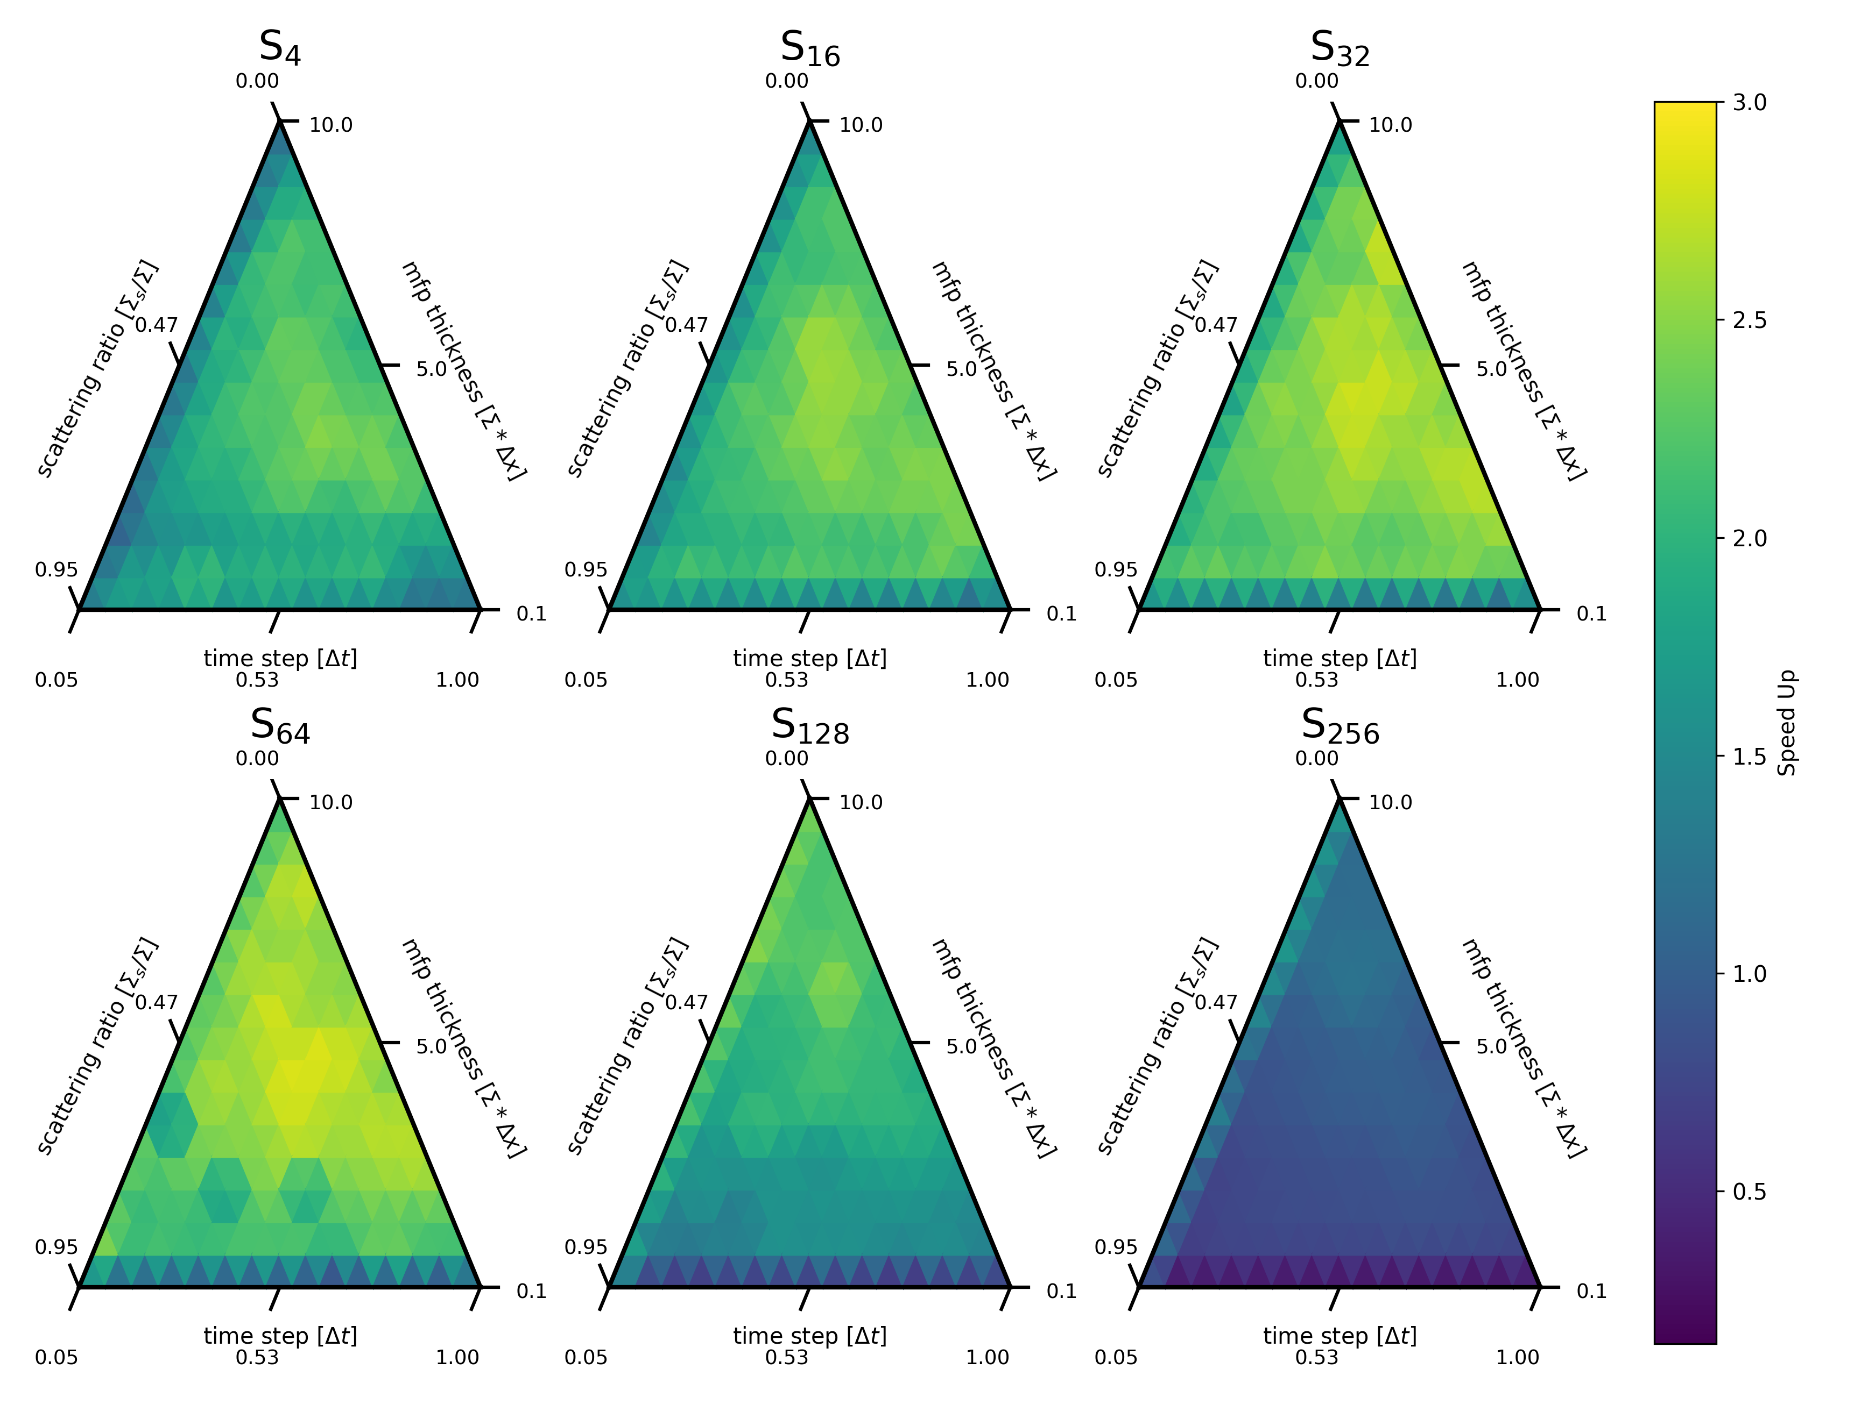

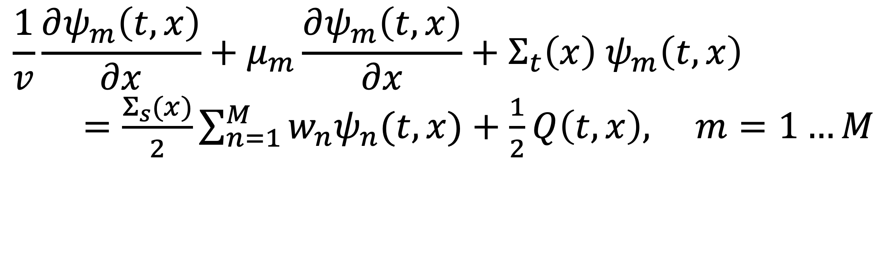
Exploring One-Cell Inversion Method for Transient Transport on GPUs
Joanna Piper Morgan, Ilham Variansyah, Todd S. Palmer, & Kyle E. Niemeyer
The Center for Exascale Monte Carlo Neutron Transport (CEMeNT) at Oregon State University
https://cement-psaap.github.io/
Objective
Spectral Radius Convergence Comparison
Conclusions
The spectral radius (⍴) is a measure of the rate of convergence of the iteration operator, and illustrates that one cell inversion (OCI) requires more iterations to converge for problems with optically thinner cells, but it it outperforms source iteration in problems with optically thick cells
One Cell Inversions on GPUs can increase performance when the spatial dimension is dominant over angular quadrature
Devise a transient neutron transport scheme that is parallelizable over the spatial dimension to increase performance on GPUs
Time Dependent Neutron Transport Equation
In lower quadrature orders on the GPU, OCI outperforms SI with a maximum speedup of 3.4X in S₆₄. We observed decreasing speedup with increasing quadrature orders, until the two methods are nearly equivalent in runtime at S₂₅₆. This indicates that the original idea of this work—parallelizing over the largest number of degrees of freedom (spatial cells), will incur performance boosts—is correct. For this scheme when quadrature order is smaller than number of cells, OCI leads in performance. Then as quadrature order approaches the number of cells, the benefit of OCI decreases.
$$\frac{1}{v}\frac{∂ψ_{m}\left(t,x\right)}{∂x}+μ_{m}\frac{∂ψ_{m}\left(t,x\right)}{∂x}+Σ_{t}\left(x\right) ψ_{m}\left(t, x\right)$$
$=\frac{Σ_{s}(x)}{2}\sum_{n=1}^{M}{w_{n}ψ_{n}(t,x)}+\frac{1}{2}Q\left(t,x\right), m=1…M$
1D transient, neutron transport equation in S_{N} (Gauss-Legendre in 1D) angle quadrature in slab geometry assuming isotropic scattering and isotropic sources.
However even in these worst-case scenarios we hope that OCI’s expected better performance on GPUs due to decreased thread divergence through parallelization over the largest number of degrees of freedom (spatial unknowns) will mitigate this slower iterative convergence.
Future Work
Space and Time Discretizations
We are currently expanding our simulation to energy dependence using a multi-group discretization. To validate our solutions, we are deriving a transient multigroup benchmark. We will verify our implementations using a transient multigroup benchmark problem, and subsequently make performance comparisons to begin to explore:
This iterative method coupled to preconditioners and/or synthetic acceleration schemes (as is done in the state of the art);
Various linear algebra libraries and their performance on target hardware (e.g., cuSPARSE, PETSc); and
Direct comparisons to production codes.
Using a Simple corner balance (in space) and time dependent multiple balance [1] (in time) discretization, a set of linear equations can be used to solve for angular flux (ψ) in all angles, cells, and time steps. The order of unknowns within a time step is given by
Runtime Comparison
To test this hypothesis, we compute and plot speed-up (wall clock runtime of SI/OCI) as a function of angular quadrature order, time step size, scattering ratio, and spatial discretization size for a given test problem (Σ_{t}=2 cm⁻¹).
$$Order={4 N}_{angles} N_{cells}$$
One Cell Inversions
An iterative scheme is needed to treat the integro-differential nature of the neutron transport equation. Normally this is done using transport sweeps (aka source iterations or Richardson iterations) accompanied by preconditioners or synthetic accelerators [2]. Information flows from cell to cell within each iteration and is inherently parallel over the angular quadrature and not the spatial domain. This is problematic as in most problems the spatial domain is much larger than the quadrature order
One cell inversions (aka single-cell parallel-block-Jacobi iterations) communicates information such that incident information on cell surfaces is assumed known so all angular fluxes in each spatial cell can be computed in parallel.
Citations
[1] I. Variansyah, E. W. Larsen, and W. Martin. “A Robust Second- Order Multiple Balance Method for Time-Dependent Neutron Transport Simulations.” The European Physical Journal Conferences, 247, p. 03024 (2021).
[2] M. L. Adams and E. W. Larsen. “Fast iterative methods for discrete-ordinates particle transport calculations.” Progress in Nuclear Energy, 40(1), pp. 3–159 (2002).
Acknowledgments
This work was supported by the Center for Exascale Monte-Carlo Neutron Transport (CEMeNT) a PSAAP-III project funded by the Department of Energy, grant number DE-NA003967.
joannapipermorgan@gmail.com

