Slide 1
LLMs from Scratch
James Morris

Slide 2
Title slide
Review of LLM Inner Workings

Slide 3
Agenda
LLM From Scratch
Real-World LLM Architectures

Slide 4
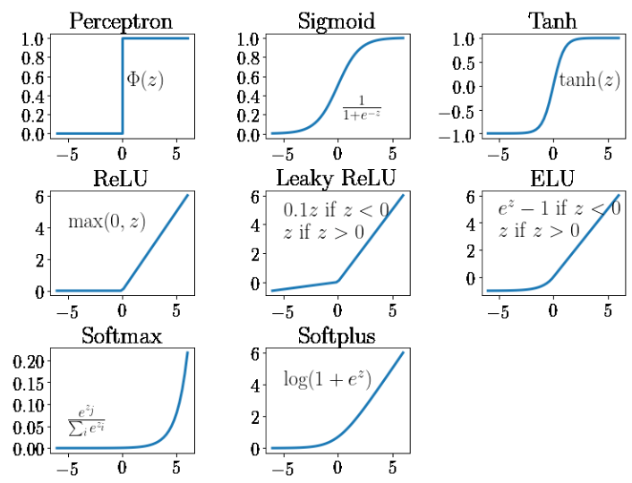
Chart
Some figure

