Slide 1
Non Graphical Solutions for the Cattell’s Scree Test
Gilles Raîche, UQAM
Martin Riopel, UQAM
Jean-Guy Blais, Université de Montréal
Montréal
June 16th 2006

Slide 2
STEPS
Scree test weekness
Classical strategies for the number of components to retain
Non graphical solutions for the scree test

Slide 3
Scree Test Weekness
Figural non numeric solution
Subjectivity
Low inter-rater agreement (from a low 0.60, mean of 0.80)

Slide 4
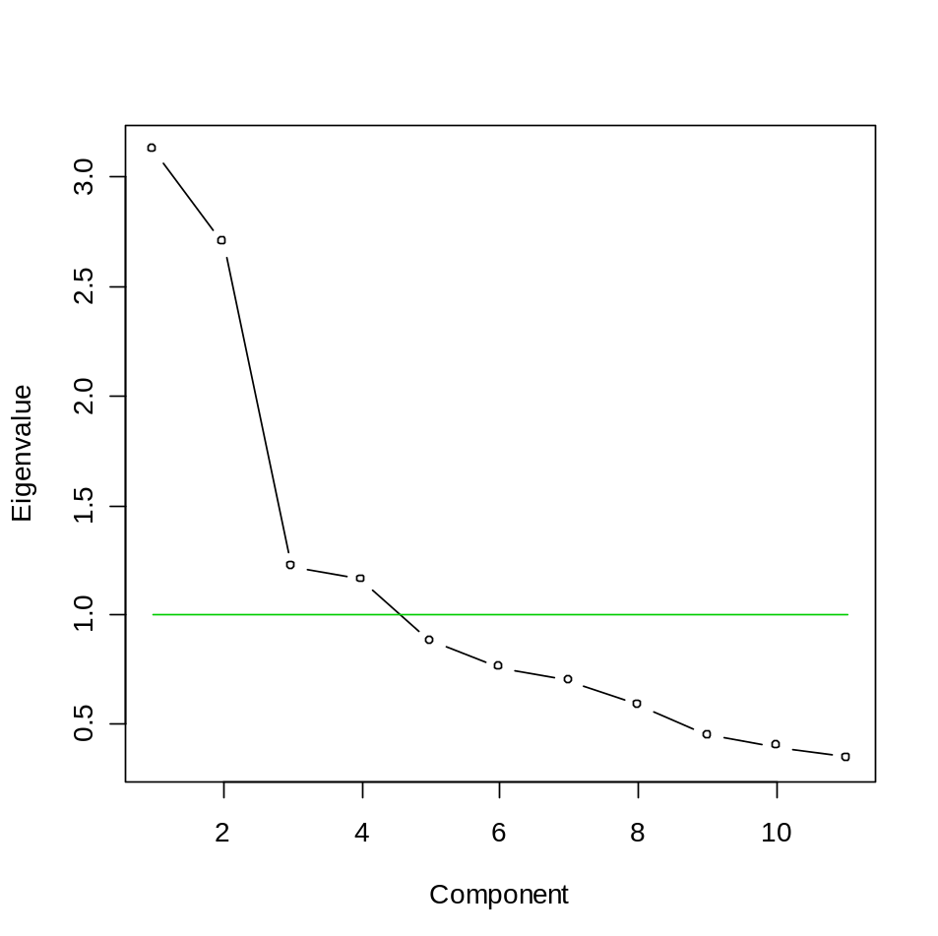

Classical Strategies for the Number of Components to Retain
Kaiser-Guttman rule

Slide 5
Classical Strategies for the Number of Components to Retain
Parallel Analysis
  Generate n random observations according to a N(0,1) distribution independently for p variates
  Compute the Pearson correlation matrix
  Compute the eigenvalues of the Pearson correlation matrix
  Repeat steps 1 to 3 k times
  Compute a location statistic () on the p vectors of k eigenvalues : mean, median, 5th centile, 95th centile, etc.
  Replace the value 1.00 by the location statistic in the Kaiser-Guttman formula.

Slide 6
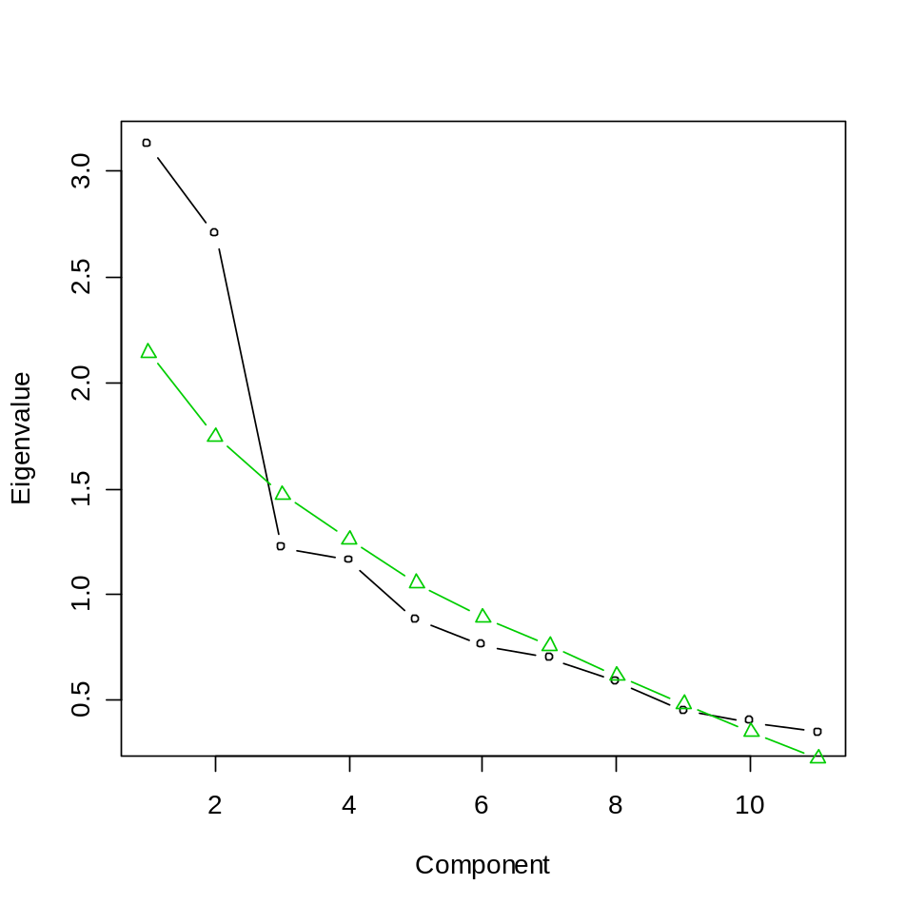
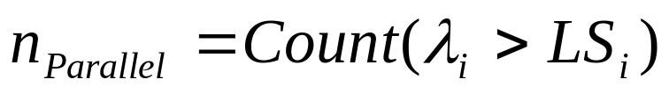
Classical Strategies for the Number of Components to Retain
Parallel Analysis

Slide 7
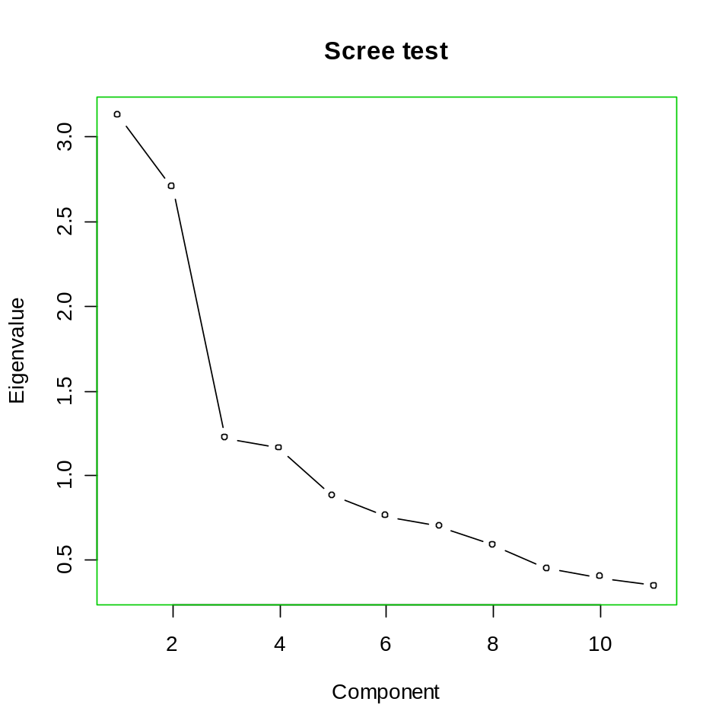
Classical Strategies for the Number of Components to Retain
Cattell’s Scree Test

Slide 8
Non Graphical Solutions to the Scree Test
Optimal Coordinates

Slide 9
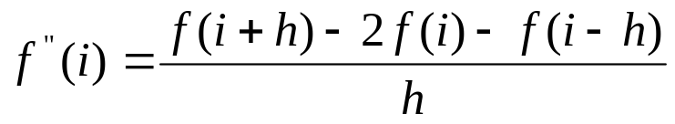



Non Graphical Solutions to the Scree Test
Acceleration Factor

Slide 10
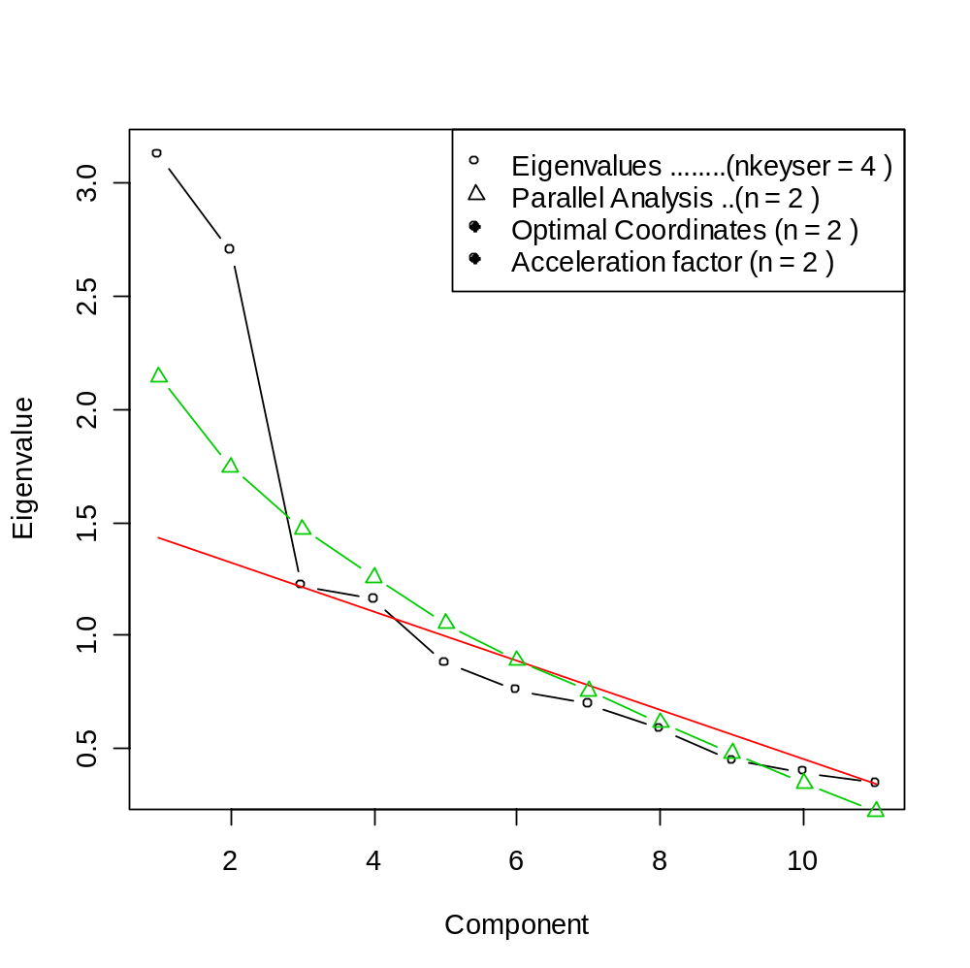
Non Graphical Solutions to the Scree Test
Example I

Slide 11
Non Graphical Solutions to the Scree Test
Component | Eigenvalue | Parallel Analysis | Optimal Coordinate | Acceleration Factor
1 2 3 4 5 6 7 8 9 10 11 | 3.12 2.70 1.22 1.16 0.88 0.76 0.70 0.59 0.45 0.40 0.35 | 2.15 1.75 1.47 1.26 1.05 0.89 0.76 0.62 0.48 0.35 0.23 | 2.96 1.33 1.28 na na na na na na na na | na -1.06 1.42 na na na na na na na na

Slide 12
Conclusion
Parsimonious solutions
Easy to implement
More comparisons have to be done with other solutions

Slide 13
To Join Us
Raiche.Gilles@uqam.ca
http://www.er.uqam.ca/nobel/r17165/
Riopel.Martin@uqam.ca
http://camri.uqam.ca/camri/membre/riopel/
Jean-Guy.Blais@umontreal.ca

