Slide 1

Milestone 4: Bacchus Winery Case Study Solution
By: Julio Pochet, Andrew Stiles, and James Cortes
Class: CSD-310
2-28-2025

Slide 2
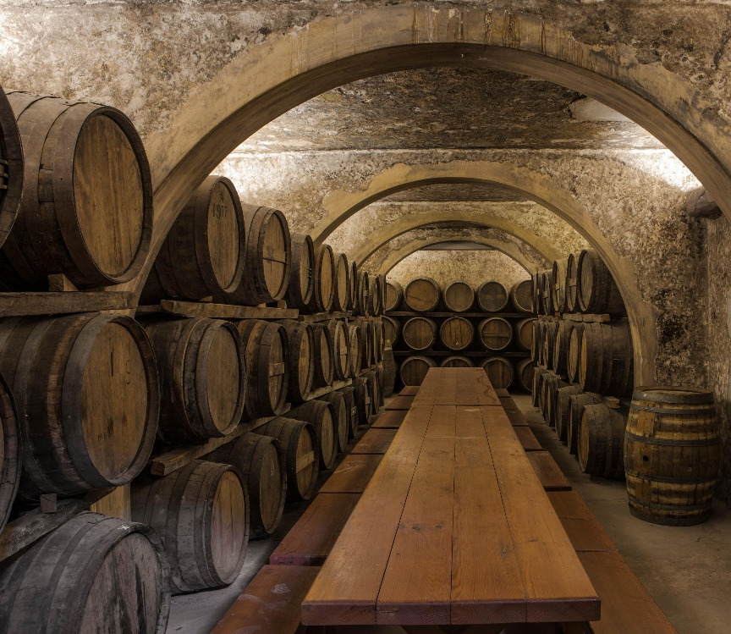
Overview:
Introduction
Entity Relationship Diagram
Report 1: Supplier Delivery Performance
Report 2: Wine Sales Trends
Report 3: Employee Work Hours by Quarter
Conclusion
End of Presentation

Slide 3

Introduction
Group Introduction:
Our group collaborated to develop a database solution for Bacchus Winery. Julio led the programming efforts, implementing the database and queries with input from James and Andrew.
Andrew created this presentation, and edited some entries into the database, with feedback and suggestions from Julio and James. Together, we designed an efficient system to support this winery’s operations and reporting.
About Bacchus Winery:
Bacchus Winery is a growing business that produces four types of wine: Merlot, Cabernet, Chablis, and Chardonnay.
The winery grows its own grapes and handles all wine production, distribution, and sales aspects.
Business Challenges:
Difficulty tracking supplier deliveries, leading to production delays.
No efficient inventory system, making stock management difficult.
Limited sales analysis, making it hard to identify best-selling wines and distributor performance.
Employee work hours are not properly tracked, causing workforce inefficiencies.
Need for a Database Solution:
Implementing a database would provide structured tracking of inventory, supplier performance, and sales data.
Ensures efficient workforce management and improves decision-making for production and distribution.

Slide 4
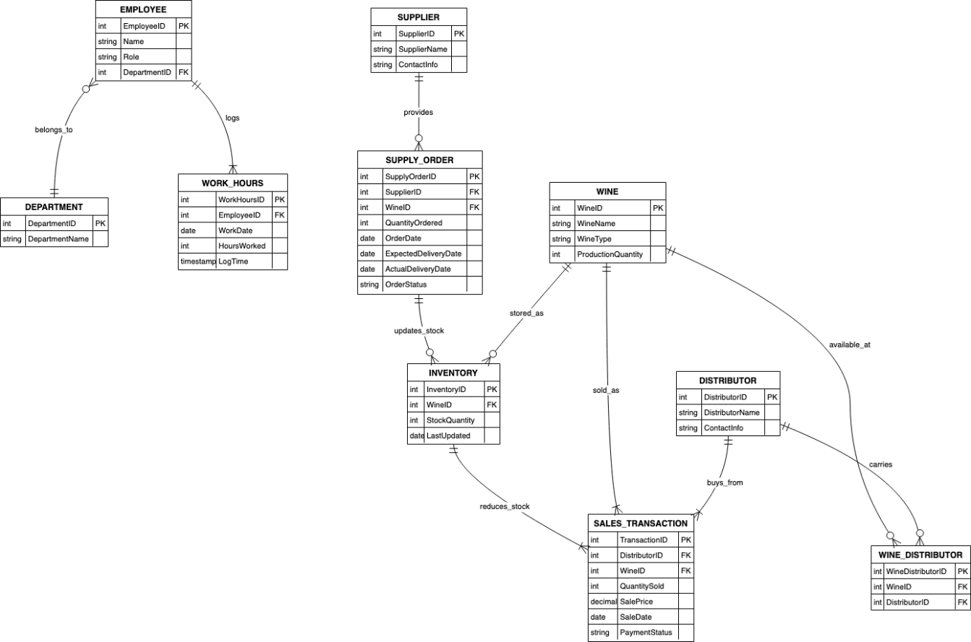
Entity Relationship Diagram
What is an Entity Relationship Diagram (ERD)?
An ERD is a visual model showing how databases relate to others. They are created to help database designers organize connected databases.
Key Relationships:
Employee ↔ Work Hours
Tracks workload per quarter
Supplier ↔ Supply Order
Ensures inventory availability
Wine ↔ Inventory
Monitors production levels
Distributor ↔ Sales Transactions
Tracks wine sales performance

Slide 5

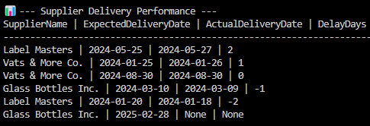
Report 1: Supplier Delivery Performance
Purpose: Tracks whether suppliers deliver on time or late.
What It Shows:
Supplier names
Expected vs. actual delivery dates
Number of delayed days. Negative Numbers indicate early arrival.
How It Helps:
Identifies reliable suppliers
It helps avoid production delays
Screenshot: A query result for supplier delivery performance.

Slide 6

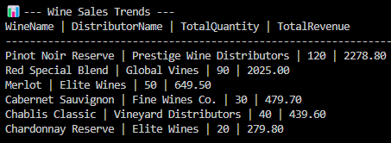
Report 2: Wine Sales Trends
Purpose: Identifies best-selling and slow-moving wines.
What It Shows:
Product Name and Distributor
Total wine sales per distributor
Revenue generated per wine
Which wines are underperforming
How It Helps:
Optimizes production by increasing focus on top-selling wines.
Helps adjust marketing strategies for slow-selling wines.
Strengthens relationships with high-performing distributors.
Screenshot: SQL query result for wine sales trends.

Slide 7
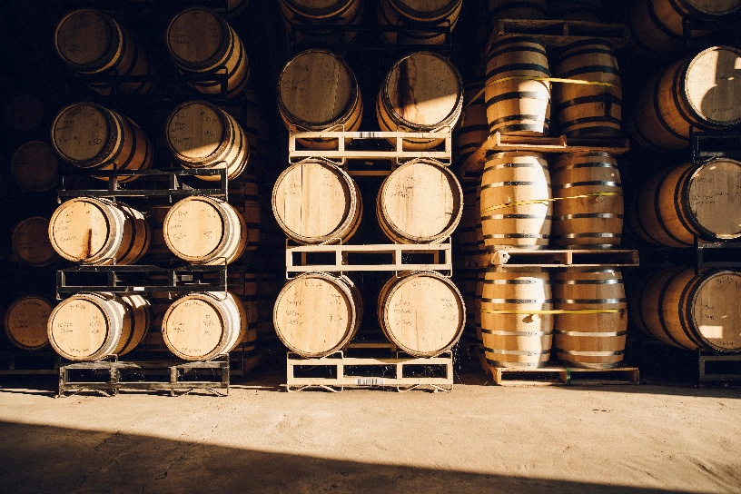

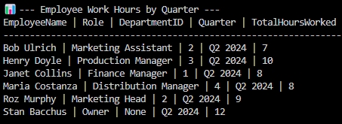
Report 3: Employee Work Hours
Purpose: Tracks workload distribution.
What It Shows:
Employee Names and Departments
Employee hours worked per quarter. Hours may seem low as this is a prototype
Departmental workload analysis
How It Helps:
Prevents over/understaffing
Balances work hours for efficiency
Forecasting for quarterly/yearly overhead costs
Screenshot: SQL query result for employee work hours.

Slide 8

Conclusion
How This Database Solution Helps Bacchus Winery:
Improves inventory tracking → Prevents supply shortages.
Optimizes supplier management → Reduces delivery delays.
Enhances sales analytics → Supports better marketing and production decisions.
Ensures workforce efficiency → Prevents burnout and underutilization.
Potential Future Enhancements:
More Detailed Reporting: Advanced sales and production analytics.
Notification System: Alerts about overtime, low work hours, or supplier delivery delays.
Automated Supplier Performance Evaluation: Tracks consistent delivery issues and suggests alternative suppliers.
Customer Demand Forecasting: Uses past sales data to predict future wine demand and optimize production.
Predictive Ordering System: Automatically suggests inventory orders based on past trends.

Slide 9
Thank You!
Creators: Julio Pochet, Andrew Stiles
and James Cortes
Course: CSD-310
Assignment: Milestone 4
Date: 2-28-2025

