Slide 1


Authentication & Authorization Options
CSD 370 – Secure Software Development
Module 1: Assignment 1.2 – Authentication and Authorization
This assignment compares three popular authentication methods to help Mesusa Corporation choose the right access management strategy.
by Julio Pochet

Slide 2

Overview
Mesusa Corp wants to step up its security game. They’re looking into three ways to manage who gets access to what: SSO, OAuth, and OpenID Connect. This breakdown explains what each does, how to implement them, and their pros and cons.
SSO
OAuth
Single Sign-On for simplified user access across multiple applications.
Open Authorization for secure delegation of access without sharing passwords.
OpenID Connect
Identity layer on top of OAuth 2.0 for user authentication and profile information.

Slide 3
SSO (Single Sign-On)
SSO lets users sign in once to access many apps. It simplifies login experiences—one password, one login, and you’re good across platforms like Gmail, Slack, or Dropbox.
How to Set Up SSO:
Use an identity provider (like Okta or Azure AD)
Connect apps to the identity provider
Configure SAML or OAuth protocols
Set access rules
SSO: The Good & The Not-So-Good
✔ Easy login for users
✘ If SSO goes down, users can’t access anything
✔ Fewer passwords = less reset hassle
✘ Takes effort to set up securely
✔ Better control over access

Slide 4





OAuth (Open Authorization)
OAuth lets one app get permission to use info from another—without sharing passwords. Think: using your Google account to sign into Spotify.
How to Set Up OAuth:
Register your app with the provider (Google, Facebook, etc.)
Get client ID and secret
Handle redirect and token exchange
Use scopes to limit what info is shared
OAuth: Strengths & Weaknesses
No need to store user passwords
Safer user experience
Widely supported
Can be complex for devs
Needs secure token storage

Slide 5





OpenID Connect
OpenID Connect builds on OAuth but adds login features. It confirms who the user is and gives some profile info. It’s like OAuth with ID verification.
How to Set Up OpenID Connect:
Use an OpenID provider (Google, Microsoft, etc.)
Set up OAuth 2.0 first
Request ID token with authentication
Verify token and use claims
OpenID Connect: Upsides & Downsides
Combines OAuth + user ID
Simplifies login flow
Supports mobile and web
Setup can be confusing
Still evolving in some areas

Slide 6

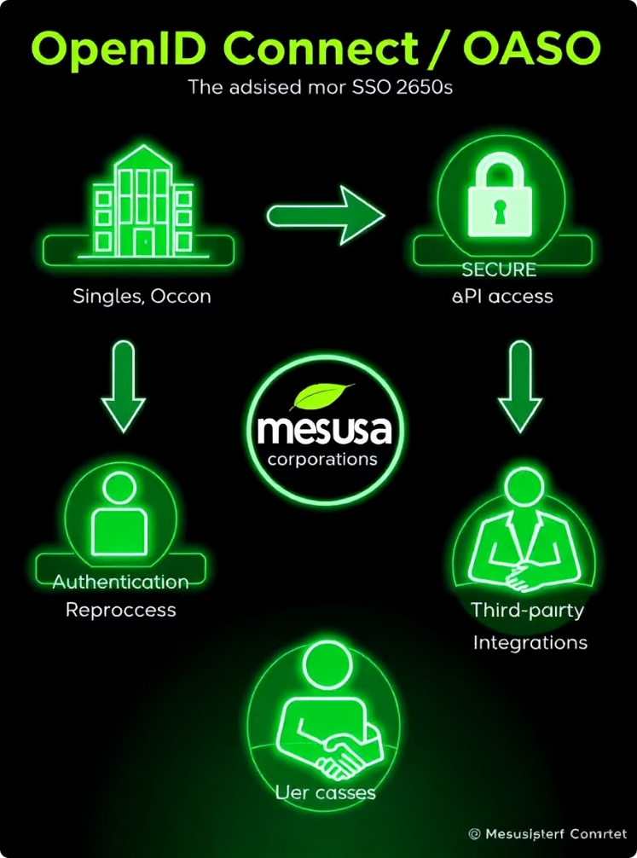



Recommendation for Mesusa
For Mesusa, OpenID Connect might be the best fit—it provides authentication and access control together. If the goal is just access management between apps, OAuth is enough. SSO works well for simplifying user login across internal enterprise tools.
OpenID Connect
Best for combined authentication and access control.
OAuth
Sufficient for access management between applications only.
SSO
Ideal for simplifying user login across internal enterprise tools.

Slide 7
References
NIST. (2023). Digital Identity Guidelines. https://pages.nist.gov/800-63-3/
OAuth.net. (n.d.). OAuth 2.0. https://oauth.net/2/
OpenID Foundation. (n.d.). OpenID Connect. https://openid.net/connect/
Microsoft Docs. https://learn.microsoft.com/
Okta Developer Docs. https://developer.okta.com/docs/

