Slide 1
TowsonBook: A Social Networking Website
Developed and Presented By Group 2:
Robert Bathmann
Jlaja Pandora Podier
Jose Quinchuela

Slide 2
Outline
Project Aim and Motivation
Main Stories
Software Process
Lead to the solution through your user stories/uses cases.
Data Models
External Resources
Applied Rails Features
Demo
Responsibilities
Learned Lessons
Questions

Slide 3
Project Aim & Motivation
Wanted a way to connect Towson University current students, alumni, and faculty members via an online social networking website
Allow students and alumni to keep in touch with one another long distance
Provide a platform for students to form relationships based on similar interests, activities, and field of studies
Users
Current Students
Alumni
Faculty/Staff

Slide 4
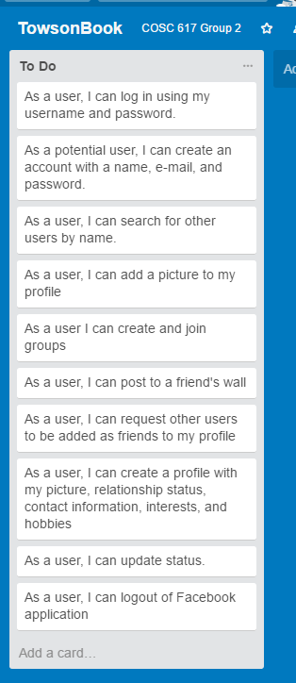
Main Stories
Establish Account
Sign-up
Sign-In/Login
Sign-Out/Logout
Create Profile
Add Personal Information
Add Interests
Add Pictures
Add/Update Status
Update Profile
Authentication
Login via username and password
Establish Friendships with other users
Request friendships
Accept/Reject Friendship
Post to wall
Join Groups

Slide 5
Software Process
We developed the User Stories, discussed the approached and divided the User stories amongst team members
Design and Layout (Robert, Pandora, and Jose)
Initialize Controllers, Models, and Views (Robert, Pandora, and Jose)
User Interface- (Robert)
Sign-in, Sign-out, and Sign-Up (Robert and Pandora)
Establishing Friendships (Robert)
Joining Groups –(Robert)
Search For Users- (Jose)
Allow Users to Write Wall Posts and Update Status (Pandora)
Upload Files and Photos (Jose)
Profile Creation and Modification (Pandora, Robert and Jose)
Used GitHub Repository for collaboration and version control
Scheduled weekly meetings to discuss progress and work on the project

Slide 6
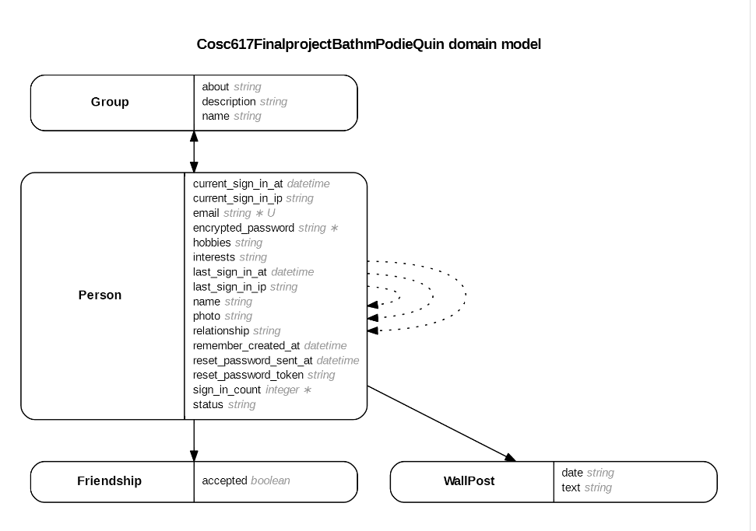
Data Models

Slide 7
Data Models
Friendships
Requester_id (FK)
Granter_id (FK)
Accepted
Groups
Name
Group_id
Groups_people
Person_id
Group_id
People
Name
Interests
Hobbies
Relationship
Email
Encrypted Password
Reset_password_token
Wall_Posts
Text
Date
Person_id
Author_id (FK)
**NOTE: Id is explicitly created.

Slide 8
User Stories/Use Cases
Creating Profile
1. Go to the Welcome Page of TowsonBook and select Get Started
2. Select Sign-Up Link at the lower left
3. Enter in email address and create password with a minimum of 6 characters
4. Click the Sign Up Button
Updating Profile Information
1. Login to your Towsonbook account
2. Click the My Profile Link at the top of the page
3. Click the Edit My Profile Button
4. Update any of the fields you want to change (Name, email, profile photo, Relationship status, Hobbies, Interest, etc.)
5. Click the Update Person Button to save the changes
Adding Friends
1. Login to your Towsonbook account
2. Click the People Link at the top of the page
3. Friendships can be managed here via the radio buttons. User can request to Add a Friend, Confirm a Friend, or Cancel Friend Request of the fields you want Relationship status, Hobbies, Interest, etc.)to change (Name, email, profile photo,
4. Click the Button of your choice to manage friendship

Slide 9
User Stories/Use Cases (cont’d)
Joining Groups
1. Login to your Towsonbook account
2. Click the Groups Link at the top of the page
3. Manage Groups There (Join Groups or Leave Groups)
Writing Wall Posts
1. Login to your Towsonbook account
2. Click the
Searching for Users
1. Login to your Towsonbook account
2. Enter the friend’s name in the search field in the upper left hand side on the People site
3. Click the Search Button
4. The results of the search are displayed in the user’s All People page.

Slide 10
Applied Rails Features
Gems
Devise
Carrierwave
Twitter-bootstrap-rails
Sdoc
Byebug
Web-console
Session Handling
Form Helpers

Slide 11
External Resources
Devise- It is a flexible authentication solution for Rails based on Warden. We used the Devise Gem to generate the login screen and authenticate user login credentials and it also allows users to sign up for the TowsonBook app if they currently do not possess login credentials.
Carrierwave- this handles file and photo uploads on our TowsonBook application.
Twitter-bootstrap-rails- Bootstrap is a toolkit from Twitter designed to kickstart development of webapps and sites. It includes base CSS and HTML for typography, forms, buttons, tables, grids, navigation, and more.
Sdoc- is an HTML template built on top of the RDoc documentation generator for Ruby code.
Bye bug- is a debugger that stops execution and open up the debugger console that allows you to see what is going on inside a Ruby program while it executes
Web console- Web Console is a debugging tool for your Ruby on Rails applications that allows you to execute arbitrary code on the server through an interactive Ruby session in your browser

Slide 12
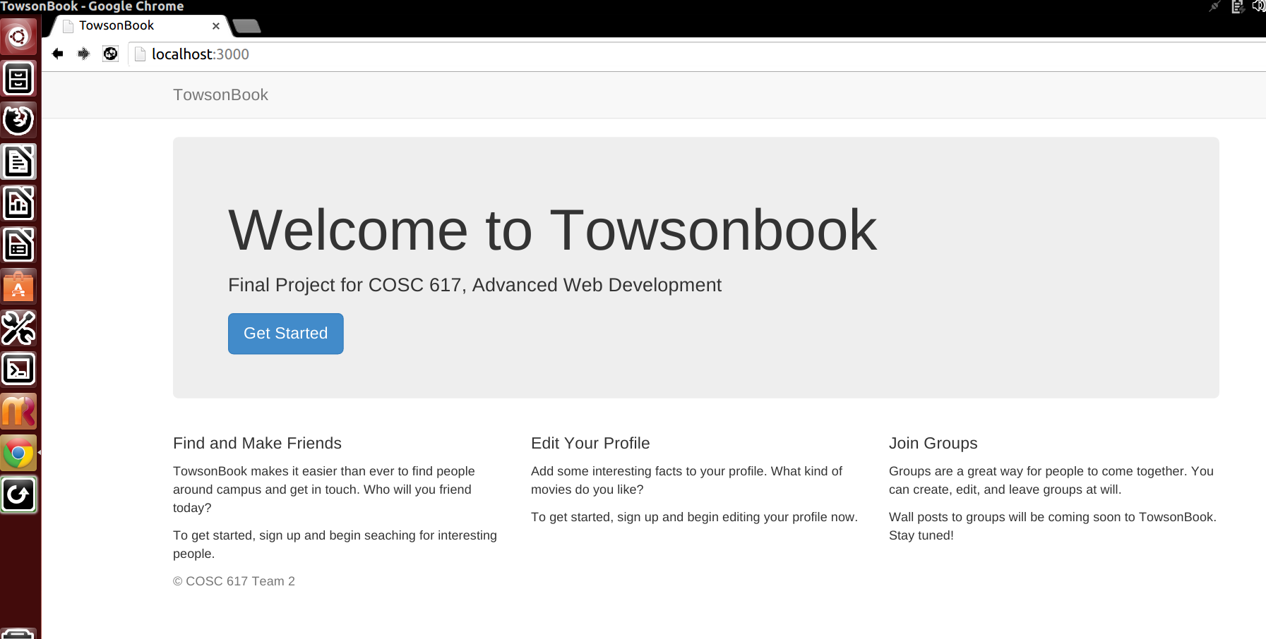
Welcome Splash Page

Slide 13
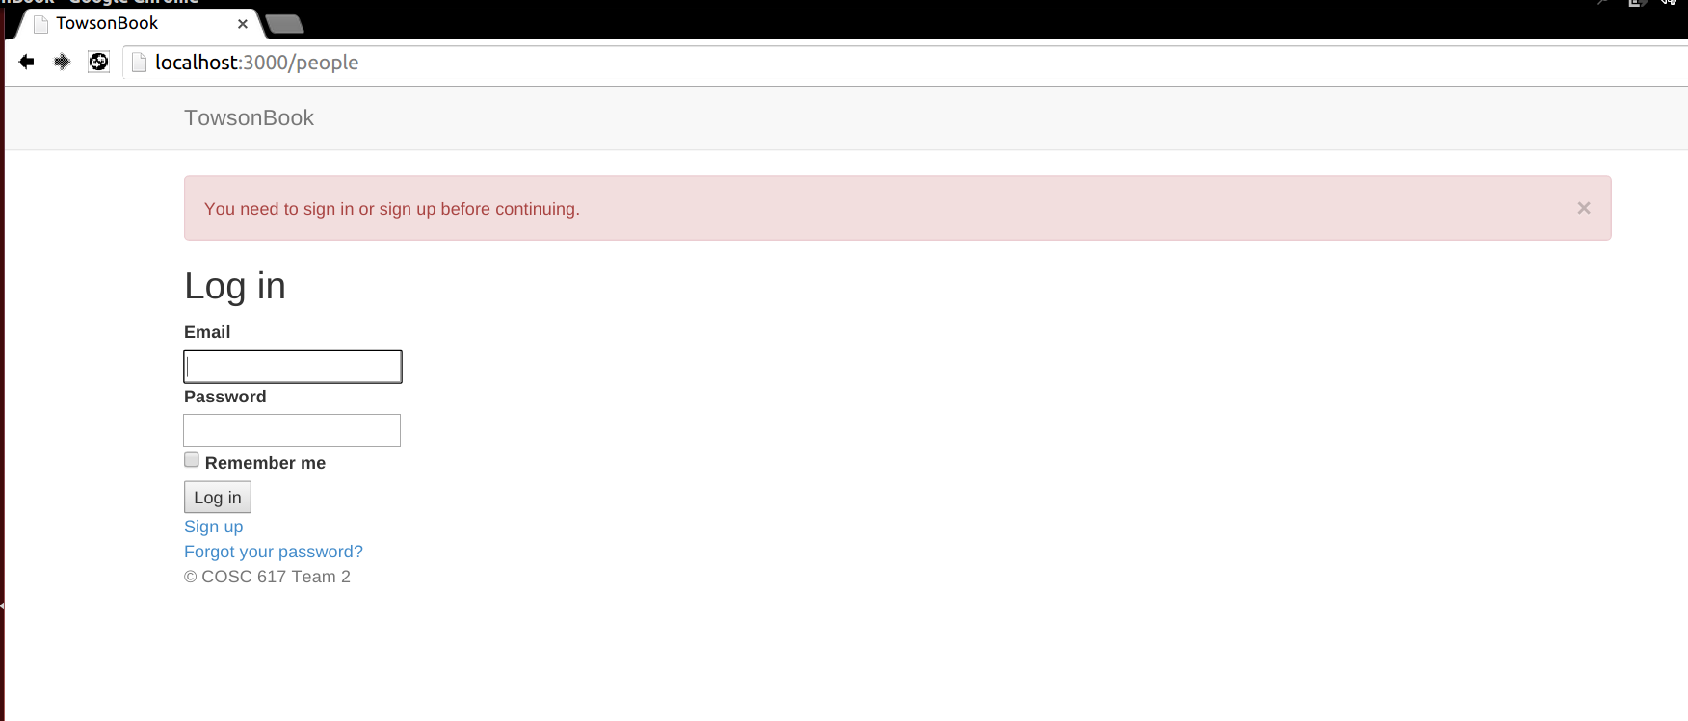
Main Login

Slide 14
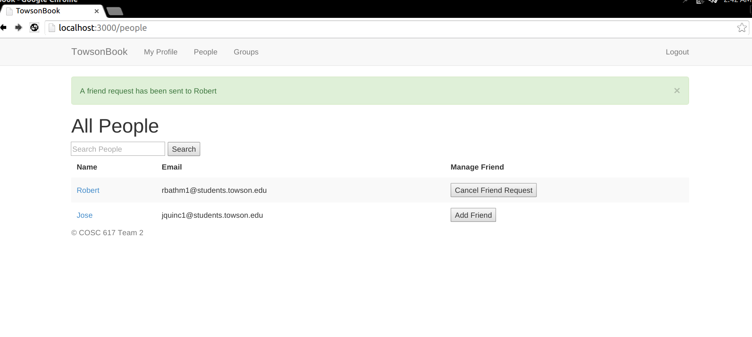
Friendships

Slide 15
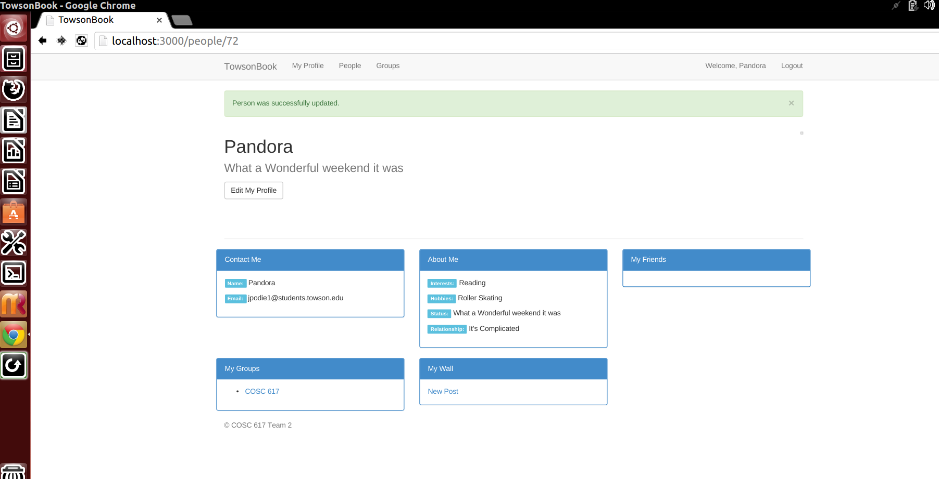
User’s Profile Page

Slide 16
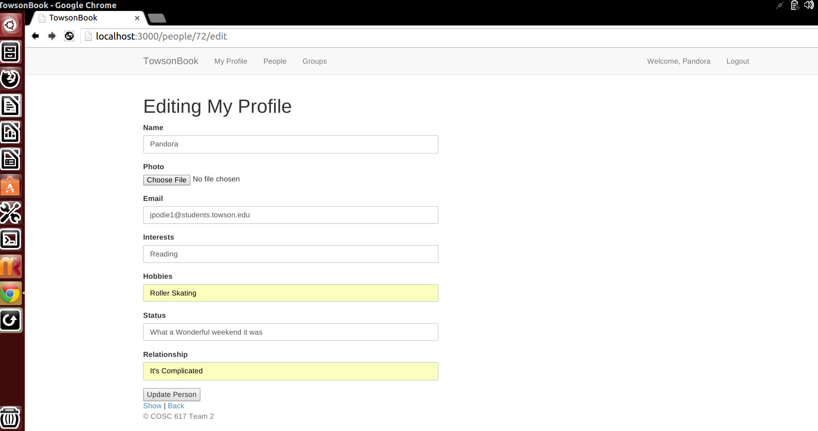
Editing a Profile

Slide 17
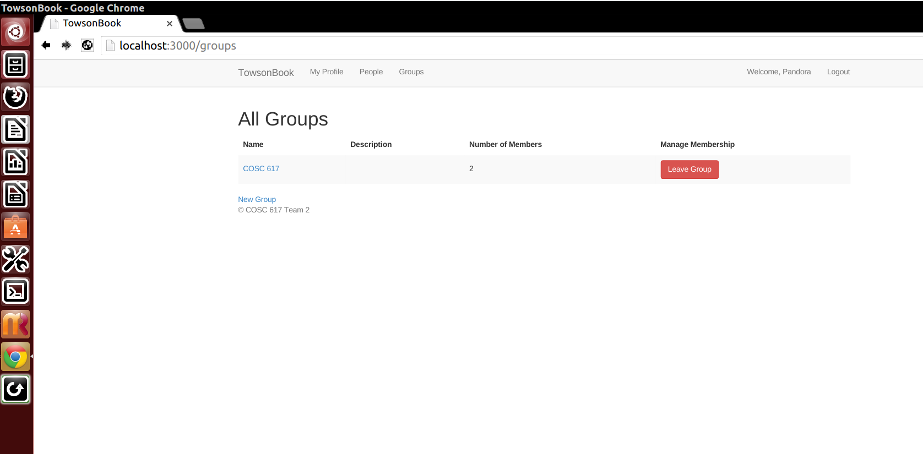
Manage Groups

Slide 18
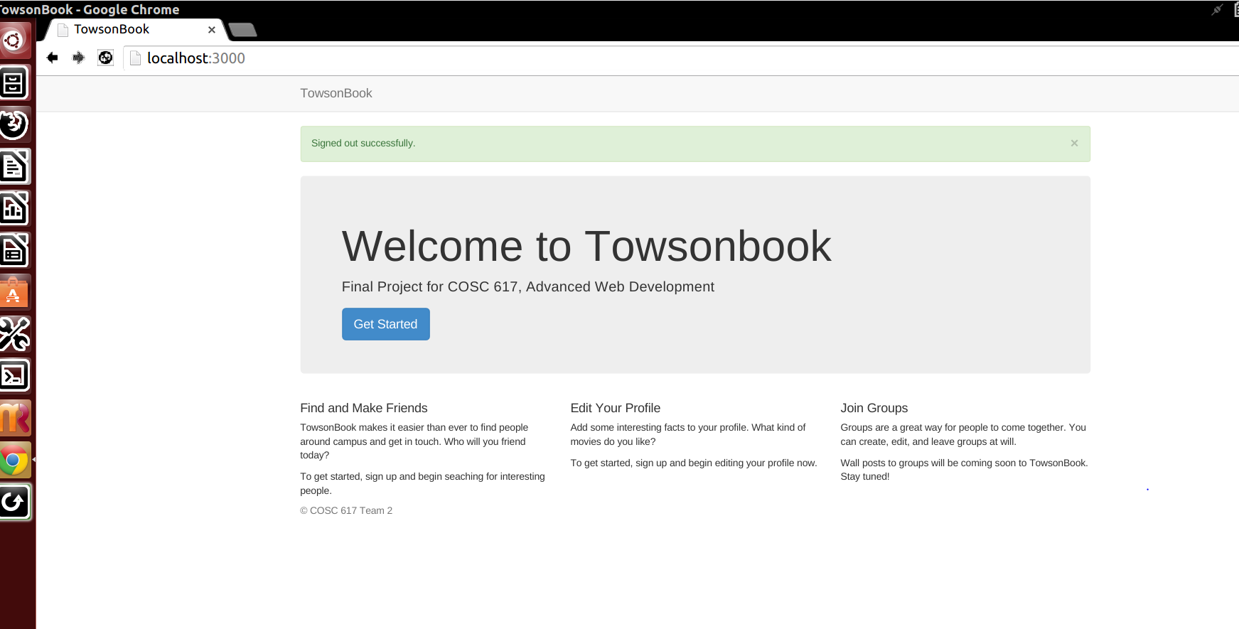
Sign-Out/Logout

Slide 19
Demo
Demonstrated By: Jose
Explained By: Robert and Pandora

Slide 20
Lessons Learned
Value in having an online configuration management tool
Learned how to develop a RoR application

Slide 21
Responsibilities: Who Did What
Robert Bathmann
Project Creation
Friendship Model
Adding Users to Groups
Profile creation and modification
Jlaja Pandora Podier
Established GitHub Repository for version control
User Login (Facebook Authentication Login)
Instantiation of the Wall Post Feature
Friendship Model
Jose Quinchuela
File/Photo Upload
Search for Users
Friendship Model
Profile Edits

Slide 22

Questions

