Slide 1
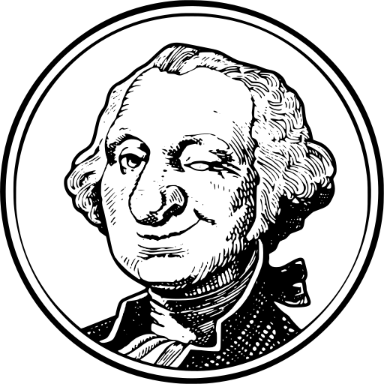
MyGovernment
Juston Points
Principles of user Experience Winter 2020

Slide 2
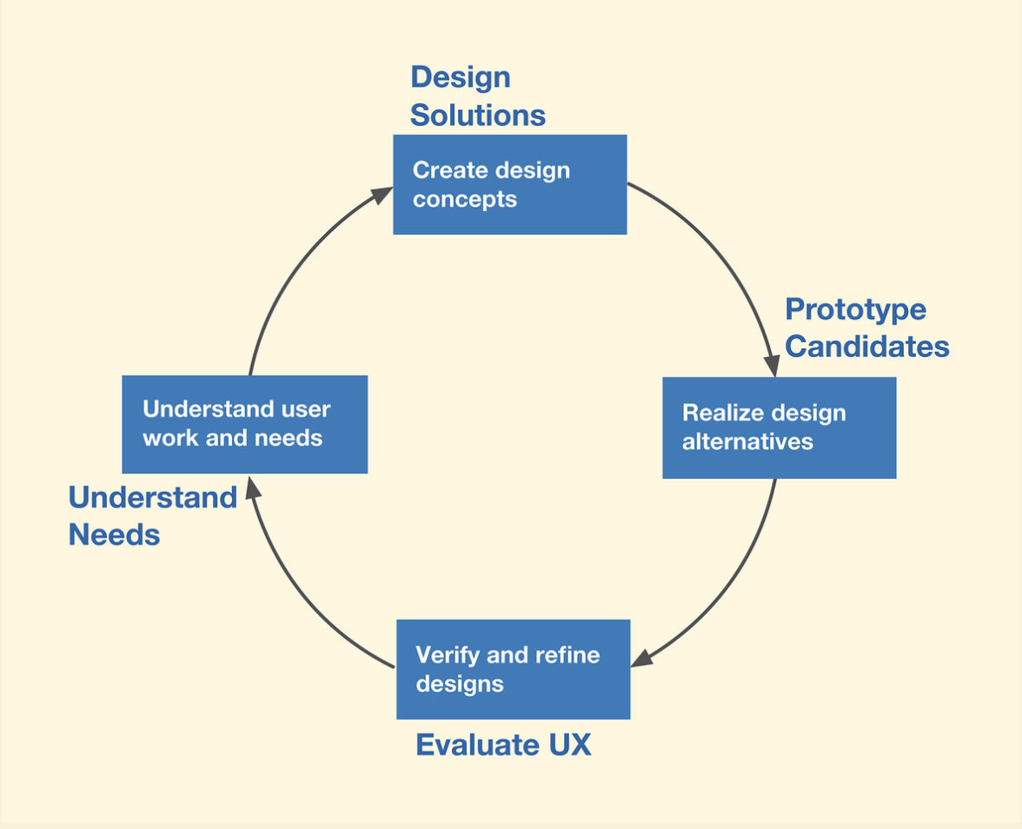
UX Wheel
The wheel helps defined the process that was taken to develop the prototype for the MyGovernment application.
Since we are starting the project from scratch, then we need to start at the understanding the users needs stage. We will keep track of where we are in wheel with the message at the bottom of each slide.
We are here

Slide 3
The Problem
People are poorly informed about the inner workings of their local governments.
This leads to low voter turn out
Not knowing what is being worked on.
People not knowing how to report or file an issue.
Some local governments have town halls, and people just end up yelling at each about a single problem.
We do not know how many other people want the same issue to be addressed, until there is a town hall concerning it.
People do not know how to run for office, and as a result some elections go unopposed.
Elected officials have to deal with allot of information, and often the people that yell the loudest or are the majority get their attention.
This results in special interests getting priority.
Policy that follows agendas created by large political parties, and not the people they represent.
The official is not able to show progress on issues, so the voters do not know if their concerns are being addressed.
The official is not informed about problems, until the issue gets to a critical mass of complaints.
Before we start to understand the user’s needs, we need to clarify what is the problem that we are trying to solve with the application.
Understand Needs

Slide 4
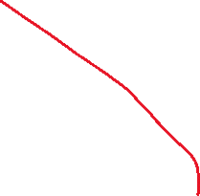
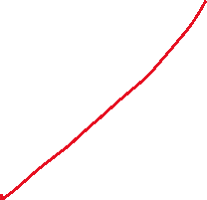
Brain Storming
Allow the user to video chat and spy on their representative. Ring doorbell installed inside of their office.
Allow users to vote on the posted issues
Provide the user with information about which offices are open for election.
Schedule a weekly vote on open issues
Inform representative when issues reach a critical mass of votes
Allow the user to post an issue, so that others can see it.
This stage we are generating ideas that can help solve the problem.
This stage is messy, and many of the ideas may never leave this stage.
Post issues on a map. This will help people see where the majority of the problems are located
Allow candidates to review the data, and contact constituents about issues that they filed
Allow elected officials to indicate that an issue is being worked on, or has been resolved
Bug tracking for local governments
Understand Needs
Design Solution

Slide 5


Personas
Constituents
Any person that lives in the community
Does not know what is going on in their local government
Affected by issues in their community
Does not know how to participate
Wants to report issues that they encounter
Votes for an elected official
Open to using new tools
This is a stage where we try to understand the users that will be using the product.
This is important because people have different knowledge sets and intents.
This helps clarify what those are, and elements need to be designed with that in mind.
Elected official
A person who holds an elected office
Worried about being reelected
Does not directly know what is going on with their constituents.
Has to filter allot of information from various sources
Provides time and attention to people that provide them resources to get reelected.
May only address issues that can get their attention
May have to deal with a crisis, or an issue that was not addressed until the problem made their constituents mad.
Could be stubborn to use new tools
Design Solution

Slide 6
Scope
After reviewing the scope, the project was reduced to the following.
It will be easier to get constituents to use the application, and add issues to it, than it would be to get elected officials to post information to an application for consumers.
So, the initial application will focus on the constituent persona and giving users the ability to voice concerns. Then in second cycle of the UX wheel, we will start adding civic information, and figure out how to entice the elected official persona to use the application.
This reduces the scope of the application to inserting issues and allowing users to view issues posted by other users.
The Map aspect seems to provides allot of value, because it will allow users to see cluster of problems on the map, and this should increase the visibility of the problem.
While the complex voting mechanic would be useful, it would require allot of study to implement it correctly.
A simpler Reddit like voting mechanic would give the user a means to vote on issues without complexity. I decided to go with this instead.
At this stage we reviewed the big picture that we developed while brainstorming and developing user personas.
We need to review this information and ask what is practical with our current resources and time.
Then once we narrow that down, we decide which work stream will help the project be most successful. If the project is successful, then the UX wheel can iterate on the project, and add the other elements.
This was a stage that was important for me to understand. I am good at seeing the big picture, but I needed to reduce the projects scope for it to be practical. Trying to design for the big picture almost consumed me. The Persona’s helped me reduce the projects scope
Design Solution

Slide 7
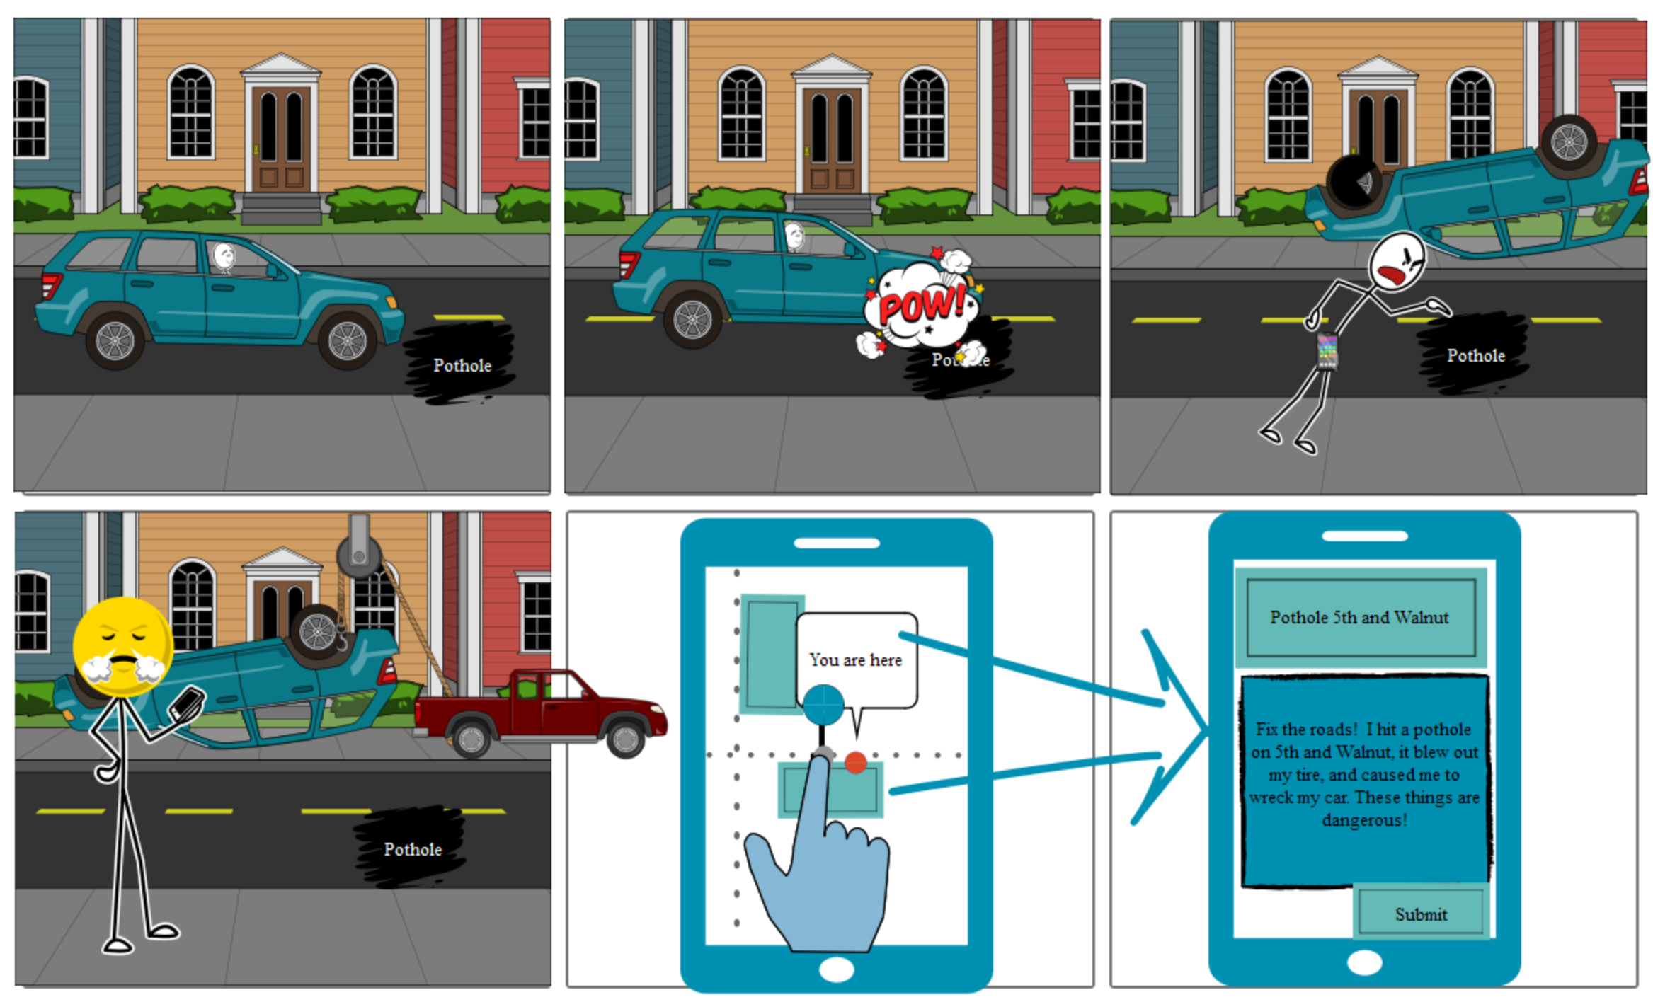
Story Boards
Why are the roads such a mess
I am going to report this while I wait for my ride.
Once we clarified what we are going to build, we start designing the project.
The storyboard approach allows us to see how the project will be used. This can be used to evaluate whether the design is practical and may uncover challenges with it.
This storyboard shows the importance that mobile access will be for the application. The user is most likely to report issues while they are out and about.
Design Solution

Slide 8
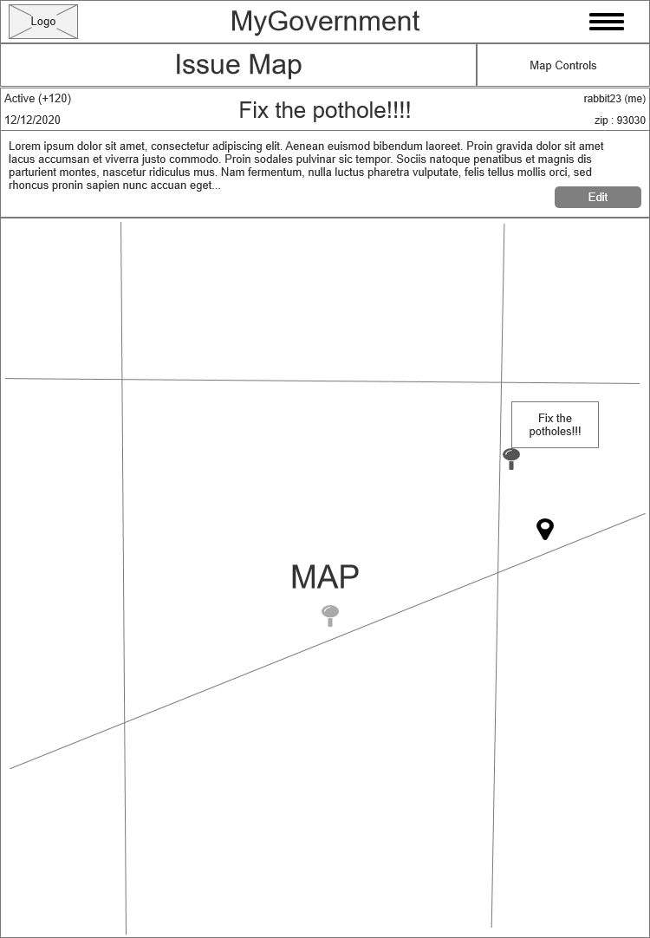
Wireframe
Once we believe the design is practical and worth developing, then the next step is to create a cheap prototype. For web applications, a cheap prototype is called a wireframe. It is intended to show what the application may look like, but without color or images. This helps us understands the layout of the application.
Also it helps us understand what elements will be needed for the project. Which can help us understand the complexity and cost of the project.
For example, allowing the user to upload images can add to the cost of an application.
Design Solution
Prototype Candidates

Slide 9
Interactive Wireframe
To see the interactive wireframe for this project go to the link below.
https://97pdvd.axshare.com Password : rabbitfire
I provided yellow notes that appear next the designs that explain the various interactions that the prototype currently supports.
With modern tools, we can develop interactive wireframes. This can help the customers see how the application might work, without having to explain it to them with a storyboard.
Prototype Candidates

Slide 10
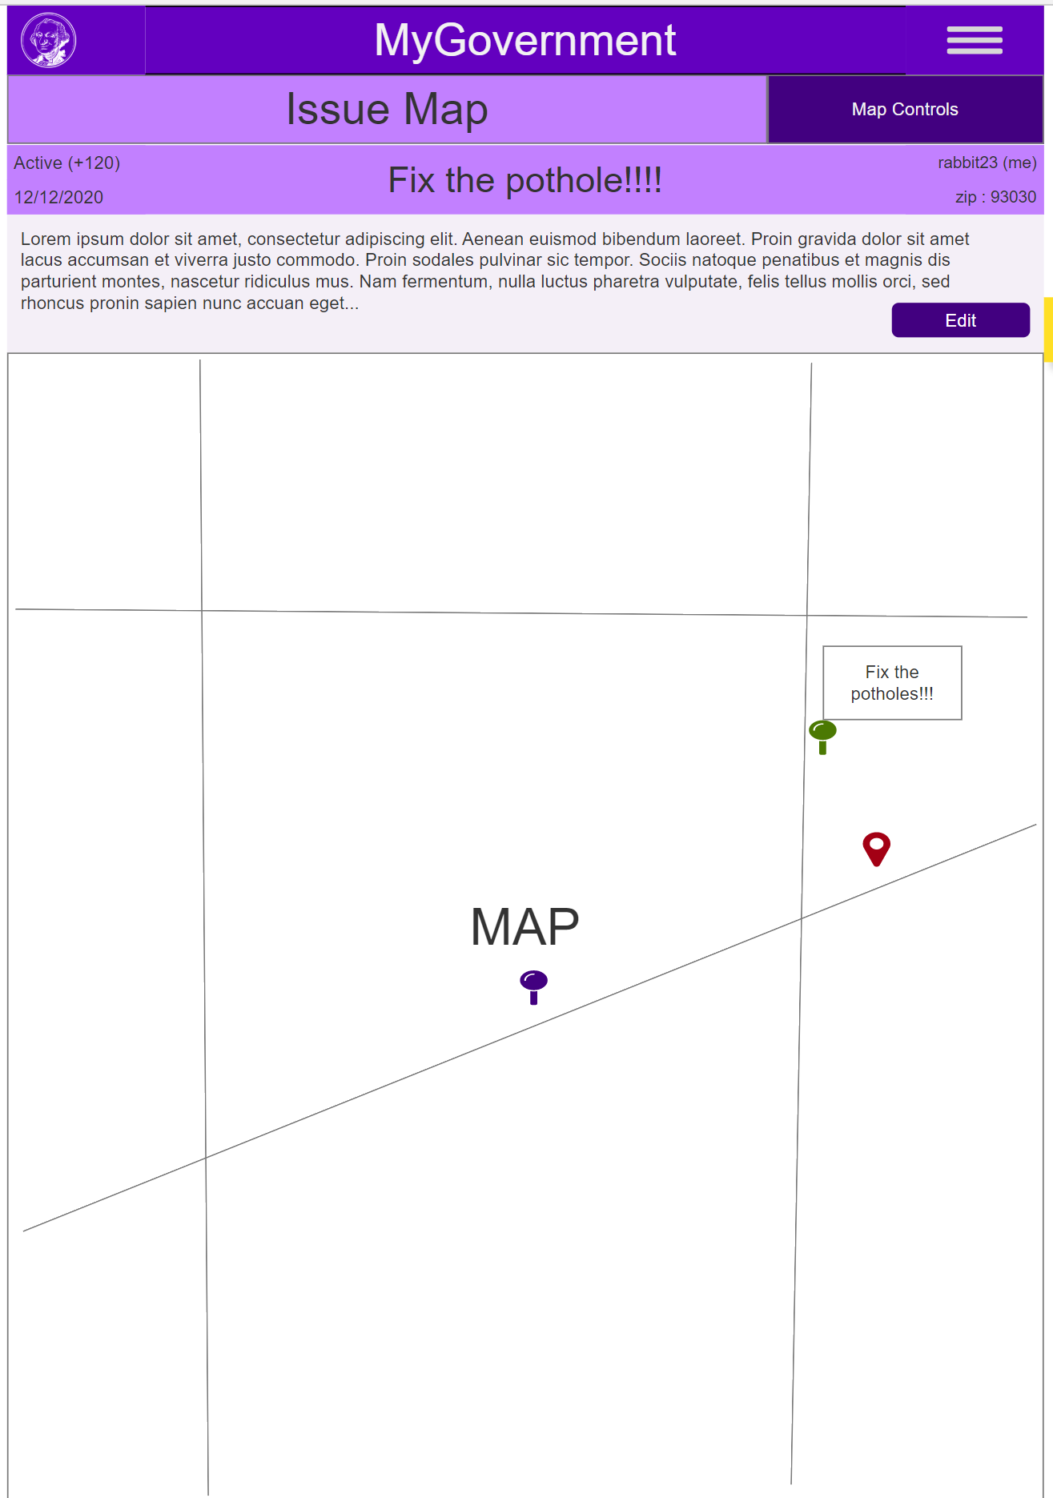
Prettifyied Prototype
To see the prettified prototype for this project go to the link below.
https://6kh0mp.axshare.com
Password : rabbitfire
After we have evaluated the wireframe, and we agree on the layout and needed elements, then we can start styling the prototype.
This is that stage when we start decide on the projects look and feel. This is when we can start talking about color, and other elements for the projects look and feel. Note, the customer really wanted a purple color scheme.
Prototype Candidates

Slide 11
User Evaluation
In the next few slides we will go over each view in the application and get your initial impressions and understandings of the application’s prototypes.
Before that, in the previous slide, feel free to review the prototype before we go into the details. The reason is that, I want know how you use the application without it being explicitly explained to you. The reason is that it should give us an initial understanding of how the user may see the application. Please takes notes, and we can address them as we go through each view.
Lunch break ☺
https://6kh0mp.axshare.com
Password : rabbitfire
It is important that we review the application with a subset of user.
It is possible we made assumptions that only we understand.
I would provide an example without the notes, but you get the point
Evaluate UX

Slide 12
Now Lets Review the MyGovernment Application

Slide 13
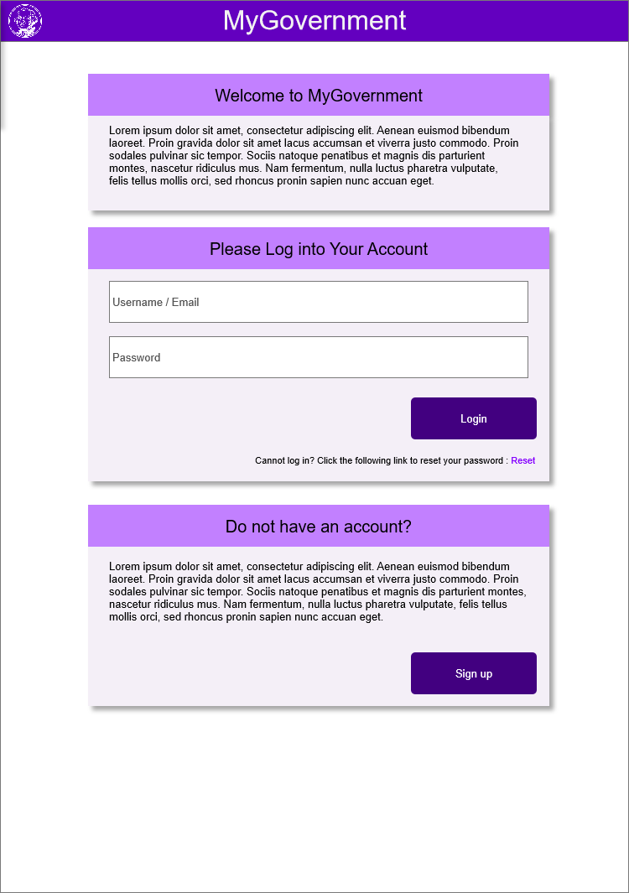
Login View
This is the introduction page for users wanting to enter the application.
The login view has three sections.
Welcome card : This allows for content to be added that explains the application or provide news about the application.
Login card : This allows the user to provide their username and password. When they click the Login button they are brought to the Issue List view. Also, there is a reset password option. (I need to make a view for password reset).
New Account Card : Provides information about signing up. When the user clicks the Sign Up button, they are taken to the New Account view.

Slide 14
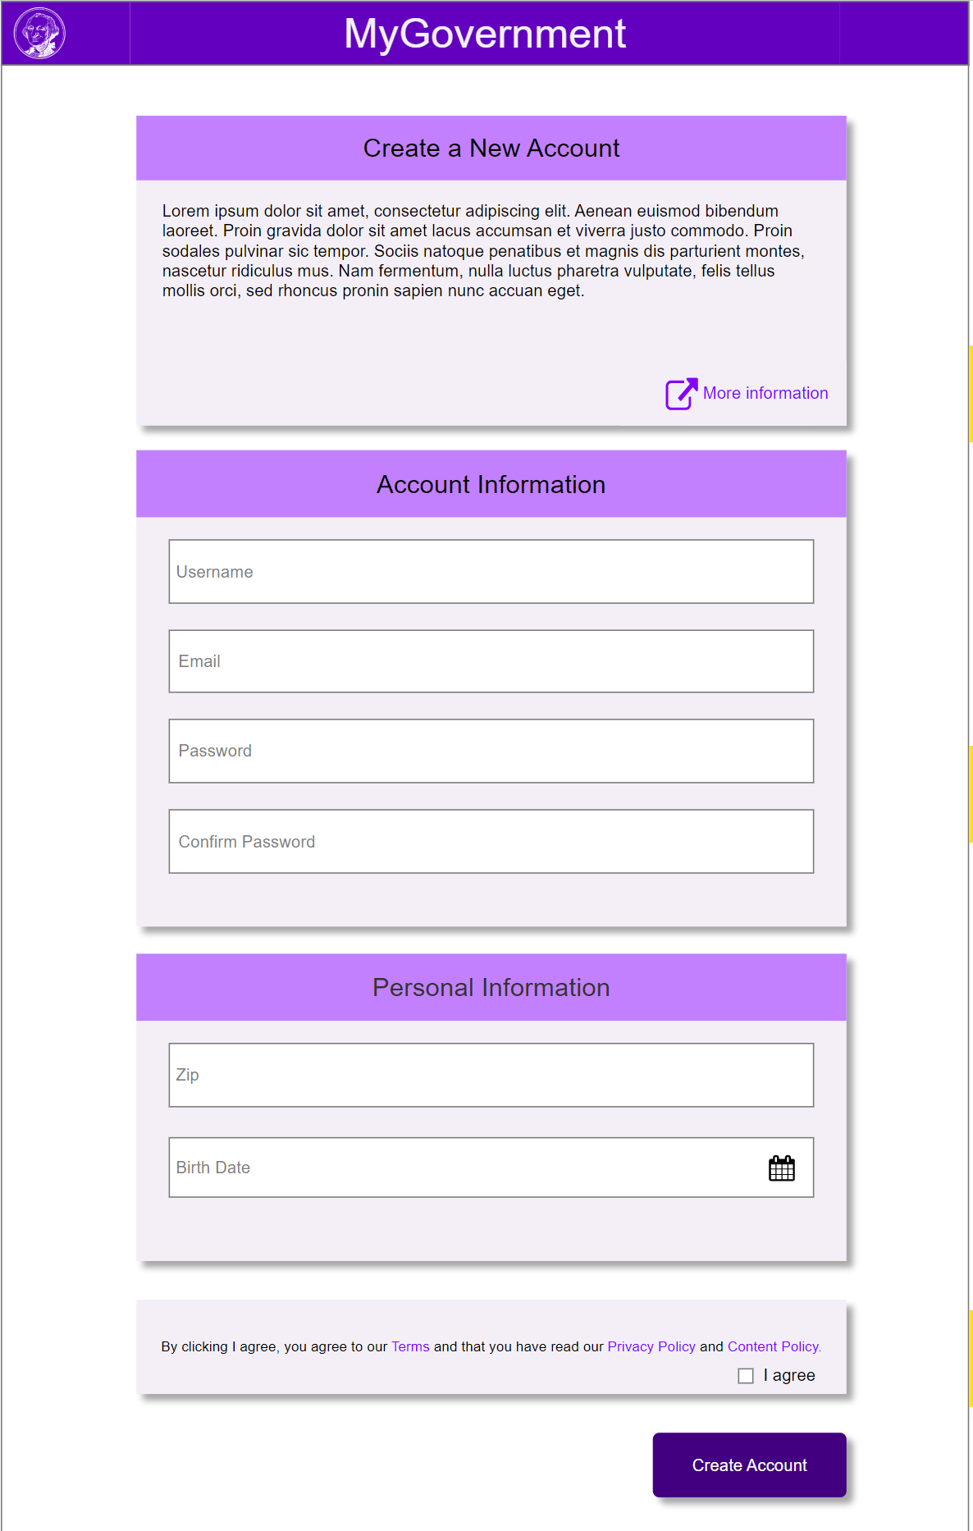
Sign-Up View
This view is for users who do not have an account. Info Card : Provides the user with information about the application. Also, invites them to click a link to go to the company website for more information.
Account Card : This is information that is required to create an account.
Personal Information: This is information that is not required, but if provided can be used to enhance the user experience. Policy card : The user has to agree to terms and conditions before being able to sign up.
When the user clicks the Create Account button, then the account is created, and the user is taken to the Log In view so they can login.

Slide 15
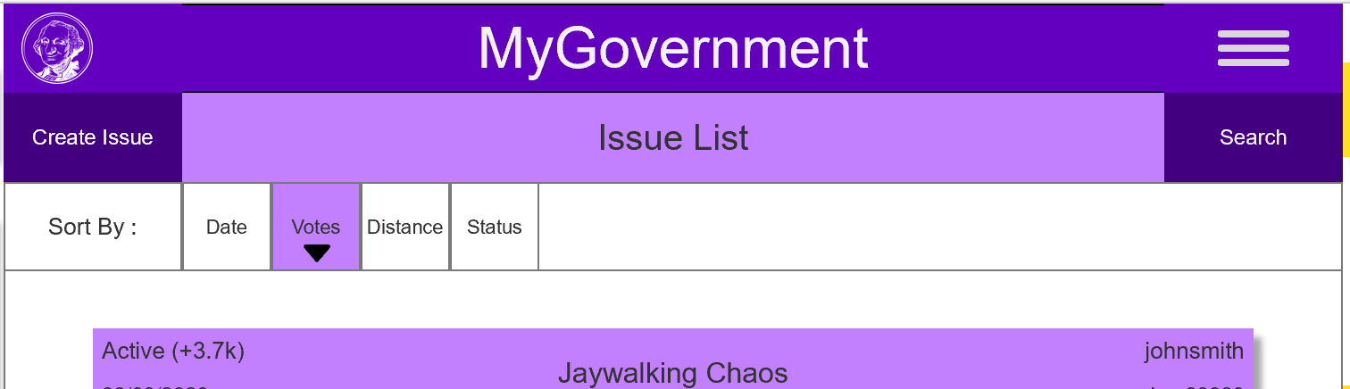
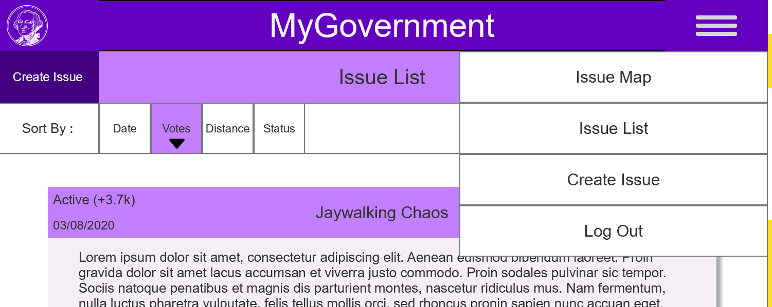
Menu
The navigation menu for the application is hidden from the user.
When the user clicks the hamburger menu in the right corner, then the menu opens for the user.
The menu should allow the user to navigation to area in the application. It also provides the user the option to logout of the application. When the user clicks the Logout option, then the user is taken to the Login view.
Menu opens when the hamburger icon is clicked

Slide 16
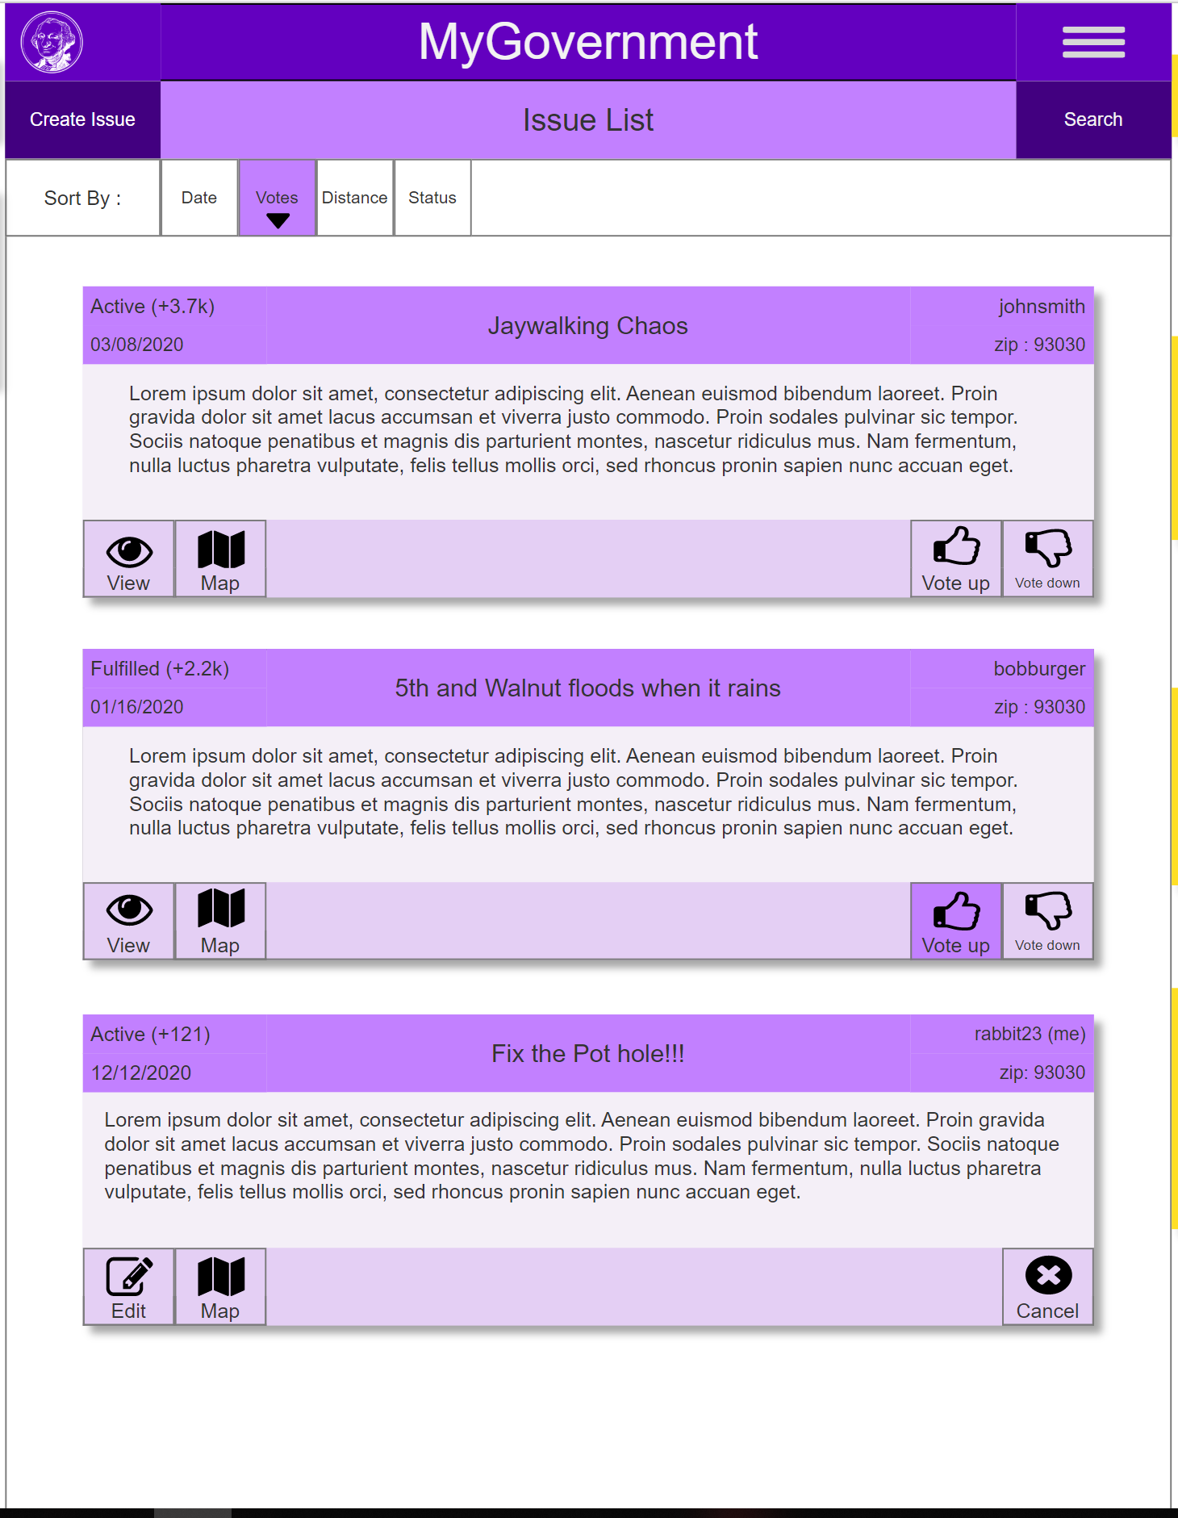
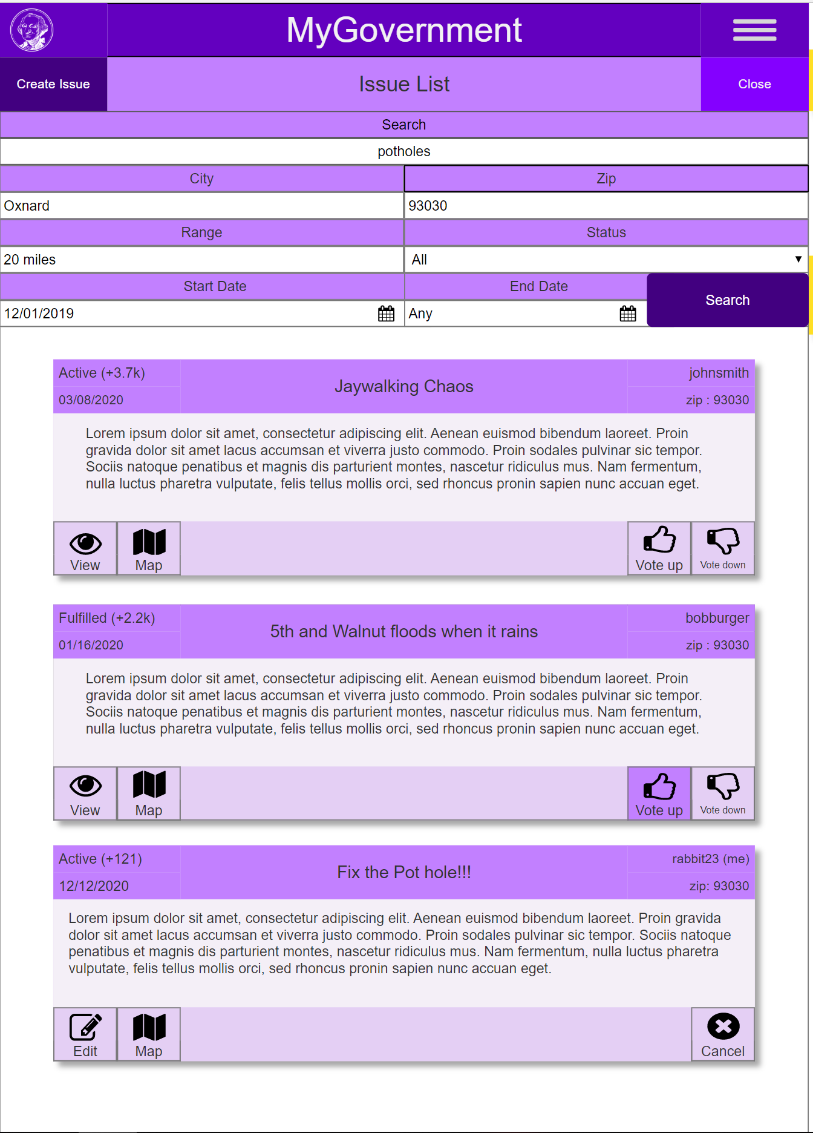
Issue List
This is a view where the user can review and search for various issues.
When the user presses the Create button, they are taken to the Create Issue view.
When the user clicks the Search button, then the Search Panel opens.
The user can adjust the search parameters, and when they click the Search button in the panel, the list updates.
When the user clicks an item in the Sort panel, then the view sorts down on the selection. If they select it again, then it sorts up for that selection.

Slide 17
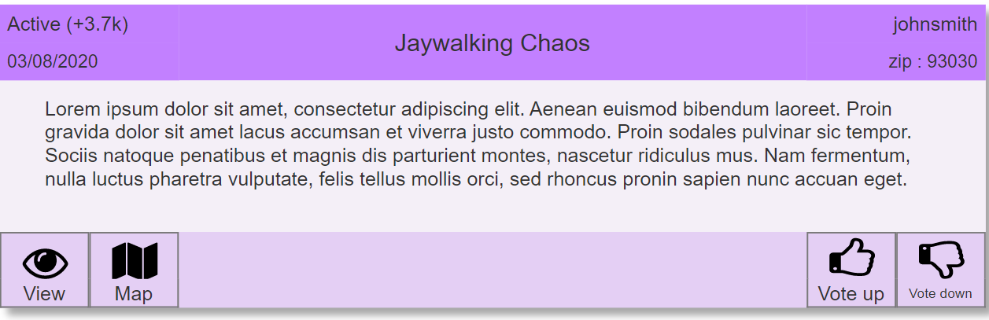
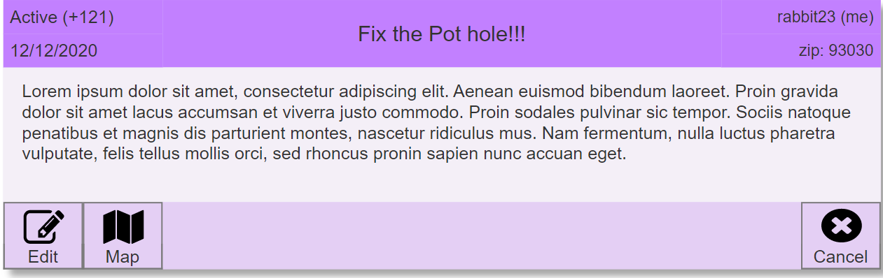
Issue Card
When an issue belongs to another user
An issue card contains information about an issue in the Issue list view. The card is slightly different when it belongs to the current user.
Issue Card Header : This contains meta information about the issue.
The left corner contains the status, vote total, and submission date for the issue.
In the center is the title of the issue.
The left corner contains the username of who filed the issue, and zip of the issues location.
Issue Card Content : In the center of the card, the description of the issue is present.
Issue Card Footer : This contains various actions the user can take with the issue. The button differ when the issue belong to the current user.
View Button : Takes the user to the Issue View for the issue.
Edit Button : Takes the user to the Edit Issue view for the issue.
Map Button : Takes the user to the Map View for the issue, and the issue is selected in the map.
Vote up/down Button : Allows the user to vote on the issue.
Cancel Button : Allows the use to set the status of the issue to canceled.
When an issue belongs to the current user

Slide 18
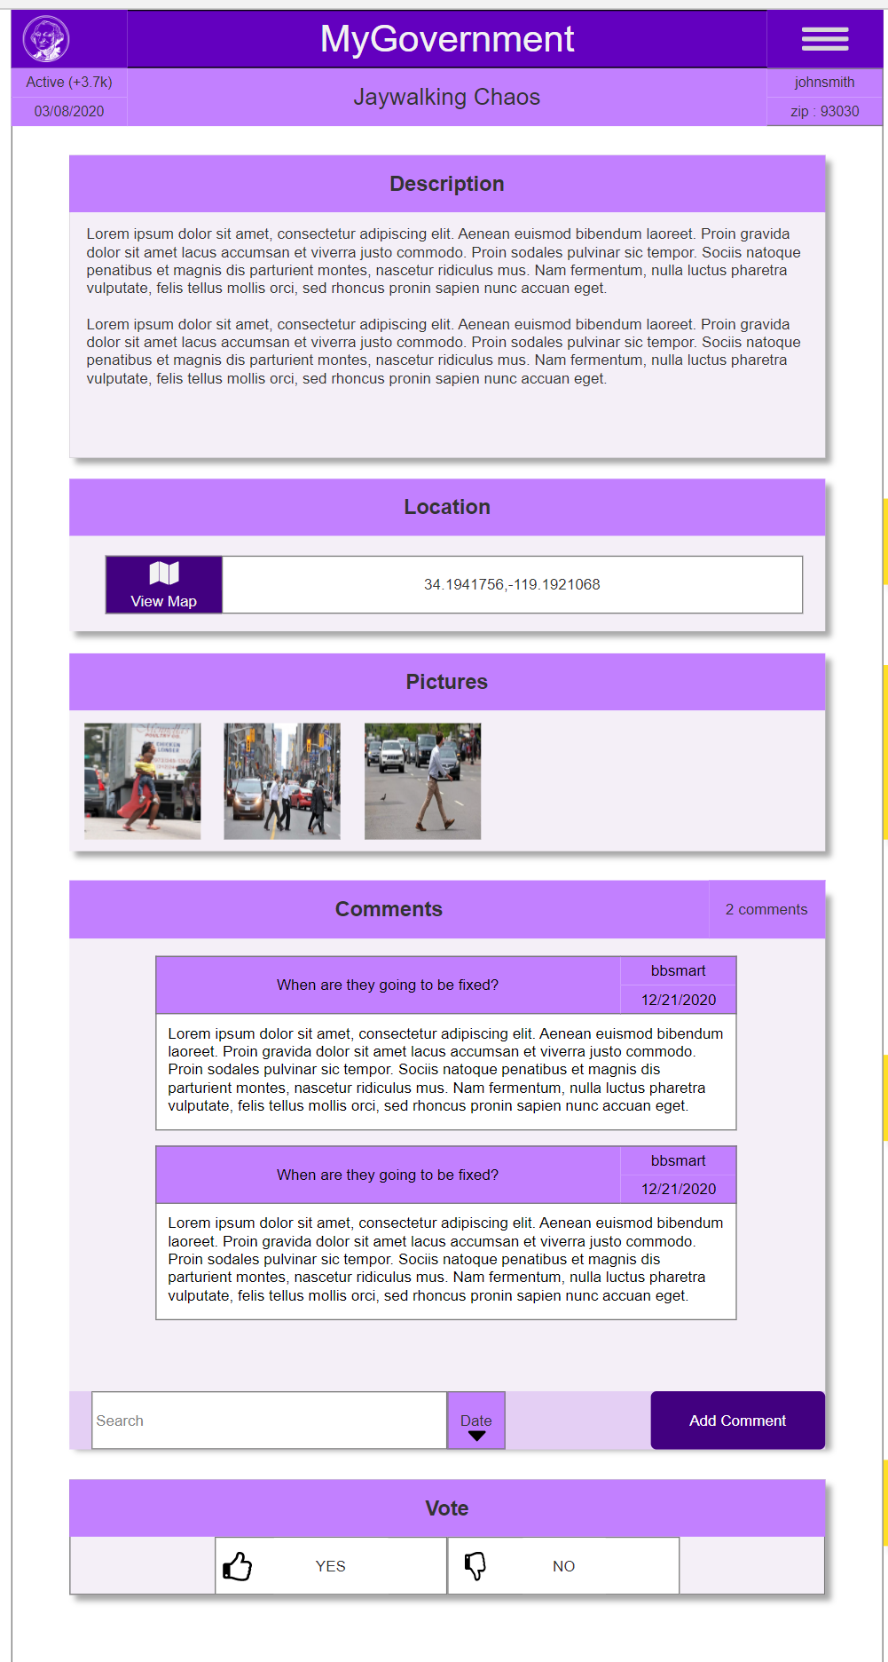
View Issue
This view allows the user to see the issue in more detail.
Issue View Header : This contains meta information about the issue.
The left corner contains the status, vote total, and submission date for the issue.
In the center is the title of the issue.
The left corner contains the username of who filed the issue, and zip of the issue's location.
Description Card : Contains the description of the issue.
Location : Provides the GPS location of the issue. When the View Map button is clicked, then the user is taken to the View Issue Map for the issue.
Pictures Card : The user can view pictures concerning the issue.
Comments Card : The user can view comments about the issue. They can sort and search the comments. When the user clicks the Add Comment Button, then the user can add a comment.
Vote Card : The user can click Yes or No button to vote on whether the approve that the issue be addressed by elected officials.

Slide 19
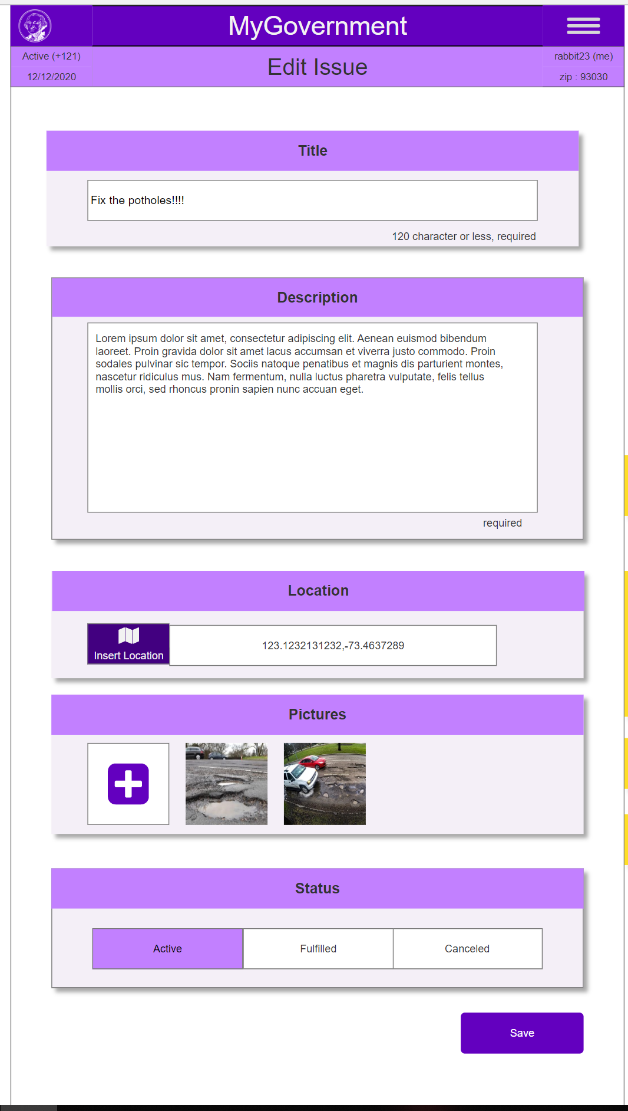
Edit Issue
This views allows the owner of an issue to make edits to that issue.
The header is the same as the one in the View Issue view.
Edit Title Card : Allows the user to edit the issue’s title.
Edit Description Card : Allows the user to edit the issues description.
Edit Location Card : Allows the user to edit the issues description.
Add Image Card : Allows the user to view the current issue pictures. When the user presses the [+] button, then the user can upload an image.
Edit Status Card : Allows the user to change the status of the issue. When one of the three options (Active, Fulfilled, Canceled) is clicked, then that item is selected, and the other items are deselected.
When the user presses the Save button, then the changes are saved, and the user is redirected to the Issue List view.

Slide 20
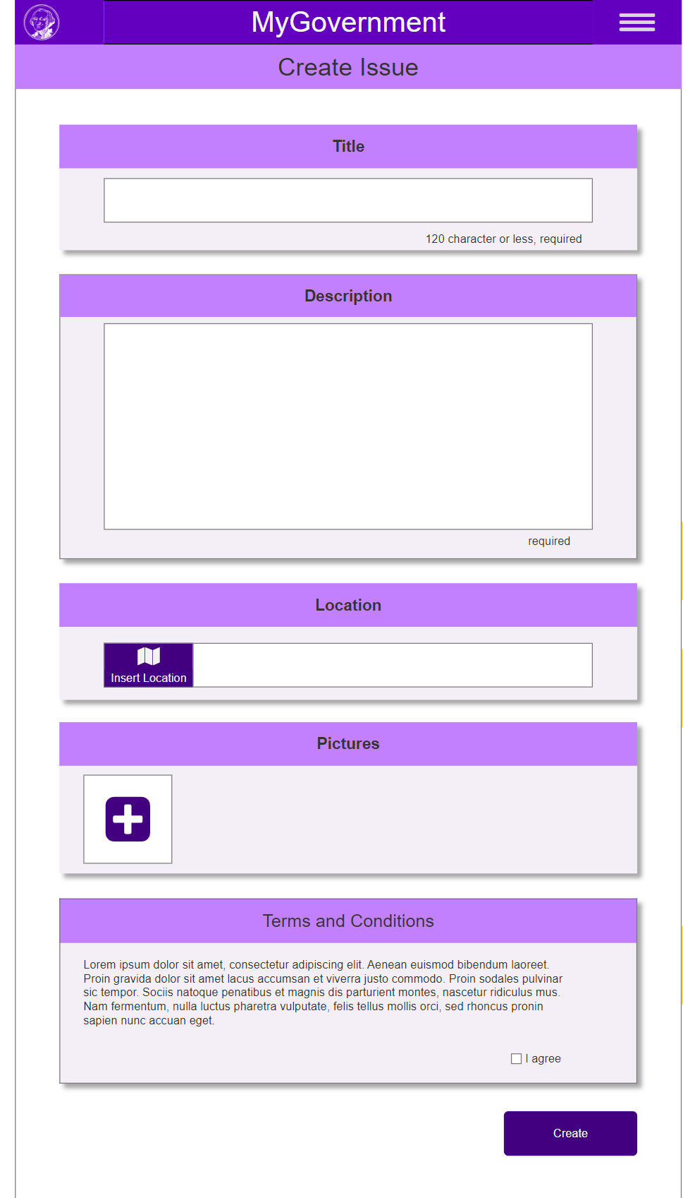
Create Issue
This view allows the user to create an issue.
The header simply has the title Create Header.
Edit Title Card : Allows the user to insert the issue’s title.
Edit Description Card : Allows the user to insert the issue’s description.
Edit Location Card : When the user clicks the Insert Location button, the user can use the map to select a location. When the location is selected, then they are taken back to the Create Issue view, maintaining the previous state.
Add Image Card : When the user presses the [+] button, then the user can upload an image.
Policy Card : Before posting an issue, the user needs to agree to the terms and conditions.
When the user clicks the Create button, then the issue is created with the status Active, and the user is redirected to the issue list view.

Slide 21
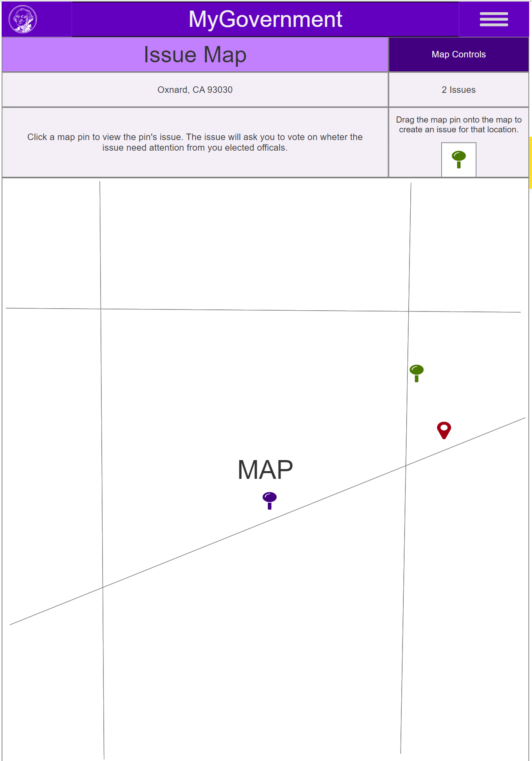
Issue Map
The issue map allows the user to view the various issues plotted on a map.
The header contains the title “Issue Map” and the Map Controls button.
When the user presses the Map Controls button, then the Map Control panel opens.
Info panel : The top left section contains the city, zip, and city that the map is currently focused on.
The top right section contains the number of issues that are in view.
The bottom left section contains info about using the map view.
The bottom right contains a pin that the user can user to create an issue.
When the user drags the pin to a location on the map, then the Create Issue view opens, with the location pre-populated in the Edit Location card.
On the map the user is provided a red marker to indicate their current location.
On the map a purple pin represents an issue filed by another user.
On the map a green pin represents an issue filed by the current user.
When the pin is clicked, then the Pin Title appears, and the Issue Panel appears covering up the Info panel.

Slide 22
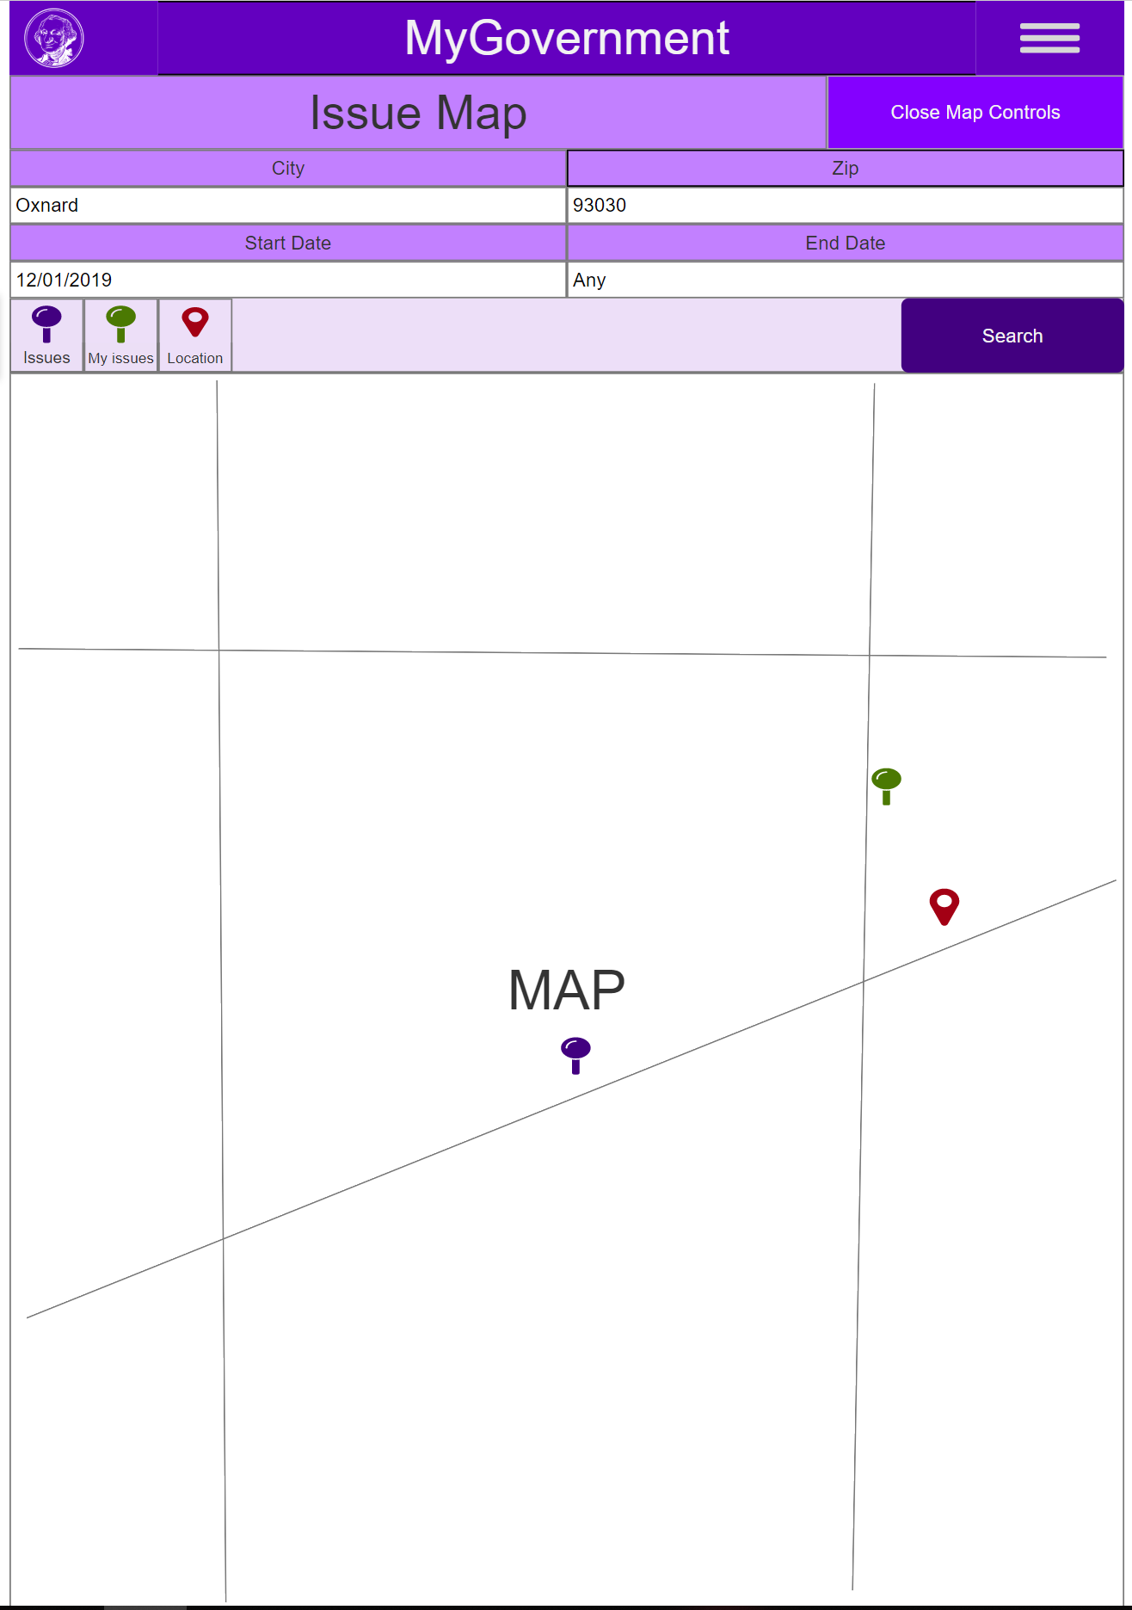
Issue Map – Controls
When the user clicks the Map Control button, then the Map Control panel replaces the Info panel.
The Map Control panel allows the user to adjust the location of the map, and the pins that appear. The user can provide a city name or zip code, to adjust the maps location, and show pins related to that location.
The user can also provide a start and end date, so that they only show pins created within a certain date range.
The user can enable/disable which pins and markers appear in the map. When the user clicks the Search button, then the map updates with the changes, and the Map Control panel closes.

Slide 23
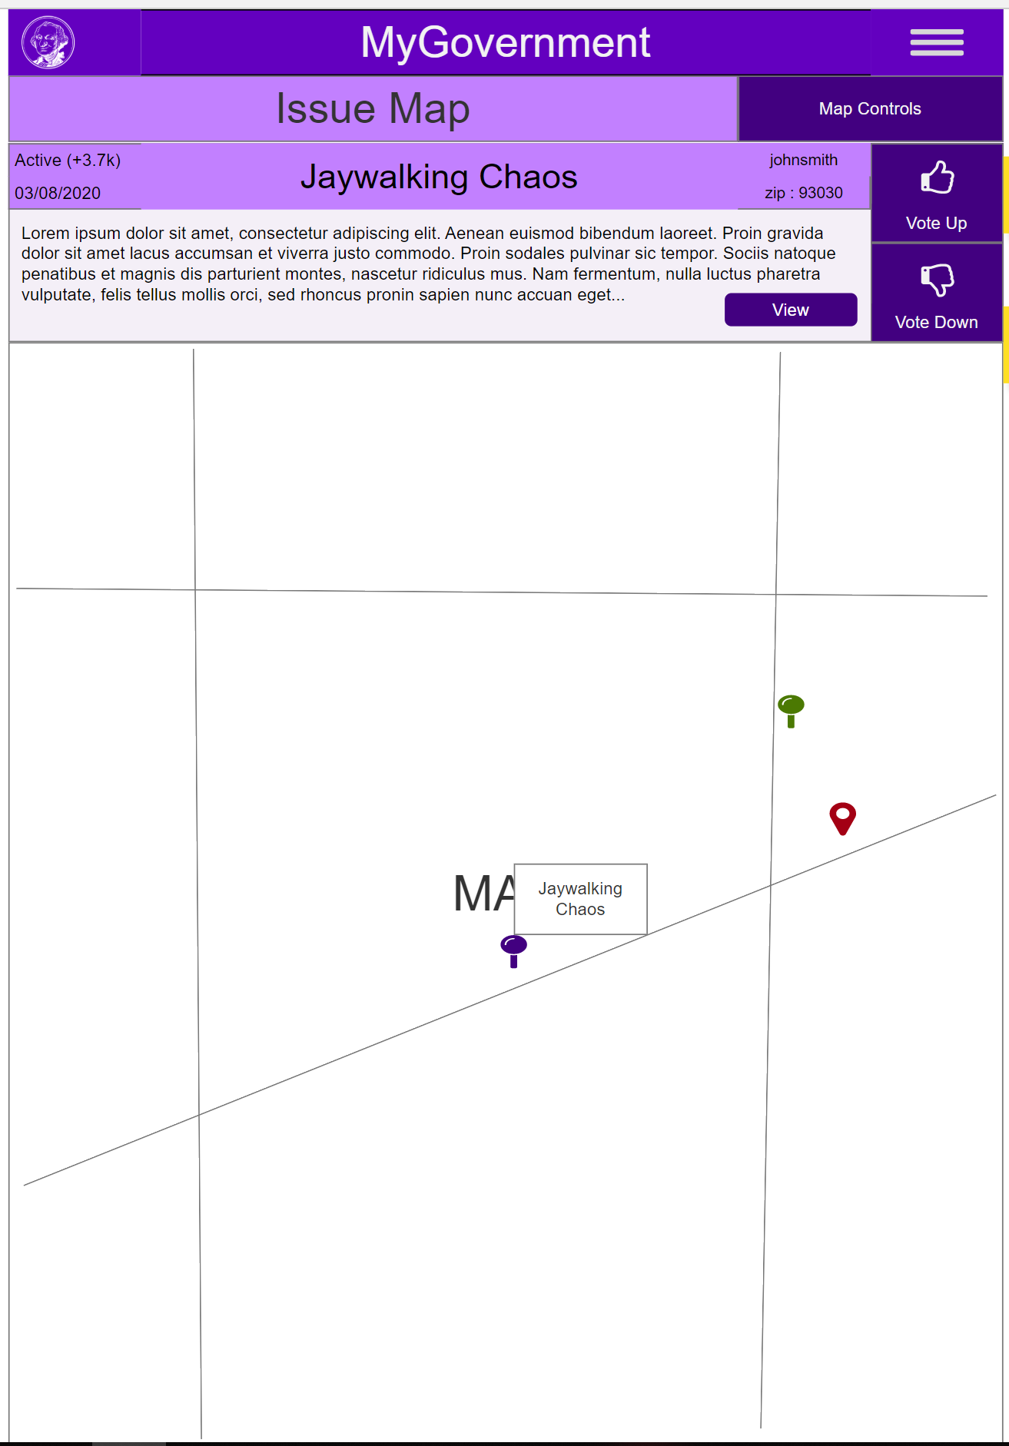
Issue Map Issue Selected
Issue belongs to another user
Issue belongs to current user
When the user clicks a pin, then the Pin Title tooltip appears, and the Issue panel appears on the Info panel.
Pin Title tooltip: This is a tooltip that appears next to the pin when it is selected. The tooltip contains the issues title.
The Issue panel is different when the issue belongs to the current user.
Issue panel Header : This contains the same information as the Issue Card header.
Issue panel Content : This contains the description of the issue. It also contains a View/Edit button. When the View/Edit button is clicked, then the user is taken to the View/Edit Issue view for the issue.
Issue panel Vote : This section is only present when the user does not own the issue. When the user clicks the Vote up/down button, then the issue’s vote total increments +/- 1. When the user clicks the selected pin, then the pin is unselected, and the Info panel appears again.

Slide 24
The End? Nope, now we repeat
After we finish evaluating the application, we now move back into the “Understand User’s Needs” stage and ask what do we need to do to improve the projects overall design.

