Slide 1
CSE 20 Discussion - Week 10
Review

Slide 2
Administrative Stuff
Project Part 3 due Thursday, December 2nd
Week 10 (Monday, Wednesday, Friday) Review Quiz due Friday, December 3rd
Final Exam
Detail on the website

Slide 3
Agenda
Overview
Practice Problems
Review Quiz Revisited

Slide 4
Representations of data and precise modes of communication
Data types (Week0and1 note: page 5-6)
Function (Week0and1 note: page 11)
Base b expansion and representing negative integers in binary (Week2 note: page 5-6)
Circuit (Week2note: page9)
Technical Skepticism
Condition statement and logical equivalences (Week3 note: page 5-6)
Predicate, quantifiers, universal/existential quantification (Week4 note: page 4-5)
Proving claims
Proof strategy (Week5 note: page 1-2; week7 note: page 10)
Induction (Week6 note: page 3,8 ; week 7 note: page 1)
Difference between structural and mathematical induction (Week6 Wednesday RQ2)
Difference between strong and mathematical induction (Week7 note: page 4, Monday RQ3)

Slide 5
Continue to use precise representations
Set, subset(Week0and1note: page7; Week5 note: page2)
Set operations, Power set (; Week5 note: page6)
Linked list (Week6 note: page 11)
Numbers
Greatest common divisor (Week7 note: page13)
Rational numbers, irrational numbers (Week7 note: page14-15)
Facts about numbers (Week5 note: page9, 11)
Factoring, even, odd, prime
Real numbers (Week8 note: page 14)

Slide 6
Cardinality
Well-defined functions (Week8 note: page 2-4)
One-to-one, onto, bijection
Properties, Categories (Week8 note: page 7, 11, 14-15)
Binary Relation
Definition and traits, Equivalence relation (Week9 note: page 1-4)
Equivalence class, partition (Week9 note: page 6)

Slide 7
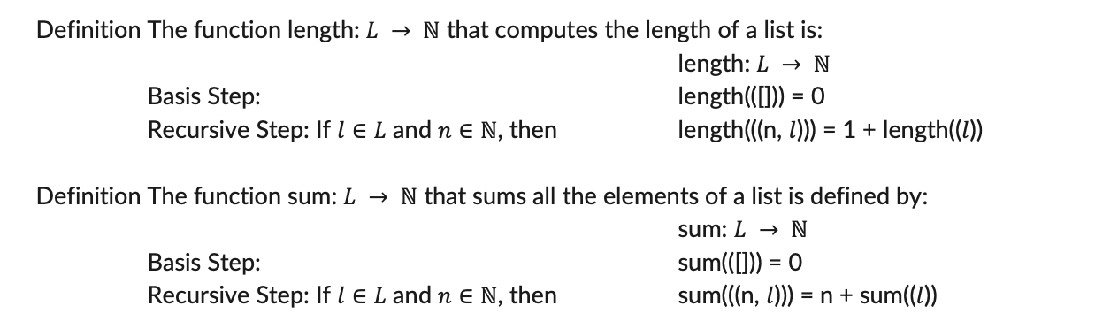
Definition The function length: $L → ℕ$ that computes the length of a list is:
length: $L → ℕ$
Basis Step: length(([])) = 0
Recursive Step: If $l∈L$ and $n∈ℕ$, then length(((n, $l$))) = 1 + length(($l$))
Definition The function sum: $L → ℕ$ that sums all the elements of a list is defined by:
sum: $L → ℕ$
Basis Step: sum(([])) = 0
Recursive Step: If $l∈L$ and $n∈ℕ$, then sum(((n, $l$))) = n + sum(($l$))

Slide 8

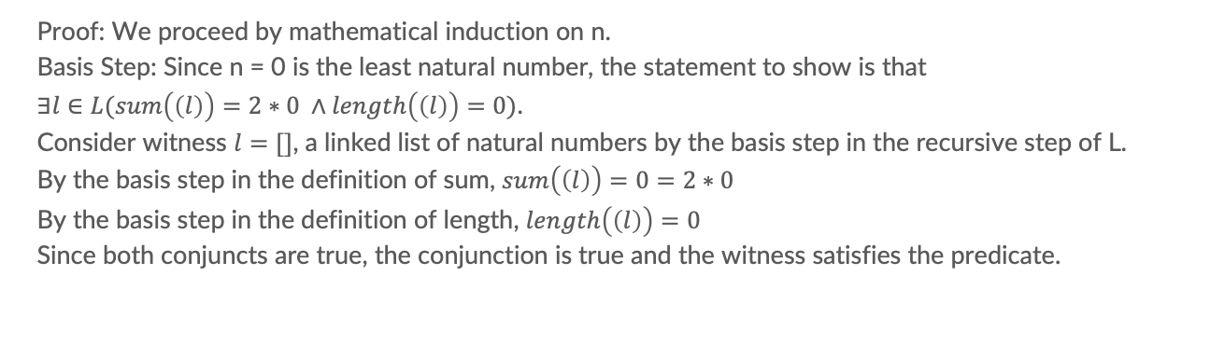
Problem 1
Use mathematical induction to prove following statement:
$$∀n∈ℕ∃l∈L(sum\left(\left(l\right)\right)=2n ∧length\left(\left(l\right)\right)=n)$$
Proof: We proceed by mathematical induction on n.
Basis Step: Since n = 0 is the least natural number, the statement to show is that
$∃l∈L(sum\left(\left(l\right)\right)=2∗0 ∧length\left(\left(l\right)\right)=0)$.
Consider witness $l=[]$, a linked list of natural numbers by the basis step in the recursive step of L.
By the basis step in the definition of sum, $sum\left(\left(l\right)\right)=0=2∗0$
By the basis step in the definition of length, $length\left(\left(l\right)\right)=0$
Since both conjuncts are true, the conjunction is true and the witness satisfies the predicate.

Slide 9

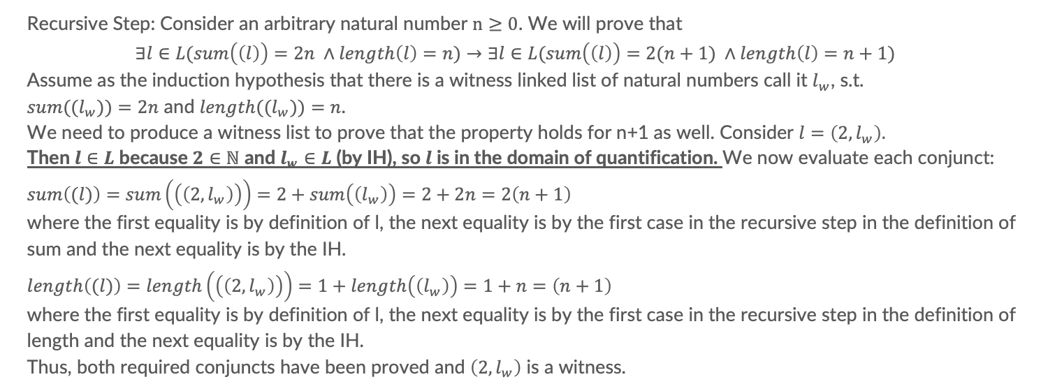
Problem 1
Use mathematical induction to prove following statement:
$$∀n∈ℕ∃l∈L(sum\left(\left(l\right)\right)=2n ∧length\left(\left(l\right)\right)=n)$$
Recursive Step: Consider an arbitrary natural number $n≥0$. We will prove that
$$∃l∈L(sum\left(\left(l\right)\right)=2n ∧length\left(l\right)=n)→∃l∈L(sum\left(\left(l\right)\right)=2(n+1) ∧length\left(l\right)=n+1)$$
Assume as the induction hypothesis that there is a witness linked list of natural numbers call it $l_{w}$, s.t.
${sum((l}_{w}))=2n$ and ${length((l}_{w}))=n$.
We need to produce a witness list to prove that the property holds for n+1 as well. Consider $l=\left(2,l_{w}\right).$
Then $l∈L$ because $2∈ℕ$ and $l_{w}∈L$ (by IH), so $l$ is in the domain of quantification. We now evaluate each conjunct:
$$sum\left((l)\right)=sum\left(\left(\left(2,l_{w}\right)\right)\right)=2+sum\left(\left(l_{w}\right)\right)=2+2n=2\left(n+1\right)$$
where the first equality is by definition of l, the next equality is by the first case in the recursive step in the definition of sum and the next equality is by the IH.
$$length\left((l)\right)=length\left(\left(\left(2,l_{w}\right)\right)\right)=1+length\left(\left(l_{w}\right)\right)=1+n=\left(n+1\right)$$
where the first equality is by definition of l, the next equality is by the first case in the recursive step in the definition of length and the next equality is by the IH.
Thus, both required conjuncts have been proved and $\left(2,l_{w}\right)$ is a witness.

Slide 10
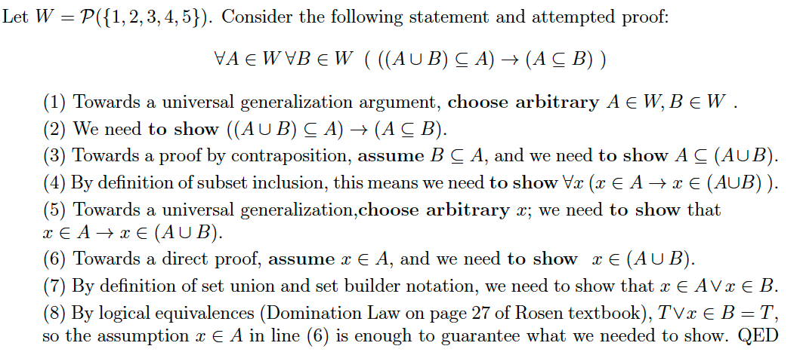
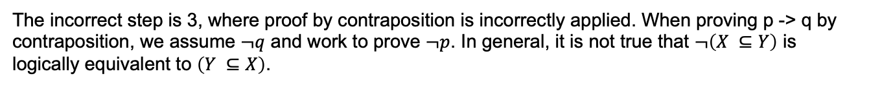
Problem2
Q: which step a definition or proof strategy is used incorrectly?
The incorrect step is 3, where proof by contraposition is incorrectly applied. When proving p -> q by contraposition, we assume $¬q$ and work to prove $¬p$. In general, it is not true that $¬\left(X ⊆Y\right)$ is logically equivalent to $\left(Y ⊆X\right)$.

Slide 11


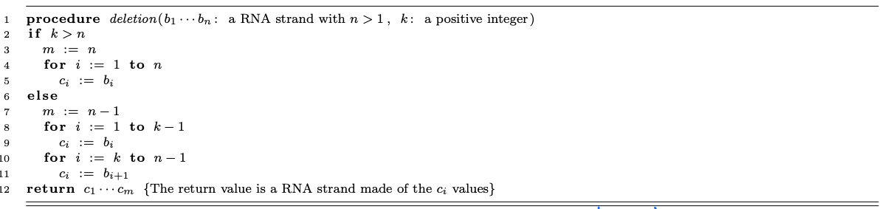
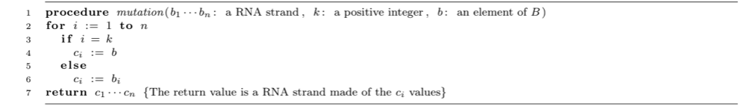
Problem3
Provide a witness which could be used to prove following existential quantification:
$$∃t∈S x S (Mut\left((t)\right)∧Del\left((t)\right))$$

Slide 12
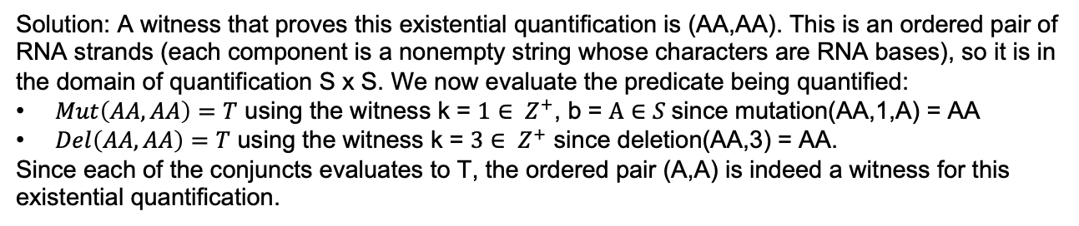
Problem3
Provide a witness which could be used to prove following existential quantification:
$$∃t∈S x S (Mut\left((t)\right)∧Del\left((t)\right))$$
Solution: A witness that proves this existential quantification is (AA,AA). This is an ordered pair of RNA strands (each component is a nonempty string whose characters are RNA bases), so it is in the domain of quantification S x S. We now evaluate the predicate being quantified:
$Mut\left(AA,AA\right)=T$ using the witness k = $1∈ Z^{+}$, b = $A∈S$since mutation(AA,1,A) = AA
$Del\left(AA,AA\right)=T$ using the witness k = $3∈ Z^{+}$ since deletion(AA,3) = AA.
Since each of the conjuncts evaluates to T, the ordered pair (A,A) is indeed a witness for this existential quantification.

Slide 13
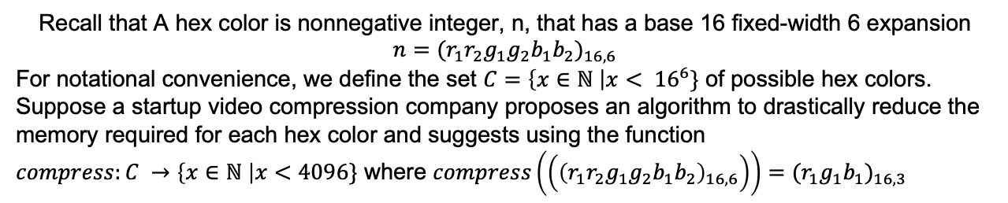
Problem4
Recall that A hex color is nonnegative integer, n, that has a base 16 fixed-width 6 expansion $n{=(r_{1}r_{2}g_{1}g_{2}b_{1}b_{2})}_{16,6}$
For notational convenience, we define the set $C=\left\{x∈ℕ \right|x< {16}^{6}\}$ of possible hex colors.
Suppose a startup video compression company proposes an algorithm to drastically reduce the memory required for each hex color and suggests using the function
$compress:C →\left\{x∈ℕ \right|x<4096\}$ where $compress\left(\left({\left(r_{1}r_{2}g_{1}g_{2}b_{1}b_{2}\right)}_{16,6}\right)\right){=(r_{1}g_{1}b_{1})}_{16,3}$
Q1: Is compress one-to-one?
Q2: Is compress onto?

Slide 14
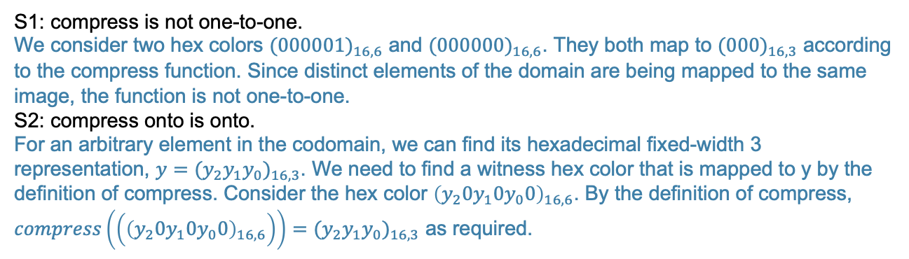
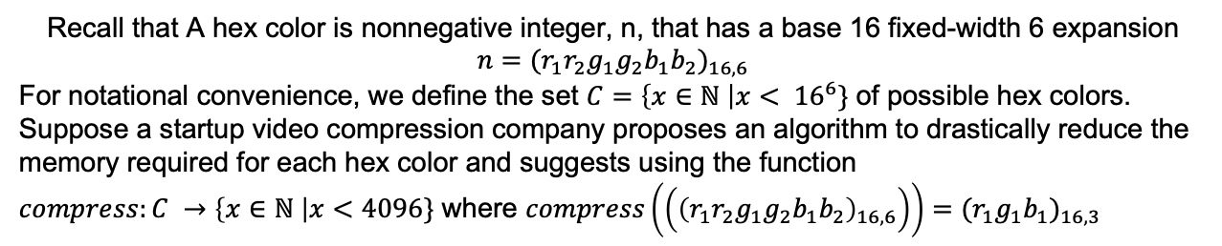
Problem 4
Recall that A hex color is nonnegative integer, n, that has a base 16 fixed-width 6 expansion $n{=(r_{1}r_{2}g_{1}g_{2}b_{1}b_{2})}_{16,6}$
For notational convenience, we define the set $C=\left\{x∈ℕ \right|x< {16}^{6}\}$ of possible hex colors.
Suppose a startup video compression company proposes an algorithm to drastically reduce the memory required for each hex color and suggests using the function
$compress:C →\left\{x∈ℕ \right|x<4096\}$ where $compress\left(\left({\left(r_{1}r_{2}g_{1}g_{2}b_{1}b_{2}\right)}_{16,6}\right)\right){=(r_{1}g_{1}b_{1})}_{16,3}$
S1: compress is not one-to-one.
We consider two hex colors ${(000001)}_{16,6}$ and ${(000000)}_{16,6}$. They both map to ${(000)}_{16,3}$ according to the compress function. Since distinct elements of the domain are being mapped to the same image, the function is not one-to-one.
S2: compress onto is onto.
For an arbitrary element in the codomain, we can find its hexadecimal fixed-width 3 representation, $y{=(y_{2}y_{1}y_{0})}_{16,3}$. We need to find a witness hex color that is mapped to y by the definition of compress. Consider the hex color ${\left(y_{2}{0y}_{1}0y_{0}0\right)}_{16,6}$. By the definition of compress,
$compress\left(\left({\left(y_{2}{0y}_{1}0y_{0}0\right)}_{16,6}\right)\right){=(y_{2}y_{1}y_{0})}_{16,3}$ as required.

Slide 15
Extra Problem
A shade of gray is one where the red component, green component, and blue component all have the same color. To convert a color to grayscale, we can average its three component values and use this average as the grayscaled color’s red component, green component, and blue component. Fill in the blanks in the following definition of the function
grayscale by specifying its domain, codomain, and the rule for application.
Restriction: your expression for the rule may use only n, constant integers, and the operations +(addition), -(subtraction), *(multiplication), div(integer division), and mod(remainder).
grayscale: ______________ $→$ ___________________
where, for each $c∈________________________$,
grayscale(c) =
For notation convenience, we define the set C = $\left\{x∈ℕ \right|x< {16}^{6}\}$, a set of possible hex colors.

Slide 16
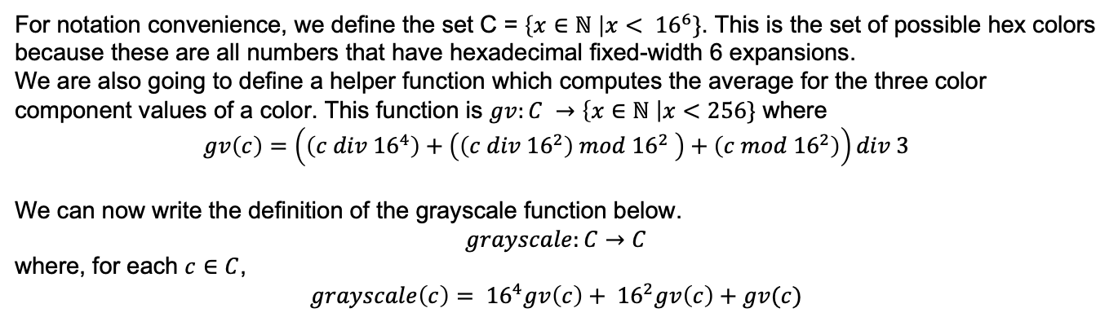
For notation convenience, we define the set C = $\left\{x∈ℕ \right|x< {16}^{6}\}$. This is the set of possible hex colors because these are all numbers that have hexadecimal fixed-width 6 expansions.
We are also going to define a helper function which computes the average for the three color component values of a color. This function is $gv:C →\left\{x∈ℕ \right|x<256\}$ where
$$gv\left(c\right)=\left(\left(c div {16}^{4}\right)+\left(\left(c div {16}^{2}\right) mod {16}^{2} \right)+\left(c mod {16}^{2}\right)\right)div 3$$
We can now write the definition of the grayscale function below.
$$grayscale:C→C$$
where, for each $c∈C$,
$$grayscale\left(c\right)= {16}^{4}gv\left(c\right)+ {16}^{2}gv\left(c\right)+gv(c)$$

Slide 17
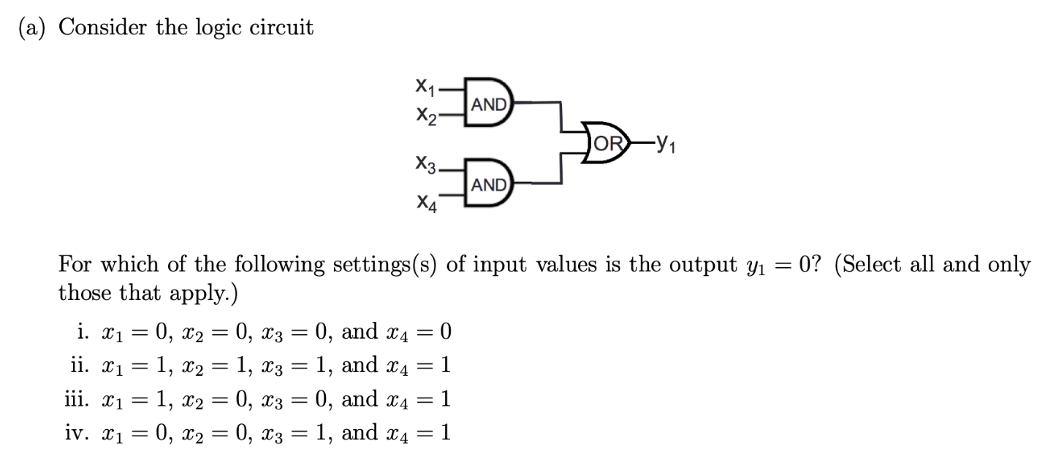
Logic Circuits

Slide 18
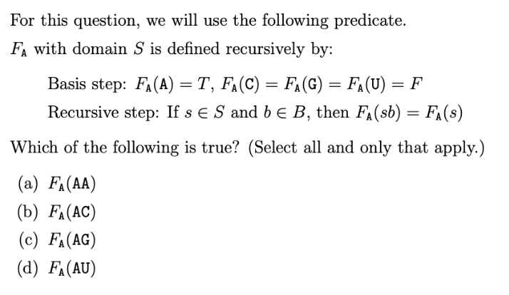
Predicate problem

Slide 19
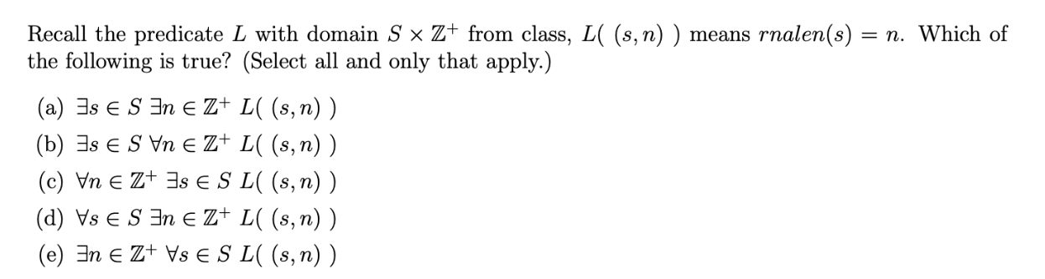
Problem 2

Slide 20

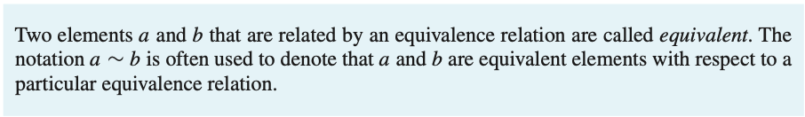
Equivalence Relation

Slide 21
Problem 1
Consider the following relation on the set of real numbers: $R=\left\{\left(a,b\right)\right| (a−b)∈ℤ\}$.
Is R an equivalence relation?

Slide 22
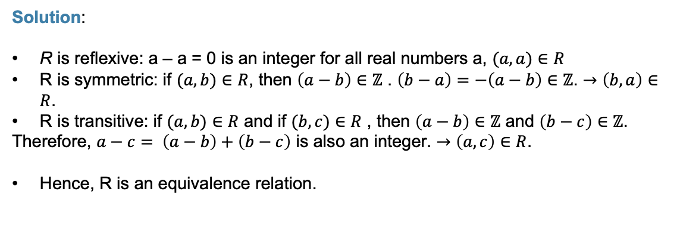
Problem 1
Consider the following relation on the set of real numbers: $R=\left\{\left(a,b\right)\right| (a−b)∈ℤ\}$.
Is R an equivalence relation?
Solution:
R is reflexive: a – a = 0 is an integer for all real numbers a, $(a,a)∈R$
R is symmetric: if $(a,b)∈R$, then $\left(a−b\right)∈ℤ$ . $\left(b−a\right)=−\left(a−b\right)∈ℤ$. $→\left(b,a\right)∈R$.
R is transitive: if $(a,b)∈R$ and if $(b,c)∈R$ , then $\left(a−b\right)∈ℤ$ and $\left(b−c\right)∈ℤ$.
Therefore, $a−c= \left(a−b\right)+\left(b−c\right)$ is also an integer. $→\left(a,c\right)∈R$.
Hence, R is an equivalence relation.

