Slide 1
High Standards, Multiple Tries How I’ve Been Grading
Joe Gibbs Politz University of California San Diego
Illinois Computer Science Summer Teaching Workshop 2024
jpolitz@ucsd.edu @joepolitz https://jpolitz.github.io

Slide 2
Context – Courses
Senior/grad: Compilers
Sophomore/junior: Software Engineering, Advanced Data Structures, Systems Programming
Freshman: (Accel) Intro Programming, Data Structures, Discrete Math, Software Tools

Slide 3

Context – Software Tools & Techniques 2021-2023
git
ssh
UNIX command line
Using a debugger
Testing tools
Build scripts
Continuous integration
Code review
In this course, we'll explore a number of Software Tools & Techniques that are used commonly by developers in their day-to-day work. You'll learn how to manage files and programs from the command line, and you'll get direct practice (and build muscle memory!) with keyboard shortcuts, tricks, and techniques for managing data and programs. Throughout, you'll exercise and improve your skills in program understanding and debugging.
Major Course Components
Students
2 hour in-person lab
Lab reports Main assignment type, a mix of code and prose in blog post style
“Exams” (more on this later)
Taken in first year (but not in fall) for 1st years
Taken in fall as first course for CC transfers
Offered every quarter
~400 students/offering
My Reflections on Kemi’s Roles

Slide 4
Insights from my Gmail
Disclaimer 1: These made-up emails are works of fiction. Any resemblance to actual emails or student posts, in your inbox or mine, is entirely predictable coincidental.
Disclaimer 2: These examples are not opportunities to roll our eyes or mock the students (or professors) who sent them.

Slide 5
The day after a deadline

Slide 6
Working from Car <car-hustle@ucsd.edu> Nov 3, 2023, 11:52pm
to Joe Gibbs Politz <jpolitz@ucsd.edu>▾
Mr. Politz,
I’m writing to request that I be allowed to resubmit the most recent assignment.
I don’t have WiFi at home, so I’ve been driving over to the Starbucks nearby (they’re closed at night but their WiFi is still on) to do my work and submit my assignments. Unfortunately, that parking lot is under construction this week so I wasn’t able to get close enough to get a signal. I’m sending this from my phone hoping you can help accommodate.
Sincerely,
Working from Car
Dad to ER <family-guy@ucsd.edu> Nov 4, 2023, 4:23am
to Joe Gibbs Politz <jpolitz@ucsd.edu>▾
Professor, yesterday unfortunately my dad had a medical emergency and I had to rush him to the ER.
I was unable to submit the assignment and was hoping for an extension.
Just Missed It <oops@ucsd.edu> Nov 4, 2023, 9:04am
to Joe Gibbs Politz <jpolitz@ucsd.edu>▾
Professor, I’m not sure how but I completely spaced out the deadline for the assignment last night. I really need to pass this class. Is there any way that I can still submit it and not get a 0?
Submission Broken <cant-submit@ucsd.edu> Nov 4, 2023, 9:45am
to Joe Gibbs Politz <jpolitz@ucsd.edu>▾
Professor,
When I went to upload the assignment to Gradescope last night it was broken and wouldn’t accept the upload.
Can I please submit it late since it’s not my fault that Gradescope wasn’t working?
Arm Broken <arm-broken@ucsd.edu> Nov 4, 2023, 2:00pm
to Joe Gibbs Politz <jpolitz@ucsd.edu>▾
Professor,
I broke my arm yesterday when some one on a scooter hit me on my way home from class.
I was in the ER and didn’t get a chance to submit the assignment – can I get an extension?\
Very Sick <just-sick@ucsd.edu> Nov 4, 2023, 3:01pm
to Joe Gibbs Politz <jpolitz@ucsd.edu>▾
Professor,
I was vomiting all day yesterday and fatigued and had a fever, this has lasted all day today as well. Can I submit the assignment late?
Quick! Respond to each of these students compassionately and with an appropriate resolution.

Slide 7
Working from Car <car-hustle@ucsd.edu> Nov 3, 2023, 11:52pm
to Joe Gibbs Politz <jpolitz@ucsd.edu>▾
Mr. Politz,
I’m writing to request that I be allowed to resubmit the most recent assignment.
I don’t have WiFi at home, so I’ve been driving over to the Starbucks nearby (they’re closed at night but their WiFi is still on) to do my work and submit my assignments. Unfortunately, that parking lot is under construction this week so I wasn’t able to get close enough to get a signal. I’m sending this from my phone hoping you can help accommodate.
Sincerely,
Working from Car
Dad to ER <family-guy@ucsd.edu> Nov 4, 2023, 4:23am
to Joe Gibbs Politz <jpolitz@ucsd.edu>▾
Professor, yesterday unfortunately my dad had a medical emergency and I had to rush him to the ER.
I was unable to submit the assignment and was hoping for an extension.
Just Missed It <oops@ucsd.edu> Nov 4, 2023, 9:04am
to Joe Gibbs Politz <jpolitz@ucsd.edu>▾
Professor, I’m not sure how but I completely spaced out the deadline for the assignment last night. I really need to pass this class. Is there any way that I can still submit it and not get a 0?
Submission Broken <cant-submit@ucsd.edu> Nov 4, 2023, 9:45am
to Joe Gibbs Politz <jpolitz@ucsd.edu>▾
Professor,
When I went to upload the assignment to Gradescope last night it was broken and wouldn’t accept the upload.
Can I please submit it late since it’s not my fault that Gradescope wasn’t working?
Arm Broken <arm-broken@ucsd.edu> Nov 4, 2023, 2:00pm
to Joe Gibbs Politz <jpolitz@ucsd.edu>▾
Professor,
I broke my arm yesterday when some one on a scooter hit me on my way home from class.
I was in the ER and didn’t get a chance to submit the assignment – can I get an extension?\
Very Sick <just-sick@ucsd.edu> Nov 4, 2023, 3:01pm
to Joe Gibbs Politz <jpolitz@ucsd.edu>▾
Professor,
I was vomiting all day yesterday and fatigued and had a fever, this has lasted all day today as well. Can I submit the assignment late?
Who “deserves” an extension? Is breaking an arm “bad enough” but getting sick isn’t? How sick were they really? Should we verify? How much extension? 1 day? 2 days?

Slide 8
No Java <no-java@uxx.edu> Nov 4, 2023, 5:55pm
to Joe Gibbs Politz <jpolitz@ucsd.edu>▾
Professor Joe,
I went to XYZ community college and they didn’t teach Java there. As a result, I really struggled with the assignment that was due last night. I submitted my best effort, but I know it didn’t work on most of the examples.
I’m sure with more time that I could study more Java and do a much better job (thanks for the resources you provided on the course message board – it just takes a long time to get through them all!)
Rushed <rushed@uxx.edu> Nov 4, 2023, 6:50pm
to Joe Gibbs Politz <jpolitz@ucsd.edu>▾
Hi Joe,
I really didn’t manage my time well this week and I ended up rushing a lot when finishing the assignment. What I submitted wasn’t my best work; I know if I had a little more time I could do a lot better. Is there any way I could get an extension?
Who “deserves” an extension? Learning is a good reason for an extension too, right?

Slide 9

Forgot Java <forgot-java@uxx.edu> (draft) Nov 4, 2023, 5:55pm
to Joe Gibbs Politz <jpolitz@ucsd.edu>▾
Professor Joe,
I took the prerequisite for this over a year ago and basically forgot everything about Java.
I’m sure with more time that I could study more Java and do a much better job.
I don’t feel good about reaching out about this so I’m not actually going to send this email, though.
Realized Later <rushed@uxx.edu> (draft) Nov 7, 2023, 6:50pm
to Joe Gibbs Politz <jpolitz@ucsd.edu>▾
I realized a few days later that I completely misunderstood part of the assignment description.
As a result I got a really low score, even though I have the ability to get it right! Frustrating!
I don’t feel good about reaching out about this so I’m not actually going to send this email, though.
Specifically, working-class parents stressed "no-excuses" problem-solving, encouraging children to respect teachers' authority by not seeking help.
Middle-class parents instead taught "by-any-means" problem-solving, urging children to negotiate with teachers for assistance.”
— J. Calarco, “Coached for the Classroom: Parents' Cultural Transmission and Children's Reproduction of Educational Inequalities”

Slide 10
All students get a resubmission chance on each assignment.
Students who miss the deadline for any reason can resubmit and can still get TA help.
Joe Gibbs Politz <jpolitz@ucsd.edu> Nov 4, 2023, 3:01pm
to Very Sick <very-sick@ucsd.edu>▾
Very Sick, I’m so sorry to hear you were sick the past few days. You may already know this, but the campus resources for health care are here and here.
Regarding the extension, you can submit the assignment at the resubmission deadline in 2 weeks (this is the policy for all late submissions). Please do come to office hours with questions or for help with your resubmission (calendar here).
Students who submitted on time can use grading feedback for resubmission.

Slide 11
All students get a resubmission chance on each assignment.
Students who submitted on time can use grading feedback for resubmission.
(Sort of like one round of mastery learning.)
Cohen, Steele, and Ross: “wise interventions” that both “invoke high standards and assure students of their capacity to reach those standards” shown to improve outcomes + responses of students who would otherwise believe criticism came from bias/suffer from stereotype threat.
The Mentor’s Dilemma: Providing Critical Feedback Across the Racial Divide, 1999

Slide 12
All students get a resubmission chance on each assignment.
Week 1
Week 2
Week 3
Week 4
Week 5
Assignment 1 due
Assignment 1
grades returned
Talk it up in class!
Assignment 1
resubmits due
Assignment 2 due
Assignment 2
grades returned
If you don’t get a full score on the lab report, you’re in good company! A large portion of the class did not! Please pay attention to the feedback and address it in the resubmission to make your work excellent.
Week 6
Week 7
Week 8
Week 9
Week 10
Assignment 2
resubmits due
Assignment 3 due
Assignment 3
grades returned
Assignment 3
resubmits due
Assignment 4 due
Assignment 4
grades returned
Assignment 4
resubmits due
Assignment 5 due

Slide 13
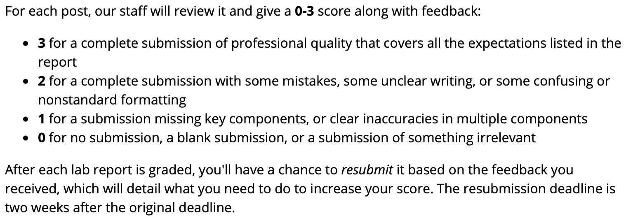
All students get a resubmission chance on each assignment.
But isn’t that twice as much grading?!
Yes, but: we use coarse rubrics while promoting specific feedback from TAs.

Slide 14
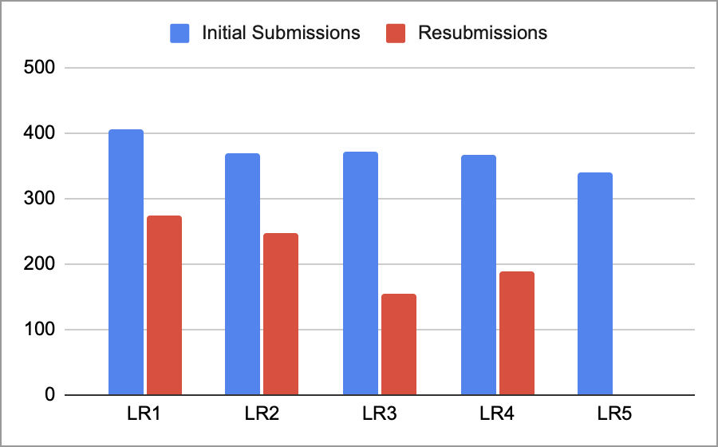
All students get a resubmission chance on each assignment.

Slide 15

Concerned Senior Colleague <erudite@uxx.edu> May 20, 2023, 9:06am
to AllCSFaculty▾
Colleagues,
I’m concerned about some student questions I’m getting in my upper division machine learning/computer graphics/distributed systems course. Numerous students are posting on the course message board with basic questions about calculus/using Makefiles/managing code with git.
I’d like to have a discussion about what’s going on in [courses that Joe teaches] in the lower division, where I believe students should be getting this basic preparation.
…
But sometimes (like when I’m teaching compilers), I am the concerned senior colleague…

Slide 16
CSE15L – Software Tools and Techniques Laboratory
Hands-on exploration of software development tools and techniques. Investigation of the scientific process as applied to software development and debugging. Emphasis is on weekly hands-on laboratory experiences, development of laboratory notebooking techniques as applied to software design.
Course Outcomes
git
ssh
UNIX command line
Using a debugger
Writing tests
Build scripts
Continuous integration
Code review

Slide 17
CSE15L – Software Tools and Techniques Laboratory
Hands-on exploration of software development tools and techniques. Investigation of the scientific process as applied to software development and debugging. Emphasis is on weekly hands-on laboratory experiences, development of laboratory notebooking techniques as applied to software design.
Course Outcomes
Topics
git
ssh
UNIX command line
Using a debugger
Writing tests
Build scripts
Continuous integration
Code review
Course Outcomes
Students will be able to on their own (e.g. not with a TA over their shoulder)…
clone a public git repository
add a unit test to an existing project
locate and change into a directory and run its build script, given a README
log into a ssh session given a username and password
copy files to and from a remote computer
print out the value of a variable in a deeply nested loop using a debugger
make an edit to a file, rebuild a project, and push the change from the command line
…

Slide 18
What do I know about outcomes for my students?
Do the assignments tell me?
I don’t think so!
(Undetectable) collaboration with other students
TAs “give away” answers (by design or not)
LLMs

Slide 19
(Undetectable) collaboration with other students
TAs “give away” answers (by design or not)
LLMs
These are not bad things! I want them to happen!
They are (can be) good for learning.
But they are confounds for assessment.

Slide 20
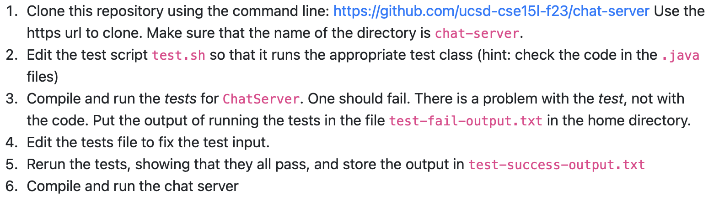
High Standards assessments targeted at outcomes
“Skill Demonstration”:
20 minute proctored, timed, on-computer assessment
Specific task list based on activities from lab and assignments
Similar practice tasks provided in advance

Slide 21
High Standards assessments targeted at outcomes
Again, coarse rubrics for Skill Demonstrations:
“Full Pass” – All the steps completed
“Partial Pass” – Most steps completed, usually all of the provided practice steps
“No Pass Yet” – Less than that (e.g. no partial credit for just getting started)

Slide 22
High Standards assessments targeted at outcomes
Even if you get a No Pass tomorrow, it has no permanent impact on your grade. So treat it as an opportunity to show your best try.
Week 1
Week 2
Week 3
Week 4
Week 5
Assignment 1 due
Assignment 1
grades returned
Talk it up in class!
Assignment 1
resubmits due
Assignment 2 due
Assignment 2
grades returned
Skill Demo 1
Skill Demo 2
Week 6
Week 7
Week 8
Week 9
Week 10
Assignment 2
resubmits due
Assignment 3 due
Assignment 3
grades returned
Assignment 3
resubmits due
Assignment 4 due
Assignment 4
grades returned
Assignment 4
resubmits due
Assignment 5 due
Skill Demo 3
Skill Demo 4

Slide 23
High Standards assessments targeted at outcomes
Week 1
Week 2
Week 3
Week 4
Week 5
Assignment 1 due
Assignment 1
grades returned
Talk it up in class!
Assignment 1
resubmits due
Assignment 2 due
Assignment 2
grades returned
Skill Demo 1
Skill Demo 2
Week 6
Week 7
Week 8
Week 9
Week 10
Exam Week
Assignment 2
resubmits due
Assignment 3 due
Assignment 3
grades returned
Assignment 3
resubmits due
Assignment 4 due
Assignment 4
grades returned
Assignment 4
resubmits due
Assignment 5 due
Retries for:
Skill Demo 1
Skill Demo 2
Skill Demo 3
Skill Demo 3
Skill Demo 4
Skill Demo 4

Slide 24
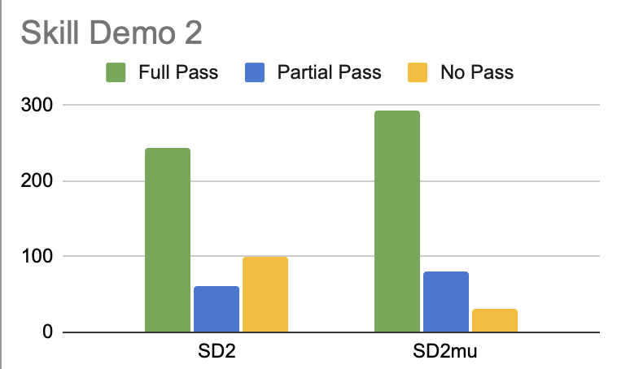
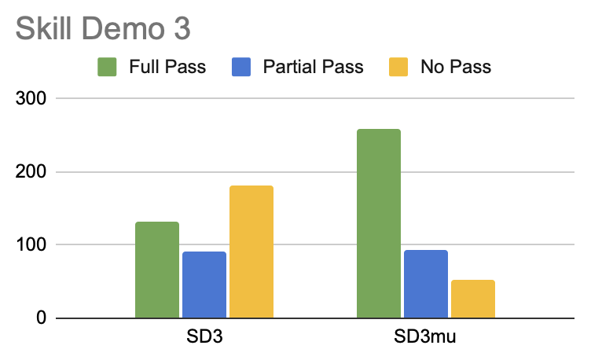
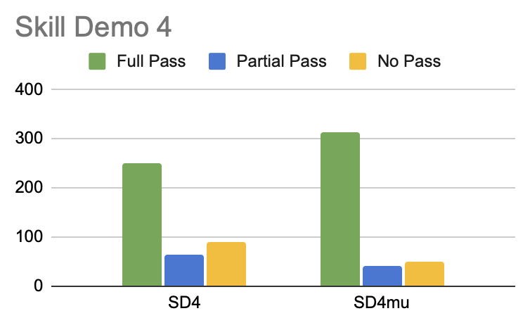
High Standards assessments targeted at outcomes

Slide 25
Putting it all together – student messaging
Even if you get a No Pass tomorrow, it has no permanent impact on your grade. So treat it as an opportunity to show your best try.
Advice – do not give an assessment that 1/3 of the class will “fail” without messaging a lot—I mean a lot—about it!
It is totally normal in this class to take more than one try at these assessments. They are designed to have very high standards that we want you to reach, not necessarily on your first try!
If you don’t get a 3/3 on the lab report, you’re in good company! A large portion of the class did not as well. Please pay attention to the feedback and address it in the resubmission so you can understand the standards for professional writing.

Slide 26
Putting it all together – course grades
Assignments 40%
Exams 40%
Lab Attendance
20%
Assignments 40/40
Exams 20/40
Attendance 20/20
80%
(Undetectable) collaboration with other students
TAs “give away” answers
LLMs

Slide 27
Putting it all together – course grades
Assignments 40%
Exams 40%
Lab Attendance
20%
Assignments 40/40
Exams 40/40
Attendance
0/20
80%
No engagement at all with community/group work?

Slide 28
Putting it all together – course grades
Exams 80%
Other stuff 20%
Disincentives doing the assignments and doing group work in lab!

Slide 29
Putting it all together – course grades
Assignments 40%
Exams 40%
Lab Attendance
20%
Exams 80%
Other stuff 20%
F
C
B
A
Each category has cutoffs, need A/B/C level across all categories for that grade.
All course activities are incentivized and have high standards, all give multiple tries.
Assignments
Exams
Participation

Slide 30
Putting it all together – course grades
Assignments 40%
Exams 40%
Lab Attendance
20%
Exams 80%
Other stuff 20%
F
C
B
A
Each category has cutoffs, need A/B/C level across all categories for that grade.
All course activities are incentivized and have high standards, all give multiple tries.
Assignments
Exams
Final grade: B
Participation

Slide 31
Putting it all together – course grades
Assignments 40%
Exams 40%
Lab Attendance
20%
Exams 80%
Other stuff 20%
F
C
B
A
Each category has cutoffs, need A/B/C level across all categories for that grade.
All course activities are incentivized and have high standards, all give multiple tries.
Assignments
Exams
Final grade: C
Participation

Slide 32
Putting it all together – course grades
Assignments 40%
Exams 40%
Lab Attendance
20%
Exams 80%
Other stuff 20%
F
C
B
A
Each category has cutoffs, need A/B/C level across all categories for that grade.
All course activities are incentivized and have high standards, all give multiple tries.
Assignments
Exams
Final grade: A
Participation

Slide 33
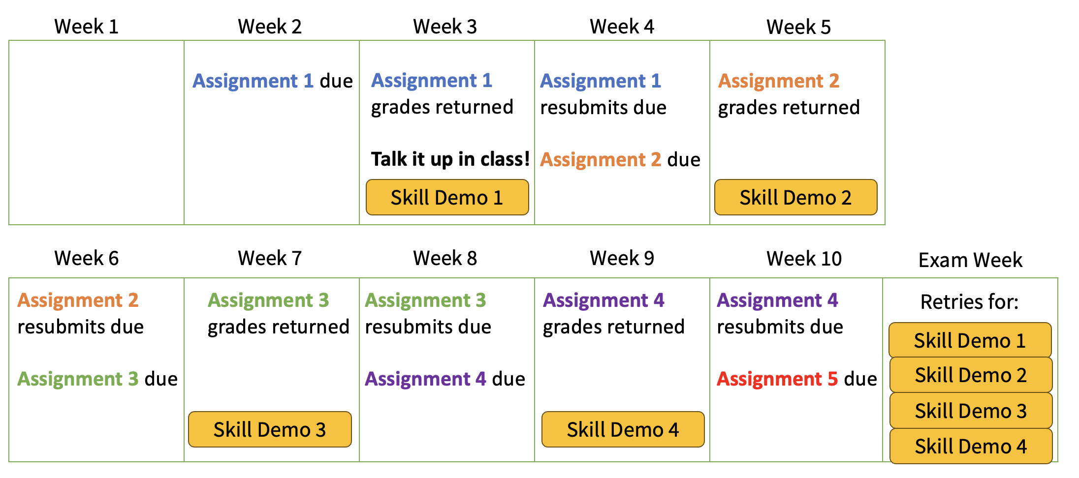
jpolitz@ucsd.edu
@joepolitz
https://jpolitz.github.io
Even if you get a No Pass tomorrow, it has no permanent impact on your grade. So treat it as an opportunity to show your best try.
F
C
B
A
Assignments
Exams
Participation

Slide 35
