Slide 1


Drury Explorer
Daniel Chick, Daiv McBride, Josef Polodna

Slide 2
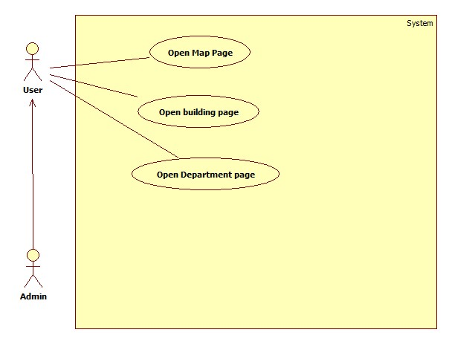
Use Case & Non-Functional Requirements
Have the map open to Drury
Have a correct list of buildings
Have a correct list of departments

Slide 3
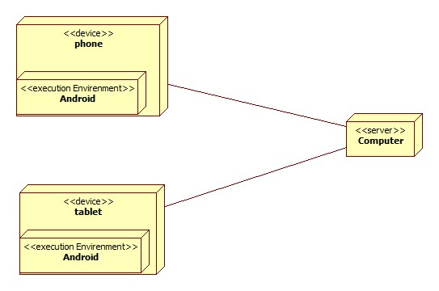
Deployment Diagram

Slide 4
Tech Plan
Android Studio
SQLite
Josef P
MySQL
PHP
Daniel C and Josef P
Google Maps (Research)
Group
Daiv

Slide 5
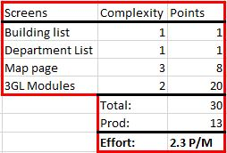
Cost Analysis

Slide 6
Risk Analysis
Android Studio is in Beta and may be buggy or lack features we need.
Google doesn’t have many tutorials for android studio, most tutorials are for Eclipse.
We need to learn Android architecture.
Map plugins may or may not be what we need.
We are students and each of us work a lot.

Slide 7
Mitigation Strategies
We can use Eclipse for features that AS may not have.
Find tutorials by developers rather than Google.
If we have problems with the map and Sprint 1 is nearly done, we will stop and work on pages.
Dedicate ALL FREE TIME to this project!

Slide 8

Sprint 1 - Elaboration Plan
Daiv
Refined use case and class diagram
Daniel
Sequence Diagram and component diagram
Josef
Test app construction
Updated Deployment Diagram

