Slide 1


Drury Explorer
Developed by: Daniel Chick, Josef Polodna, Daiv McBride

Slide 2
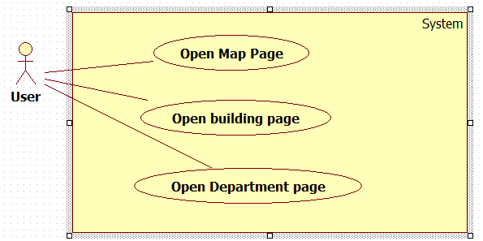
Use Case

Slide 3
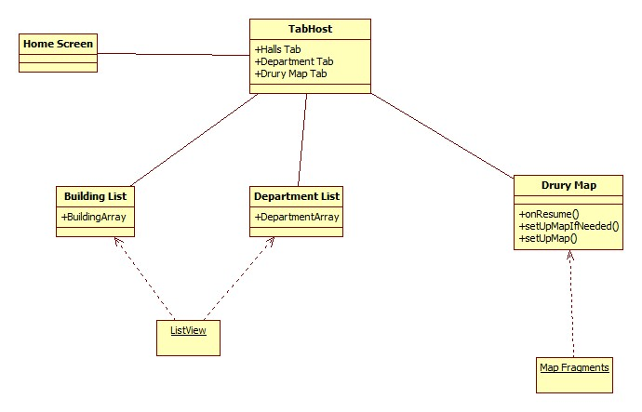
Class Diagram

Slide 4
Risk Analysis
Android Studio being in beta has not been an issue.
Despite lack of AS tutorials, Eclipse tutorials have been alright.
Android architecture isn't too difficult.
We don't need map plugins, using only the API provided.
Despite being students, we have been able to get everything desired accomplished.
SQLite is a tentative risk given Sprint 1
Google maps not providing every desired function

Slide 5
Technology Plan
Android Studio
Google Maps
SQLite

Slide 6
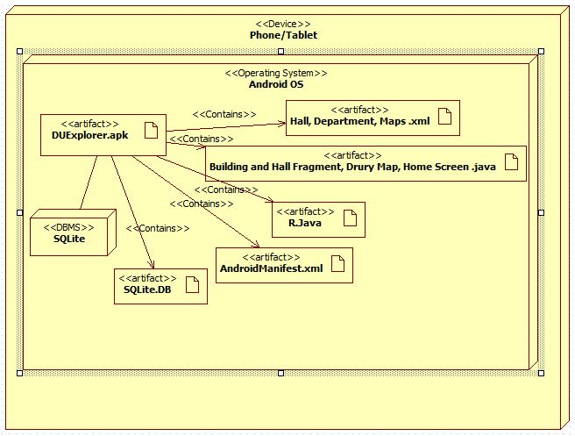
Deployment Diagram

Slide 7
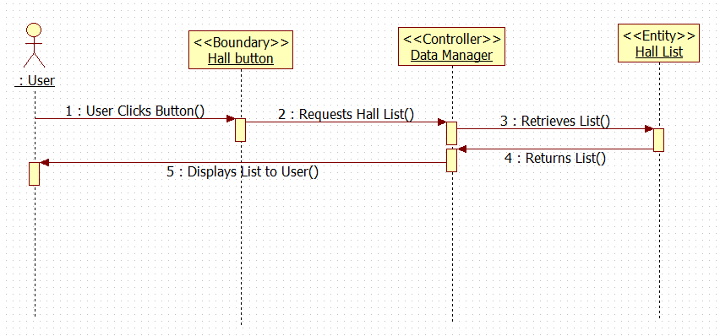
Sequence Diagram

Slide 8
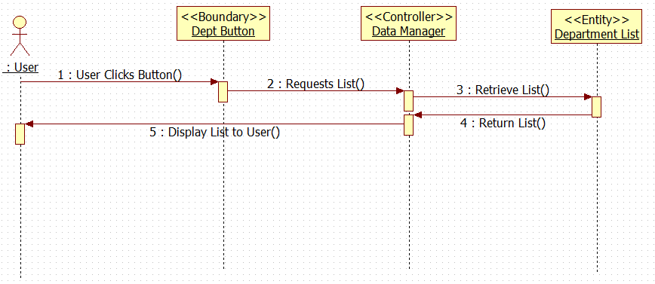

Slide 9
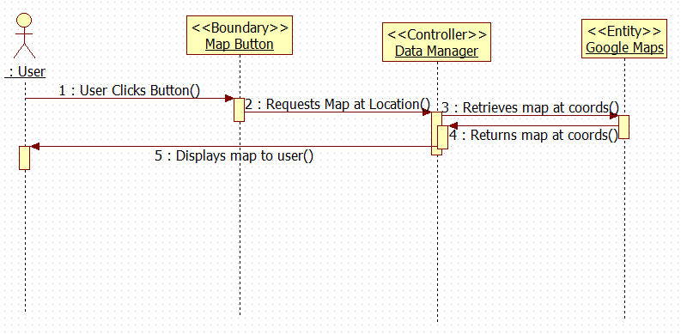

Slide 10
Acceptance Test Report
Pull up pages
Switch Tabs
See Correct Titles
displaced department header
Client Meeting

Slide 11
Sprint 2 Tasks
Josef
Technology Plan, Deployment Model
Daiv
Use Case
Daniel
Risk Analysis, Cost Analysis

