Slide 1
README
BURN AFTER READING
about_SlideDeck
The actual presentation starts with slide 6 ("Session title"). The first five slides have a purely organisational purpose. During the break before your session, you should start the presentation with slide 2 ("Next up"), so that the audience knows that they are in the right room. It's fine if you start chatting with the audience during this break, but we need a precise starting point for your presentation in terms of editing your video. That means:
The recording of your presentation will start after the countdown. Please (RE)START talking after the countdown, not during it! Otherwise your recording will start with a half sentence.
It is not necessary to explicitly signal to the PA operator, this is your signal!
Finally, do you have to use this slide deck? No, you are free to present the way you like it. But you are asked to use the intro slides: countdown, session title, sponsor slide. Beyond that, use what is good for the cause – from no slides to sketches from your children, from Jupyter to $youNameIt.
You will find additional information in the notes below.
Sincerely, your hosts!
Dear Speaker, we are thrilled and honored to have you with us in Malmö in 2025. Take your time and read this before you prepare your session.
Since most of you have been with us before, you will already know a lot about PSConfEU. You know that we try to capture all sessions carefully and publish your work on YouTube. There are a few easily avoidable stumbling blocks that we would like to draw your attention to:
Your screen resolution should be 1920x1080 px (FullHD)
You should provide a full size HDMI socket
Mirror your screen
Disable "Presenter View" in PowerPoint
Using MAC or Surface book? Be aware of HDCP!
Disable the ‘Night Light Mode’
Notes:
The fine print (additional information)
Why should you care about HDCP?
"High-bandwidth Digital Content Protection (HDCP) is a form of digital copy protection developed by Intel Corporation to prevent copying of digital audio and video content as it travels across connections. Types of connections include DisplayPort (DP), Digital Visual Interface (DVI), and High-Definition Multimedia Interface (HDMI), as well as less popular or now deprecated protocols like Gigabit Video Interface (GVIF) and Unified Display Interface (UDI)."
https://en.wikipedia.org/wiki/High-bandwidth_Digital_Content_Protection
Some notebooks ignore the HDCP standard, some vendors comply with the standard. Apple and Microsoft are somehow famous for strictly following the HDCP guidelines. Sadly, we will not be able to guarantee, that your session can be recorded in the latter case.
But you can do simple things, to overcome these problems. It is also very likely that you presented with your notebook before. So you will know, if this worked fine.If you are in doubt and if the agenda allows, try a dry-run a day before and connect everything.
In general you can easily bypass HDCP restrictions with a cheap splitter (the cheaper the better), just like the one you see below. This is an example device that we bought for 16 euros (in Germany).
Ask us, we will lend you such a device.
Thorsten also gave a whole presentation about "Broadcasting yourself" - easy steps to record yourself and create a (backup) session recording on your own. If you want to invest your time and dive deeper, take a look at his recordings and notes:
https://vimeo.com/thorstenbutz/byourself
This is of course completely voluntary, but perhaps you will find it helpful.

Slide 2
Next Up:
Jess Pomfret

Slide 3
3
3

Slide 4
2

Slide 5
1

Slide 6
Unleashing PowerShell in the Cloud with Azure Automation
Jess Pomfret

Slide 7
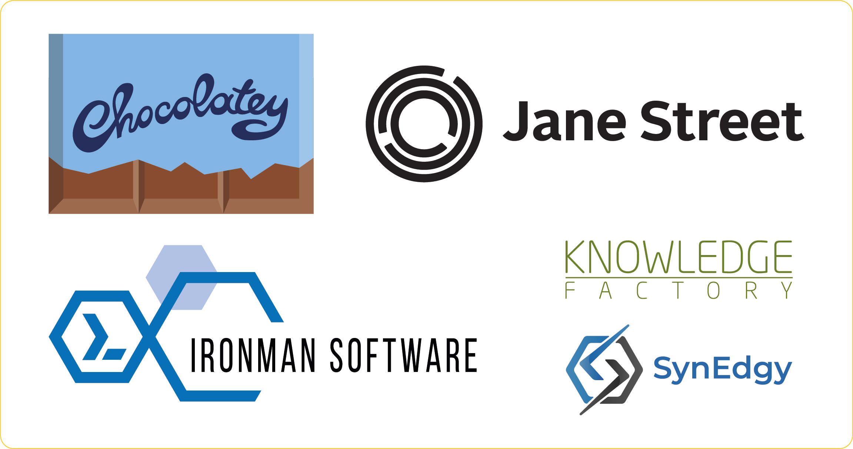
Many thanks to our sponsors:

Slide 8
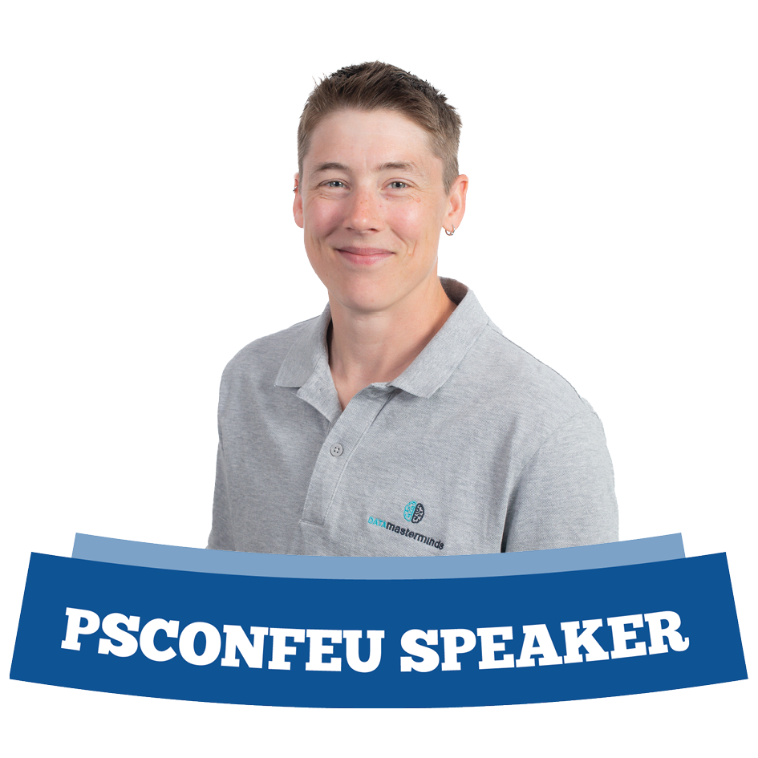
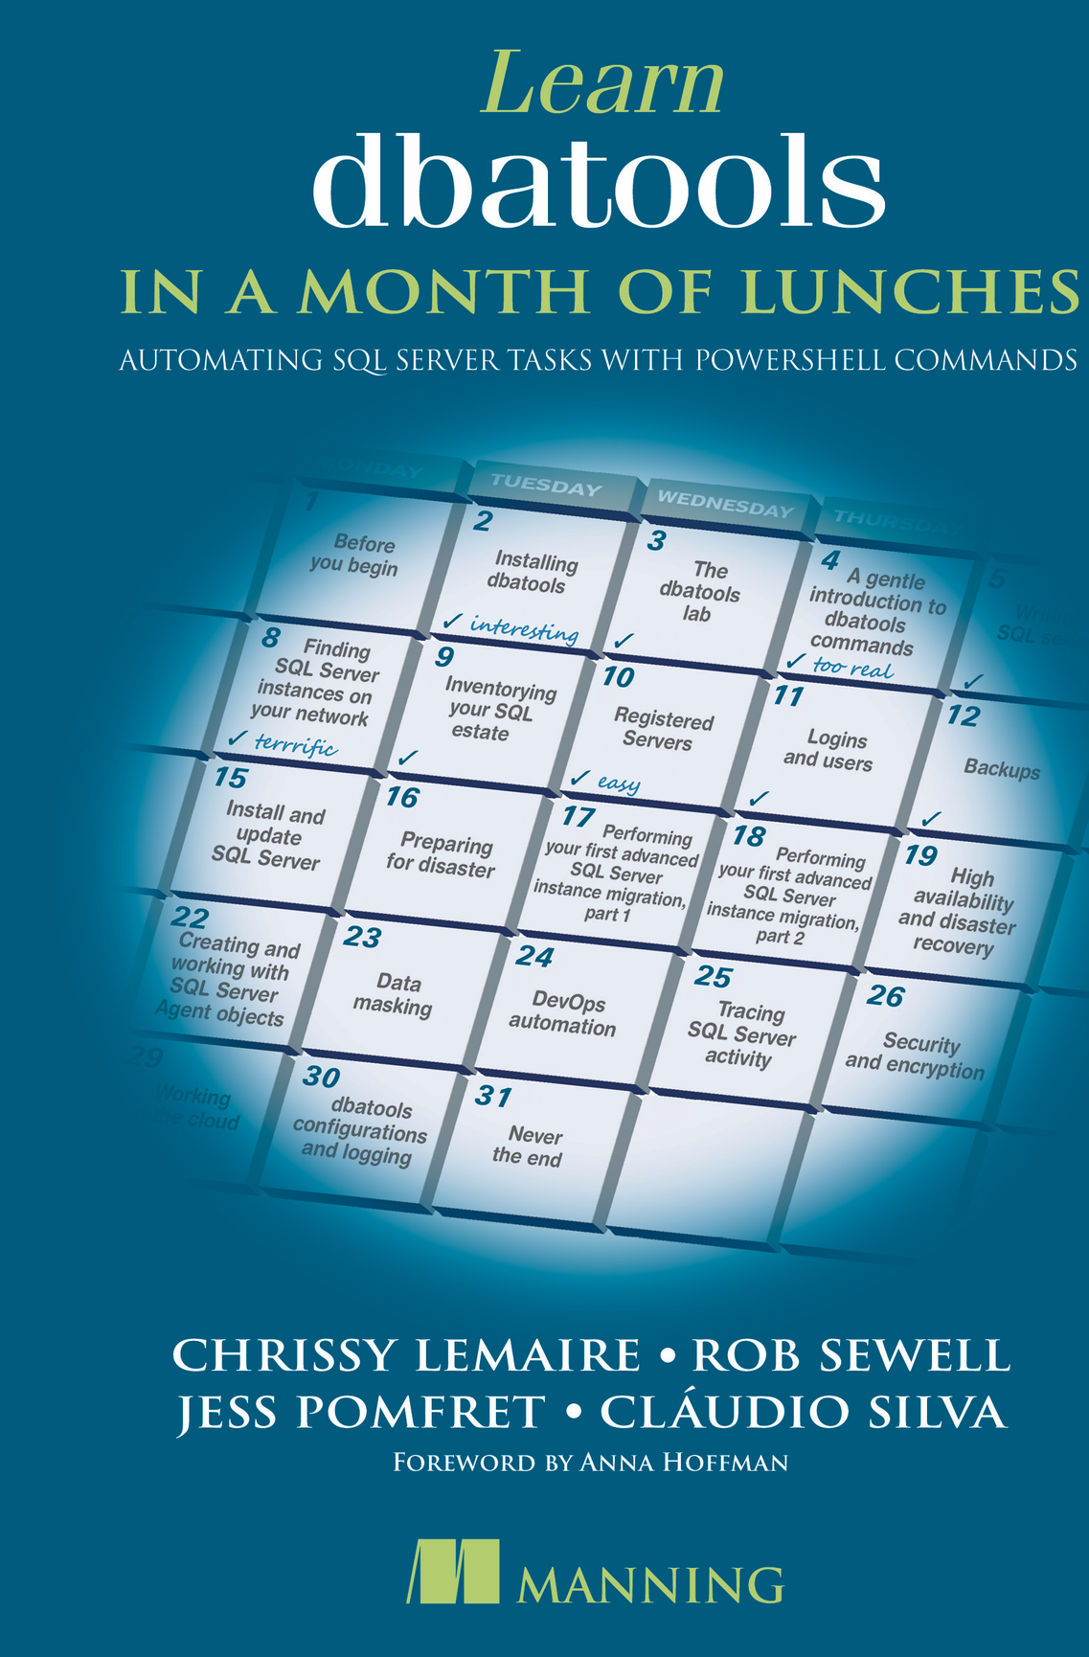
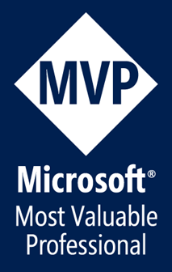

Jess Pomfret She/Her
Data Platform Engineer
Open Source Contributor
dbatools, dbachecks, FabricTools
Passionate about Automation, Proper Football & Fitness
jpomfret7@gmail.com
jesspomfret.com
linkedin.com/in/jpomfret/

Slide 9
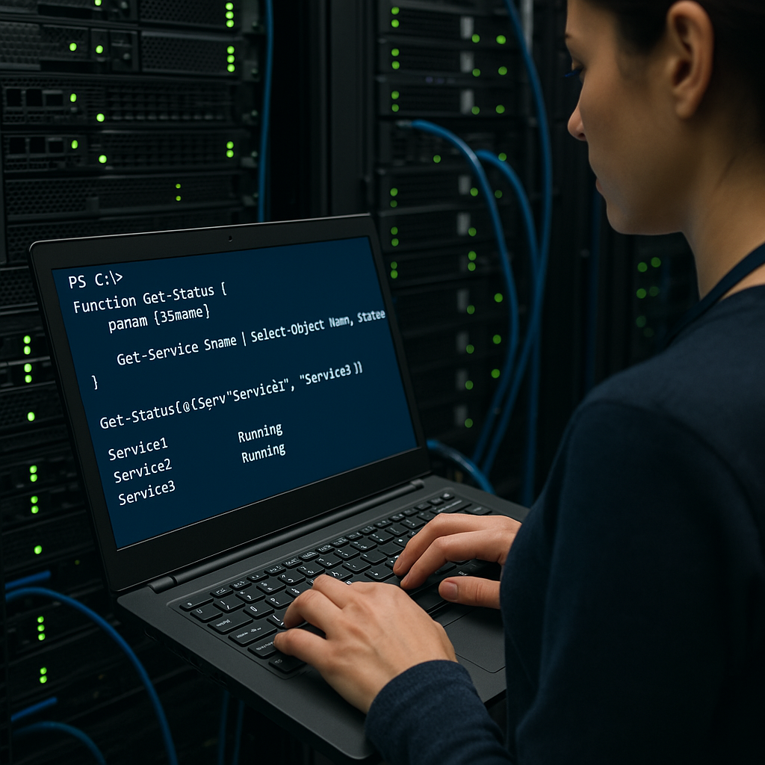
The old days…
Notes:
Asked copilot to make me a picture of someone writing powershell in a server room – and I got a woman!
We used to have on-prem servers, we could write PowerShell and schedule it as windows scheduled tasks!

Slide 10
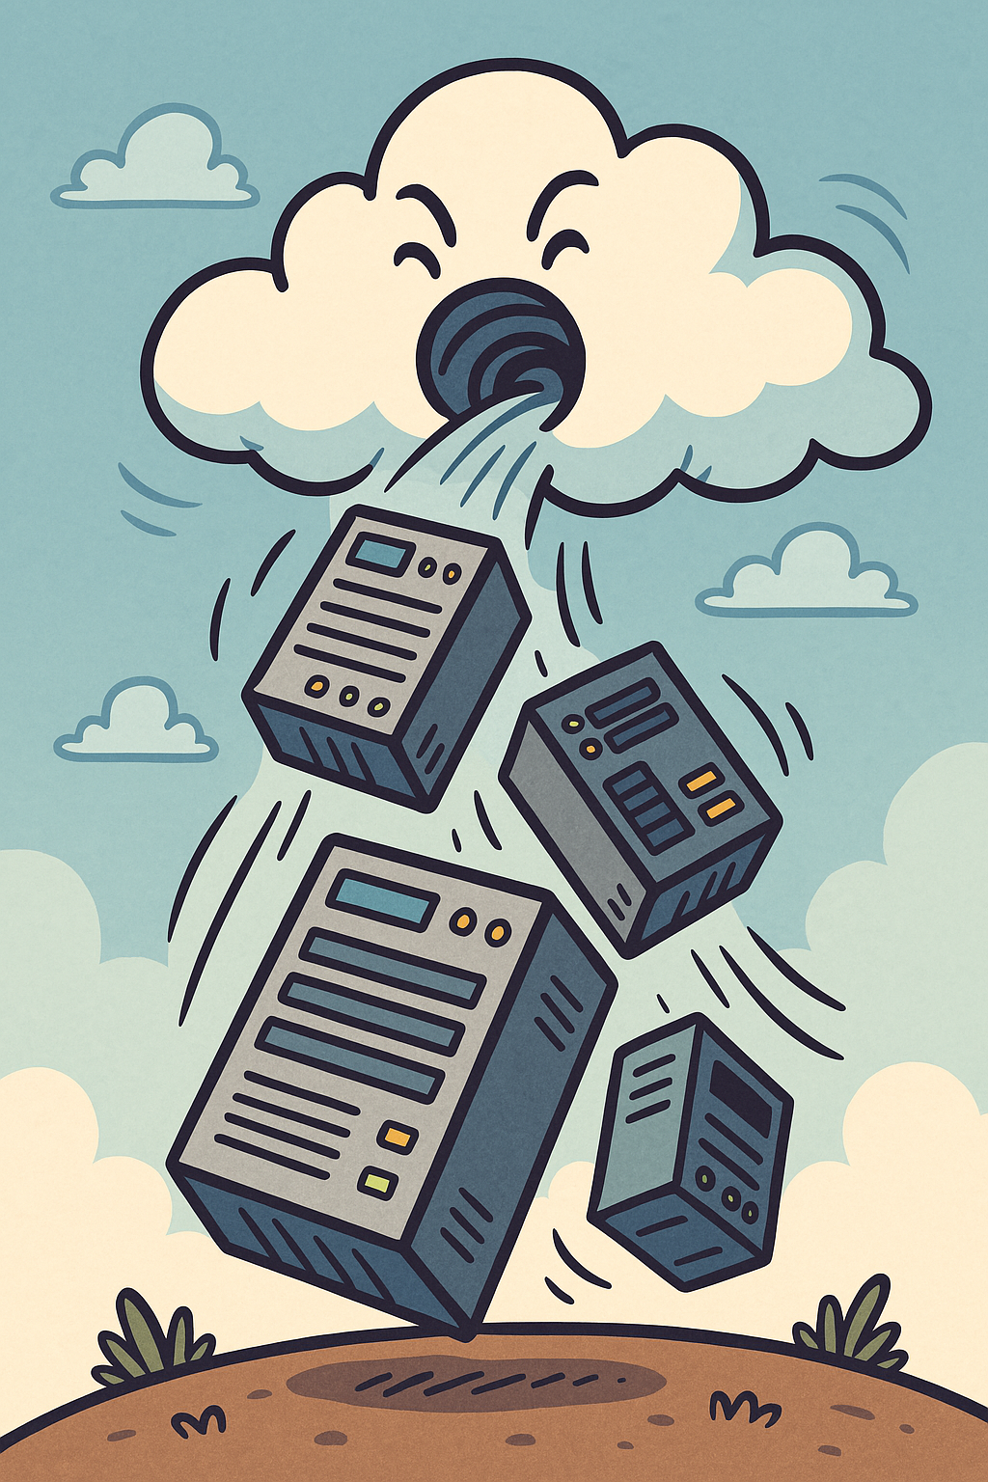
Notes:
But then our servers and processes were sucked or migrated into the cloud.
Things became serverless… what does this mean?
Well instead of virtual machines for every application.

Slide 11







Azure Services
Notes:
We get Azure Services – this is a quiz!
There is no operating system for us to schedule tasks on
Storage accounts
App services
Databricks
SQL MI
SQL Database
Data Factory
Azure Kubernetes Service

Slide 12
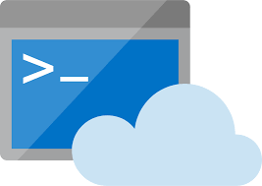
But where is our PowerShell now?
Notes:
There are many options available
We need to decide which tool is right for the job
How much control do we need?
Do we need to run adhoc code or scheduled jobs?
Or code triggered by events?
Who’s writing it? Business or IT?
Cloud shell – great for running adhoc code from the Azure Portal

Slide 13
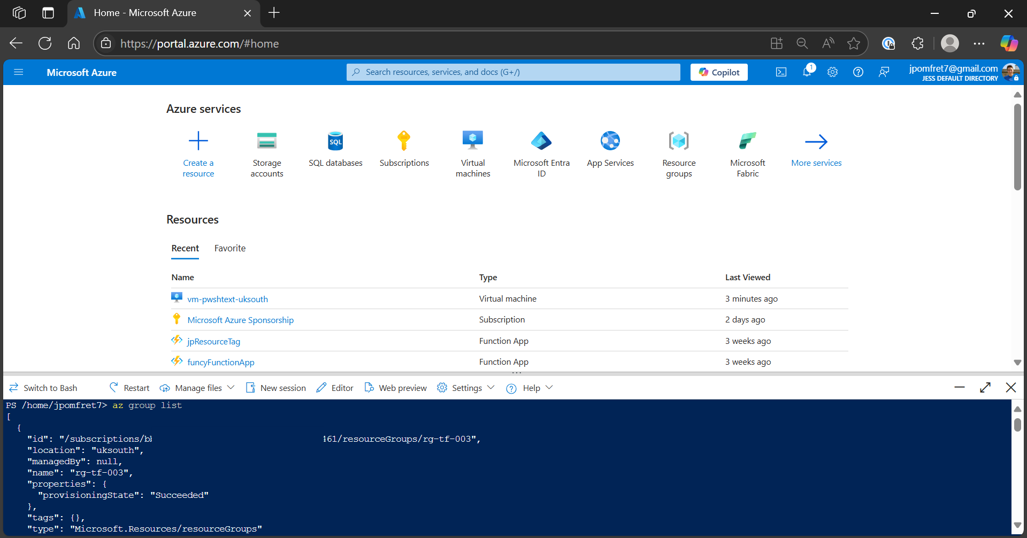
Azure Cloud Shell
Notes:
Cloud Shell
– browser-based shell
- Bash or PowerShell
- Az CLI and Azure PowerShell modules are preinstalled
And session is pre authenticated

Slide 14
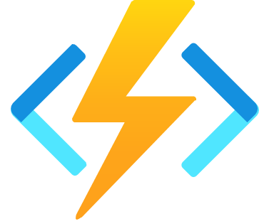
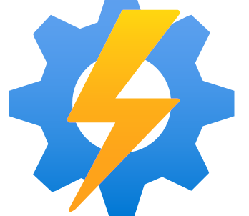
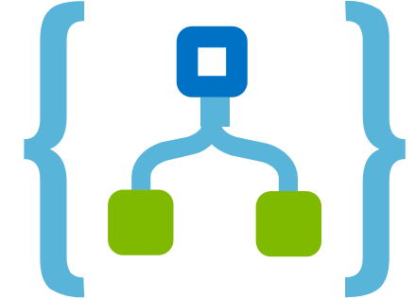
But where is our PowerShell now?
Notes:
Then we have our serverless offerings…
Moving away from adhoc code
These can be scheduled or triggered by events

Slide 15
Serverless Automation in Azure
Notes:
Azure Functions
Azure Automation – our focus for today
Logic Apps
All enable us to run PowerShell in the cloud in a serverless fashion
That means no infra to worry about!
Maybe not enough control?

Slide 16
Serverless Automation in Azure
Azure Functions
Azure Automation
Logic Apps
Run event driven code
Automate administration scripts
No
-
Code
\
Low
-
Code option for
automating processes
Event
-
driven
Schedule or trigger
Workflow
-
driven
Massively scalable
Great for infrastructure
Easy to use for business
automation
Cost per second of execution
Cost per minute of job execution
Cost per action
(extra costs over 1 million execs)
Choose the right tool for the job!
Notes:
Pricing - there are different options, but these can all be very cheap options for running code
All three are useful – but in different scenarios
It’s about choosing the right tool for the job

Slide 17
Serverless Automation in Azure
Azure Functions | Azure Automation | Logic Apps
Run event driven code | Automate administration scripts | No-Code\Low-Code option for automating processes
Event-driven | Schedule or trigger | Workflow-driven
Massively scalable | Great for infrastructure automation | Easy to use for business
Cost per second of execution (extra costs over 1 million execs) | Cost per minute of job execution | Cost per action
Choose the right tool for the job!
Notes:
Pricing - there are different options, but these can all be very cheap options for running code
All three are useful – but in different scenarios
It’s about choosing the right tool for the job

Slide 18

But where is our PowerShell now?
Notes:
There are many options available
We need to decide which tool is right for the job
How much control do we need?
Do we need to run adhoc code or scheduled jobs?

Slide 19
Azure VM
Full Control
Task Scheduler (Windows)
Easy integration with application
Notes:
Azure VM AWS EC2 Instances
If you need more control than you can get with the other options
You can still build a VM
Could be more costly though – and now you need to be responsible for the server – patching, maintenance, security – whereas previous serverless techs take care of that.

Slide 20
Unleashing PowerShell in the Cloud with Azure Automation
Jess Pomfret

Slide 21
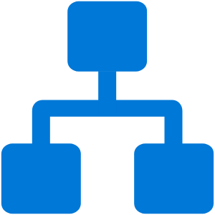
Azure Automation
Runbooks
Runtime Environments
PowerShell
Python
Hybrid Worker
Variables
Source Control
Notes:
Runbooks is where our code is going
We can configure runtime environments that specify the version of PowerShell & which modules are installed
Hybrid worker – allows you to run Azure Automation scripts on-prem, means they can have access to your on-prem resources
(extension based hybrid workers – vs the old style agent based, deprecated)
Variables- available to all runbooks, can have encrypted ones
Source control integration – update runbooks from source control – GitHub, ADO

Slide 22
Where Should Your Runbooks Run? Hybrid vs. Cloud
Feature | Hybrid Runbook Worker | Azure Cloud Runner
Execution Location | Runs on on-premises or Azure VMs | Runs natively in Azure
Best For | Managing on-premises or hybrid cloud resources | Automating Azure-native tasks
Connectivity | Can access local network resources | Limited to Azure services
Performance | Uses local compute power | Uses Azure-managed compute
Setup Complexity | Requires VM setup & configuration | Fully managed by Azure
Use Case Example | Running scripts that interact with on-prem AD | Automating Azure VM scaling
Notes:
We can still move our scripts to the cloud – even if we need to access on-prem resources

Slide 23
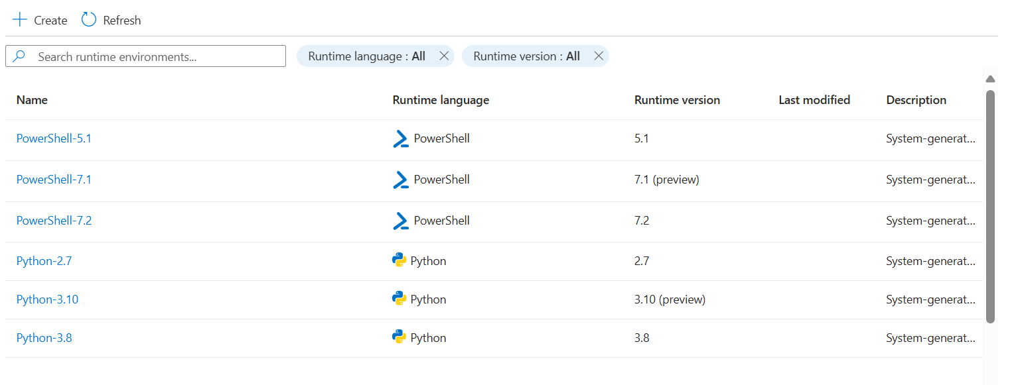
Runtime Environments
Notes:
New way of managing modules\packages & files that are available to your runbookes
System runtimes – but you can’t change those

Slide 24
Where Should Your Runbooks Run? Hybrid vs. Cloud
Feature
Hybrid Runbook Worker
Azure Cloud Runner
Execution Location
Runs on
on
-
premises
or
Azure VMs
Runs
natively in Azure
Managing
on
-
premises
or
hybrid cloud
Best For
Automating
Azure
-
resources
native
tasks
Connectivity
Can access
local network resources
Limited to
Azure services
Performance
Uses
local compute power
Uses
Azure
-
managed compute
Setup Complexity
Requires
VM setup & configuration
Fully
managed by Azure
Running scripts that interact with
on
Use Case Example
-
Automating
Azure VM scaling
prem AD
Notes:
We can still move our scripts to the cloud – even if we need to access on-prem resources

Slide 25
Example Use Cases
Calling an API to delete records from a database
MongoDB Scaling
Creating Azure DevOps Tickets on a schedule
…
Keeping your Azure tenant tidy

Slide 26
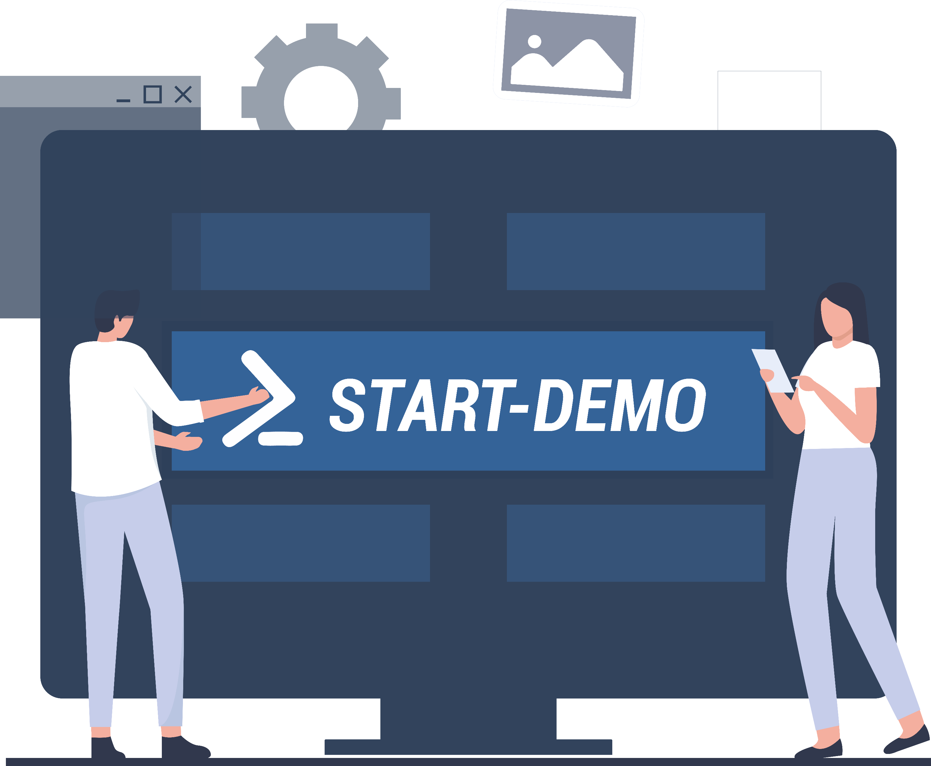
Demos
We love Demos!
Notes:
Azure Automation extension in VSCode
Create runbook – ‘Azure Cleanup’
Add code to look for resources to clean up (script 1.)
Publish from vscode
Run from vscode – with tracked output
Get permissions error – but it didn’t fail the runbook
Add try\catch and errorAction preference (script 2)
Now it’s failing the runbook, and stopping when it hits the first error
Let’s fix the error
We added a managed identity
Need to give it permissions
Go to identity page for Azure Automation
Azure Role assignments
Give reader to subscription – explain that permissions should be minimal – but for this task we’re looking for all kinds of things across the sub
Rerun – works
Add schedule
Done…. But would be cool to do something with the output
ADO
Work items – Boards - https://dev.azure.com/jpomfret7/ProjectPomfret/_workitems/recentlyupdated/
Add Managed identity to users & assign permissions to create WI
Add code to rest api call to create WI (script 3)
Basic info …. But ADO descriptions can be HTML (md coming soon!)
Format body (HTML)
Add a bunch of css and html to make it pretty (script 4)
Makes the code pretty long and messy – move CSS to a shared variable and pull that in (script 5)
TODO – move some of the logic into a shared function too?

Slide 27
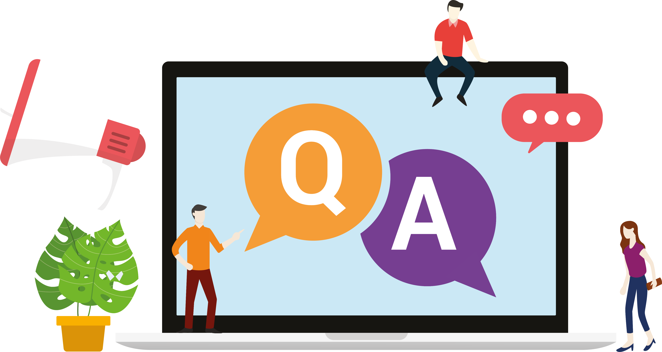
Q&A
15 minutes
Notes:
Other things to look into
Runbooks calling runbooks

Slide 28
Instructions
Use this template if you want, it’s preferred but not mandatory.
Please make sure our sponsors are mentioned on your first slide after the title.
Do not amend the ratio or the colours of the sponsors’ logo and background.
Update your twitter handle through the master page (see next slides).

Slide 29
Instruction (Continued)
The session is 30 min.
Then 15min Q&A.
At the end of your 45 min, please leave the room to the next speaker.
You’re welcome to continue the discussion in the Foyer area.

Slide 30
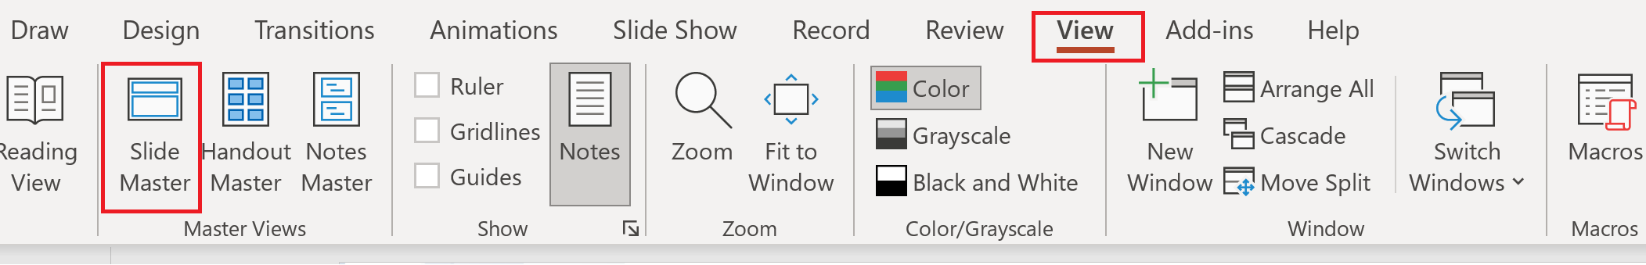
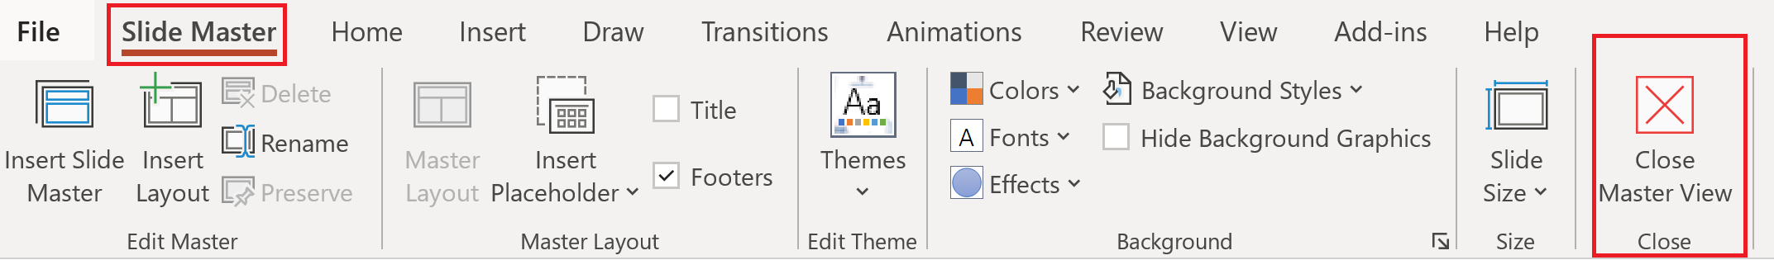
Update the twitter handle on the master slide
To open the slide master:
To close the Master view:
If you need any help, do not hesitate to email us at psconfeu@synedgy.com

