Slide 1
Next Up:
Jess Pomfret

Slide 2
3
3

Slide 3
2

Slide 4
1

Slide 5
Persist Your PowerShell Script Data with Data API Builder
Jess Pomfret

Slide 6

Many thanks to our sponsors:
Notes:
PSConfEU does not happen without our sponsors. A quick thank you to all of them — please check them out on the booths, they pay so we get to be here.
Don't dwell. 15 seconds, move on.

Slide 7

Jess Pomfret
(She/Her)
Data Platform Engineer
LinkedIn Learning Instructor
Open Source Contributor
dbatools, MicrosoftFabricMgmt
Passionate about Automation, Proper Football & Fitness
jpomfret7@gmail.com
jesspomfret.com
linkedin.com/in/jpomfret/

Slide 8
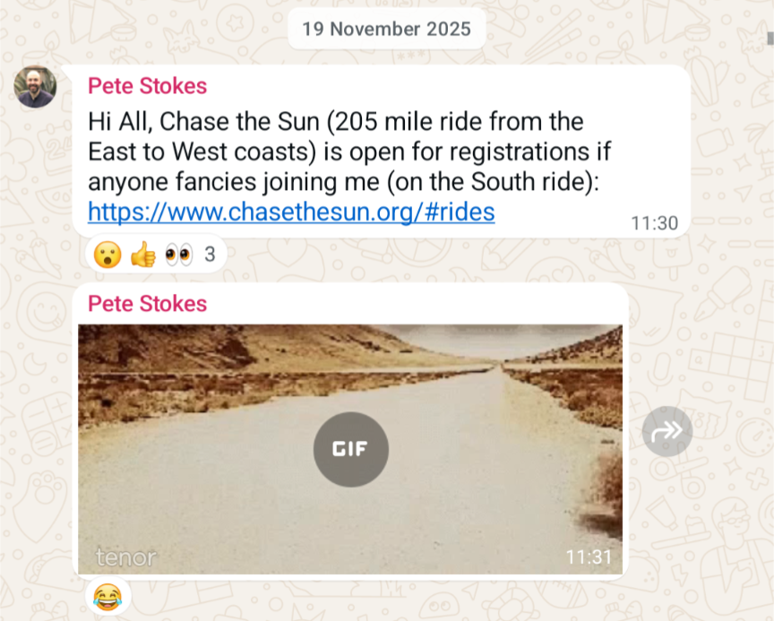
if I wanted to cycle 205 miles in one day…
One day someone asked
Notes:
Last November I got a text message in a gym cycling group
Pete said ‘hey does anyone want to do this’ … and I thought – what a terrible idea, absolutely not…
And then…
Wait a min….
That’s the gif of a tumbleweed…

Slide 9
On 20th June 2026, I'm cycling 205 miles… in one day!
Notes:
Big number, sets up the bet. Pause. Let it land.
what a great plan 🤣
In 30 days time

Slide 10
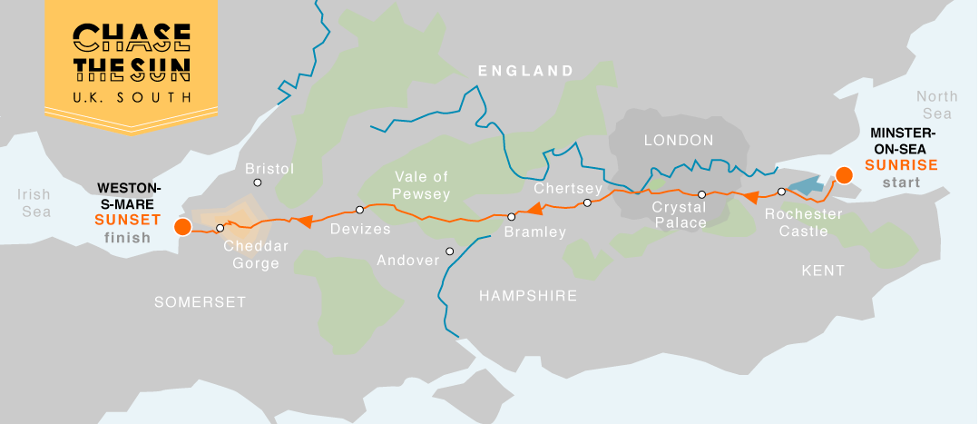
Chase the Sun 2026
205 miles. Minster-on-Sea to Weston-Super-Mare
Sunrise to sunset. One day. Coast to coast.
3 days after my 40th birthday.
Notes:
3 days after my 40th birthday – midlife crisis anyone?

Slide 11

The Problem?
Getting to the start line. Trained. Fuelled. Ready
Notes:
It’s also worth saying that I have a somewhat addictive personality – which tends to mean when I’m in… I’m all in….

Slide 12
This has generated a lot of data
Wellness, fitness, fueling.
Many devices. Many Apps. No shared view. No way to query it together.
I'm a data nerd. I want it in my database.
Notes:
This has generated a lot of data – and I thought what better way to procrastinate writing this presentation… than building something to solve this problem, while showing how cool DAB really is – so here we are!
Heart Rate Variability (HRV) is the measure of the variation in milliseconds between consecutive heartbeats
Rate of Perceived Exertion (RPE) is a subjective 1–10 scale
And when I say there has been a lot of data…

Slide 13
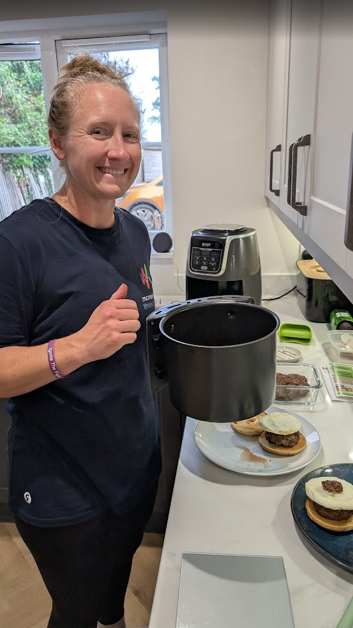
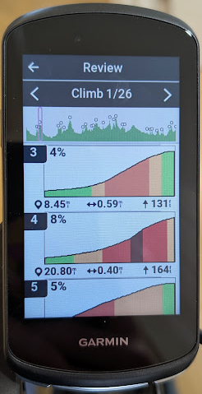

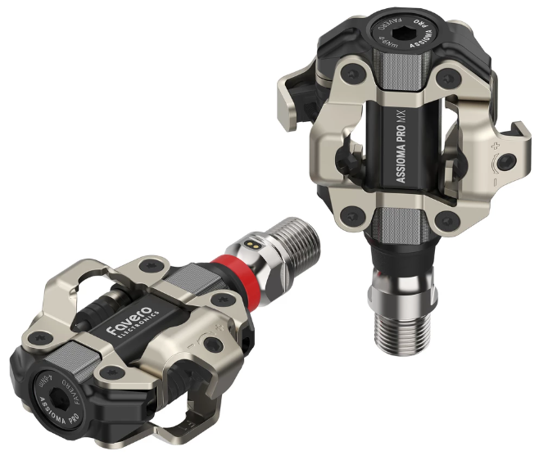
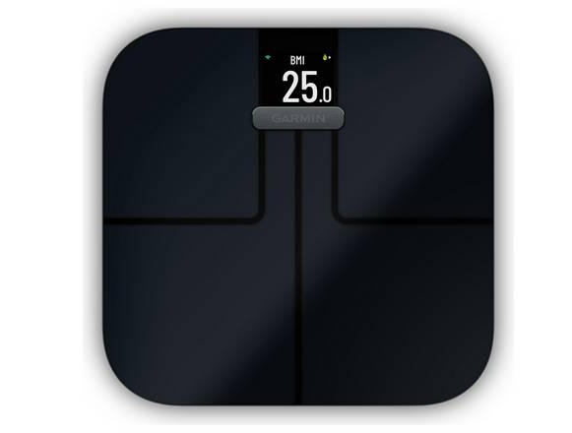
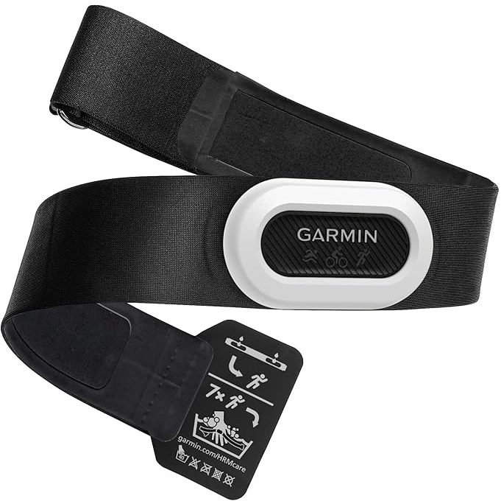
No… like A LOT of data
Notes:
We’ve got sleep stats, heart rate, heart rate variability, body battery, recovery, training readiness all coming from my Garmin watch
And We’ve got bike ride data coming from a Garmin edge head unit – distance, speed, maps of where I’ve been
+ HR strap for more accurate HR reading
+ power pedals – how much force I’m putting through the pedals
And we’ve got weights and calories of all the food that my wife is cooking, and I’m busy eating…
The last few months have been a lot of cycling, eating, recovering… and obviously working (literally my whole team is here shh)
Heart rate, sleep, HRV, RPE, distance, speed, power, fueling

Slide 14
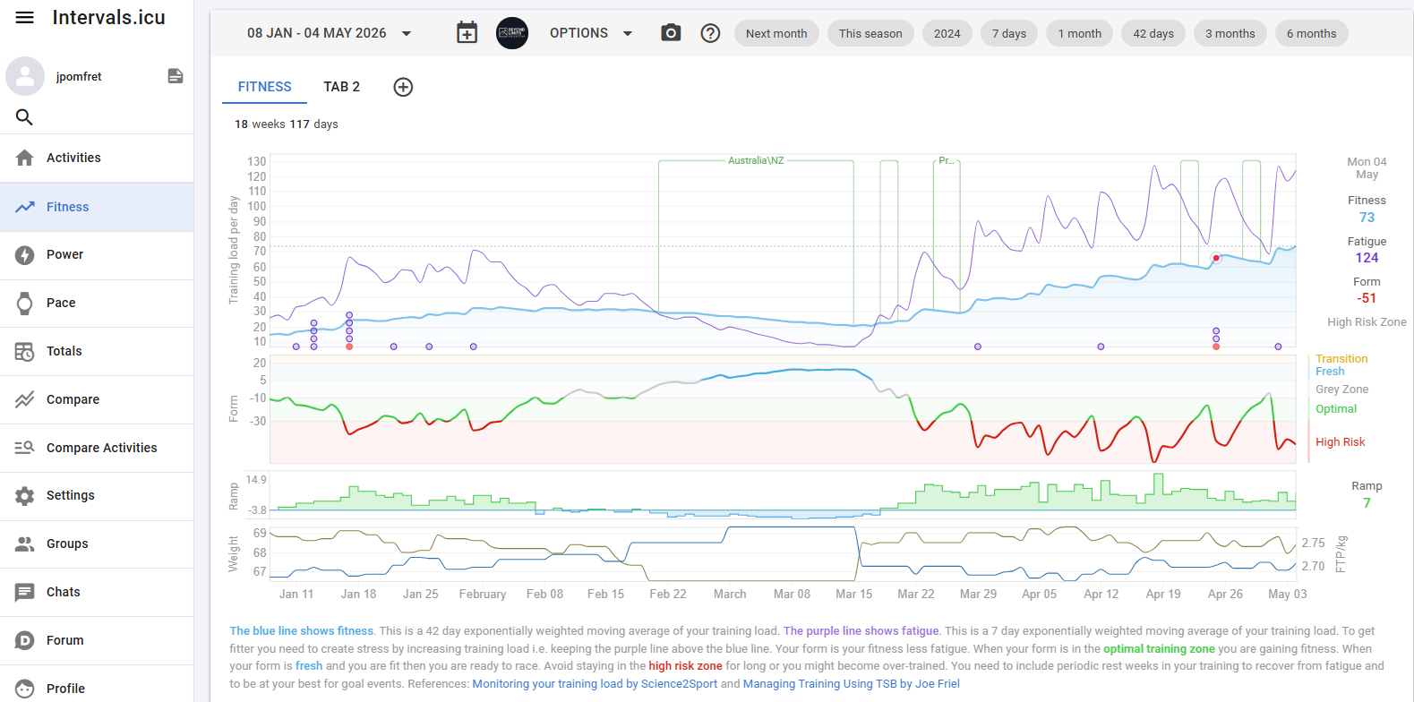
Intervals.icu
Notes:
So most of this data goes via Garmin into intervals.icu a great open source tool for training data
They have all kinds of metrics, and explanations on metrics
And all kinds of graphs – this top one is fitness vs fatigue, basically if you keep the purple fatigue line above the blue fitness line your fitness will increase
You can see the opposite happened while I was in Australia
But too much training is bad, so also aim to keep this form line close to green…
You can also plan your training here, chat to other cycling nerds, but nothing for weight\nutrition

Slide 15
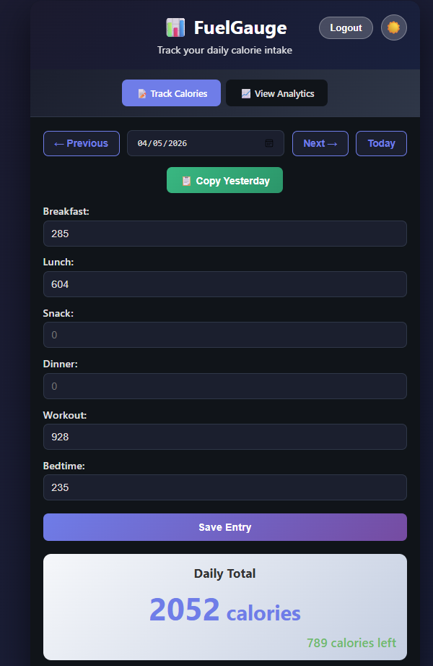
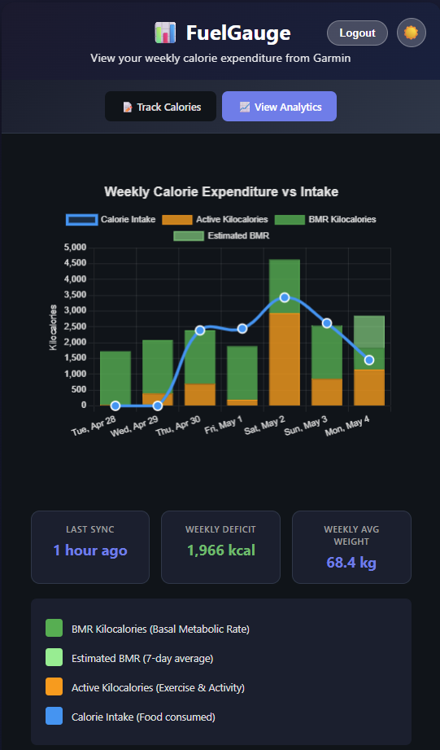
FuelGauge
Home grown app
Tracks Calories Consumed
Compares to Calories Burnt
Stored in postgres & influx databases running on Kubernetes (don’t ask)
Notes:
So I built my own simple app
And then I built my own app to track my calories consumed, it pulls in data from Garmin for my daily calories burned to make sure I’m eating enough \ not eating too much

Slide 16
One place. One way in. One way out.
Everything in SQL Server.
PowerShell writes to it.
A dashboard reads from it.
I do not want to write a backend.
Notes:
I want to collect my data – load it into my Azure SQL Database – we’ll use Data API Builder as the API layer
We can use DAB to create GET and POST endpoints – meaning we can get and set data using this – and it’s so simple to get it set up

Slide 17
Notes:
So I built this…
Centred around Data API Builder which is cool – but this session is about persisting data from our scripts – and we can use DAB for that too.

Slide 18
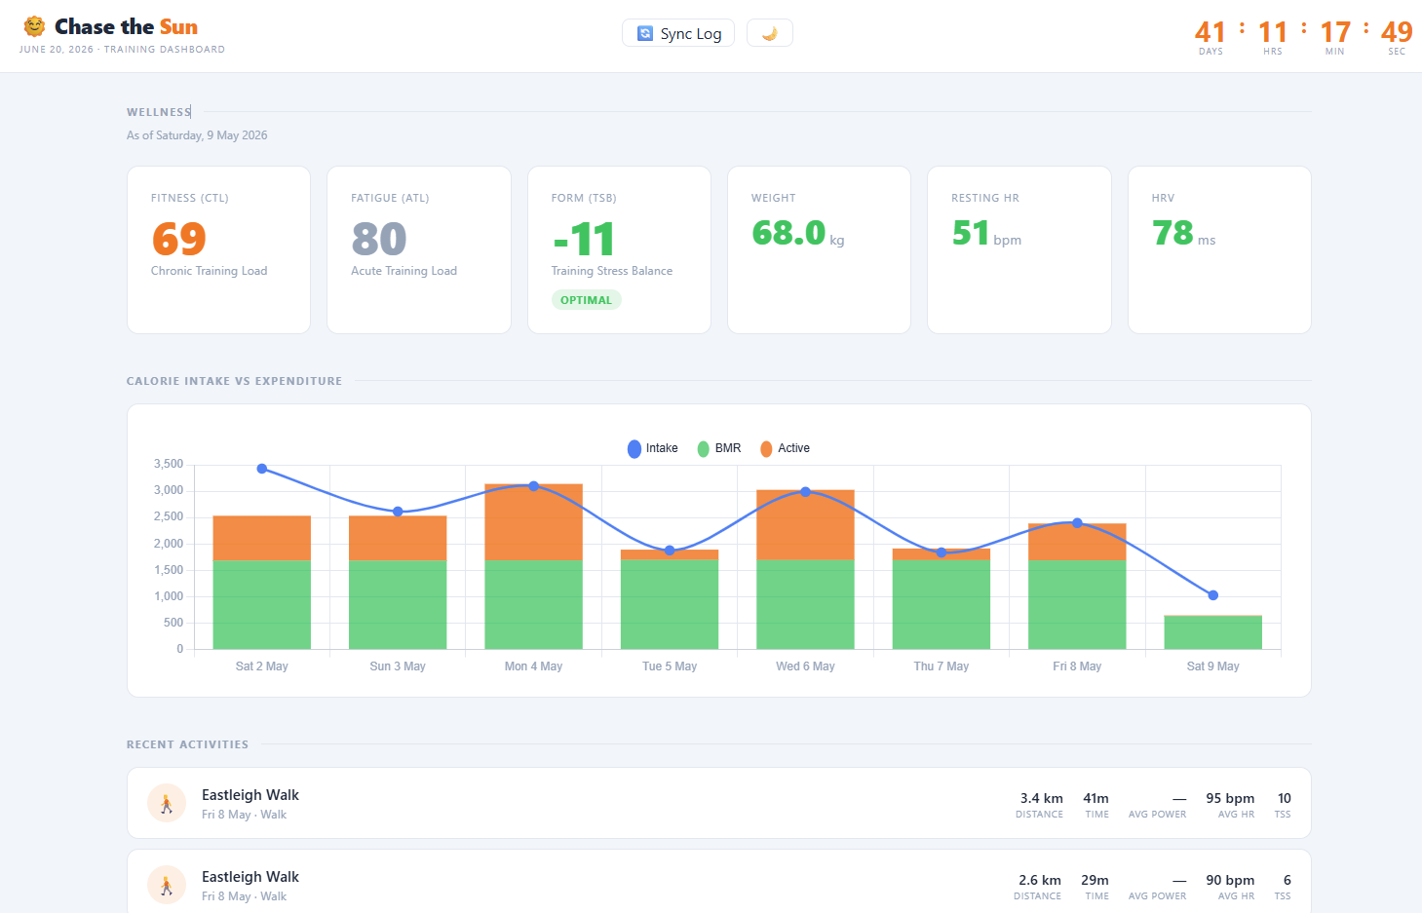
Wellness dashboard
Notes:
Go to the dashboard

Slide 19
Notes:
So I built this…
Centred around Data API Builder which is cool – but this session is about persisting data from our scripts – and we can use DAB for that too.

Slide 20
Notes:
We are going to focus on this corner
An Azure Function that gets that data from intervals.icu and puts it into the Azure SQL Database via DAB… but how do we know it’s working? And what it got up to?

Slide 21
Notes:
We are going to focus on this corner
An Azure Function that gets that data from intervals.icu and puts it into the Azure SQL Database via DAB… but how do we know it’s working? And what it got up to?

Slide 22
What is Data API Builder?
A config-driven engine that instantly generates REST and GraphQL APIs over your database — with zero backend code.
Just define a dab-config.json and you're live.
Open source, Microsoft-backed

Slide 23
Databases & Endpoints
Supported Databases
SQL Server · PostgreSQL · MySQL · CosmosDB
Expose as HTTP Endpoints
Tables
Views
Stored Procedures

Slide 24
The config file
One JSON file. Two important parts: data source and entities.
{
"data-source": {
"database-type": "mssql",
"connection-string": "@env('DATABASE_CONNECTION_STRING')"
},
...
"entities": {
"SyncLog": {
"source": {
"object": "dbo.SyncLog",
"type": "table"
},
"permissions": [{ "role":"authenticated", "actions": [{"action": "*"}] }]
}
}
}
Notes:
Simplest form of config
Using an environment variable for the connection string
Exposing one table for authenticated access
The name of the entity ‘SyncLog’ in this example will become the API endpoint

Slide 25
Keeping History Data with DAB
Azure Functions generate valuable runtime data: logs, stats & metrics
DAB gives you an instant REST API on top of Azure SQL Database
POST log data, stats & history from your function via simple HTTP calls
No custom data-access code or connection string management needed
Persist history for reporting, auditing & troubleshooting

Slide 26
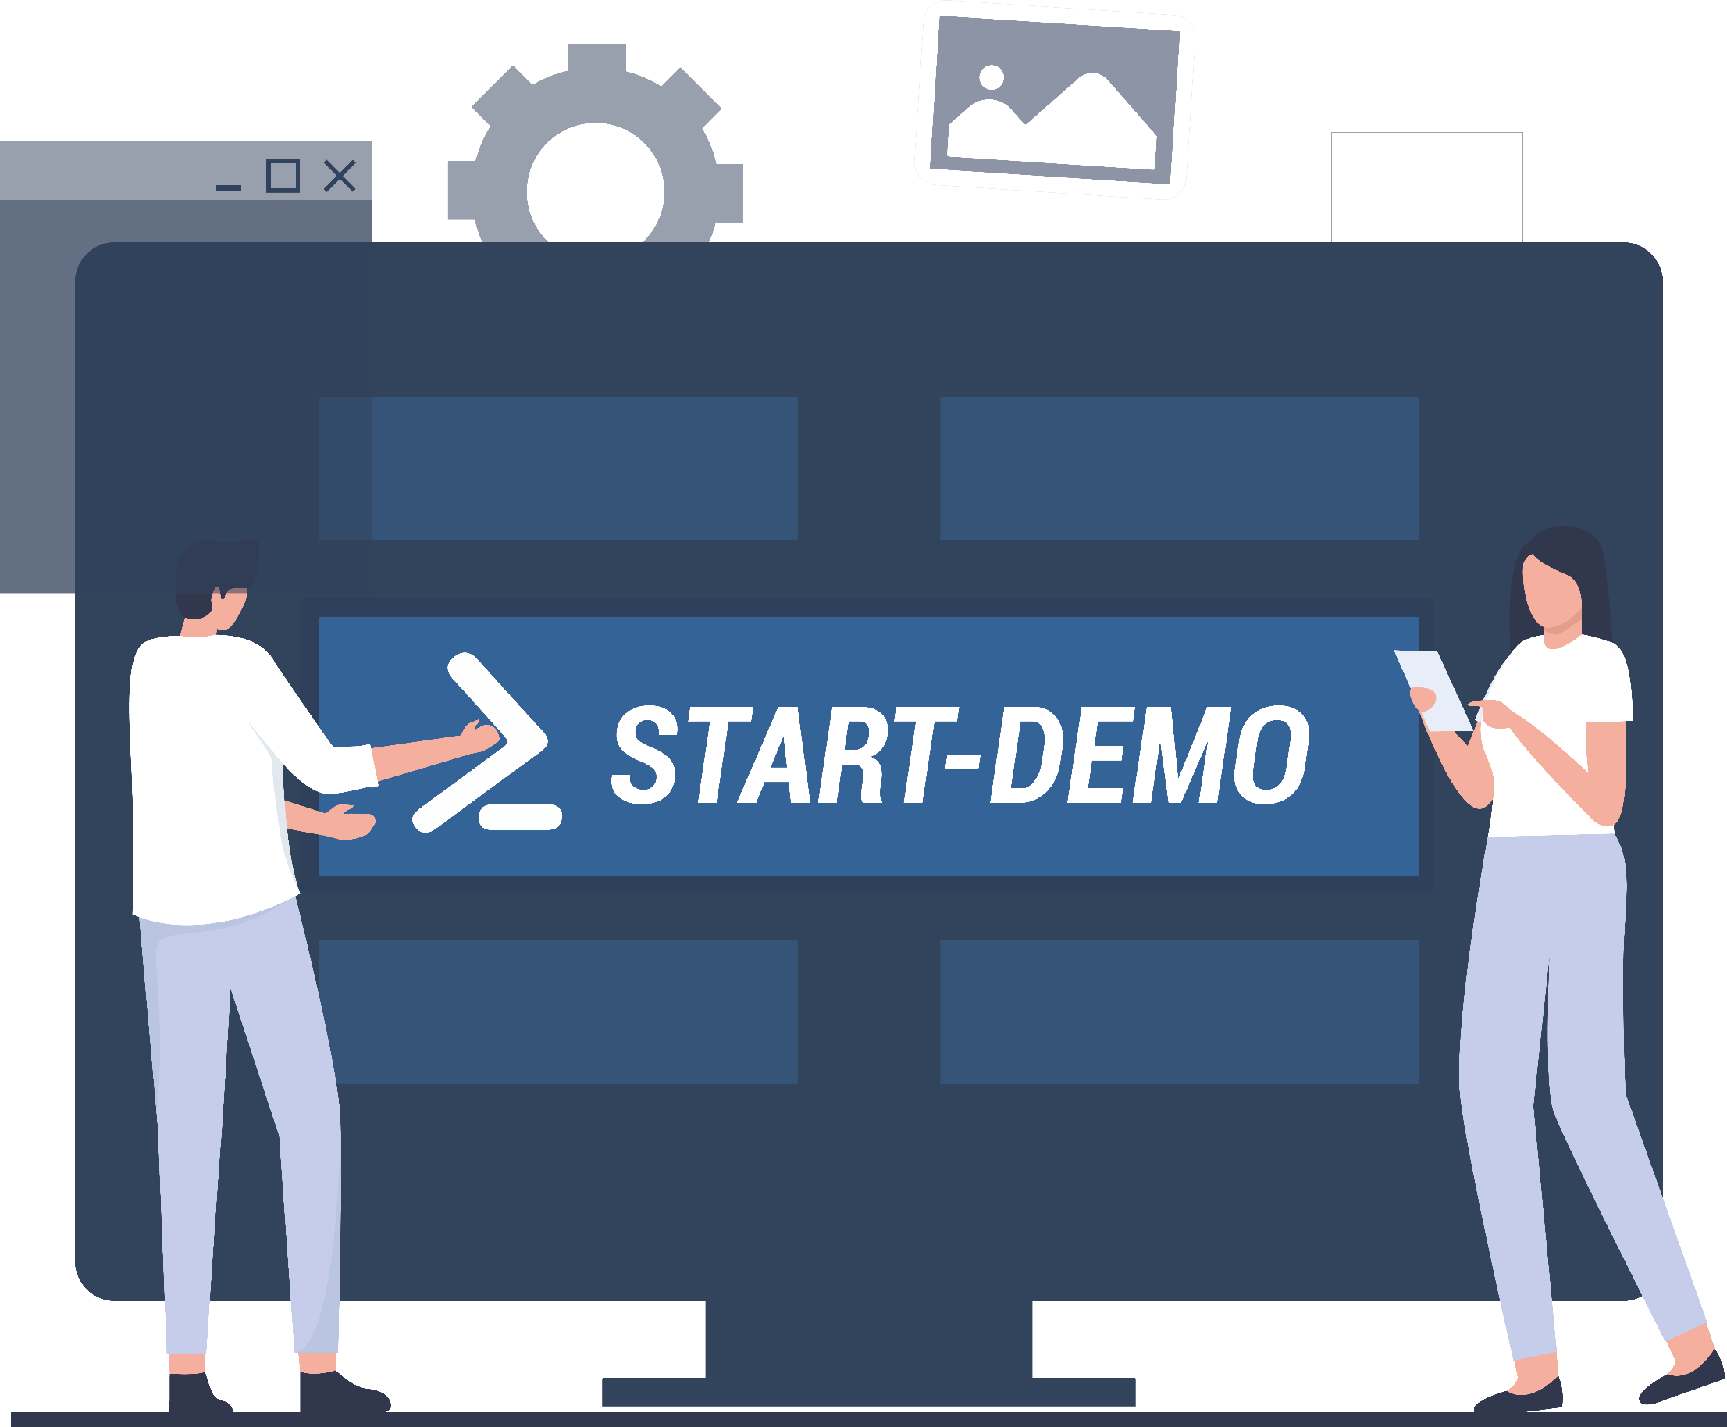
Demos
We love Demos!
Notes:
ZeroToDab
Docker Container

Slide 27
Zero to API in Minutes
1. Install
dotnet tool install --global Microsoft.DataApiBuilder
2. Initialise Config
dab init --database-type mssql --connection-string "@env('CONN_STR’)”
3. Add an Entity
dab add Author --source "dbo.authors" --permissions "anonymous:*"
4. Start
dab start
http://localhost:5000/api/Author
Notes:
Demo – 1-zerotodab.ps1

Slide 28

Deployment
One container image.
Multiple ways to run it.
01
Docker container
Single image, runs anywhere — local dev, CI pipelines,
or bare-metal servers. Just point it at your database.
02
Azure Container Apps
Serverless container hosting with auto-scale. No cluster to manage. Pay only for what you use.
03
Azure App Service
Managed PaaS with built-in auth, custom domains, and deployment slots. Familiar to any .NET team.
04
Azure Kubernetes (AKS)
Full orchestration if you already run K8s. Helm chart included.
Fits into your existing cluster.
All options use env vars or JSON config — zero code changes between environments
Notes:
Deployment — four options, one container image
Docker container:
- The DAB runtime ships as a single Docker image from Microsoft Container Registry.
- docker run is all you need for local development — pass your connection string as an environment variable.
- Same image works in CI pipelines for integration testing — spin it up, run tests, tear it down.
- For bare-metal or VM deployments, just run the container directly. No framework dependency on the host.
Azure Container Apps:
- Recommended starting point for most teams. Serverless — you don't manage infrastructure.
- Built-in auto-scale from zero to N replicas based on HTTP traffic. You pay per request, not per VM.
- Supports revision-based traffic splitting for canary deployments.
Azure App Service:
- If your team already runs .NET apps on App Service, DAB slots right in.
- Deployment slots give you blue-green deployments out of the box.
- Built-in auth integration with Entra ID (formerly AAD) — no code changes needed.
Azure Kubernetes Service (AKS):
- For teams that already operate a K8s cluster. Helm chart is provided.
- Fits into existing service mesh, observability, and scaling policies.
- Most operational overhead — only choose this if you already have the K8s muscle.
Key message: identical image everywhere. The only thing that changes between environments is the config — connection strings, auth settings, CORS rules. All of that lives in environment variables or a JSON config file, never in source code. Connection strings should be stored in Azure Key Vault and referenced via env vars.

Slide 29
Sorting & Selecting
Sorting — order by any exposed column, ascending or descending
GET /api/SyncLog?$orderby=RunAt desc
GET /api/SyncLog?$orderby=DurationMs asc
$select — slim the payload, fetch only what you need
GET /api/SyncLog?$select=LogId,RunAt,Status,DurationMs

Slide 30
Filtering
OData-style $filter expressions — query exactly what you need, no extra code.
GET /api/SyncLog?$filter=Status eq 'Error'
GET /api/SyncLog?$filter=Source eq 'IntervalsSync'
GET /api/SyncLog?$filter=Status eq 'Error' and RunAt ge 2025-01-01T00:00:00Z
Operators: eq, ne, gt, lt, ge, le — combine with and / or

Slide 31
Pagination
Cursor-based pagination with $first and $after — no offset, no skipped rows.
GET /api/SyncLog?$first=10
Response includes nextLink with a $after cursor token
GET /api/SyncLog?$first=10&$after=<token>
Works with any page size — 10, 25, 50 rows — stable under concurrent writes

Slide 32
Authentication
Plug in your identity provider
Entra ID, EasyAuth, any JWT server, or Simulator for dev.
Role-based access control
Anonymous + Authenticated system roles, custom user roles, one effective role per request.
Database policies
Row-level security filter results. Claims flow to SQL session context.
Notes:
DAB delegates authentication to your identity provider and validates the tokens it receives. Four provider options cover every scenario:
EntraID / AzureAD – JWT bearer validation with extra signing-key issuer checks specific to Microsoft Entra tokens. Configure audience and issuer in the host section. Supports managed identity for the database connection.
AppService (EasyAuth) – App Service handles the OAuth flow and injects the X-MS-CLIENT-PRINCIPAL header. Works with Microsoft, Google, Facebook, Twitter, and OpenID Connect. No jwt.audience or jwt.issuer settings needed.
Custom JWT – Any standards-compliant JWT server (e.g. Keycloak, Auth0, Okta). You supply the audience and issuer.
Simulator – Treats all requests as authenticated without validating a real token. Development and testing only.
Authorization is role-based. Every request resolves to exactly one effective role. Two system roles (Anonymous, Authenticated) are auto-assigned; custom roles map to token claims via the X-MS-API-ROLE header.
Database policies add row-level filtering – predicates are injected into queries so users only see authorised records. Token claims can also be passed to the SQL session context for stored-procedure or trigger-level logic.
Key detail: DAB validates the user token but connects to the database with its own credentials (managed identity or SQL auth) by default. On-Behalf-Of (OBO) is optional if you need the database to authenticate as the actual caller. Secrets can be stored in Azure Key Vault and referenced via @akv() in the config.

Slide 33
What Can You Persist?
Script Execution Logs — when it ran, result, errors
Automation State — resume where you left off
System Health — inventory, ping results, disk usage
Job Results — pipeline outputs, test data, reports
Anything you'd put in a CSV — now queryable forever.
Notes:
Anywhere you can call an API from – get a token, auth, put data in the database

Slide 34
How It Works
Azure Function
runs your script
Data API Builder
REST endpoints
Azure SQL
persists history
Your function POSTs log data, stats & history to SQL via DAB — zero custom data-access code.
Notes:
Simplest setup – we have a database, we have DAB running in a container say, and then we can access the endpoints

Slide 35
Azure Function + DAB
No direct database connections in your functions — just HTTP.
Architecture
DAB in Azure Container Instance (config in Azure File Share)
Azure SQL Database as the backend
Workflow
Azure Function runs on a schedule
Fetches data from external API, POSTs to DAB endpoint
DAB writes to SQL — function never touches the DB

Slide 36
Demos
We love Demos!
Notes:
More advanced demos against synclog / container app

Slide 37
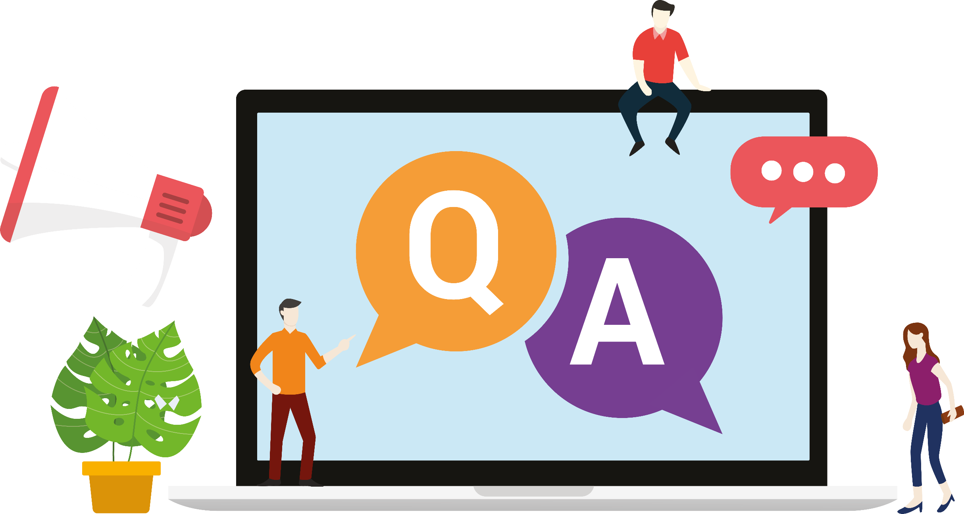
Q&A
15 minutes

Slide 38
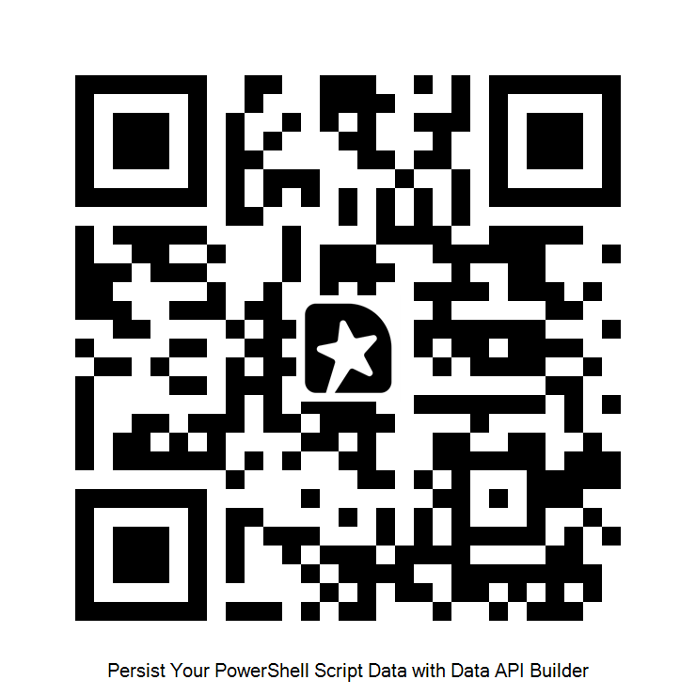
GIVE ME FEEDBACK
INSERT YOUR SESSION QRCODE HERE

Slide 39
Get Started Today
Resources
Install dotnet tool install --global Microsoft.DataApiBuilder
Docs aka.ms/dab
GitHub github.com/Azure/data-api-builder
Slides + Demos github.com/jpomfret/dab-presentation
Pick one script that writes to a CSV today.
Make it write to a database instead.

Slide 40
This
Notes:
Now this session is about DAB – Data API Builder
But it’s also about persisting data from your scripts\jobs\tasks
And while I was building this session – I was struck with an idea – some will call it procrastination
How could I show how great DAB is? And how it can be used to persist script data?
Well a fun side project of course!

Slide 41
README
BURN AFTER READING
about_SlideDeck
The actual presentation starts with slide 6 ("Session title"). The first five slides have a purely organisational purpose. During the break before your session, you should start the presentation with slide 2 ("Next up"), so that the audience knows that they are in the right room. It's fine if you start chatting with the audience during this break, but we need a precise starting point for your presentation in terms of editing your video. That means:
The recording of your presentation will start after the countdown. Please (RE)START talking after the countdown, not during it! Otherwise your recording will start with a half sentence.
It is not necessary to explicitly signal to the PA operator, this is your signal!
Finally, do you have to use this slide deck? No, you are free to present the way you like it. But you are asked to use the intro slides: countdown, session title, sponsor slide. Beyond that, use what is good for the cause – from no slides to sketches from your children, from Jupyter to $youNameIt.
You will find additional information in the notes below.
Sincerely, your hosts!
Dear Speaker, we are thrilled and honored to have you with us in Wiesbaden in 2026. Take your time and read this before you prepare your session.
Since most of you have been with us before, you will already know a lot about PSConfEU. You know that we try to capture all sessions carefully and publish your work on YouTube. There are a few easily avoidable stumbling blocks that we would like to draw your attention to:
Your screen resolution should be 1920x1080 px (FullHD)
You should provide a full size HDMI socket
Mirror your screen
Disable "Presenter View" in PowerPoint
Using MAC or Surface book? Be aware of HDCP!
Disable the ‘Night Light’ Mode
Enable the presentation setting (presentationsettings.exe in Windows)
If you present sensitive information on web portals, consider using something like "CloudCloak"
Notes:
The fine print (additional information)
Why should you care about HDCP?
"High-bandwidth Digital Content Protection (HDCP) is a form of digital copy protection developed by Intel Corporation to prevent copying of digital audio and video content as it travels across connections. Types of connections include DisplayPort (DP), Digital Visual Interface (DVI), and High-Definition Multimedia Interface (HDMI), as well as less popular or now deprecated protocols like Gigabit Video Interface (GVIF) and Unified Display Interface (UDI)."
https://en.wikipedia.org/wiki/High-bandwidth_Digital_Content_Protection
Some notebooks ignore the HDCP standard, some vendors comply with the standard. Apple and Microsoft are somehow famous for strictly following the HDCP guidelines. Sadly, we will not be able to guarantee, that your session can be recorded in the latter case.
But you can do simple things, to overcome these problems. It is also very likely that you presented with your notebook before. So you will know, if this worked fine.If you are in doubt and if the agenda allows, try a dry-run a day before and connect everything.
In general you can easily bypass HDCP restrictions with a cheap splitter (the cheaper the better), just like the one you see below. This is an example device that we bought for 16 euros (in Germany).
Ask us, we will lend you such a device.
Thorsten also gave a whole presentation about "Broadcasting yourself" - easy steps to record yourself and create a (backup) session recording on your own. If you want to invest your time and dive deeper, take a look at his recordings and notes:
https://vimeo.com/thorstenbutz/byourself
This is of course completely voluntary, but perhaps you will find it helpful.

Slide 42
Instructions
Use this template if you want, it’s preferred but not mandatory.
Please make sure our sponsors are mentioned on your first slide after the title.
Do not amend the ratio or the colours of the sponsors’ logo and background.
Update your twitter handle through the master page (see next slides).

Slide 43
Instruction (Continued)
The session is 30 min.
Then 15min Q&A.
At the end of your 45 min, please leave the room to the next speaker.
You’re welcome to continue the discussion in the Foyer area.

Slide 44
Under the Hood
How Data API Builder works, how you configure it, and where you can run it.
Architecture
Database → DAB engine → REST & GraphQL endpoints
Configuration
One JSON file defines data sources and entity exposure
Deployment
Docker, Container Apps, App Service, or AKS

