Slide 1
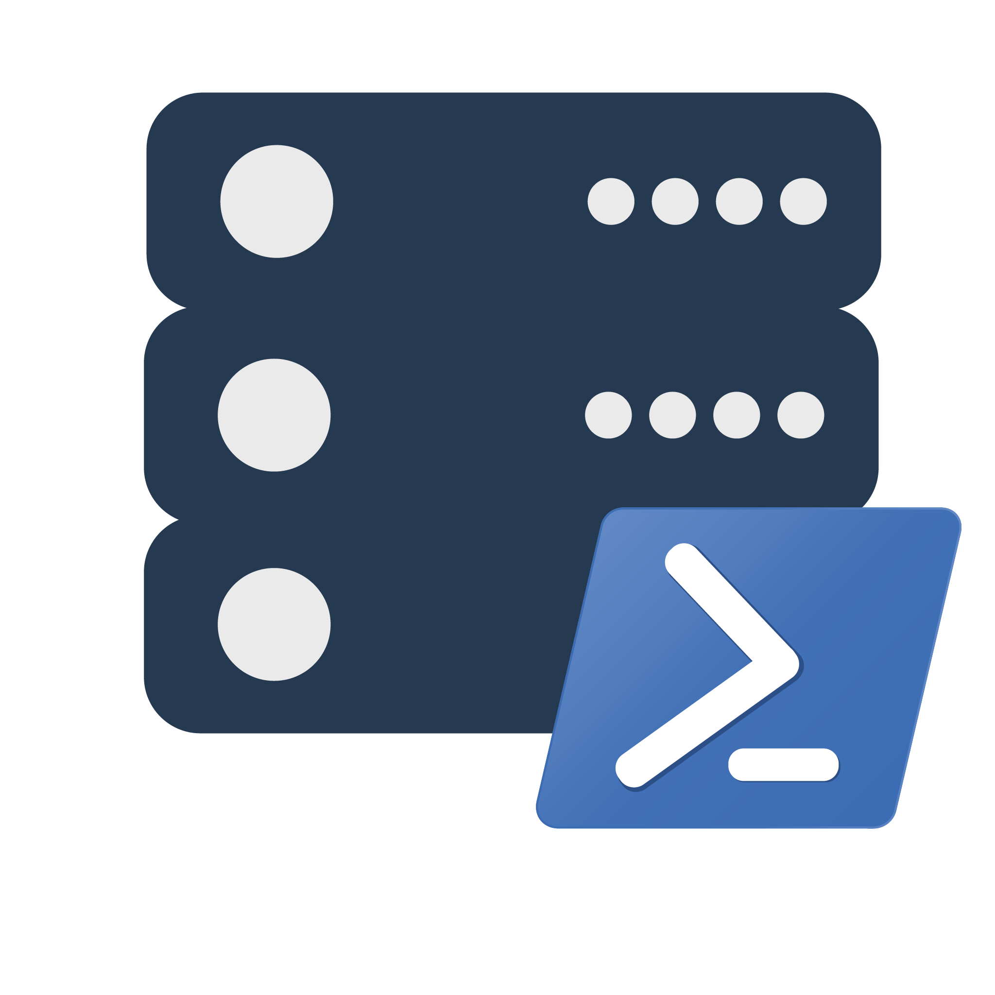
dbatools: Morning Checks

Slide 2


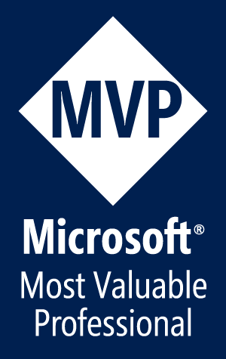
Jess Pomfret (She/Her)
Data Platform Engineer
Open Source Contributor
dbatools, dbachecks, SqlServerDsc
Passionate about Automation, Proper Football & Fitness
jpomfret7@gmail.com
jesspomfret.com
linkedin.com/in/jpomfret/

Slide 3
Ingredients
dbatools
Morning Checks
PHSTML

Slide 4


Ingredients
dbatools
Az
PHSTML
Morning Checks
FabricTools

Slide 5

The Secret...
PHSTML
Morning Checks

Slide 6
Demo Time
Demo Files available here:
https://github.com/jpomfret/dbatools-MorningChecks

Slide 7
Questions?
Jess Pomfret
jpomfret7@gmail.com
jesspomfret.com
jpomfret.co.uk
linkedin.com/in/jpomfret/
github.com\jpomfret

Slide 8
Resources
dbatools Blog
https://dbatools.io/meap/
https://dbatools.io/secure/
Docs
https://docs.dbatools.io/
https://dbatools.io/build
Other
https://dbatools.io/github
https://dbatools.io/slack/
http://dbatools.io/twitter - @psdbatools

Slide 9

What is dbatools?
Open-Source PowerShell Module
Command line SSMS
Great for handling multiples
MIT Licensed
“A short and simple permissive license”
Secure!
PowerShell - “Secure by Design”
Code Signed
Pester tests
Branch policies
Notes:
PowerShell Module – Command line SSMS
- makes it easier to manage multiples… multiple servers, databases, jobs, logins, etc.
Support all the ways to login to SQL Server that SSMS does (including Multi Factor Authentication)
Support SQL Server 2000 and PowerShell 3 wherever possible – goal is still to make migrations easy
Support for Azure (can migrate to Azure Managed Instances)
75% of commands run on Mac OS and Linux
MIT license - https://dbatools.io/mit/ - only requirement is to maintain copywrite and license notices.
OK for private use or commercial use, modification, distribution
Talking to your company about dbatools - https://dbatools.io/secure/
PowerShell team works hard at “Secure by Design” approach
Code signed – verifies the code you receive hasn’t been modified by a third party. Chrissy & Rob are the only people who can sign dbatools releases
Enterprise ready
Pester tests
Restricted merging to master branch
PowerShell gallery runs a virus scan against the module

Slide 10
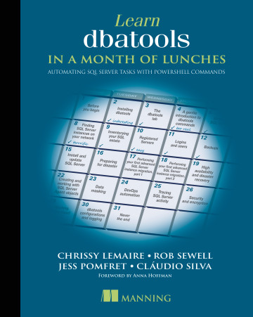
dbatools: a short history
Created by Chrissy LeMaire to migrate SharePoint instances
September 2015 – First commit to GitHub
June 2019 – 1.0 launch at DataGrillen
Dec 2022 – 2.0 launch – split into two modules
692 Functions (as of 26/2/2021) – v2.1.28
700+ Pester tests
Learn dbatools in a Month of Lunches
Notes:
2014 – Chrissy had to do a SharePoint migration – lot of databases/logins/jobs/etc.
1.0 - Over 160 contributors and 550 commands
Standardize naming
Standardize parameters
Early days – Chrissy would troll reddit, looking for common problems, automating them and then adding them to dbatools

