Slide 1

SQL Server Automation
with PowerShell, dbatools
and GitHub Actions
Notes:
1000

Slide 2



Jess Pomfret (She/Her)
Data Platform Engineer
LinkedIn Learning Instructor
Open Source Contributor
dbatools, MicrosoftFabricMgmt
Passionate about Automation, Proper Football & Fitness
jpomfret7@gmail.com
jesspomfret.com
linkedin.com/in/jpomfret/
Notes:
ADD Li instructor?

Slide 3

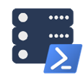
What’s the plan?
dbatools
GitHub Actions
Final Project

Slide 4
dbatools
Notes:
1004

Slide 5
It’s like a command line SQL Server Management Studio If you can do it in SSMS – you can do it in dbatools* *mostly

Slide 6
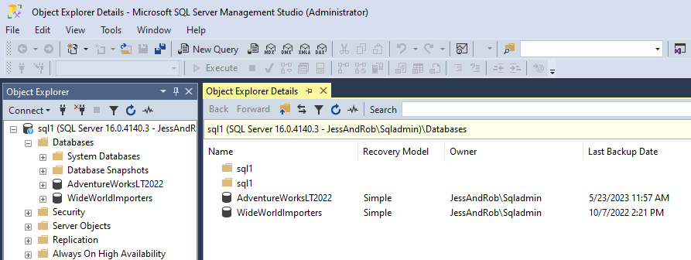
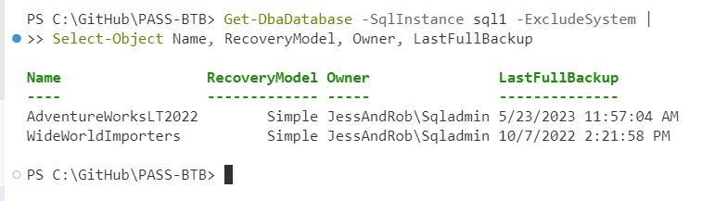
Get Database Info for User Database on Sql1

Slide 7
Get Database Info for User Database on Sql1

Slide 8
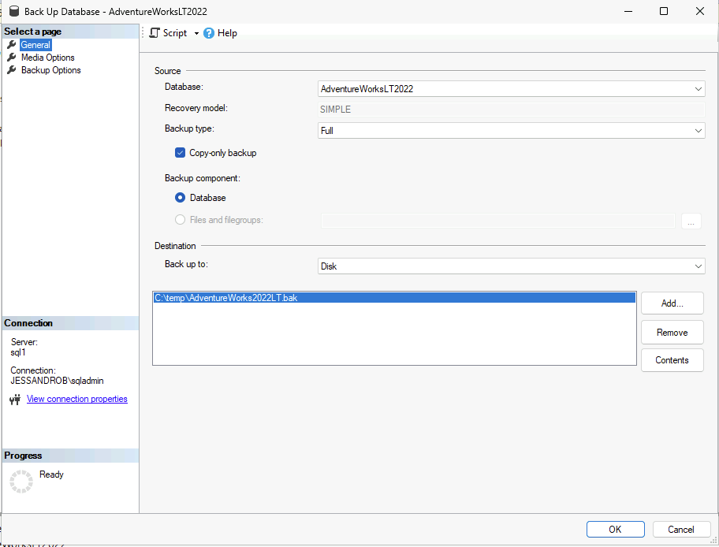
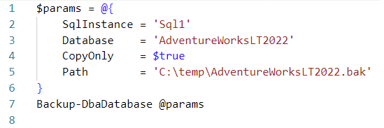
Backup a database on Sql1
Notes:
Right click database > tasks > backup

Slide 9
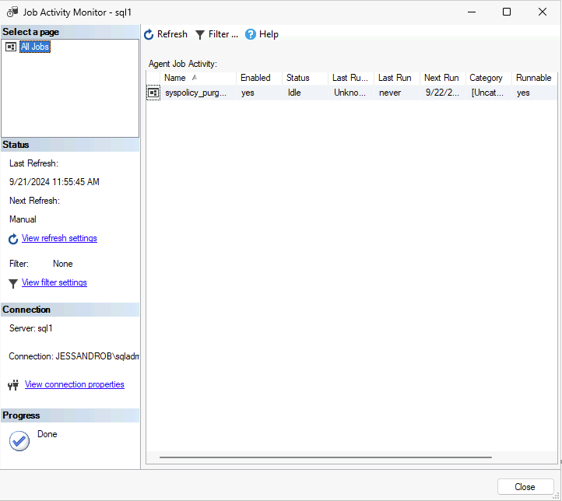
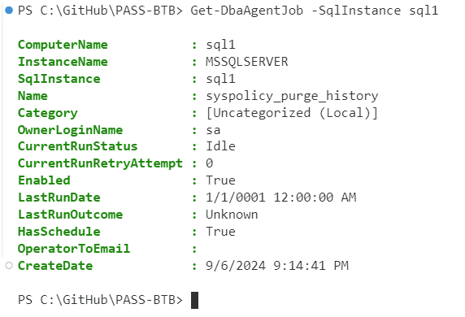
Get SQL Agent jobs on Sql1

Slide 10
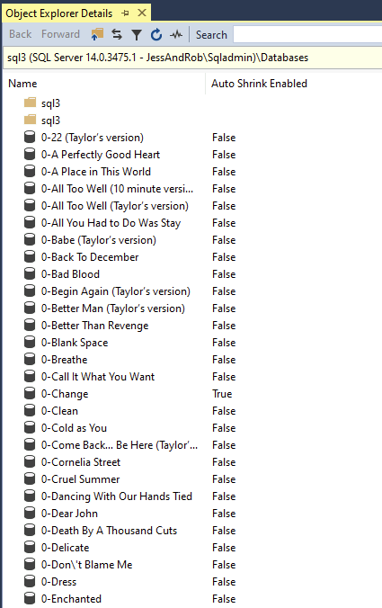
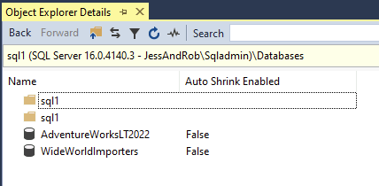
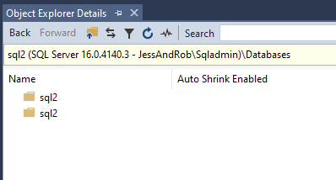
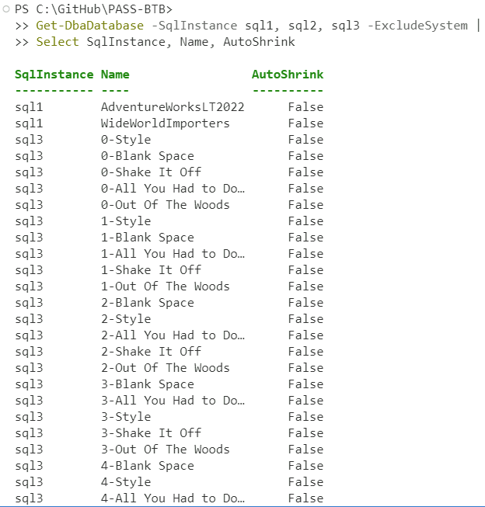
Get Database Name and AutoShrink status on Sql1, Sql2 and Sql3

Slide 11
Get Database Name and AutoShrink status on Sql1, Sql2 and Sql3

Slide 12
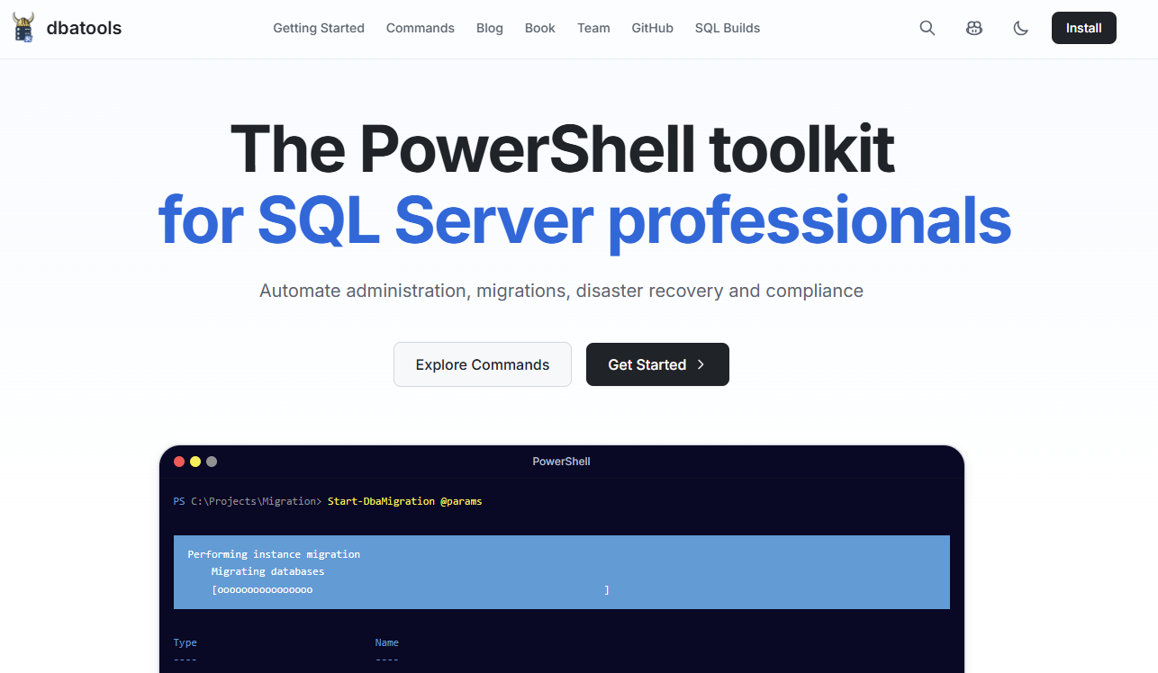
dbatools.io
Notes:
CHANGE THIS SLIDE it’s old webstite
Talk about new site

Slide 13
Demo Time – dbatools Magic
Create a new database
Backup some databases
Collect some information
Notes:
1009

Slide 14

GitHub Actions
Notes:
1020

Slide 15
GitHub Actions
CI\CD Platform
Allows you to automate things
Based on triggers
Schedule
Commit
Pull Request
Issue
Uses GitHub Hosted or Self-Hosted runners
Notes:
Who’s already using GitHub Actions?

Slide 16

Azure DevOps Pipelines
CI\CD Platform
Allows you to automate things
Based on triggers
Schedule
Commit
Pull Request
Work Item (not as easy – need to use webhook trigger)
Uses Microsoft Hosted or Self-Hosted agents
Notes:
It’s the same
There are other options too, these are the main two

Slide 17
GitHub Actions use cases
On push – run automated tests
On schedule – look for issues that are stale
Manually – publish package to NuGet
On issue creation
Create a SQL Server database?
add article to replication?
Start an agent job?

Slide 18
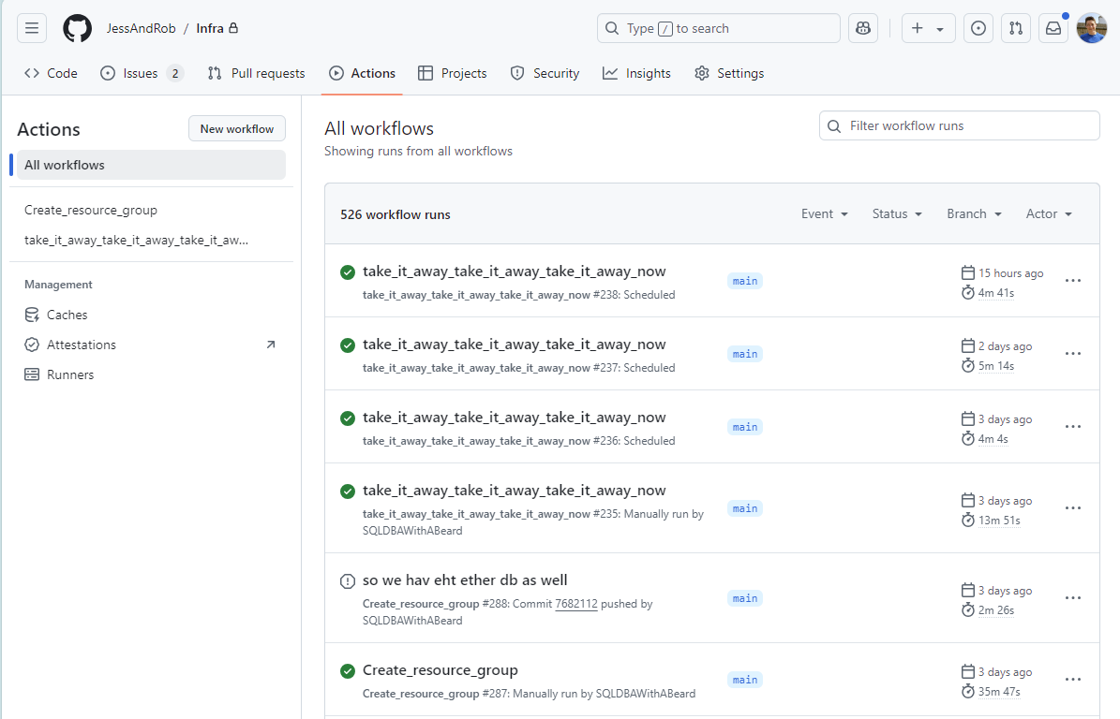
Notes:
Point out schedule runs
Manually triggered runs
One that was cancelled

Slide 19
Demo Time – Our first GitHub Action!
Mark Stale Issues
AI Summaries
Notes:
1442

Slide 20
GitHub Actions Next Level
Automate all the things
Notes:
1030

Slide 21

GitHub Actions - Runners
Where the code runs
GitHub-hosted runners
VMs hosted by GitHub
Runner images – Windows, Linux, MacOS
Preinstalled tools
Self-hosted runners
Agent installed on your VMs
Within your environment
https://docs.github.com/en/actions/concepts/runners
Notes:
GitHub Hosted
GitHub Actions usage is free for standard GitHub-hosted runners in public repositories
Series of types you can choose – windows, linux, different versions
Self-hosted
More control
Free to use (for now!)
Inside your network so access to things
Note – if you swap your repo to be public you need to change a setting that allows your self-hosted runner to run – otherwise it sits there waiting for jobs, and your actions sit there waiting for runners

Slide 22
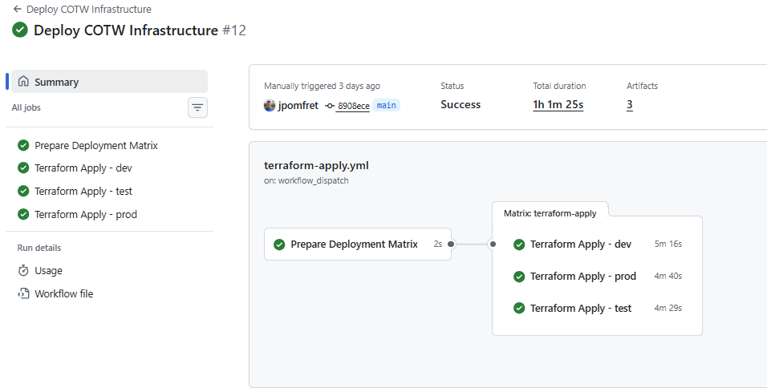
Hierarchy
Workflow – automated process
Job
Notes:
Workflow – top level – the whole process
That workflow can contain one or many jobs
Jobs can run in parallel or in sequential order

Slide 23
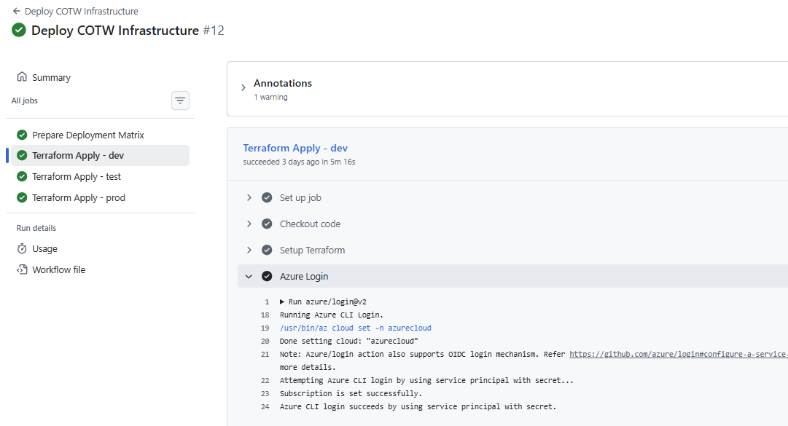
Hierarchy
Workflow – automated process
Job
Step
Action
Notes:
Each Job has one or many steps – executed in order
Each step runs an action – or script
These actions can be from the marketplace – or home built

Slide 24
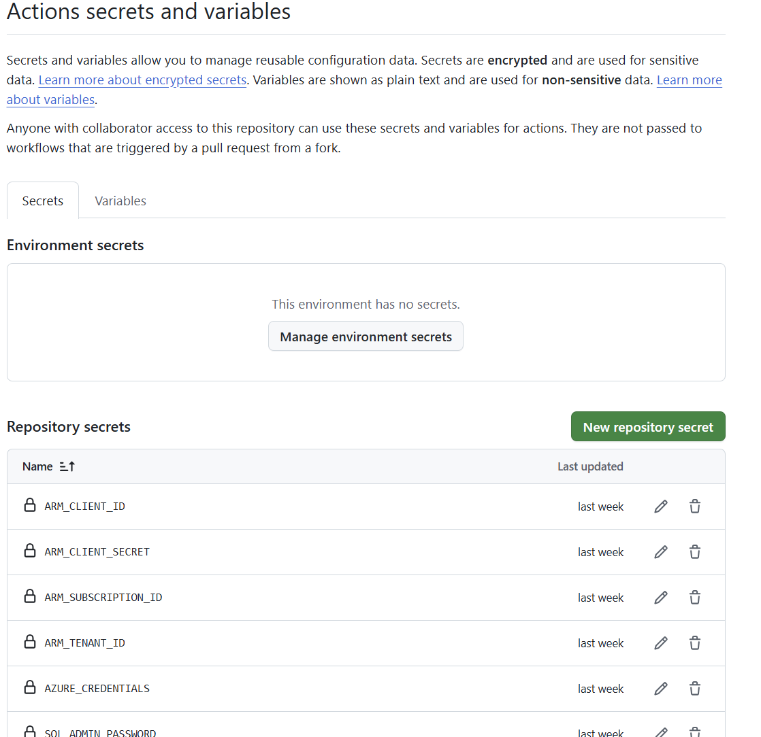
Variables & Secrets
Variables – Non Sensitive Data
Plain text
${{ vars.MY_VAR }}
Secrets – Sensitive Data
Encrypted
${{ secrets.MY_SECRET }}
Stored
Organisation
Repo
Environment
Notes:
Variables – use these to control actions – pass in configuration data so it’s not hardcoded in your scripts
Secrets – encrypted – once it’s saved you can no longer view it
Name your secrets sensibly
More specific secret\variable wins – so if you have Organisation and Repo the repo secret is used

Slide 25
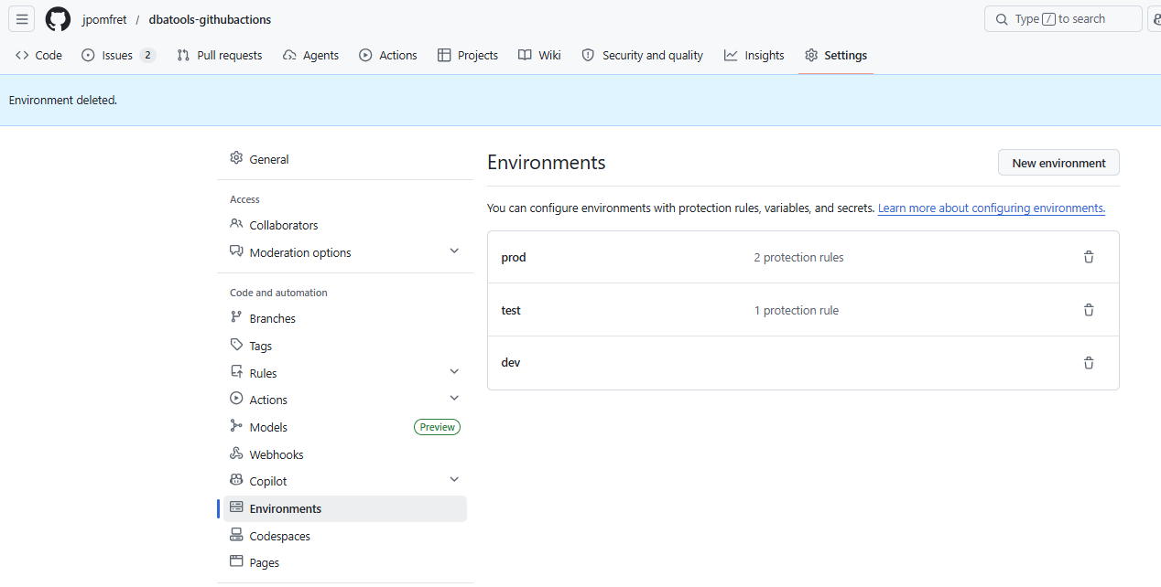
Environments & Approvals
Notes:
Environments can be referenced by jobs
Add protection rules to these to protect them
You can see dev has no protection rules, 1 for test, 2 for prod
For example in prod…

Slide 26
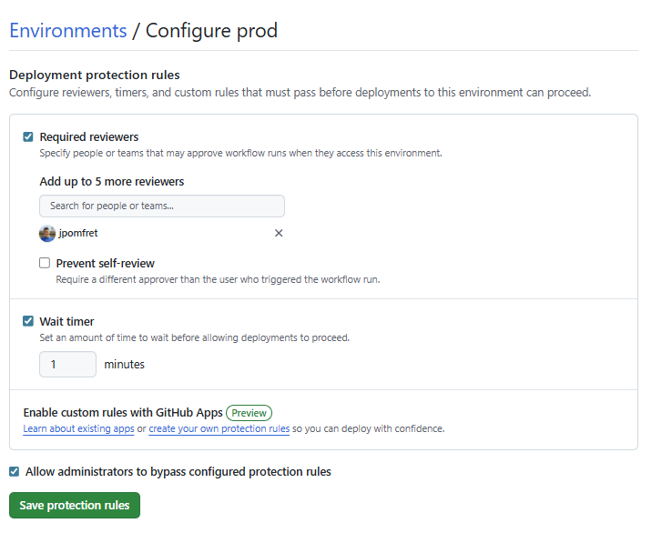
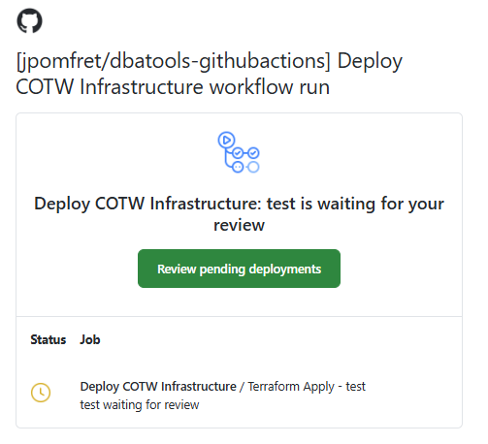
Environments & Approvals
Notes:
We have a required reviewer
(best not to have it be yourself – hence the block self review button)
And this time a timer – a cooling off period as I like to call it
When a workflow tries to run a job which is tied to an environment it’ll be blocked until the approval is given – in this case I got an email.

Slide 27
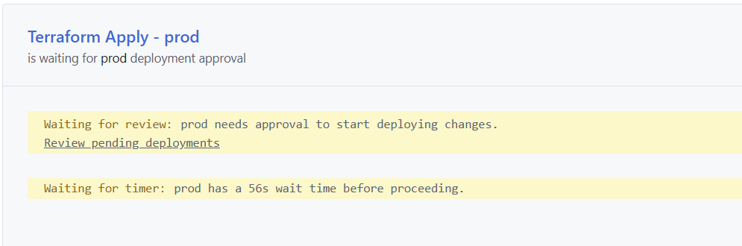

Slide 28


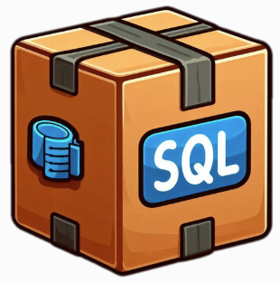

Automation – Big Boss Level
Notes:
1032
Three different actions – this is going to be a lot
But I wanted to build something you could take away and use
This demo will show you what we have and show you how it works – we won’t dig into all the specifics
Folder of terraform files in a git repo – pushed to GitHub – Triggers on commit of specific files → deploying Azure Infrastructure
SQL Project in a git repo → push to GitHub → Trigger on specific files → Deploy Database Changes
Create an issue in GitHub for a new database → GitHub Action to create database & optionally deploy SQL package

Slide 29
Automation – Big Boss Level
Notes:
1032
Three different actions – this is going to be a lot
But I wanted to build something you could take away and use
This demo will show you what we have and show you how it works – we won’t dig into all the specifics
Folder of terraform files in a git repo – pushed to GitHub – Triggers on commit of specific files → deploying Azure Infrastructure
SQL Package in a git repo → push to GitHub → Trigger on specific files → Deploy Database Changes
Create an issue in GitHub for a new database → GitHub Action to create database & optionally deploy SQL package

Slide 30


Demo Time
Demo Files available here:
github.com/jpomfret/dbatools-githubactions
References:
https://docs.github.com/en/actions
https://github.com/marketplace?type=actions
Notes:
1047

Slide 31




Questions & Feedback Please!
Jess Pomfret
jpomfret7@gmail.com
jesspomfret.com
linkedin.com/in/jpomfret/
github.com/jpomfret

Slide 32
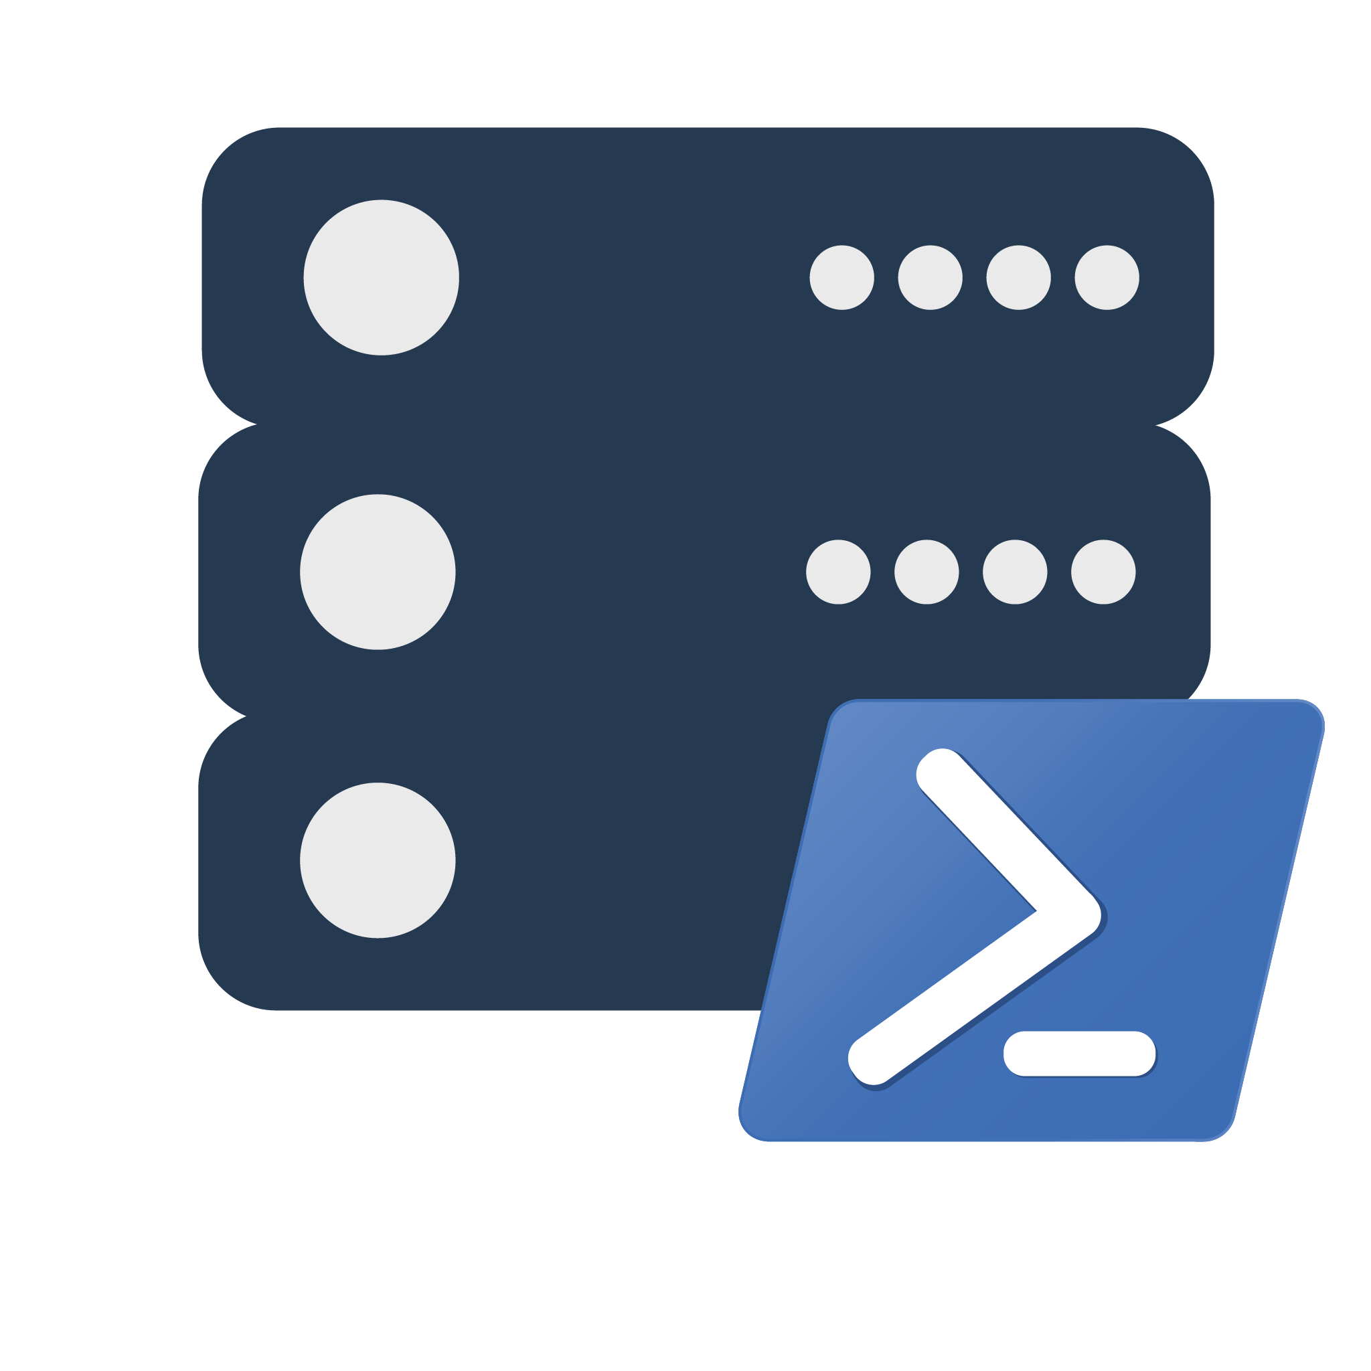


SQL Server Automation with PowerShell, dbatools and GitHub Actions

Slide 33

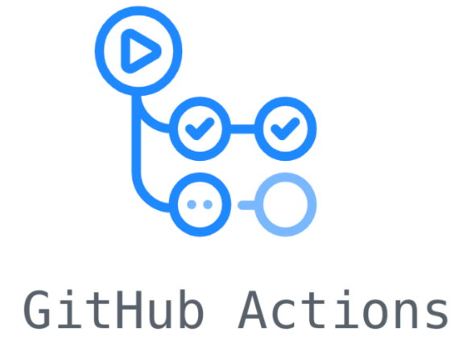

What’s the plan?
Quick Refresh of dbatools
GitHub Actions
Automation Project

Slide 34
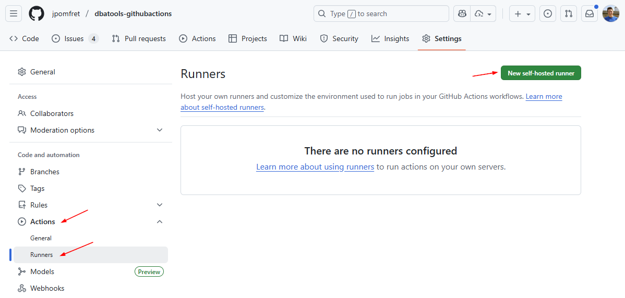
Install a Self-Hosted Runner

Slide 35
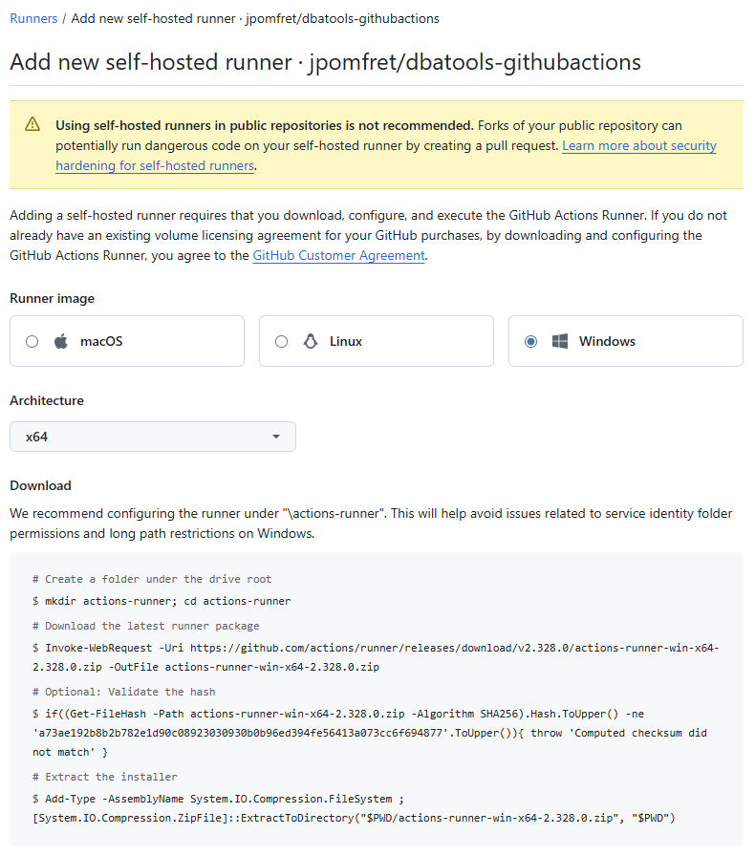

Slide 36
