Slide 1

SQL Server Automation
with PowerShell, dbatools
and GitHub Actions

Slide 2
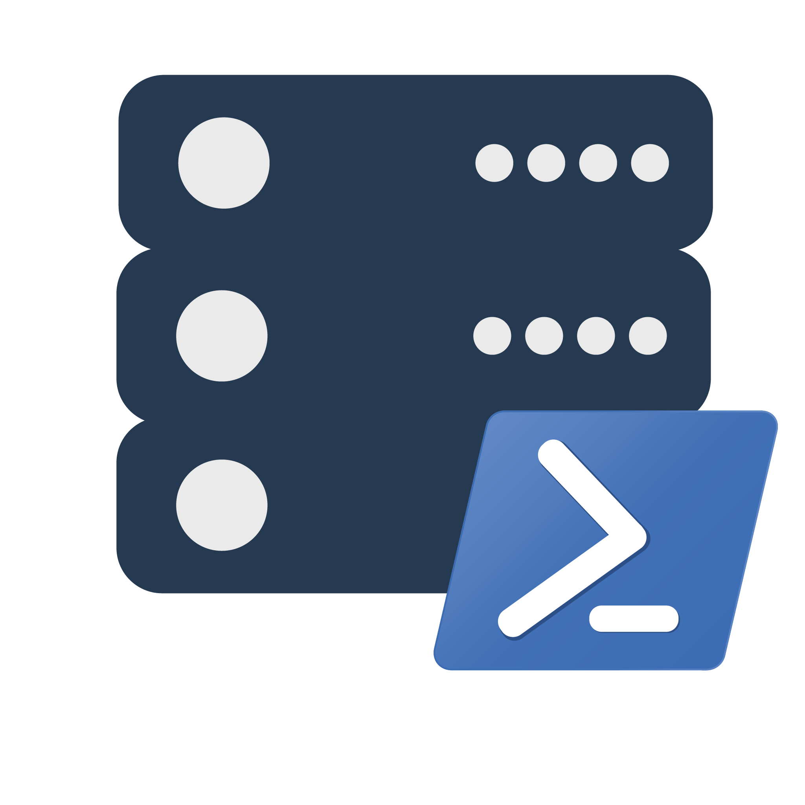


SQL Server Automation with PowerShell, dbatools and GitHub Actions

Slide 3



Jess Pomfret (She/Her)
Data Platform Engineer
LinkedIn Learning Instructor
Open Source Contributor
dbatools, MicrosoftFabricMgmt
Passionate about Automation, Proper Football & Fitness
jpomfret7@gmail.com
jesspomfret.com
linkedin.com/in/jpomfret/
Notes:
ADD Li instructor?

Slide 4
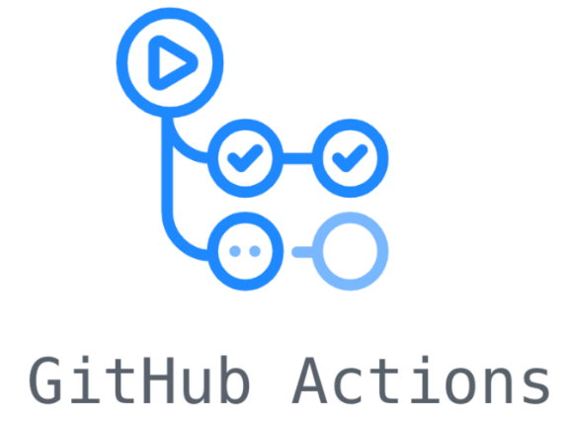



What’s the plan?
What are GitHub Actions?
Add in some PowerShell & dbatools
Automate some administration tasks
Notes:
Backups are useless if they can’t be restored
https://dbatools.io/dedicated-server/

Slide 5

GitHub Actions

Slide 6
GitHub Actions
CI\CD Platform
Allows you to automate things
Based on triggers
Schedule
Commit
Pull Request
Issue
Uses GitHub Hosted or Self-Hosted runners
Notes:
Who’s already using GitHub Actions?

Slide 7

Azure DevOps Pipelines
CI\CD Platform
Allows you to automate things
Based on triggers
Schedule
Commit
Pull Request
Work Item (not as easy – need to use webhook trigger)
Uses Microsoft Hosted or Self-Hosted agents

Slide 8
GitHub Actions use cases
On push – run automated tests
On schedule – look for issues that are stale
Manually – publish package to NuGet
On issue creation
Create a SQL Server database?
add article to replication?
Start an agent job?

Slide 9
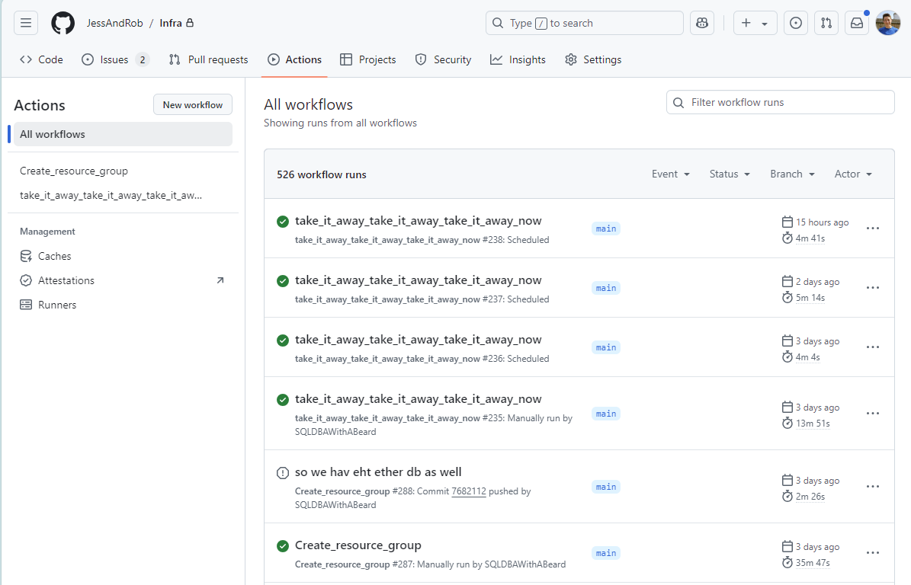
Notes:
Point out schedule runs
Manually triggered runs
One that was cancelled

Slide 10
Demo Time – Our first GitHub Action!
Mark stale issues and pull requests
AI Summaries?
Notes:
1442

Slide 11

dbatools
Notes:
1453

Slide 12
It’s like a command line SQL Server Management Studio If you can do it in SSMS – you can do it in dbatools* *mostly

Slide 13
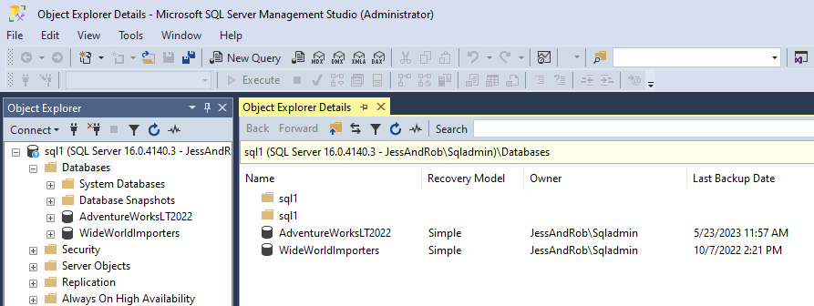
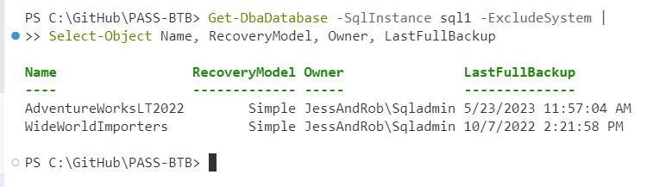
Get Database Info for User Database on Sql1

Slide 14
Get Database Info for User Database on Sql1

Slide 15
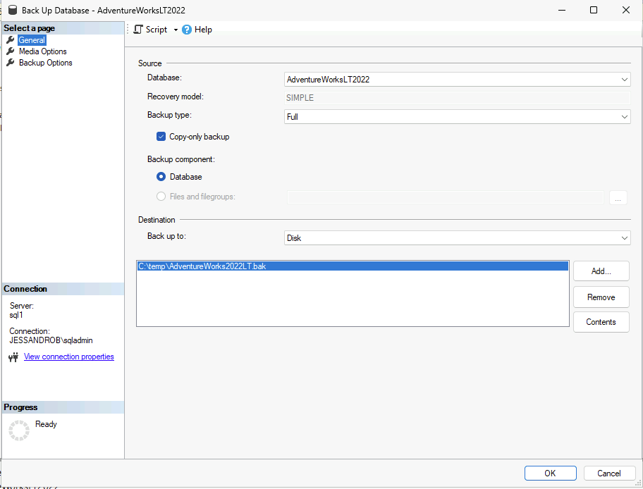
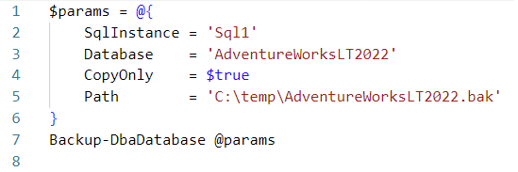
Backup a database on Sql1
Notes:
Right click database > tasks > backup

Slide 16
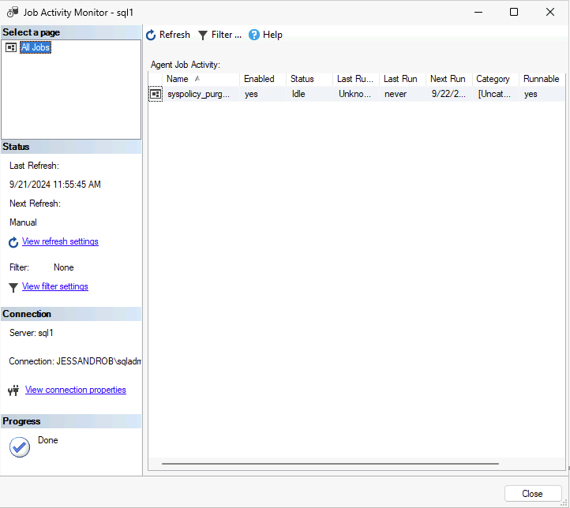
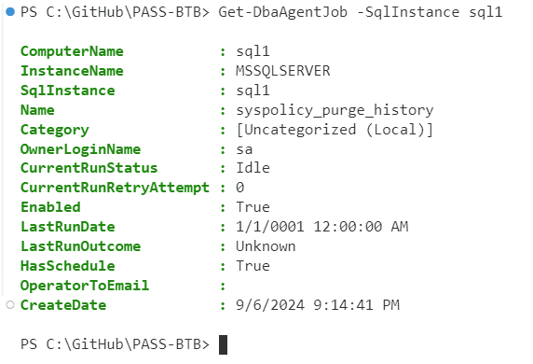
Get SQL Agent jobs on Sql1

Slide 17
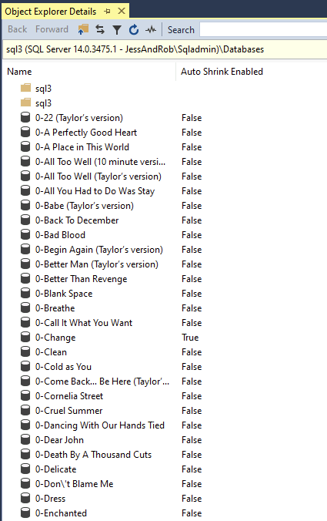
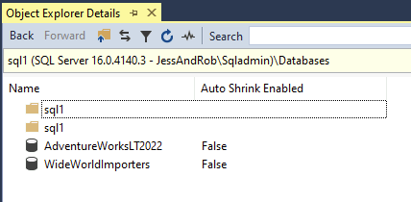
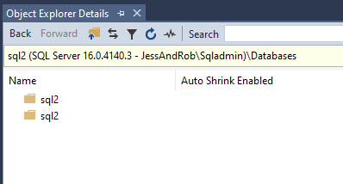
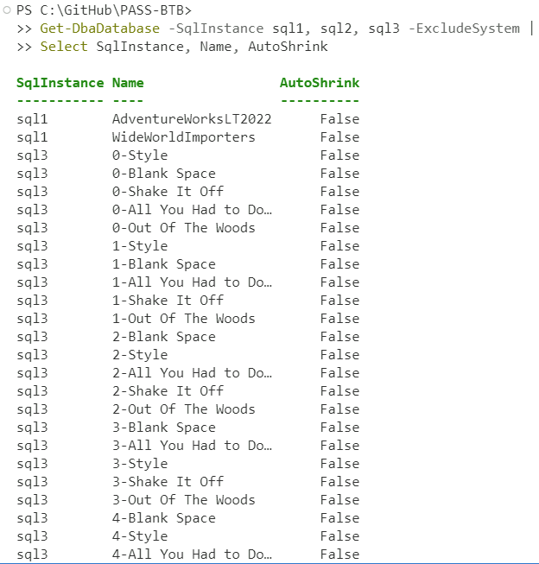
Get Database Name and AutoShrink status on Sql1, Sql2 and Sql3

Slide 18
Get Database Name and AutoShrink status on Sql1, Sql2 and Sql3

Slide 19
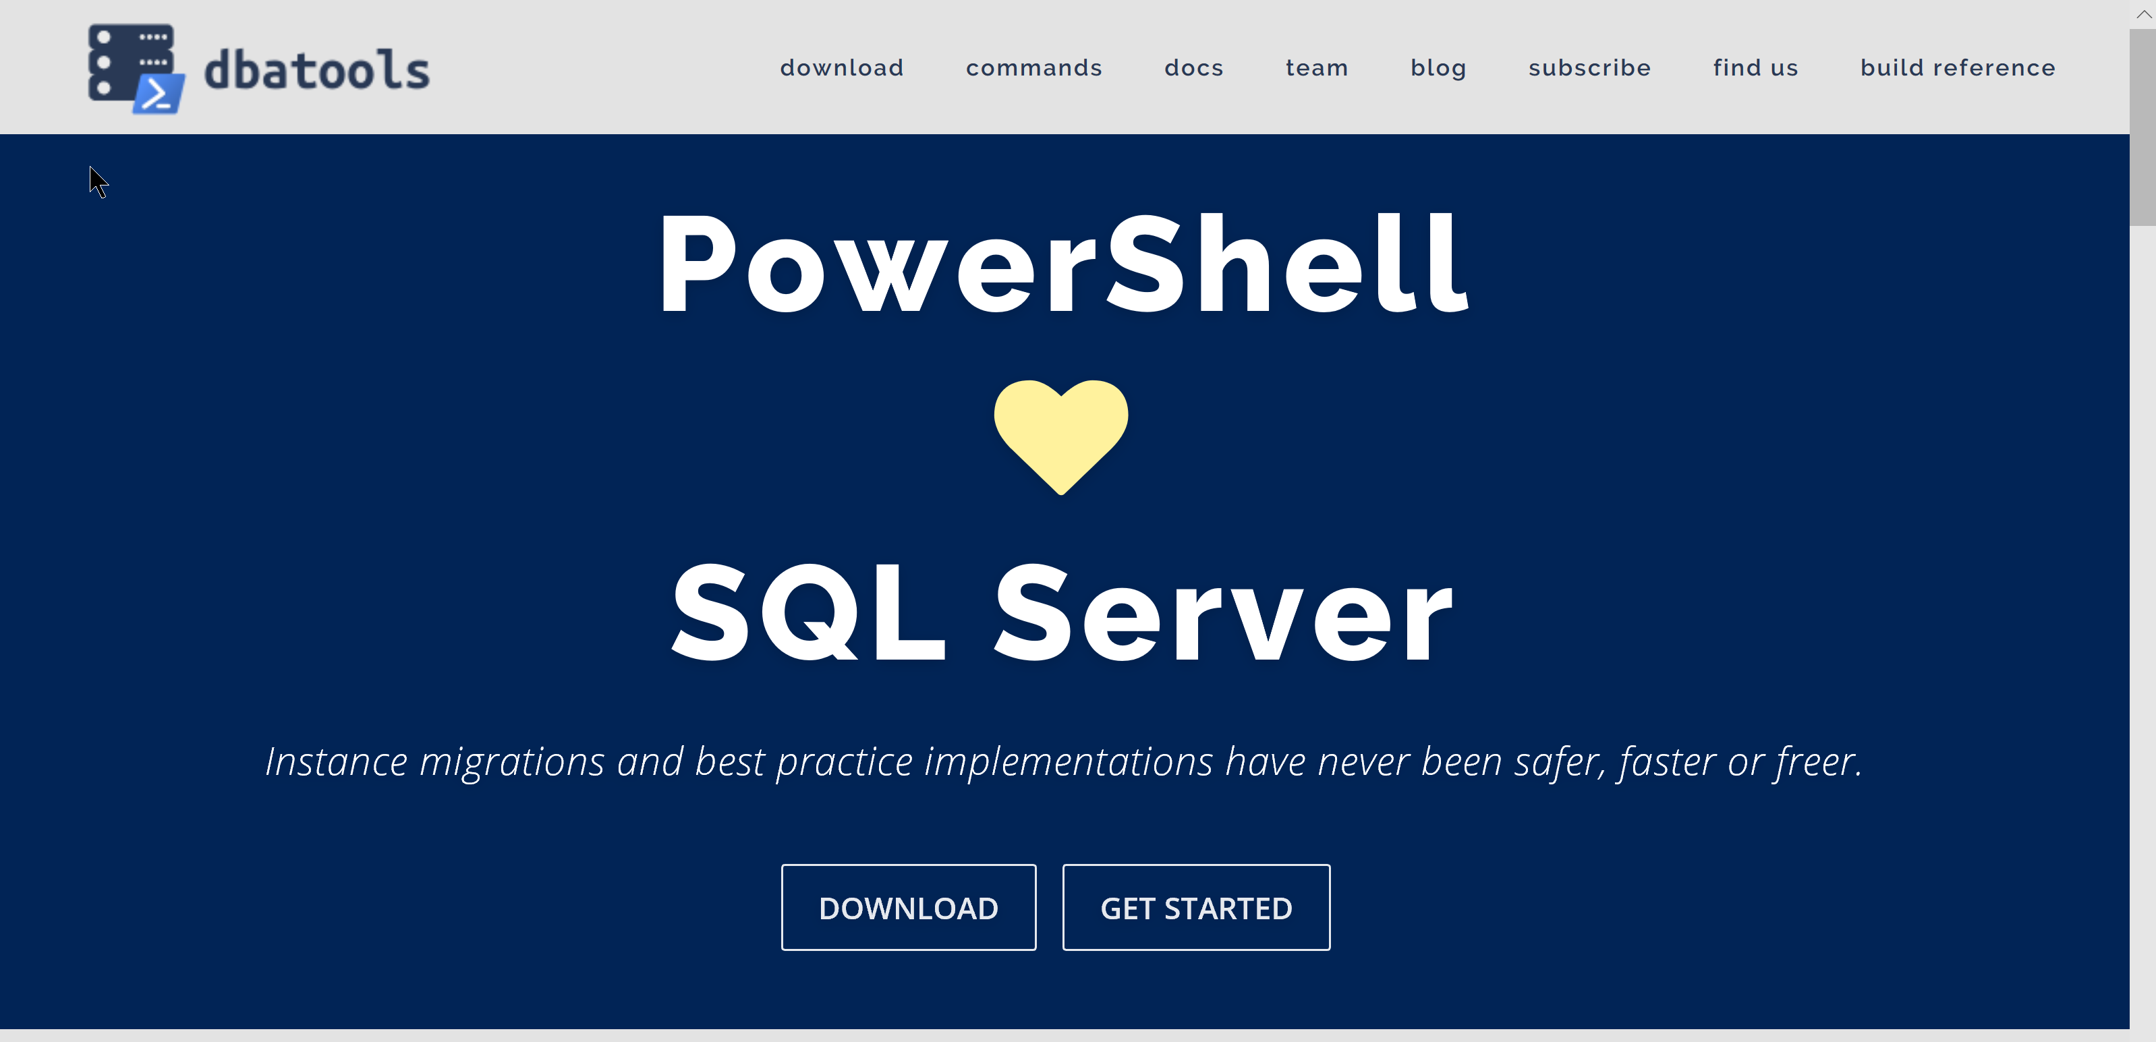
dbatools.io

Slide 20
Demo Time – dbatools Magic
Create a new database
Backup some databases
Collect some information
Notes:
1458

Slide 21
GitHub Actions & dbatools
Notes:
1510

Slide 22

GitHub Actions - Runners
Where the code runs
GitHub-hosted runners
Self-hosted runners
https://docs.github.com/en/actions/concepts/runners
Notes:
GitHub Hosted
GitHub Actions usage is free for standard GitHub-hosted runners in public repositories
Series of types you can choose – windows, linux, different versions
Self-hosted
More control
Free to use
Inside your network so access to things
Note – if you swap your repo to be public you need to change a setting that allows your self-hosted runner to run – otherwise it sits there waiting for jobs, and your actions sit there waiting for runners

Slide 23
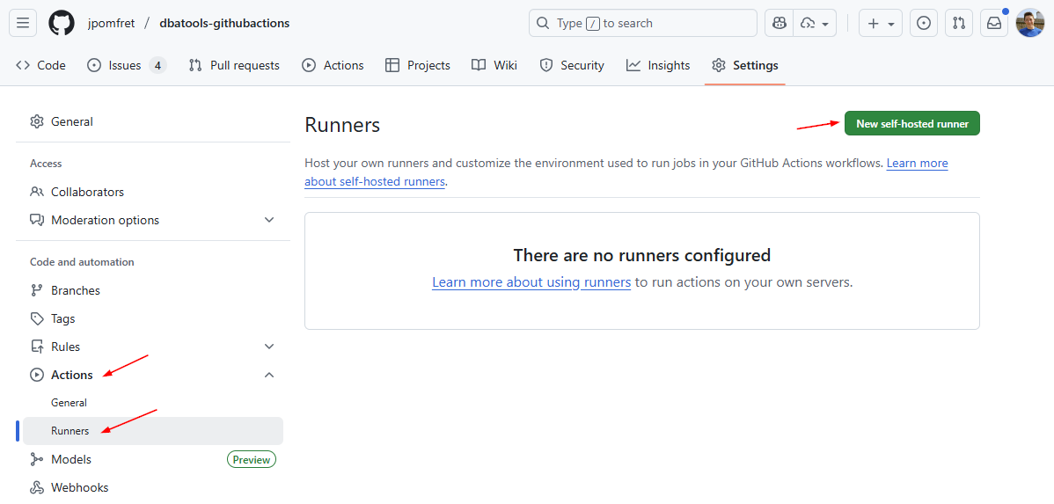
Install a Self-Hosted Runner

Slide 24
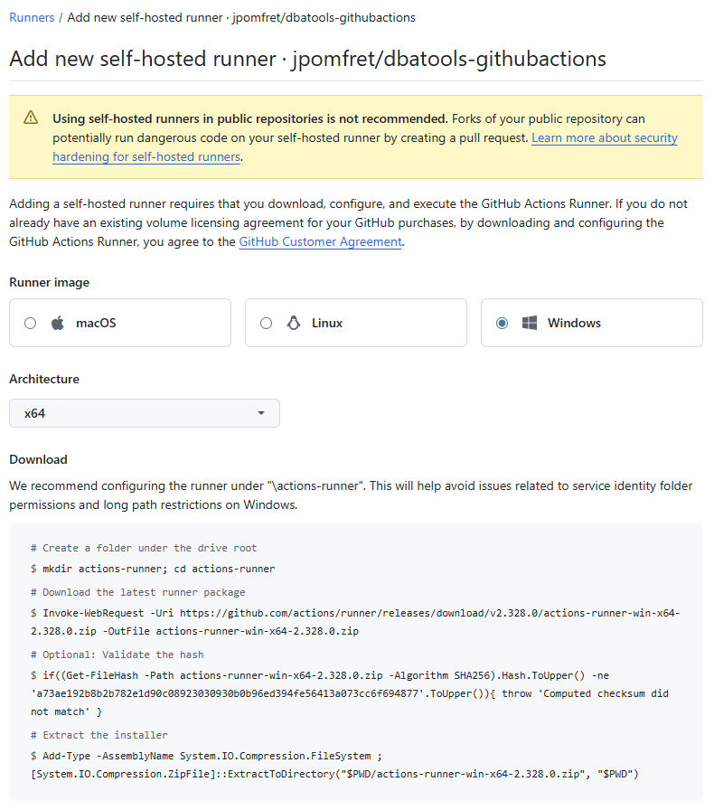

Slide 25
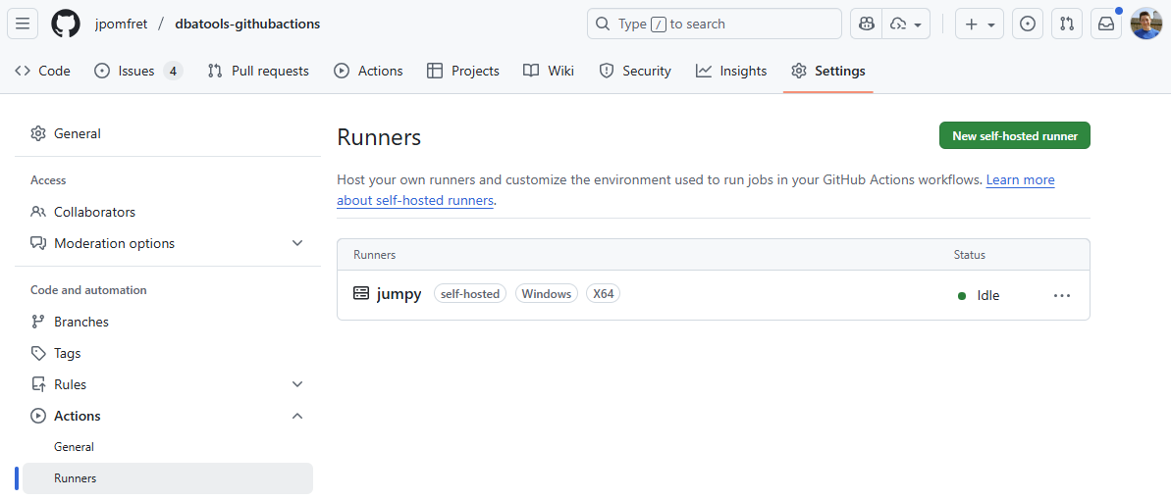

Slide 26
Demo Time – extra magic
On issue creation
Create a new database
Add article to replication
On commit
Deploy database code
Notes:
1512

Slide 27


Demo Time
Demo Files available here:
https://github.com/jpomfret/dbatools-githubactions

Slide 28




Questions?
Jess Pomfret
jpomfret7@gmail.com
jesspomfret.com
linkedin.com/in/jpomfret/
github.com/jpomfret

