Slide 1
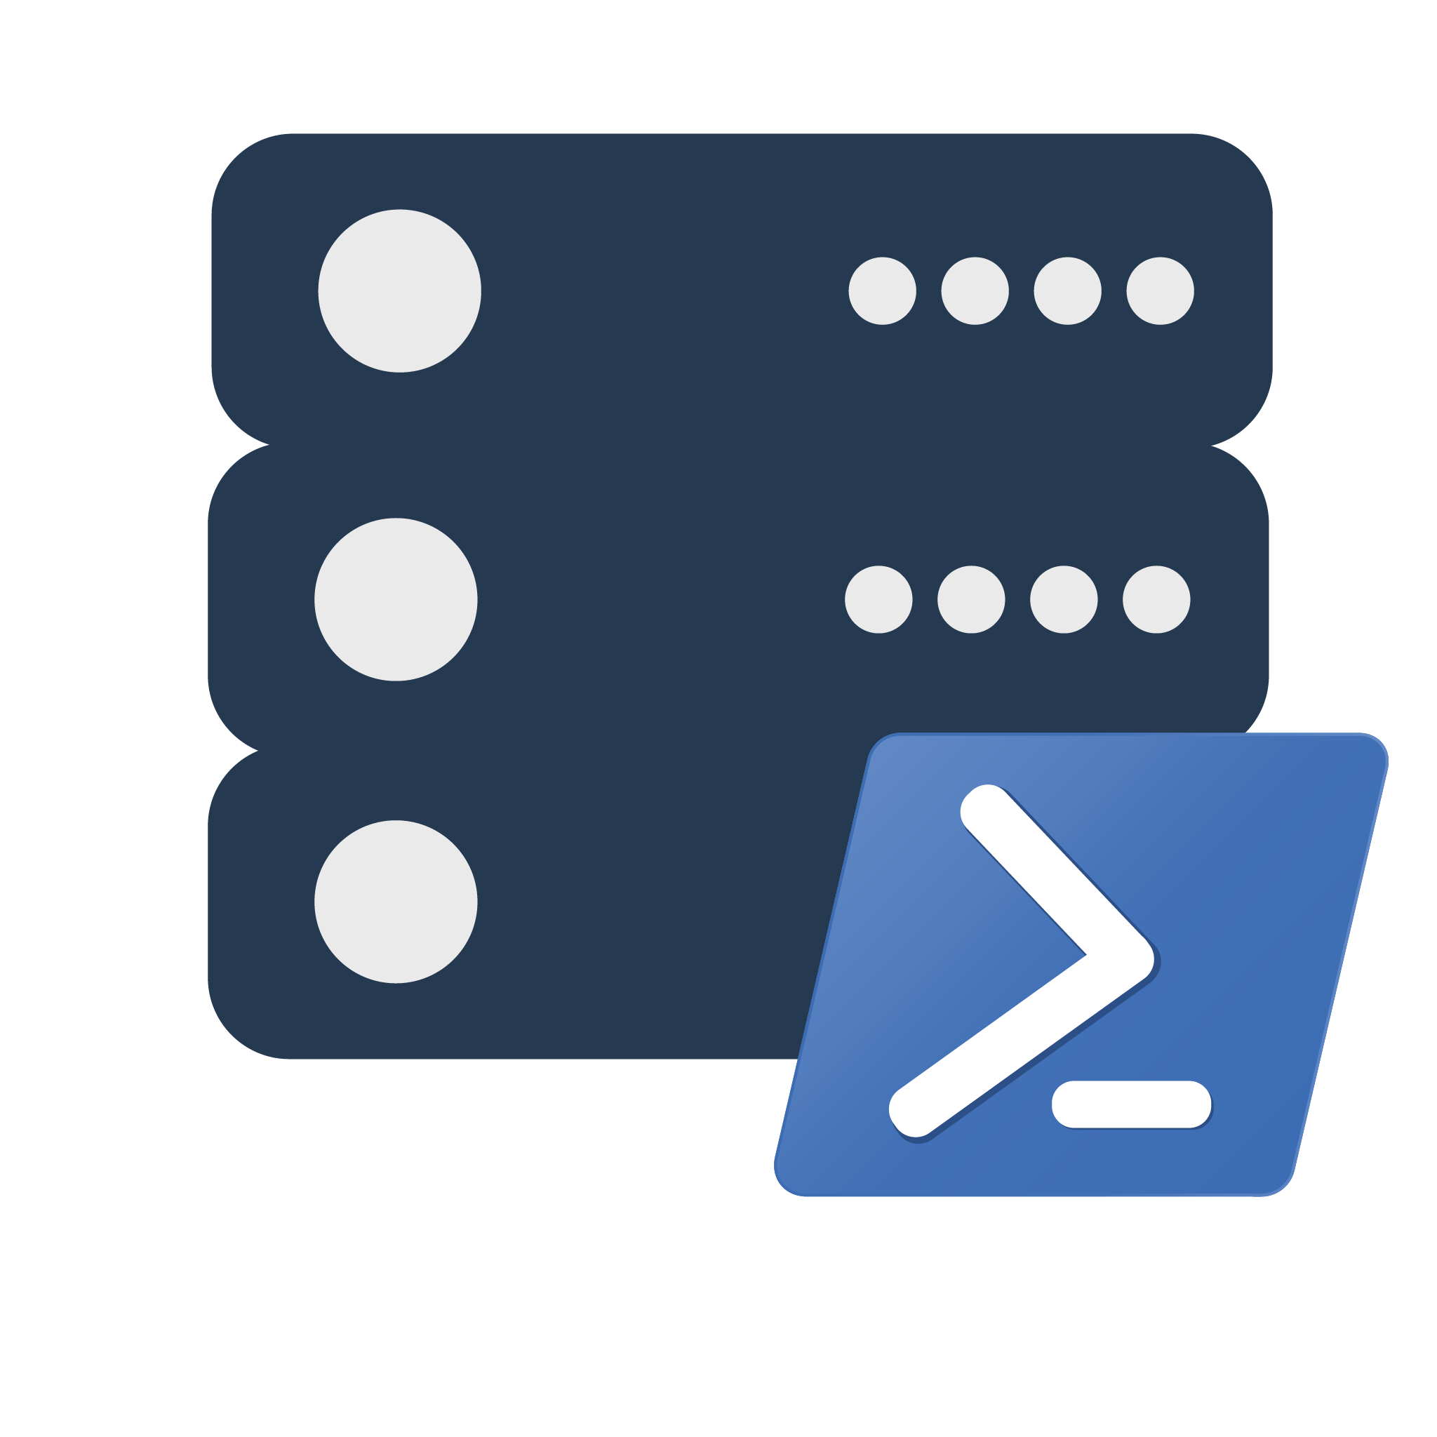
dbatools 💜 Replication

Slide 2



Jess Pomfret (She/Her)
Data Platform Engineer
Open Source Contributor
dbatools, dbachecks, SqlServerDsc
Passionate about SQL Server, PowerShell & Proper Football
jpomfret7@gmail.com
linkedin.com/in/jpomfret/

Slide 3

Agenda
What is dbatools?
What is replication?

Slide 4
Agenda
dbatools and replication!

Slide 5
Warnings
I’m definitely not a replication expert!
This is not a Replication best practice session
Notes:
We will cover what replication is and how it works

Slide 6
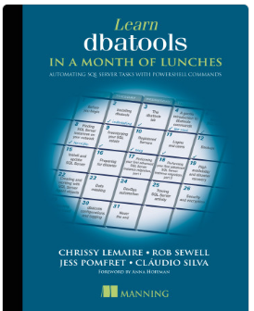
dbatools
Open-source PowerShell Module
Written by the community
650+ commands
https://dbatools.io/
https://github.com/dataplat/dbatools

Slide 7
Replication 101
Add William slides

Slide 8
dbatools commands for replication
Distribution
Publications
Articles
Subscriptions
Enable-DbaReplDistributor
Publishing
Disable-DbaReplDistributor
Enable-DbaReplPublishing
Disable-DbaReplPublishing
New-DbaReplPublication
Remove-DbaReplPublication
Get-DbaReplArticle
Get-DbaReplArticleColumn
Add-DbaReplArticle
Remove-DbaReplArticle
New-DbaReplCreationScriptOptions
Get-DbaReplDistributor
Get-DbaReplPublication
New-DbaReplSubscription
Get-DbaReplSubscription
Remove-DbaReplSubscription
Get-DbaReplServer
Misc

Slide 9
Demo Time
Demo Files available here:
https://github.com/jpomfret/dbatools-replication
dbatools PR:
https://github.com/dataplat/dbatools/pull/8958
Notes:
620

Slide 10
Questions & Feedback
https://github.com/jpomfret/dbatools-replication
Jess Pomfret
jpomfret7@gmail.com
JessPomfret.com

