Slide 1
Life Hacks: dbatools edition
Jess Pomfret

Slide 2
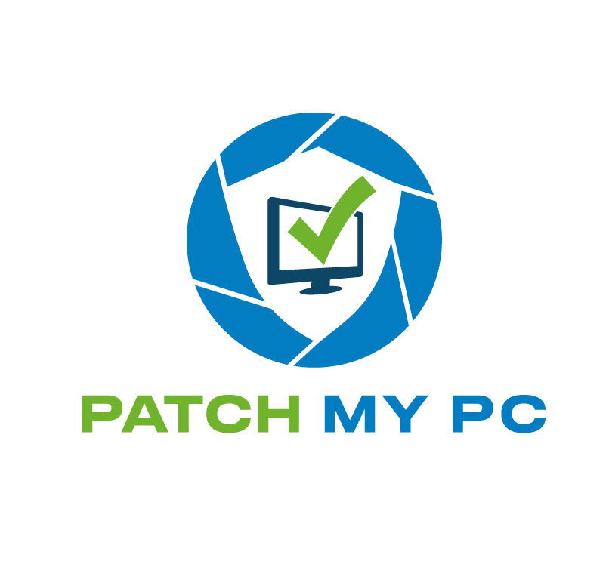

Many thanks to our sponsors!

Slide 3

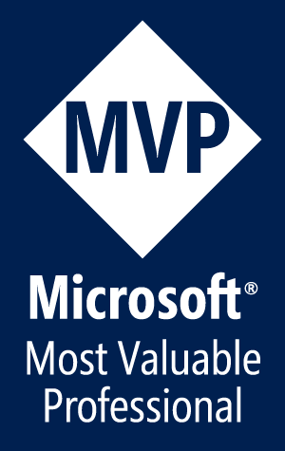


Jess Pomfret
(she/her)
Data Platform Architect
Open Source Contributor
dbatools, dbachecks, SqlServerDsc
Passionate about SQL Server, PowerShell & Proper Football
jpomfret7@gmail.com
LinkedIn - jpomfret

Slide 4
Agenda
What is dbatools?
PowerShell 101\Intro to dbatools
Life Hacks
Test Your Backups
Manage Logins & Access
Database Snapshots
Migrate… Everything
Meet Best Practices
Documentation for everyone

Slide 5
What is dbatools?
Open Source PowerShell Module
Command line SSMS
Great for handling multiples
MIT Licensed
“A short and simple permissive license”
Secure!
PowerShell - “Secure by Design”
Code Signed
Pester tests
Branch policies
Notes:
PowerShell Module – Command line SSMS
- makes it easier to manage multiples… multiple servers, databases, jobs, logins, etc.
Support all the ways to login to SQL Server that SSMS does (including Multi Factor Authentication)
Support SQL Server 2000 and PowerShell 3 wherever possible – goal is still to make migrations easy
Support for Azure (can migrate to Azure Managed Instances)
Over 75% of commands run on Mac OS and Linux
MIT license - https://dbatools.io/mit/ - only requirement is to maintain copywrite and license notices.
OK for private use or commercial use, modification, distribution
Talking to your company about dbatools - https://dbatools.io/secure/
PowerShell team works hard at “Secure by Design”
Code signed – verifies the code you receive hasn’t been modified by a third party. Chrissy & Rob are the only people who can sign dbatools releases
Enterprise ready
Pester tests
Restricted merging to master branch
PowerShell gallery runs a virus scan against the module

Slide 6
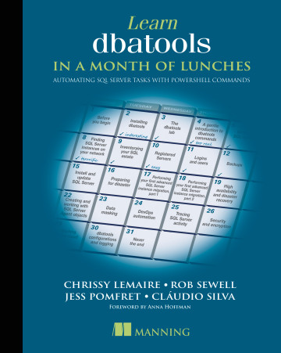
dbatools: a short history
Created by Chrissy LeMaire to migrate SharePoint instances
September 2015 – First commit to GitHub
June 2019 – 1.0 launch at DataGrillen
July 2021 – 1.1 update – SMO, Azure connections
Coming soon – 2.0 – New SMO, Replication, more!
533 Commands (2020-03-01) – v1.1.145
590 Pester tests1
Learn dbatools in a Month of Lunches
Notes:
2014 – Chrissy had to do a SharePoint migration – lot of databases/logins/jobs/etc.
1.0 - Over 160 contributors and 550 commands
Standardize naming
Standardize parameters
https://dbatools.io/meap/ (16/28 chapters available)
Release v1.1.0 · sqlcollaborative/dbatools (github.com)
Early days – Chrissy would troll reddit, looking for common problems, automating them and then adding them to dbatools

Slide 7
Demos
We love Demos!
https://github.com/jpomfret/dbatoolsLifehacks

Slide 8
Q&A
jpomfret7@gmail.com
LinkedIn - jpomfret
15 minutes

