Slide 1
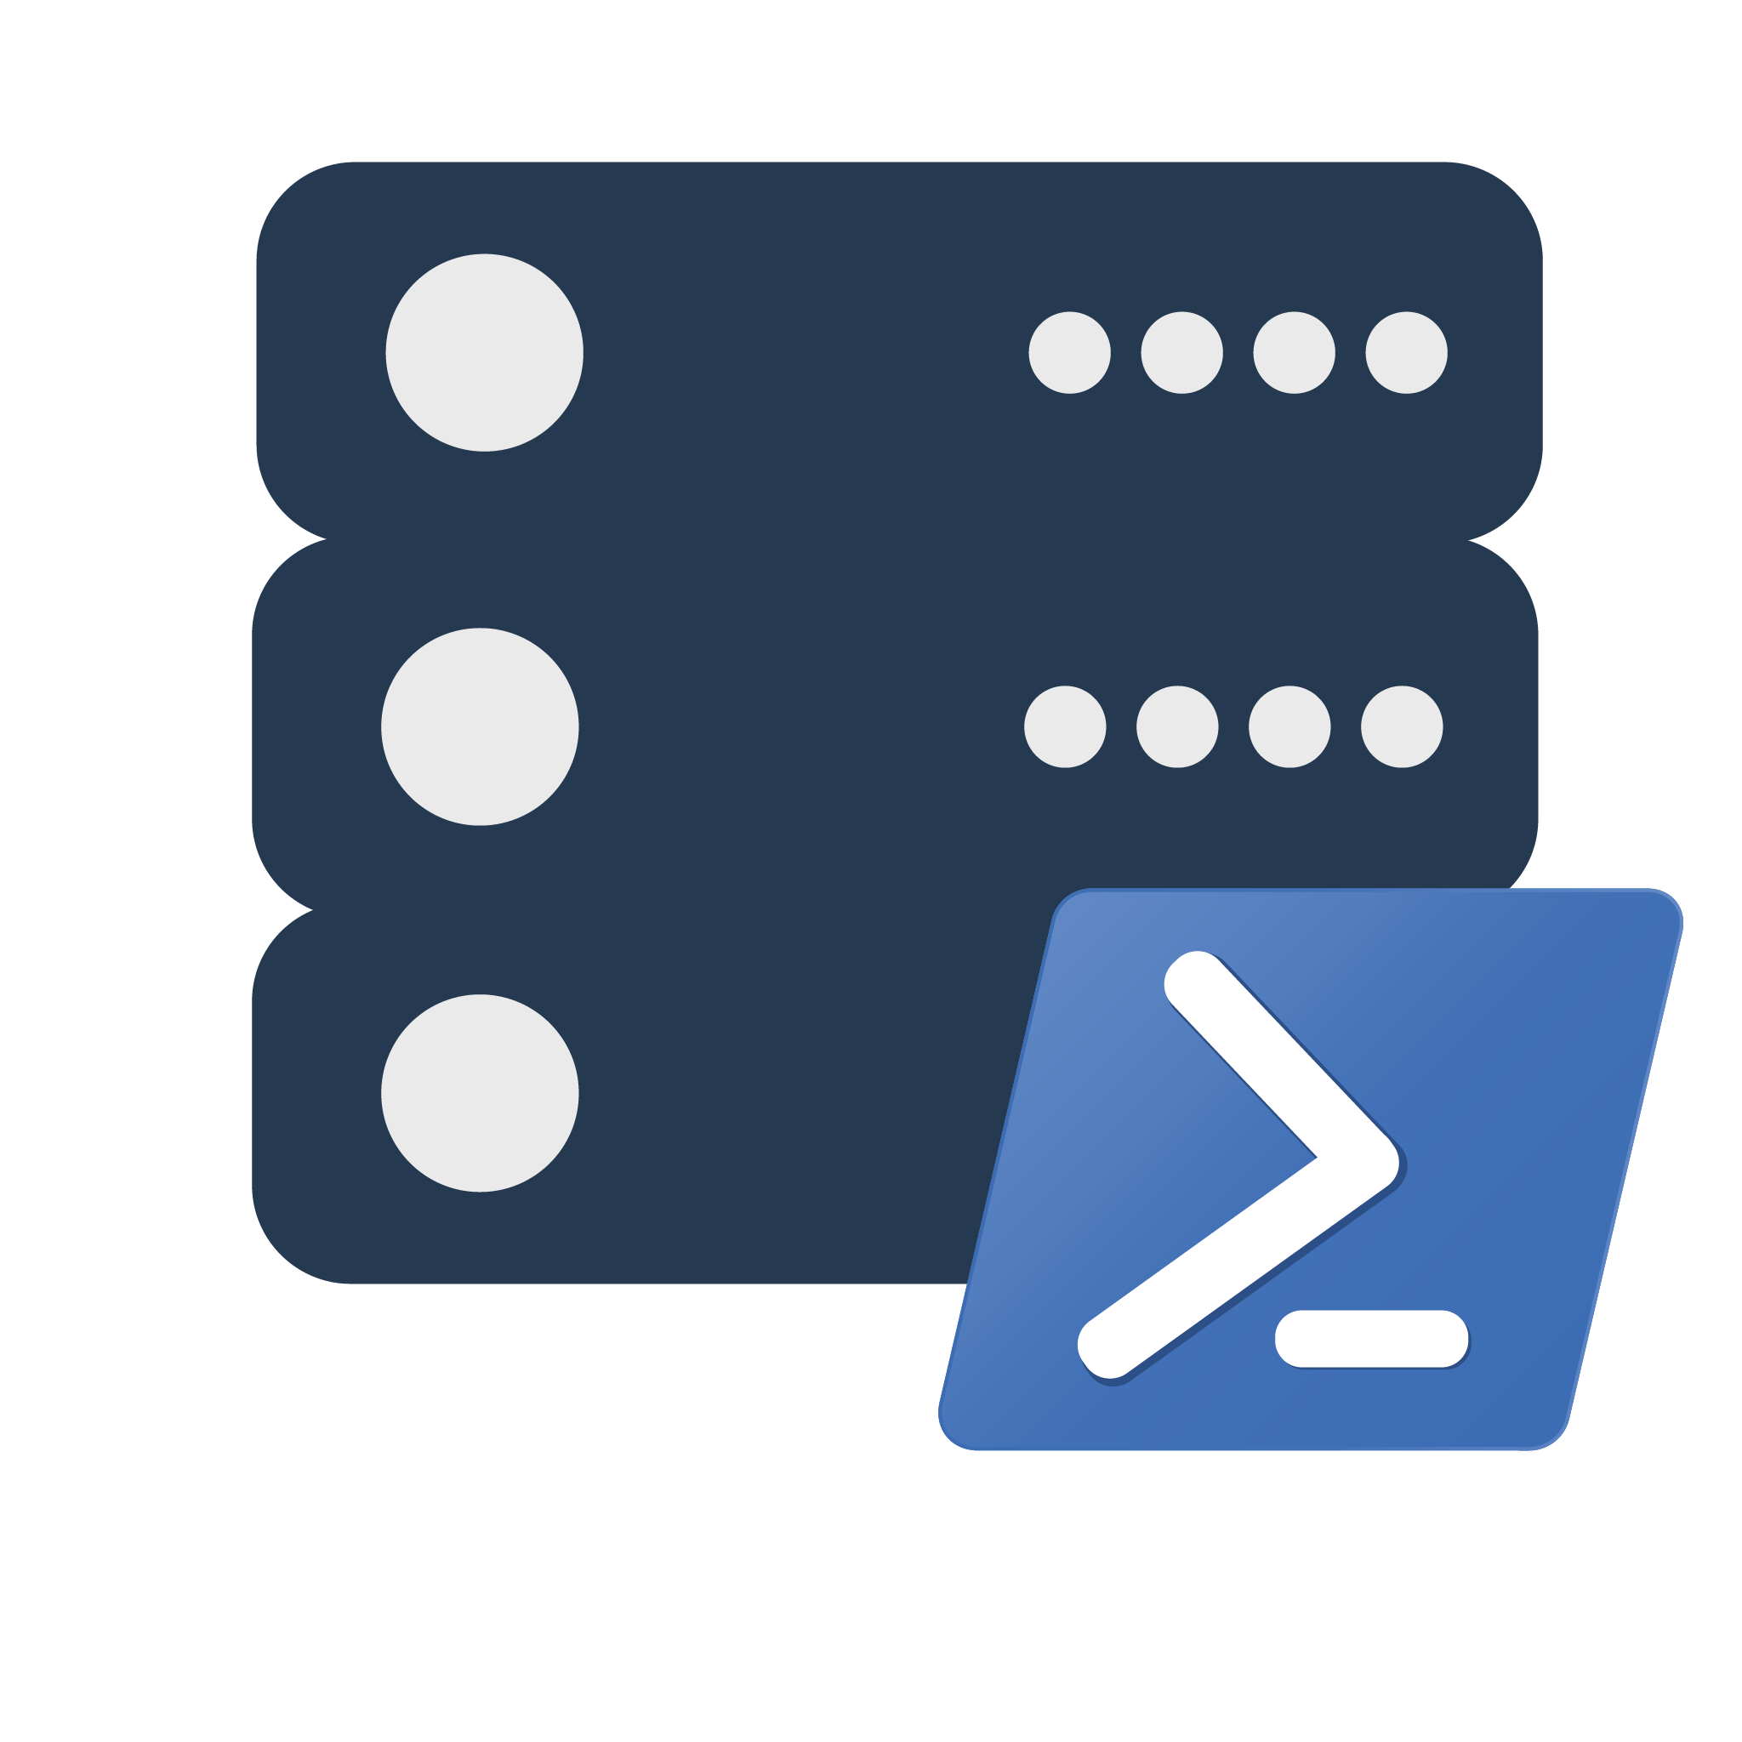
dbatools 💜 SQL 2022

Slide 2



Jess Pomfret (She/Her)
Data Platform Architect
Open Source Contributor
dbatools, dbachecks, SqlServerDsc
Passionate about SQL Server, PowerShell & Proper Football
jpomfret7@gmail.com
https://tech.lgbt/@Jpomfret

Slide 3
Agenda
What is dbatools?
Migrate to SQL Server 2022
Planning – the hard part
Migrating – the easy part
Notes:
Backups are useless if they can’t be restored
https://dbatools.io/dedicated-server/

Slide 4
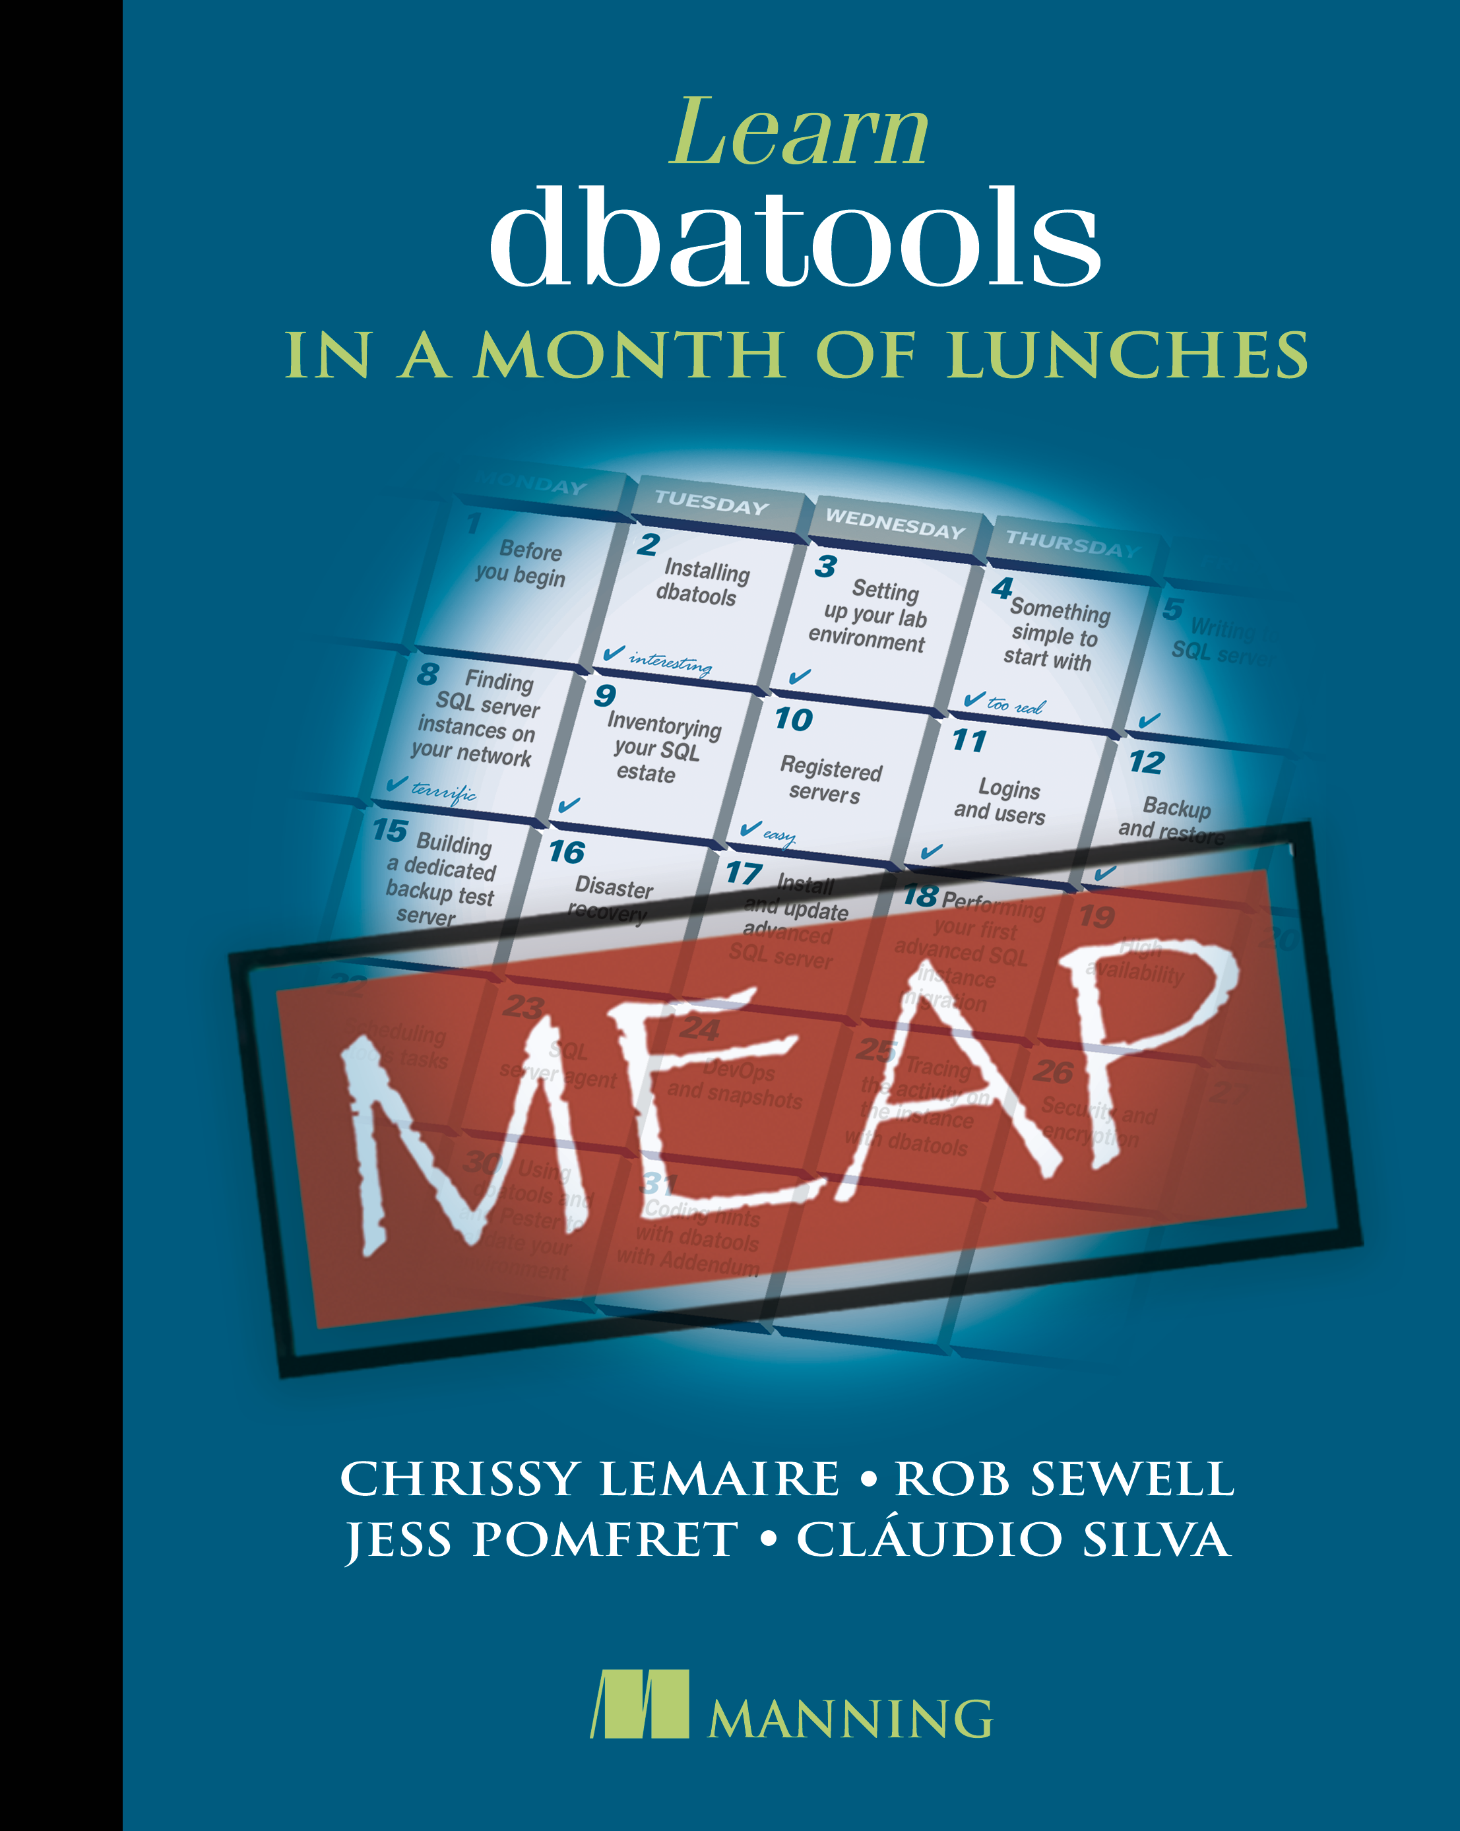
What is dbatools?
Open Source PowerShell Module
Command line SSMS
Great for handling multiples
MIT Licensed
“A short and simple permissive license”
Secure!
PowerShell - “Secure by Design”
Code Signed
Pester tests
Branch policies
au35pom
Notes:
PowerShell Module – Command line SSMS
- makes it easier to manage multiples… multiple servers, databases, jobs, logins, etc.
Support all the ways to login to SQL Server that SSMS does (including Multi Factor Authentication)
Support SQL Server 2000 and PowerShell 3 wherever possible – goal is still to make migrations easy
Support for Azure (can migrate to Azure Managed Instances)
Over 75% of commands run on Mac OS and Linux
MIT license - https://dbatools.io/mit/ - only requirement is to maintain copywrite and license notices.
OK for private use or commercial use, modification, distribution
Talking to your company about dbatools - https://dbatools.io/secure/
PowerShell team works hard at “Secure by Design”
Code signed – verifies the code you receive hasn’t been modified by a third party. Chrissy & Rob are the only people who can sign dbatools releases
Enterprise ready
Pester tests
Restricted merging to master branch
PowerShell gallery runs a virus scan against the module

Slide 5
Migrating to SQL Server 2022
2022 supports upgrades from 2012+
source database compatibility level is 90+
2022 supports backups from 2008
Notes:
90 – SQL Server 2005 – Migrate this to 2022 and the compat level will be bumpd to 100, all other compat levels will remain unchanged on upgrade

Slide 6
Migrating to SQL Server 2022
Why?
New stuff
Availability improvements
Security
Query Store and Intelligent Query Processing
T-SQL additions
Stay on supported technology
Notes:
Availability
Link to Azure SQL Managed Instances
Security
Purview integration access policies
Query Store and Intelligent Query Processing
Query store on secondary replicas
Query store hints – shape plans without code changes
Parameter sensitive plan optimization
T-SQL
New JSON and time series and aggregate functions
Stay on supported tech – who still has a 2000 box? Keeping up with the newer versions means less major upgrades (2019→2022 not as difficult as 2000→2022)

Slide 7
Migrating to SQL Server 2022
How?
In-place upgrade
Side-by-Side upgrade ➡️ Migration
Rolling upgrade
Notes:
In-place
Easiest
Downtime during the upgrade
Longer rollback
Side-by-side\Migration
New hardware, new OS
Migrate databases, logins, linked servers, jobs, etc.
Make sure you get everything
Repoint application \ change connection strings – use DNS aliases to make this easier
Rollback easy – just repoint at old databases (until you start adding data to new databases)
Rolling upgrade
AlwaysOn Availability Group
Failover Cluster Instances
Mirroring\Log Shipping

Slide 8

Migrating to SQL Server 2022
How?
In-place upgrade
Side-by-Side upgrade ➡️ Migration
Rolling upgrade
Notes:
In-place
Easiest
Downtime during the upgrade
Longer rollback
Side-by-side\Migration
New hardware, new OS
Migrate databases, logins, linked servers, jobs, etc.
Make sure you get everything
Repoint application \ change connection strings – use DNS aliases to make this easier
Rollback easy – just repoint at old databases (until you start adding data to new databases)
Rolling upgrade
AlwaysOn Availability Group
Failover Cluster Instances
Mirroring\Log Shipping

Slide 9
dbatools
Easily Migrate
Databases
Logins
Jobs
…?

Slide 10
Demo Time
Demo Files available here:
https://github.com/jpomfret/dbatoolsmigrate2022

Slide 11
Questions?
Jess Pomfret
https://tech.lgbt/@Jpomfret
jpomfret7@gmail.com
www.JessPomfret.com
https://github.com/jpomfret/dbatoolsmigrate2022

