Slide 1

Data Compression
Squeeze Into Some Free Gains
Notes:
Slides and scripts available:
https://github.com/jpomfret/demos/tree/master/DataCompression

Slide 2
About Me
Jess Pomfret
SQL Server DBA at Westfield Insurance, Ohio
Open Source Contributor (dbatools, dbachecks, SqlServerDsc)
Passionate about SQL Server, PowerShell & Proper Football
jpomfret7@gmail.com
@jpomfret

Slide 3
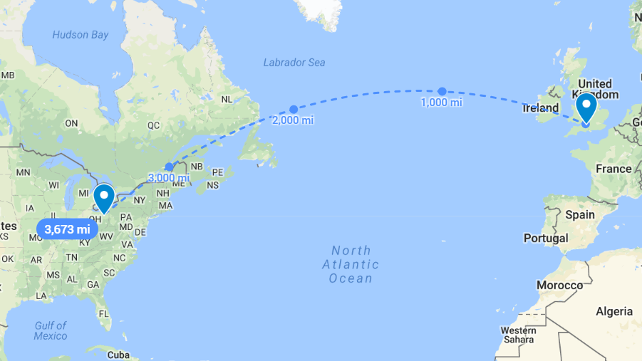

Slide 4
Agenda
Advantages/Disadvantages of Data Compression
What you can Compress
Types of Compression
What you should Compress
How you can Compress
Performance implications
Wizardry

Slide 5
SQL Server Editions
 | Standard Edition | Enterprise Edition
SQL Server 2008 |  | ✓
SQL Server 2008 R2 |  | ✓
SQL Server 2012 |  | ✓
SQL Server 2014 |  | ✓
SQL Server 2016 | SP1+ | ✓
SQL Server 2017 | ✓ | ✓
SQL Server 2019 | ✓ | ✓
Azure SQL Database | ✓
Azure SQL Database Managed Instance | ✓
Notes:
Data compression has been around since 2008, why is it important now?
SQL Server 2019
sp_estimate_data_compression_savings – now supports COLUMNSTORE and COLUMNSTORE_ARCHIVAL as options

Slide 6
Advantages of Data Compression
Reduces database size
More data per page
  Improved performance for I/O intensive workloads
  More rows in memory

Slide 7
Disadvantages of Data Compression
CPU cost of compressing and decompressing
Slightly slower single row inserts/updates
Slower bulk updates/inserts
Notes:
CPU cost – Microsoft Whitepaper says 10% or less for row
Data is decompressed when it is needed for filtering/joining/sorting/query response or when it is updated by application.
And we’ll talk more about the performance costs later on

Slide 8
Disadvantages of Data Compression
Enterprise Level feature*
Can’t restore a compressed database to a Standard edition instance
Failure occurs when SQL Server attempts to bring the database online, after however long it took to restore!
Check for enterprise features sys.dm_db_persisted_sku_features
Notes:
Enterprise level feature if you’re on a version older than 2016 SP1, as a side note if you have a enterprise level system and you use data compression you can no longer restore/attach/etc. this database to a standard edition. Could be a problem if you say refresh test from production, but I’m sure no one does that ☺
Also it is important to note that if you do try and restore this backup that includes enterprise level features to your standard edition server it won’t let you know before you wait 5 hours for that database to restore. It’ll work away, everything is looking good, then when the restore is basically complete and SQL Server tries to bring it online, failure. Database cannot be started in this edition…

Slide 9
What Can You Compress?
Table
  Heap
  Clustered Index
Nonclustered Index
Indexed Views
Individual Partitions
Notes:
If you add a NC index it defaults to NONE, no matter what the current compression setting on the table is.
If you add a CL index on a heap it will by default inherit the compression setting of the heap
If you have a table partitioned by month, where there is a lot of read and write activity on the current month it might not make sense to compress that. However it might make sense to compress the older months which are just used for read activity or reporting.
Compression & Encryption: compress first, then encrypt (TDE). When you compress data is re-written as un-encrypted data and then encrypted.
Application encryption can be used, but effect of compression will be lessened since encrypted data is more unique.
TDE + backup compression – same deal, pages are backed up encrypted, therefore more unique data so less compression gains
Row/Page Compression + Backup Compression - https://jesspomfret.com/double-compression/
none we get a 78% reduction in the size of the backup file.
row compressed we get a 70% savings
page compressed we still get a 60% reduction in size

Slide 10
What can’t be compressed?
System tables
Memory-optimized tables
Tables with Sparse columns
If maximum row size plus the compression overhead exceeds the maximum row size (8060 bytes)
Notes:
Table cannot be enabled for compression when the maximum row size plus the compression overhead exceeds the maximum row size (8060 bytes)
Row-size check is performed when an object is initially compressed and checked when rows are inserted/updated
Update to fixed-length must always succeed
Disabling data compression must always succeed – even if the compressed row fits an update will fail if the row when uncompressed would not fit
Unsupported with compression:
Data compression is not supported for memory-optimized tables.
Because of their size, large-value data types are sometimes stored separately from the normal row data on special purpose pages. Data compression is not available for the data that is stored separately

Slide 11
Compression Types
Row
Page
Columnstore
Columnstore Archival
Backup Compression
Notes:
Backup compression also came out in 2008
Columnstore 2012

Slide 12
Row Compression
Changes physical storage format of the data
Variable length storage for fixed length datatypes
  smallint, int, bigint – only uses the bytes needed
  datetime, datetime2 – uses integer date representation with two 4-byte integers
  char – trailing spaces removed
  bit – metadata overhead brings this to 4 bits
Notes:
Smallint – 2 bytes
Int – 4 bytes
Bigint – 8 bytes

Slide 13
Row Compression
EmployeeID | FirstName | LastName | Address1 | City
1 | Alex | Young | 2 Sand Run | Akron
2 | Richard | Young | 77 High St. | Akron
3 | Alexis | Young | 1 First Ave. | Richfield
bigint | char(100) | char(100) | char(250) | char(50)
1 | Alex | Young | 2 Sand Run | Akron
2 | Richard | Young | 77 High St. | Akron
3 | Alexis | Young | 1 First Ave. | Richfield
Notes:
Now our database designer is not a fan of variable length columns, you can see that there is a lot of whitespace.
Data isn’t stored exactly like this on pages, but when you have fixed length columns with data values that don’t take up all the allotted room you get a lot of white space on your pages.
This is important since SQL Server reads pages into memory and you want to be as efficient as you can with your memory.
And we have a local family business here so lots of repeating data in LastName and City.
Bigint – was taking up 8 bytes. 1,2 and 3 all fit in one byte so that’s all they get.
Char fields – all the trailing white space is gone, they only get the bytes they need.

Slide 14
Page Compression
Row Compression
Prefix Compression
Dictionary Compression
Notes:
Prefix and dictionary are type agnostic – can replace duplicate values from any data type

Slide 15
Page Compression
EmployeeID | FirstName | LastName | Address1 | City
1 | Alex | Young | 2 Sand Run | Akron
2 | Richard | Young | 77 High St. | Akron
3 | Alexis | Young | 1 First Ave. | Richfield
bigint | char(100) | char(100) | char(250) | char(50)
Step 1 – Row Compression
1 | Alex | Young | 2 Sand Run | Akron
2 | Richard | Young | 77 High St. | Akron
3 | Alexis | Young | 1 First Ave. | Richfield

Slide 16
Page Compression
EmployeeID | FirstName | LastName | Address1 | City
1 | Alex | Young | 2 Sand Run | Akron
2 | Richard | Young | 77 High St. | Akron
3 | Alexis | Young | 1 First Ave. | Richfield
bigint | char(100) | char(100) | char(250) | char(50)
Step 2 – Prefix Compression
 | Alexis | Young |  | Akron
1 | [4] | [empty] | 2 Sand Run | [empty]
2 | [0Richard] | [empty] | 77 High St. | [empty]
3 | [empty] | [empty] | 1 First Ave. | [0Richfield]
Notes:
Prefix compression looks for a common value at the beginning of columns that could reduce storage
That value is stored on the page, in an anchor-record directly after the header in the Compression Information (CI)
Repeated values are then replaced with a pointer to the CI

Slide 17
Page Compression
EmployeeID | FirstName | LastName | Address1 | City
1 | Alex | Young | 2 Sand Run | Akron
2 | Richard | Young | 77 High St. | Akron
3 | Alexis | Young | 1 First Ave. | Richfield
bigint | char(100) | char(100) | char(250) | char(50)
Step 3 – Dictionary Compression
 | Alexis | Young |  | Akron
 | Richfield
1 | [4] | [empty] | 2 Sand Run | [empty]
2 | (0[4ard]) | [empty] | 77 High St. | [empty]
3 | [empty] | [empty] | 1 First Ave. | (0)
Notes:
The final step of PAGE compression is dictionary compression
This looks for repeated values anywhere on the page and stores them in the Compression Information (CI)
Dictionary compression is not restricted to one data type

Slide 18
Internals – Let me show you!
-- Find pages in Employee table
DBCC IND ('CompressTest', 'employee', 1);
-- TF to output in messages instead of event log
DBCC TRACEON (3604);
GO
DBCC PAGE('CompressTest',1,416,3)
-- pminlen - size of fixed length records-- 512
-- m_slotCnt - records on the page-- 3
-- m_freeCnt - bytes of free space on the page-- 6545

Slide 19
What Should You Compress?
Numeric or fixed-length columns where most values don’t use all allocated bytes
Nullable columns with a lot of NULL values
Repeating data values
Based on workload
  Low Percent of Updates = good for PAGE compression
  High Percent of Scans = good for PAGE compression
Notes:
So we’ve talked about what you can compress, and the different types of compression you can use, but what should you compress?
Tiger team – SQL Server Engineering
https://blogs.msdn.microsoft.com/blogdoezequiel/2011/01/03/the-sql-swiss-army-knife-6-evaluating-compression-gains/
Compression gains script – can be downloaded from Tiger team github repo
- the longer your server has been up the more reliable this script as it uses index usage DMVs to calculate percent of updates and percent of scans
- percent update – percentage of update operations relative to total operations
- percent scan – percentage of scan operations on that object relative total operations

Slide 20
Demo
What should I compress
  sp_estimate_data_compression_savings
  TigerTeam – Evaluate Compression Gains
How to apply Compression
  T-SQL
  SQL Server Management Studio
Notes:
https://github.com/Microsoft/tigertoolbox/tree/master/Evaluate-Compression-Gains
sp_estimate_data_compression_savings – doesn’t work in azure, after this presentation in Cleveland, Erin tweeted about this and Kalen Delaney built one for Azure - https://www.sqlserverinternals.com/blog/2018/6/6/creating-my-own-spestimatedatacompressionsavings

Slide 21
T-SQL – Apply Compression
--Apply compression to the Clustered Index
ALTER TABLE [Sales].[SalesOrderDetail] REBUILD PARTITION = ALL
WITH (DATA_COMPRESSION = ROW)
--Apply compression to the NC Index
ALTER INDEX [IX_SalesOrderDetail_ProductID]
ON [Sales].[SalesOrderDetail] REBUILD PARTITION = ALL
WITH (DATA_COMPRESSION = ROW)

Slide 22
Compression performance impacts
CPU increases to compress/decompress
Disk I/O decreases since objects require less pages
Demo

Slide 23
Compress a whole Database?
Build T-SQL Scripts from sys.objects etc.
Create a cursor that loops through applying compression
What about compressing multiple databases?..
Or even multiple databases across multiple servers?..
Notes:
So we have covered most of our agenda:
Advantages/Disadvantages of Data Compression
What you can Compress
Types of Compression
What you should Compress
How you can Compress
Performance implications
Time for some Wizardry

Slide 24

dbatools
Open Source PowerShell Module
Hosted on GitHub
“sort of like a command-line SQL Server Management Studio”
Over 500 Functions
http://dbatools.io
Notes:
http://dbatools.io
https://github.com/sqlcollaborative/dbatools
https://jesspomfret.com/t-sql-tuesday-101/

Slide 25
dbatools & Data Compression
>Get-Command -Module dbatools -Name *Compression*
  Get-DbaDbCompression
  Set-DbaDbCompression
  Test-DbaDbCompression
Notes:
Two cmdlets you need to know to get started
Get-Command
Get-Help
Cmdlets Use Verb-Noun Names
Approved list of Verbs - https://msdn.microsoft.com/en-us/library/ms714428(v=vs.85).aspx
Get-Verb

Slide 26
> Get-Help Get-DbaDbCompression
NAME
  Get-DbaDbCompression
SYNOPSIS
  Gets tables and indexes size and current compression settings.
SYNTAX
  Get-DbaDbCompression [-SqlInstance] <DbaInstanceParameter[]> …
DESCRIPTION
  This function gets the current size and compression for all objects in the specified database(s), if no database is specified it will return all objects in all user databases.
Notes:
REMARKS
To see the examples, type: "get-help Get-DbaDbCompression -examples".
For more information, type: "get-help Get-DbaDbCompression -detailed".
For technical information, type: "get-help Get-DbaDbCompression -full".
Also I have a blog post on this function http://jesspomfret.com/t-sql-tuesday-104-code-you-cant-live-without/

Slide 27
Compression with dbatools Demo
$results = Test-DbaDbCompression `
-SqlInstance localhost\sql2016 `
-Database AdventureWorks2016
Set-DbaDbCompression `
-SqlInstance localhost\sql2016 `
-Database AdventureWorks2016 `
-InputObject $results

Slide 28

Demo
docker pull jpomfret7/datacompression:demo
docker run -e ACCEPT_EULA=Y -e SA_PASSWORD=$SaPwd -p 1433:1433 -d jpomfret7/datacompression:demo
Notes:
https://jesspomfret.com/data-compression-containers/

Slide 29
Tell Me More
Data Compression BOL
  https://docs.microsoft.com/en-us/sql/relational-databases/data-compression/data-compression
Data Compression Whitepaper
  https://docs.microsoft.com/en-us/previous-versions/sql/sql-server-2008/dd894051(v=sql.100)
TigerTeam – Evaluate Compression Gains
  https://github.com/Microsoft/tigertoolbox/tree/master/Evaluate-Compression-Gains
dbatools
  http://dbatools.io
  https://github.com/sqlcollaborative/dbatools
Notes:
https://www.sqlskills.com/blogs/jonathan/enlarging-the-adventureworks-sample-databases/

Slide 30
Any Questions?
Jess Pomfret
jpomfret7@gmail.com
JessPomfret.com
@jpomfret

