Slide 1
Building Azure Infrastructure with PowerShell Azure Functions inside Azure SQL Database
Jess Pomfret

Slide 2
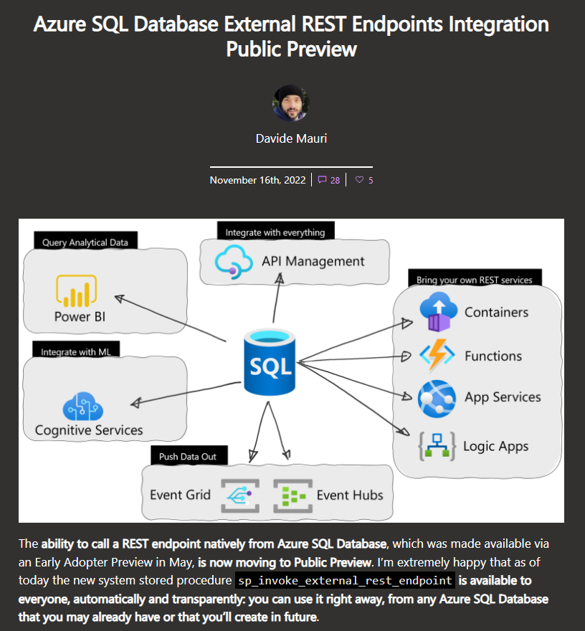
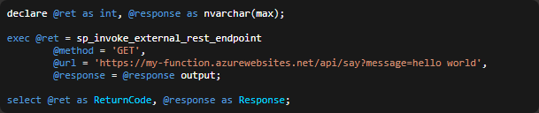
Notes:
Saw this blog post and I started thinking about all the things this could be used for
I already love Azure Functions
(little intro to them)

Slide 3
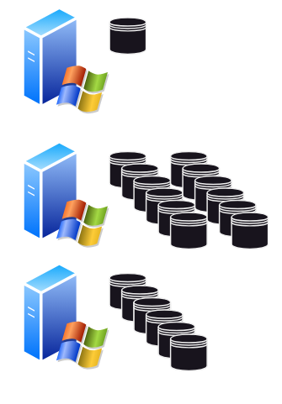


Traditional Inventory systems
Notes:
Why inventory system
What do we have
Whats important
Patch levels
How traditional inventory system work
collect daily
Update inventory system
What if we flip this around?

Slide 4

Infrastructure as Code
Infrastructure as code (IaC) is the process of managing and provisioning computer data centers through machine-readable definition files, rather than physical hardware configuration or interactive configuration tools.
Notes:
Then I was thinking about IaC and what if … the inventory database was ‘single source of truth’ or the ‘golden record’
What if I have a table named SqlDbs that not only keeps track of our deployed Azure SQL Dbs – but deploys them if there are new rows in there
This session is going to attempt to explain a bunch of cool tech that’ll make this happen – and we should end up with a table in a database that is the single source of truth for our storage accounts in Azure

Slide 5



Jess Pomfret (She/Her)
Data Platform Engineer
Open-Source Contributor
dbatools, dbachecks, SqlServerDsc
Passionate about SQL Server, PowerShell & Proper Football
jpomfret7@gmail.com.
jesspomfret.com
linkedin.com/in/jpomfret/
github.com/jpomfret

Slide 6

sp_invoke_external_rest_endpoint
WARNING: Public preview feature
System Stored Procedure
Azure SQL DB
Ability to call ‘Allowed endpoints’
sp_invoke_external_rest_endpoint (Transact-SQL)
https://github.com/Azure-Samples/azure-sql-db-invoke-external-rest-endpoints
Notes:
Public preview
Normal SLAs do not apply
Things might change
System stored procedure
Supply the url of the HTTPS REST endpoint to call
Send a JSON payload
@credential parameter to include DATABASE SCOPED CREDENTIAL
Receive a response in JSON
Permission to run this
EXECUTE ANY EXTERNAL ENDPOINT
What’s an allowed endpoint? On the next slide

Slide 7
Authentication
DATABASE SCOPED CREDENTIAL
Name
must be a valid URL
domain in the allow list
more generic than the request URL
IDENTITY Parameter
HTTPEndpointHeaders
HTTPEndpointQueryString
Managed Identity
Managed Identity for Authentication
Enabled for Azure SQL Server
Enable Azure AD authentication in Azure Function
Create DATABASE SCOPED CREDENTIAL
Notes:
DATABASE SCOPED CREDENTIAL to store the authentication data
HTTPEndpointHeaders – use to add the credential to your request header
HTTPEndpointQueryString – adds to the query string
Managed Identity – authentication info is taken from the System-Assigned Managed Identity of the Azure SQL Server and passed in request headers. Set the secret to the app_id
- Both system-assigned and user-assigned managed identities are supported

Slide 8
What about SQL Performance?
Throttling
Concurrent connections – capped at 10% of worker threads
Max 150 workers
Enforced at
Single database – database level
Elastic pool – database and pool level
Wait type
HTTP_EXTERNAL_CONNECTION – waiting on invoked service to complete
Notes:
sp_invoke_external_rest_endpoint (Transact-SQL) - SQL Server | Microsoft Learn

Slide 9
What APIs to call?
Azure Functions
Azure Logic Apps
Azure Event Hubs
Azure Cognitive Services
PowerBI
IoT Central
API Management
Notes:
azure-sql-db-invoke-external-rest-endpoints/azure-cognitive-services.ipynb at main · Azure-Samples/azure-sql-db-invoke-external-rest-endpoints · GitHub
Azure Cognitive Services
Anomaly detection (table growth sizes)
REST API published by API Management
OPENAPI Specification
PowerBI - Execute DAX queries against published dataset

Slide 10
What APIs to call?
Azure Functions
Azure Logic Apps
Azure Event Hubs
Azure Cognitive Services
PowerBI
IoT Central
API Management
Notes:
azure-sql-db-invoke-external-rest-endpoints/azure-cognitive-services.ipynb at main · Azure-Samples/azure-sql-db-invoke-external-rest-endpoints · GitHub
Two examples\demos
Azure Functions to manage our infrastructure
REST API to get data
- maybe this is to get something that relates to the need for storage accounts – get data – insert into table – then call function to create storage accounts

Slide 11




Demo - invoke – API to get data
exec @ret = sp_invoke_external_rest_endpoint
@method = 'GET',
@url = @url,
@response = @response output;
Notes:
Got here at 11:30
Azure API Management
Azure API Management terminology | Microsoft Learn
The OpenAPI Specification is a specification language for HTTP APIs that provides a standardized means to define your API to others. You can quickly discover how an API works, configure infrastructure, generate client code, and create test cases for your APIs. Read more about how you can get control of your APIs now, understand the full API lifecycle and communicate with developer communities inside and outside your organization. Home - OpenAPI Initiative (openapis.org)
APIs.guru – 2,529 APIs listed
Appveyor
GitHub
Gitlab
Google
Microsoft
AWS
Instagram
Kubernetes
Trello

Slide 12

Azure Functions
Notes:
Intro to Azure functions
Serverless solution
Binding
- Input and output – can have multiples
- Connect up to other things
- Input binding from SQL Database to get some data
- Output binding to write the result onto a message queue
Triggers
- Specific type of input trigger – one per function
- timer
- HTTP request
- blob storage
- event hubs
Function
Code
Written in your language of choice – C#, Java, Python... Or PowerShell

Slide 13






demo - develop
Notes:
Develop code in VsCode within a dev container
Push the code to GitHub
Action fires to deploy the function code to the Azure Function App (already setup outside of this process)
DEMO – take a look at this

Slide 14
demo – invoke – Azure Function
exec @ret = sp_invoke_external_rest_endpoint
@method = 'GET',
@url = @url,
@response = @response output;
Notes:
Develop code in

Slide 15

and then…
Photo by AbsolutVision on Unsplash

Slide 16
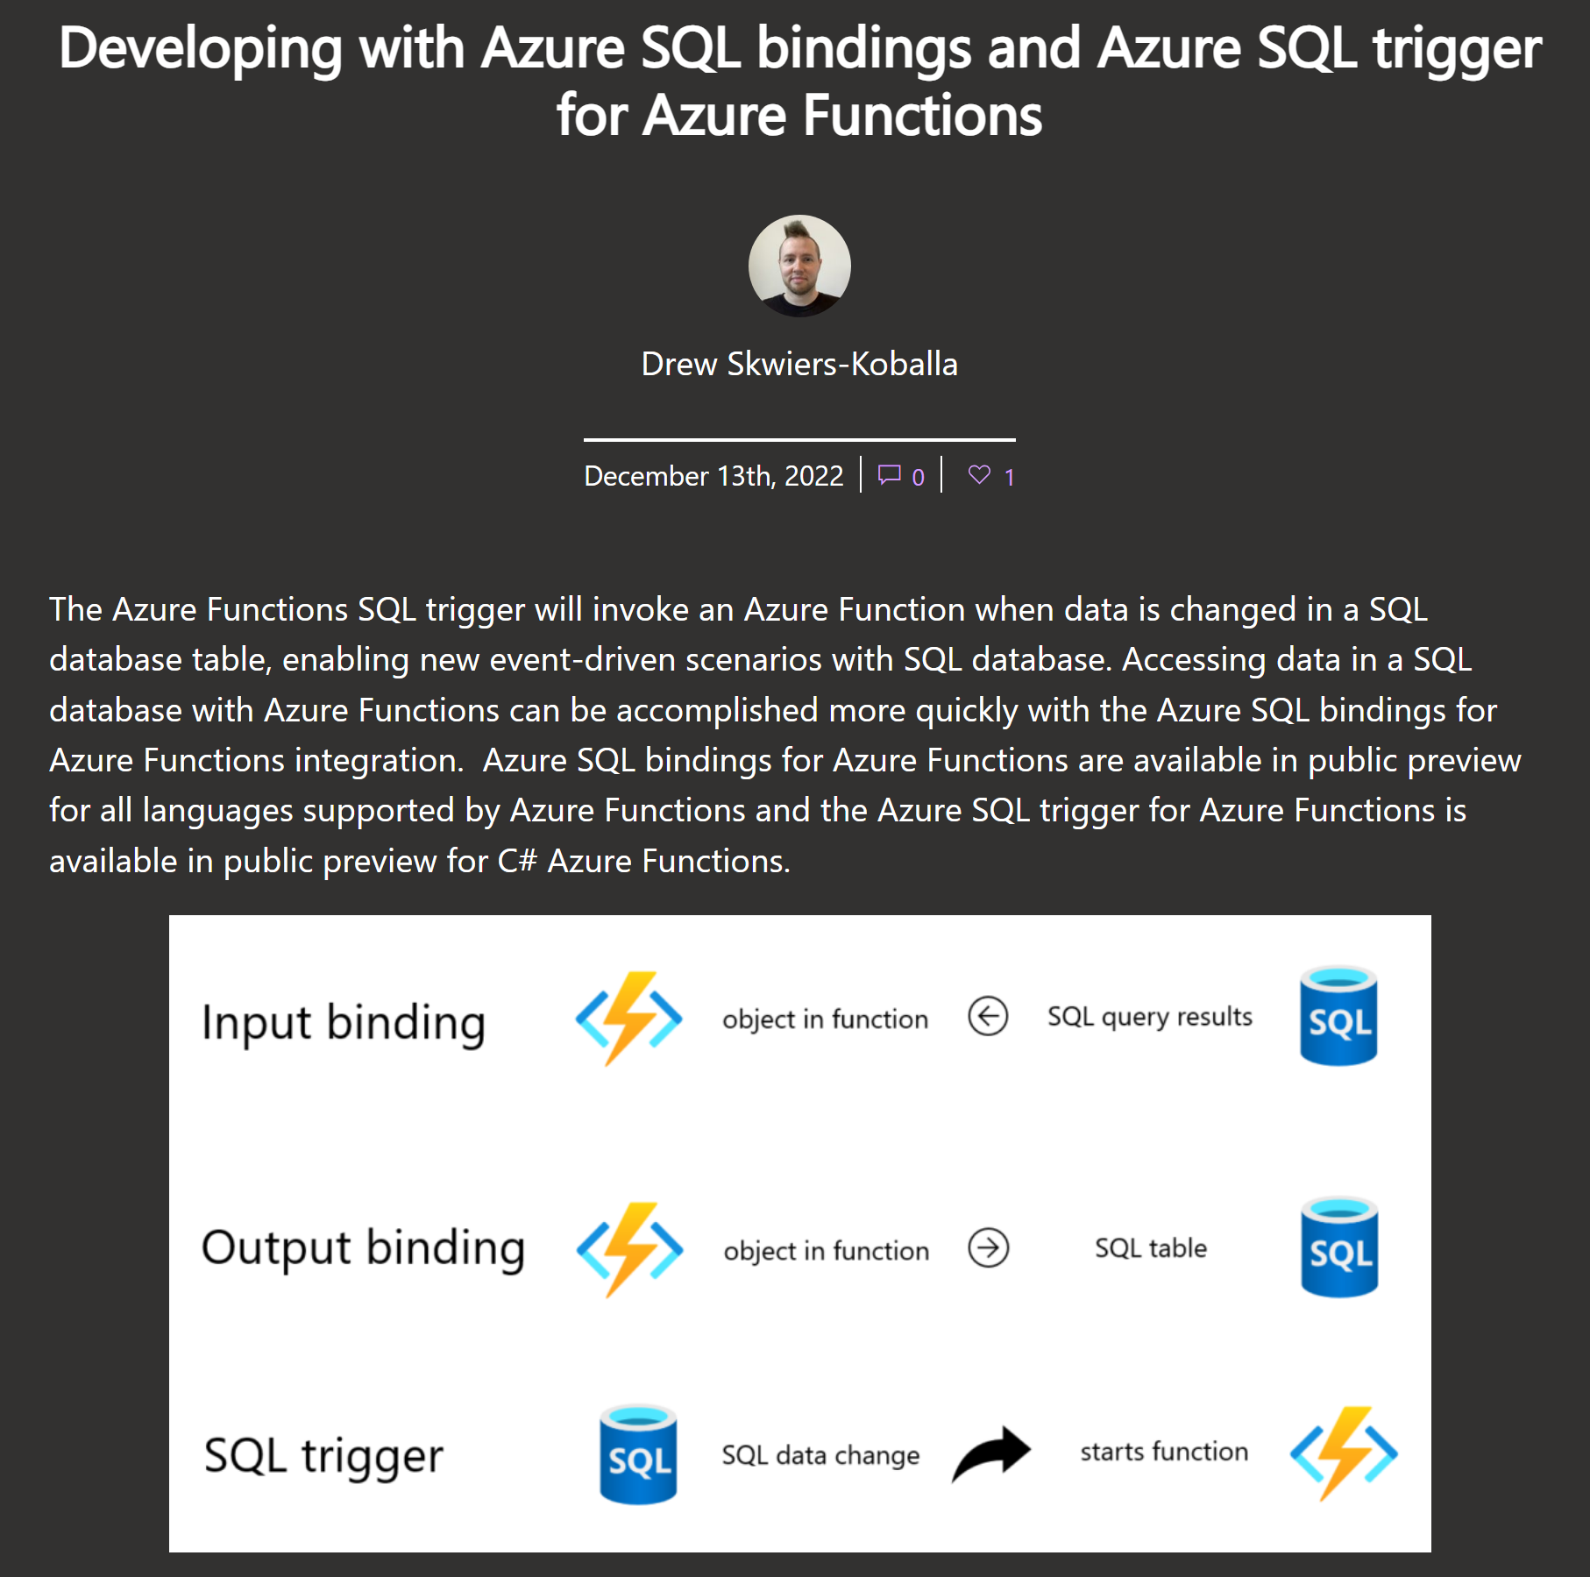
Notes:
https://devblogs.microsoft.com/azure-sql/developing-with-azure-sql-bindings-and-azure-sql-trigger-for-azure-functions/

Slide 17
demo – invoke – Azure Function v2
DATA CHANGE
INSERT DATA
Notes:
Develop code in

Slide 18
What else could we do?
Anything you can write in <<ENTER Azure Function Language>>
Application calls
Data processing
Azure Infrastructure tasks
Data API Builder
CDC from one database → into the other
Inserting data ‘across a linked server’
Notes:
https://redmondmag.com/articles/2023/05/05/building-apis-for-databases.aspx
Lot of integration options for Azure SQL Databases

Slide 19
Questions & Feedback
https://github.com/jpomfret/psconf23-azuresql
Jess Pomfret
jpomfret7@gmail.com
JessPomfret.com

