Slide 1
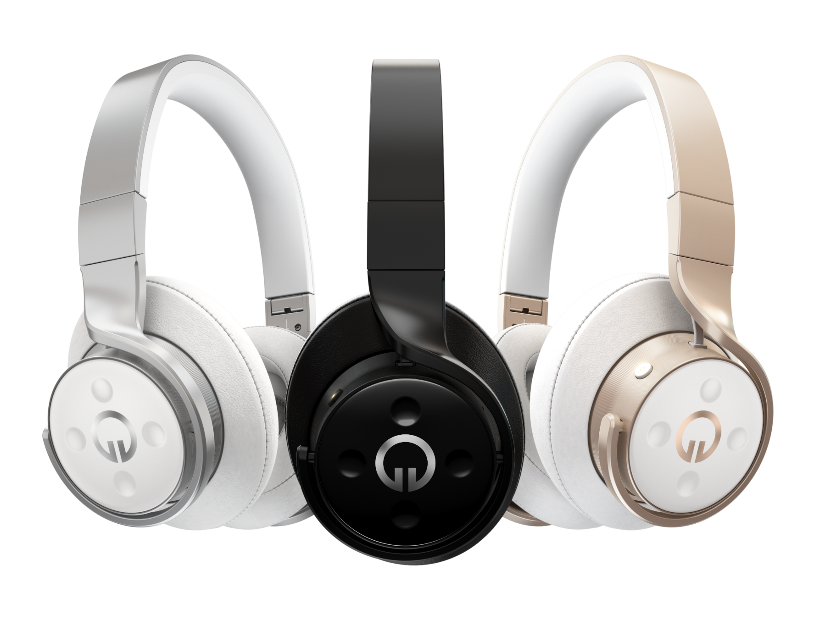


MuzikHack April 23-24. Vancouver, Canada.

Slide 2
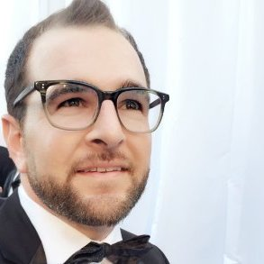
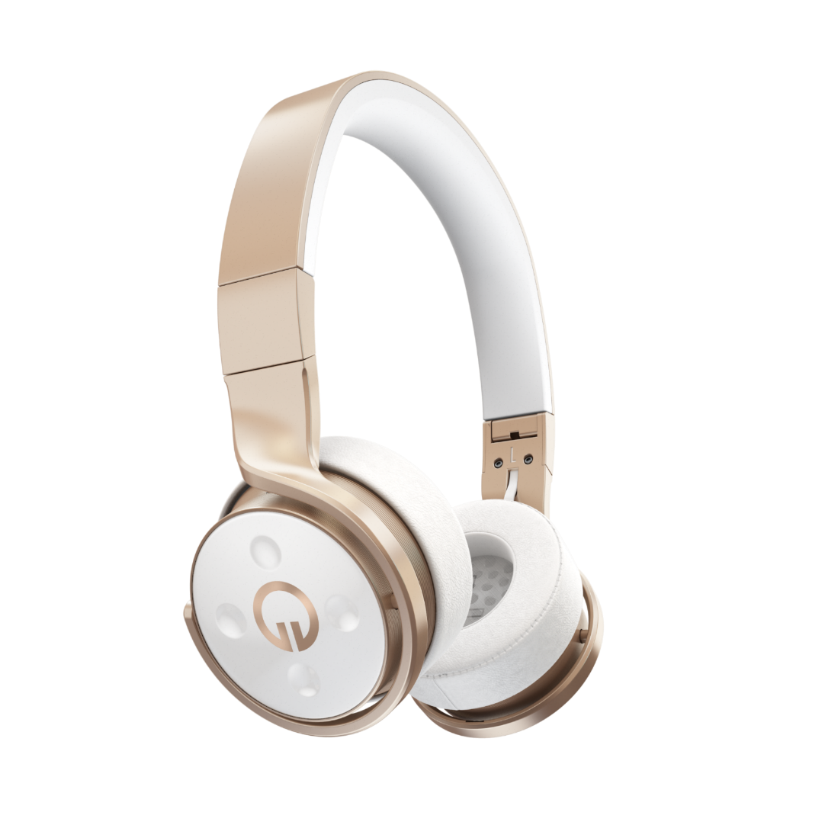
Jonathan Lazar (Join Skype Meeting)
Muzik

Slide 3


Slide 4
Schedule
Saturday, April 23
9:00 AM | Breakfast & Registration
10:00 AM | Hackathon Starts
11:00 AM | Tech Talk – Muzik SDK Deep Dive
12:00 PM | Lunch & Form Teams
1:00 PM | Tech Talk - Cordova w/ Visual Studio
6:00 PM | Dinner
10:00 PM | Go Home
Sunday, April 24
9:00 AM | Breakfast
12:00 PM | Lunch
12:30 PM | Submission Deadline*
1:00 PM | Presentations**
1:45 PM | Announce Winners!
2:00 PM | Hackathon End
*Send team name and repo link to
Jason.poon@Microsoft.com
**Each team will have 1 minute to present their hack on their machine/phone

Slide 5
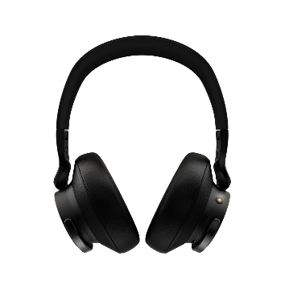
Teams
1-4 people
Each team will be loaned:
1 Muzik Convertible headphone
If needed, we also have Android/iPhones to develop against

Slide 6
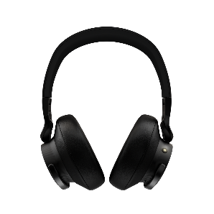

Prizes
Best Hack
Muzik Convertibles for the team
Honorable Mention
IoT Starter Kit (BeagleBone) for the team
The Head Scratcher (Best Issue/PR)
Muzik Convertible for the individual that files/fixes the most “wtf?!” bug against the SDK

Slide 7
Judging
Effective use of the Muzik SDK
Does your app effectively use multiple parts of the Muzik SDK?
Is the Muzik SDK an integral part of the app?
Scale of Awesome
Judges will focus on creativity, cleverness, and that deep-down sense of “Whoaaaaa”

Slide 8

Hackathon Staff
?
?
?
?
Need help?
Ask Us
In Person
Volunteers available to help jumpstart your development
On Slack
https://muzikhackyvr.azurewebsites.net/

Slide 9
Other Important Details
WiFi
MSFTOPEN
Sunday Location
MCEC 725 Granville Street 7th floor, MPR 707
Twitter
#muzikhack

