Slide 1
Continuous Deployment using Squirrel & VSTS
Jason Poon (@jasonthepoon) Software Engineer, Microsoft

Slide 2
Agenda
Why Continuous Deployment?
Road to Continuous Deployment
Demo: Squirrel & VSTS
Questions

Slide 3





The Problem

Slide 4
The Goal
Deliver quality software regularly and painlessly
Oh! We deployed today?
OMG! We have 10 more days until we deploy! Go go go!
Notes:
- How long does it take to go to production

Slide 5

Benefits
Faster Time to Market
Quick reactions to stimuli, both external and internal
Reduced Risk
Confidence in release infrastructure
Higher Quality
Automated tools help find regressions
Releases Tied to Business Needs
Not operational constraints
Notes:
Researcher using your app unannounced at BlackHat of what-not-to-do

Slide 6
Road to Continuous Deployment
Version Control
Continuous Integration
[version control] + build + test
Continuous Delivery
[continuous integration] + ready to deploy
Continuous Deployment
[continuous delivery] + automatic deployment
Notes:
- Large Changes
Developed in isolation, then brought together at the last minute will cause merge conflicts
CI
Automatically build, test, integrate changes to a shared repository
Travis/Appveyor/VSTS/Felix (CircleCI)
Continuous Delivery
“production-ready”
Continuous Deployment
cloud/SaaS easier as you can update in the background
Mozilla nightly builds
Windows insider

Slide 7
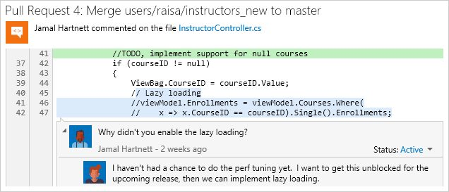

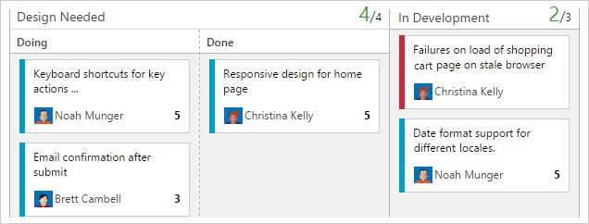
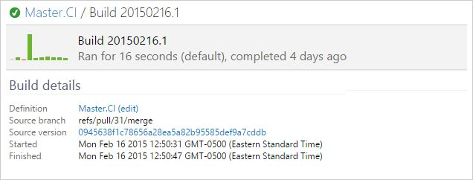
Visual Studio Team Services
Notes:
Formerly VSO
Version control
Tools for agile items, Kanban, scrum, dashboard
Continuous integration

Slide 8








Squirrel
Installation & update framework
Works on:
Used by:
OS X
& more…

Slide 9
Build/Test/Deploy Pipeline
Notes:
Remove all operational constraints

Slide 10
Let’s build it

Slide 11
In Review
Create a repeatable, reliable process for releasing software
Play around with VSTS + Squirrel – it’s free!
Resources
Sample Repo: https://github.com/jpoon/decodedconf-squirrel-sample/
Squirrel: https://github.com/Squirrel/Squirrel
VSTS: https://www.visualstudio.com/en-us/products/visual-studio-team-services-vs.aspx

Slide 12



thanks for listening
Jason Poon github.com/jpoon
@jasonthepoon
jason.poon@microsoft.com

