Slide 1
UML
Use Case Modelling

Slide 2
Gathering information (We can use these in Q1)
Introduction to Use Case Modelling
Surveys
Interviewing domain experts
Brainstorming (would look nice but not expected)
Studying business documentation (We have the use case, this could sections could be highlighted to emphasise that this was undertaken)

Slide 3
Use Case Perspective
Introduction to Use Case Modelling
It helps to define the key software deliverables
It helps to breaks down complex processes into simpler steps
Provides a method way to describe various actions and processes.
Helps to define the systems users (actors) (patients, external organisation, LLM Staff (doctor, surgeon, sales team)

Slide 4
Use Case Basics
Introduction to Use Case Modelling
Actors
Use Cases
Communication relationships

Slide 5
Actors
Introduction to Use Case Modelling
Are outside the system
Interact with the system
May receive or deliver information to the system or do both

Slide 6
Use Cases
Introduction to Use Case Modelling
A use case
describes the interaction between users and an application system
use case describes what a user does with the system to produce a business process
Use case model represents the dialogue between the actor and the System

Slide 7
Use Cases (2)
Introduction to Use Case Modelling
A use case
represents the functions which are made available by the system to the actor
is a sequence of transactions performed by a system that produces a measurable result for a particular actor (common definition)

Slide 8
Communications Relationship
Introduction to Use Case Modelling
Each use case represents a task or coherent unit of functionality that is valuable for at least one actor
An actor may interact with the system to perform a task or to be the recipient of a task
Shown by a relationship line between the actor and the use case

Slide 9
Use Case Diagram Example
Introduction to Use Case Modelling
A Library System

Slide 10
Identifying Actors
Introduction to Use Case Modelling
Who is interested in a certain requirement?
Where in the business is the system used?
Who will benefit from the use of the system?
Who will supply the system with this information, use this information, and remove this information?
Who will support and maintain the system?
Does the system use an external resource?
Does one person play several roles?
Do several people play the same role?
Does the system interact with a previous system?

Slide 11
Identifying Use Cases
Introduction to Use Case Modelling
What are the tasks of each actor?
Will the actor create, modify, delete read or write information in the system?
What use case will create, modify, delete read or write information in the system?
Can all functional requirements be met by the use of the use cases identified?

Slide 12
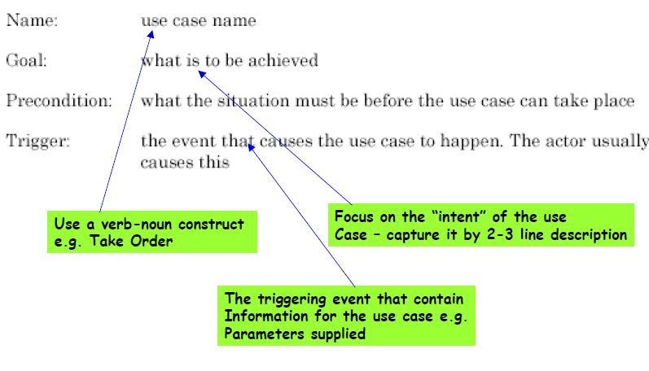
Use Case Description
Introduction to Use Case Modelling
Use case

Slide 13
Example: Confirm Booking
Introduction to Use Case Modelling
Use case name: Confirm Booking
Goal: Ensure that the provisional booking is now confirmed so that it is saved for the customer
Pre-condition: The customer is registered and a provisional booking exists
Trigger: Customer selects confirm option

Slide 14
Structuring Use Cases
Introduction to Use Case Modelling
Use cases can be structured in two ways
<<Includes>>
– Used for factoring out common functionality
– Use case “A” <<includes>> “B” if a trace through A can exercise the script through B
<<extends>> (USE WITH CAUTION)
– A primary use case is extended with alternate paths based on a condition

Slide 15
Includes
Introduction to Use Case Modelling
Includes:

Slide 16
Constructing the Use Case Model
Introduction to Use Case Modelling
Open Account
Example

Slide 17
Extends and Extension Points
Introduction to Use Case Modelling
Extends: Relationship from a use case to another use case that specifies how the behaviour defined for the first use case can be inserted into the behaviour defined for the second use case
Use when one use case is similar to another use case but does a bit more – break the “bit more” off into another use case that extends the basic one
Split complex use cases into a basic use cases with extensions
Define extension points where the basic use case is extended i.e. define where behaviour is inserted

