Slide 1

PENTAHO DATA CATALOG · COMPANION APP
Arizona Water Glossary Generator
Build a business glossary for Pentaho Data Catalog
Scan sources · review & refine · assign stewardship · export import-ready JSONL · AWC · PDC 10.2.11
Notes:
Frame this as the technical-track session. It is NOT a twelfth product workshop — it teaches the public API by driving the AWC Glossary Suggester. Assumes the audience already built the glossary and ran profiling by hand.

Slide 2


SET THE FRAME
A custom companion app — one screen, four steps
What this is
What this is NOT
The Arizona Water Glossary Generator — a reference implementation built for this course.
It walks the whole glossary workflow on one screen: connect, review, govern, apply.
It profiles your sources locally and calls real PDC endpoints for you.
Not a Data Catalog UI feature — “Apply to PDC” and “dry-run” are app features, not product menus.
Not magic — scanning is local; every PDC write is an HTTP call you could make yourself.
Pentaho Data Catalog is the product; the app is the on-ramp.
Arizona Water Glossary Generator · PDC 10.2.11
1
Notes:
Protect the product-vs-custom line. If learners can't tell which is which, they'll think these are PDC features. The endpoints underneath ARE the product; the app just wraps them.

Slide 3

GETTING STARTED · INSTALL & CONNECT
Stand it up on your own PDC
Goal: Run the app against your PDC instance — Docker or local — then point it at your catalog.
1. Get it running Docker compose, or ./run.sh locally; check /health.
2. Configure for AWC Set GLOSSARY_COMPANY + the water_utility domain pack.
3. Open the PDC panel Glossary → Data Elements; enter base URL + version.
4. Get a token Admin or Business Steward; held in memory only.
The setup, in brief
# run it (Docker)
docker compose up --build
# or local: ./run.sh
# verify it’s up
curl http://<host>:5000/health
Arizona Water Glossary Generator · PDC 10.2.11
2

Slide 4
CONNECT → REVIEW → GOVERN → RESOLVE & APPLY
The four steps, end to end
1
Connect & scan
Local · Connections
2
Review & prune
Local · Glossary
3
Govern & generate
Local · Govern → PDC UI · Import
4
Resolve & apply
PDC public API
Arizona Water Glossary Generator · PDC 10.2.11
3
Notes:
The crucial column is the last one — where each step runs. Two are local, one is UI-only (import), the rest are API. Point at row 4 and tee up the golden rule.

Slide 5



WHERE THIS FITS · PDC PROCESSING ORDER
Run PDC’s data scan first, the app second, Trust Score last —
so nothing overwrites your governance.
PDC’s data scan — first
The app — over the API
The order
Metadata ingest — schema, keys. Data Profiling — stats + intermediate data (bitsets, HLL, patterns, DQ); feeds FK detection & data flow. Identification + PII — pattern / dictionary tags + sensitivity.
Glossary terms + term↔column links. Stewardship (steward / owner / custodian). Sensitivity, CDE, verified-lineage, rating, a quality score. Then Calculate Trust Score.
Ingest → Profile → Identify → Import glossary → Resolve → Apply → Trust Score (last). The app merges on top; Trust Score needs quality + classification, so it runs last.
Arizona Water Glossary Generator · PDC 10.2.11
4

Slide 6
PDC PROCESSING SPINE · STRUCTURED ‖ UNSTRUCTURED
Structured and unstructured share one spine
SCAN — same step, two lanes
Structured · DB → Data Profiling
Unstructured · docs → Data Discovery
Connect
Metadata Ingest
Data Identification + PII
Govern — glossary + app
Calculate Trust Score
(last)
→
→
→
→
→
Both lanes share Metadata Ingest and Data Identification — they differ only at the scan step. The Generator app lives in Govern, after Identification (its Workshop 5 slot); Calculate Trust Score runs last.
At AWC: awc_operations (database) takes the Profiling lane; awc-documents (object store) takes the Discovery lane.
Arizona Water Glossary Generator · PDC 10.2.11
5

Slide 7
STEP 1 · CONNECT
Connections are pulled from PDC
1 · Bulk-load into PDC
2 · Harvest from PDC
3 · Add to app connections
One CSV registers many sources — each row creates the source and runs its ingest; an existing one shows EXISTS, so re-runs are safe.
Pull the glossary from what PDC already cataloged — DB columns and object-store files. No re-created connection, no DB password.
Populate the app’s own connections from the same CSV, with a reachability remap (az-water-postgres → localhost:5433).
Arizona Water Glossary Generator · PDC 10.2.11
6
Notes:
The sequencing turns redundancy into a payoff: 'you've done this in the UI; here's the automation and exactly which calls it makes.'

Slide 8





STEP 1 · SCAN & DISCOVER
What a scan turns up
One term per column
Definitions & purpose
Sensitivity & PII
Every column becomes a candidate term — you prune, not hunt for gaps.
Derived locally from names, comments and keys at scan time.
Flags HIGH / MED / LOW and PII categories from names and samples.
CDE & keys
Data quality
Structured + unstructured
Reads PK/FK and infers Critical Data Elements for the steward to confirm.
Discover profiles distribution, uniqueness and patterns — evidence, not name guesses.
Add to glossary merges a database and a document store into one glossary.
Arizona Water Glossary Generator · PDC 10.2.11
7

Slide 9
STEP 1 · UNDER THE HOOD
The scan reads sources directly, then hands off
Database lane · SQL
Object store · S3 API
Local · no API calls
information_schema.columns — cols, types pg_catalog — primary & foreign keys pg_description — comments → definitions sample rows — distribution, uniqueness
list_objects_v2 — walk bucket → folders get_bucket_tagging / get_object_tagging head_object — x-amz-meta-* owner get_object — preview & data quality
Merge — one term, all its columns Auto-disambiguate — unique by table Keep High+Med conf — table terms kept → Apply writes the businessTerms superset
Arizona Water Glossary Generator · PDC 10.2.11
8

Slide 10
STEP 2 · REVIEW & PRUNE
Review & prune the terms
Goal: Every column is already a candidate term — so you prune and refine, never hunt for gaps.
1. Edit inline definition, purpose, sensitivity, tags — your edit always wins.
2. Cut the noise filter, then Keep High+Med confidence to drop weak guesses.
3. Reuse existing work open a glossary export, or enhance a scan against one.
4. Optional: LLM enrich the one optional call here; all else is local.
How confidence is set
Confidence ladder:
High a DB comment or a key
Medium name + type inference
Low templated from the name
Raise it: add column comments,
or enhance against a glossary.
Tip: Terms export as Draft — proposals until a Business Steward approves them.
Arizona Water Glossary Generator · PDC 10.2.11
9

Slide 11
STEP 3 · GOVERN & GENERATE
Assign stewardship, generate JSONL
Goal: Set who owns each term, bake it in, and export an import-ready glossary for PDC.
1. Build the roster add people manually, or fetch live from Keycloak.
2. Set stewardship steward, owner, custodian, status, rating, reviewed — global or per category.
3. Bind to PDC people resolve to PDC accounts by UUID (per-instance).
4. Generate & import Generate JSONL here, then PDC Business Glossary → Import.
The import is whole-glossary
Generated JSONL (one line each):
glossary · category · term
steward / owner UUIDs baked in
Import replaces the whole glossary
— reuse _ids to update in place,
not create duplicates.
Tip: UUIDs are per-instance — fetch the roster from the target Keycloak.
Arizona Water Glossary Generator · PDC 10.2.11
10

Slide 12

THE GOLDEN RULE
The API never creates your glossary.
It only updates entities that already exist.
There is no “create term” endpoint. You import the glossary through the UI (JSON Lines or CSV); only then can the API attach those terms to columns.
Import (UI)
→
Resolve (API)
→
Apply (API)
Arizona Water Glossary Generator · PDC 10.2.11
11
Notes:
This is the single most important idea in the session. Apply-first is impossible — a term has no id until it's imported.

Slide 13
STEP 4 · THE API SURFACE
The endpoint map
Group
Method & path
Used for
Auth
POST /auth
Obtain the bearer token
Search
POST /search
Find a term → its id + glossary
Entities
POST /entities/filter
Find a column by name / fqdn / parent
Entities
PATCH /entities/{id}
Write businessTerms + features
Entities
POST /entities/filter/profiling-info
Pull PDC's profiling stats
Jobs
POST /jobs/execute/calculate-trust-score
POST /jobs/execute/data-discovery
Trust score · profile files & folders
Jobs
GET /jobs/{id}/status
Poll a running job
All require the bearer token except auth.
Arizona Water Glossary Generator · PDC 10.2.11
12

Slide 14
STEP 4 · AUTHENTICATE
Authenticate
Goal: Get a token and confirm who you are before writing anything.
1. Open the PDC panel under Glossary → Data Elements.
2. Fill base URL, version, username and password.
3. Click Get admin token. The app fills the token field and shows role + expiry.
4. Verify the admin badge and that the expiry covers your run.
The call underneath
curl -sk -X POST \
https://<host>/api/public/v2/auth \
-d username=<user> -d password=<pwd> \
-d client_id=pdc-client \
-d grant_type=password \
| jq -r .data.accessToken
Arizona Water Glossary Generator · PDC 10.2.11
13
Notes:
The 'Get admin token' button decodes the JWT and shows whether the account carries an admin role, plus the expiry countdown.

Slide 15
STEP 4 · RESOLVE
Resolve term IDs
Goal: Turn term names into the per-instance ids PDC needs — which is why the glossary must be imported first.
1. Glossary already imported in PDC.
2. Click Resolve & stamp IDs. The app searches each term.
3. It stamps id + glossaryId into the Data Elements JSON.
4. Unresolved names are flagged — usually a missed import.
The call underneath
POST /api/public/v2/search
{ "searchTerm": "Customer Name",
"searchFacets":
{ "type": ["term"] } }
// hit carries _id (term id) and
// rootId (= glossaryId)
Order: Import → Resolve → Apply. A term has no id until it exists.
Arizona Water Glossary Generator · PDC 10.2.11
14
Notes:
Resolve depends on the glossary existing. This is the practical face of the golden rule.

Slide 16



STEP 4 · WHICH TERMS MAP
Map by business value, not volume — link the right columns, hold back the rest.
Mapped automatically
Held back
You stay in control
Critical Data Elements, PII columns, and terms with real evidence behind them — a DDL comment, a key, or a profiling hit (High or Medium confidence).
Low-confidence terms templated from a column name alone, and conceptual terms (Trust Score, Tag) with no physical column. No link is a valid outcome.
A per-row Map = Yes/No always wins. Tune the policy: Selective (default), Strict (CDE · PII · High), or Map everything (legacy).
Arizona Water Glossary Generator · PDC 10.2.11
15
Notes:
This is the governance gate, and it runs before Apply writes anything. The old behaviour linked every scanned column - one term per column - which is exactly the over-mapping the manual workshop warns against. Now the app maps selectively: CDEs, PII, and evidence-backed columns (a comment, a key, a profiling hit) go through; low-confidence, name-only columns and conceptual terms like Trust Score are held back. Make the payoff concrete - volume does nothing for the Trust Score, whose glossary-term input is binary, and over-linking pollutes lineage and search. Then point to the two controls: a per-row Map = Yes/No always wins, and the policy dropdown (Selective / Strict / Map everything) tunes the gate - with a mapped-vs-held-back count so the steward sees exactly what was withheld.

Slide 17



STEP 4 · APPLY · THE CENTERPIECE
Apply to PDC
Resolve column
→
Read current
→
Merge
→
PATCH superset
PATCH the merged superset
PATCH /api/public/v2/entities/<id>
{ "attributes": {
"businessTerms": [ {existing}, {
"id":..., "glossaryId":...,
"name":"Customer Name" } ],
"features": { "sensitivity":"HIGH",
"isCriticalDataElement": true,
"isLineageVerified": true } } }
// valid term keys: id, glossaryId, name,
// sourceName, sourceType, confidenceScore
// extra keys (e.g. glossary) -> 400
Arrays full-replace
businessTerms is an array, so sending just the new term would drop the rest. The app reads current, unions, and sends the superset.
Dry-run first
Preview every PATCH (id + body) before a single write. Then untick dry-run; each column reports applied / not-found / error.
Arizona Water Glossary Generator · PDC 10.2.11
16
Notes:
The centerpiece. Emphasise the merge: the PATCH contract full-replaces arrays, so the client sends the merged superset. Dry-run is the safety rail — mandatory on a new instance.

Slide 18
STEP 4 · TRUST SCORE
Where Trust Score lives
Scored: Table = File · Not scored: Column = Folder
Table
File
Column
Folder
SCORED
SCORED
NOT SCORED
NOT SCORED
The app rolls each column’s mean qualityScore + rating up to here, then runs Calculate Trust Score. The Steward links the table-level term by hand.
The app applies rating, DQ and term directly to the file; Calculate Trust Score runs here too.
The app writes qualityScore + rating here from the scan — inputs to the table score, not a score itself.
Skipped — a folder is a container, never a Trust Score target.
The app’s Apply mirrors this exactly: write columns → roll up to tables (Steward links the table term) → apply files directly → skip folders.
Arizona Water Glossary Generator · PDC 10.2.11
17

Slide 19
STEP 4 · TRUST SCORE
Calculate Trust Score
Goal: Ask PDC to compute Trust Score for the TABLES behind the columns you touched — it’s a table / file rollup, never a per-column score.
1. Four inputs linked term + verified lineage + rating + data quality.
2. Lab C wrote them per column (Data Quality + Rating); PDC averages those up to the table.
3. Submit the job scoped to the TABLE ids — not the columns.
4. Poll /jobs/{id}/status until COMPLETED.
The call underneath
POST /api/public/v3/
jobs/execute/calculate-trust-score
{ "scope":[ "<table id>", ... ] }
// -> { data:{ _id, workerName } }
GET /jobs/<id>/status
-> { "status":"COMPLETED" }
Remember: Trust Score is a table / file rollup. Columns feed it (Data Quality + Rating) but never carry their own score.
Arizona Water Glossary Generator · PDC 10.2.11
18
Notes:
The v3 jobs catalog settles the earlier ambiguity: CALCULATE_TRUST_SCORE is first-class, alongside METADATA_INGEST, DATA_PROFILE, DATA_DISCOVERY and PII detection.

Slide 20
STEP 4 · COMPARE
Compare with PDC profiling
Goal: Lay PDC's own profiling numbers next to the app's discovery, column by column.
1. Fill the PDC connection on the discovery panel.
2. Click Compare with PDC profiling.
3. Each cell shows app / PDC completeness, distinct, uniqueness.
4. Gaps usually mean a different sample, or not yet profiled.
The call underneath
POST /api/public/v2/entities/
filter/profiling-info?sampleLimit=20
{ "filters": {
"parentIds":["<table id>"],
"types":["COLUMN"] } }
// stats: cardinality, density,
// uniqueness, nulls, min/max/avg
Arizona Water Glossary Generator · PDC 10.2.11
19
Notes:
Close agreement validates the app's heuristics. Columns PDC hasn't profiled show 'not in PDC' — run a DATA_PROFILE job and compare again.

Slide 21
STEP 4 · PROFILE DOCS
Profile documents in PDC
Goal: Have PDC profile the object-store files you applied to, so SKIPPED documents gain a Data Quality score.
1. Open Step 4 — Profile docs after a non-dry-run apply.
2. Click Run Data Discovery app resolves folders to ids, submits job.
3. Poll status or watch Workers profiling runs on a Remote Worker.
4. Re-run Lab E to compare each file’s new PDC Data Quality.
The call underneath
POST /api/public/v3/
jobs/execute/data-discovery
{ "scope":[ ids ],
"configs":{ "buildSamples":true,
"withProfile":true } }
// files: Data Discovery (this job)
// DB columns: PDC Data Profiling
Arizona Water Glossary Generator · PDC 10.2.11
20

Slide 22
ALTERNATIVE INPUT · INSTEAD OF STEP 1
Harvest from PDC
Goal: Reads what PDC already cataloged and loads it directly — no scan, no Discover, no profiling. Prefer Connect (Step 1) for those options.
1. List the sources entities/filter finds the schemas & stores PDC scanned.
2. Authenticate username + password, or paste a bearer token.
3. Pick a source & Harvest columns (database) or files (object store) become terms.
4. Already-governed flagged items PDC governs show an “in PDC” badge.
The call underneath
POST /entities/filter Bearer <token>
{ filters:{ types:["SCHEMA"] } }
-> schemas / sources to pick
POST /entities/filter Bearer <token>
types: COLUMN (db) | FILE (store)
-> column or file metadata
Arizona Water Glossary Generator · PDC 10.2.11
21

Slide 23


BEFORE YOU POINT IT AT PRODUCTION
Caveats & best practices
Terms are Draft
Whole-glossary import
Proposals until a Business Steward approves them — review before importing.
Import replaces the glossary; reuse _ids to update in place, not duplicate.
Confidence is a signal
CDE is the steward’s call
High = a DB comment or key; Low = templated from the name. Raise it, don’t trust it.
Auto-inferred from keys, sensitivity and critical terms — always human-confirmed.
Dry-run before writes
Least privilege
PATCH arrays full-replace; always preview on a new instance first.
Business Steward role suffices; re-auth on 401; never store the token.
Arizona Water Glossary Generator · PDC 10.2.11
22

Slide 24

FROM CONNECT TO GOVERNED DATA
Four steps, one screen
connect → review → govern → resolve & apply
Scan and govern locally; import once in the UI; resolve & apply over the PDC API.
Arizona Water Glossary Generator · PDC 10.2.11
23

Slide 25
ARCHITECTURE REFERENCE · 1.6.x
How the registry, drift, and
enrichment fit together
Generic to any industry · the utility vocabulary is one example pack
Glossary Generator · PDC 10.2.11 · 1.6.1
25

Slide 26
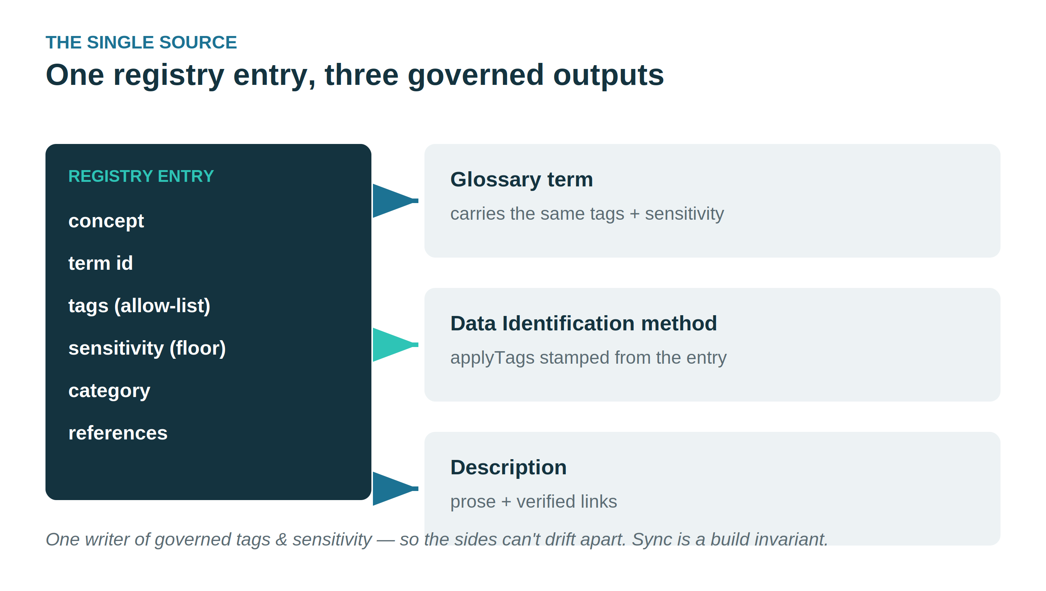
THE SINGLE SOURCE
One registry entry, three governed outputs
Term, method tags, and description all generated from one entry — they cannot drift apart.
Glossary Generator · PDC 10.2.11 · 1.6.1
26

Slide 27
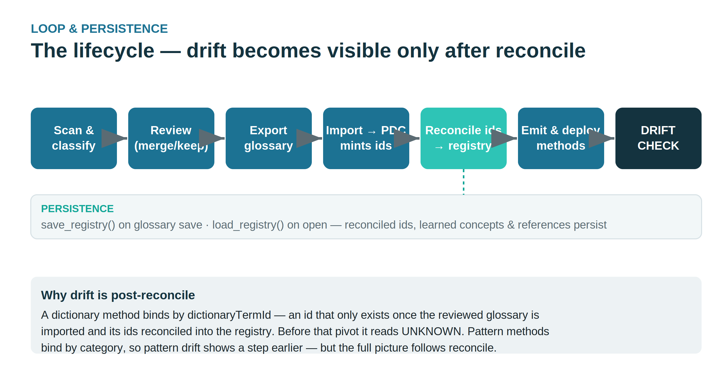
LOOP & PERSISTENCE
The lifecycle — and why drift is post-reconcile
Drift is only assessable after minted term ids are reconciled back into the (persisted) registry.
Glossary Generator · PDC 10.2.11 · 1.6.1
27

Slide 28
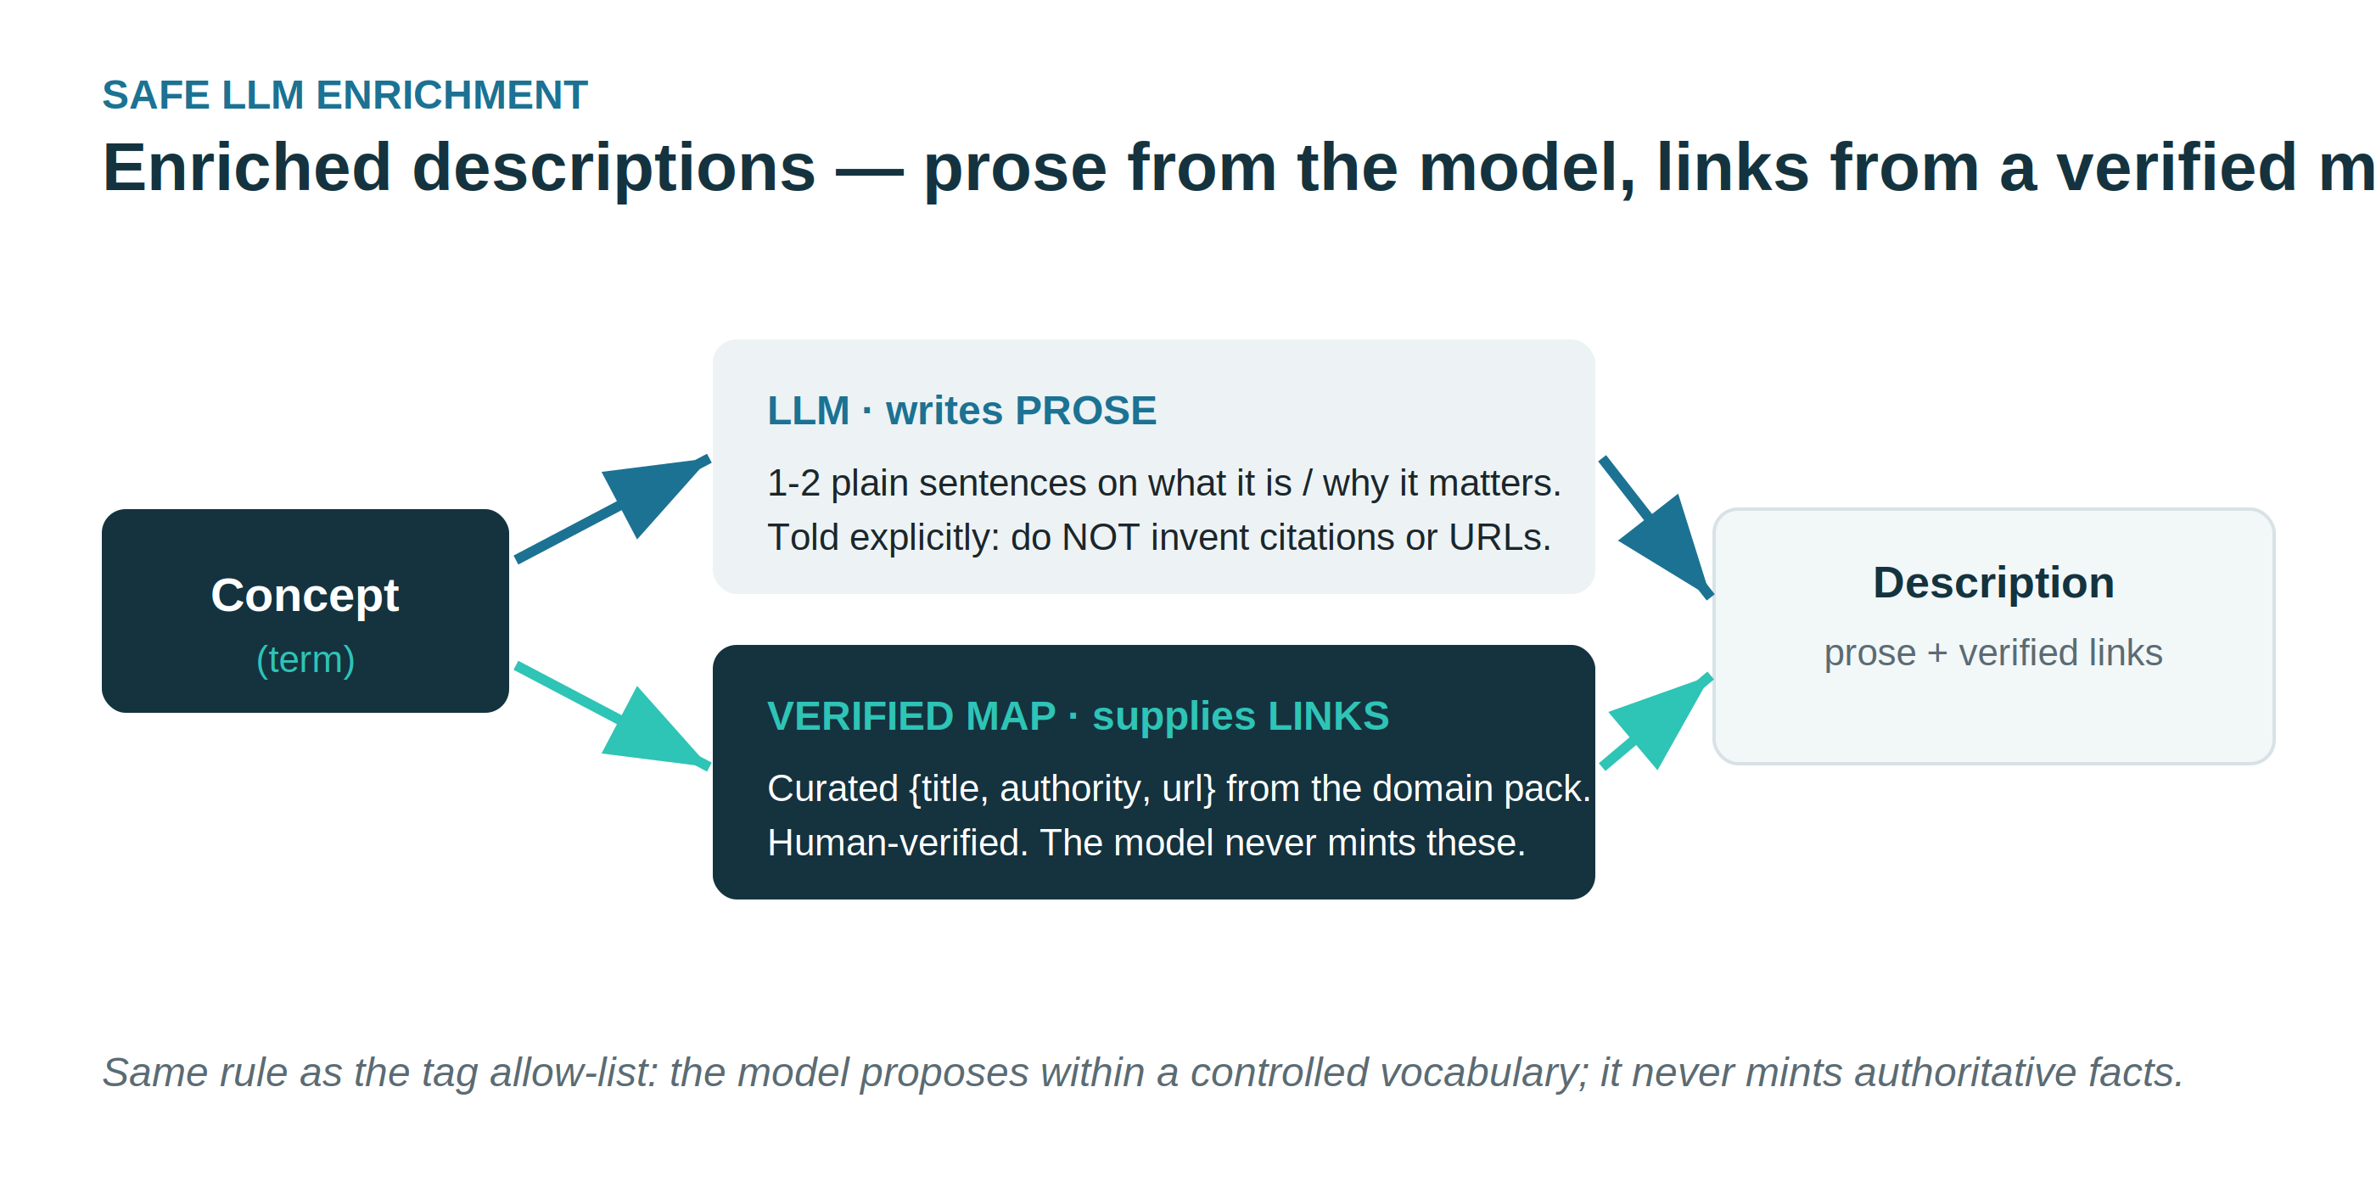
SAFE LLM ENRICHMENT
Descriptions: prose from the model, links from a verified map
The model writes prose only; compliance links come from a curated, human-verified map — never invented.
Glossary Generator · PDC 10.2.11 · 1.6.1
28

Slide 29
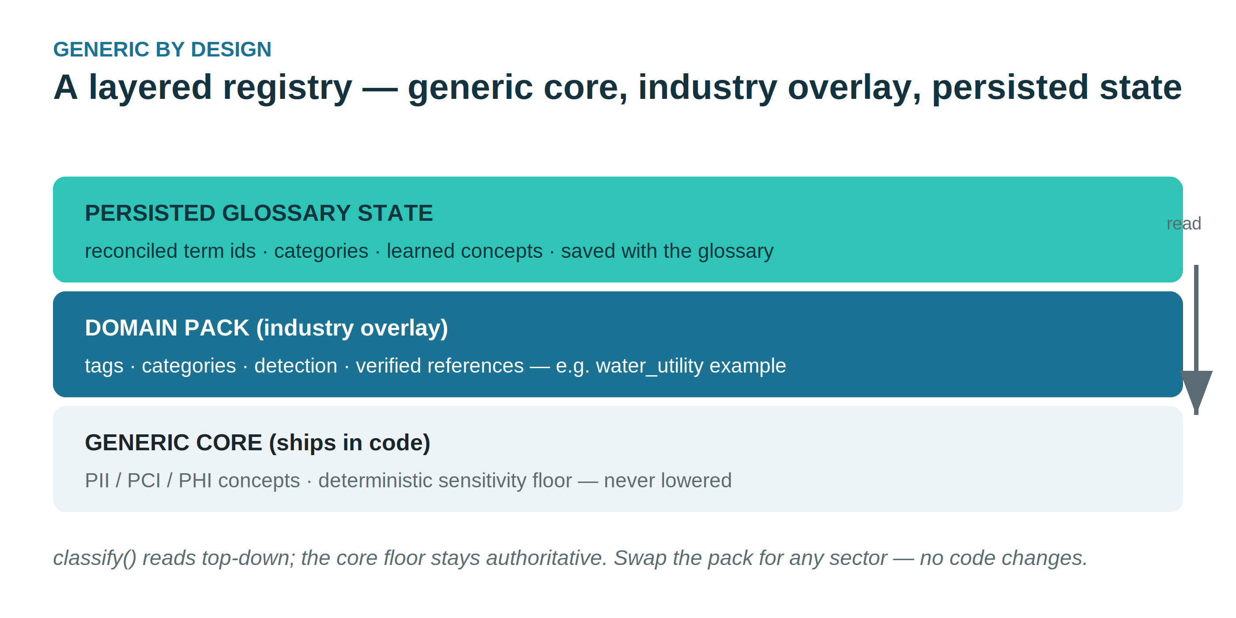
GENERIC BY DESIGN
A layered registry — core, industry overlay, persisted state
Generic PII/PCI/PHI core stays authoritative; industry vocabulary loads from a swappable pack.
Glossary Generator · PDC 10.2.11 · 1.6.1
29

Slide 30
ARIZONA WATER COMPANY · PDC 10.2.11 COURSEWARE
Glossary Generator
What's New
Releases 1.6.4 → 1.6.11
One governed vocabulary — from scan, to glossary, to Data Identification policy.

Slide 31
AT A GLANCE
The road to 1.6.20, one direction
1.6.5
Inline duplicate-cluster review
1.6.6–7
Bulk loader: create → metadata ingest → poll
1.6.7
Export saved connections to a loader CSV
1.6.8
Meaningful controlled tags · table terms locked
1.6.9
Persisted per-company tag dictionary
1.6.10
Two layers · guard-rails · registry embed
1.6.12–19
Connections pulled from PDC · object stores fixed · non-destructive enrich

Slide 32
CONNECT & BULK-LOAD
Register many sources from one CSV
Per CSV row
1 create the data source
2 trigger a metadata ingest scoped to it
3 poll the job to completion
The ingest footgun — fixed
A new source uses metadata/ingest (config body + resourceId).
NOT
metadata/re-ingest — that refresh job wants entity UUIDs, so a new id returns:
Export existing
turns the connections you built by hand into a loader-ready CSV — credentials included, reloads straight in.
400 /scope/0 must match format "uuid"

Slide 33
MEANINGFUL TAGGING
Tags say what a term is
Account Number
TABLE
financial · sensitive · identifier · customer · maskable · CDE
Table terms are locked
The record term that feeds a table's Trust Score is badged and its keep box is disabled — it can't be dropped at low confidence or by any bulk action.
pH Level
water-quality · compliance
Email
PII · contact · privacy · customer
Also: applying an LLM-suggested name renames every instance of that term, so duplicates stay mergeable.

Slide 34
THE TERM & TAG DICTIONARY
Two layers, governed and gated
Generic baseline
Company layer
Common terms + tags with common sensitivity. Built-in. Protected — can't be removed.
Specific to this deployment. Seeded from the domain, grown from scans, steward-owned.
1
Approval gate
2
Guard-rails
3
Sensitivity lift
New scanned items are pending until a steward approves — only then do they govern.
Baseline can't be deleted, rule tags must exist, sensitivity validated — edits can't silently drift.
A tag's / term's floor raises a term's sensitivity — never lowers it.

Slide 35
THE TERM & TAG DICTIONARY
Safe to make mistakes — recoverable by design
A reseed keeps
A reseed discards
Approved company terms & tags and company rules survive — the governed set is kept.
Pending scan-grown items and usage counts — baseline + domain pack reload fresh.
1
Backup before touch
2
Audit trail survives everything
3
Pending is cheap to rebuild
Every reseed snapshots tag_dictionary.json first — even a deliberate wipe is recoverable from disk.
Append-only: who approved what, when. A summary travels inside the Registry to the Policy Generator.
Every scan grows the vocabulary — including Harvest from PDC. Re-harvest, then Approve all: two clicks.

Slide 36
REGISTRY HAND-OFF
One artifact for the Policy Generator
→
→
Glossary
Registry
Policy Generator
reviewed terms, tags, sensitivity
one concept per term + the governed vocabulary embedded
Data Identification methods, tags held to the same allow-list
“Ready for the Policy Generator” — after Generate, the Govern page shows glossary saved, JSONL generated, and Registry written: registries/registry.<id>.json. Term ids fill in after import + Resolve Term IDs.

Slide 37
BUILD FROM THE TERM, MATCH THE TAGS
Term-first or tag-first?
Same outcome — for a reason worth stating.
The Term is the canonical anchor: it has an identity, links to the glossary, and carries a fixed governed tag set. Tags are attributes of the term.
So authoring term-first — one method per concept, emitting that concept's tags — guarantees consistency. Tag-first gives the same methods only because the registry already binds tags to terms, and it has no anchor to merge against.
Tag consistency isn't a competing goal — it's a consequence of term-anchored authoring against one governed vocabulary.

