Slide 1
Manual Rate Command Augmentation Systems
A brief Chronology from 1950’s Simulations to the Space Shuttle
José Portillo Lugo jportillo34@hotmail.com
Notes:
17
9
8

Slide 2
Manual Rate Command Augmentation Systems
A brief Chronology from 1950’s Simulations to the Space Shuttle
1958: NACA technical paper describing “Systems that Command Velocity” as
feedback control concept.
* Simulator investigation of Command Reaction Controls - Holleman, Euclid C.; Stillwell,
Wendell H. - NACA RM H58D22 - April 14, 1958.
1959: Development of a Self-Adaptive flight control system for the X-15 research
1960: vehicle including an Analog Manual Rate Command Augmentation/Attitude-Hold capability.
* Development of the X-15 Self-Adaptive Flight-Control System – Johannes, Robert P. ;
Armstrong, Neil A. ; Hays, Thomas C. – January 1961.
* Operational Experience with the X-15 Reaction Control and Reaction Augmentation Systems –
Jarvis, Calvin R. ; Lock, Wilton P. – Nasa Technical Note TN D-2864 – 1965.
1961: Research on “Majority Logic” and “Code Redundancy” by which replicated
control paths in a Digital system use a voting scheme to decide who is right,
and N Processors are loaded with and running identical Software.
* Blind Faith: The United States Air Force and Development of Fly-By-Wire Technology –
Tomayko, James E. – Technology and the Air Force, A Retrospective Assessment – 1997.
1962: First study on a Lunar Landing Research Vehicle simulator, including an Analog
Rate Command Augmentation capability with Attitude-Hold loop.
* Feasibility Study for a Lunar Landing Flight Research Vehicle – Report No. 7161-950001 -
Bell Aerosystems Company – March 8, 1962.
1963: Development of an Analog Manual Rate Command Augmentation/Attitude-Hold
Control system for the Gemini Spacecraft: Control Parameter tests conducted at the
Langley Research Center Gemini-Agena Docking Simulators.
* Full-Scale Gemini-Agena Docking using Fixed and Moving base Simulators - Hatch, Howard G.;
Riley, D. R.; Cobb, J. - AIAA paper 64-334 - June-July 1964.
Notes:
17
9
8

Slide 3
Manual Rate Command Augmentation Systems
A brief Chronology from 1950’s Simulations to the Space Shuttle
1964: Apollo Lunar Program: decision to implement a “Digital Autopilot” for the
Lunar Module Primary Guidance System.
* Personal letters from Cline Frasier – July 1999 and August 2003.
1966: NASA LRC technical paper describing a Rate Command and Acceleration Command
Electronic Control system for the Lunar Landing Research Vehicle.
* Flight Tests of a Manned Rocket-Powered Vehicle Utilizing the Langley Lunar Landing
Research Facility - O’Bryan, Thomas C. - Presented at AIAA Guidance and Control Specialists
Conference - Siattle, Washington - August 1966.
1966: NASA technical paper describing a Rate Command Augmentation system (fly-by-wire bang-bang)
with Attitude-Hold loop implemented in the DFRC lunar Landing Research simulation vehicle.
* Operational experience with the Electronic Flight control Systems of a lunar-Landing
Research vehicle - Jarvis, Calvin R. - NASA TN D-3689 - July 5, 1966.
1966: Grumman Aircraft developed a Lunar Module Simulator for development and testing purposes.
An Analog processing for the Hand Controller was implemented.
* Lunar Module Hover and Landing, Separation and Docking Simulation - Greene S.; Russo, J. -
Presented at AIAA Flight Test, Simulation and Support Conference - Cocoa Beach, Florida -
February 6-8, 1967.
1968: Development of a Rate Command Augmentation system embedded into the LGC Digital Autopilot:
separate Interface Circuits for Proportional and Discrete Manual Hand Controller inputs
to the Apollo Digital Guidance Computer.
* Lunar Module Attitude Controller Assembly Input Procesing – Portillo Lugo, José –
MAPLD 2004 Conference paper – September 2004.
1969: First test flight of the Lunar Module Digital Autopilot, including a Manual Rate Command
Augmentation/Attitude-Hold capability (Apollo IX).
* Manual Attitude Control of the Lunar Module – Stengel, Robert F. – AIAA paper 69-892 - 1969
Notes:
17
9
8

Slide 4
Manual Rate Command Augmentation Systems
A brief Chronology from 1950’s Simulations to the Space Shuttle
1969: First Lunar Landing operation for the Lunar Module Digital Autopilot (Apollo XI).
* Manual Attitude Control of the Lunar Module – Stengel, Robert F. – AIAA paper 69-892 - 1969
1971: Development and testing of an experimental Rate Command Augmentation system
1972: for the M2-F3 Lifting Body test vehicle.
Development of a Rate Command Augmentation system for the Nasa DFRC Digital Fly-By-Wire
Project using the Apollo Digital Guidance Computer and Inertial system: Phase I.
* Wingless Flight, The Lifting Body Story – Reed, R. Dale – Nasa SP-4220 - 1997.
* Digital Fly-By-wire Flight Control Validation Experience – Szalai, K. ; Jarvis, C. ; Krier, G. ;
Megna, V. ; Brock, L. ; O’Donnell – Nasa Technical Memorandum 72860 – December 1978.
1973: Development of a Multiple/Code Redundancy Digital Computer system for the DFRC
Digital Fly-By-Wire Project, Phase II: Support for Space Shuttle Command Augmentation
system design and validation (adopted the same Space Shuttle Computer: AP-101).
* Computers Take Flight: A history of Nasa’s Pioneering Digital Fly-By-wire Project –
Tomayko James, E. – Nasa SP-2000-4224 – 2000.
* Digital Fly-By-wire Flight Control Validation Experience – Szalai, K. ; Jarvis, C. ; Krier, G. ;
Megna, V. ; Brock, L. ; O’Donnell – Nasa Technical Memorandum 72860 – December 1978.
1974: Development of a Multiple/Code Redundancy Digital Computer system for the Space Shuttle,
1975: including a Manual Rate Command Augmentation/Attitude-Hold capability.
* Computers Take Flight: A history of Nasa’s Pioneering Digital Fly-By-wire Project –
Tomayko James, E. – Nasa SP-2000-4224 – 2000.
* The Space Shuttle Primary Computer System – Spector, Alfred ; Gifford, David –
Comunications of the ACM, Volume 27, Number 9 – September 1984.
Notes:
17
9
8

Slide 5
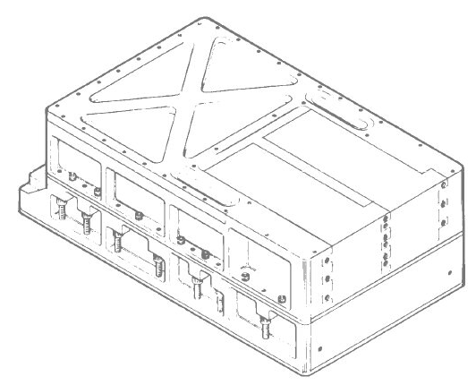
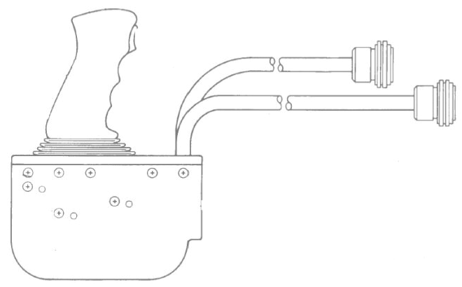
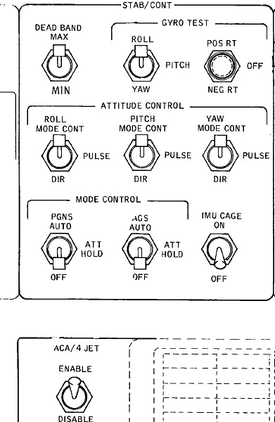
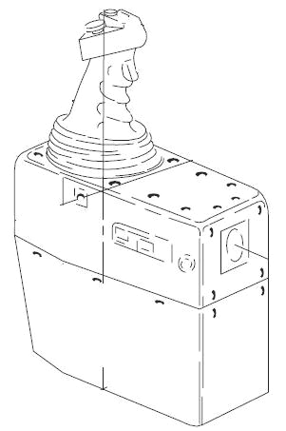
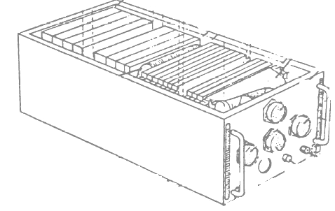

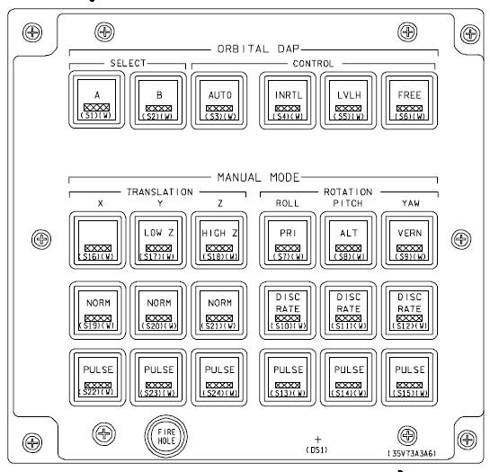
Manual Rate Command Augmentation Systems
Apollo and Space Shuttle Command Paths
Single Channel
for each axis
Apollo Digital Autopilot
(Single)
Proportional /
Discrete
DETENTCK EXTEND
READ CHAN31
TS CH31TEMP
MASK BIT15
EXTEND
BZF RHCMOVED
CAF OURRCBIT
MASK DAPBOOLS
EXTEND
BZF PURGENCY
RHCMOVED CS RCSFLAGS
MASK BIT9
ADS RCSFLAGS
CA OURRCBIT
MASK DAPBOOLS
EXTEND
BZF JUSTOUT - 1
RATERROR CA CDUX
TS CDUXD
Apollo ACA Command Path
Attitude Controller
Assembly (ACA)
PGNS Mode Control
Panel
Triple Channel (Redundancy)
for each axis
plus Trim rate and BFCS Switches
Shuttle Digital Autopilot
(Redundancy)
Proportional /
Discrete
AH LJOB
BCT F$JOB
LA JQOSLTST
LA
STH
SVC
SVCAD LA SVCTA0
AH SVCNQ
AH SVCNQ
STH SVCPS
BCT F$JOB
LA JQOSLTST
LA
AH LJOB
BCT F$JOB
LA JQOSLTST
LA
STH
SVC
SVCAD LA SVCTA0
AH SVCNQ
AH SVCNQ
STH SVCPS
BCT F$JOB
LA JQOSLTST
LA
Shuttle RHC Command Path
AH LJOB
BCT F$JOB
LA JQOSLTST
LA
STH
SVC
SVCAD LA SVCTA0
AH SVCNQ
AH SVCNQ
STH SVCPS
BCT F$JOB
LA JQOSLTST
LA
AH LJOB
BCT F$JOB
LA JQOSLTST
LA
STH
SVC
SVCAD LA SVCTA0
AH SVCNQ
AH SVCNQ
STH SVCPS
BCT F$JOB
LA JQOSLTST
LA
Rotational Hand
Controller (RHC)
Shuttle Digital Autopilot
Mode Control Panel

Slide 6
References
Manual Attitude Control of the Lunar Module – Stengel, Robert F. – AIAA paper 69-892 – August 1969.
Lunar Module Attitude Controller Assembly Input Procesing – Portillo Lugo, José – MAPLD 2004 Conference paper – September 2004.
Digital Autopilot for Apollo: A Radical Change – Frasier, Cline – MAPLD 2004 Conference – September 2004.
Apollo Experience Report - Crew Station Integration - Volume III – Spacecraft Hand Controller Development - Wittler, rank E. – Lyndon B. Johnson Space Center, Huston Texas 77058 - March 1975.
Lunar Module Digital Autopilot - Widnall, William S. - Journal of Spacecraft - Vol. 8, No. 1 - January 1971.
Digital Fly-By-wire Flight Control Validation Experience – Szalai, K. ; Jarvis, C. ; Krier, G. ; Megna, V. ; Brock, L. ; O’Donnell – Nasa Technical Memorandum 72860 – December 1978.
Computers Take Flight: A history of Nasa’s Pioneering Digital Fly-By-wire Project - Tomayko James, E. – Nasa SP-2000-4224 – 2000.
MIT's Role in Project Apollo - Volume III – Computer Subsystem – Hall, Eldon C. - August 1972.
The Space Shuttle Primary Computer System – Spector, Alfred ; Gifford, David – Comunications of the ACM, Volume 27, Number 9 – September 1984.
Notes:
17
9
8

