Slide 1
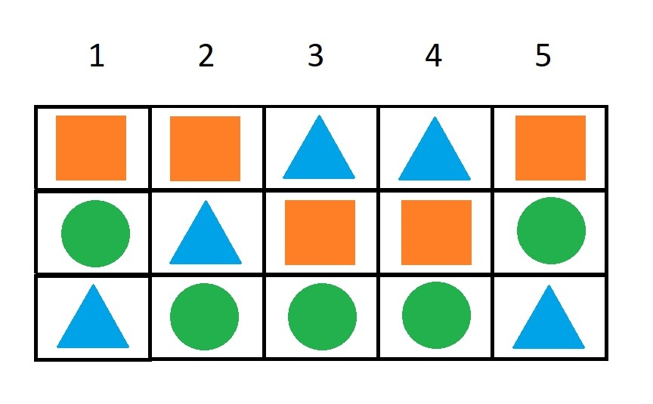
Unanimity

Slide 2
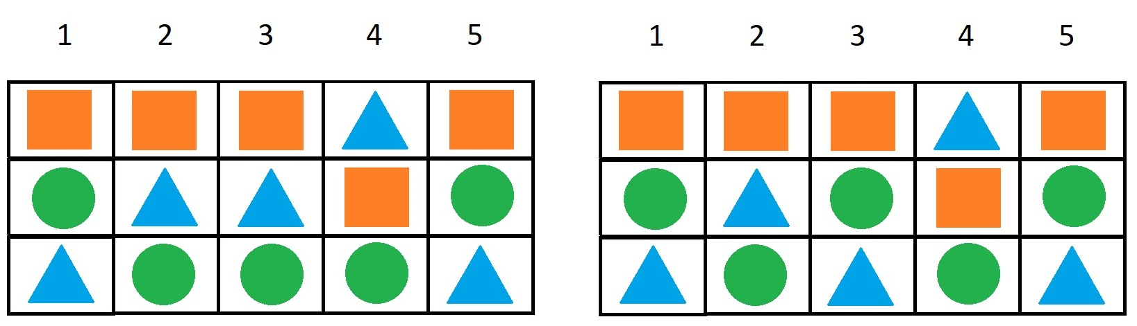
Independence of irrelevant alternatives

Slide 3
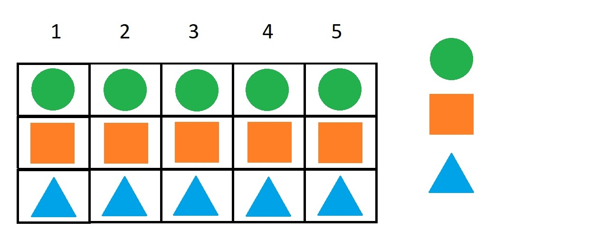
Because of unanimity green beats orange

Slide 4
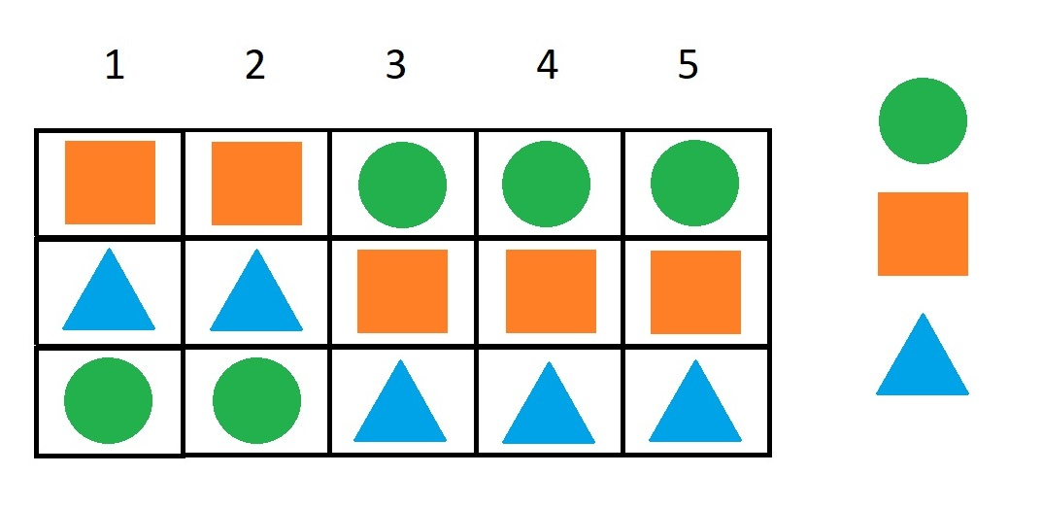
Green is first (majority), orange is second because of unanimity

Slide 5
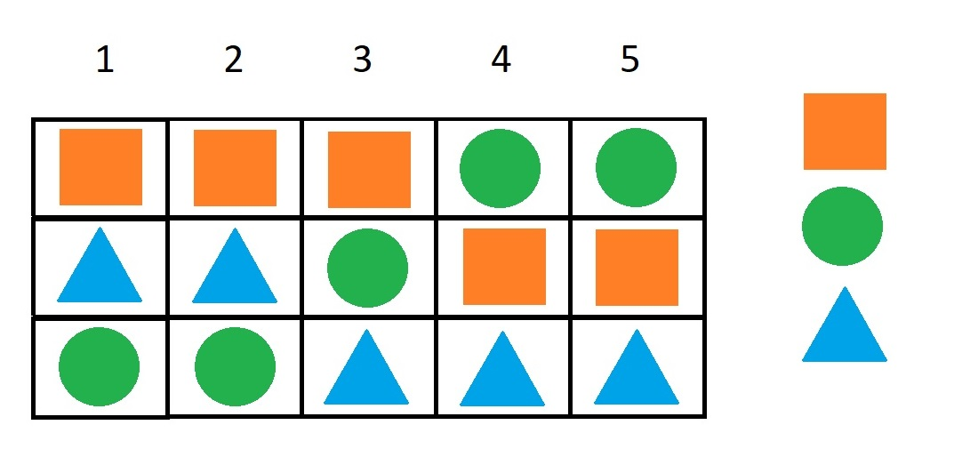
Voter 3 changes green and orange with affects the ranking (majority). Because of independence of irrelevant alternatives, green still beats blue

Slide 6
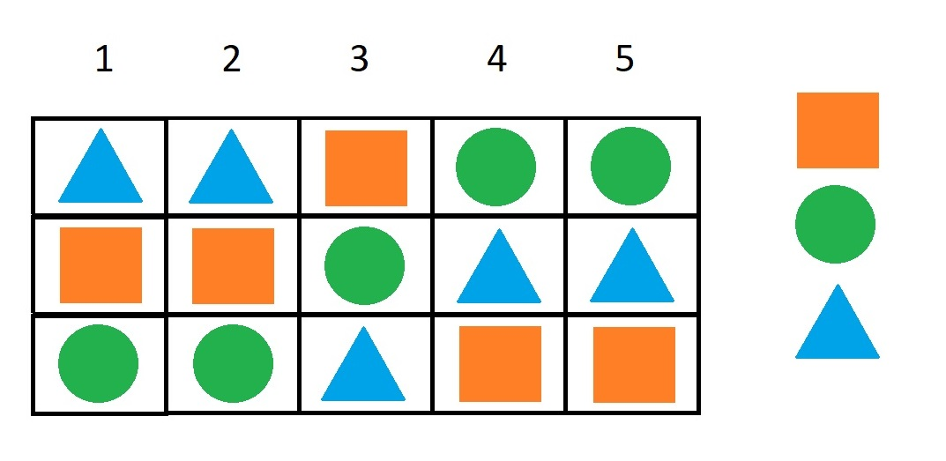
Even if all voters but voter 3 now have blue before orange, green still beats blue because of independence of irrelevant alternatives. Also orange beats green for the same reason

Slide 7
But now all of voters but voter 3 have blue before orange. The result will always be the same until voter 3 changes his ranking. We call voter 3 a dictator

