Slide 1
Personal Informatics Reflections
Group ID: 2
Group Members: Steven Zhang, Dongthi Nguyen, Chris Song

Slide 2
Week 1
(9/22 - 9/28)

Slide 3
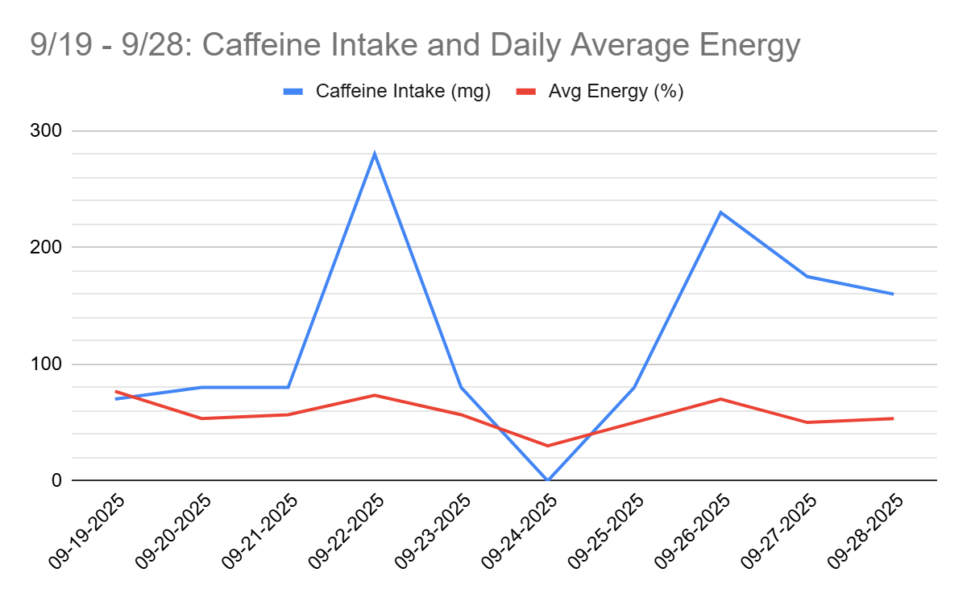
Steven Zhang
9/19/25-9/28/25
My observations during this time range show that my caffeine intake amount correlates with my daily average energy level. On the days that I do consume more caffeine, my average energy also rises, and on the days that I do not consume caffeine, my energy is lower as well.
Notes:
Use whole quote -> continuation of correlation analysis.

Slide 4
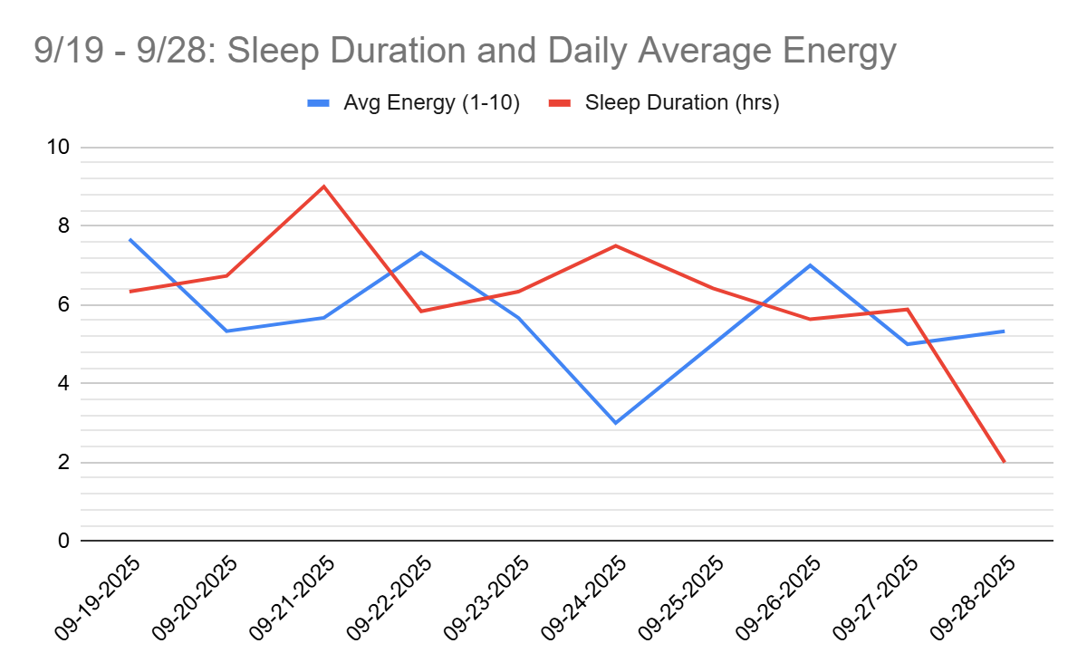
Steven Zhang
9/19/25-9/28/25
My observations during this time range suggest that my sleep duration kind of has a negative correlation with my daily average energy level. When my sleep duration increases, my energy level decreases, and vice versa.

Slide 5
Steven Zhang Reflection
By keeping track of my data, it has made me realize that I regularly consume caffeine to keep me energized throughout the day. If I do not consume caffeine, I will likely feel tired or sluggish that day. I also noticed that I am not meeting my sleep goals. I frequently go to sleep past 1 AM and sleep less than 7 hours per night. These may also be factors that impact my energy levels throughout the day.
From now, I would like to focus on other outcome variables like productivity duration rather than daily mood, as mood is similar to energy. They are both measures of what I feel. I would rather measure how long I am productive during the day.

Slide 6
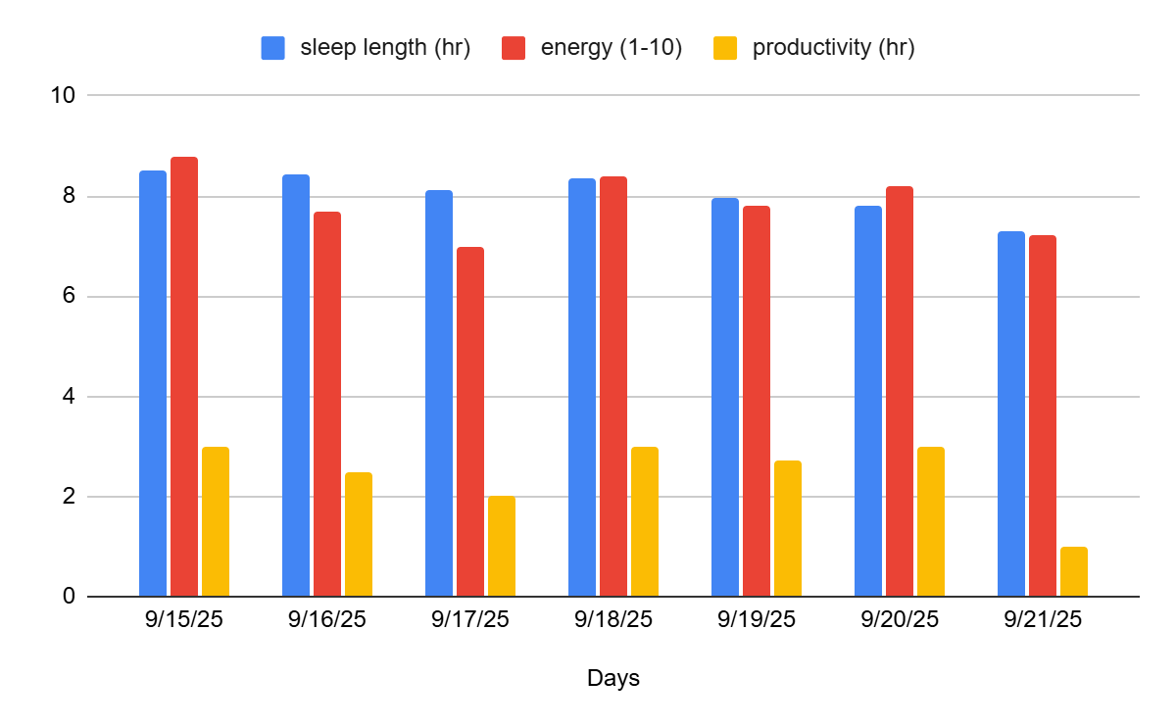
Dongthi Nguyen
9/15/25-9/21/25
This week felt fairly standard, but my observations from this data suggest that my sleep length strongly correlates with my energy levels. I’ve noticed that my schedule is quite consistent—I tend to go to bed and wake up around the same time each day. As a result, my energy and productivity remained steady throughout the week, likely because I’ve been getting enough rest. I also realized that if my sleep were to be cut short, my energy and focus would probably drop significantly like on sunday the sleep was lower the rest of the week but so was the energy and productivity.
Notes:
**AI can help with inconsistencies in the future

Slide 7
Dongthi Nguyen Reflection
Reflection: A takeaway from this week is how structured my routine has become. Waking up early, driving to work, and then heading to school until late in the evening has created a predictable rhythm. I hadn’t realized just how scheduled my life has become because of school until reflecting on it this week.
I would like to possibly focus more on how different the data is on the weekends when I do not have work or school, does my responsibilities really influence my routine that much or is it simply how I am

Slide 8
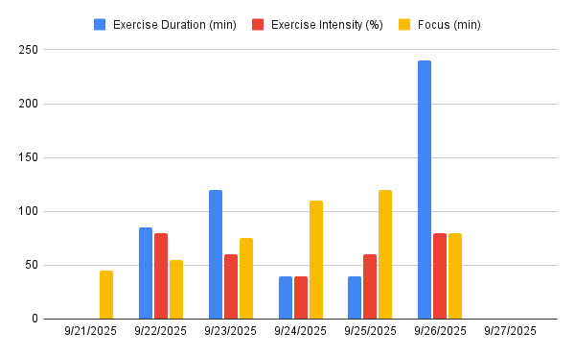
Chris Song - working out before focusing on school
Insight:
Most days I have exercised (before studying) and focused =>50 minutes.
Day 4&5 had peak focus and least exercise duration and intensity.
Reflection
Keep experimenting with workout intensity (before studying) to see focus time correlation
The data generally does not support that exercise and focus are mutually exclusive. However, moderate-to-vigorous activity may improve concentration.

Slide 9
Group reflection
Chris:
I’m interested in finding out my sweet spot for exercise intensity to find my optimal concentration time.
Both Steven and DT have noticed that their sleep affects their energy. DT has noticed that if he reduces his sleep, his energy gets lowered. Whereas, Steven has noticed that too much sleep (+8hrs) may correlate to decreased energy levels.
DT:
I can see Chris is really dedicated to his personal data sheet, being very consistent with his work outs and recording it within his data, I would like to ask for his motivation
Steven data sheet is very organized, and he does well in keeping track of his outcomes I would like to adopt his formatting within mine
Steven
DT has a very consistent schedule which I believe is really good to have. He usually gets a good amount of sleep which helps him with his energy and productivity.
Chris highly values exercise, and it can be seen in his data. He exercises regularly and it is interesting to see how that affects his cognitive performance.

Slide 10
Week 2
(9/29 - 10/5)

Slide 11
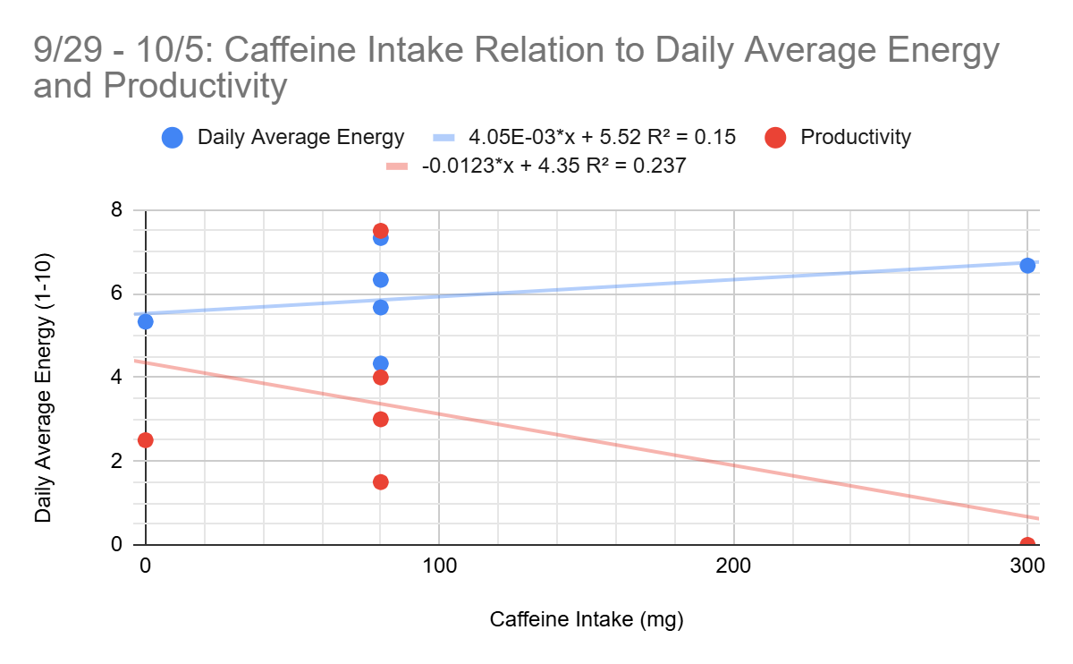
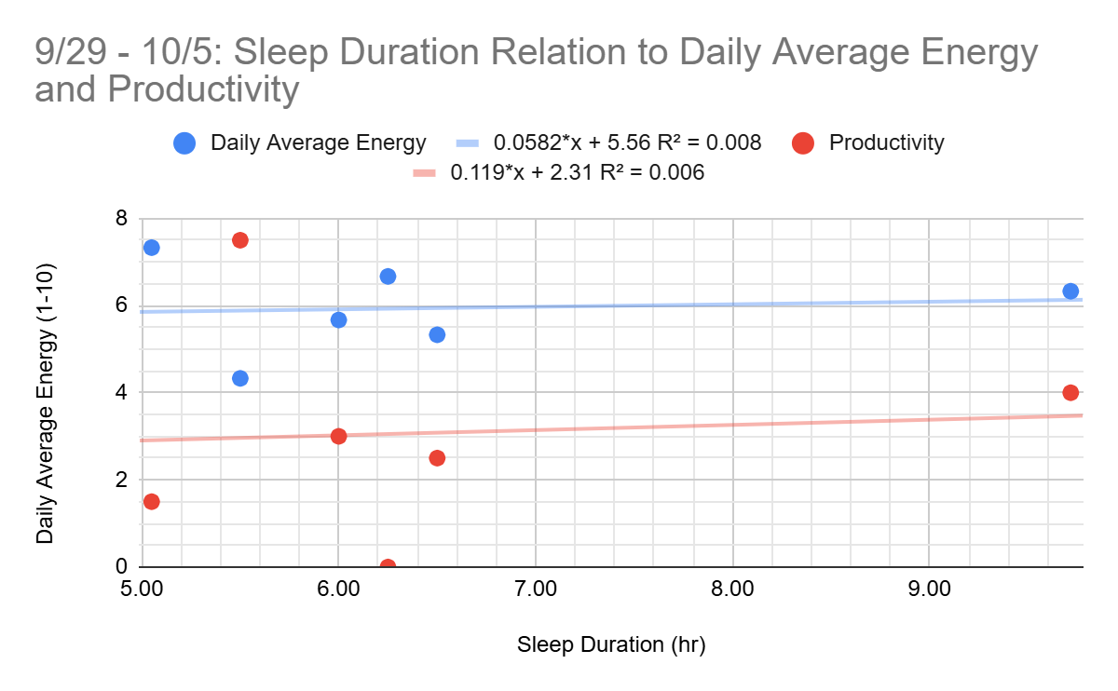
Steven Zhang
Insight:
This past week was not a regular week. I attended a concert, went to the zoo, recovered from sleep deprivation from hackUMBC, and more. There were far more factors that affected my energy throughout the day and productivity than just caffeine and sleep duration. When there is an event, it brings excitement and energy, so the amount of caffeine I had that day does not really matter. This also affects how much work I get done in a day. When there are events, I have less time to study and be productive.

Slide 12
Steven Zhang Reflection
I started visualizing my data using scatter plots rather than using separate line charts. This helps me better understand the relationship between my dependent and independent variables in my study. I also incorporated a regression line or line of best fit and an R² value to better identify the strength of the relationship.
For the Caffeine Intake graph, the R² values for Daily Average Energy and Productivity were 0.15 and 0.237, respectively. These values indicate a relatively weak relationship. On the other hand, on the Sleep Duration graph, the R² values were 0.008 for Daily Average Energy and 0.006 for Productivity. These values indicate little to no relationship between Sleep Duration and the two variables I am studying.
This correlates with what I believe in my insight. With so many things that went on in the past week, I think those events had a larger impact on my energy and productivity than caffeine intake and sleep duration.

Slide 13
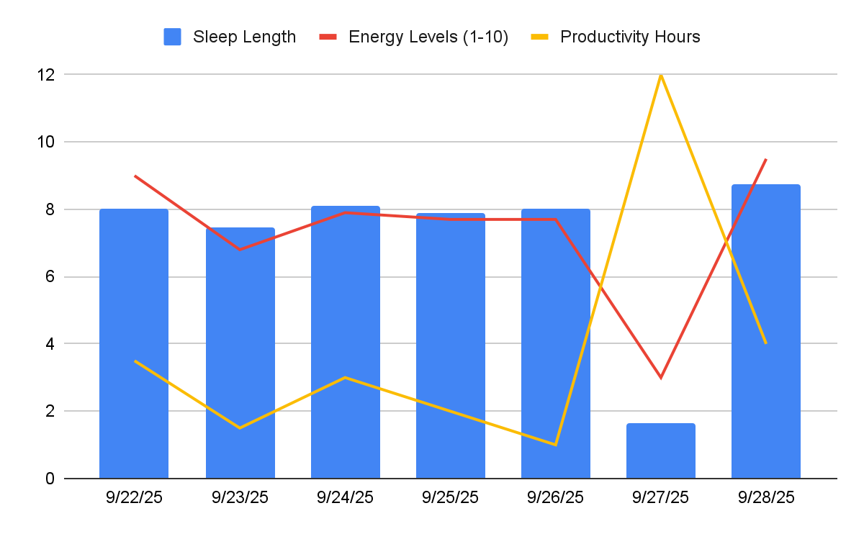
Dongthi Nguyen
Last week was also a very standard week, for me consistently sleeping and waking up around the same time as the previous week. After changing the formatting of my graph it is more apparent that energy levels have a strong correlations with sleep length with it being consistent to each other.
Last Friday was the start of HackUMBC, and I did not get much sleep on Saturday, because I stayed up all night coding, and had no energy at all that day. The moment I returned home I slept early, and recovered all my energy.
This is good insight because the day I had little to no sleep, was the day I had little energy, and it seems that productivity hours is possessing little correlation to the other two measures.

Slide 14
Dongthi Nguyen Reflection
Reflection: My takeaway for this week is that my sleep length, really impacts the amount of energy I have in the day, I remember that Saturday was very rough for me because I had no sleep, and needed to work on my project, but I had little to no energy and needed a lot of caffeine to continue my work.
As I record my hours for productivity it really seems like it has little correlations to my energy, or sleep length, but I would like to continue to examine it because I originally thought before going into this, that my energy really affects how long I spend being productive. Usually if I do not have energy I would spend less time being productive vice versa, but it seems my data is suggesting otherwise.

Slide 15
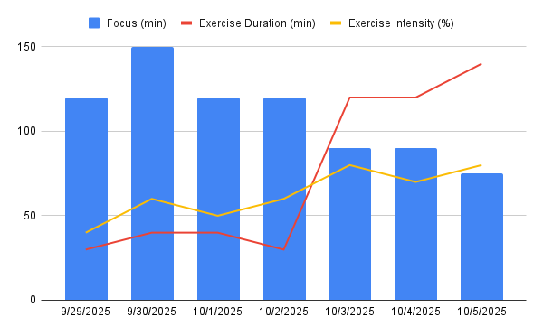
Chris Song
Insight:
9/29-10/2 focus time was higher than the latter portion of the week and the exercise duration and intensity was low
Weekends were spent more on exercise than studying
Duration does not correlate with intensity of exercise
Reflection:
I will be more intentional with my physical activity before studying

Slide 16
Chris Song Reflection cont.
I tried to be more intentional this week with my intensity of working out before exercising. The weekdays I spent doing a bit of exercise before deciding to study/academic work, which went well. With the days on the weekday, I was consistent with my mental goal of hitting 2 hours, in which was a good time for me to stop naturally as I was getting tired. On the weekend, I decided to spend more time and being less intentional before studying. This stress on the body was a lot, and during the initial part of studying I was focused and then my focus dropped substantially, ultimately leading me to stop. I think this experiment has been going well and providing good insights into how I can use exercise to my advantage.

Slide 17
Group Reflection
DT:
- I know Chris & Steven both participated in HackUMBC, so it was interesting to see how it affected their data, because I know for me it was a huge outlier in my datasheet
- Steven & I data sheets have a lot of similarities to it the more I see, which is nice because I can ask for his advice and his approach towards data collection. Chris datasheet motivates me in a way because I like how consistent he is, which motivates me to match that energy.
Chris:
DT input his data when he participated in HackUMBC which highlighted a great dip into his sleep. This lead to very low energy, but a surprising amount of productivity. I believe that it he believes his productivity was high because there was a time constraint in his situation
Steven had a fun and busy weekend, so seeing his energy not be affected that much makes sense to me. He mentions factors outside of caffeine, such as excitement, to provide him energy even if he was already low on energy.
Steven
DT, Chris, and I all participated in hackUMBC the past weekend, so there would be similarities in our data in that aspect.
DT has very consistent sleep, which I lack. Thus, I want to be more like him and get better sleep.
Chris spends a lot of time on exercise which I also lack, I want to be able to exercise like him.

Slide 18
Week 3
(10/6 - 10/12)

Slide 19
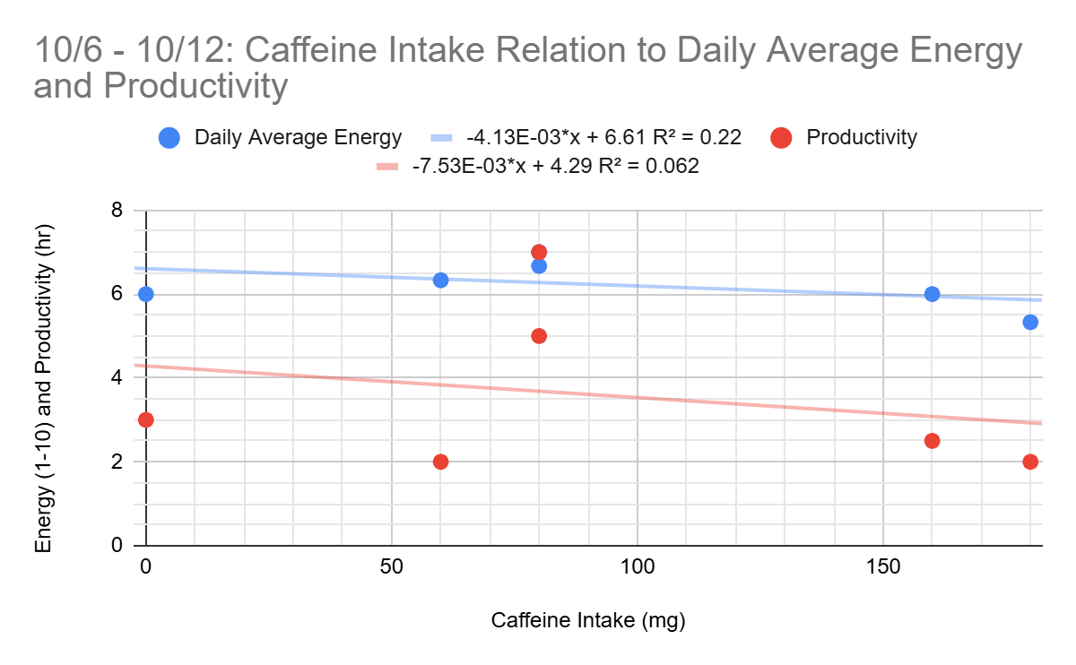
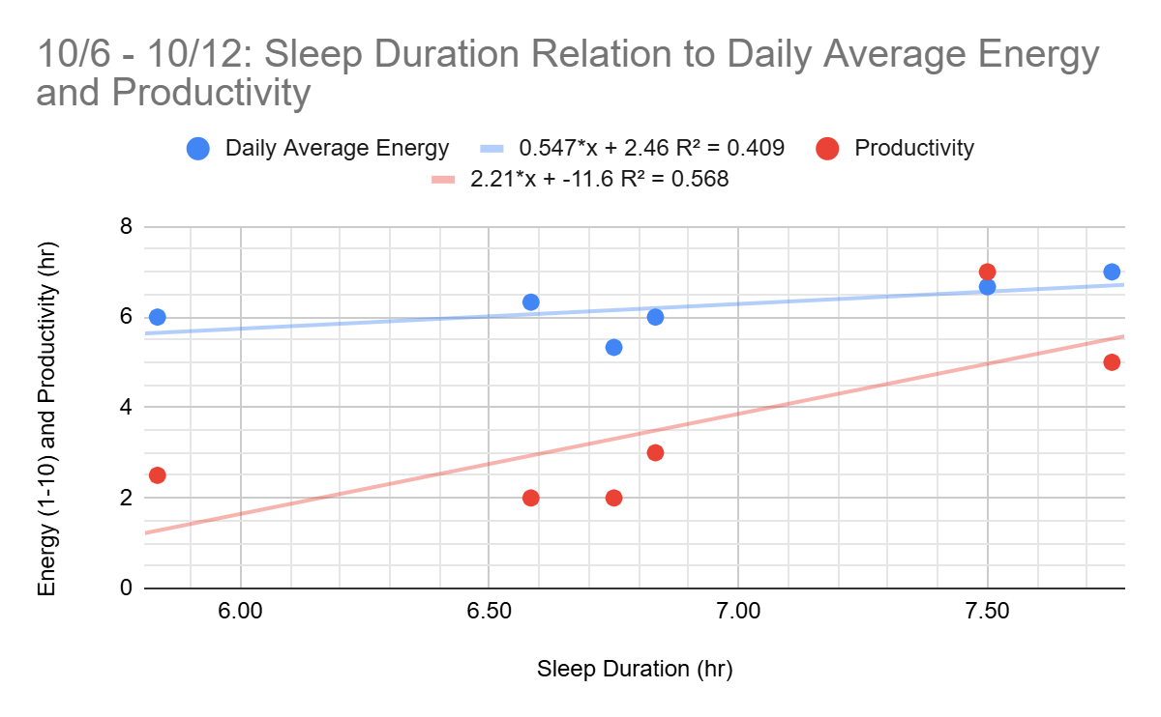
Steven Zhang
Insight:
This past week was more like a typical week for me. I exercised a bit, went to classes and work, and studied. However, I have exams during the week following this week, so I had to put more time into studying. Since I had more time that wasn’t preoccupied by external factors like events, I could focus more on studying and doing other productive things.

Slide 20
Steven Zhang Reflection
This week I visualized both my caffeine and sleep duration data as scatter plots since the data for both were not clustered. Now, the data are properly visualized. Again, I incorporated a regression line or line of best fit and an R² value to better identify the strength of the relationship.
For the Caffeine Intake graph, the R² values for Daily Average Energy and Productivity were 0.22 and 0.062, respectively. These values indicate a relatively weak relationship, but also show that caffeine had little to no influence on my productivity. On the other hand, the R² values on the Sleep Duration graph were 0.409 for Daily Average Energy and 0.568 for Productivity. These values indicate that there is a relationship between my sleep duration and my energy and productivity. The lines are both positive, so it indicates that more sleep correlates with more energy and productivity. I do feel this throughout the week because on the days where I get more sleep, I feel more energetic and get more work done.
To relate back to my insight, I believe that this past week’s lack of events also allowed me to be more productive. With less things going on, I can focus more on studying and getting other things done.

Slide 21
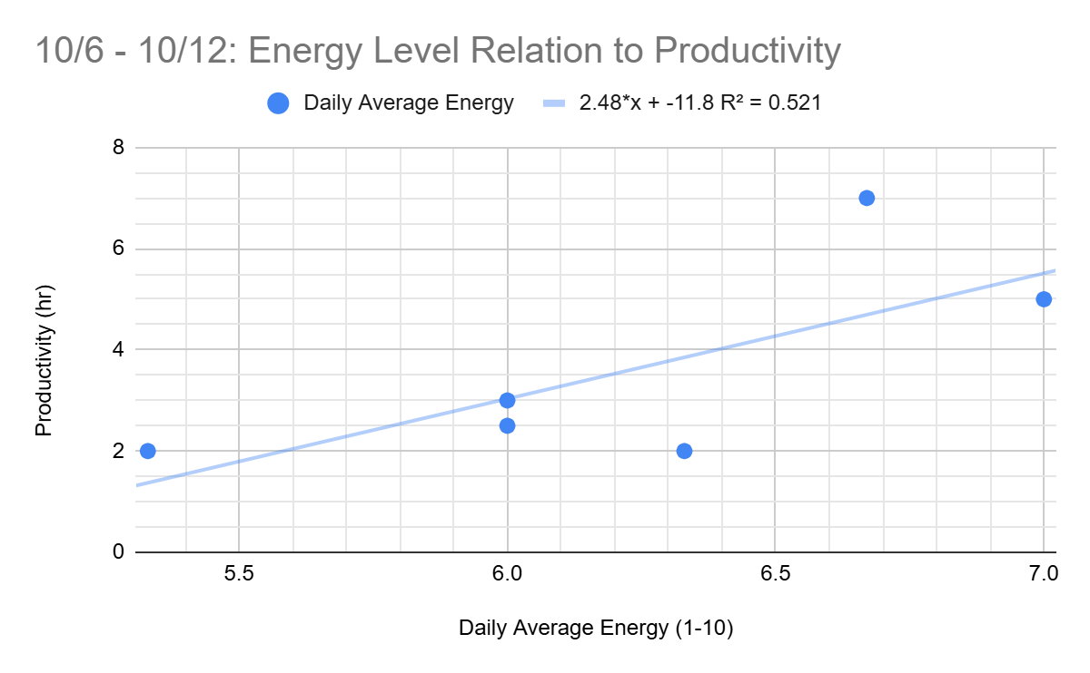
Steven Zhang
Insight:
Dr. Chen suggested to analyze the relationship between energy level and productivity, so I did so through a scatter plot.
Reflection:
This scatter plot visualizes the relationship between the two factors as well as provides a regression line with an R² value. Based on this, I conclude that there is a positive relationship between my productivity and daily average energy. I do feel this correlation since on days that I feel energetic, I study more and do other tasks.

Slide 22
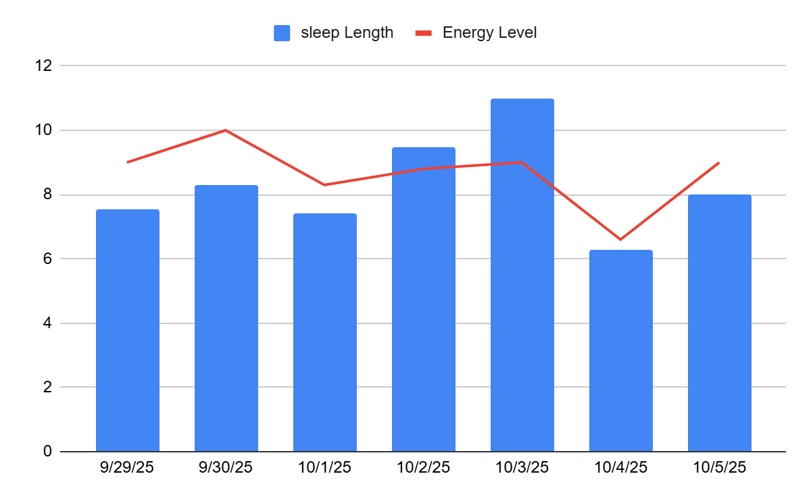
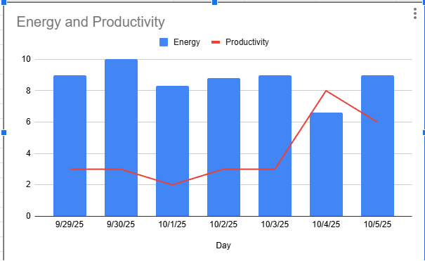
Dongthi Nguyen
Recently I’ve been going to bed a lot later in the day due to my recent schedule change for work. But it seems like, I have been getting adequate sleep still and my energy level seems to be high correlating with my good sleep durations. In addition to this I made a second graph to show the correlation between my energy levels and productivity hours. It seems like the productivity hours, has little to no correlation with energy levels. This is good insight because it means even im tired or very energetic my productivity does not change.

Slide 23
Dongthi Nguyen Reflection
I’ve managed to maintain a fairly consistent amount of sleep each night. Looking at the first chart, it’s clear that my sleep duration aligns closely with my energy levels — on days when I get more sleep, my energy tends to be higher, and vice versa. This reinforces the idea that quality and consistency of sleep have a direct impact on how energized I feel throughout the day.
For the second chart there doesn’t seem to be a strong correlation. Even on days where my energy level was low I had a high amount of productivity. I hope I can try to manage my time better so I can have high productivity hours on days I am feeling energetic.

Slide 24
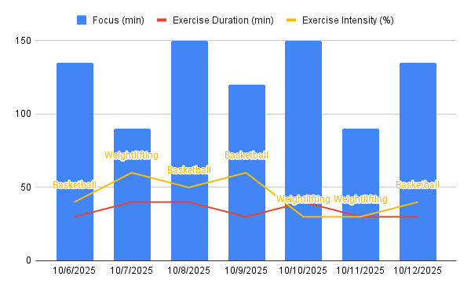
Chris Song
Insight:
Peak focus: 10/8/, 10/10 - Focus duration was 150 minutes; ~40 minutes of exercise
On days with shorter workouts (around 30 minutes on 10/9 and 10/11), focus duration was significantly lower.
Reflection:
My shorter workout days (~30 min) suggests that while some exercise is beneficial, there may be an optimal duration to maximize cognitive returns.

Slide 25
Chris Song Reflection cont.
This week I was more intentional as Professor Chen mentioned about planning focus times more deliberately. My two most productive days were days where exercise sessions were approximately 40 minutes, placing them in the middle of my proposed 20-60 minute window. The intensity of my workouts on peak focus days was moderate. This could indicate that for enhancing deep work, consistency and adequate duration of exercise may be more critical than pushing for maximum intensity, which can sometimes lead to fatigue. I believe that my experiment so far of physical activity before deep work has shown increases of focus by the circulation, delivering more oxygen and essential nutrients to the brain.

Slide 26
Group Reflection
DT:
I saw that Steven switched up the type of graph he used, based on Dr.Chen’s advice maybe I should follow his example and incorporate a scatter plot to show the correlation between productivity and energy levels.
Chris is very motivational and a really good group mate to work with, he is constantly checking in, and reminding me to keep track of my data, he seems really organized and on top of this assignment.
Chris:
Steven’s data showed that his sleep was an important factor in energy and productivity. This is something that I also have encountered in my day to day life as well as when I see him occasionally.
DT’s data strongly supports that energy does not lead to productivity. He seemed to be pushed more to be productive when he was tired.
Steven
Dt and I both made charts about the relationship between energy and productivity. I noticed how his show no relationship between the two variables. For him, his energy does not affect his productivity, so he probably has other motivations that make him productive.
Chris’s data is insightful in the aspect that consistent exercise results in better focus for him. Intense workouts do result in fatigue, so it is reasonable that his focus on those days may be lower than on days where he does his more consistent exercise routine.

Slide 27
Week 4
(10/13 - 10/19)

Slide 28
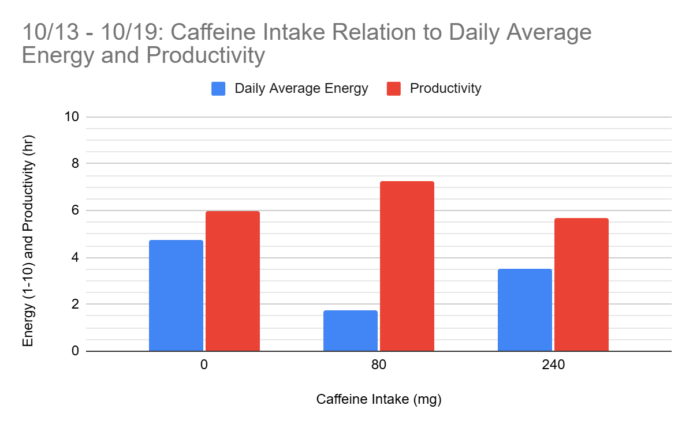
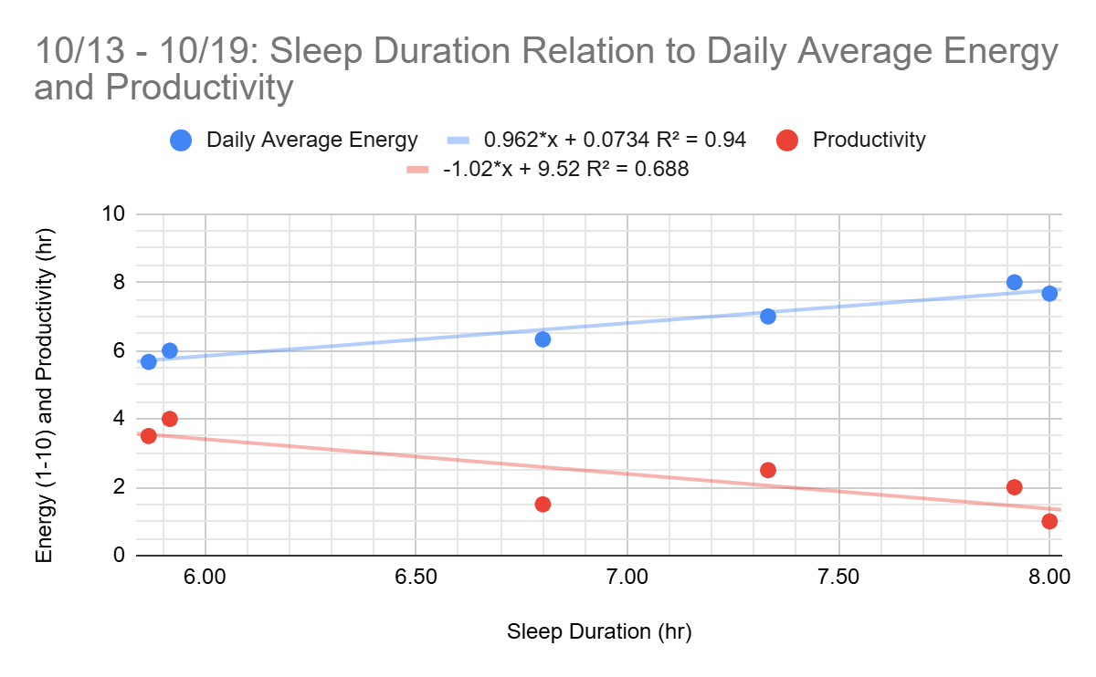
Steven Zhang
Insight:
I had two midterm exams during this past week. To prepare for these exams, I had to study, beforehand and more on the day of the exam. In the later half of this week, I had a couple of outside events going on. For example, I spent my Friday outside to have fun, so I did not really get any work done that day. On Sunday, I went to a wedding so that also took up most of my day. I think this week’s productivity and energy was more affected by events rather than my caffeine intake or sleep duration.

Slide 29
Steven Zhang Reflection
This week, I chose to visualize my caffeine intake graph using a bar chart rather than a scatter plot because a lot of my points were clustered together this week. The data are grouped into 3 categories that represent no/low caffeine intake, moderate caffeine intake, and high caffeine intake. The values are aggregated based on the average of the daily average energy and productivity values. There does not appear to be a relationship between the caffeine intake and energy/productivity for this week. Productivity stayed relatively the same throughout the week while energy levels fluctuate a lot.
On the other hand, the R² values on the Sleep Duration graph were 0.94 for Daily Average Energy and 0.688 for Productivity. These values indicate that there was a strong relationship between sleep and energy, and a semi-strong relationship between sleep and productivity. However, there is a negative correlation between sleep and productivity, showing that on days where I got more sleep, I was less productive.
To relate back to my insight, I believe that this past week’s events did have more impact on my energy and productivity than my caffeine intake and sleep. The caffeine graph displayed no relationship between the variables, and my sleep graph showed that I was less productive when I got more sleep, which does not really make sense in my daily life.

Slide 30
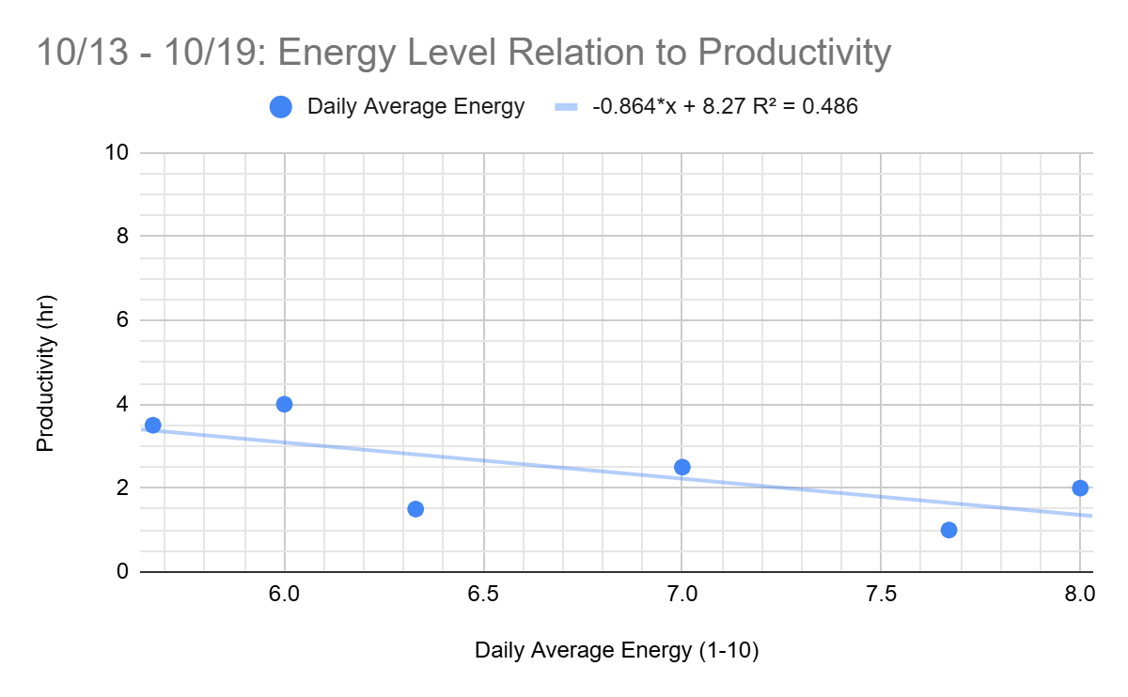
Steven Zhang
Insight:
On the days where I was more energetic, I also had other things going on (exams, pumpkin patch trip, wedding, etc.)
Reflection:
Based on this scatter plot, negative regression line, and R² = 0.486, there was a semi-strong negative relationship between my energy and productivity. During this week, my energetic days were spent on doing different activities rather than doing something productive like studying.

Slide 31
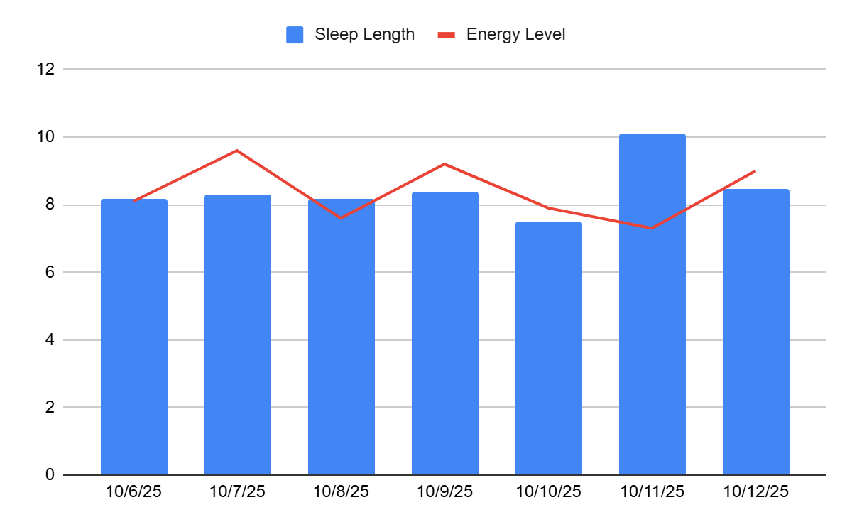
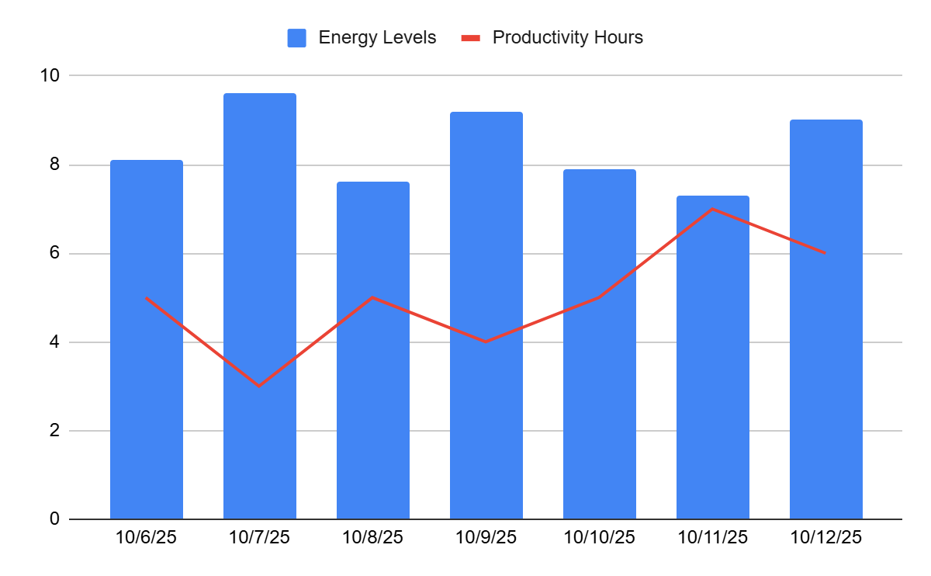
Dongthi Nguyen
Insight: This was the week prior to exams, so I had to make sure I got plenty of sleep, so I would have the energy to be productive.
Within this graph the following days I got in a lot of sleep, which resulted in a high corresponding energy levels. I know during this week I felt very productive because I studied for all the midterms that were coming up this week. Because of all that rest, I had the energy to remain productive, which resulted in a high productivity hours compare to the previous weeks, which could imply their might be some correlation between the two

Slide 32
Dongthi Nguyen Reflection
This week was exam week, which had me very stressed, but I still wanted to get plenty of sleep and I need to be productive. I made the effort to get enough sleep and stay energized so I could study for these exams, and complete all my assignments for the week. The graph really displays how the days I slept for a long time, my energy levels, and productivity hours increased with it, which to me suggests a positive relation between sleep and performance.
However I did noticed that the day I got a lot of sleep I did not feel like I had more energy, instead I felt more tired. Other factors that may have affected that was stress, workload, etc. I also think that the more I sleep the more tired or sluggish I feel waking up, and I also been sleeping late, and waking up later in the afternoon, which could affect how I feel waking up.

Slide 33
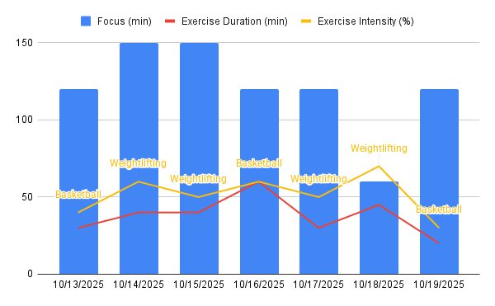
Chris Song
Insight:
Oct 18: Least amount of focus time and highest workout intensity
Oct 14-15: Peaked at 150 min of focus
Oct 13,16,19: Basketball at similar intensity (40-50%) resulted in 120 min of focus
Reflection:
High intensity does not lead to “better” cognitive function
My sweet spot for Weightlifting is 40 min at a challenging but sustainable 50-60% intensity.

Slide 34
Chris Song Reflection cont.
The most notable observation is the significant drop on October 18th. I recorded my highest exercise intensity of the week at 70% during a 45 minute weightlifting session. Following this, my focus time for the rest of the day dropped to only 60 minutes, and I completed zero assignments. This suggests that there is a threshold where physical exertion begins to significantly reduce my available mental capacity. I feel that the 150 minute focus sessions weren't random. They happened when I finished the workout feeling energized and ready, rather than completely drained. For weightlifting, my ideal balance appears to be around 40 minutes at a challenging but sustainable 50-60% intensity. For basketball, perhaps ~45 minutes a session.
I also believe that my "Assignments Completed" metric is currently too simple, as completing one major paper holds more weight than one minor lab report. I will add a "Task Weight (1-5)" column to my "Assignments Completed" log, where 1 is a small task/reading and 5 is a major paper/project. This will provide a more accurate measure of true Output Value. I will also add an “Energy Level (%)” column that I will subjectively fill out right after I workout to help confirm whether a low energy score reliably predicts the subsequent drop in Focus time.

Slide 35
Group Reflection
DT:
It was interesting to see all the activities Chris Implements within his data, and how well labeled everything is. In addition Chris, insights are very analytical, and really displays a lot of percentages that I should possibly incorporate into my data.
Steven’s scatter plots really shows the relationship between variables, which my data also does, so maybe I should use a scatter plot next week to display the correlation between my sleep length, energy levels, and productivity hours.
Chris:
It was interesting to see that Steven’s productivity didn’t really correlate to neither his energy levels or hours of sleep, but rather the events happening within his life. I feel that external motivation can be a big factor in my life too.
In similar fashion, DT did not do well with excess sleep (Steven also did not do well with more than usual sleep time). Both of them had midterms this past week and experienced similar productivity.
Steven
DT's data, particularly in the lower graph comparing energy levels and productivity, shows a general trend where high energy levels in the first half of the week seem to lead to greater productivity, suggesting he utilizes his rest well when preparing for events like exams.
Chris’s insights clearly demonstrate that the intensity of his exercise is a critical factor impacting his focus. The data points to intensity between 50-60% being much more effective for cognitive function than intense workouts.

Slide 36
Week 5
(10/20 - 10/26)

Slide 37
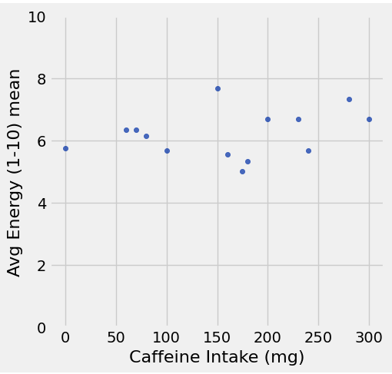
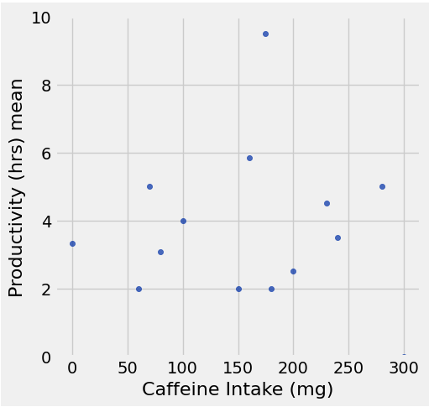
Steven Zhang
Caffeine Intake and Avg Energy
Analysis #1:
Hypothesis: Having a reasonable amount of caffeine daily (~100mg from coffee, tea, and/or energy drinks) will increase energy levels and productivity time.
The results do not support my hypothesis for the relationship between caffeine intake and average energy. Throughout this study, the amount of caffeine consumed have varied daily from 0 mg to 300 mg of caffeine. However, my average energy level stayed consistently between 4 and 8. It does not appear that there is a positive or negative relationship, so there may be no relationship between caffeine intake and average daily energy.
The results do somewhat support my hypothesis for the relationship between caffeine intake and productivity. There appears to be a weak, positive relationship between caffeine intake and productivity. On some days, higher caffeine intake did correlate with higher productivity for that day. However, this relationship is not strong across the entire data.
Caffeine Intake and Productivity

Slide 38
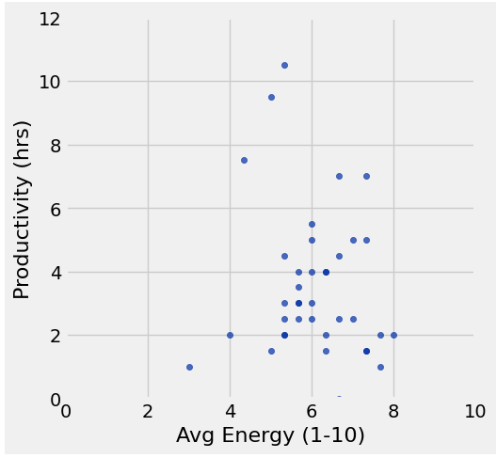
Steven Zhang
Analysis #2:
What is the relationship between Avg Energy and Productivity time?
There appears to be a weak positive relationship between average energy and productivity time. My average productivity across all days recorded is 3.55 hours, which a majority of the points hover around despite the the differences in average energy level.
For example, on days where my average energy level ranges from 4-8, the productivity time generally stays within 2-4 hours. There are a few days where my productivity time is very high, but my energy for that day was about the same as every other day.
and Productivity

Slide 39
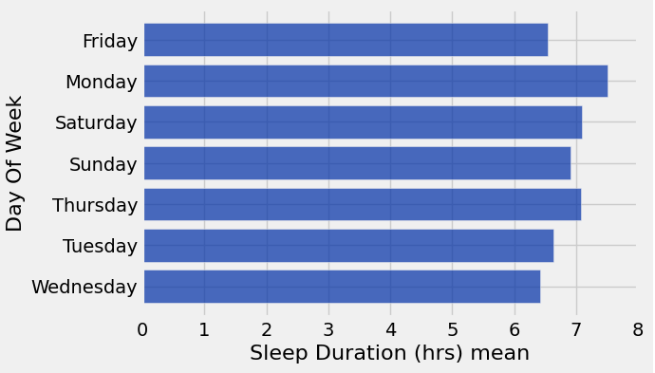
Steven Zhang
Analysis #3:
What is the pattern of sleep duration on each day of the week?
The average sleep duration on each day of the week is about the same. They fall in the range of 6-7 hours. I also noticed that on average, I get the most sleep on Mondays. As a summary, my sleep is consistently the same on every day of the week.
Note: I have always gone to sleep after 12 AM, so the sleep starts on the day it is recorded for. For example, Monday's sleep is from going to sleep on 'Sunday night' and waking up Monday morning.
Average Sleep Duration on each Day of the Week

Slide 40
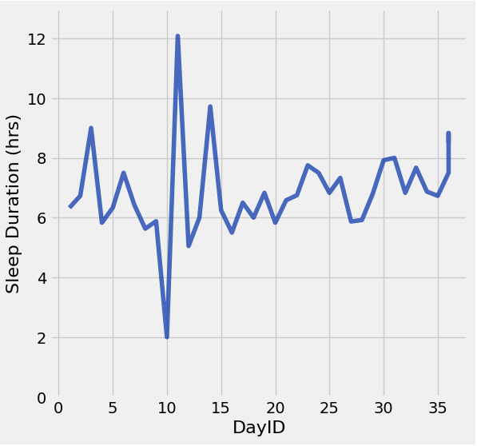
Steven Zhang
Analysis #4:
What is the trend of Sleep Duration (hrs)
Throughout this study, my sleep duration has mainly fluctuated between 6-8 hours of sleep, which I believe is a good amount of sleep.
There are some details in the trend that are different from the rest of the graph. On day 10, I only slept for around 2 hours. This was because of hackUMBC. On day 11, I slept for over 12 hours. I went to sleep early that evening and did not wake up until the morning due to lack of sleep. The few other days when I got more than 8 hours of sleep were because I was particularly tired on those days.
Sleep Duration Trend Across All Days

Slide 41
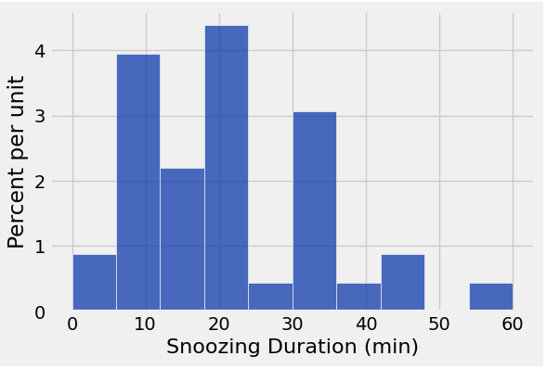
Steven Zhang
Analysis #5:
Distribution of Snoozing Duration (min)
This histogram shows the distribution of snoozing time each morning. Usually, I lay in bed for a while before actually getting up. This histogram shows that I usually snooze for around 10-20 minutes, or 30-35 minutes.
Snoozing Duration Distribution

Slide 42
Steven Zhang: Journey of being a scientist
What kind of experimentation you did to improve outcome?
Due to this project, I became more interested in tracking how caffeine intake and sleep duration influenced my energy and productivity throughout the day. At first, I assumed that more sleep and caffeine would make me feel more energized and thus make me more productive. However, I found out that my average energy did not have a relationship with my caffeine intake, and on a majority of days, my productivity stayed between 2-4 hours regardless of how much energy I felt. To improve the outcome, I tried to have a better balance of sleep and caffeine so that I can have more energy throughout the day, and focus that energy on being more productive. Throughout this experiment, I also noticed that external factors such as events have taken up my whole day, making me energetic but left no room to do productive things like study. I will also focus on improving this aspect so that external factors do not take up so much of my time.
What works what does not work
My optimal energy and productivity comes from moderate sleep (around 6 hours) and moderate caffeine intake. Excessive amounts of caffeine does not always work, since I may experience a caffeine crash. Too little sleep does not work because I would be too tired later on in the day, and too much sleep also correlated with less energy and productivity.
What is one message you want to send to your peer regarding improving outcome
Having a consistent sleep schedule and taking moderate amounts of caffeine may help you focus on being productive during the day while also having the energy to do so.

Slide 43
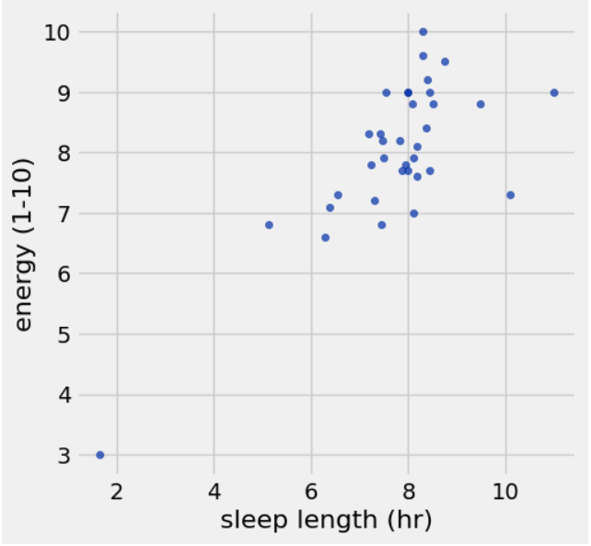
Dongthi Nguyen
Hypothesis: Increasing sleep length improves energy levels, which then can also increases hours of productivity.
My first analysis was to focus on the correlation between sleep length, and energy levels.
My hypothesis was that if I were to increased the duration of sleep of sleep it would produce higher energy.
In this plot, the x-axis is sleep length, and as sleep length increases, the higher the y-value is, which was energy levels. This supports the first half of my hypothesis that increased sleep length does have a correlation with higher energy.
However I noticed that too much sleep can lead to potentially lower energy levels, examples are the days when I have 10+ hours of sleep yet, my energy levels were lower compared to the days I only got 8 hours of sleep. Still having a good amount of sleep will result in having higher energy levels, compare to having no sleep.

Slide 44
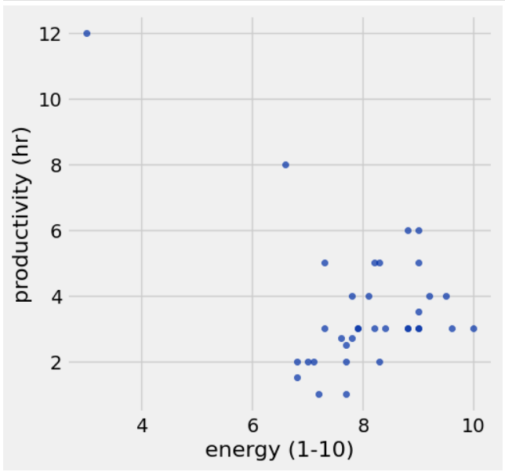
Dongthi Nguyen
My second analysis was to analyze the correlation between high energy levels, and the productivity hours.
Based on the plot the correlation seems to be weak-to-moderate correlation between the two variables.
There were several days where i felt energetic but still was not very productive compared to days when I was tired yet still was very productive. This explanation could be explained by external factors like deadlines, exams, and extracurricular activities. One of the days I was very productive was during Hackathon, which I lacked sleep due to putting all my time into my project to ensure it will be finished before the deadline.
This plot does fully support my hypothesis, which predicted that high energy levels would directly lead to more productive time, instead my data suggests productivity is influenced by a lot of factors, instead of just energy

Slide 45
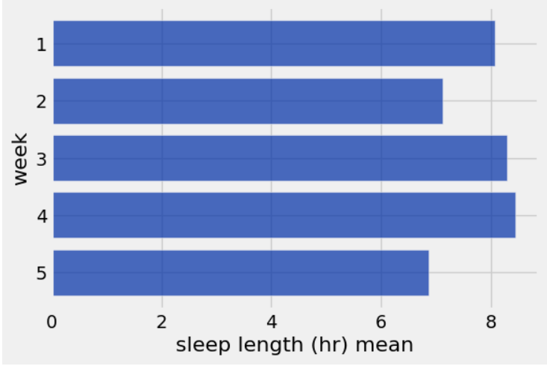
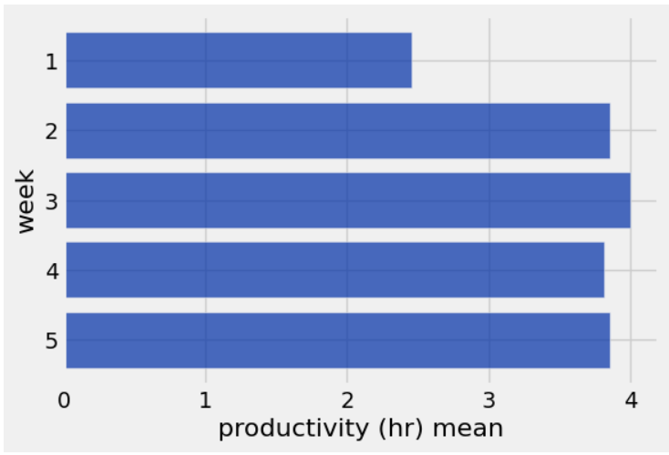
Dongthi Nguyen
For my third analysis I compared my sleep length directly with my productivity hours.
The plots shows that there is little correlation between the two variables.
For example week 1 was almost my most highest average slept week, but it was my least productive wee. Another example is week 5, which had the lowest average sleep, yet it was one of my most productive weeks.
This rejects my hypothesis, that having more sleep will lead to higher levels of productivity, due to having higher energy levels. This plot is indicating that having more sleep on average, does not necessarily lead to more productivity, and further supports that productivity is more related to external factors that forces us to be productive.

Slide 46
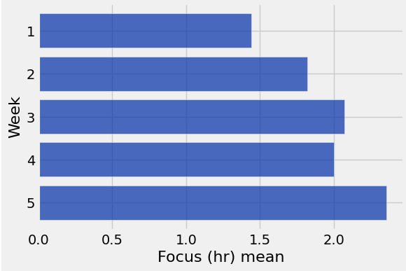
Hypothesis: 20 to 60 minutes of exercise before doing cognitive tasks will increase the duration of deep work
Chris Song
Week Pattern (I do not have weekdays as a column in my sheets)
I began this experiment with a lack of drive, however I began to put more effort into focusing more after doing exercise. I intentionally experimented with different exercise durations and intensity, but after the second week, I began with narrowing the time and intensity of my exercise time to be between 20-60 minutes. This reflects my hypothesis as I began to average more focus time as the weeks progressed as I began to average the appropriate time supporting my hypothesis.

Slide 47
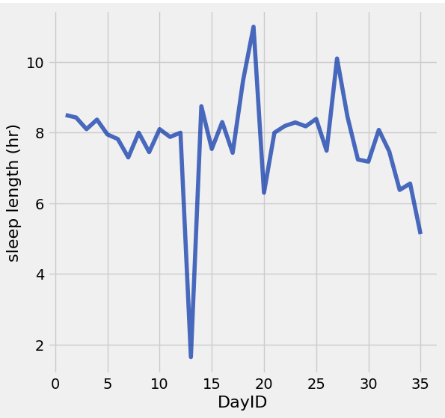
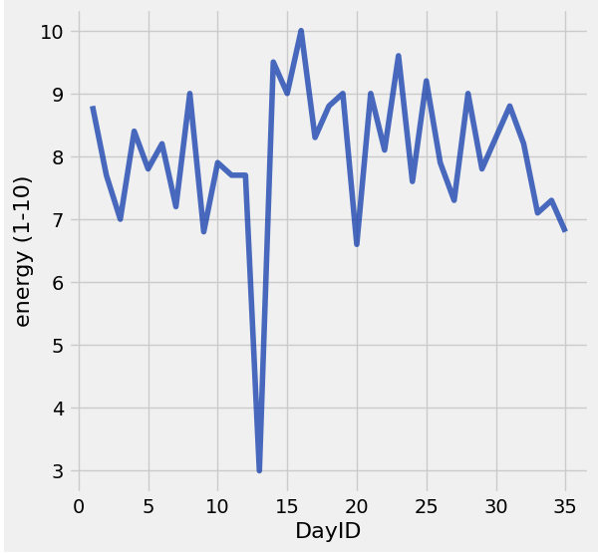
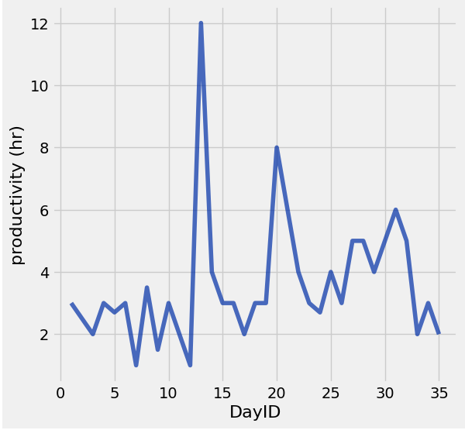
Dongthi Nguyen
My Final analysis was to analyze the trends for sleep, energy, and productivity as the days go by.
As shown in the plot the line trends for sleep and energy are very similar, and reinforces my hypothesis that, the two variables are correlated with each other.
For productivity it seems like it is contrasting with the other plots, rejecting my hypothesis that sleep and energy directly affects productivity.
This line charts displays al the data I collected throughout this project, and is the summary for all of my work.

Slide 48
Dongthi Nguyen Reflection
To improve the outcome for my project I introduced sleep routines, incorporate various alarms, and monitoring apps to record my steps, sleep, and calories. In addition I made sure to record my data the moment I wake up, and before I go to bed to ensure accuracy. I recorded outliers, and provided explanations. I had a strict routine, and followed it throughout the experiment.
A lot of my methods, is very practical like having apps record data, for you, and having a good morning and night routine significantly improves your data collection. However, I would say it is difficult to record going to bed, because it is easy to fall asleep, and being unaware of what time you fell asleep, which will cause your data to be inaccurate.
A message for my peers, is to really mentally prepare yourself for data collection and keep your focus up, one mistake can lead to bad data, and inaccurate one that will skew your analysis.

Slide 49
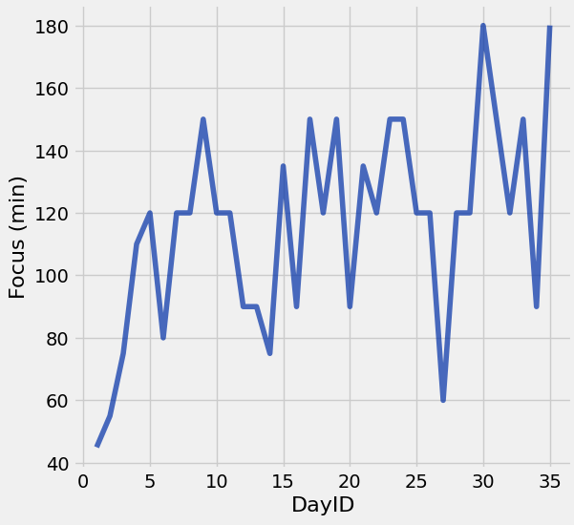
Trend of Focus
Chris Song
The trend of focus throughout this experiment was chaotic. The dips in the graph represented mostly weekends, but some weekdays, where I didn’t want to exercise/study or days where I did more physical activity so I may have had more trouble getting into deep work. Although this trend line fluctuates a lot, it still steadily showed focus beginning to go up. This reflects the previous slides’ story where I began to narrow down my exercise duration and intensity as the experiment progressed.

Slide 50
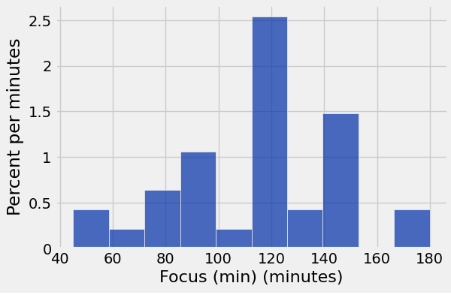
Distribution of Focus
Chris Song
To preface, 120 minutes of deep work is a satisfactory time for me in terms of this experiment and in general. Deep work to me means to have a focus that does not break away for more than a minute. If I begin to have thoughts that diverge away from the task, I quickly jot them down to a paper next to me. If the thoughts become too loud, then that is when I stop and look at the clock. However, I set a timer that was in increments of 30 minutes to make the experiment more structured and provide visual clarity. The 120 minute deep work sessions were the most common which may confirm my hypothesis. It was fascinating to see this grouping be the reality of this experiment because I was unfamiliar with how long I engage in deep work without exercise before a session. I am more motivated to continue exercising before engaging in deep work because of this distribution.

Slide 51
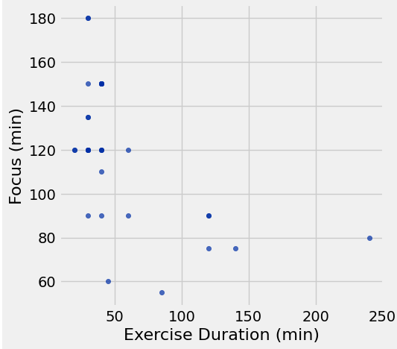
Relationship between Focus and Exercise Duration
Chris Song
This reflects my hypothesis of 20-60 minutes being a “goldilocks zone” for optimal focus time. The mean focus time for the hypothesis group (20 to 60 minutes of exercise) was 128.0 minutes, which represents the highest average focus achieved across all groups. In contrast, the low-exercise control group (0 to 19 minutes) averaged only 101.25 minutes, and the high-exercise group (>60 minutes) saw the average drop to a low 77.5 minutes. The scatter plot depicts the relationship between exercise and focus duration reinforces this finding, showing that high-focus data points are clustered primarily around the 20 to 60 minute mark on the exercise axis. The pattern suggests that optimal focus is achieved within my hypothesis’ specified range. Sessions outside this window, especially those lasting over an hour, frequently correlate with the lowest focus durations, likely due to increased physical fatigue, which undermines cognitive performance.

Slide 52
Chris Song: Journey of being a scientist
What kind of experimentation you did to improve outcome?
As the experiment went on, I was more intentional with my days and followed my curiosity that led me to ask questions such as “what matter more: exercise duration or intensity?”, “how much exercise would be ‘enough’?”, “do I need to include more metrics?”. I’ve come to the conclusion that exercise intensity may matter a bit more than duration. Although, duration can lead to more intensity, so they share a similar light. I found out that my sweet spot is between my hypothesized 20-60 minutes range, but more specifically a 30-50 minutes of moderate intensity exercise window, before I begin to engage in cognitive tasks. At the end, I inserted an “Energy Level (1-10)” and a “Task Weight (1-5)” column to provide more context to the data because this project has opened my eyes to consider more variables when it comes to this hypothesis of mine: 20-60 minutes of exercise will improve concentration. These changes, although at the end, improved my data collection and improved my outcome and the way I approach life.
What works what does not work
What worked best for me was being intentional and realizing that the initial hypothesis, while close, wasn't specific enough, but guided me to the true sweet spot of 30 to 50 minutes of moderate intensity exercise. This confirmed that intensity matters a bit more than duration for priming the brain. This moderate range was far more effective than the extremes, where exercising for too long (over 60 minutes) proved detrimental, leading to my lowest focus times due to fatigue. The biggest improvement to the project's outcome wasn't a finding about exercise itself, but the realization that other variables matter—prompting me to add the "Energy Level" and "Task Weight" metrics—which improved my overall data collection and approach to life.
What is one message you want to send to your peer regarding improving outcome
Treat your data collection like an experiment and be curious about your variables so you can find your “sweet spot”. If not exercise, moving around like walking for a 10-30 minutes before working on any task may improve your focus, so try a movement/exercise and see what works for you.

Slide 53
Group Reflection
DT:
Chris’s experiments are always thorough and very meticulous. I always felt energized and motivated seeing his data, because of how well-made it is; I could see the effort put in, which made me want to match that energy. Chris reflections taught me a lot about the benefits of exercise. I would like to incorporate more physical routine in my life, and maybe I would like to incorporate it into my tracksheet, to see how it can affect my existing data. I hope Chris continues to improve his focus and do his exercise, because that is a very healthy habit, and overall, his data collection was well made.
Steven experiments were organized and very precise, because of how similar our variables was, he gave me advice on how to improve data collection. His plots and graphs were very informative, and it inspired me to try to do something similar. Steven did a great job with his reflections and graphs, and helped me out a lot throughout these weeks, I am very grateful for him, and I wish him the best of luck.
Chris:
Steven’s experiment was well documented and it was interesting to see his variables change throughout the experiment. Seeing the difference and parallels to his caffeine intake between energy and productivity gave me insight to not just his life but how I can potentially view caffeine in my life. I am not an avid caffeine user, but I have noticed that some days it help and other days it doesn’t and I could use his data as another perspective to consider. A piece of advice I would give is to keep the consistent sleep schedule and to find intrinsic motivators to be more productive. Your work is very thorough and concise, so I hope to see more of that in the future!
DT’s experiment was adjacent to Steven’s experiment in which he hypothesized that more sleep would lead to more energy which leads to productivity gains. In a similar light, his energy did not determine whether he was productive or not. I learned that energy may not be that much of a factor when it comes to productivity from these two. I’d recommend for him the same thing I said to Steven- to find intrinsic meaning behind the work to be more productive. Your data collection was neat, hope you up the good work!
Steven
Chris had intentionally increase his focus throughout this project. I do believe that this is a good thing. Being more focused is good, and it is interesting to see how he made reflections on how his focus related to other parts of his life, such as exercise intensity. Chris also found his optimal exercise duration (20-60 minutes) to be the most helpful to him. I would want to implement this into my daily routine to see if it helps me as well. I find Chris’s lifestyle as very inspiring. Keep up the good work!
DT’s experiment focus and results were similar to mine in the aspect that his productivity was not determined by his energy. I believe our productivity is heavily influenced by external factors rather than our energy. We feel the need to be more productive at certain times, such as before exams. This seems like our priority on being productive is not very high, since we do not have a general motivation to be productive. I wish DT the best of luck!

