Slide 1
Parameter
Definition
eeg_etParams.m
General preprocessing
- Get eye data
- Cleaning pre-experiment and experiment data for ICA
- Perform ICA and identify eye components
CondProb
toolbox
eyeread.m.m
eeget2fixmat.m
feature/saliency
maps
(*)_eye.mat
synchronEYEz.m
(*)_fixmat.mat
(*)_eye.mat
feat2eye.m
artifact_rej.m
expICA.m
(*)_eye.mat
(*)_expgen_epoch2reject.mat
(*)_ica.mat
trial2movie.m
(*)_(#_trial).avi
(*)_eye.mat
artifact_reject.m
(*)_ica.mat
(*)_(name_analysis)_epoch2reject.mat
define_events.m
procexp.m
(*)_(name_analysis).m
(*)_(name_analysis)_clean.mat

Slide 2
Pre - processing
Pre-experiment
- Read eyedata
- Synchronyze with EEG
- Remove of artifact
Manual
Automatic
- ICA
Identification eye-movement
related artifacts
Experiment
- Read eyedata
- Synchronyze with EEG
- Subject-Population Stats
After remove of eye-movement
related artifacts
variance,range,kurtosis
- Identification of artifact segment in
continous data
Manual
Automatic
Analysis
Experiment
- Get eyedata
- define events/epochs of interest
- remove epochs that occur in previousle
Identified segments with artifacts
- Epoching
- Remove eye movement artifact
ICA components
- TLA – TFR
- Grand average
- Plot & Stats

Slide 3
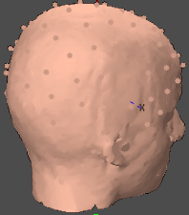
EEG & Eye-Tracking experiments
Apple
Cinema HD
Apple Cinema HD
Ubuntu
2560 x 1600
EyeTracker
Eyelink remote
500 Hz
16 mm lens
Camera in level position
Display PC
PowerMac
Eye-tracker
Host PC
Apple
Cinema HD
1 x Battery
2 x 32 Channels
BrainAmp
Amplifiers
USB2 adapter: integrates
signal from amplifiers (optical cable from brainamps)
with triggers (parallel cable from Display PC)
Experiment:
Programed in Python
Pre – experiment
Experiment

Slide 4
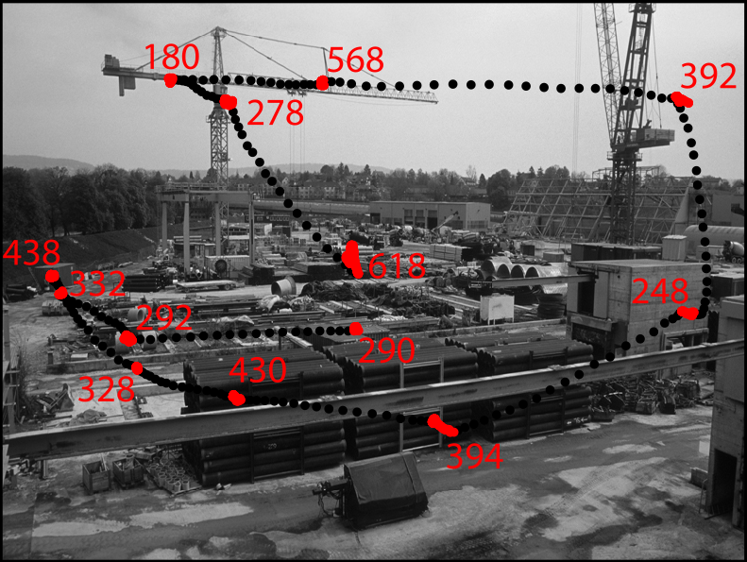
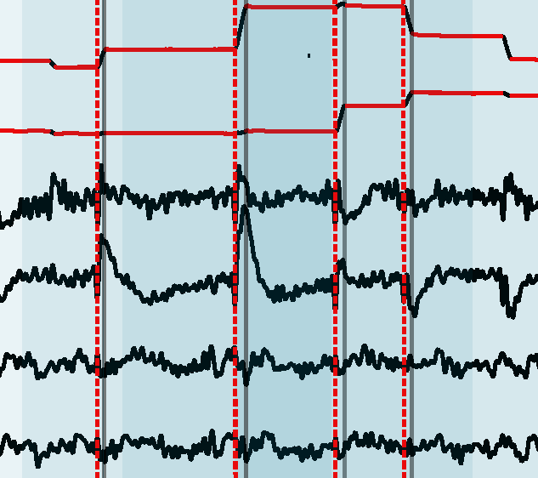
EEG & Eye-Tracking experiments output
Eye-tracker
- *.EDF file
EEG VisionRecorder
- Datafile. *.eeg
- Header: *.vhdr
- Marks/Triggers:*.vmrk

Slide 5
EEG & Eye-Tracking experiments analysis
- Feature analysis
with CondProb
- Get feature values
into eyedata structure
Pre - processing
Pre-experiment
- Read eyedata
- Synchronyze it with EEG
- Remove of gross artifacts
* Manual
* Automatic
- ICA
* Identification
eye-movement
components
Experiment
- Read eyedata
- Synchronyze it with EEG
- Subject-Population Stats
variance,range,kurtosis, ...
- Identification of artifact segments in
continous data
* Manual
* Automatic
EEG pool
ICA pool
Analysis
- Get eyedata
- define events/epochs of interest
- remove epochs that occur in previousle
Identified segments with artifacts
- Epoching
- Remove eye movement artifact
ICA components
- TLA – TFR
- Grand average
- Plot & Stats

Slide 6
sujetos = [9:10, 12:14,16:24,26:28, 30, 32:39];
for subj = sujetos
cfg = eeg_etParams('sujid',sprintf('%03d',subj),'analysisname','visual_selection');
load([cfg.eyeanalysisfolder cfg.EDFname(1:end-4) 'eye'])
[trl,events] = define_event(cfg,eyedata,2,{'amp','>4'; '|angle','<-135';...
'|angle','>135';'empsal','>4'; 'condition',['== 10']},[1500 300],...
{-2,2,'origstart','>0';-1,1,'type','==1'});
cfge = basic_preproc_cfg(cfg,cfg.event,'lpfilter','yes','lpfreq',40,...
'blcwindow',[-1000 -500]);
[trl,toelim] = clean_bad(cfg, cfg.EDFname, trl);
cfge.trl = double(trl);
load([cfg.analysisfolder 'ICA/' cfg.EDFname(1:end-4) '_ICA.mat'],'cfg_ica')
data = preprocessing(cfge);
data = ICAremove(data,cfg_ica,cfg_ica.comptoremove,1:64,[],[]);
cfgerp.keeptrials = 'no';
ERP_ESleft = timelockanalysis(cfgerp, data);
save([cfg.eeganalysisfolder, cfg.analysisname, '/subj_ica_' num2str(subj)],'ERP_ESleft')
end

