Slide 1

Popularity Prediction of Instagram Posts
Team hodor
Ziad chemali
Josh Posyluzny
Patrick Pickard

Slide 2
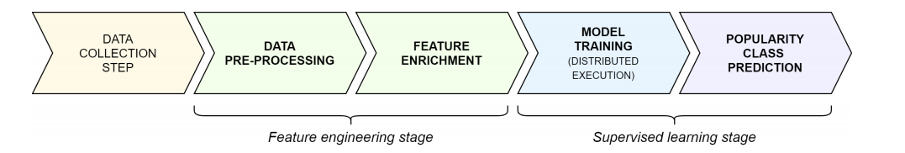
Project process
Notes:
We have collected the data, compiled it, labeled it, processed it, and generated features in the earlier presentations.
We have now trained and evaluated our models on this dataset we have obtained and generated.

Slide 3
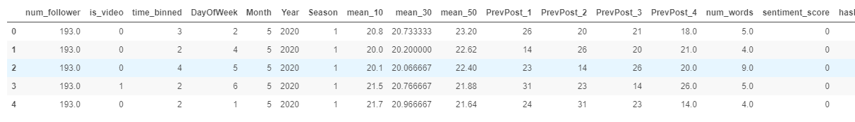
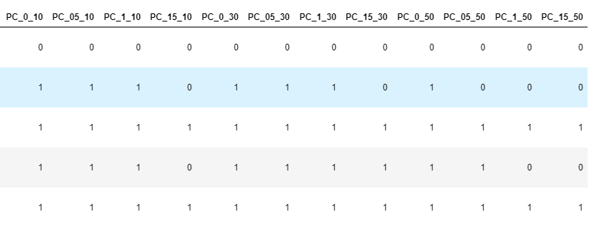
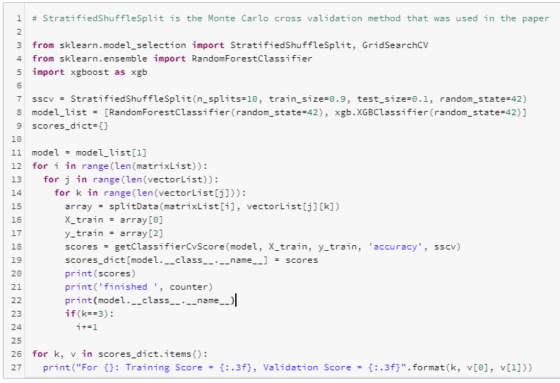
Phase Three: Model Training
Feature Matrices:
Data: bin the Time column, encode the is_video and Season columns, drop extraneous columns to form Feature Matrices
Vectors: Column titles are in the format of PC_X_Y, where X is the delta value, and Y is the amount of previous posts taken into account
Each feature matrix has 4 target vectors
Models: XGBoost and Random Forest Models
Run basic Monte Carlo cross-validation to find baseline scores
Use GridSearch to find optimal hyperparameters for each model and optimize
Target Vectors
Model Training
Notes:
Briefly mention this in passing, just to highlight our multiple target vectors (10 – 15 sec explanation)

Slide 4
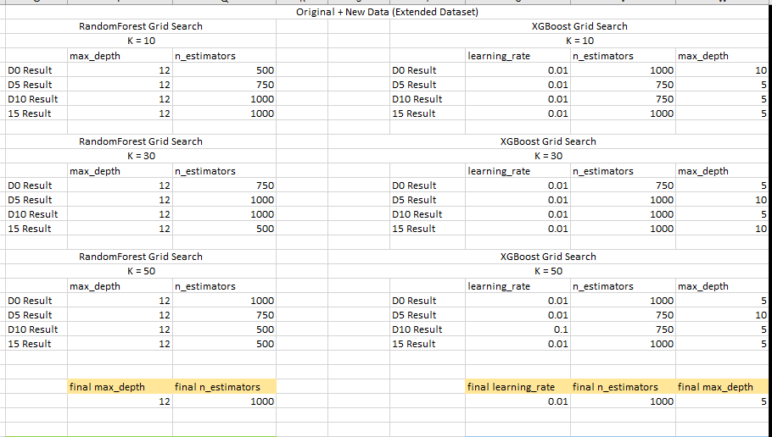
Results
Compare papers experimental results (using same metric types) to ours.
Accuracy, Balanced Accuracy, and F1 score were used
See if our new LGBoost model outperforms?
Notes:
Skim next slides to show that number of models ran on target vectors, and the metric types computed for each.

Slide 5
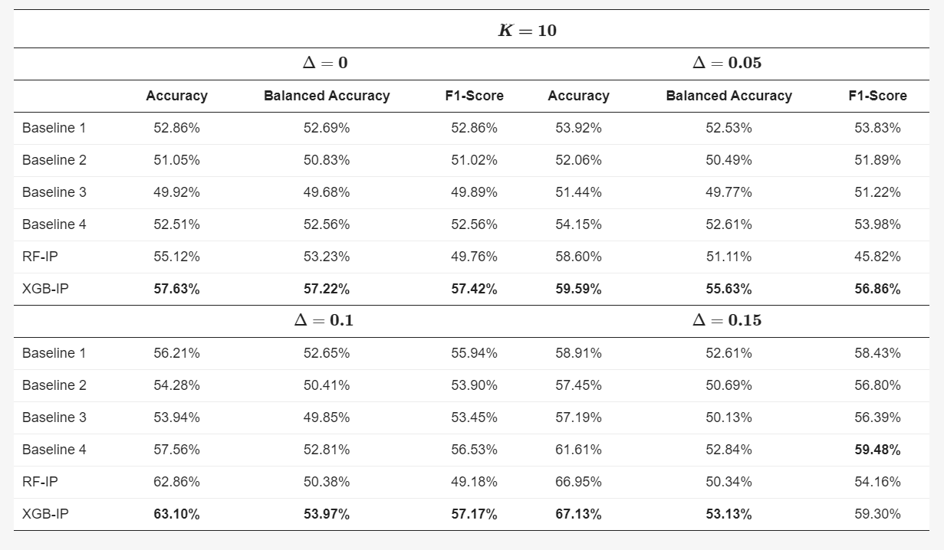
 | Training Data | RandomForest Test Data Results
 | Accuracy | Accuracy | Balanced Accuracy | F1 | Precision | Recall
K10D0 | 67.29 | 56.57 | 55.96 | 54.56 | 58.81 | 35.12
K10D5 | 63.63 | 58.68 | 52.76 | 48.83 | 62.07 | 10.24
K10D10 | 65.44 | 62.74 | 50.81 | 49.66 | 64.67 | 2.42
K10D15 | 68.54 | 67.01 | 50.19 | 54.03 | 63.64 | 0.54
 | Training Data | XGBoost Test Data Results
 | Accuracy | Accuracy | Balanced Accuracy | F1 | Precision | Recall
K10D0 | 59.97 | 57.08 | 56.71 | 56.37 | 57.54 | 44.13
K10D5 | 61.19 | 59.21 | 54.07 | 52.34 | 58.89 | 17.23
K10D10 | 64.53 | 63.26 | 52.04 | 52.32 | 61.60 | 6.54
K10D15 | 68.35 | 67.34 | 50.94 | 55.34 | 66.00 | 2.53
Notes:
This is for our last 10 post avg.

Slide 6
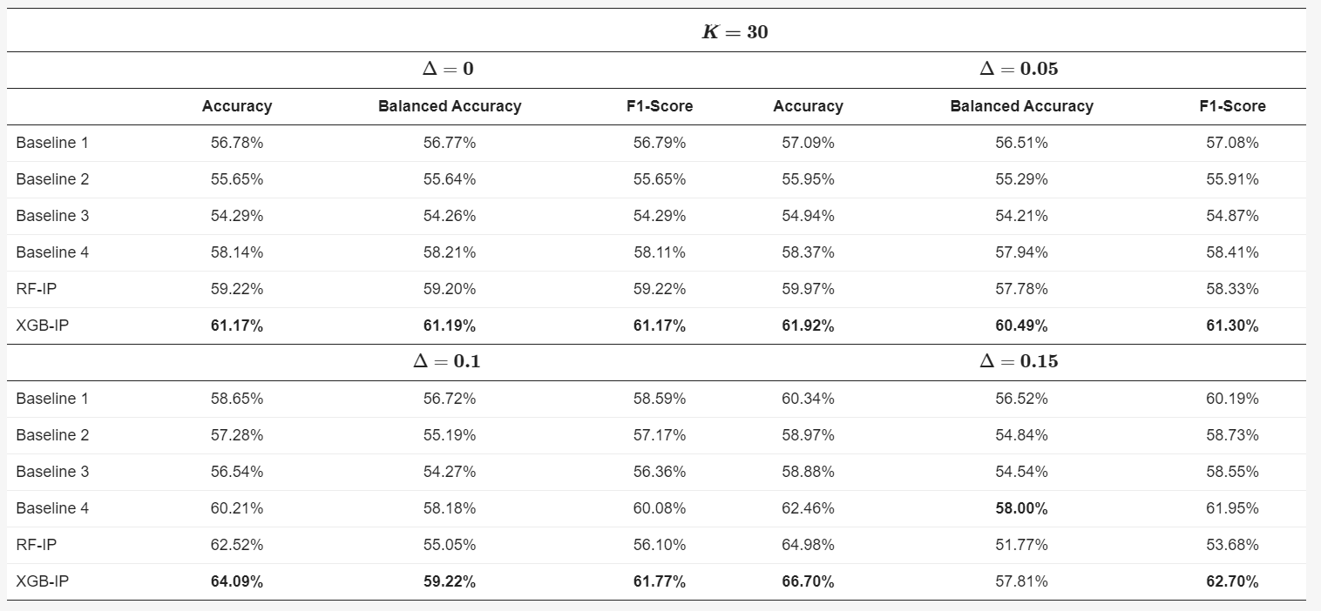
Notes:
This is for our last 30 post avg.

Slide 7
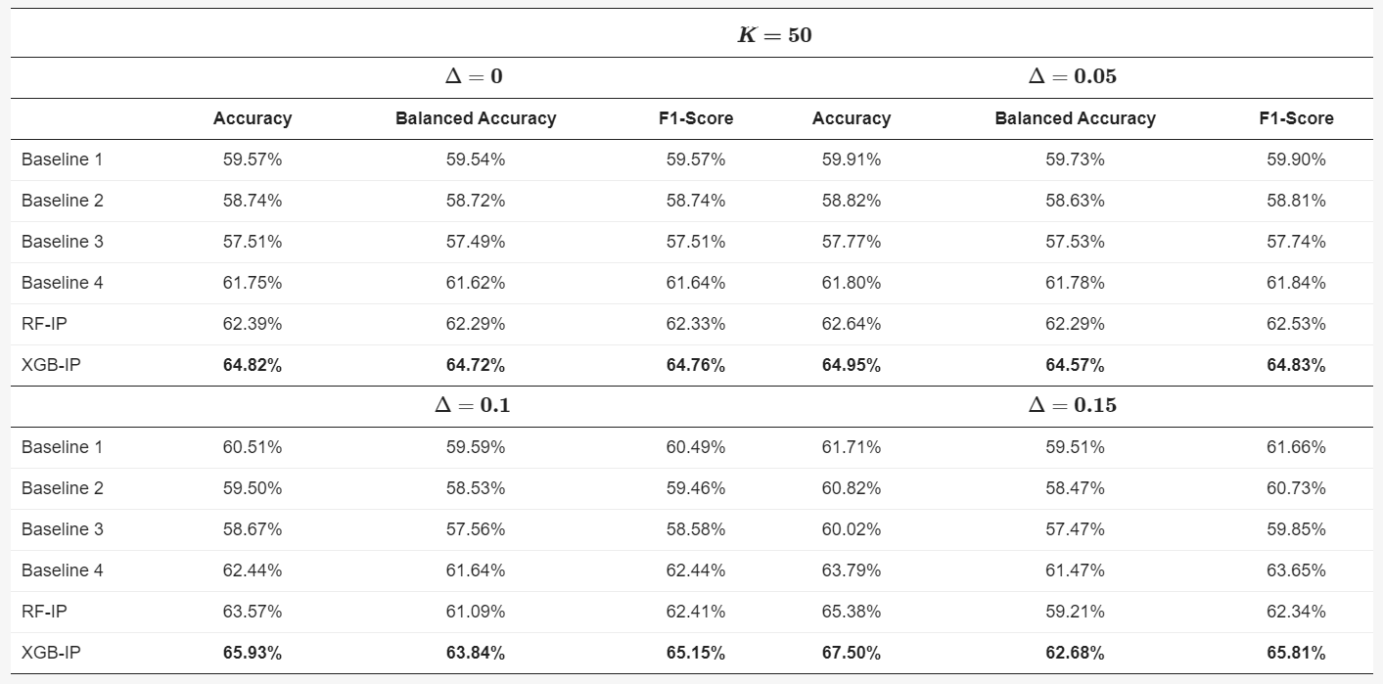
Notes:
This is for our last 50 post avg.

Slide 8
LGBoost – Additional Model Trained
Performed almost identically to the XGBoost model (< ~1% discrepancies in F1 scoring metric)
Notes:
So better than RandomForest as well.

Slide 9
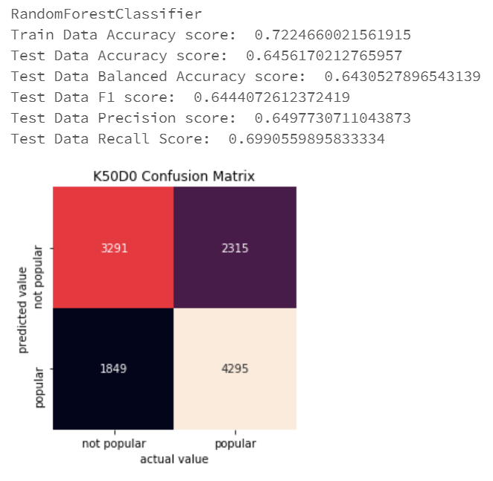
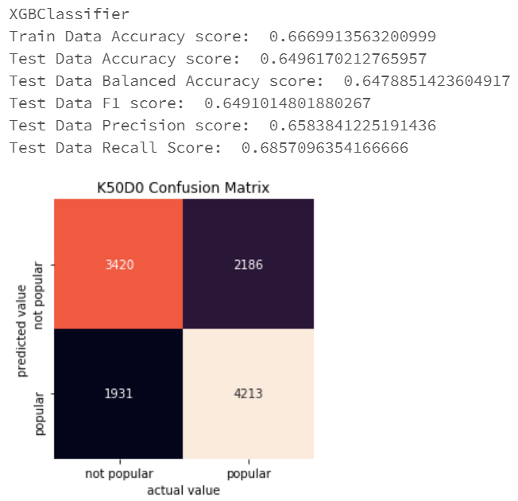
Metrics Evaluation
Accuracy, balanced accuracy, F1 score were used to match paper metrics
Precision and recall scores were included as per report template requirements.

Slide 10

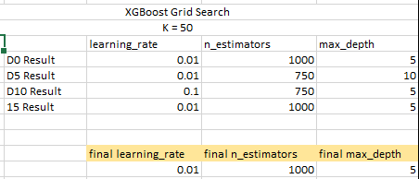
Possible constraints on our data
Cluster lifetime was an issue when GridSearchCV was ran
4 Target vectors with 4 different thresholds forces many iterations
GridSearch optimal parameters returned were edge cased occasionally
Notes:
Small detail of Joshes issues on running these models.
Could be improved by : Clusters remaining open to run models for longer periods (would allow us to check edge cases and fine tune parameters).
Scrape larger number of posts from profiles to see if even larger rolling averages of previous posts improved scores.
Could see if this holds true for “non-ordinary” users.
New features scraped from profiles could be considered.

Slide 11
Conclusions
- The more previous posts are considered in classifying the target vector, the more accurate the model is. This agrees with paper results.
- The higher the threshold required for a post to be considered popular (ie, 15% vs 5% more likes), Accuracy increases, Balanced accuracy decreases, F1 score decreases. This agrees with the paper results.
- XGBoost model always outperformed the Random Forest model.
- Our models on the extended dataset outperformed the papers reported results.
- Our extra model not used by the original paper (LGBoost) performed comparably with the XGBoost model, and outperformed the RandomForest model.
Notes:
FOR POINT 2: For lower previous posts considered (previous 10 vs previous 50 posts average). Still large decrease at larger posts numbers considered but lesser in magnitude as post count goes up.

