Slide 1

JavaScript - Part 1
Jelizaveta Potapova
Senior JavaScript Engineer

Slide 2
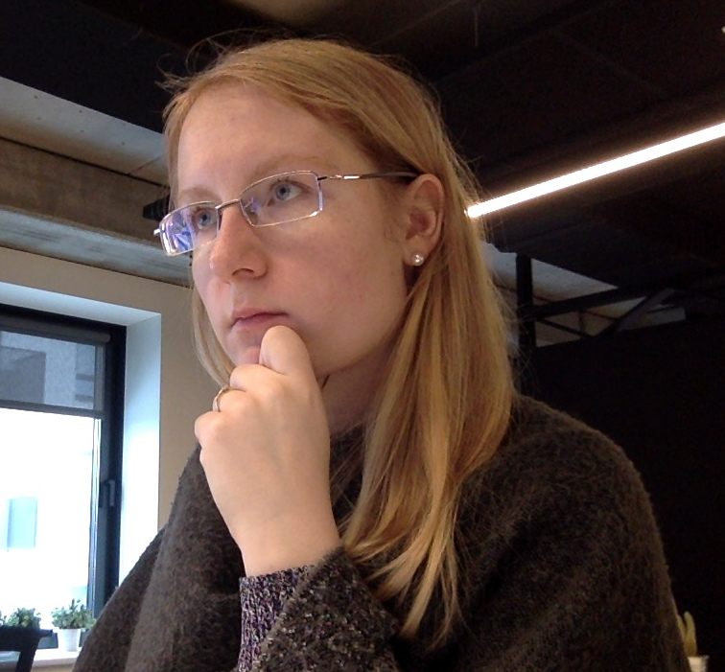
I ♥ coding

Slide 3
Lectures plan
Part 1
Fundamentals, language building blocks
DOM – access, manipulate, calculate size
Part 2
Element size & coordinates
Events
ES6

Slide 4
Intro

Slide 5
What is JavaScript & what can I do with it?
Interpreted scripting language
Computations, input & output data, like any other language
Environment specific tasks
Access and manipulate website content on the fly
React to user interaction with the website
Send network requests
Access location, camera, gyroscope
Access filesystem, connect to DB (server-side)

Slide 6
Tasks & code snippets
Clone or download:
https://github.com/jpotapova/js-lecture-1
Structure:
each topic has a number (in the slides and in file structure)
1 folder for each topic
Examples topic-name.example.js
Tasks: topic-name.task.js

Slide 7
1. Run a script
node path/to/my-script.js

Slide 8
TASK:
hello.task.js

Slide 9
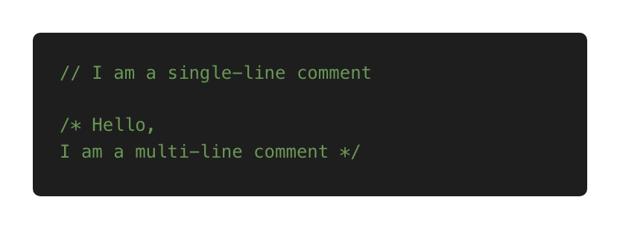
2. Comments

Slide 10
TASK:
comments.task.js

Slide 11
3. Variables: name limitations
Allowed: letters, digits, $, _
Cannot start with digit
Cannot use reserved words (e.g. function, new, this)
Reserved words reference: https://developer.mozilla.org/en-US/docs/Web/JavaScript/Reference/Lexical_grammar#Keywords

Slide 12
TASK:
variables.task.js

Slide 13
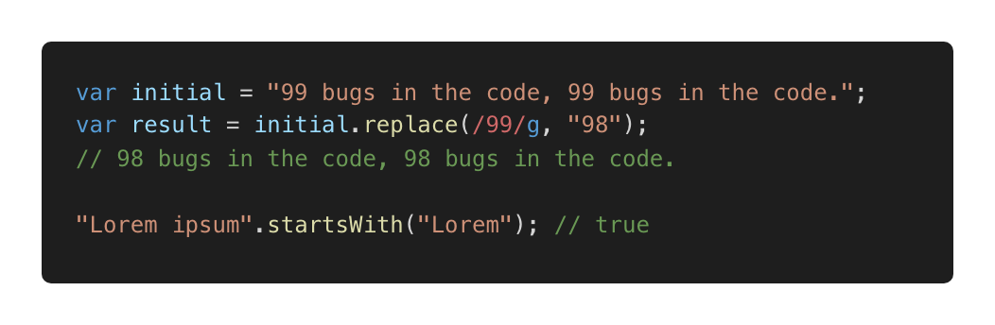
Primitives: String
Some useful methods: startsWith, search etc
Reference:
https://developer.mozilla.org/en-US/docs/Web/JavaScript/Reference/Global_Objects/String

Slide 14
TASK:
primitives.task.js

Slide 15
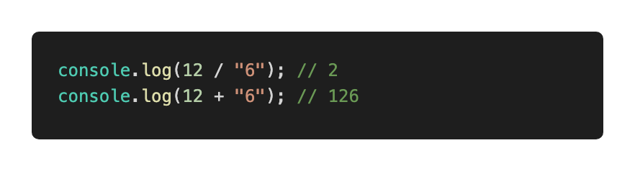
5. Type coercion: implicit
Also referred as: type casting, type conversion
Process of converting a value from one type to another

Slide 16
TASK:
5-coercion.task.js

Slide 17
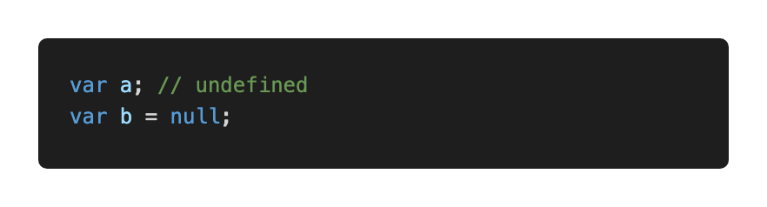
6. Null and undefined
null – intentional absence of value
undefined – value is not assigned yet

Slide 18
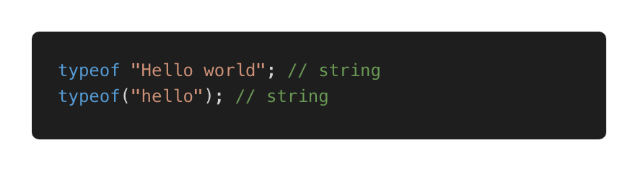
7. typeof
Use to detect type
Returns a string

Slide 19
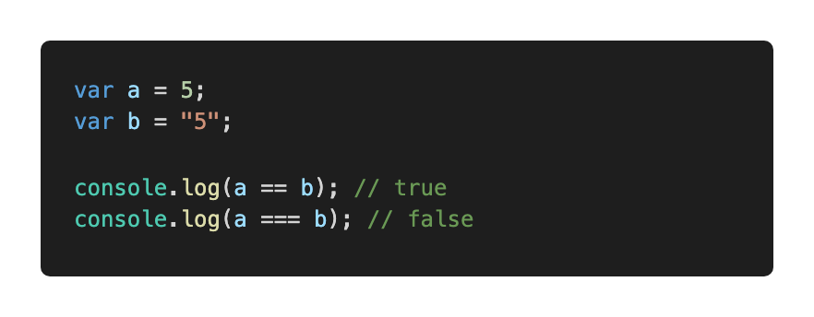
9. Decisions: comparison
Loose equality == (type conversion performed before comparing)
Strict equality === (type conversion prevented)
Prefer ===

Slide 20
TASK:
decisions.task1.js

Slide 21
TASK:
decisions.task2.js

Slide 22
TASK:
decisions.task3.js

Slide 23
TASK:
decisions.task4.js

Slide 24
TASK:
decisions.task5.js

Slide 25
TASK:
decisions.task6.js

Slide 26
10: Functions: why do we need them?
Reduce code repetition
Structure large programs to subprograms and associate names
Isolate subprograms from each other

Slide 27
TASK:
functions.task.js

Slide 28
10. Functions: best practices
Thoughtful naming
Single purpose
Keep them small
Keep them pure when possible:
Just input and output, no side effects
Same input produces same output (predictable)

Slide 29
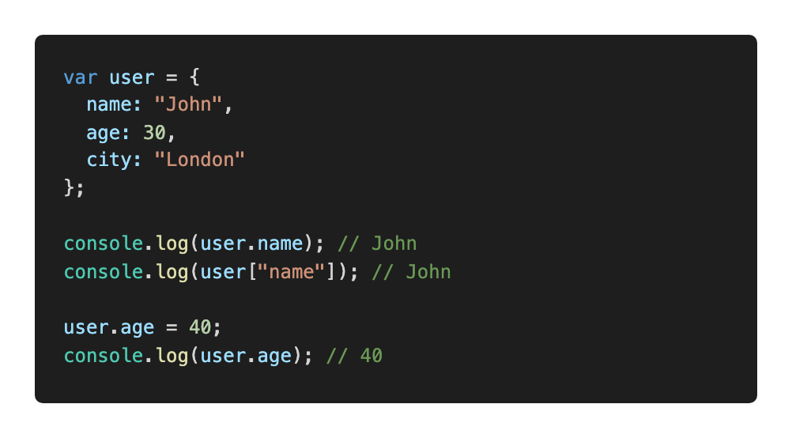
11. Objects
An unordered collection of related data
Key/value pairs

Slide 30
11. Objects: why do we need them?
Keep related stuff together
Namespace (structure the code)

Slide 31
TASK:
objects.task.js

Slide 32
12. Arrays
An ordered collection of related data
Key/value pairs
Why do we need them?
Keep related stuff together
Work with ordered data

Slide 33
TASK:
arrays.task1.js

Slide 34
TASK:
arrays.task2.js

Slide 35
TASK:
13-add-script

Slide 36
14. DOM
Document Object Model
Page contents as objects that can be modified
DOM specification https://dom.spec.whatwg.org/
DOM is not only for the browser

Slide 37
TASK:
dom.task1.js

Slide 38
TASK:
dom.task2.js

Slide 39
TASK:
dom.task3.js

Slide 40
TASK:
dom.task4.js

Slide 41
Thank you.
Jelizaveta Potapova
Senior JavaScript Engineer

