Slide 1

JavaScript - Part 1
Jelizaveta Potapova
Senior JavaScript Engineer

Slide 2
Lectures plan
Part 1
Fundamentals, language building blocks
DOM – access, manipulate, calculate size
Part 2
Element size & coordinates
Events
ES6

Slide 3
Intro

Slide 4
What is JavaScript & what can I do with it?
Interpreted scripting language
Computations, input & output data, like any other language
Environment specific tasks
Access and manipulate website content on the fly
React to user interaction with the website
Send network requests
Access location, camera, gyroscope
Access filesystem, connect to DB (server-side)

Slide 5
Tasks & code snippets
Clone or download:
https://github.com/jpotapova/js-lecture-1
Structure:
each topic has a number (in the slides and in file structure)
1 folder for each topic
Examples topic-name.example.js
Tasks: topic-name.task.js

Slide 6
1. Run a script
node path/to/my-script.js

Slide 7
TASK:
hello.task.js

Slide 8
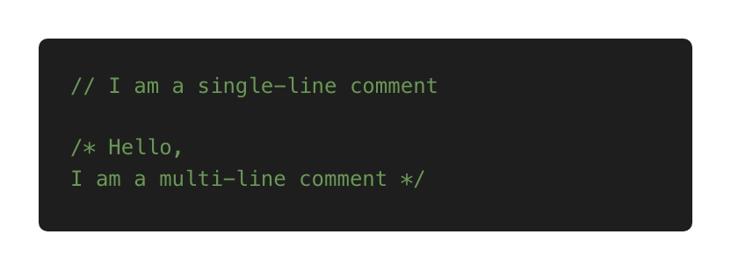
2. Comments

Slide 9
TASK:
comments.task.js

Slide 10
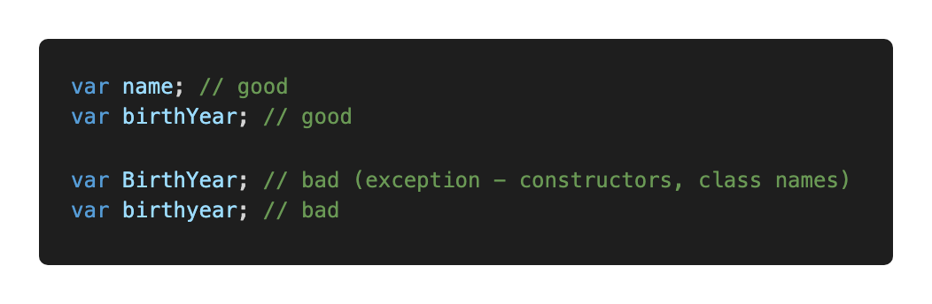
3. Variables
Convention – camelCase

Slide 11
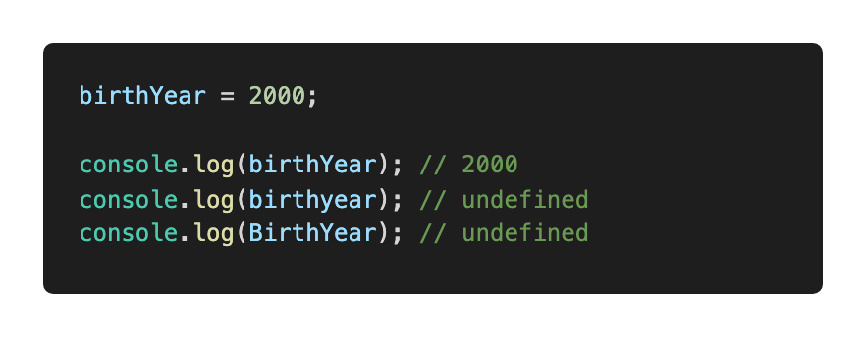
3. Variables
Names are case sensitive
Think about naming: descriptive, self-explanatory but concise

Slide 12
3. Variables: name limitations
Allowed: letters, digits, $, _
Cannot start with digit
Cannot use reserved words (e.g. function, new, this)
Reserved words reference: https://developer.mozilla.org/en-US/docs/Web/JavaScript/Reference/Lexical_grammar#Keywords

Slide 13
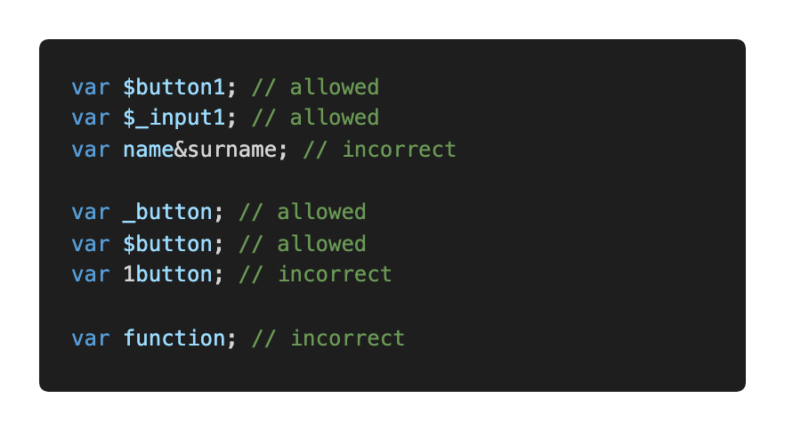
3. Variables: name limitations

Slide 14
TASK:
variables.task.js

Slide 15
Primitive types

Slide 16
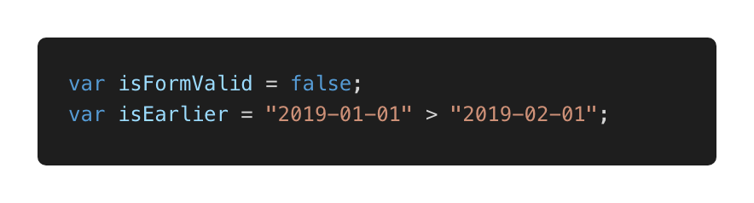
4. Primitives: Boolean
Only 2 values: true or false

Slide 17
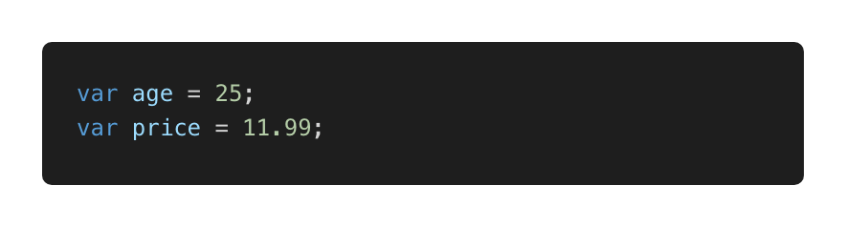
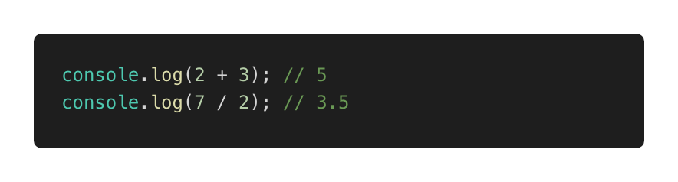
4. Primitives: Number
Perform simple operations: + - * /

Slide 18
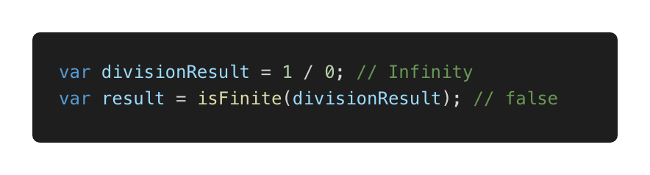
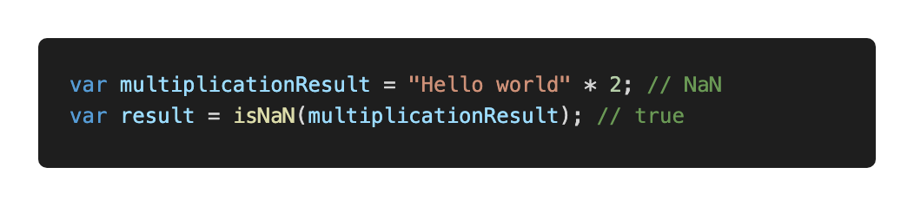
4. Primitives: special numeric values
Infinity and -Infinity
NaN – computation error

Slide 19
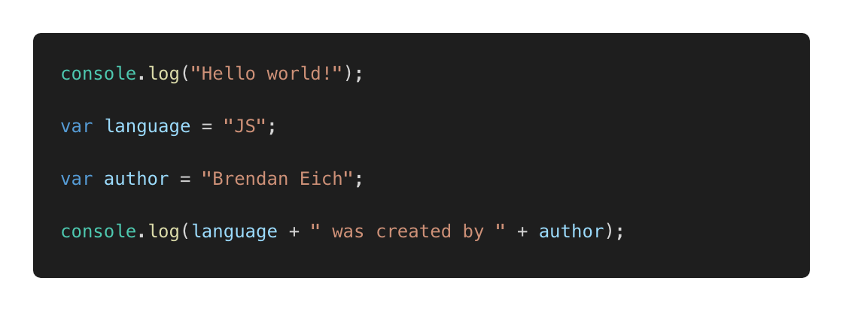
4. Primitives: String

Slide 20
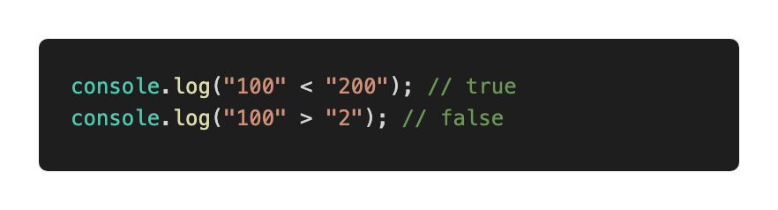
Primitives: String
Can be concatenated, compared

Slide 21
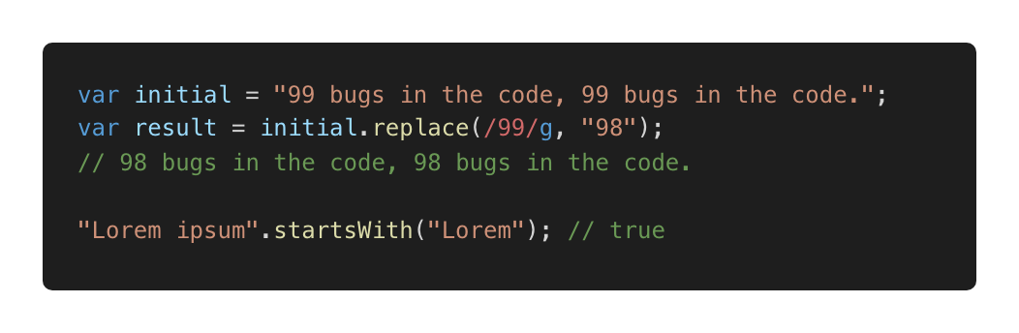
Primitives: String
Some useful methods: startsWith, search etc
Reference:
https://developer.mozilla.org/en-US/docs/Web/JavaScript/Reference/Global_Objects/String

Slide 22
TASK:
primitives.task.js

Slide 23
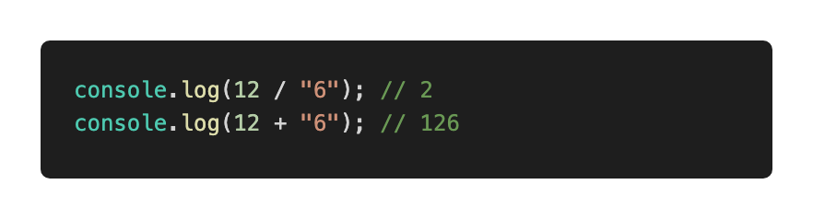
5. Type coercion: implicit
Also referred as: type casting, type conversion
Process of converting a value from one type to another

Slide 24
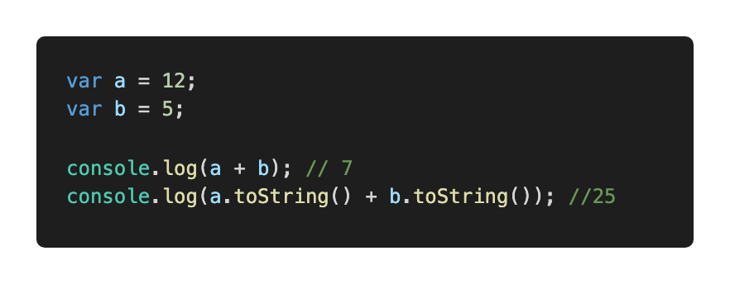
5. Type coercion: explicit
Explicit, number → string

Slide 25
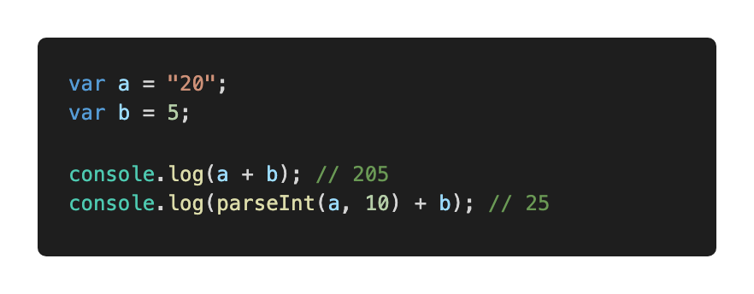
5. Type coercion: explicit
Explicit, string → number
Always specify radix with parseInt

Slide 26
TASK:
5-coercion.task.js

Slide 27
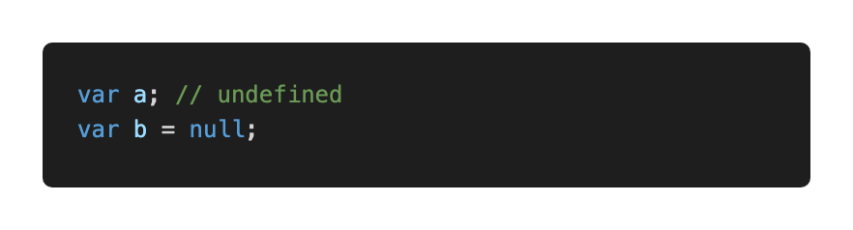
6. Null and undefined
null – intentional absence of value
undefined – value is not assigned yet

Slide 28
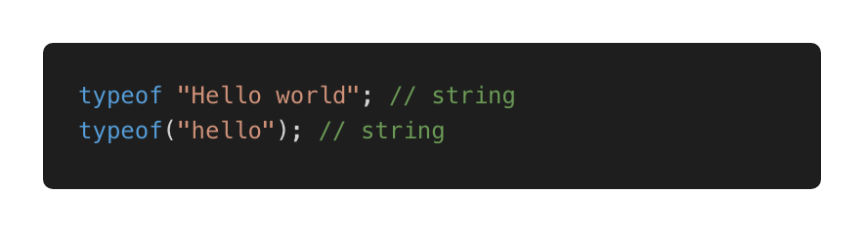
7. typeof
Use to detect type
Returns a string

Slide 29
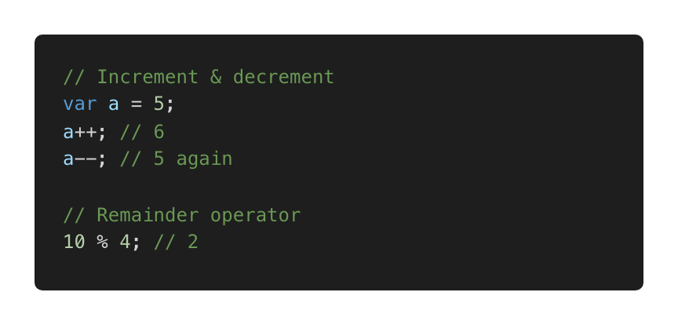
8. Operators
Already used: +, -, >, <
Assignment, e.g. var a = 5;
Some more useful operators

Slide 30
Decisions

Slide 31
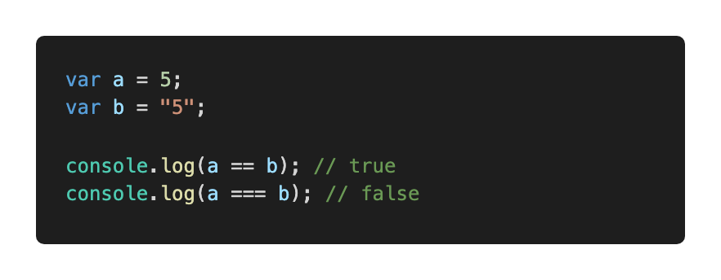
9. Decisions: comparison
Loose equality == (type conversion performed before comparing)
Strict equality === (type conversion prevented)
Prefer ===

Slide 32
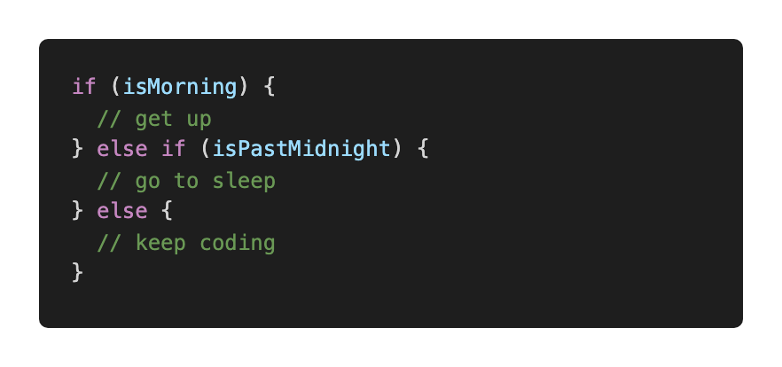
9. Decisions: if statement

Slide 33
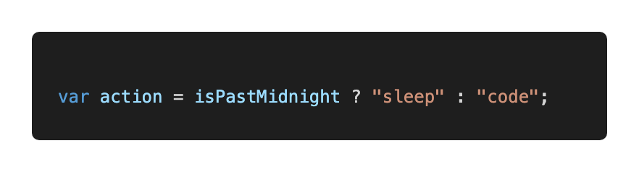
9. Decisions: ternary operator

Slide 34
TASK:
decisions.task1.js

Slide 35
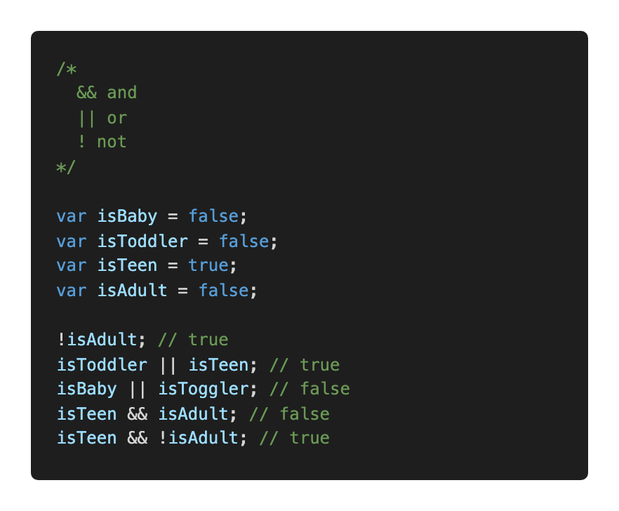
9. Decisions: logical operators

Slide 36
TASK:
decisions.task2.js

Slide 37
TASK:
decisions.task3.js

Slide 38
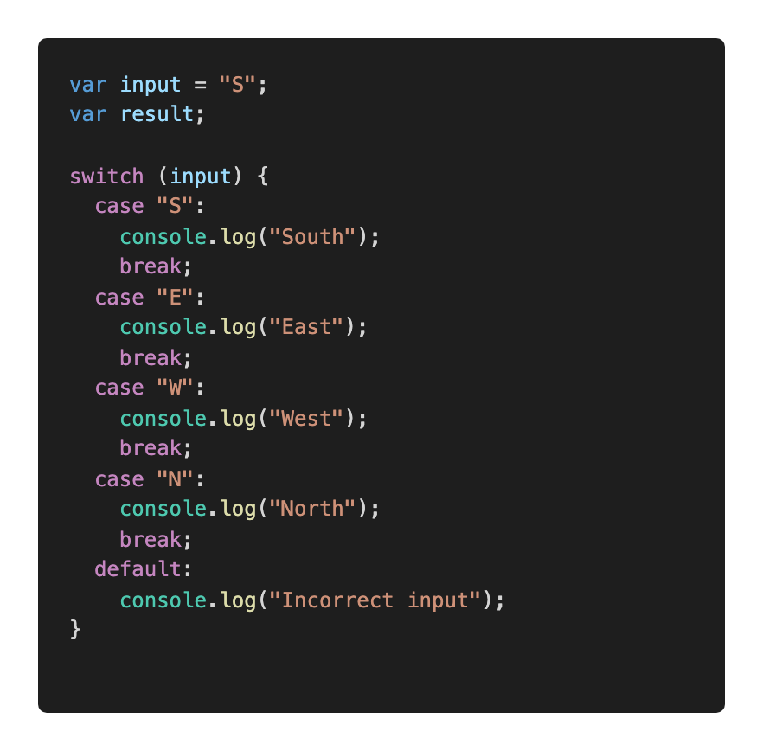
9. Decisions: switch

Slide 39
TASK:
decisions.task4.js

Slide 40
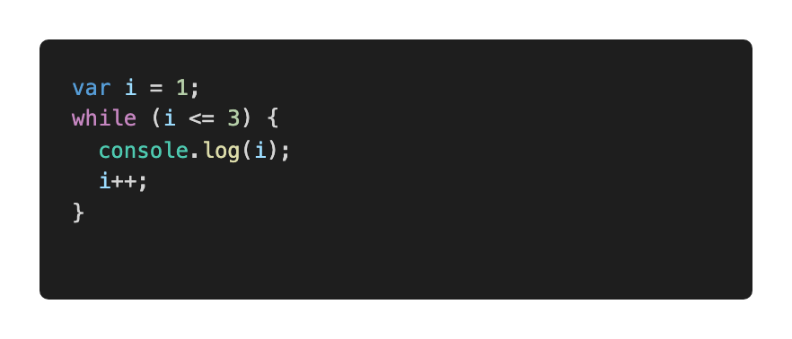
9. Decisions: while loop

Slide 41
TASK:
decisions.task5.js

Slide 42
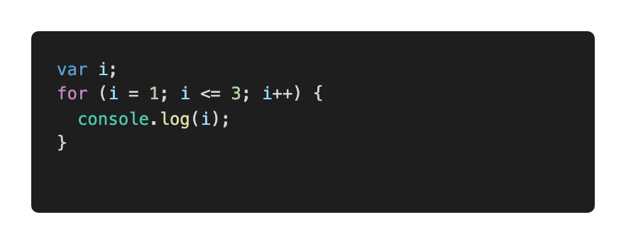
9. Decisions: for loop

Slide 43
TASK:
decisions.task6.js

Slide 44
Functions, Objects, Array

Slide 45
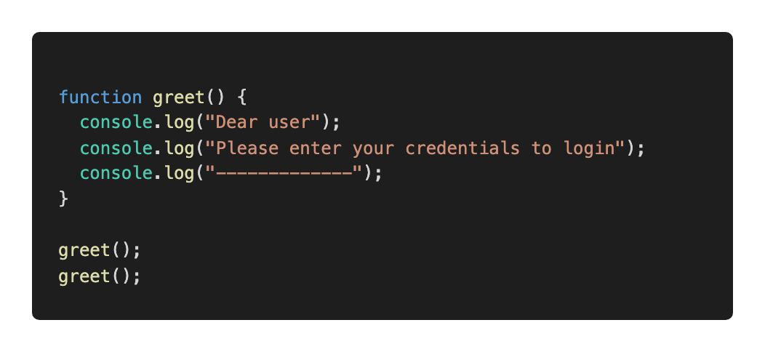
10: Functions
Basic building block, a subprogram

Slide 46
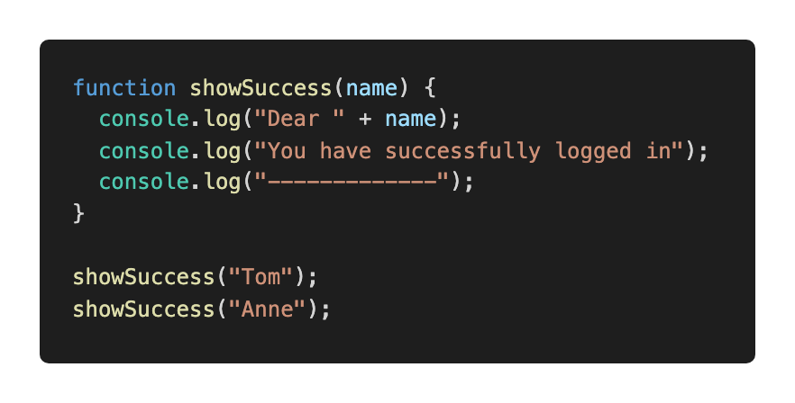
10: Functions

Slide 47
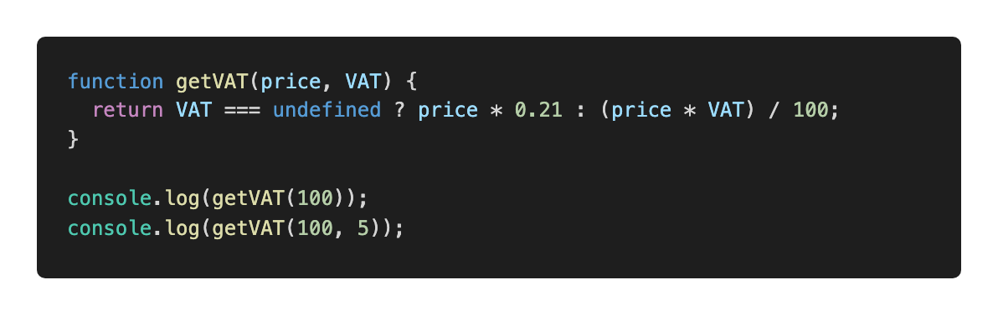
10: Functions

Slide 48
10: Functions: why do we need them?
Reduce code repetition
Structure large programs to subprograms and associate names
Isolate subprograms from each other

Slide 49
TASK:
functions.task.js

Slide 50
10. Functions: best practices
Thoughtful naming
Single purpose
Keep them small
Keep them pure when possible:
Just input and output, no side effects
Same input produces same output (predictable)

Slide 51
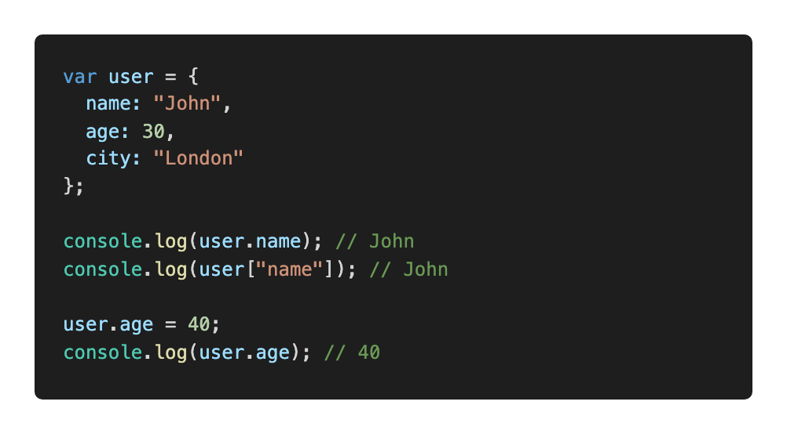
11. Objects
An unordered collection of related data
Key/value pairs

Slide 52
11. Objects: why do we need them?
Keep related stuff together
Namespace (structure the code)

Slide 53
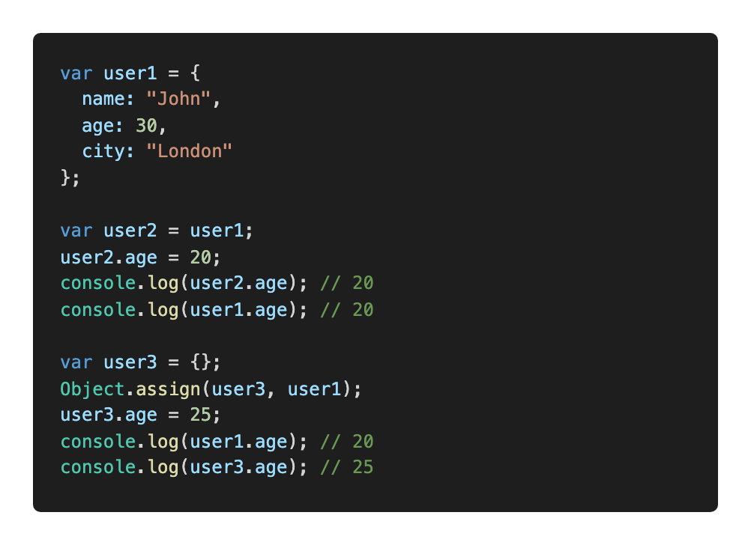
11. Objects: copying

Slide 54
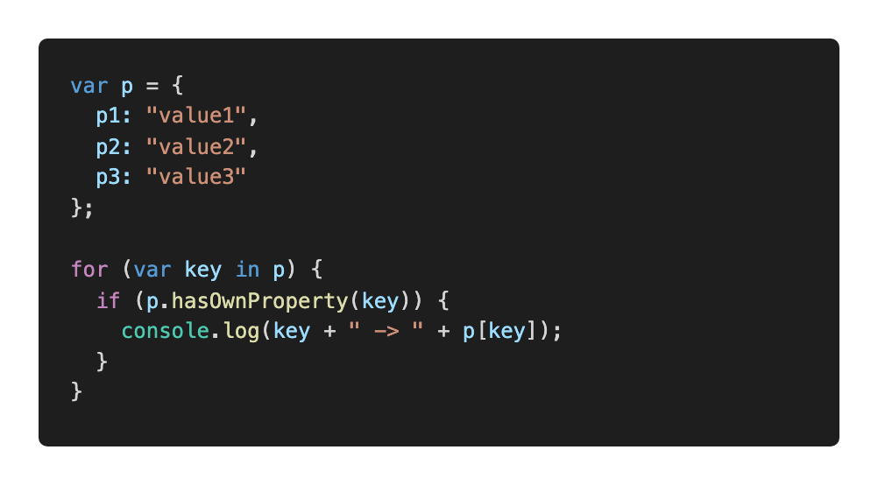
11. Objects: iterate over properties

Slide 55
TASK:
objects.task.js

Slide 56
12. Arrays
An ordered collection of related data
Key/value pairs
Why do we need them?
Keep related stuff together
Work with ordered data

Slide 57
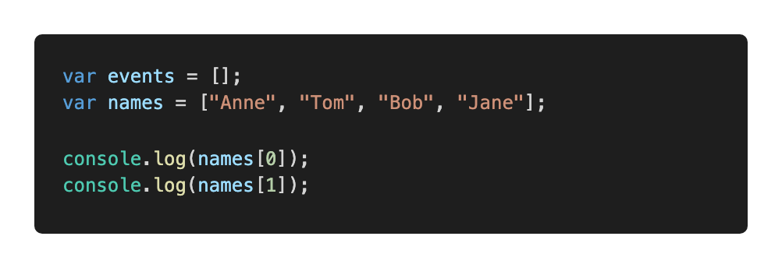
12. Arrays: example
0 based

Slide 58
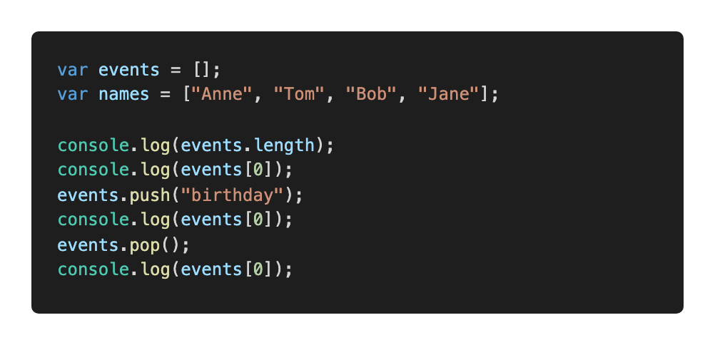
12. Arrays: length, push, pop

Slide 59
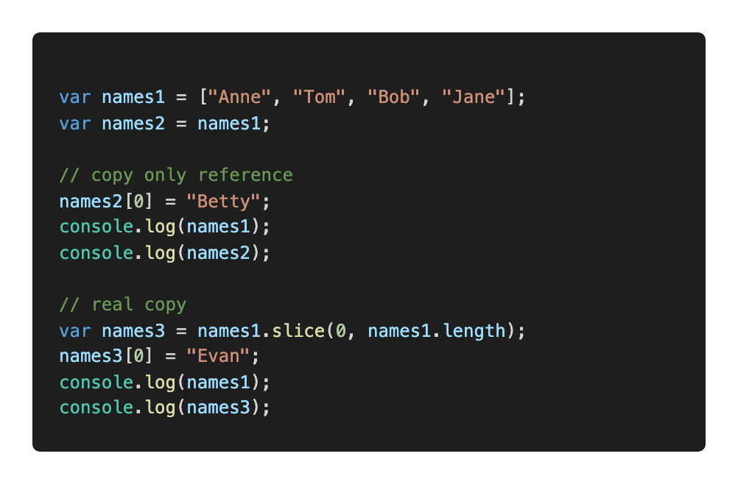
12. Arrays: copying

Slide 60
13. Arrays: useful methods

Slide 61
TASK:
arrays.task.js

Slide 62
JS and the browser

Slide 63
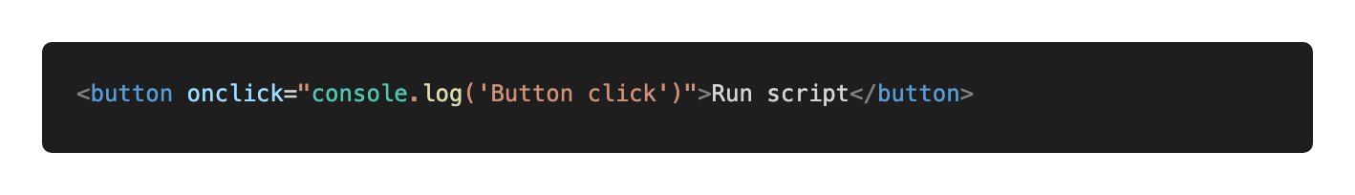
13. Adding a script to a website: inline

Slide 64
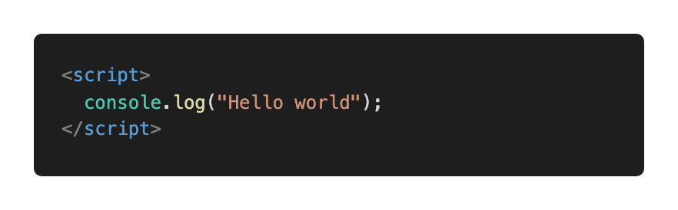
13. Adding a script to a website: internal

Slide 65
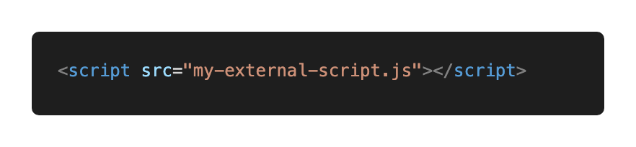
13. Adding a script to a website: external

Slide 66
TASK:
13-add-script

Slide 67
14. DOM
Document Object Model
Page contents as objects that can be modified
DOM specification https://dom.spec.whatwg.org/
DOM is not only for the browser

Slide 68
14. DOM: navigate

Slide 69
14. DOM: entry point, read text content

Slide 70
14. DOM: single element navigation

Slide 71
TASK:
dom.task1.js

Slide 72
14. DOM: collections
read-only, do not replace by reassigning
live – reflect current state

Slide 73
TASK:
dom.task2.js

Slide 74
14. DOM: searching

Slide 75
TASK:
dom.task3.js

Slide 76
14. DOM: element properties
tagName
innerHTML
type, id, value

Slide 77
14. DOM: attributes
hasAttribute
getAttribute
setAttribute
removeAttribute
dataset

Slide 78
TASK:
dom.task4.js

Slide 79
14. DOM: remove element

Slide 80
15. DOM: create element

Slide 81
Task: create-remove.js

Slide 82
Thank you.
Jelizaveta Potapova
Senior JavaScript Engineer

