Slide 1

JavaScript - Part 1
Jelizaveta Potapova
Senior JavaScript Engineer

Slide 2
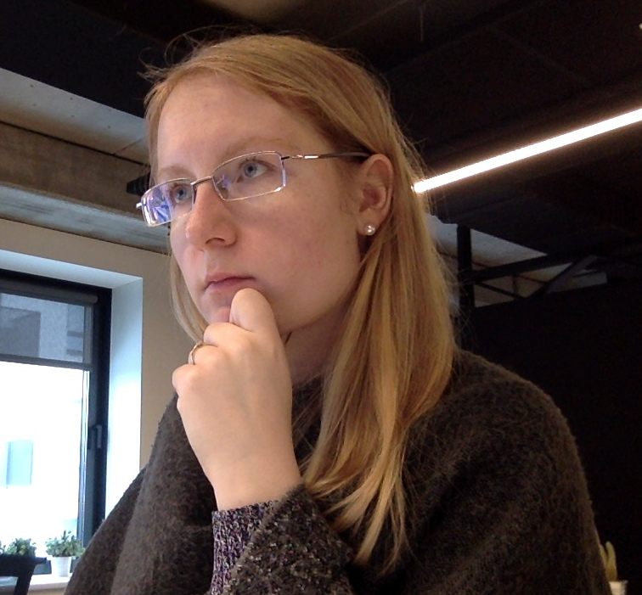
I ♥ coding

Slide 3
Lectures plan
Part 1
Fundamentals, language building blocks
DOM – access, manipulate, calculate size
Part 2
Element size & coordinates
Events
ES6

Slide 4
Intro

Slide 5
What is JavaScript & what can I do with it?
Interpreted scripting language
Computations, input & output data, like any other language
Environment specific tasks
Access and manipulate website content on the fly
React to user interaction with the website
Send network requests
Access location, camera, gyroscope
Access filesystem, connect to DB (server-side)

Slide 6
Tasks & code snippets
Clone or download:
https://github.com/jpotapova/js-lecture-1
Structure:
each topic has a number (in the slides and in file structure)
1 folder for each topic
Examples topic-name.example.js
Tasks: topic-name.task.js

Slide 7
1. Run a script
node path/to/my-script.js

Slide 8
TASK:
hello.task.js

Slide 9
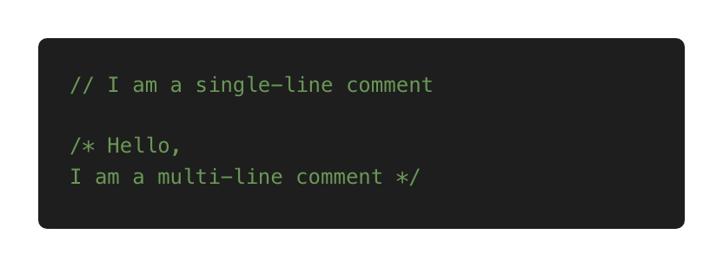
2. Comments

Slide 10
TASK:
comments.task.js

Slide 11
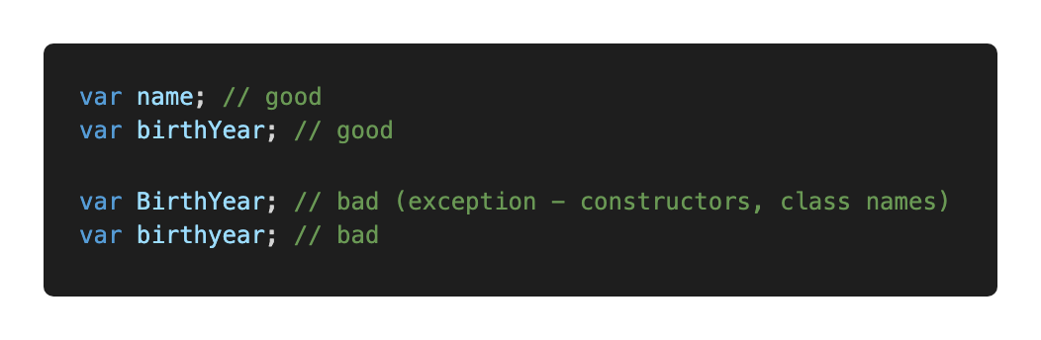
3. Variables
Convention – camelCase

Slide 12
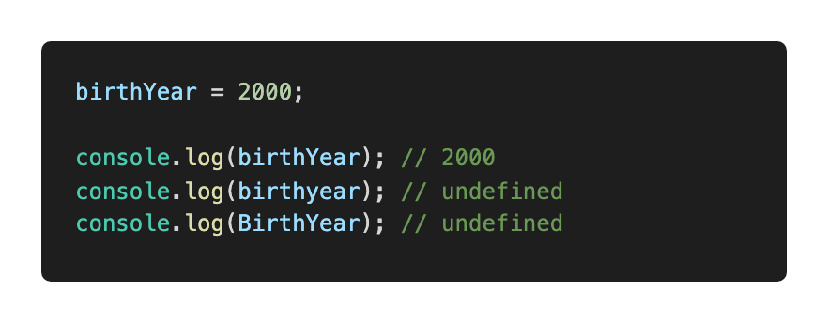
3. Variables
Names are case sensitive
Think about naming: descriptive, self-explanatory but concise

Slide 13
3. Variables: name limitations
Allowed: letters, digits, $, _
Cannot start with digit
Cannot use reserved words (e.g. function, new, this)
Reserved words reference: https://developer.mozilla.org/en-US/docs/Web/JavaScript/Reference/Lexical_grammar#Keywords

Slide 14
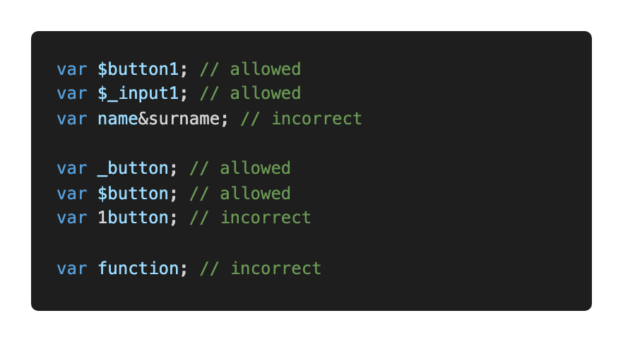
3. Variables: name limitations

Slide 15
TASK:
variables.task.js

Slide 16
Primitive types

Slide 17
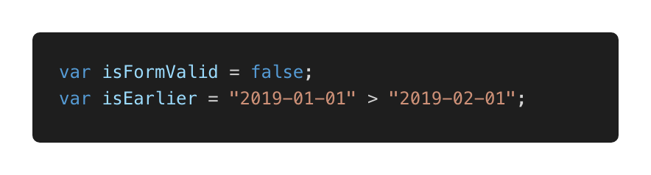
4. Primitives: Boolean
Only 2 values: true or false

Slide 18
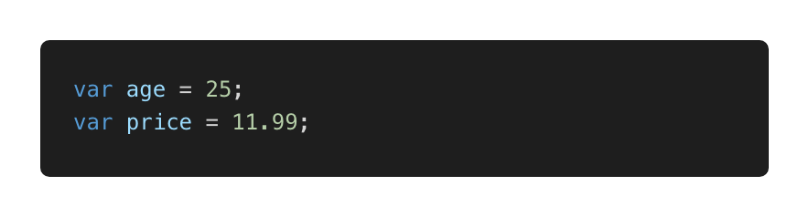
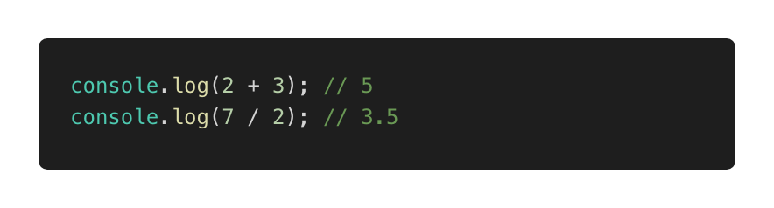
4. Primitives: Number
Perform simple operations: + - * /

Slide 19
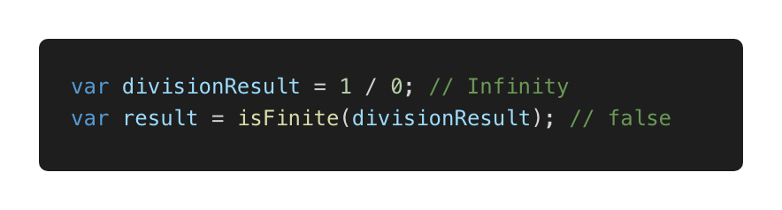
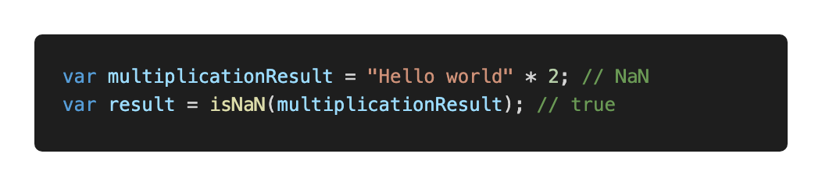
4. Primitives: special numeric values
Infinity and -Infinity
NaN – computation error

Slide 20
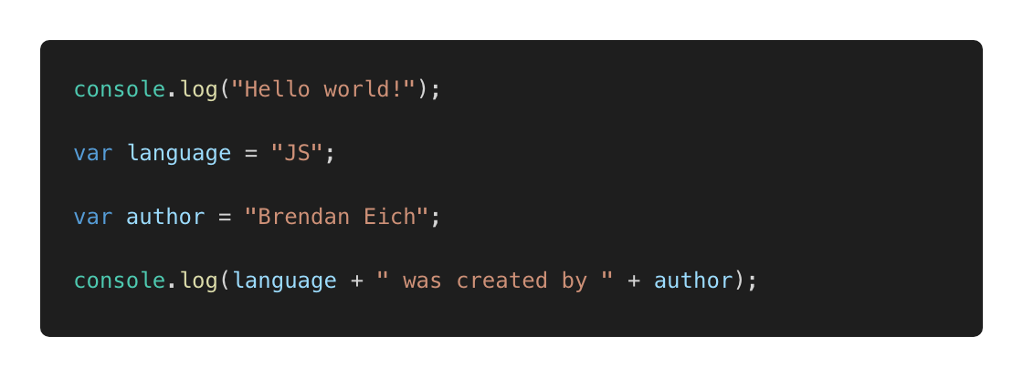
4. Primitives: String

Slide 21
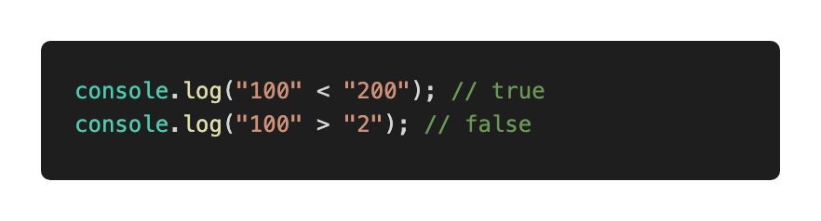
Primitives: String
Can be concatenated, compared

Slide 22
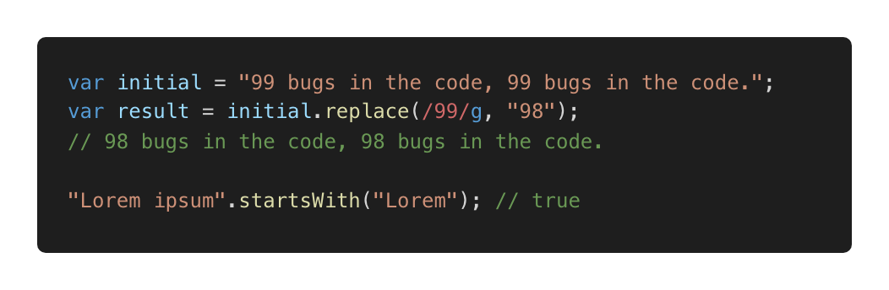
Primitives: String
Some useful methods: startsWith, search etc
Reference:
https://developer.mozilla.org/en-US/docs/Web/JavaScript/Reference/Global_Objects/String

Slide 23
TASK:
primitives.task.js

Slide 24
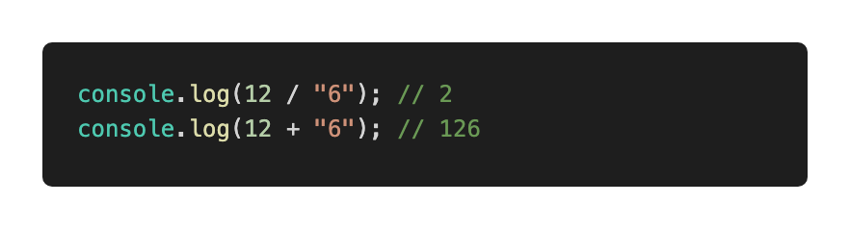
5. Type coercion: implicit
Also referred as: type casting, type conversion
Process of converting a value from one type to another

Slide 25
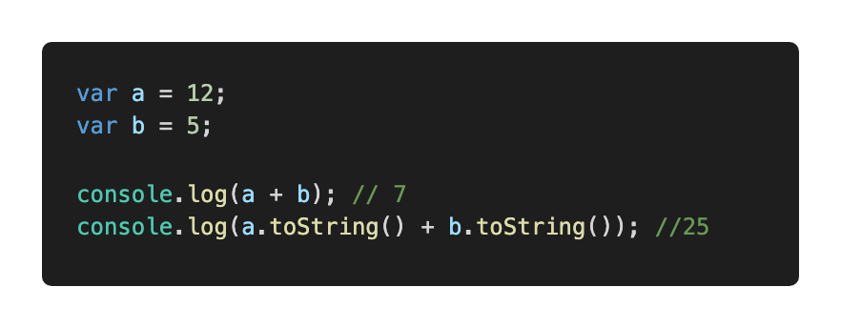
5. Type coercion: explicit
Explicit, number → string

Slide 26
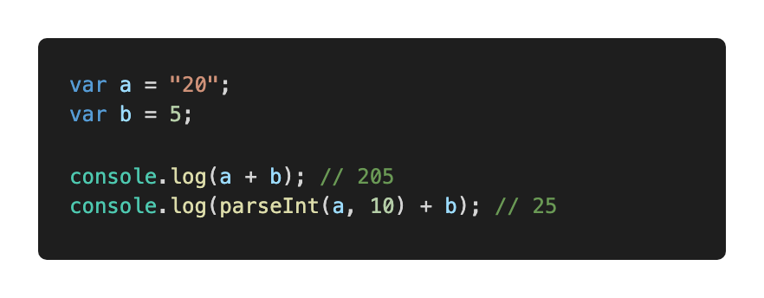
5. Type coercion: explicit
Explicit, string → number
Always specify radix with parseInt

Slide 27
TASK:
5-coercion.task.js

Slide 28
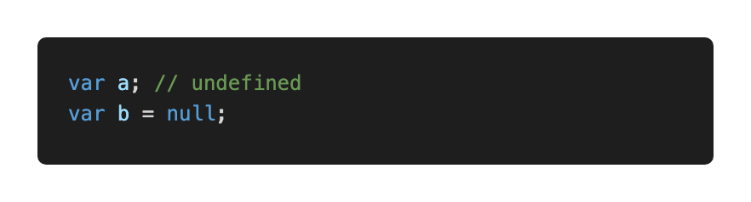
6. Null and undefined
null – intentional absence of value
undefined – value is not assigned yet

Slide 29
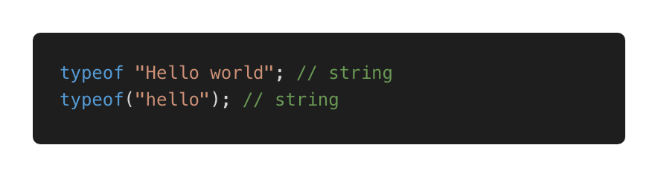
7. typeof
Use to detect type
Returns a string

Slide 30
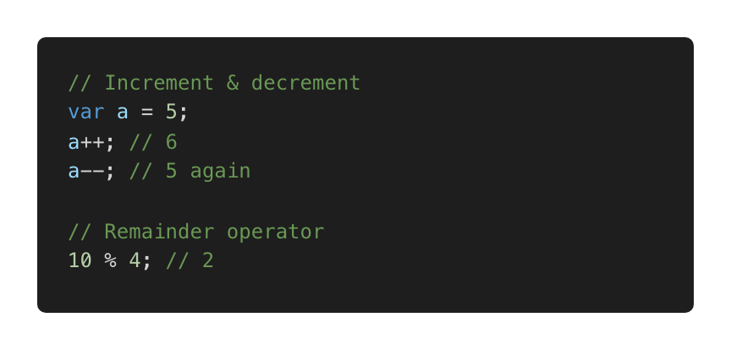
8. Operators
Already used: +, -, >, <
Assignment, e.g. var a = 5;
Some more useful operators

Slide 31
Decisions

Slide 32
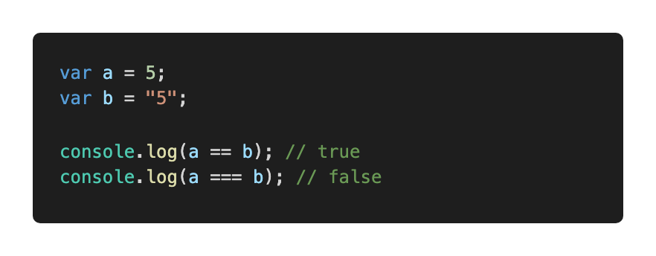
9. Decisions: comparison
Loose equality == (type conversion performed before comparing)
Strict equality === (type conversion prevented)
Prefer ===

Slide 33
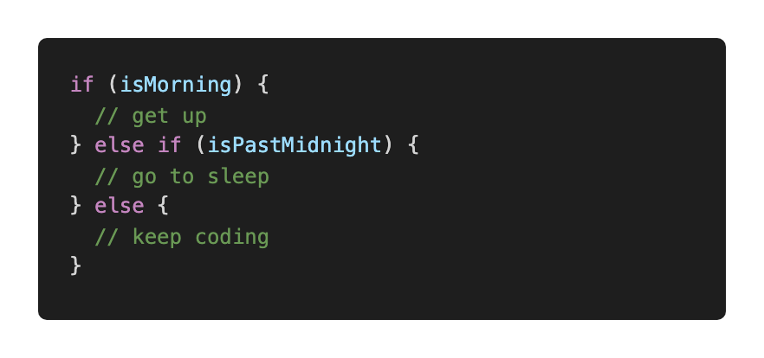
9. Decisions: if statement

Slide 34
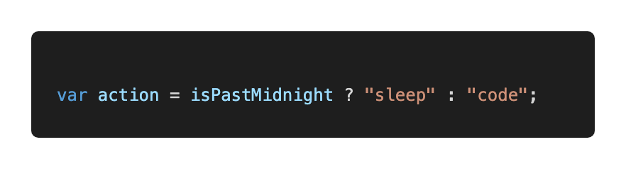
9. Decisions: ternary operator

Slide 35
TASK:
decisions.task1.js

Slide 36
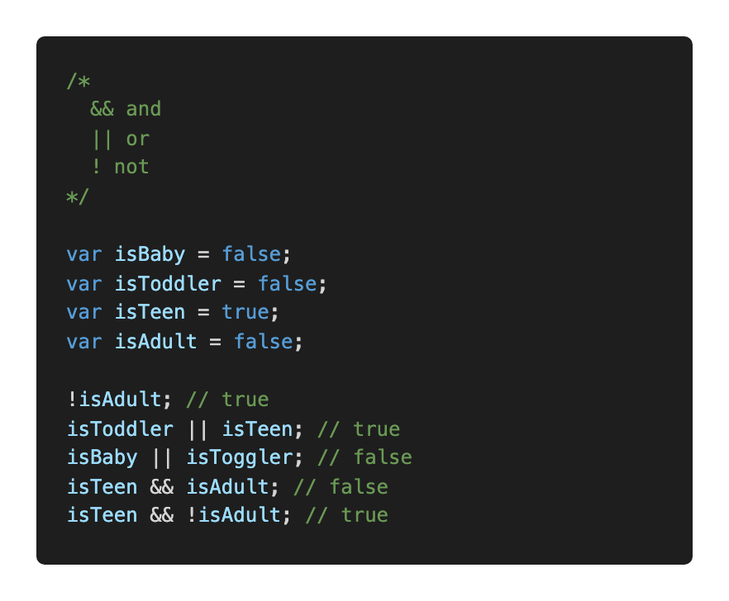
9. Decisions: logical operators

Slide 37
TASK:
decisions.task2.js

Slide 38
TASK:
decisions.task3.js

Slide 39
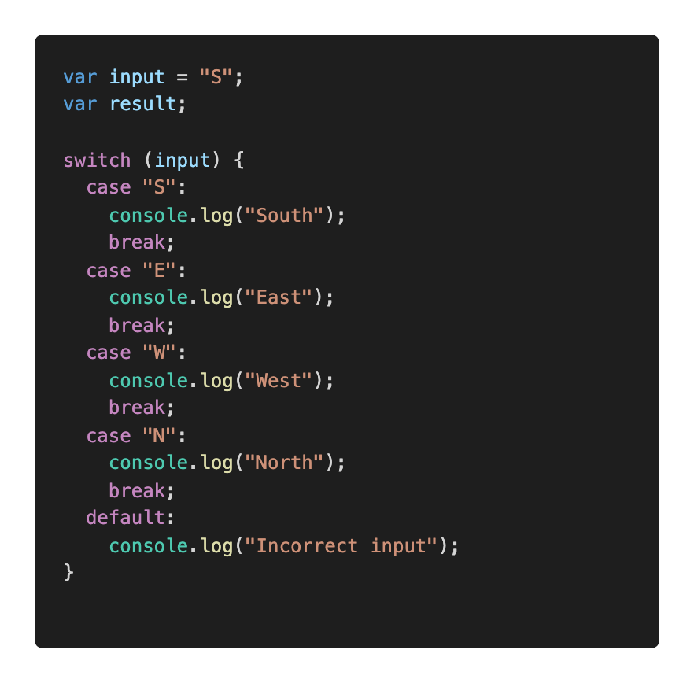
9. Decisions: switch

Slide 40
TASK:
decisions.task4.js

Slide 41
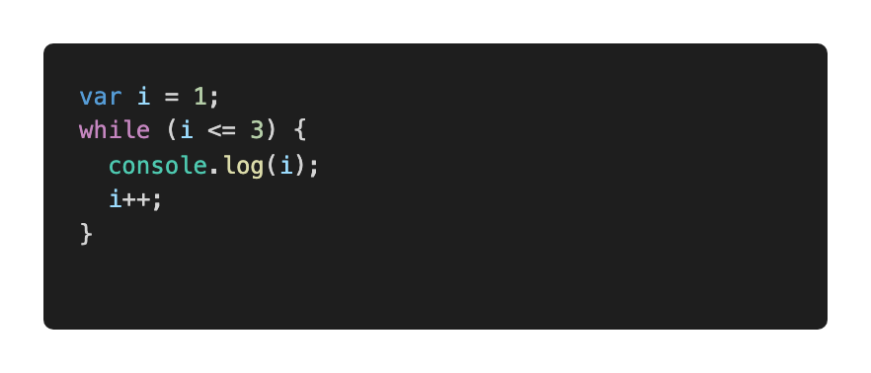
9. Decisions: while loop

Slide 42
TASK:
decisions.task5.js

Slide 43
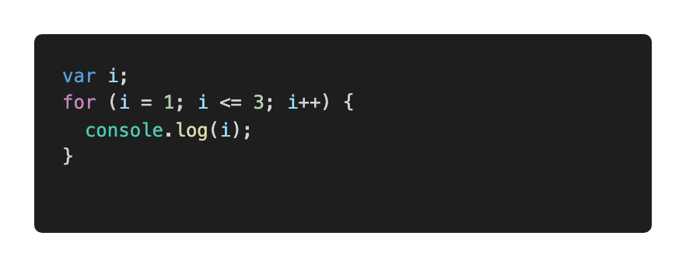
9. Decisions: for loop

Slide 44
TASK:
decisions.task6.js

Slide 45
Functions, Objects, Array

Slide 46
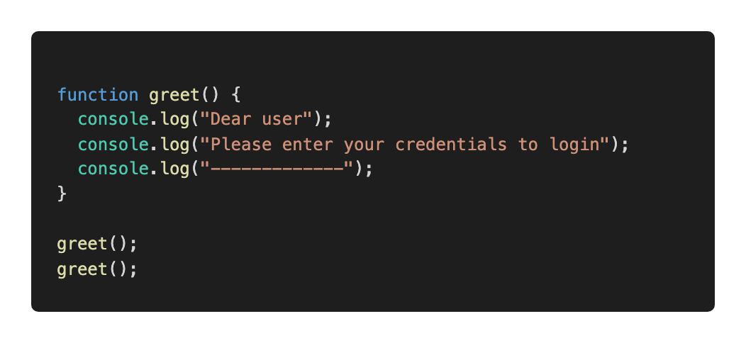
10: Functions
Basic building block, a subprogram

Slide 47
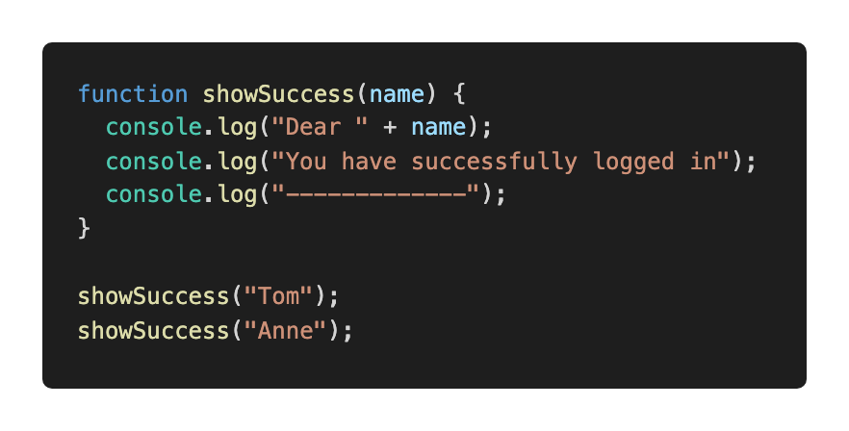
10: Functions

Slide 48
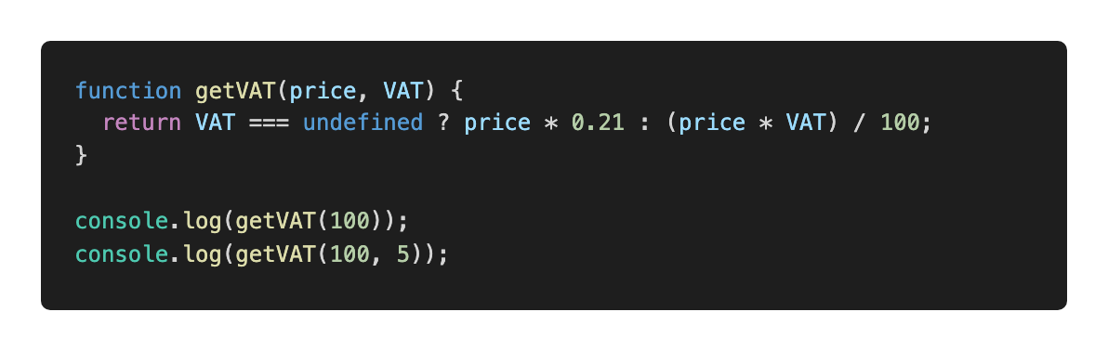
10: Functions

Slide 49
10: Functions: why do we need them?
Reduce code repetition
Structure large programs to subprograms and associate names
Isolate subprograms from each other

Slide 50
TASK:
functions.task.js

Slide 51
10. Functions: best practices
Thoughtful naming
Single purpose
Keep them small
Keep them pure when possible:
Just input and output, no side effects
Same input produces same output (predictable)

Slide 52
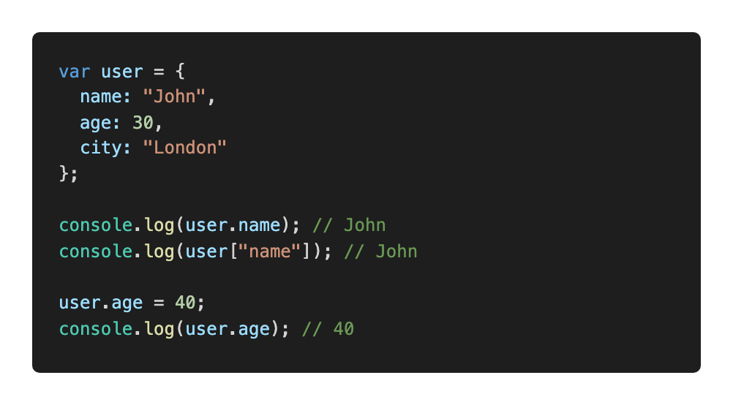
11. Objects
An unordered collection of related data
Key/value pairs

Slide 53
11. Objects: why do we need them?
Keep related stuff together
Namespace (structure the code)

Slide 54
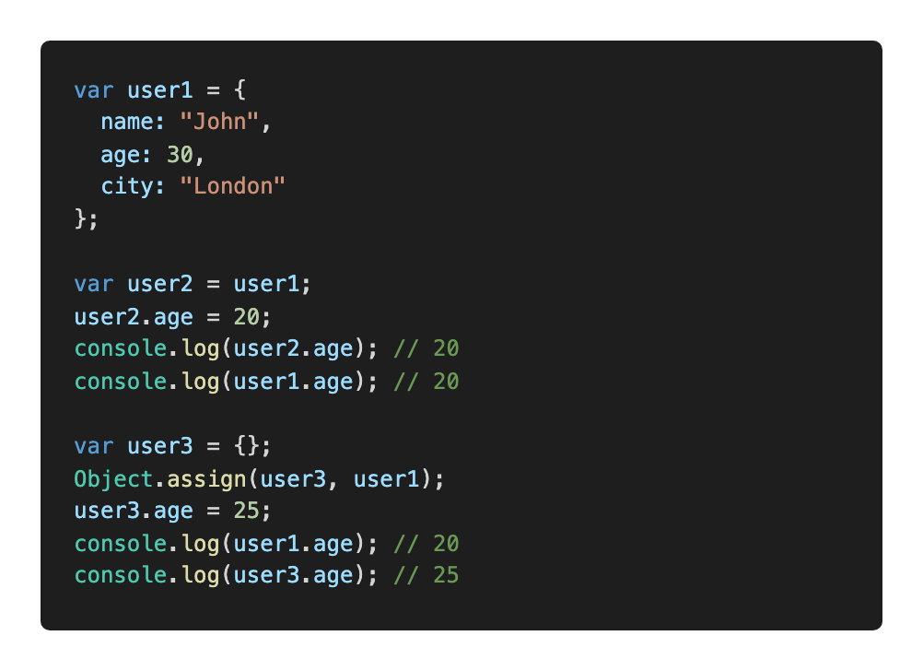
11. Objects: copying

Slide 55
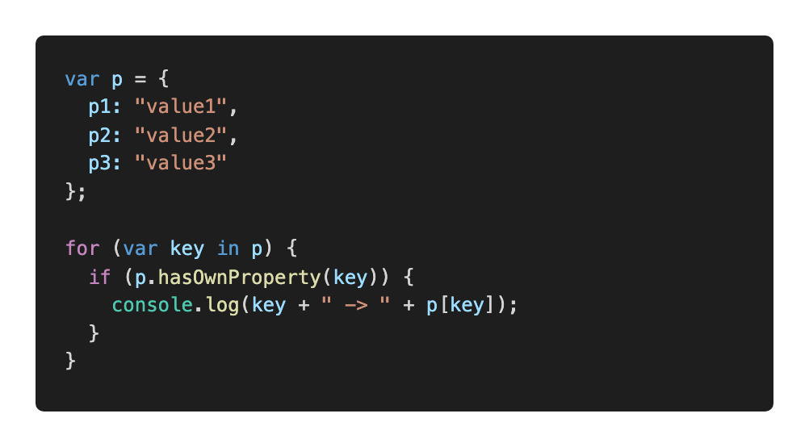
11. Objects: iterate over properties

Slide 56
TASK:
objects.task.js

Slide 57
12. Arrays
An ordered collection of related data
Key/value pairs
Why do we need them?
Keep related stuff together
Work with ordered data

Slide 58
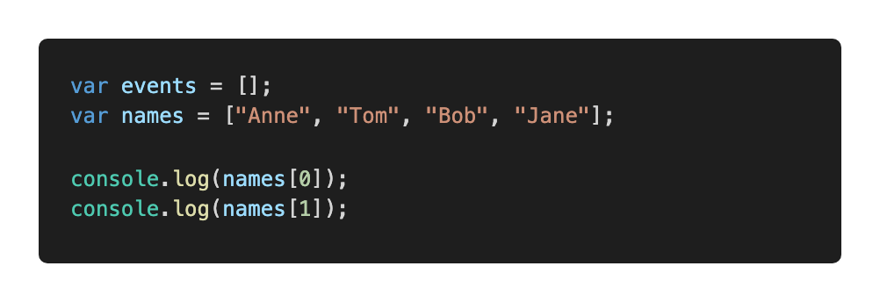
12. Arrays: example
0 based

Slide 59
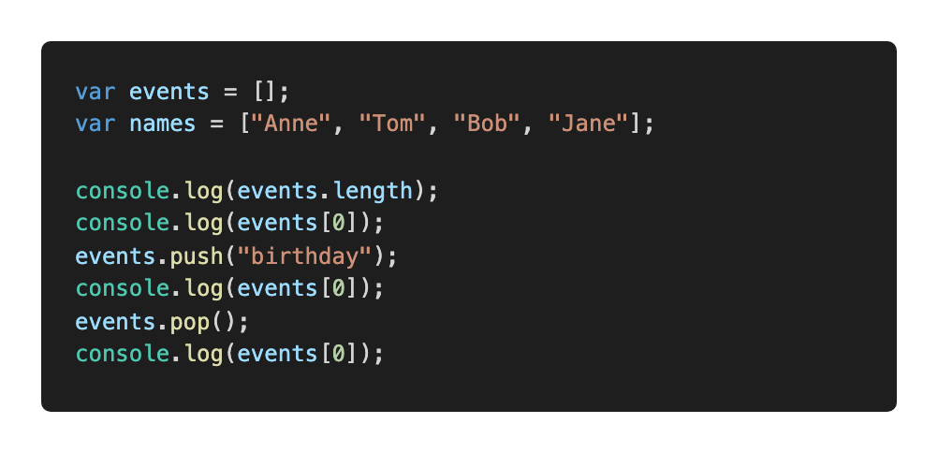
12. Arrays: length, push, pop

Slide 60
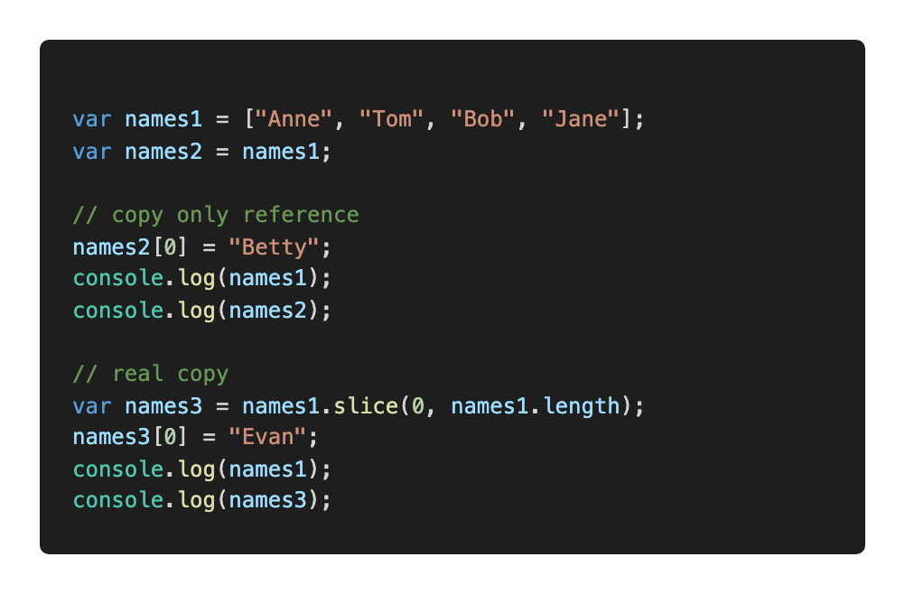
12. Arrays: copying

Slide 61
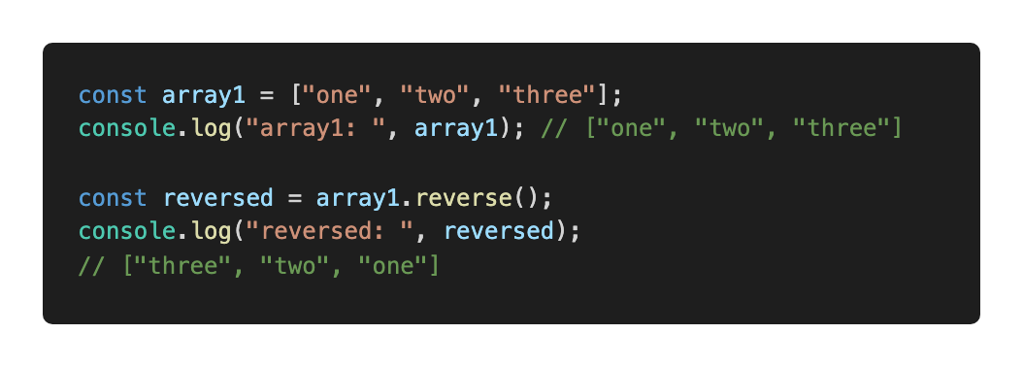
13. Arrays: useful methods
Some useful methods
Reference https://developer.mozilla.org/en-US/docs/Web/JavaScript/Reference/Global_Objects/Array

Slide 62
TASK:
arrays.task1.js

Slide 63
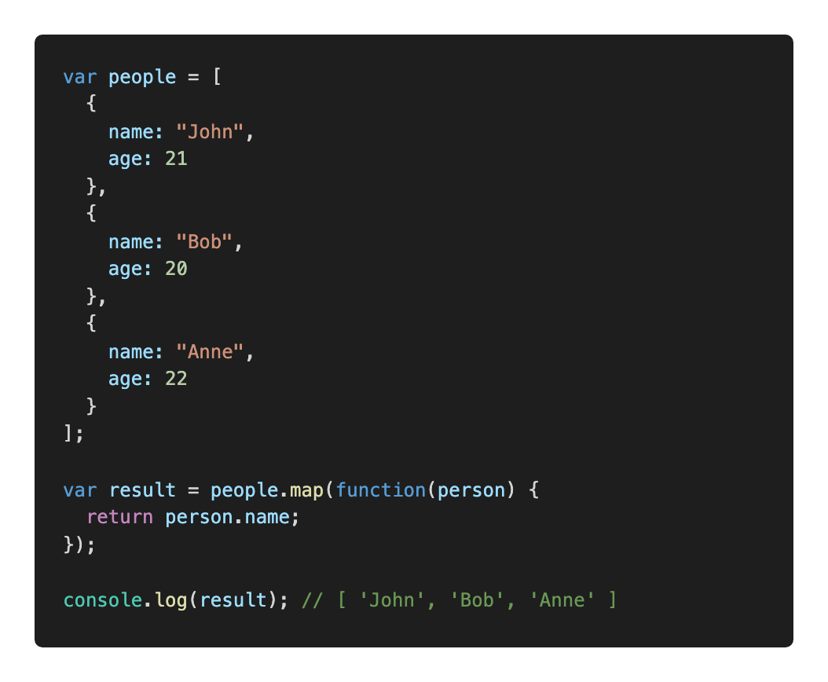
13. Arrays: map

Slide 64
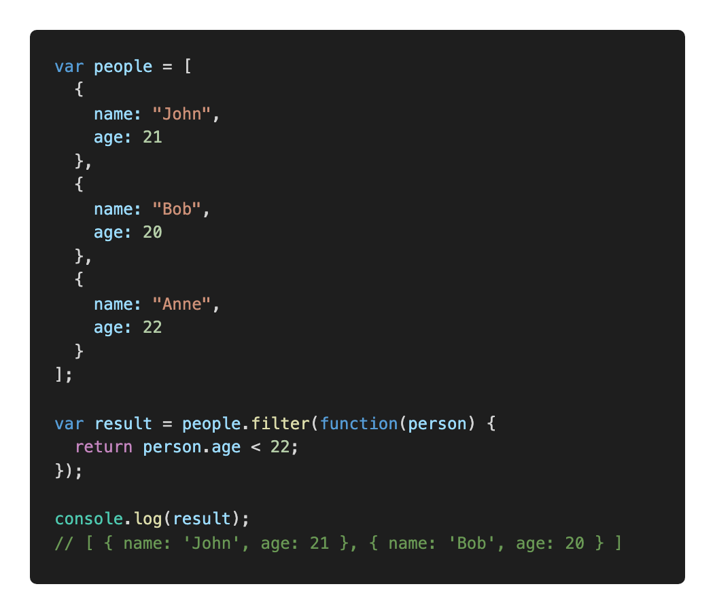
13. Arrays: filter

Slide 65
TASK:
arrays.task2.js

Slide 66
JS and the browser

Slide 67
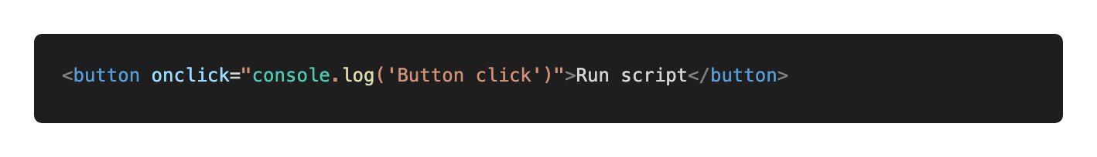
13. Adding a script to a website: inline

Slide 68
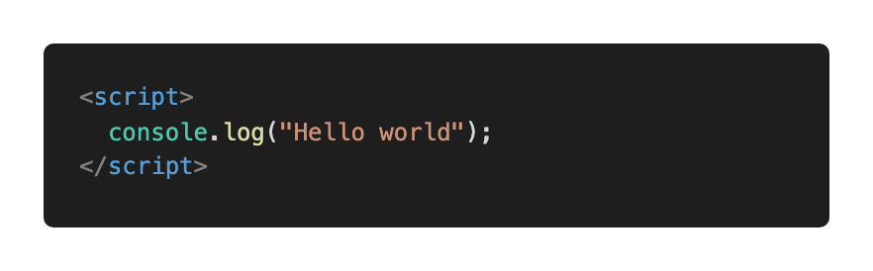
13. Adding a script to a website: internal

Slide 69
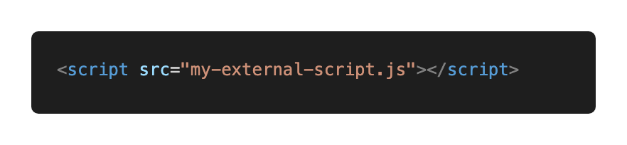
13. Adding a script to a website: external

Slide 70
TASK:
13-add-script

Slide 71
14. DOM
Document Object Model
Page contents as objects that can be modified
DOM specification https://dom.spec.whatwg.org/
DOM is not only for the browser

Slide 72
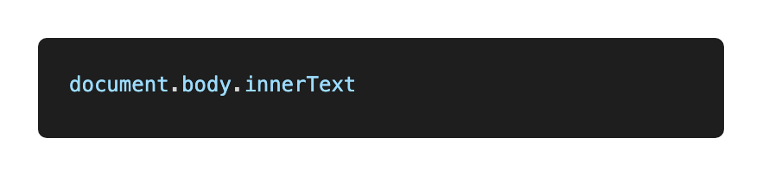
14. DOM: navigate
Entry point, read text content

Slide 73
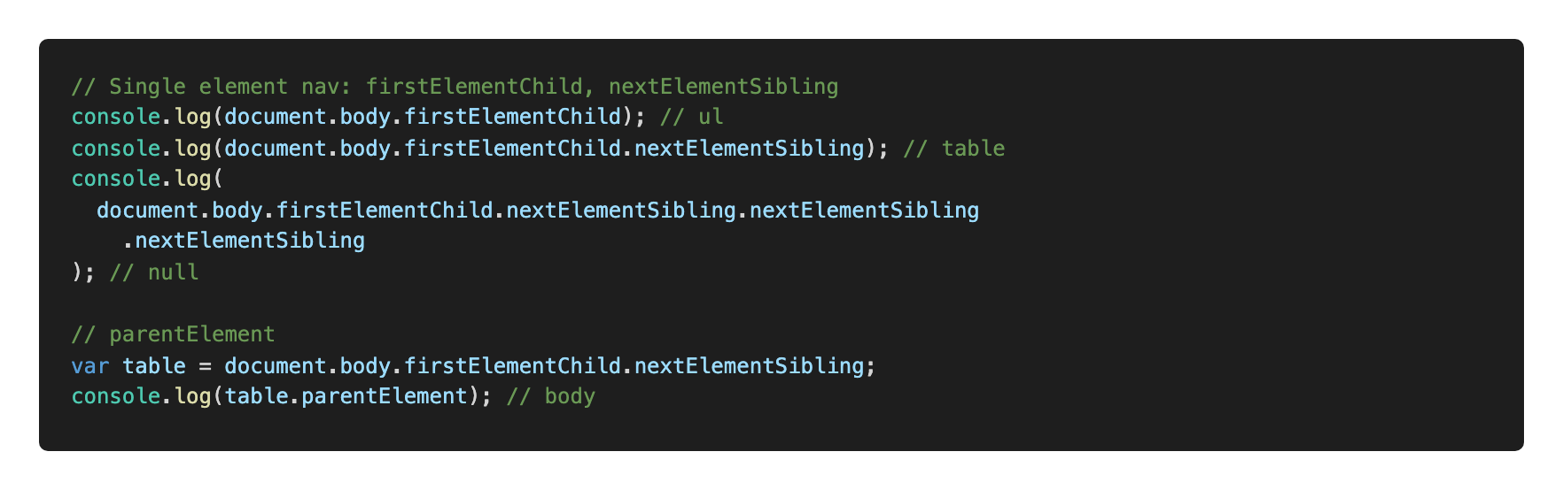
14. DOM: single element navigation

Slide 74
TASK:
dom.task1.js

Slide 75
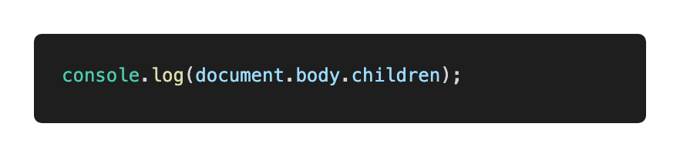
14. DOM: collections
read-only, do not replace by reassigning
live – reflect current state

Slide 76
TASK:
dom.task2.js

Slide 77
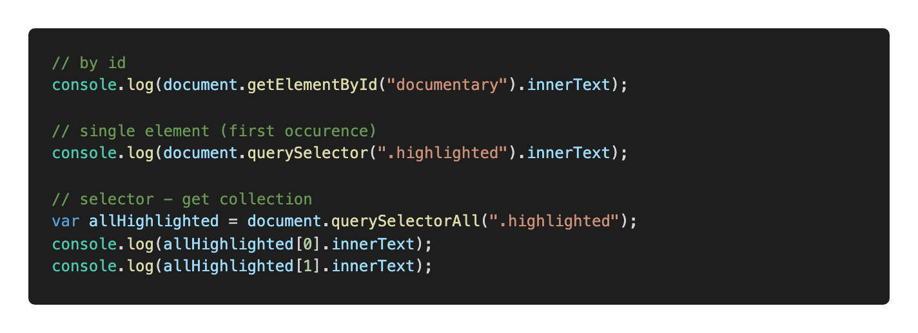
14. DOM: searching

Slide 78
TASK:
dom.task3.js

Slide 79
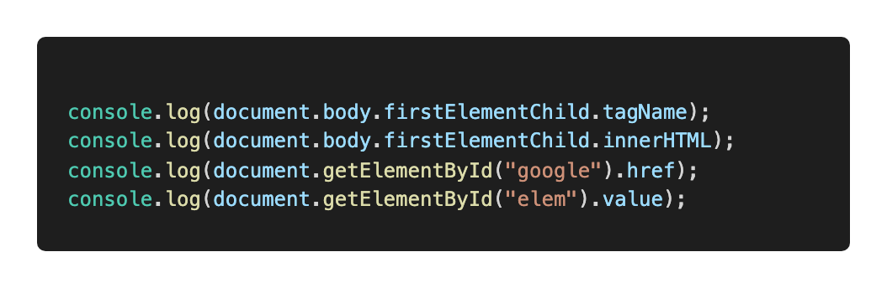
14. DOM: element properties

Slide 80
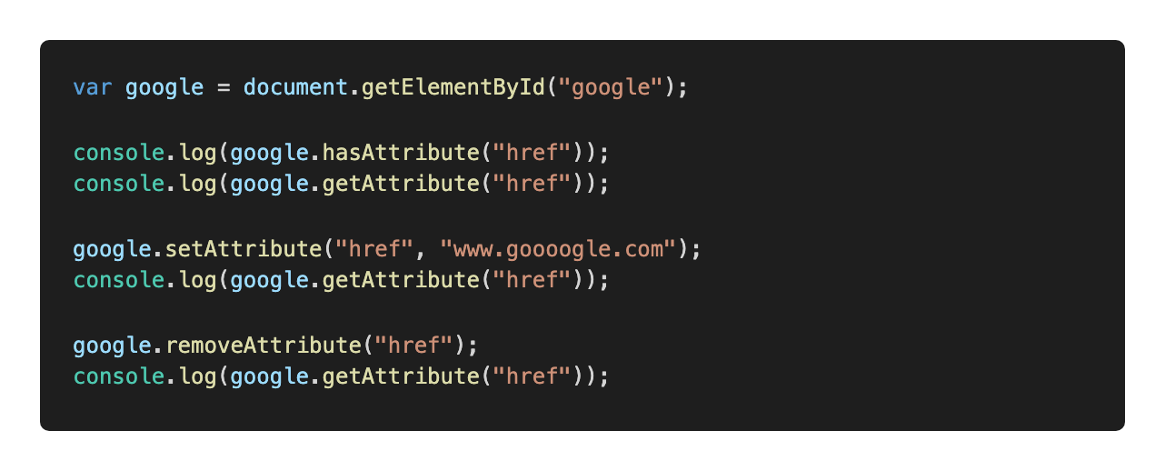
14. DOM: attributes

Slide 81
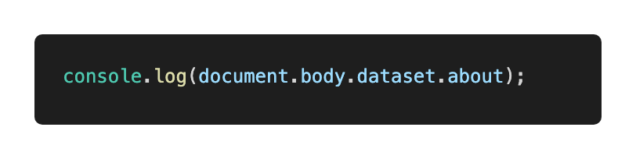
14. DOM: data attributes
Data attributes are reserved for programmers
camelCase in JS code

Slide 82
TASK:
dom.task4.js

Slide 83
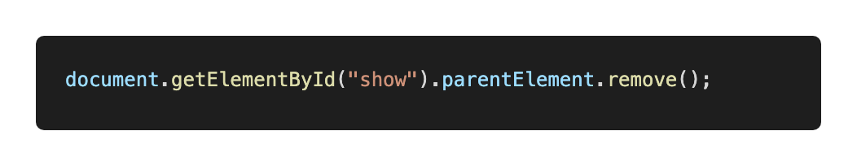
14. DOM: remove element

Slide 84
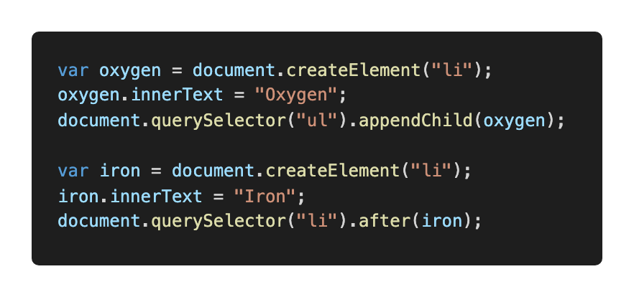
15. DOM: create element

Slide 85
Task: create-remove.js

Slide 86
Thank you.
Jelizaveta Potapova
Senior JavaScript Engineer

