Slide 1

JavaScript - Part 1
Jelizaveta Potapova
Front-End Engineer

Slide 2
Lectures plan
Part 1
Fundamentals, language building blocks
DOM – access, manipulate, calculate size
Part 2
Element size & coordinates
Events
ES6

Slide 3
Intro

Slide 4
What is JavaScript & what can I do with it?
Interpreted scripting language
Computations, input & output data, like any other language
Environment specific tasks
Access and manipulate website content on the fly
React to user interaction with the website
Send network requests
Access location, camera, gyroscope
Access filesystem, connect to DB (server-side)

Slide 5
Tasks & code snippets
Clone or download:
https://github.com/jpotapova/js-lecture-1
Structure:
each topic has a number (in the slides and in the file scructure)
1 folder for each topic
Examples topicname.example.js
Tasks: topicname.task.js

Slide 6
1. Run a script
node path/to/my-script.js

Slide 7
TASK:
hello.task.js

Slide 8
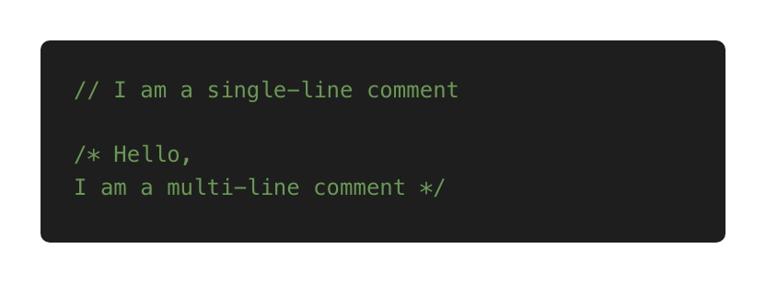
2. Comments

Slide 9
TASK:
comments.task.js

Slide 10
3. Variables
Convention – camelCase
Names are case sensitive
Think about naming: descriptive, self-explanatory but concise

Slide 11
3. Variables: name limitations
Allowed: letters, digits, $, _
Cannot start with digit
Cannot use reserved words (e.g. function, new, this)
Reserved words reference: https://developer.mozilla.org/en-US/docs/Web/JavaScript/Reference/Lexical_grammar#Keywords

Slide 12
TASK:
variables.task.js

Slide 13
Primitive types

Slide 14
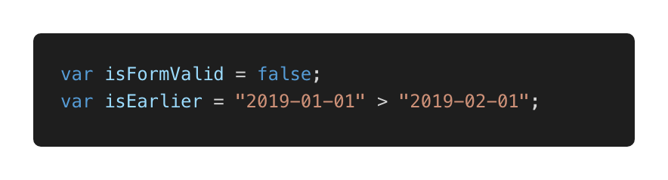
4. Primitives: Boolean
Only 2 values: true or false
Examples

Slide 15
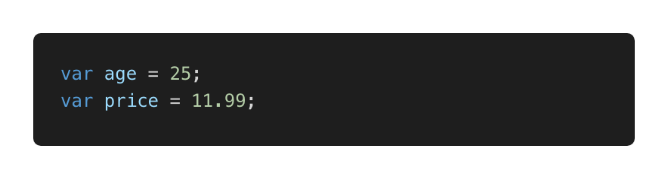
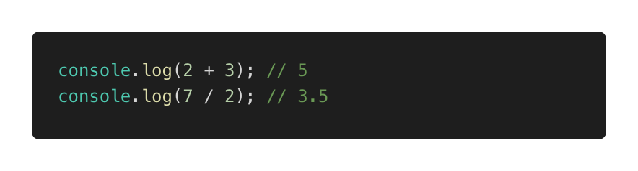
4. Primitives: Number
Examples
Perform simple operations: + - * /

Slide 16
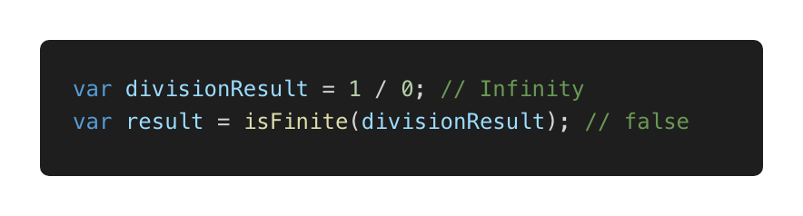
4. Primitives: special numeric values
Infinity and -Infinity
NaN – computation error

Slide 17
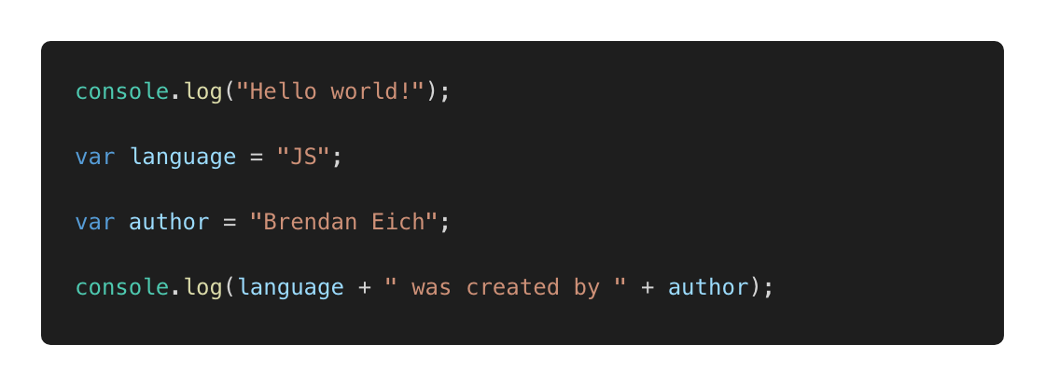
4. Primitives: String

Slide 18
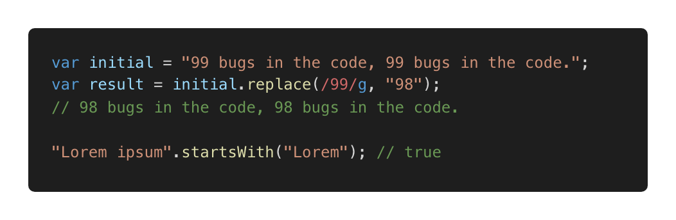
Primitives: String
Can be concatenated, compared
Some useful methods: startsWith, search etc
https://developer.mozilla.org/en-US/docs/Web/JavaScript/Reference/Global_Objects/String

Slide 19
TASK:
primitives.task.js

Slide 20
5. Type coercion: implicit
Also referred as: type casting, type conversion
Process of converting a value from one type to another Implicit:

Slide 21
5. Type coercion: explicit
Explicit, number → string

Slide 22
5. Type coercion: explicit
Explicit, string → number
Always specify radix with parseInt

Slide 23
TASK:
5-coercion.task.js

Slide 24
6. Null and undefined
null – intentional absence of value
undefined – value is not assigned yet

Slide 25
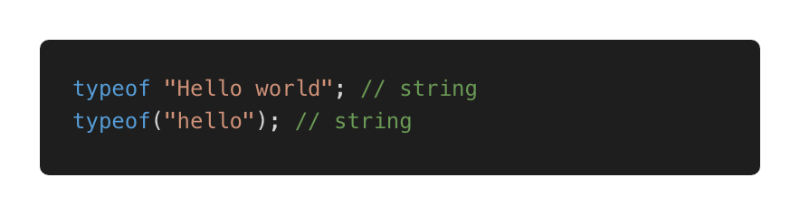
7. typeof
Use to detect type
Returns a string

Slide 26
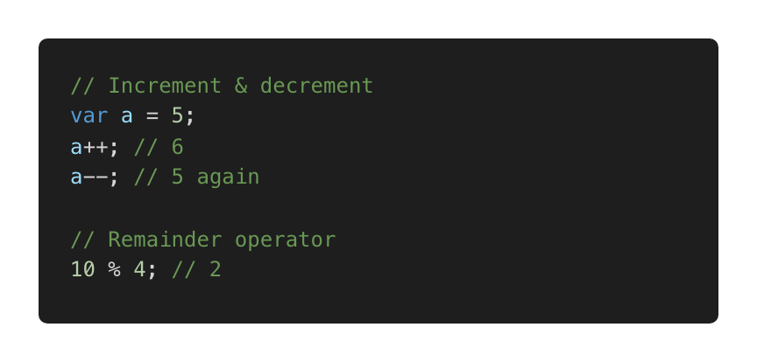
8. Operators
Already used: +, -, >, <
Assignment, e.g. var a = 5;
Some more useful operators

Slide 27
Decisions

Slide 28
9. Decisions: comparison
Loose equality == (type conversion performed before comparing)
Strict equality === (type conversion prevented)
Prefer ===

Slide 29
9. Decisions: if statement

Slide 30
9. Decisions: ternary operator

Slide 31
TASK:
decisions.task1.js

Slide 32
9. Decisions: logical operators

Slide 33
TASK:
decisions.task2.js

Slide 34
TASK:
decisions.task3.js

Slide 35
9. Decisions: switch

Slide 36
TASK:
decisions.task4.js

Slide 37
9. Decisions: while loop

Slide 38
TASK:
decisions.task5.js

Slide 39
9. Decisions: for loop

Slide 40
TASK:
decisions.task6.js

Slide 41
Functions, Objects, Array

Slide 42
10: Functions
Basic building block, a subprogram
Example

Slide 43
10: Functions: why do we need them?
Reduce code repetition
Structure large programs to subprograms and associate names
Isolate subprograms from each other

Slide 44
TASK:
functions.task.js

Slide 45
10. Functions: best practices
Thoughtful naming
Single purpose
Keep them small
Keep them pure when possible:
Just input and output, no side effects
Same input produces same output (predictable)

Slide 46
11. Objects
An unordered collection of related data
Key/value pairs
Example

Slide 47
11. Objects: why do we need them?
Keep related stuff together
Namespace (structure the code)

Slide 48
11. Objects: copying

Slide 49
11. Objects: iterate over properties

Slide 50
TASK:
objects.task.js

Slide 51
12. Arrays
An ordered collection of related data
Key/value pairs
Why do we need them?
Keep related stuff together
Work with ordered data

Slide 52
12. Arrays: example
0 based
How to define and access elements

Slide 53
12. Arrays: length, push, pop

Slide 54
12. Arrays: copying

Slide 55
13. Arrays: useful methods

Slide 56
TASK:
arrays.task.js

Slide 57
JS and the browser

Slide 58
13. Adding a script to a website
Inline
Internal
external

Slide 59
TASK:
13-add-script

Slide 60
14. DOM
Document Object Model
Page contents as objects that can be modified
DOM specification https://dom.spec.whatwg.org/
DOM is not only for the browser

Slide 61
14. DOM: navigate

Slide 62
14. DOM: entry point, read text content

Slide 63
14. DOM: single element navigation

Slide 64
TASK:
dom.task1.js

Slide 65
14. DOM: collections
read-only, do not replace by reassigning
live – reflect current state

Slide 66
TASK:
dom.task2.js

Slide 67
14. DOM: searching

Slide 68
TASK:
dom.task3.js

Slide 69
14. DOM: element properties
tagName
innerHTML
type, id, value

Slide 70
14. DOM: attributes
hasAttribute
getAttribute
setAttribute
removeAttribute
dataset

Slide 71
TASK:
dom.task4.js

Slide 72
14. DOM: remove element

Slide 73
15. DOM: create element

Slide 74
Task: create-remove.js

Slide 75
Thank you.
Jelizaveta Potapova
Front-End Engineer

